Slide 1
How to wear the Academic Hood

Slide 2
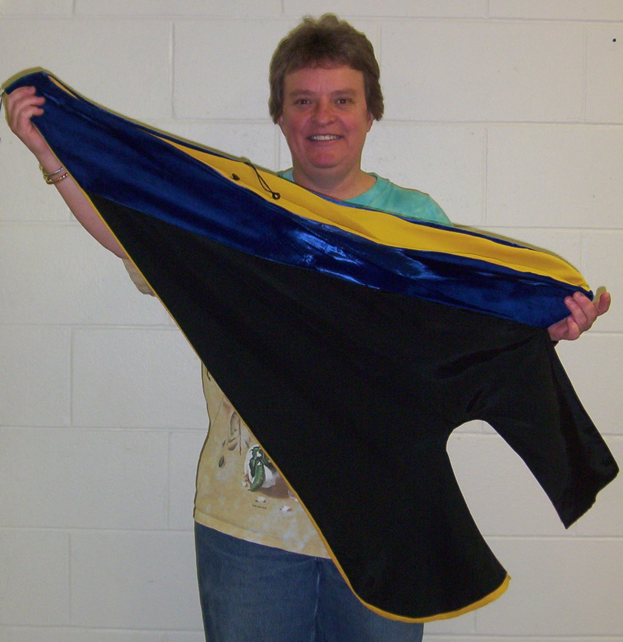
Hoods
Velvet
  Velvet indicates degree field (eg. Philosophy)

Slide 3
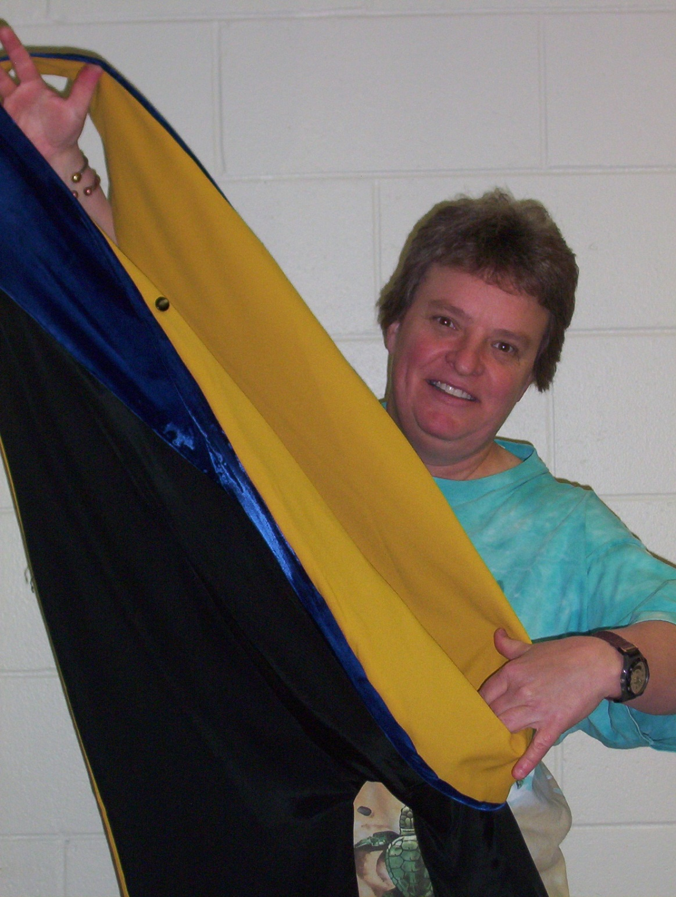

Hoods
Fold velvet over at bottom to reveal silks (school colors)
Velvet

Slide 4
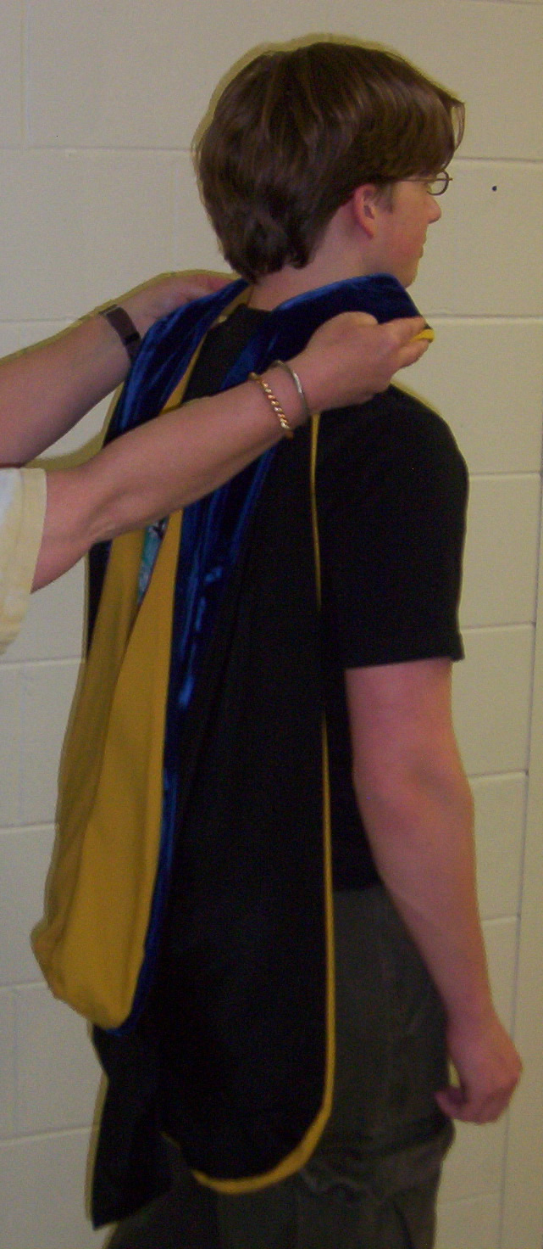
Hoods
Place around neck, silks down
Many thanks to Tristan, whom I conscripted into academic modeling. He now has a masters degree from my alma mater, New Mexico Tech!

Slide 5
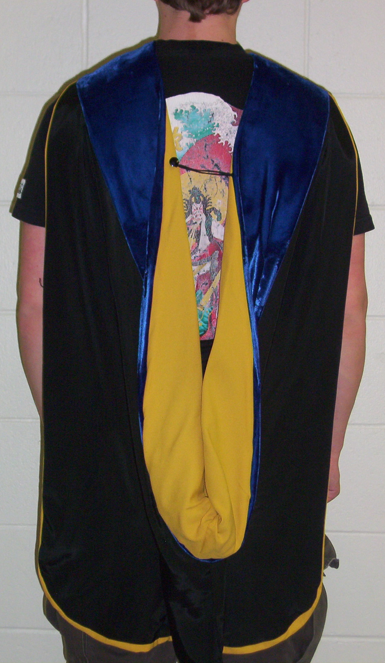
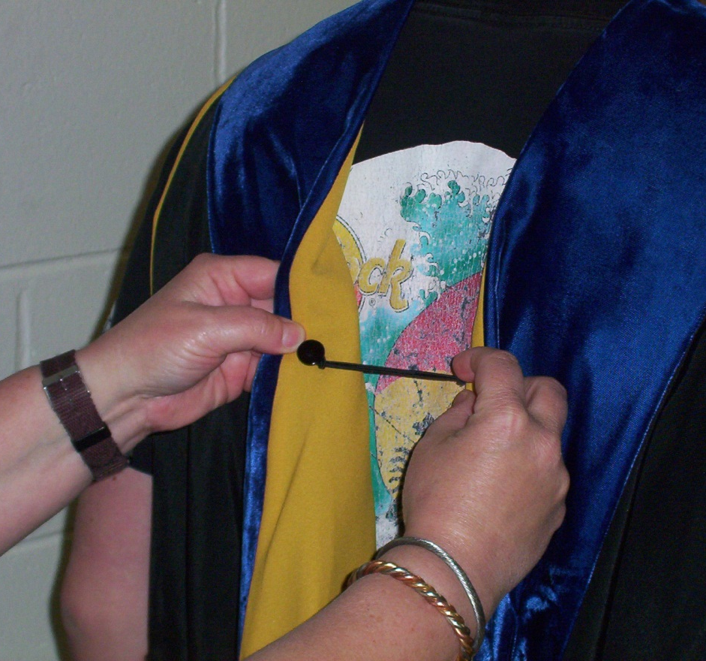
Hoods
Button keeps hood from falling off shoulders
Silks should show
Photos by Jeff Miller

