Slide 1
SOAR 2016
Global Circulation of the Atmosphere and Ocean

Slide 2
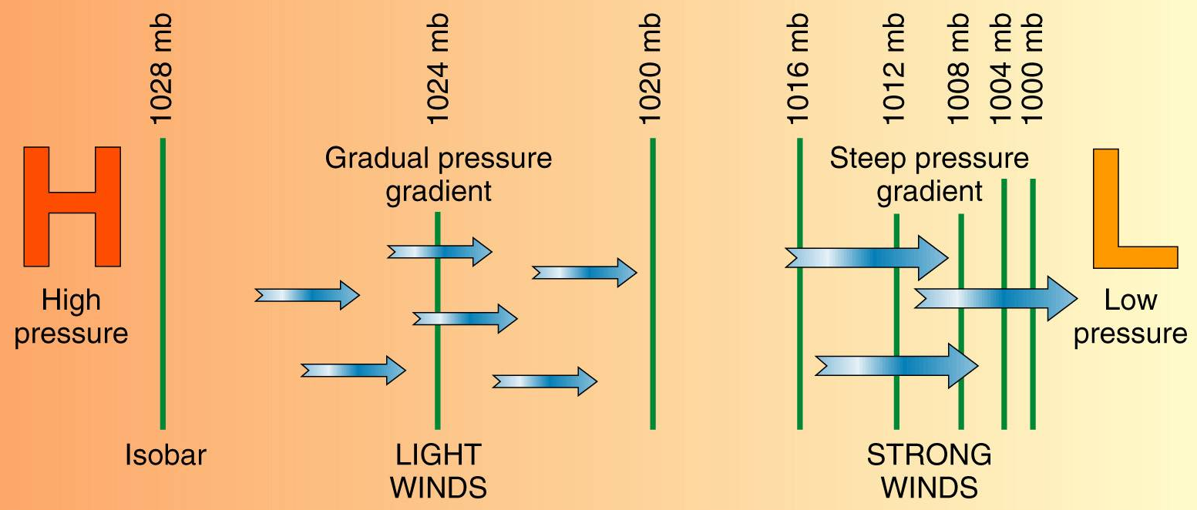
Driving Forces
Gravitational Force
Earth’s gravity holds atmosphere
Pressure Gradient force
isobar = line of constant pressure
Pressure Gradient force acts perpendicular

Slide 3
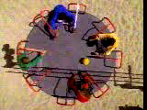
Driving Forces
Coriolis Force
Acts ONLY ON MOVING objects
proportional to velocity ( )
perpendicular to velocity
acts over large distances
Does not determine direction water spins down a drain!
r
r
force
F
∝
v
velocity
The rolling ball follows a straight path seen from above, a curved path seen from the rotating reference frame (riding on the merry-go-round).

Slide 4
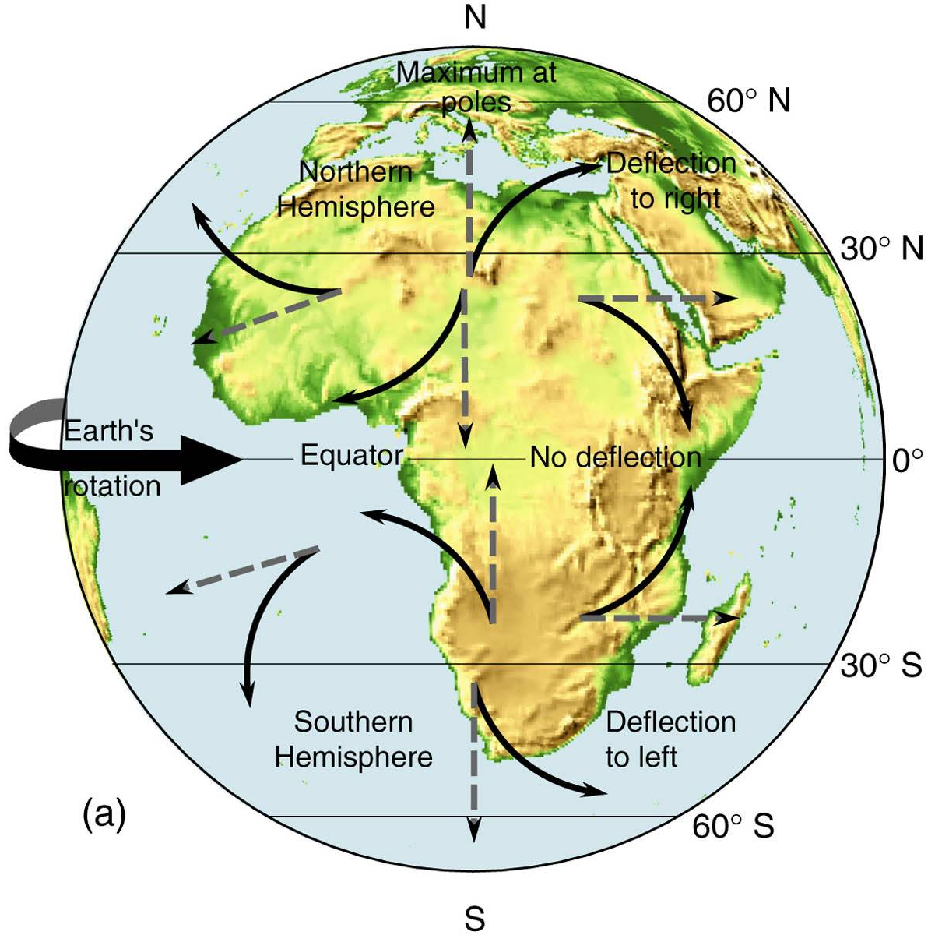
Coriolis Force:
All moving objects are deflected
to their right in northern hemisphere
to their left in southern hemisphere

Slide 5
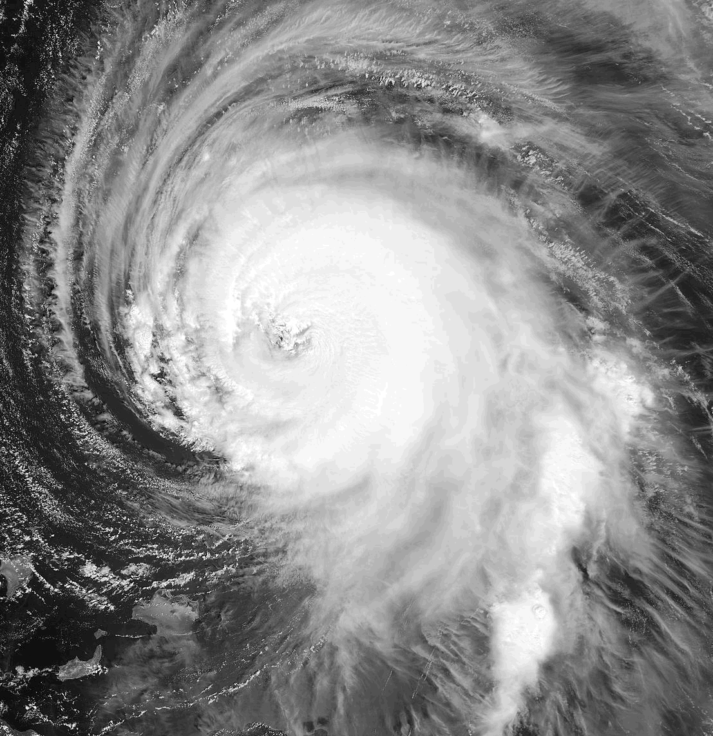
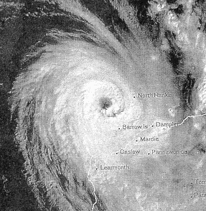
Coriolis Force
Northern Hemisphere
Moving objects deflected to their own right.
Southern Hemisphere
Moving objects deflected to their own left.
Tropical Cyclone Olyvia
L
L
Hurricane Isabel
Storms rotate counterclockwise
Storms rotate clockwise

Slide 6




Cyclones & Anticyclones
Cyclone – circulation around low pressure
CCW in northern hemisphere
CW in southern hemispere
Anticyclone – circ. around high pressure
CW in northern hemisphere
CCW in southern hemisphere
http://www.usatoday.com/weather/tg/whighlow/whighlow.htm

Slide 7

Driving Forces
Friction
Friction with ground slows wind
Extends upward ~ 500 m
Varies with surface, time
Surface air slows air aloft
Friction with ground slows wind

Slide 8
Convection Cells
Sunlight heats land, water, air
Land warms, heats air
Air circulates
Convection cells
warms -> expands -> rises
cools -> contracts -> sinks
Water circulates
Currents driven by wind & Earth rotation
Water temperature increases SLOWLY
Large energy change needed for small temp. change
Heat

Slide 9
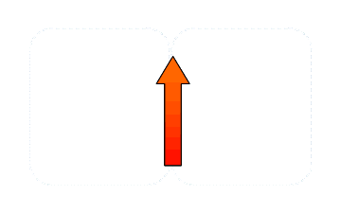
Convection Cells
Hot surface heats air
Air expands,
becomes less dense than surroundings
rises, spreads out at top
Air aloft cools,
becomes more dense than surroundings
sinks, spreads out on surface
Heat

Slide 10
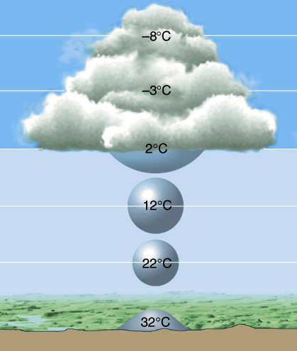
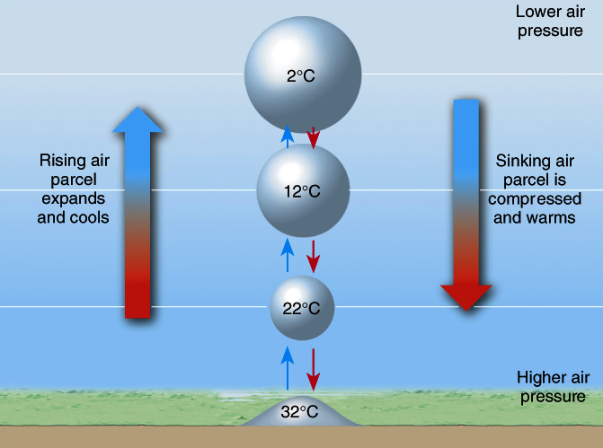
Atmospheric Circulaton
Rising Air
Cools
Water vapor condenses
(usually) results in clouds
Lowers surface pressure

Slide 11
Atmospheric Circulaton
Falling Air
Warms
DRY (lost mosture rising)
Increases surface pressure

Slide 12
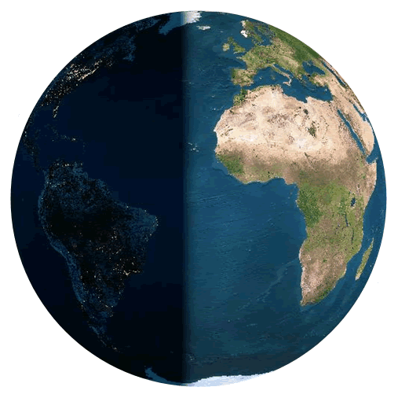
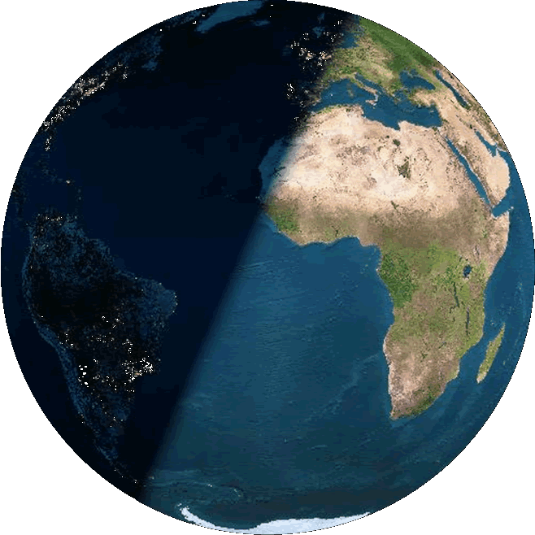
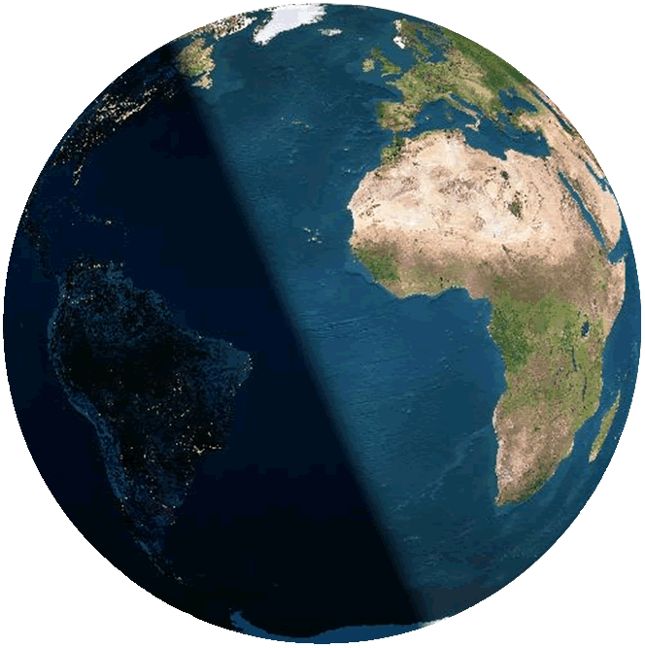
Atmospheric Circulation
Sunlight heats ground
Ground heats air , drives convection from subsolar latitude
Subsolar latitude is 0º on the equinoxes
Maximum Insolation
Heat
Subsolar latitude is 23.5º N/S on the solstices

Slide 13

Atmospheric Circulaton
Driven by heating near equator
Air rises from subsolar latitude, clouds form & precipitate, air aloft moves N & S, cools, dries & sinks at about 30º N & S
Dry air falling ⇒ Arid
Moist air rising ⇒ humid
Air spreads N & S on surface
Air aloft cools until it sinks

Slide 14

Atmospheric Circulaton
Driven by cooling near poles
Cold, dry air falling ⇒ Arid
Surface flows converge, rise
Air warms and moistens along surface
Dry air falling ⇒ Arid
Air from aloft sinks near poles, moves N & S along surface
Moist air rising ⇒ humid

Slide 15




Moist air rising ⇒ stormy
Polar Front
Dry air falling ⇒ Arid
Deserts
Moist air rising ⇒ stormy
Hadley Cells
Rainforests
Deserts
Dry air falling ⇒ Arid
Polar Front

Slide 16




Pressure Zones
InterTropical Convergence Zone
Polar Front
Rising Air: Low Pressure
ITCZ
Polar Front

Slide 17


Pressure Zones
Polar High
Falling Air: High Pressure
STHPC
STHPC
Polar High

Slide 18
Pressure Zones
Polar High
Polar Front
Pressure Zones: air motion is vertical so there is little wind!
STHPC
ITCZ
STHPC
Polar Front
Polar High

Slide 19
Wind Zones
Winds: Falling air spreads North & South along surface.
But the winds don’t go straight!

Slide 20

Wind Zones
Winds named for direction they are from
Easterlies
Polar Front
Westerlies
Horse Latitudes
NE Trades
Doldrums
SE Trades
Windless zones names vary
Horse Latitudes
Westerlies
Polar Front
Easterlies

Slide 21
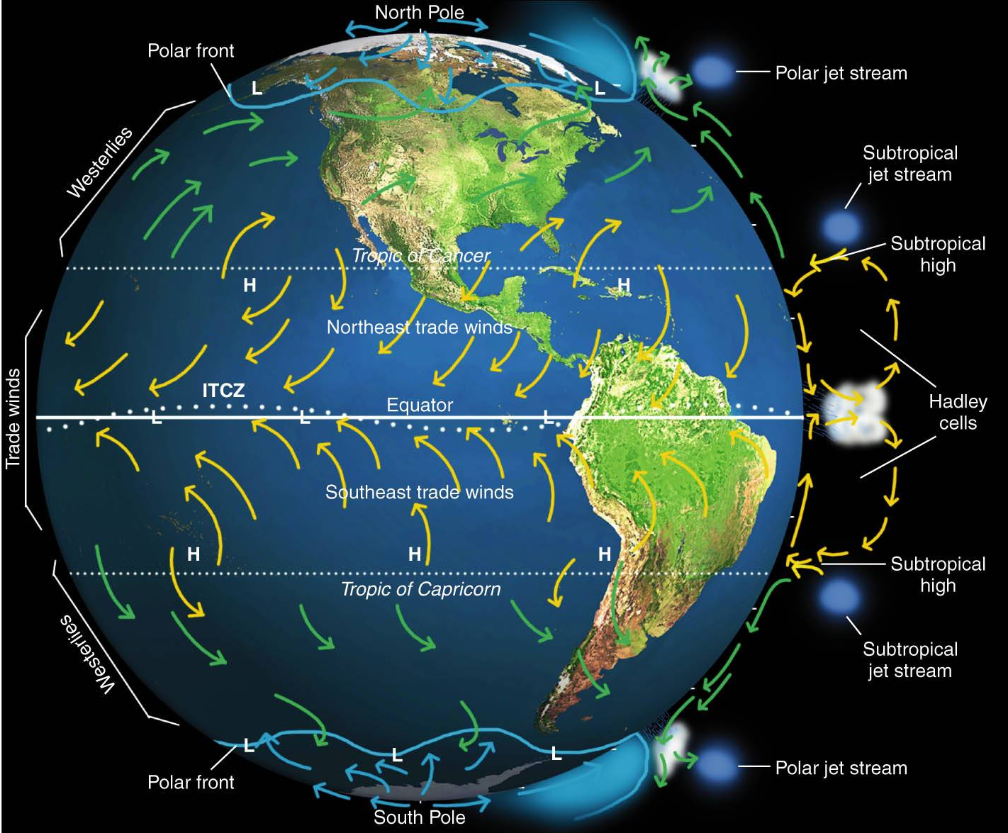

Slide 22
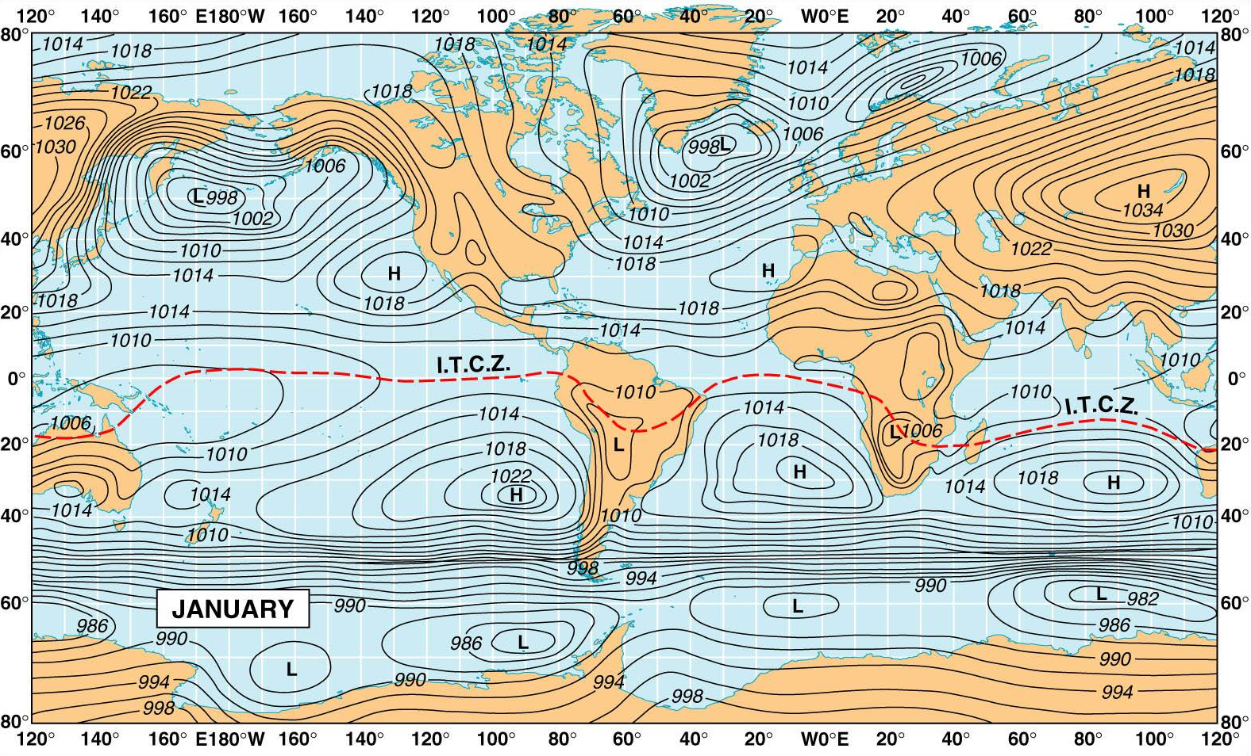
World Pressure Cells: January
North American High
Siberian High
H
Islandic Low
Aleutian Low
Parallel isobars over (low friction) ocean ⇒ rippin’ winds!!!

Slide 23
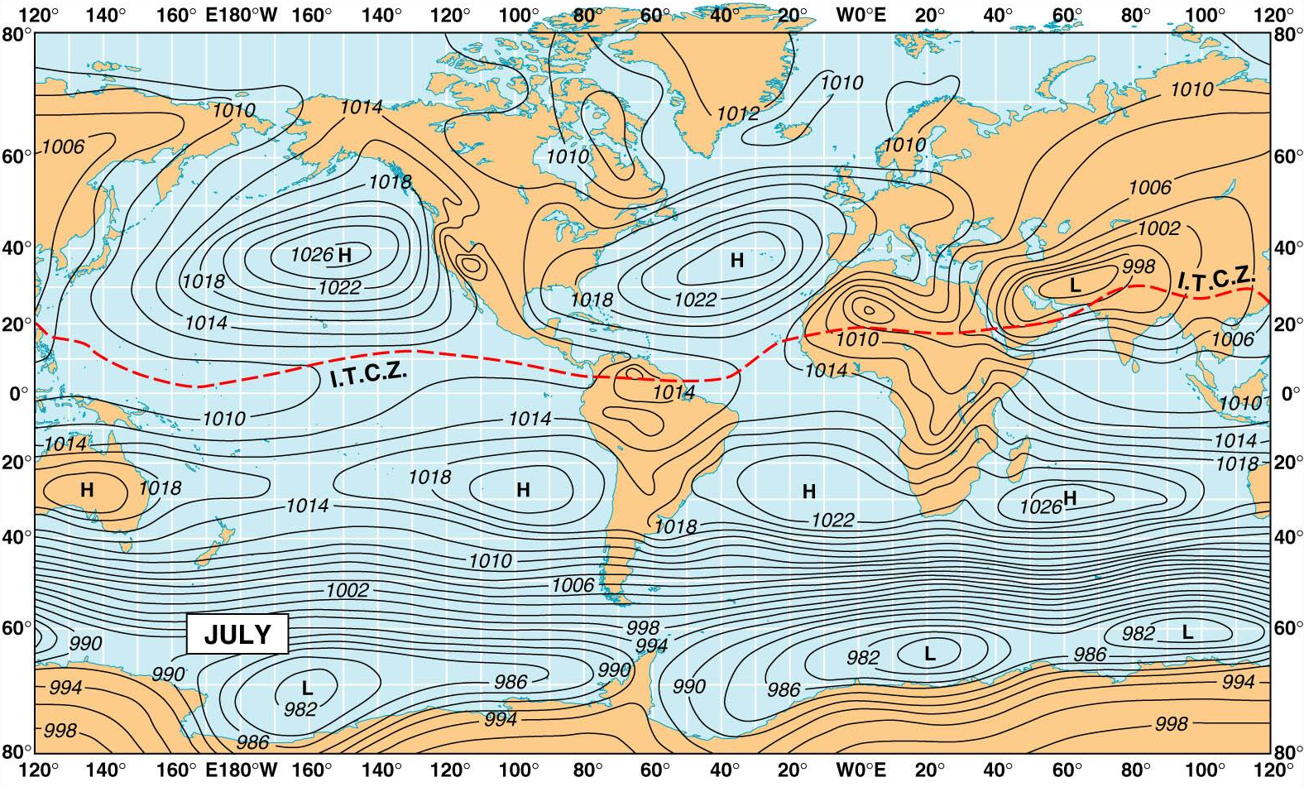
World Pressure Cells: July
Hurricane paths!
Azores High
Tibetan Low
Monsoon Winds
Parallel isobars over (low friction) ocean ⇒ rippin’ winds!!!

Slide 24
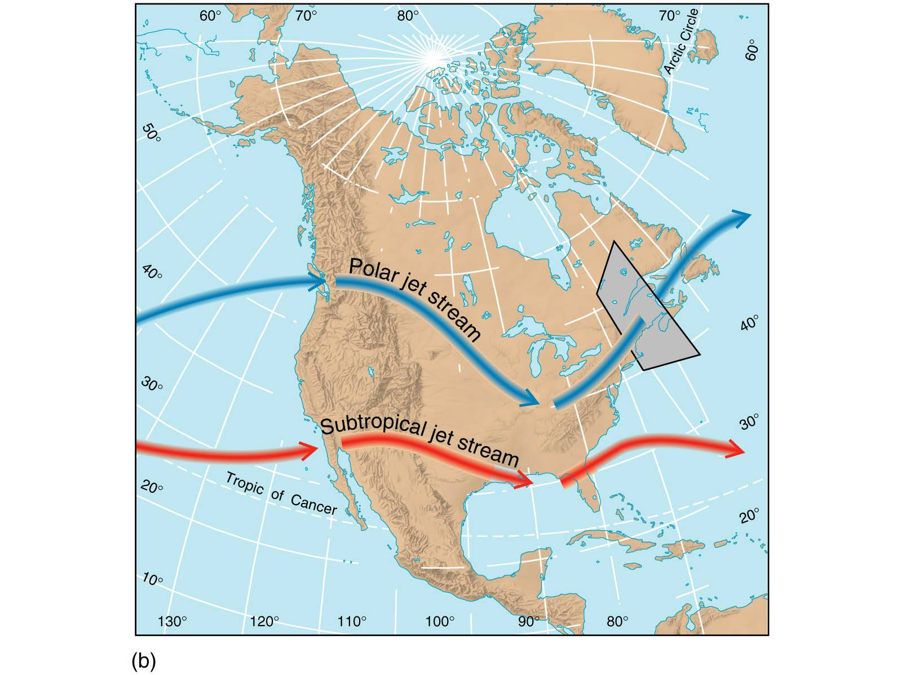
Upper Atmospheric Winds
Jet Streams: Fast Winds Aloft
Polar Jet Stream
Above Polar Front (midlatitude air meets polar)
Rossby waves move loops north & south
7,600 – 10,700 m (25-35 kf)
speeds up to 300 kph (190 mph)

Slide 25
Upper Atmospheric Winds
Jet Streams: Fast Winds Aloft
Subtropical Jet Stream
above Subtropical highs (tropical air meets midlatitude)
9,100 – 13,700 m (30-35 thousand feet)
speeds less than Polar Jet Stream

Slide 26
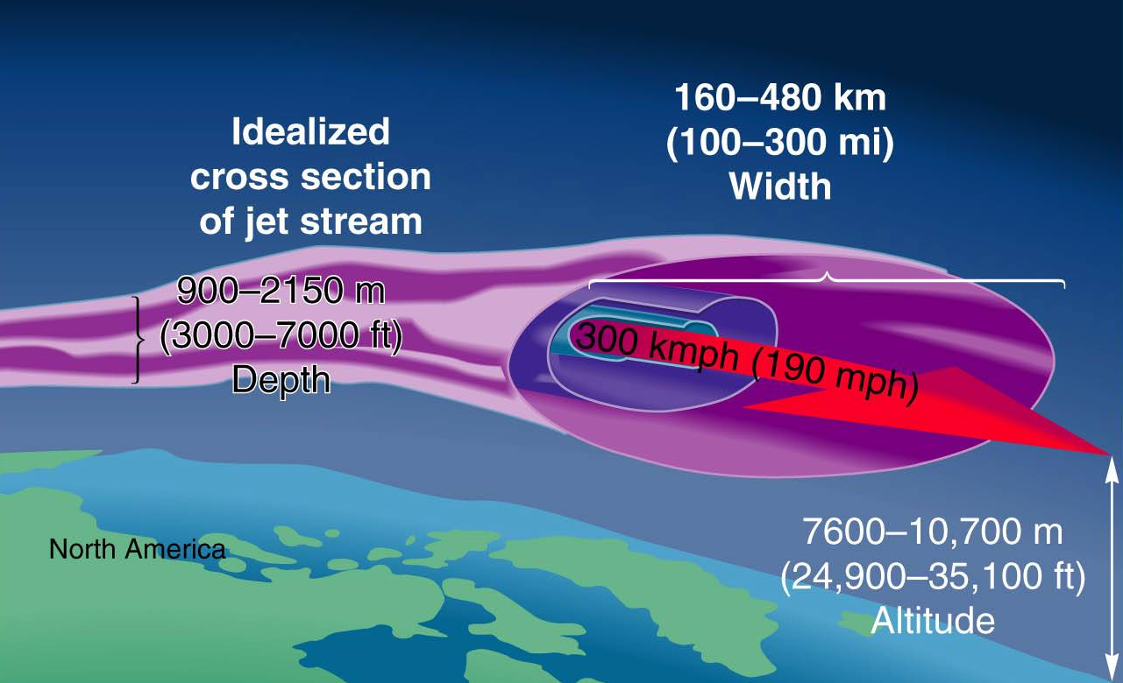
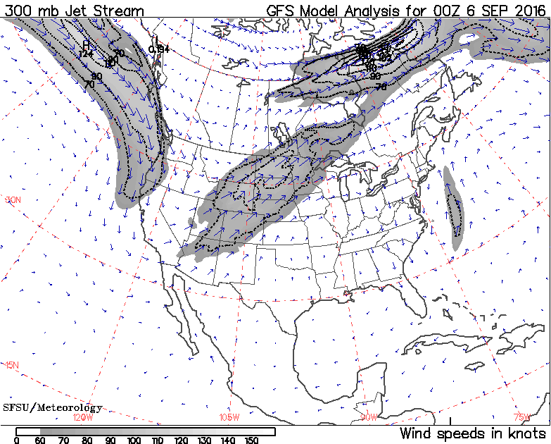
Polar Jet Stream
Determines N.Am. winter weather
Strong west wind
monitored by
weather
balloons
Check out PBS’s explanation!:
www.pbs.org/wgbh/nova/vanished/jetstream.html

Slide 27
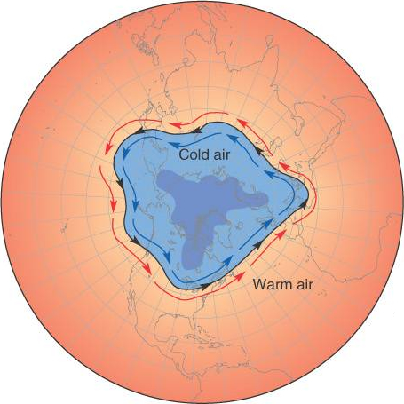
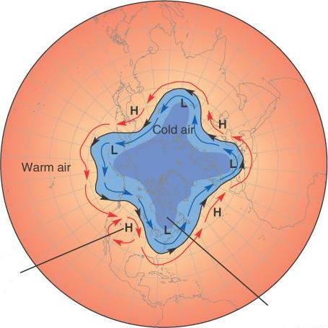
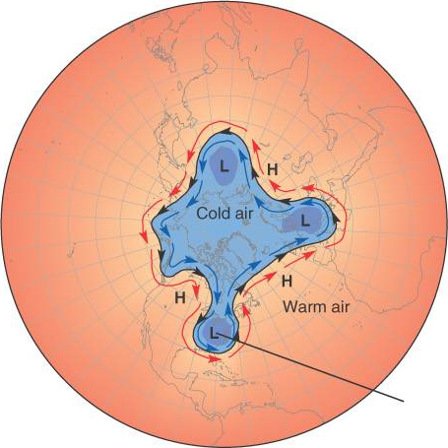
Polar Jet Stream
Determines N.Am. winter weather
Rossby waves bring cold air south

Slide 28
Earth’s Oceans
Most common compound on Earth
Covers 71% of surface area
Land area on Earth = surface on Mars
1.36 billion km³ (326 million mk³)
70% of us by weight
Major constituent of most plants & animals
Originated from
Outgasing of Volcanos (continues)
Bombardment by comets (much reduced)
Present volume established 2 by ago
Quantity in equilibrium

Slide 29
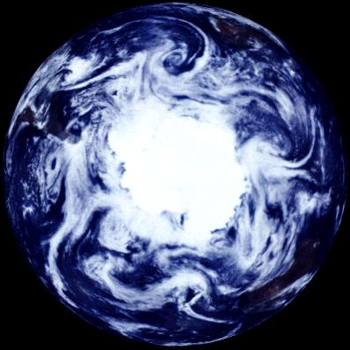
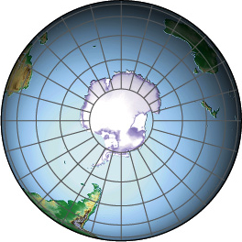
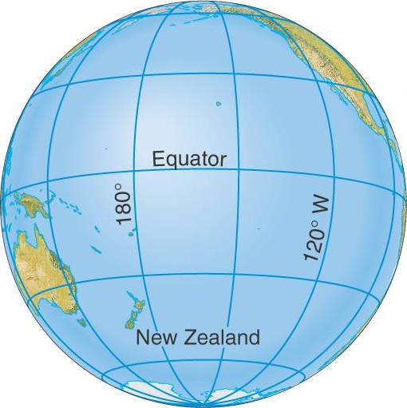
Location of Water
Westerlies
Southern Hemisphere
Moderates climate
Earth closest to sun in
January (southern summer)
Antarctica surrounded
Strong winds, currents
Isolates Antarctic High
within “polar vortex”
Traps CFC’s, Destroys ozone
Pacific Ocean
Covers ½ the Earth
Navigated by Polynesians
and Chinese in ancient times?
Easterlies
Mosaic of Antarctica from Galileo spacecraft

Slide 30
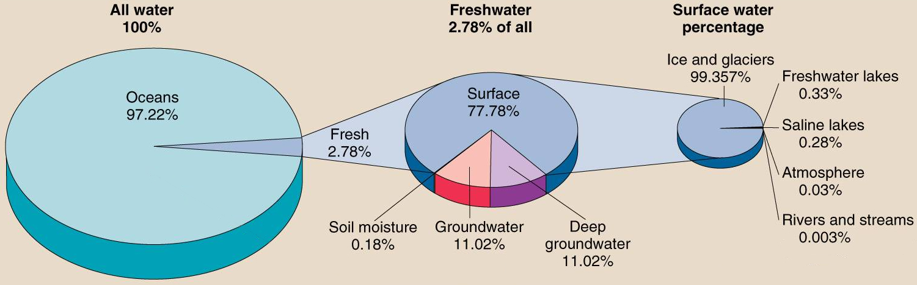
Location of Water
Oceans 97.22%
Pacific 48% 4280 km (14 kft) deep
Atlantic 28% 3930 (13 kft)
Indian 20% 3960 (13 kft)
Arctic 4% 1205 ( 4 kft)
Percentage of freshwater
Percentage of surface water

Slide 31
Oceans’ Effects on Climate
Absorbs & releases heat S L O W L Y
moderates climates
Ogdensburg has longer growing season than Potsdam!
Potsdam has harsher climate than Venice
moves heat around globe
moves heat from equator to poles
moves heat from surface to depths
transfers heat to atmosphere
evaporation absorbs heat
condensation releases heat

Slide 32


Properties of Water
General properties
Stable (hard to tear apart)
Versatile solvent (universal solvent)
Polar properties
Give rise to surface tension
Capillary action
Responds to electric fields
Solid floats in the liquid
Ponds freeze on top, ice insulates water!
Water most dense as liquid at 4°C

Slide 33
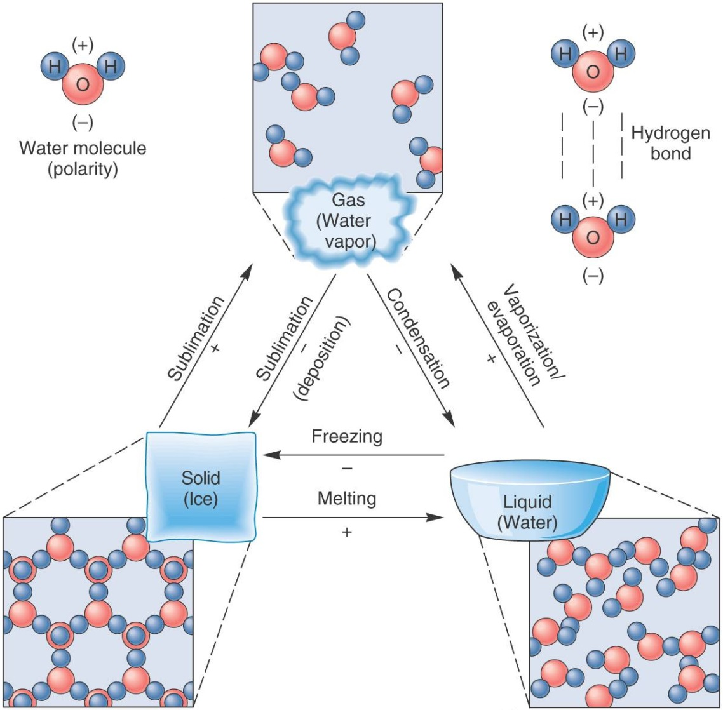
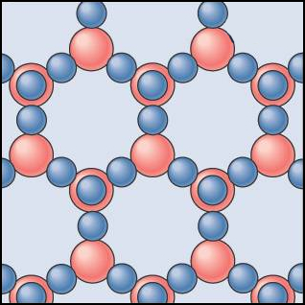
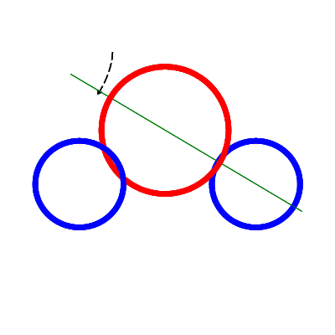
Properties of Water
Present as solid, liquid, gas on Earth
Gas & solid on Mars & most places
Solid and liquid (?) on Europa
Polar molecule H₂O
Oxygen
8 p⁺, 8 nº, 8e⁻
Hydrogen
1 p⁺, 1 e⁻
e⁻ tend to hang
around Oxygen
Making that side
negative

Slide 34
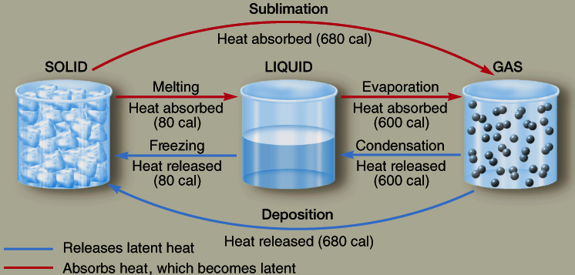
Heat Properties of Water
High latent heats
1 calorie = 4.186 Joules
High Heat Capacity
High energy gain/loss to change temperature

Slide 35
Energy Transfer by Water
Substance | Specific Heat (Joule/K/kg)
Air (50°C) | 1050
Iron or Steel | 460
Lead | 130
Glass | 840
Quartz | 762
Granite | 804
Sandstone | 1088
Shale | 712
Soil (average) | 1050
Wood (average) | 1680
Ice | 2100
Steam | 2050
Water | 4168
Specific Heat
Energy absorbed or released to change temp.
Raising 1 kg (1l) of water 1°C absorbs 4,168 Joules
10 cm square cube of water
Huge!
1 kg
4000 Joules ≈ energy to lift 400 kg or 900 lb 1 m

Slide 36
Energy Transfer by Water
Latent Heat
Energy absorbed or released to change phase
Substance | Specific Heat (Joule/kg)
 | vaporization | fusion
Alcohol | 879,000 | 109,000
Water | 2,257,000 | 333,500
Evaporating 1 kg (1l) of water absorbs 2,257,000 Joules
Even Huger!
10 cm square cube of water
1 kg
2,257,000 Joules ≈ energy to lift 225,700 kg or 507,000 lb 1 m

Slide 37
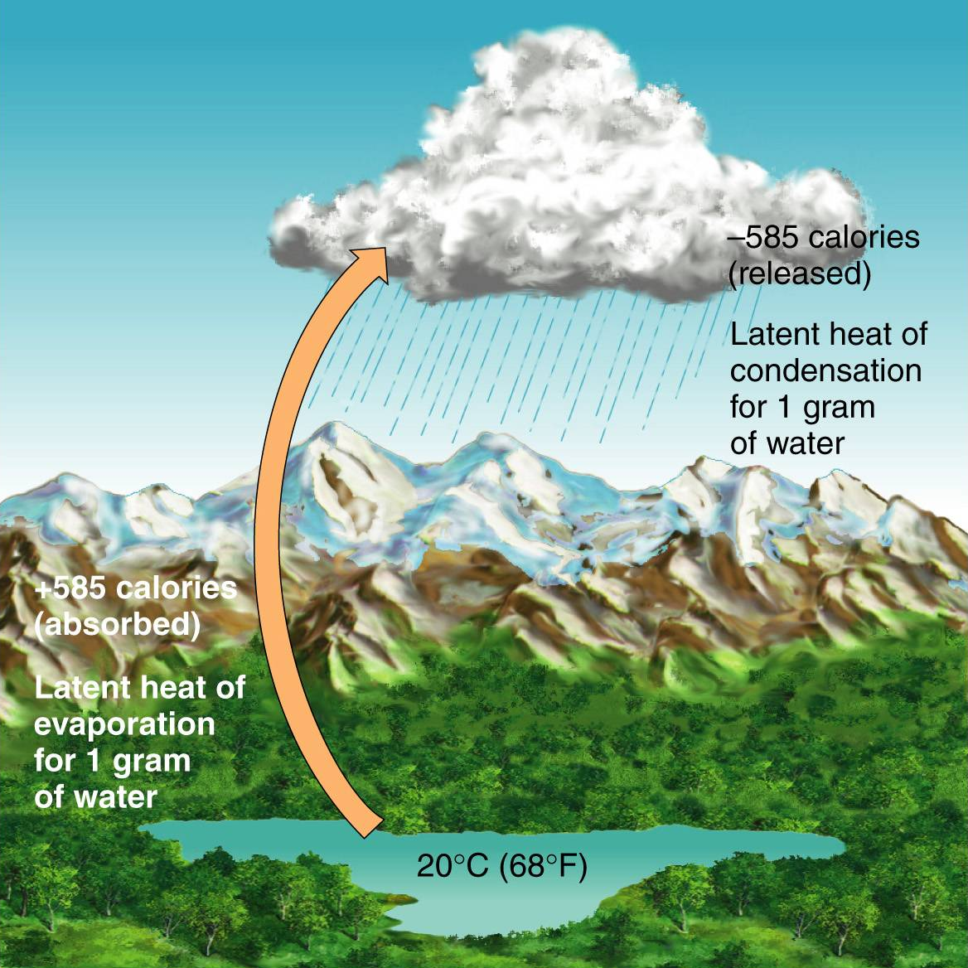
Energy Transfer by Water
Latent heat effects weather
Evaporating water absorbs energy from water, cooling it.
Condensing water releases energy to air, heating it.

Slide 38
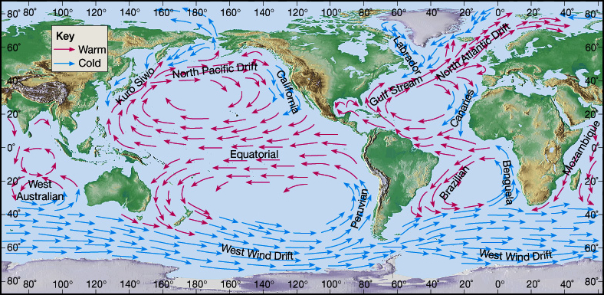
Source Regions & Climate
Prevailing winds over big continent (harsh climate)
Prevailing winds over cold ocean (mild climate)
Prevailing winds over warm ocean (hot & humid)
Prevailing winds over cold ocean (mild climate)

Slide 39
Surface Currents: Atlantic
Prevailing winds over warm ocean (VERY mild climate)
Prevailing winds over continent (harsh climate)
Winter winds over BIG continent … dry
Prevailing winds over warm ocean (rainforest)
Summer winds over warm ocean … monsoons!
Potsdam
Venice

Slide 40
Oceans
are why Potsdam
isn't Venice!

Slide 41
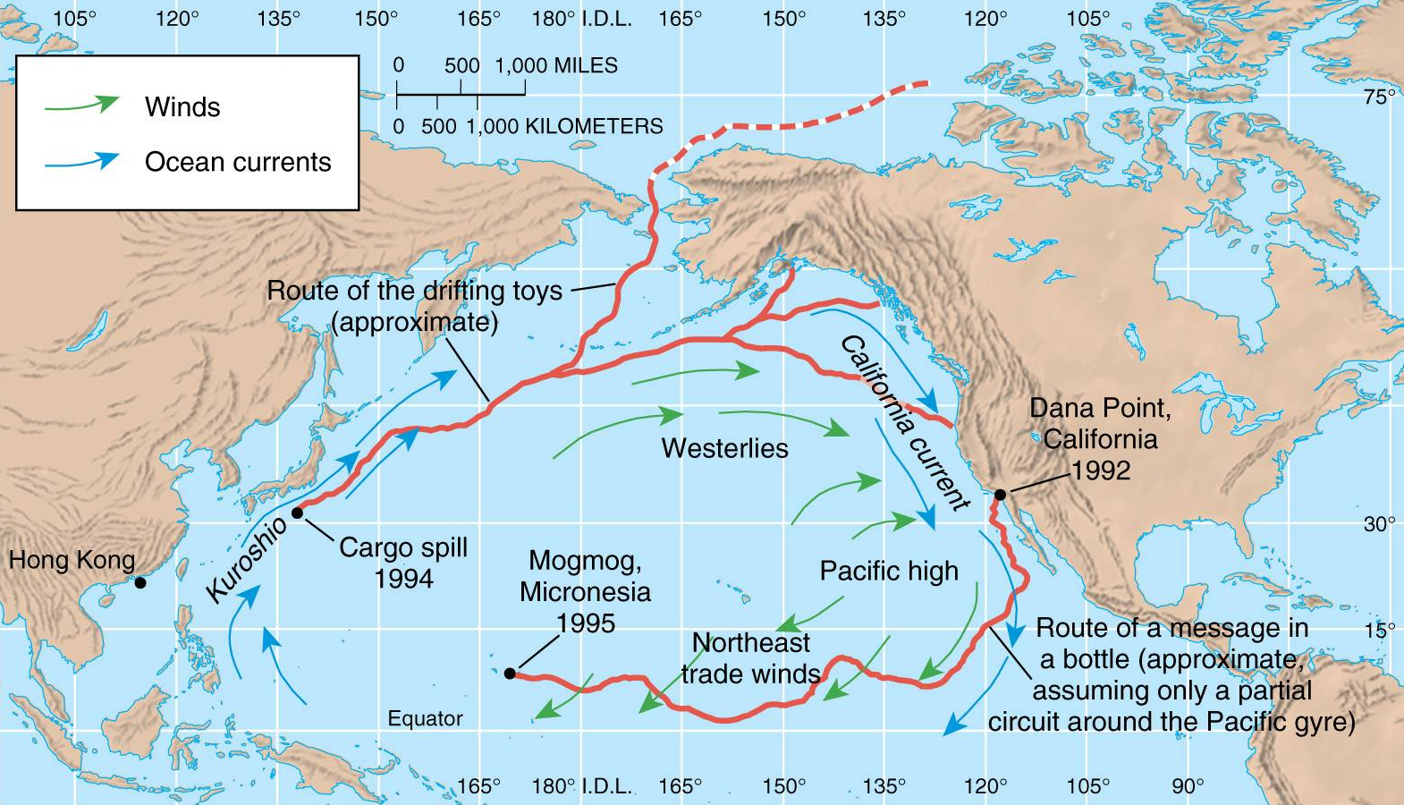


Surface Currents Move Heat
Mapped by rubber duckies, bottles

Slide 42
World Surface Currents
Driven by wind, Coriolis, continents
Distribute heat from equator toward poles

Slide 43
Deep Ocean Currents
Thermohaline circulation
Density of sea water
increases with salinity
decreases with temperature
Evaporation
decreases water surface
temperature
increases salinity
Gulf Stream
warm surface water evaporates in N. Atlantic
cools, increases salinity ⇒ sinks to bottom
Cold, salty water sinks to bottom.
Warm surface water gets colder and saltier than subsurface water.

Slide 44
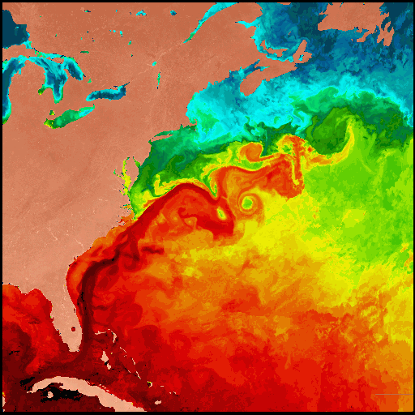
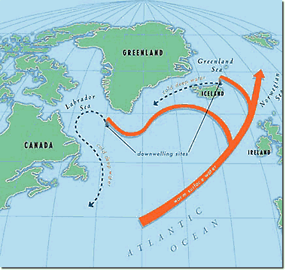
North Atlantic Downwelling
Gulf Stream
Bring warm water north … keep Europe warm!
Cools, salinates, sinks, pulling more north

Slide 45
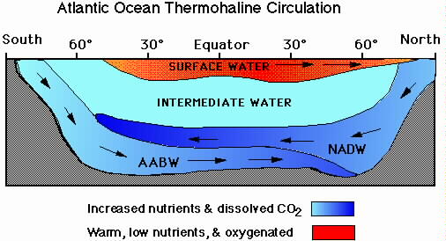
North Atlantic Downwelling
Gulf stream waters sink to bottom
Flow South along ocean bottom
Drives Deep water circulation

Slide 46
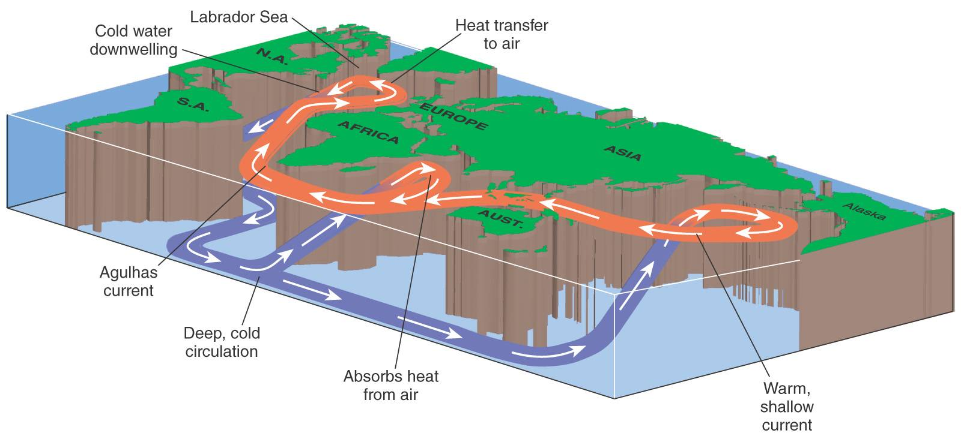
Deep Ocean Circulation
Great Conveyor Belt moving HEAT
circuit takes about 2000 years

Slide 47
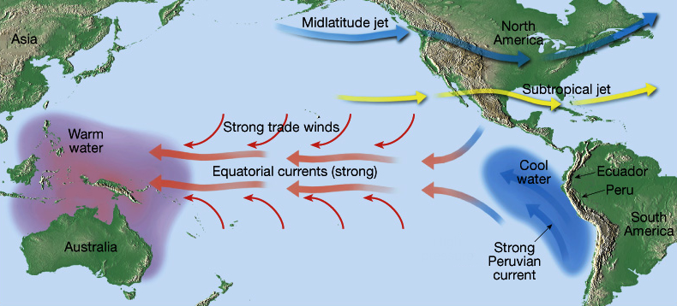
Regional Surface Currents
Equatorial Currents
Drive upwelling in east, spreading in west
Water deflects N & S due to continents & Coriolis
Currents driven by trade winds
Water leaving shore pulls water up from below: upwelling

Slide 48
Ocean-Atmosphere Interactions
Teleconnections
Correlations between time series of atmospheric pressure, temperature and rainfall
Pacific Ocean
ENSO – El Niño Southern Oscillation
PDO – Pacific Decadal Oscillation
PNA - Pacific/North American Pattern
Atlantic Ocean
NAO – North Atlantic Oscillation
AMO – Atlantic Multidecadal Oscillation
AO – Arctic Oscillation

Slide 49
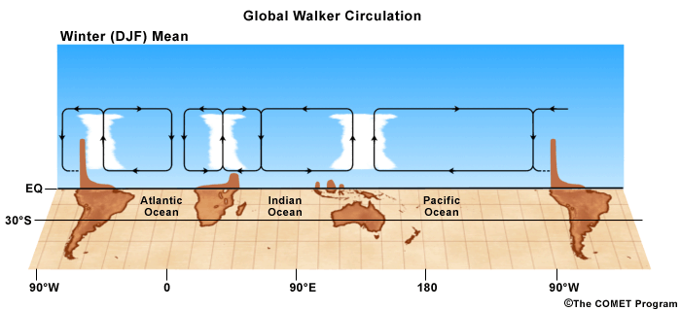
Sir Gilbert Thomas Walker
Analyzed “vast amounts of data” from across the world
Noticed oscillation of pressure between Indian Ocean and Pacific Ocean
Indicates strength of trade winds
Associated with Indian Monsoon

Slide 50

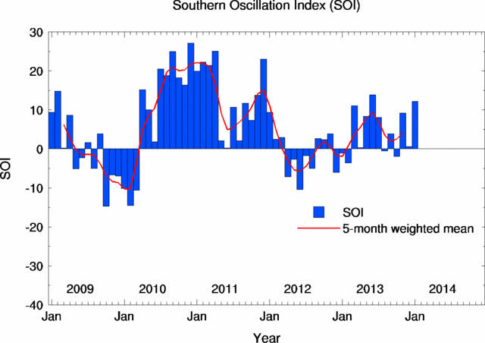
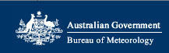

Southern Oscillation
Pressure differences between Tahiti and Darwin, Australia
Southern Oscillation Index (SOI)
Positive ⇒ La Niña
Higher pressure at Tahiti ⇒ stronger trade winds
Negative ⇒ El Niño
Lower pressure at Tahiti ⇒ weaker trade winds
http://www.bom.gov.au/climate/current/soi2.shtml

Slide 51
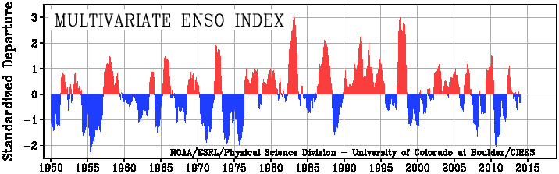
El Niño & La Niña
El Niño: A warm current off the coast of Peru replacing the usual cold current that occurs every 4 to 5 years
La Nina: A cold current off the coast of Peru
El Niño
La Niña
Includes measurements of sea-level pressure, wind, sea surface temperature, surface air temperature and cloudiness
http://www.esrl.noaa.gov/psd/enso/mei/

Slide 52
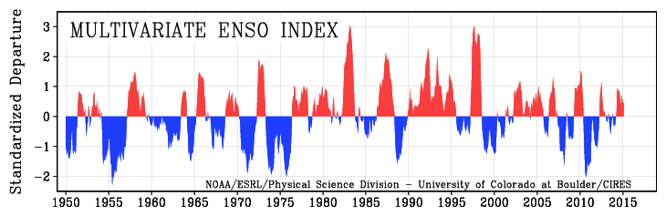
Frequency of ENSO
~ Every 2 to 7 years … not regular
High frequency in 1990s
El Niño: 1991-92, 1993, 1994 (moderate) and 1997-98 (strong).
Mostly La Niña since 2000
2012 … strongish La Nina, very warm
El Niño
La Niña
http://www.esrl.noaa.gov/psd/enso/mei/#discussion

Slide 53
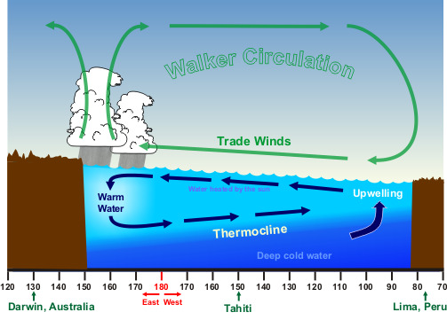
“Normal” Conditions
Atmospheric pressure higher in east (Tahiti) than west (Darwin).
Surface trade winds blow from east to west
Walker Circulation (named by Bjerknes)
Pile up water in west, drive upwelling in east

Slide 54
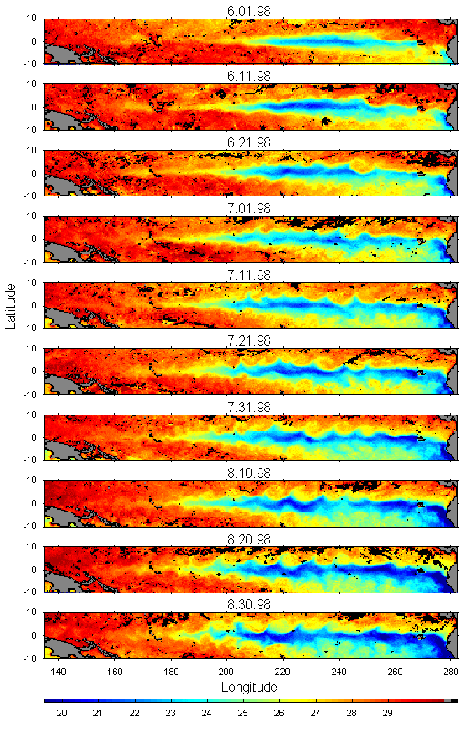
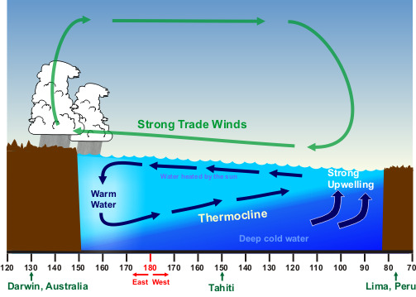
La Niña: “Enhanced Normal”
Colder than normal water off Peru
Stronger trade winds
Increased upwelling
Larger pressure difference

Slide 55
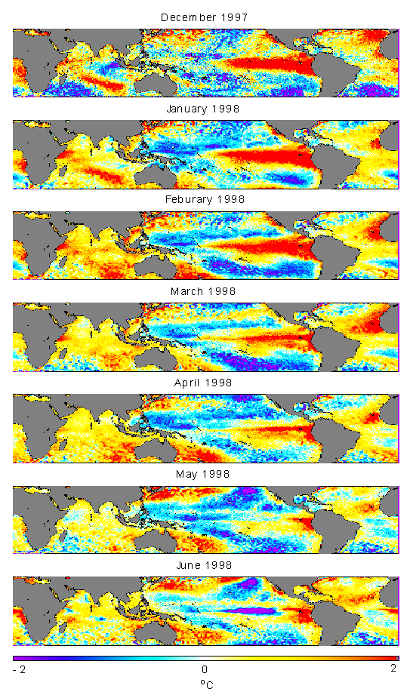
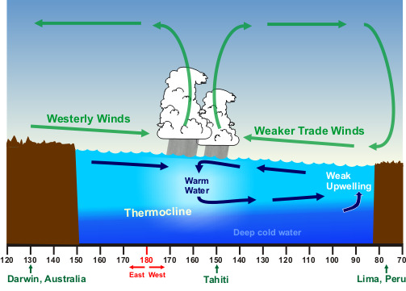
El Niño
Warmer than normal water off Peru
Weak (or opposite) trade winds
Decreased upwelling
Small or opposite pressure difference
SST Anomalies

Slide 56
Currents & Ocean Life
Nutrients
compounds of nitrogen, silicon, phosphorous
⇒ minerals ⇒ carried by upwelling cold water
Phytoplankton
Fish food (bottom of the food chain)
CO₂ sink (absorb ½ Earth’s CO₂)
Some toxic (algae blooms, “red tides”)
Fish
Prefer living in warmer water
Best fishing where cold & warm water meet!
eg. The Outer Banks

Slide 57
Regional Current Variations
North Atlantic Oscillation
Known since 19th Century
Positive
strong Gulf Stream
warm winter & spring in Scandinavia & E. US
cool along east coast of Canada & west Greenland
Negative
dry in E. N.Am
wet in S. Europe

Slide 58
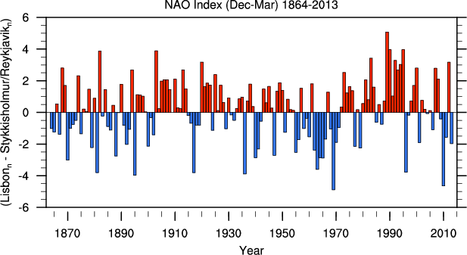
NAO
Mostly positive since mid 1970’s
Mostly negative in ’50’s – ‘60’s
Mostly Negative since 2008

Slide 59
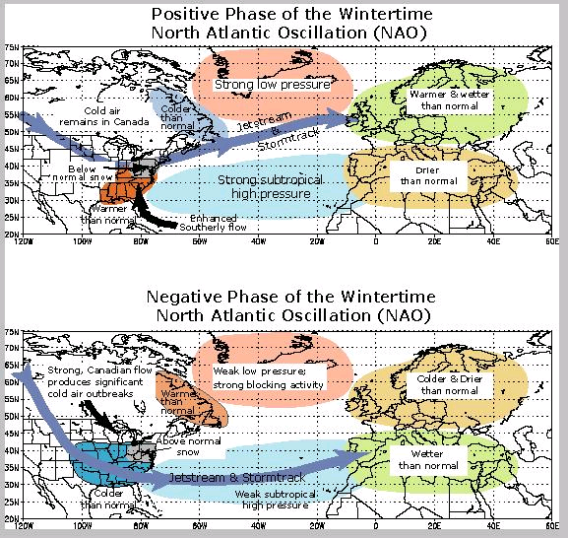
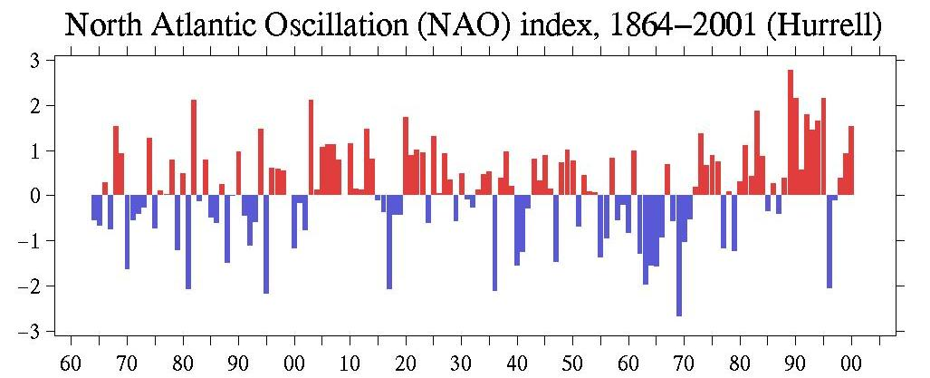
NAO
Negative Phase mid 1950’s - 1970

Slide 60
NAO
Mostly positive since mid-70’s

Slide 61
AMO
Atlantic Multidecadal Oscillation
Greenland ice cores show oscillations
80 & 180 year variations in N. Atlantic temperature
Driven by NAO?
Positive NAO
strong westerlies across Labrador sea cool ocean
strengthens Gulf Stream & Thermohaline Circulation (THC)
Negative NAO
weak westerlies across Labrador sea keep ocean warmer
weakens Gulf Stream & THC

Slide 62
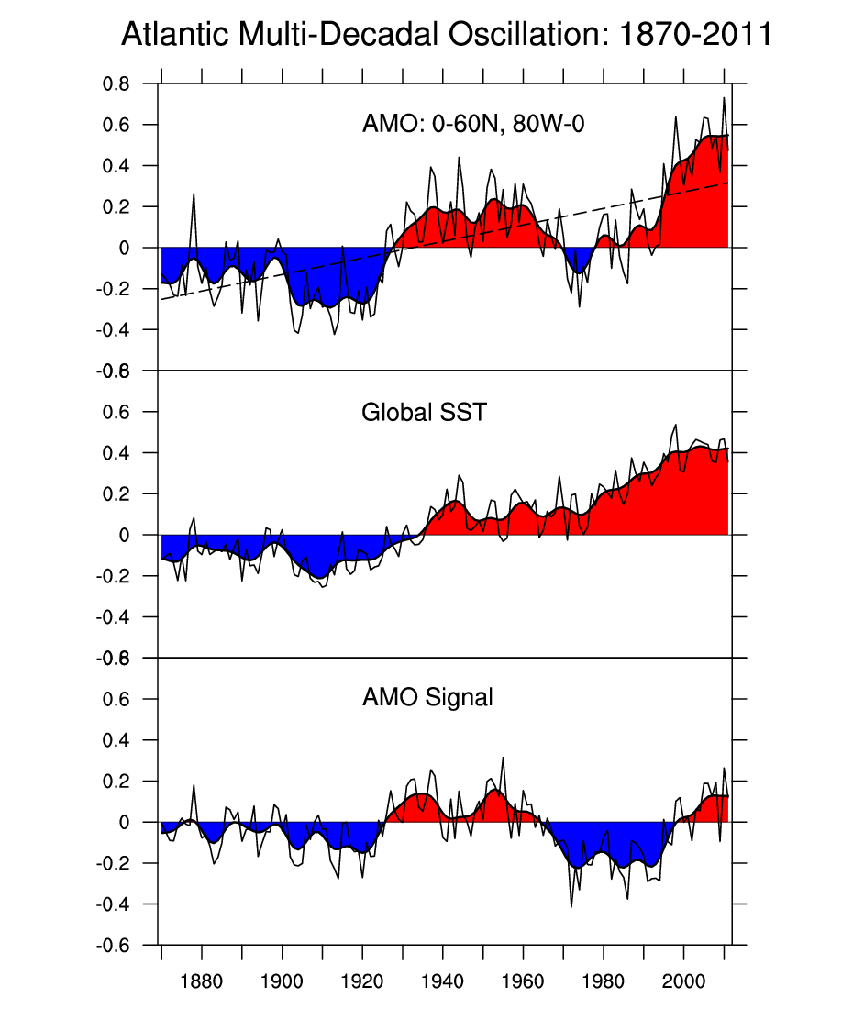

AMO
AMO Index
Global SST anomaly minus
North Atlantic SST anomaly
North Atlantic Basin
Positive may have contributed to last year’s warm, dry winter.

Slide 63

AMO
Correlates with # of Atlantic hurricanes
At least twice as many tropical storms become hurricanes when AMO is negative.
Due to wet W. Africa in positive phase?
http://www.aoml.noaa.gov/phod/faq/amo_faq.php#faq_6

Slide 64

AMO
Correlation with numbers of major hurricanes
not perfect

Slide 65
AMO
May correlate with numbers of major hurricanes
… and southwestern droughts!
Not perfect correlation … what else is going on?

Slide 66



Variations in the Atmosphere
Arctic Oscillation
Pressure over pole vs. mid-latitudes
Positive ⇒ Low over poles keeps cold North
Negative ⇒ High over poles sends cold south
Positive: Strong circumarctic winds trap cold air near pole
Negative: Weak winds allow polar air to move south

Slide 67

PDO
“Horseshoe Effect”
Coastal water “wraps around” core
Warm (Positive) Phase

Slide 68

PDO
“Horseshoe Effect”
Coastal water “wraps around” core
Cool (Negative) Phase

Slide 69


Pacific North America Pattern
Positive: Strong high near west coast
Jet stream forced north in west
West dry, east cold & stormy
Negative: Pacific high farther from coast
Jet stream plunges south in west
West stormy, east warm & dry

Slide 70
Conclusions
Atmospheric circulation is COMPLICATED
Forecasting is difficult
Models tested by “back casting”
BUT …
We learn more every day
Models improve every year
It’s good we know what we do
… the fact that we don’t know it all does not discount how much we do know!!

