Slide 1
SOAR 2016
Past Climates

Slide 2
Past Climates
Climate History
  Types of records
  Climate reconstruction for Earth
Climate variables
  Ocean/Atmosphere variations
    ENSO, PDO, NAO, AMO, Thermohaline circulation
  Events
    Volcanoes & Impacts
  Spaceship Earth
    Solar environment
    Galactic environment
    Orbital Variations

Slide 3
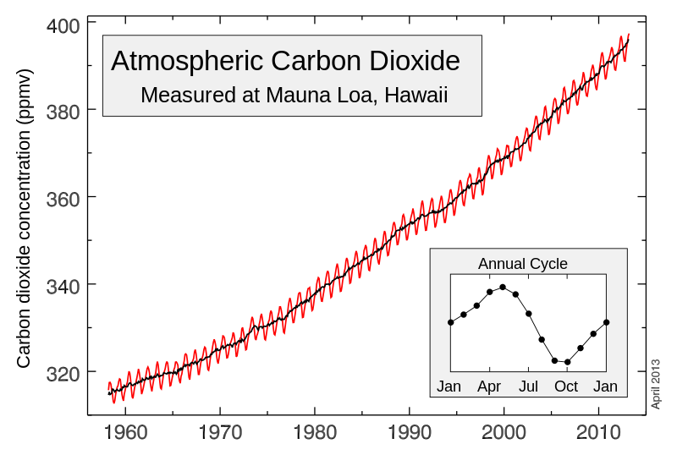
Past Climate Records
Instrumental
  18th – 21st centuries with increasing accuracy
    Best in Europe, N. America, Australia
    Very little data over oceans, 70% of surface
  Keeling Curve: 1957 - present
    CO₂ in air over Mauna Loa, Hawaii
Northern Winter: CO₂ builds up from decay.
Northern Summer: Plants absorb CO₂

Slide 4
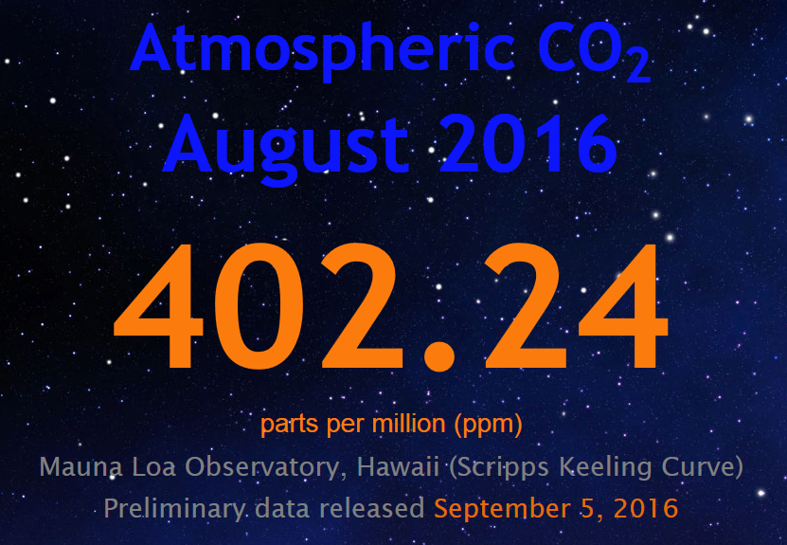
Past Climate Records
Instrumental
  18th – 21st centuries with increasing accuracy
    Best in Europe, N. America, Australia
    Very little data over oceans, 70% of surface
  Keeling Curve: 1957 - present
    CO₂ in air over Mauna Loa, Hawaii
Northern Winter: CO₂ builds up from decay.
Northern Summer: Plants absorb CO₂

Slide 5
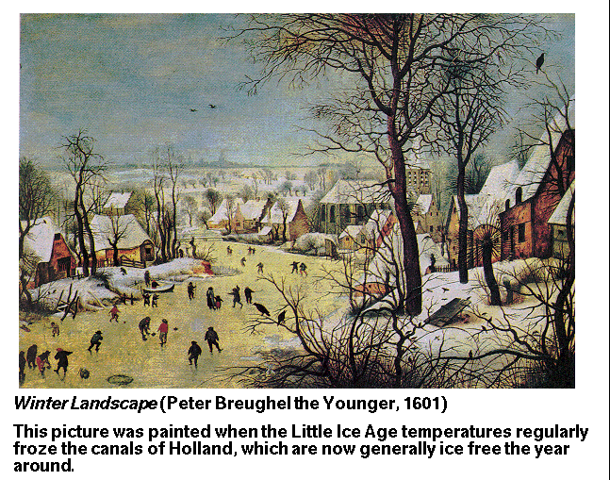
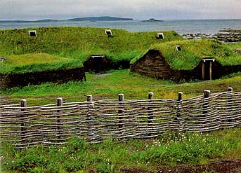
Past Climate Records
Anecdotal Records
  Written records of planting, blooming, harvests
  Frozen Dutch canals in art
  Archeological sites
    Vikings in Greenland
    and Labrador

Slide 6
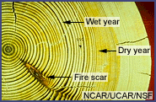
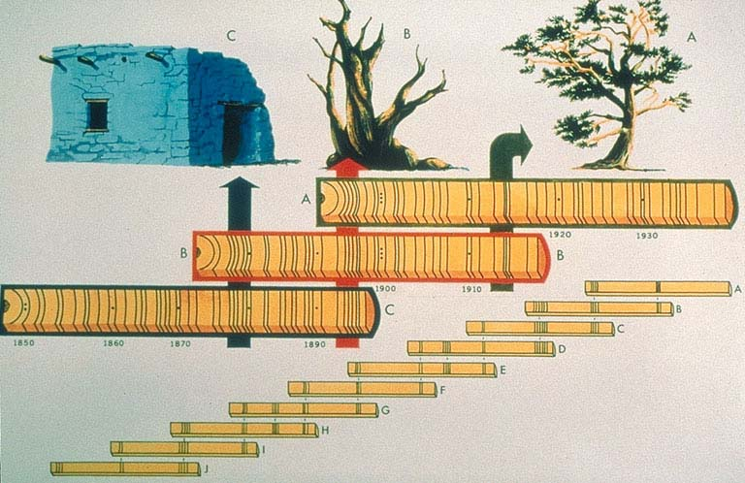
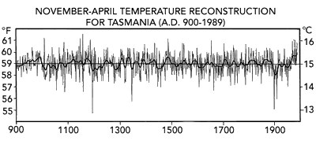
Past Climate Records
Proxy (indirect natural) Records
  Tree rings
    Temperature, precipitation, fire, insects, other stresses
    Depends on area, species level of stress
      best near stress limit
    Back to ~1000 years (bristlecone pine in CA)
      plus overlapping with structures

Slide 7
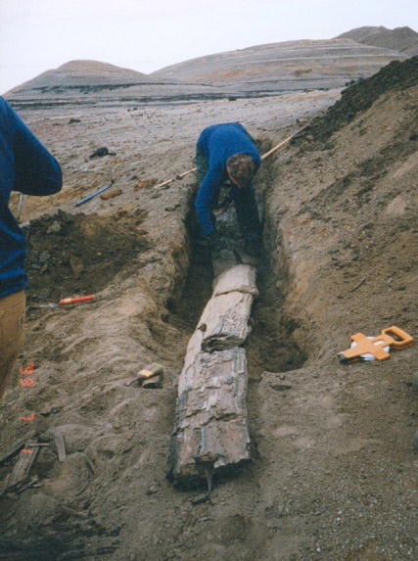
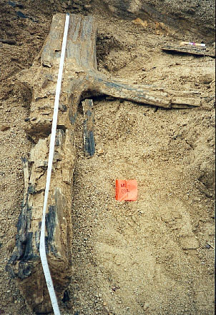
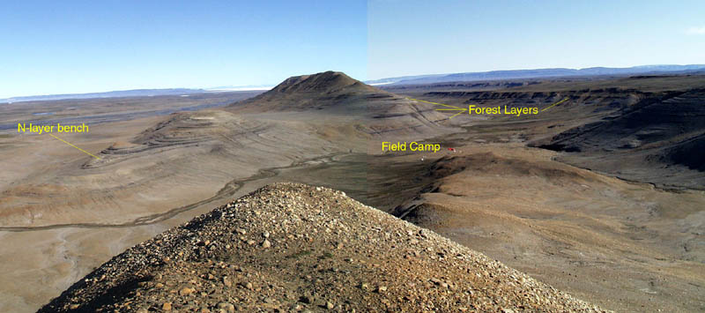
Past Climate Records
Proxy (indirect natural) Records
  Tree rings
    Fossil forests in the arctic … 60 million years old!

Slide 8

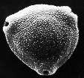
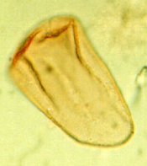
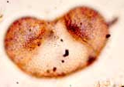
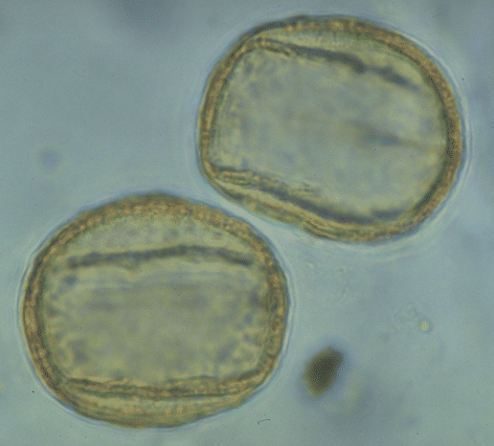
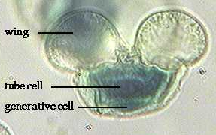
Past Climates
Proxy (indirect natural) Records
  Palynology (pollen) from sediments
    Accumulated in peat bogs & lakes
    Must be independently dated (cross-matched or ¹²C)
    Local influences complicate records
      eg. Fire, flood, etc.
    Types of pollen vary in uniqueness
      eg. Pine pollen everywhere … even ice caps!
shrub
birch
sedge
spruce
oak
Pine

Slide 9
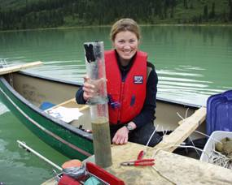

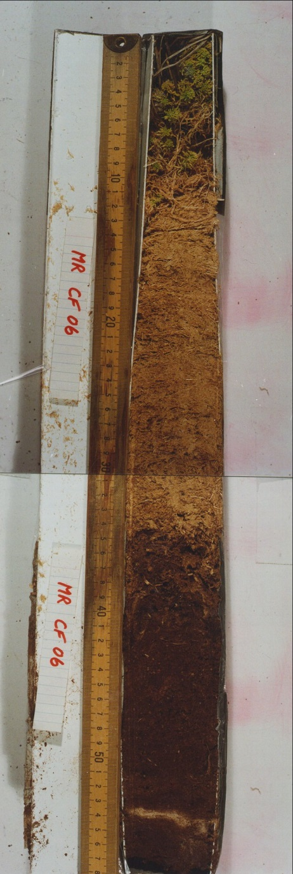
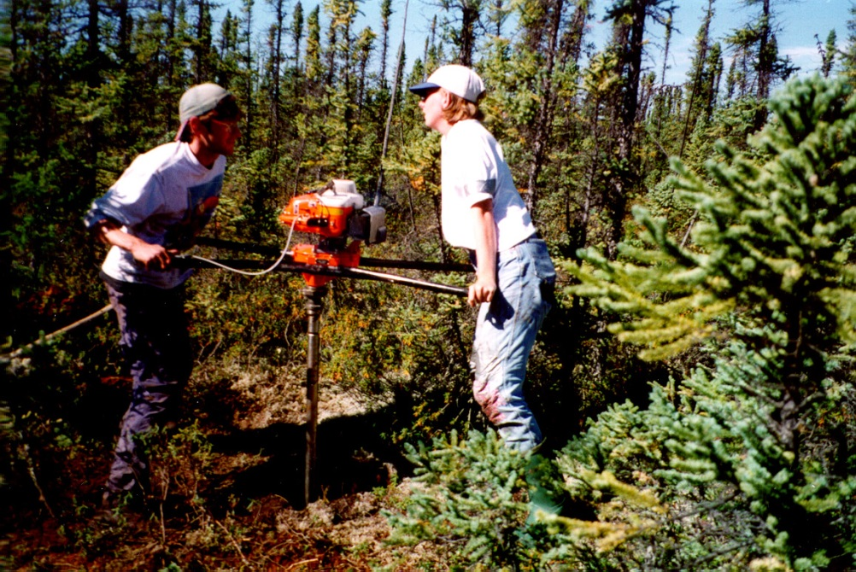
Past Climates
Collecting sediment samples in Canada
Lake sediments
Peatland cores
Dr. Steve Robinson, SLU Geology

Slide 10
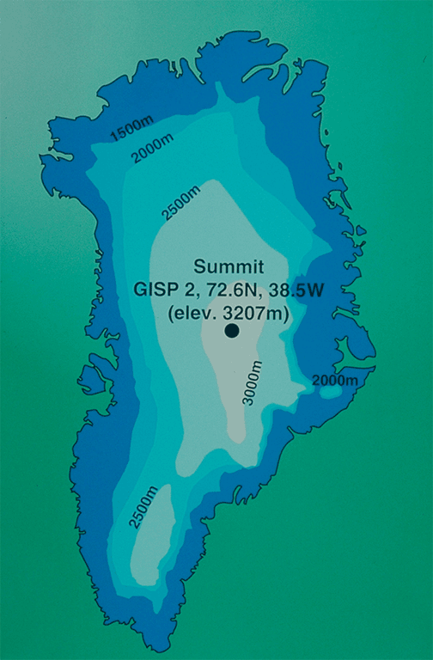
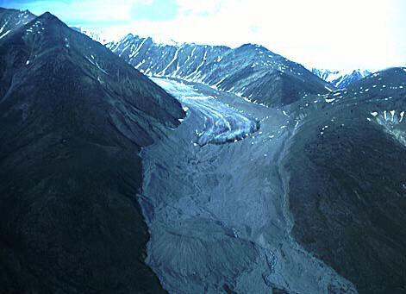
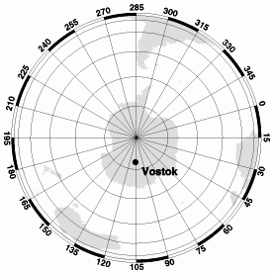
Past Climate Records
Proxy (indirect natural) Records
  Ice Cores
    Alpine glaciers
    Greenland ice sheet
    Antarctic ice sheet
Greenland ice sheet at 10,400 feet = 1.98 miles

Slide 11
Past Climate Records
Vostok & Greenland Ice Cores
  Show annual* variations of atmosphere
    Bubbles of air contain old atmosphere
      Variations in CO₂, CH₄ Give
        Comparisons to today,
        Correlations with temperature
    Ice crystals vary in composition
      Different Isotopes of Oxygen, Hydrogen, etc.
    Dust
      Volcanos, Impacts, Winds, Organic Matter
*Where annual layers unclear, chronology is reconstructed from other annual variables

Slide 12
Isotopes
Number of neutrons in nuclei varies
  eg. Oxygen 16 (¹⁶O) & 18 (¹⁸O)
  ¹⁸O heavier than ¹⁶O ⇒ harder to evaporate
    Ice Cores
      High ratio of ¹⁸O/¹⁶O for warm globe
    Deep Sea Sediments
      High ratio of ¹⁸O/¹⁶O for cool globe
¹⁶O
¹⁸O
8 protons 8 neutrons
8 protons 10 neutrons
1 ¹⁸O in 1000 ¹⁶O

Slide 13
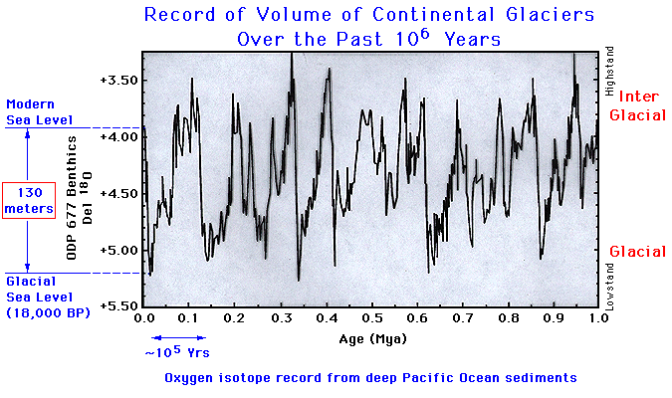
Ice Core Data
Isotopes indicate glaciations

Slide 14
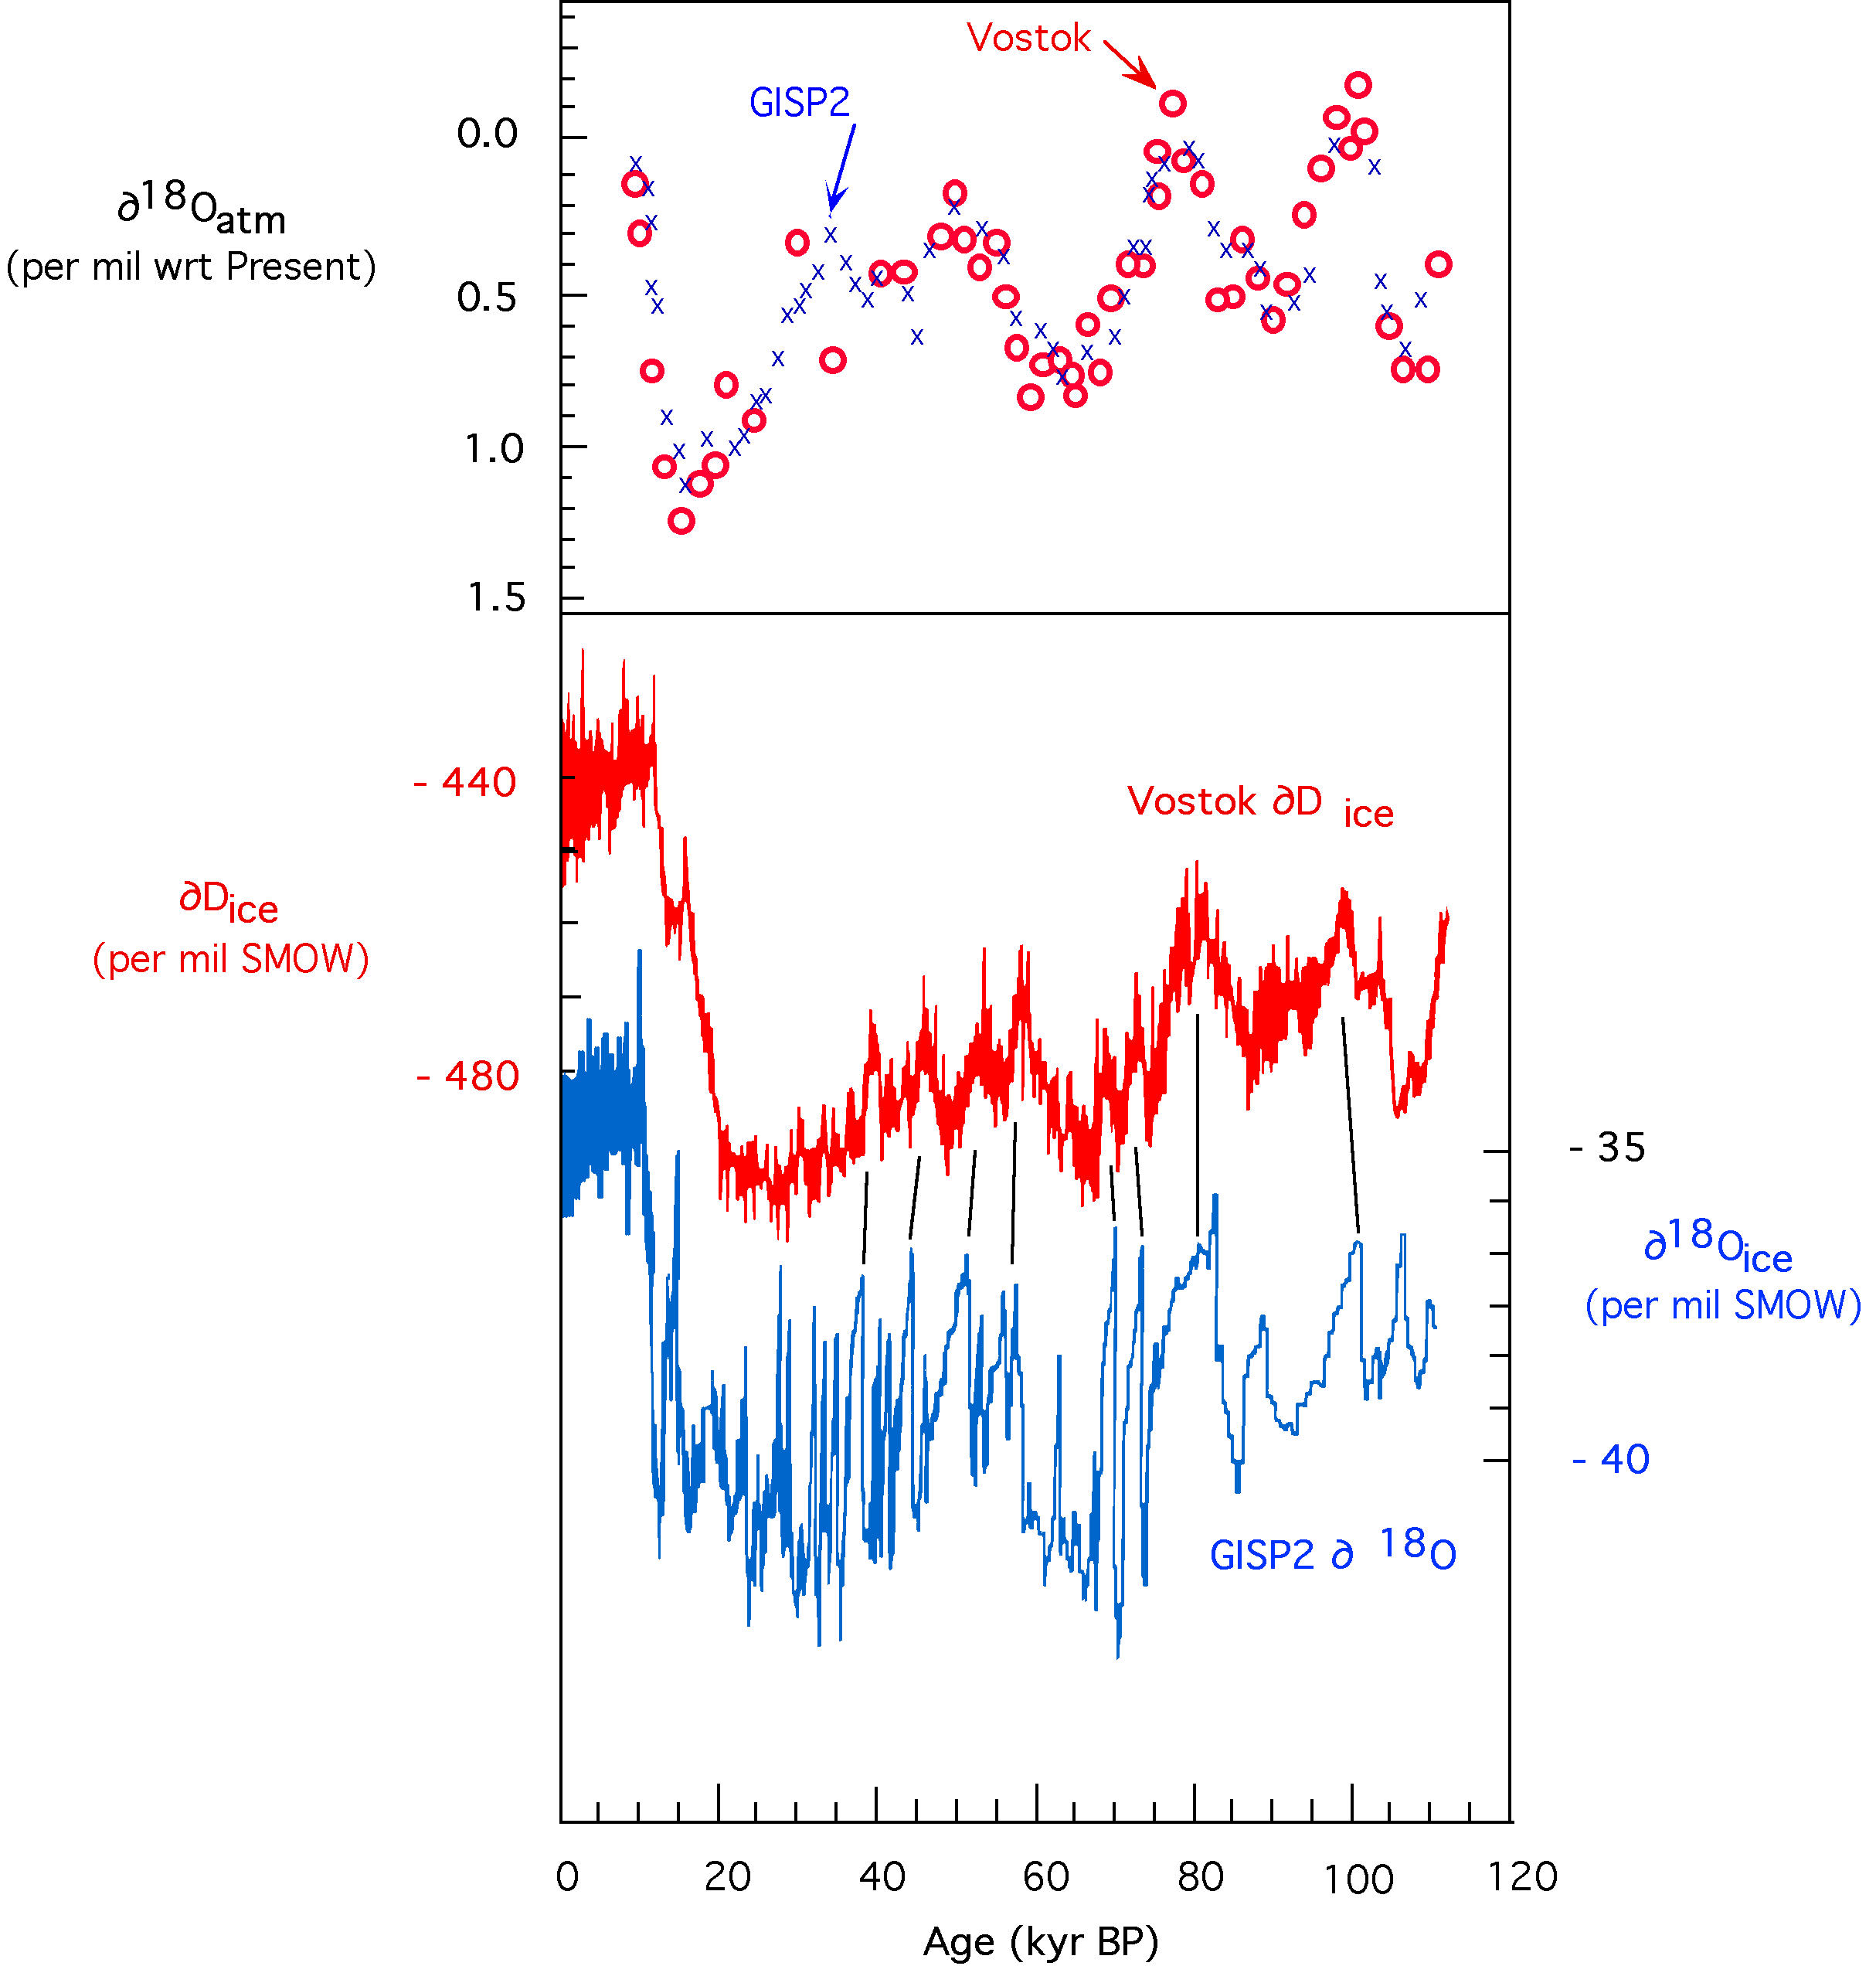
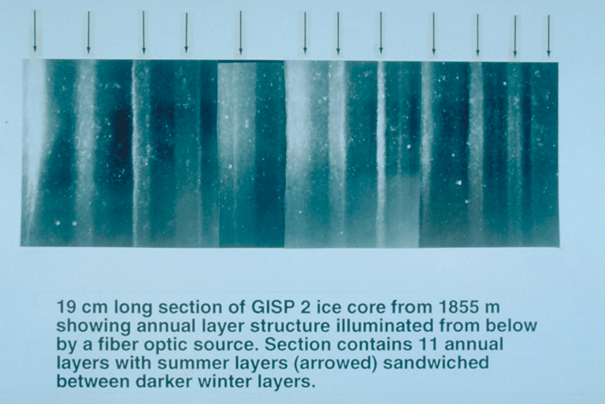
Ice Core Data
Annual Layers
  Dating & N-S correlation
Isotopes
  Correlate with temperature
  Ice rich in heavy isotope indicates a warmer ocean
Trapped air
  Atmospheric composition
¹⁸O/¹⁶O
GISP2 = Greenland
Vostok = Antarctica
Greenland ice core: arrows indicate summers.
²H/¹H

Slide 15
Isotopes
Variations indicate temperature
  Higher ¹⁸O/¹⁶O in ice ⇒ warmer
  Lower ¹⁸O/¹⁶O in ice ⇒ cooler
¹⁸O/¹⁶O
Arctic & Antarctic show same variations ⇒ variations are global
²H/¹H

Slide 16
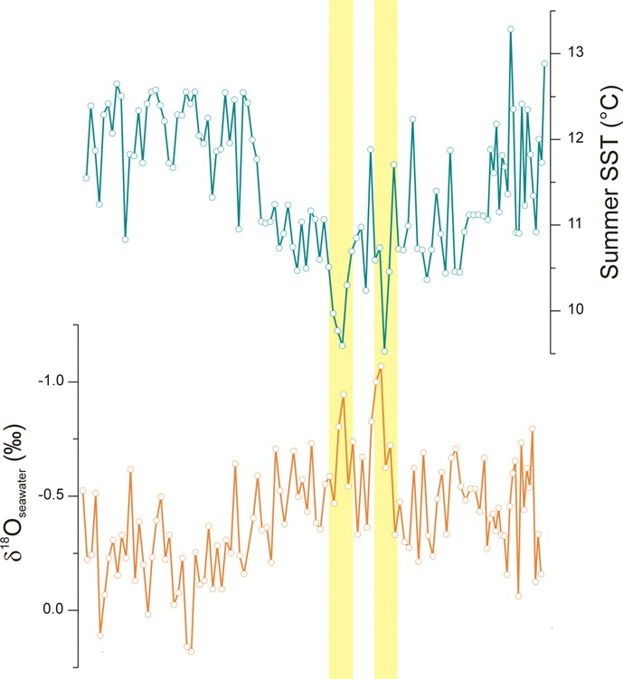

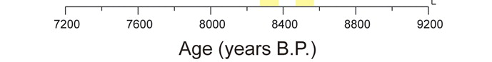
Isotopes
Sea Temp.
  Higher ¹⁸O/¹⁶O
  ⇒ cooler
  Lower ¹⁸O/¹⁶O
  ⇒ warmer
Sea surface temperature
¹⁸O/¹⁶O
C. R. W. Ellison et al., Science 312, 1929 -1932 (2006)

Slide 17
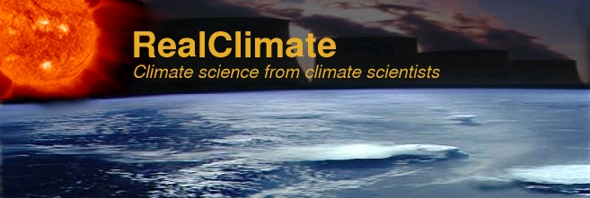
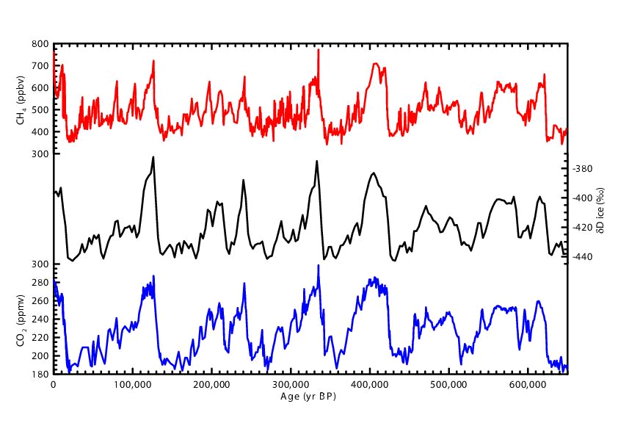
Isotopes
Variations track with GH gases
Methane
²H/¹H
Carbon Dioxide
now
²H/¹H
then
www.realclimate.org/index.php?p=221

Slide 18



Isotopes
Variations track with GH gases
Methane
408
CO₂ at levels not seen in > 600,000 years!
400
²H/¹H
380
360
340
320
Carbon Dioxide
now
then
www.realclimate.org/index.php?p=221

Slide 19
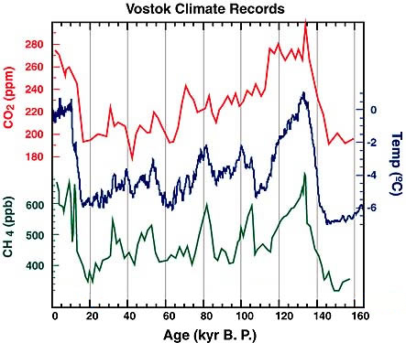
Temperature & GH Gases
Temperature tracks with gases …
Which drives which?
Carbon Dioxide
Temp (°C)
Methane
now
then
Ice Core Contributions to Global Change Research: Past Successes and Future Directions
National Ice Core Laboratory Ice Core Working Group, May, 1998.

Slide 20
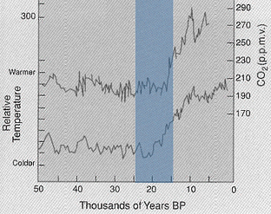
Carbon Dioxide
Long-term sources: Volcanoes
Long-term sinks: Chemical Weathering
  H₂O + CO₂ ⇒ H₂CO₃ ⇒ H⁺ + HCO₃
  CaCO₃ + H⁺ ⇒ Ca + HCO₃
Variable storage:
Biosphere
  plants absorb
  decay releases
Carbonic Acid
Bicarbonate can combine with many compounds eg. NaHCO₃, Ca(HCO₃)₂
CO₂ Concentration
Relative Temperature

Slide 21

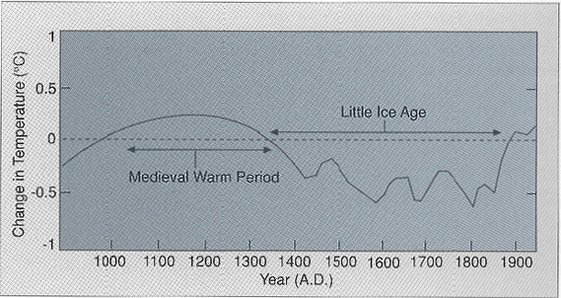
Climate History
Crowley “Remembrance of Things Past”
Last 1000 Years
Temperature Changes from 1900 level.
Seems to be Northern Hemisphere only.

Slide 22
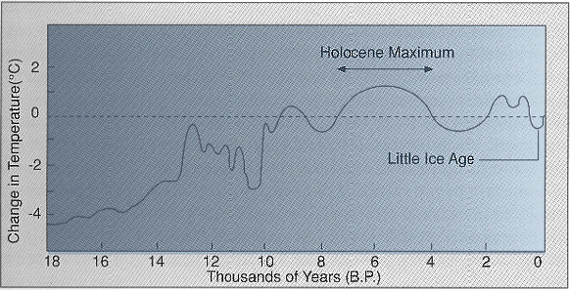
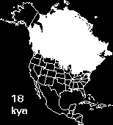
Climate History
Last 18ky
Wisconsonian Glaciation
Younger Dryas: Gulf Stream shutdown due to glacial meltwater flood down St. Lawrence River.

Slide 23
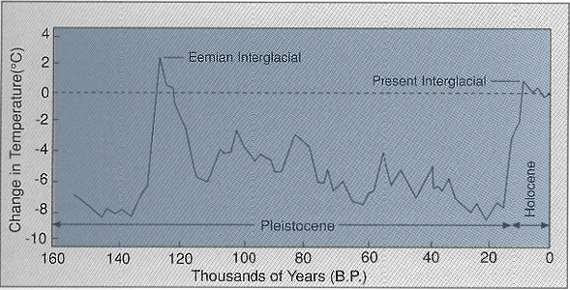
Climate History
Last 150ky
  mostly ice core data

Slide 24
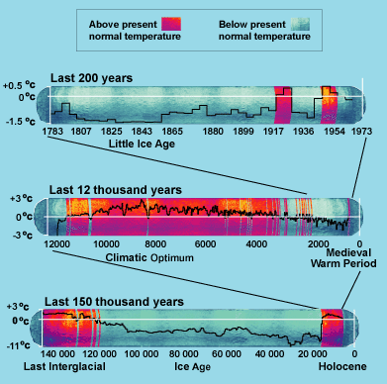
Climate History
Last 140 ky

Slide 25
Climate History
Last 140 ky
ACG Deniers claim warmer is better because of this name.

Slide 26
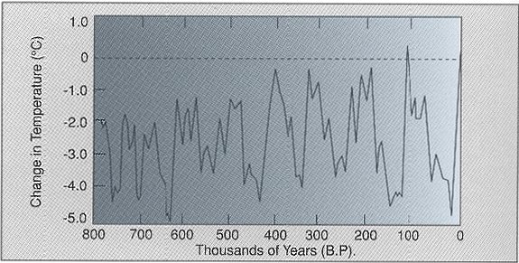
Climate History
Last 800ky
  Deep sea cores, ¹⁶O/¹⁸O
Repeating ice ages much cooler than today!
Humans

Slide 27
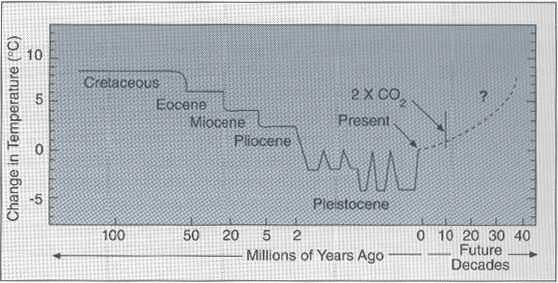
Climate History
Last 100My
  Marine & Terrestrial data
Much warmer in Mesozoic!
ice ages

Slide 28
Climatic Events
Volcanoes
  Put ash (SO₂) high in atmosphere
Comet/Meteor Impacts
  Cause fires & tsunamis
  Put dust & ash high in atmosphere

Slide 29
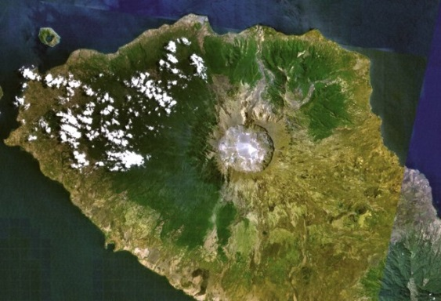
Climatic Events
Volcanoes
  Mt. Tambora, 4/5/1815
    erupted after 5000 years of dormancy
    resulted in “year without a summer” in US
In New England the summer of 1816 included … widespread frost at low level sites around New England on the 8-9th July and the damaging frosts on the 22nd of August from interior New England right the way south into North Carolina (Ludlum 1989). … This all led to crop failures and food shortages and helped stimulate a move westwards the following year. In both Connecticut and parts of New York State frosts after April are rare, but in 1816 frosts were recorded every month of the year (Lamb 1816, Neil Davids).
http://www.dandantheweatherman.com/Bereklauw/yearnosummer.html

Slide 30
Climatic Events
Mt. Pinatubo, 6/15/1991
  10 times bigger than Mt. St. Helens
In 1992 and 1993, the average temperature in the Northern Hemisphere was reduced 0.5 to 0.6°C and the entire planet was cooled 0.4 to 0.5°C. The maximum reduction in global temperature occurred in August 1992 with a reduction of 0.73°C. The eruption is believed to have influenced such events as 1993 floods along the Mississippi river and the drought in the Sahel region of Africa. The United States experienced its third coldest and third wettest summer in 77 years during 1992.

Slide 31
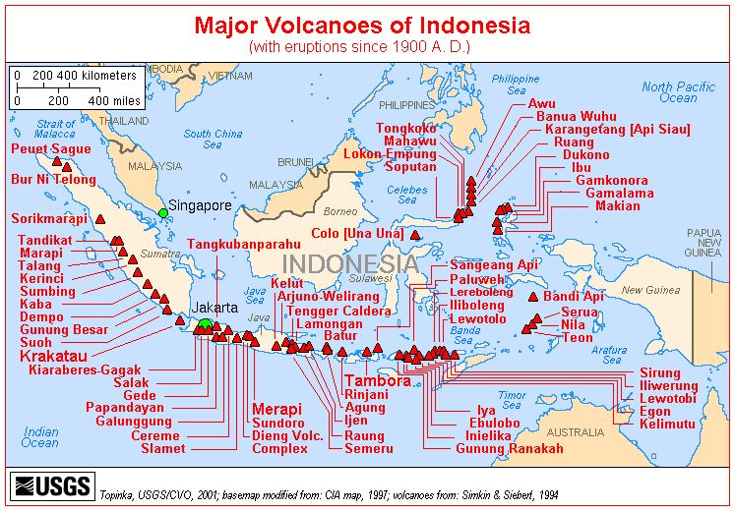
Climatic Events
Lots of Volcanoes
  Indonesia
Krakatau may have split Sumatra from Java

Slide 32
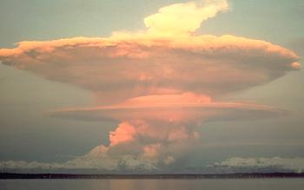
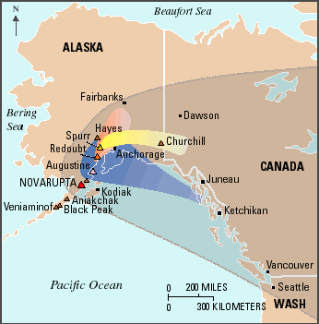
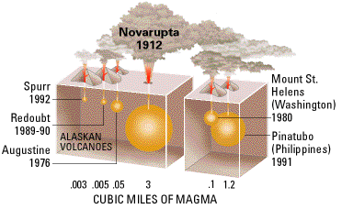
Climatic Events
Lots of Volcanoes
  Aleutian Islands
Novarupta had largest eruption in 20th Century on June 6, 1912
Novarupta ash 1912
Redoubt ash 1990
Spurr ash 1992
Augustine ash 1976

Slide 33
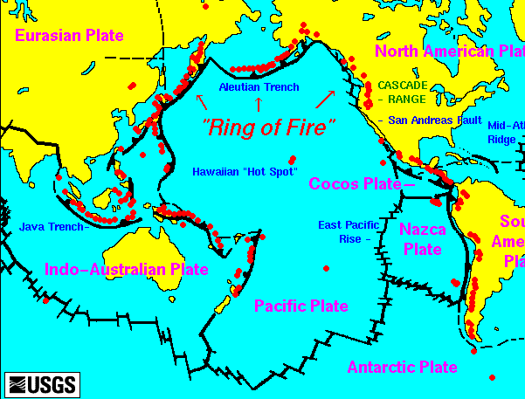
Climatic Events
Ring of Fire … Pacific Rim

Slide 34
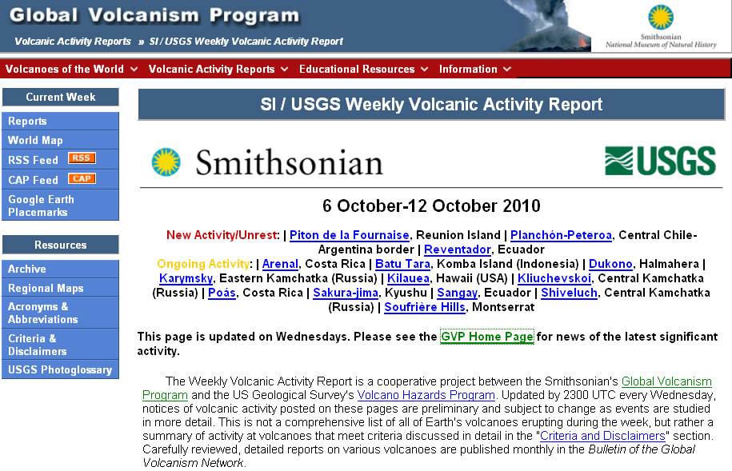
Climatic Events
http://www.volcano.si.edu/reports/usgs/

Slide 35
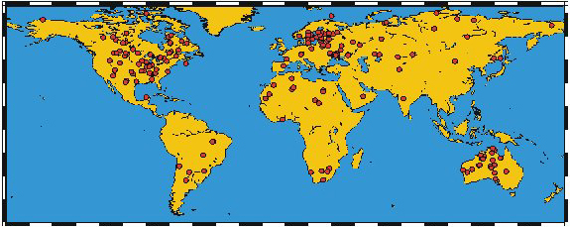
Impact Craters on Earth
Slowly erased by erosion
Fractured rock, gravitational variations indicate ancient craters
World Impact Craters

Slide 36

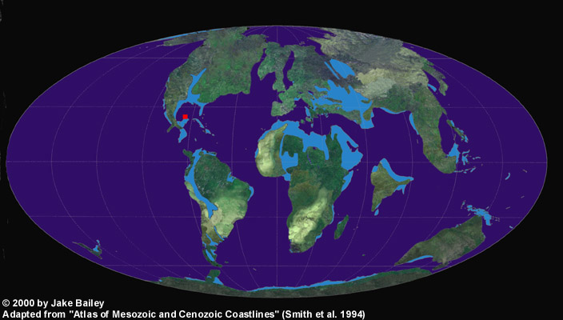
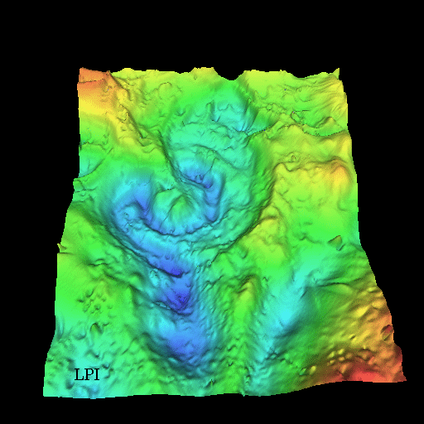
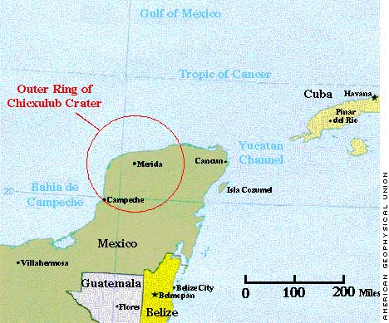
Chicxulub Impact
Demise of the dinosaurs?
Mapped by gravitational anomalies
On Edge of Yucatan Peninsula
Earth c. 65 million BCE
http://www.lpl.arizona.edu/SIC/impact_cratering/Chicxulub/Chicx_title.html

Slide 37
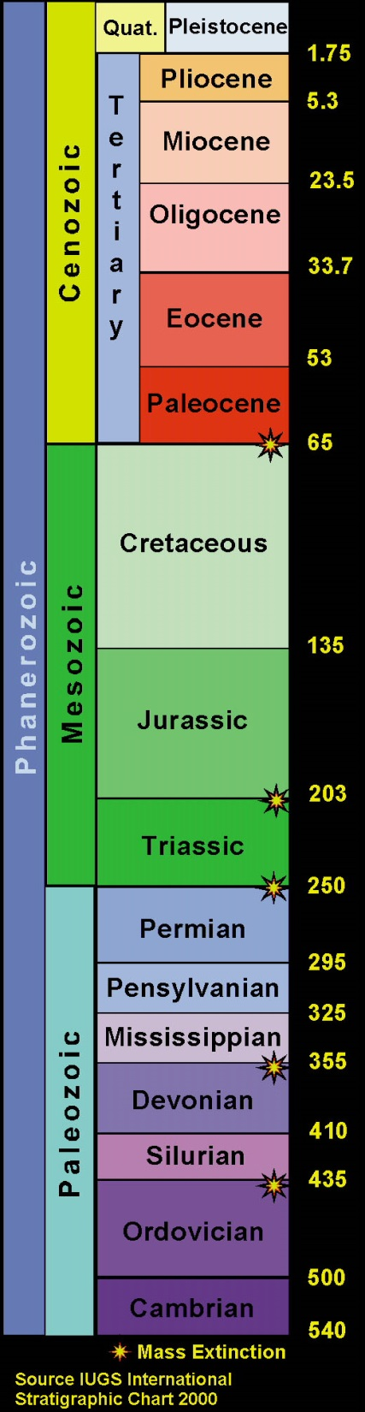
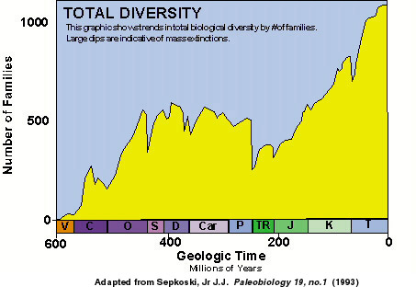
Impacts
Cause of mass extinctions?
Cause of climate change
Some may be due to nearby supernova explosions!

Slide 38

Recent Impacts
Comet impact in 2800 BCE?
  Chevrons in Madagascar
    chevron-shaped piles of sediment from tsunami waves produced by comet impacts
    include deep ocean microfossils + impact debris
http://geology.com/news/labels/Oceanography.html

Slide 39

Recent Impacts
Comet impact in 2800 BCE?
  Chevrons in Madagascar
    sea floor debris left by ancient megatsunami
http://geology.com/news/labels/Oceanography.html
Click!

Slide 40



Recent Impacts
Chevrons
Straight line on a spherical globe
Crater?
http://maps.google.com/

Slide 41

Recent Impacts
Comet impact in oceans
  Hard to find, indicated by chevrons
http://maps.google.com/

Slide 42
Variations in the Atmosphere
Insolation Variations
  Solar brightness variations
    sunspots & other stellar variations
  Earth orbital variations
    other planets’ gravity vary Earth’s orbit
  Solar system environmental variation
    moves through galactic environment

Slide 43



Spaceship Earth
Galactic Environment
  Solar system passes through nebulae
Galactic year ~ 225 million years (Sol is 22)
Sol crosses galactic plane every 33 Myr

Slide 44
Spaceship Earth
Sun is a variable star
  Solar constant ≈ 1370 W/m² … varies
    stars evolve, luminosity varies
    early sun ~ 25% -30% dimmer than today
  Sunspot Cycle
    11 year number cycle
    22 year polarity cycle
    Earth gets more energy from sun when sunspot numbers are high.

Slide 45

The Sun

Slide 46


Sunspots
Magnetic Hernias
  Sun’s equator rotates faster than poles
  Magnetic Field wraps up, bulges up

Slide 47



Sunspots
Observed since 1611 (Johann Fabricius)
  Discovered by Johann Fabricius
  Observed by Galileo
spaceweather.com
Sol 04/09/04
Sol 10/14/10

Slide 48

Sunspots
Number observed since 1611
Regular 11-year cycle
Maunder Minimum

Slide 49

Maunder Minimum
Associated with Little Ice Age
  Began due to solar cooling
  Continued due to ice albedo effect

Slide 50



Spaceship Earth
Current Orbit moderates seasons
  Northern Summer at Aphelion
    mostly land, less solar flux reduces heat
  Southern Summer at Perihelion
    mostly water, more solar flux absorbed by oceans
Aphelion: 7/5/5 r = 152.1 Gm
Perihelion: 1/2/5 r = 147.1 Gm

Slide 51
Milankovitch Cycles
Insolation changes with orbital variations
  Axial Tilt: 41,000 year cycle
    Makes seasons more or less severe
  Precession: 26,000 year cycle
    Changes season of perihelion
      Now: perihelion in early January
      ⇒ Southern summer when Earth closes to sun
  Eccentricity: 100,000 year cycle
    Changes severity of seasons
      distance to sun varies more through the year
Do Ice Ages correlate with orbit?

Slide 52

Milankovitch Cycles
Variation in Earth’s orbit due to gravitational attractions of other planets

Slide 53
Eccentricity
100,000 years
  Currently 3% difference in distance
    7% difference in insolation
  At Maximum, 9% difference in distance
    20% difference in insolation

Slide 54

Precession
23,000 years
  Changes season of perihelion
  Northern seasons much more severe
    more insolation on land masses in summer
    less insolation on land masses in winter

Slide 55
Obliquity
41,000 years
  Axis Tilt
    Now: 23.5º
    Minimum: 22.5º
      Tropics closer to equator, Circles closer to poles
      Poles get less summer insolation (glaciation?)
      Equator gets more insolation (shallow angles at solstices)
    Maximum 24.5º
      Tropics farther from equator, Circles farther from poles
      Poles get more summer insolation (melting?)
      Equator gets less insolation (steeper angles at solstices)

Slide 56

Insolation
Varies with Milankovitch Cycles
  Calculation for 65 N (Berger (1991))
9,000 years ago, ice age ended!
Some argue this is the cause of all climate change … so we can ignore our CO₂

Slide 57








Global Circulaton Zones
Polar High
Easterlies
Polar Front
Westerlies
… but it’s more complicated than this …
Sub-Tropical High
NE Trades
ITCZ
SE Trades
Sub-Tropical High
Westerlies
Polar Front
Easterlies
Polar High

Slide 58



Ocean & Atmosphere Teleconnections
Pacific Ocean
  ENSO – El Niño Southern Oscillation
  PDO – Pacific Decadal Oscillation
Atlantic Ocean
  NAO – North Atlantic Oscillation
  AMO – Atlantic Multidecadal Oscillation
  Atlantic Oscillation
  Thermohaline Circulation

Slide 59

“Normal” Conditions
Atmospheric pressure higher in east (Tahiti) than west (Darwin).
Surface trade winds blow from east to west
  Walker Circulation (named by Bjerknes)
  Pile up water in west, drive upwelling in east

Slide 60


La Niña: “Enhanced Normal”
Colder than normal water off Peru
  Stronger trade winds
  Increased upwelling
Larger pressure difference

Slide 61


El Niño
Warmer than normal water off Peru
  Weak (or opposite) trade winds
  Decreased upwelling
Small or opposite pressure difference
SST Anomalies

Slide 62

Frequency of ENSO
~ Every 2 to 7 years … not regular
High frequency in 1990s
  El Niño: 1991-92, 1993, 1994 (moderate) and 1997-98 (strong).
Mostly La Niña since 2000
2012 … strongish La Nina, very warm
El Niño
La Niña
http://www.esrl.noaa.gov/psd/enso/mei/#discussion

Slide 63

North Atlantic Oscillation
Known since 19th Century
  Pressure difference between the
  Azores High & Islandic Low
  Positive: large difference
    strong Gulf Stream
    warm winter & spring in Scandinavia & E. US
    cool along east coast of Canada & west Greenland
  Negative: small difference
    dry in E. N.Am
    wet in S. Europe

Slide 64

North Atlantic Oscillation
Primarily affects winter
  Strong pressure difference holds cold in north
Positive (warm)
Negative (cold)

Slide 65

North Atlantic Oscillation
Primarily affects winter
  Weak pressure difference allows more air mixing with north, not as cold.
Positive (warm)
Negative (cold)

Slide 66
North Atlantic Oscillation
Positive (warm)
Negative (cold)

Slide 67

NAO
Mostly positive since mid 1970’s
Mostly negative in ’50’s – ‘60’s
Mostly Positive since 2010

Slide 68
AMO
Atlantic Multidecadal Oscillation
  Greenland ice cores show oscillations
    60 & 80 year variations in N. Atlantic temperature
  Driven by NAO?
    Positive NAO
      strong westerlies across Labrador sea cool ocean
      strengthens Gulf Stream & Thermohaline Circulation (THC)
    Negative NAO
      weak westerlies across Labrador sea keep ocean warmer
      weakens Gulf Stream & THC

Slide 69

AMO
AMO Index
  Global SST anomaly minus
  North Atlantic SST anomaly
Global SST anomaly warmer than Atlantic SST Anomaly
Atlantic SST anomaly warmer than Global SST Anomaly

Slide 70

AMO
Correlates with # of Atlantic hurricanes
  At least twice as many tropical storms become hurricanes when AMO is negative.
Due to wet W. Africa in positive phase?
http://www.aoml.noaa.gov/phod/faq/amo_faq.php#faq_6

Slide 71

AMO
Correlation with numbers of major hurricanes
not perfect

Slide 72
AMO
May correlate with numbers of major hurricanes
… and southwestern droughts!
Not perfect correlation … what else is going on?

Slide 73



Variations in the Atmosphere
Arctic Oscillation
  Pressure over pole vs. mid-latitudes
    Positive ⇒ Low over poles keeps cold North
    Negative ⇒ High over poles sends cold south
Positive: Strong circumarctic winds trap cold air near pole
Negative: Weak winds allow polar air to move south

Slide 74

Variations in the Atmosphere
Arctic Oscillation
  Pressure over pole vs. mid-latitudes
    Positive ⇒ Low over poles keeps cold North
    Negative ⇒ High over poles sends cold south
Positive: Strong circumarctic winds trap cold air near pole
Negative: Weak winds allow polar air to move south

Slide 75

Variations in the Atmosphere
Arctic Oscillation
  Pressure over pole vs. mid-latitudes
    Positive ⇒ Low over poles keeps cold North
    Negative ⇒ High over poles sends cold south
Quite Variable!
Positive: Strong circumarctic winds trap cold air near pole
Negative: Weak winds allow polar air to move south

Slide 76

PDO
“Horseshoe Effect”
  Coastal water “wraps around” core
Warm (Positive) Phase

Slide 77

PDO
“Horseshoe Effect”
  Coastal water “wraps around” core
Cool (Negative) Phase

Slide 78

Regional Current Variations
PDO – Pacific Decadal Oscillation
  Currently in positive phase (since March 2014)
    Drought frequency enhanced in northern USA

Slide 79


Pacific North America Pattern
Positive: Strong high near west coast
  Jet stream forced north in west
  West dry, east cold & stormy
Negative: Pacific high farther from coast
  Jet stream plunges south in west
  West stormy, east warm & dry

Slide 80

Pacific North America Pattern
Positive: Strong high near west coast
  Jet stream forced north in west
  West dry, east cold & stormy
Negative: Pacific high farther from coast
  Jet stream plunges south in west
  West stormy, east warm & dry
Quite Variable!

Slide 81

Next Time
Future climates & the IPCC 4th Assessment
http://www.ipcc.ch/

