Slide 1
SOAR 2016
Current Changes and Future Climates

Slide 2
Predicting the Future
Climate Systems
Atmosphere – changes over hours
Oceans – surface changes over weeks
– depths change over centuries
Biosphere – changes annually to centuries
Cryosphere – ice, glaciers permafrost, snow
– various change scales
Geosphere – volcanoes, continental drift
– long time scales, large changes

Slide 3
Modeling the Climate
Systems & Feedback Among
Radiation
insolation (incoming sunlight varies)
reflection, absorption, re-radiation by surface, air
Water cycle
evaporation, precipitation, runoff
Land surface
soil moisture, vegetation, topography, snow & ice
Ocean
surface currents, deep currents, chemistry (salinity)
Sea Ice
strongly affected by feedback

Slide 4
Discovering Patterns
Ocean/Atmosphere Variations
Atlantic Ocean
NAO – North Atlantic Oscillation
AO - Arctic Oscillation
Pacific Ocean
PNA – Pacific North American Pattern
ENSO – El Niño Southern Oscillation
“Teleconnections”

Slide 5
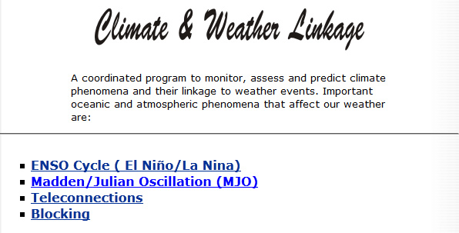
Climate Prediction Center
Climate & Weather Linkage
Mostly a tropical phenomenon

Slide 6
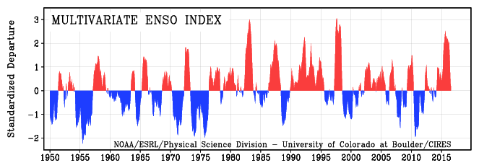

ENSO Index
Shows El Niño/La Niña years
Neutral years have index < ± 0.5
Multivariate ENSO index from NOAA
El Niño
La Niña
Makes it look like we’re in El Nino conditions

Slide 7
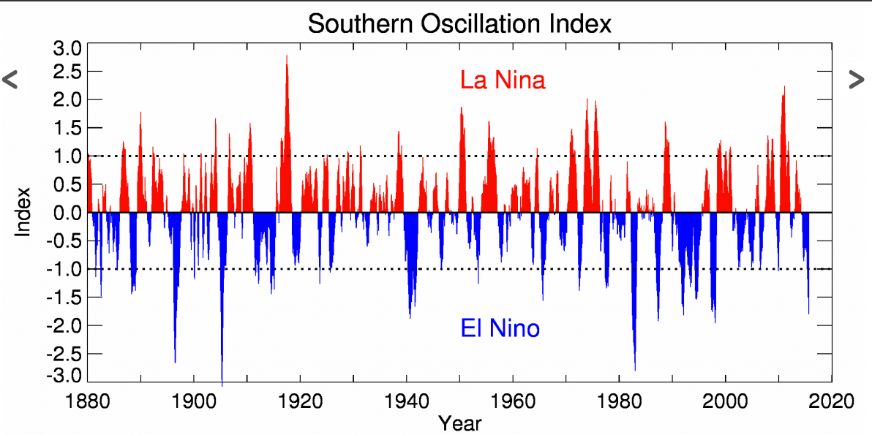
ENSO Index
Shows El Niño/La Niña years
Neutral years have index < ± 0.5
SO index from New Zealand
www.niwa.co.nz/our-science/climate/information-and-resources/clivar/elnino
El Niño
La Niña

Slide 8
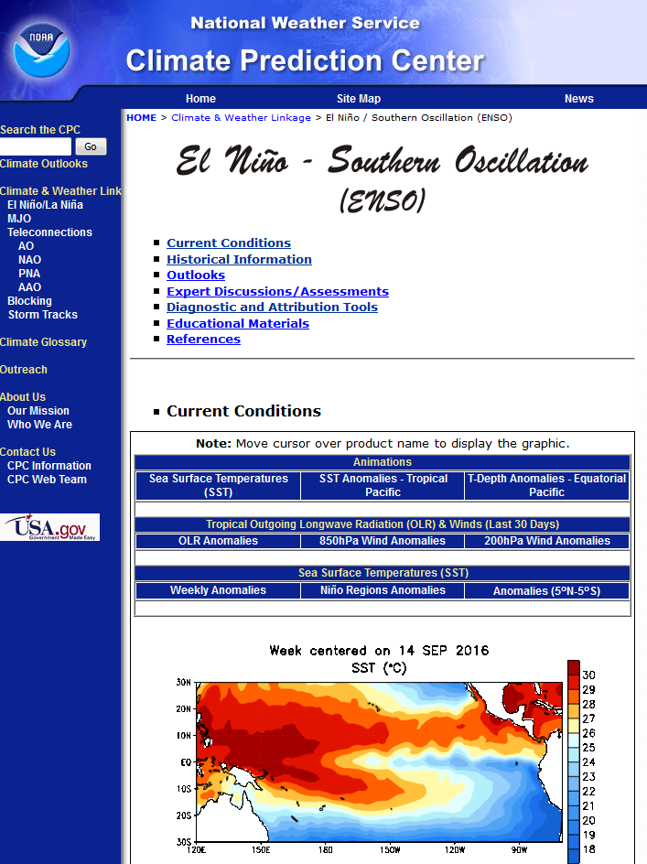
ENSO
Current Conditions:
Warm pool in western pacific ⇒
Neutral Conditions
http://www.cpc.ncep.noaa.gov/products/precip/CWlink/MJO/enso.shtml

Slide 9


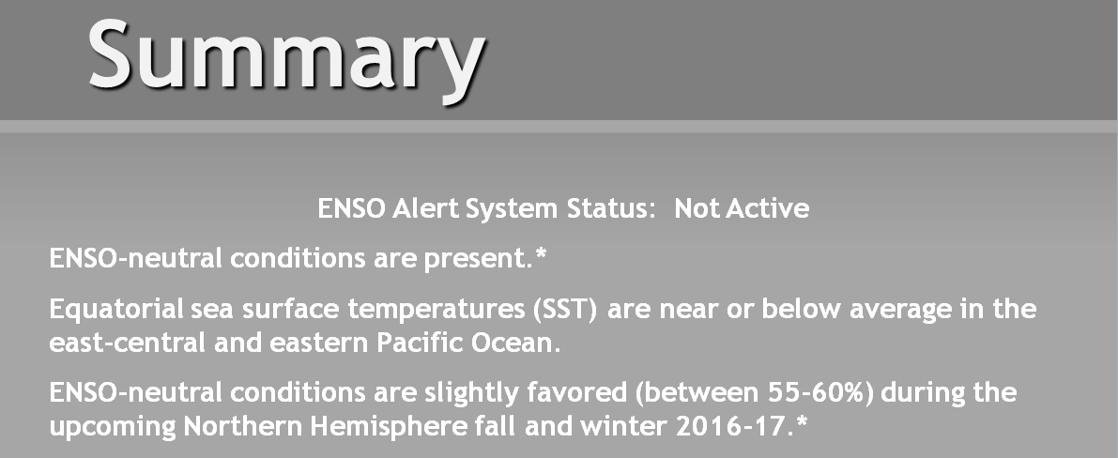
ENSO
Current Conditions:
Warm pool in western pacific ⇒
Neutral Conditions
Official NOAA prediction is for neutral conditions through winter
http://www.cpc.ncep.noaa.gov/products/precip/CWlink/MJO/enso.shtml

Slide 10
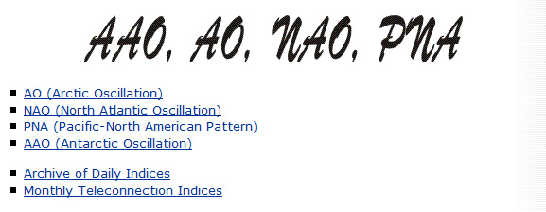
Climate Prediction Center
Oscillations

Slide 11

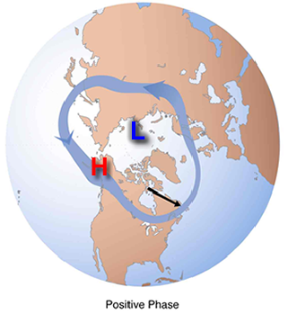
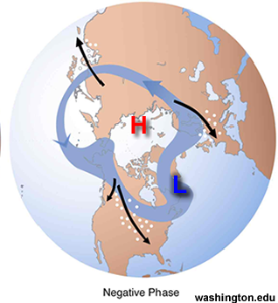
Variations in the Atmosphere
Arctic Oscillation
Pressure over pole vs. mid-latitudes
Positive ⇒ Low over poles keeps cold North
Negative ⇒ High over poles sends cold south
Positive: Strong circumarctic winds trap cold air near pole
Negative: Weak winds allow polar air to move south

Slide 12
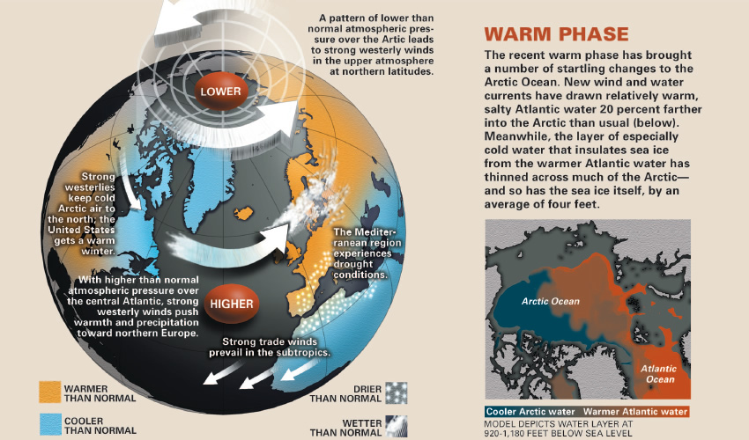
AO
Positive also known as “Warm Phase”

Slide 13
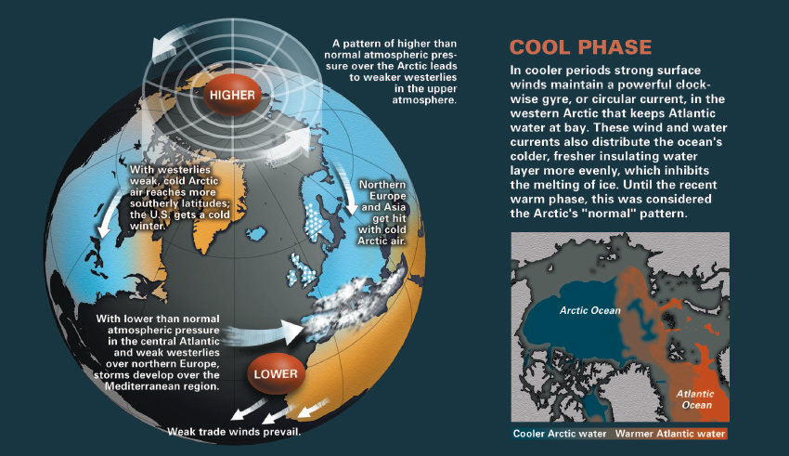
AO
Negative also known as “Cool Phase”

Slide 14
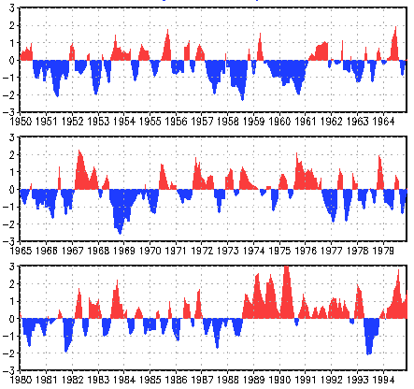
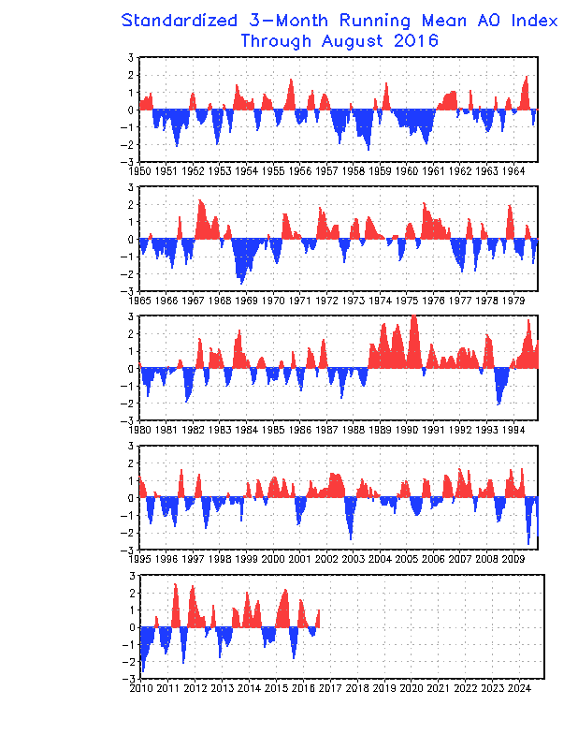
AO
Arctic Oscillation Index
Negative last winter … we got some cold
Positive now … bringing warmth
Positive last winter and now
Cold should stay north!

Slide 15
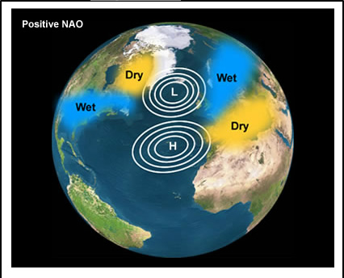
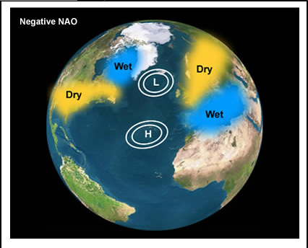
North Atlantic Oscillation
Strength of westerlies between 40°N and 60°N
Driven by Azores/Iceland pressure difference
Positive ⇒ larger difference
Recent positive phase unprecedented in last 500 years
Negative ⇒ smaller difference
Positive
Negative

Slide 16
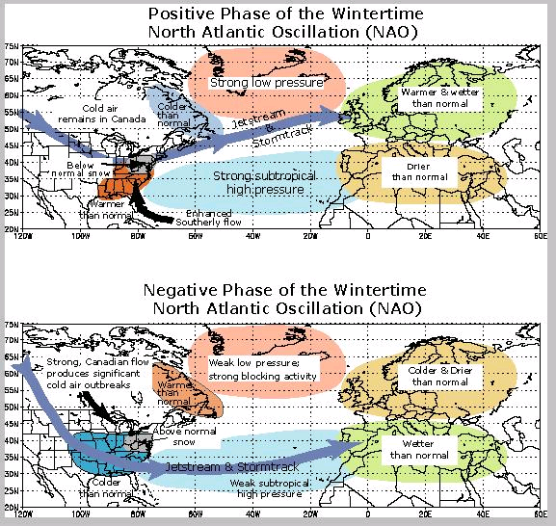
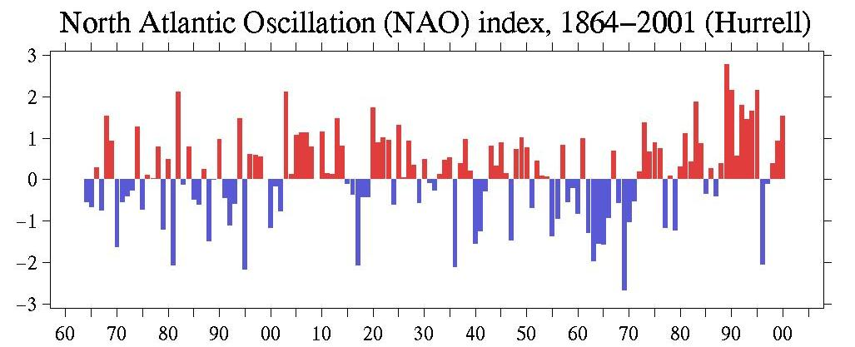
NAO
Mostly positive since mid-70’s

Slide 17
NAO
Negative Phase mid 1950’s - 1970

Slide 18
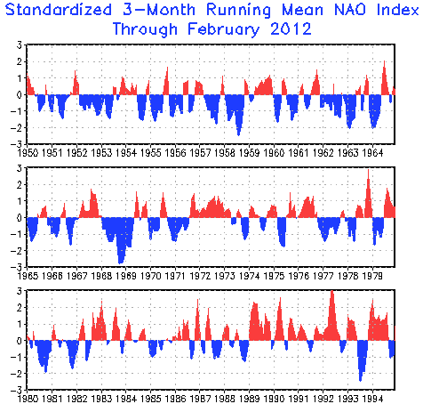
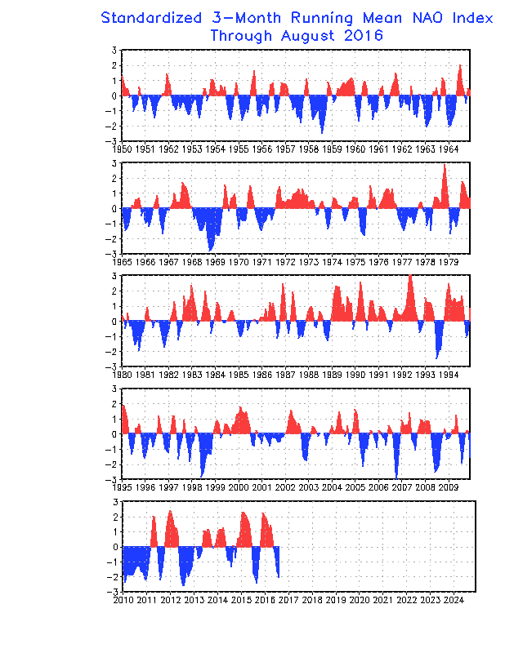
NAO
NAO Index
Currently positive … should be warmer
Positive last winter
Negative now
Cold could come south!

Slide 19
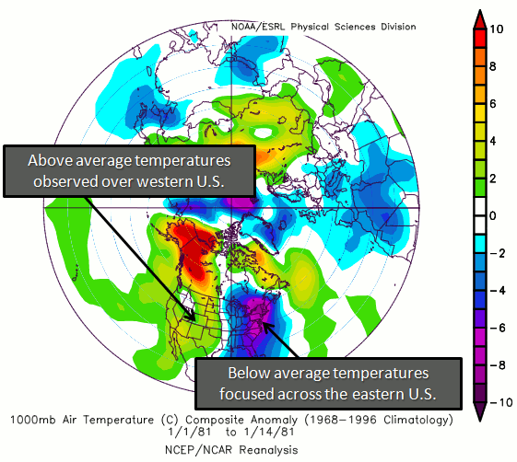
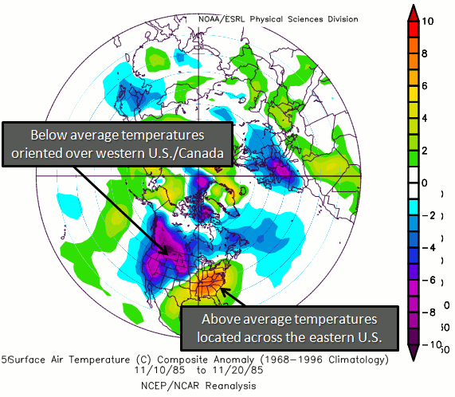

PNA
Pacific North-American Pattern
Pressure difference between Aleutian Low & Rocky Mountain high … steers jet streams
Positive
Negative

Slide 20
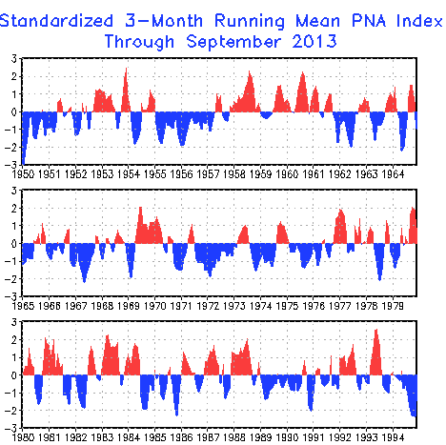
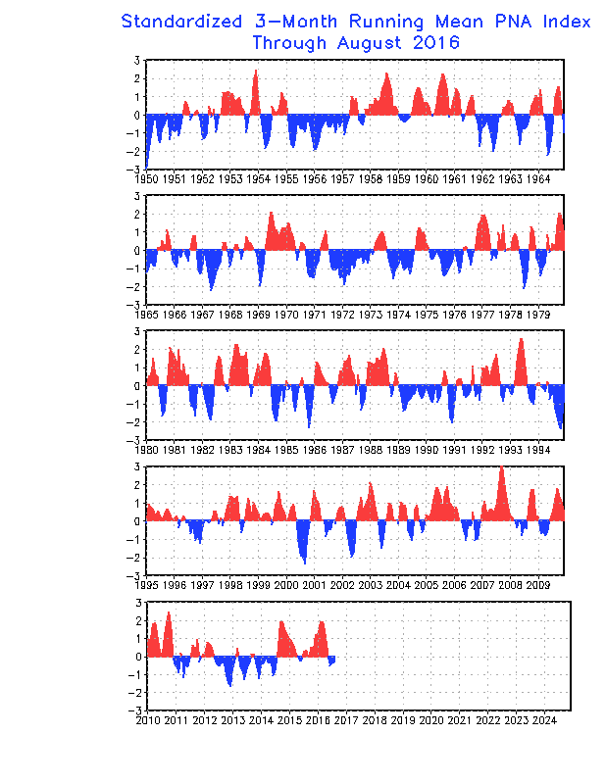
PNA
PNA Index
Currently negative … bringing warmth
Positive last winter
Negative now
Cold should stay north & west!

Slide 21

Ocean & Atmosphere Variations
How do these affect the weather?
Examine history!
Plot anomalies from NOAA data
Plot event years vs. “normal”
eg., La Niña years vs. all winters 1950-2007
Where do we get the data?
NOAA!!

Slide 22
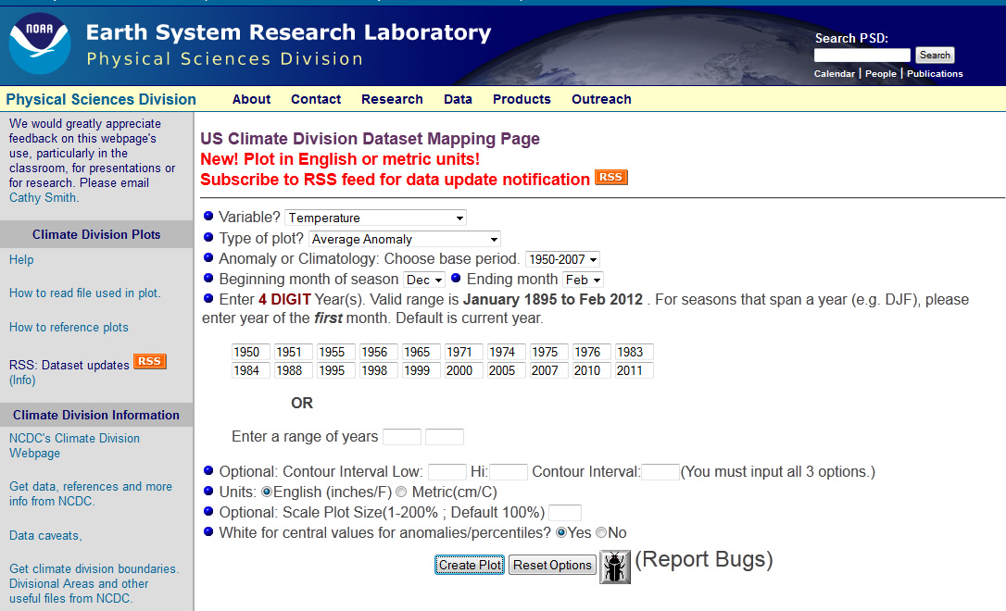
Plot La Nina Years vs. Mean
Go to ENSO years list & list La Niña
Go to plotting page & create plots
Temperature Anomalies
Compare to 1950 - 2007
Dec - Feb
La Niña years
December years listed

Slide 23
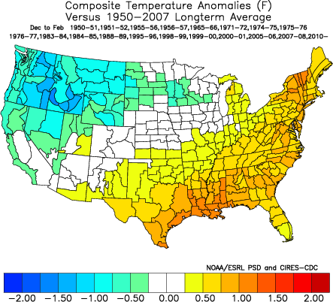
Plot La Niña Years vs. Mean
Go to ENSO years list & list La Niña
Go to plotting page & create plots
Warmer than normal here in La Niña winters!
Temperature Anomalies
Compare to 1950 - 2007
Dec - Feb
La Niña years
December years listed

Slide 24
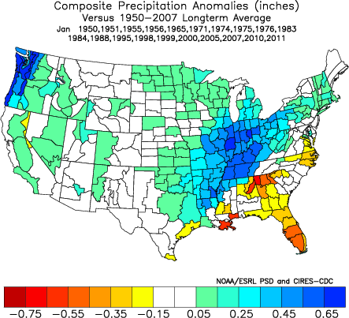
Plot La Niña Years vs. Mean
Go to ENSO years list & list La Niña
Go to plotting page & create plots
Normal precip here in La Niña winters!
Temperature Anomalies
Compare to 1950 - 2007
Dec - Feb
La Niña years
December years listed

Slide 25
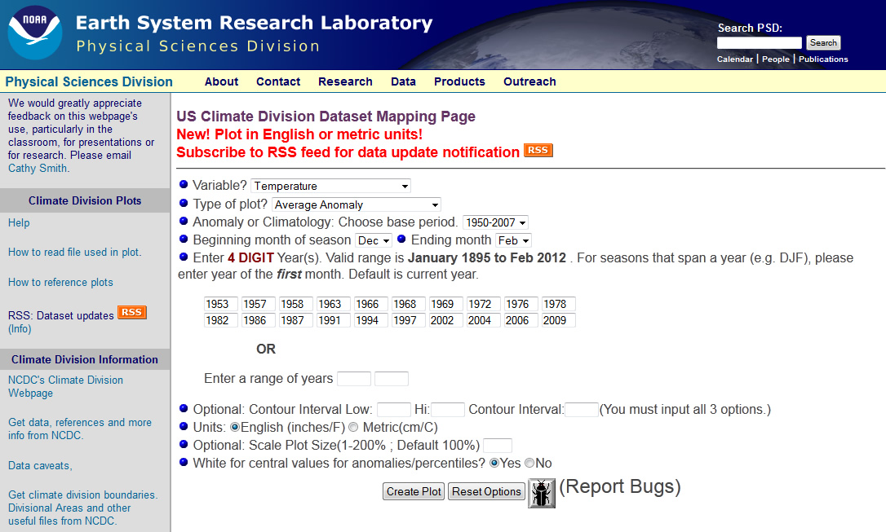
Plot El Niño Years vs. Mean
Go to ENSO years list & list La Niña
Go to plotting page & create plots
Temperature Anomalies
Compare to 1950 - 2007
Dec - Feb
EL Niño years
December years listed

Slide 26
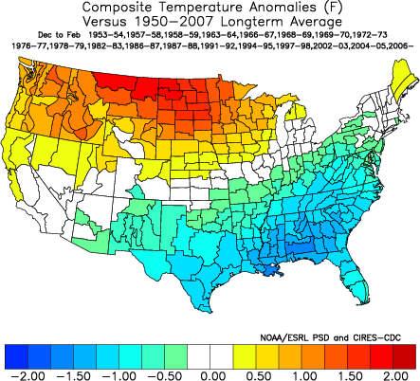
Plot El Niño Years vs. Mean
Go to ENSO years list & list La Niña
Go to plotting page & create plots
Just about normal here in El Niño winters!
Temperature Anomalies
Compare to 1950 - 2007
Dec - Feb
EL Niño years
December years listed

Slide 27
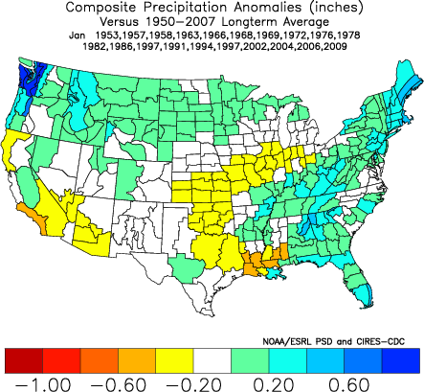
Plot El Niño Years vs. Mean
Go to ENSO years list & list La Niña
Go to plotting page & create plots
Wetter here in El Niño winters!
Temperature Anomalies
Compare to 1950 - 2007
Dec - Feb
EL Niño years
December years listed

Slide 28
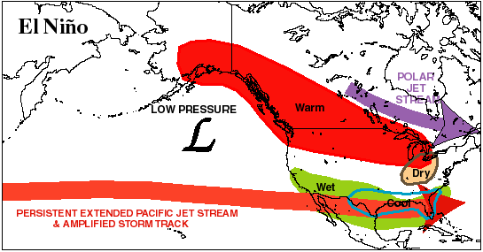
El Niño and the Ice Storm of ‘98
NOAA Web Site
http://www.erh.noaa.gov/btv/events/IceStorm1998/ice98.shtml
El Niño brings Polar Jet Stream south

Slide 29
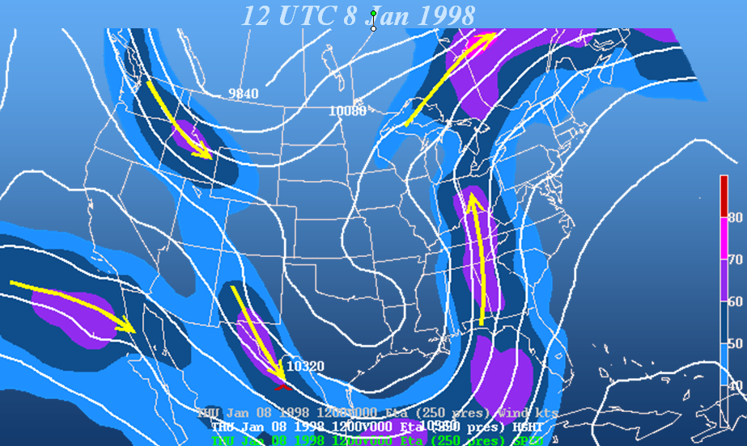
El Niño and the Ice Storm of ‘98
NOAA Web Site
http://www.erh.noaa.gov/btv/events/IceStorm1998/ice98.shtml
Tropical moisture flowing up from Gulf

Slide 30
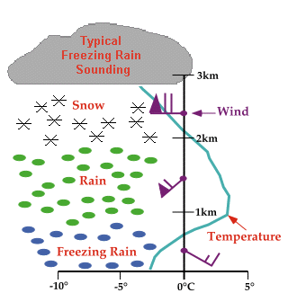
El Niño and the Ice Storm of ‘98
NOAA Web Site
http://www.erh.noaa.gov/btv/events/IceStorm1998/ice98.shtml
Freezing rain requires warm layer above cold.

Slide 31
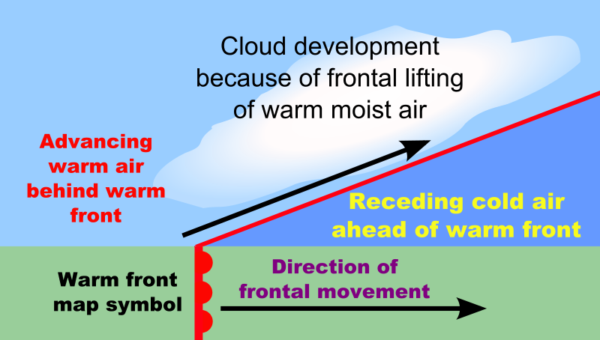
El Niño and the Ice Storm of ‘98
NOAA Web Site
http://www.erh.noaa.gov/btv/events/IceStorm1998/ice98.shtml
Warm fronts set up freezing rain structure
Warm, moist air above cold
We were here for days!

Slide 32
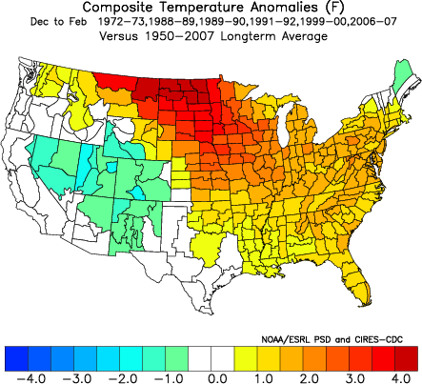
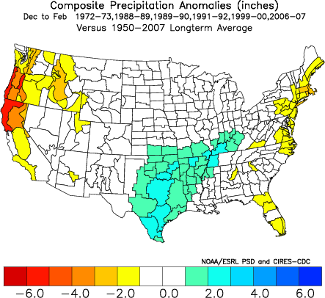
Positive AO
AO Index > 1.0
NoCoNY normal (NNY warm)
Winter of 2015-2016 … 2016-2017?
Normal Temp.
Normal Precip.

Slide 33
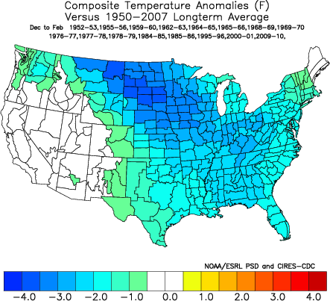
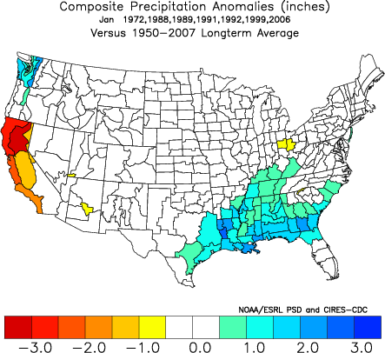
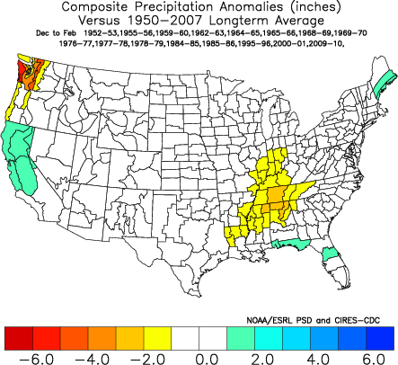
Negative AO
AO Index < -1.0
NoCoNY cool, normal precip.
Early Winter of 2014
Cool Temp.
Normal Precip.

Slide 34
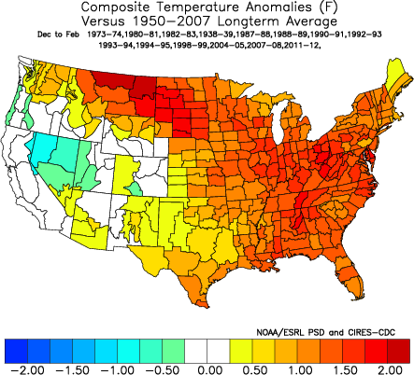
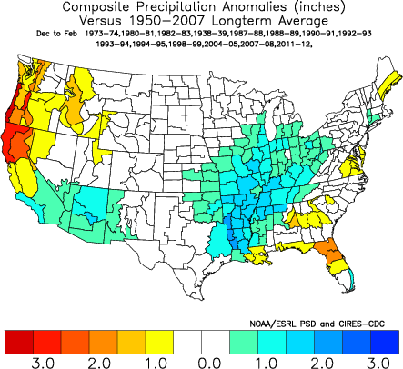
Strong Positive NAO
NAO Index > 0.5
NoCoNY warm, precip. normal
Winter 2015-2016
Warm Temp.
Normal Precip.

Slide 35
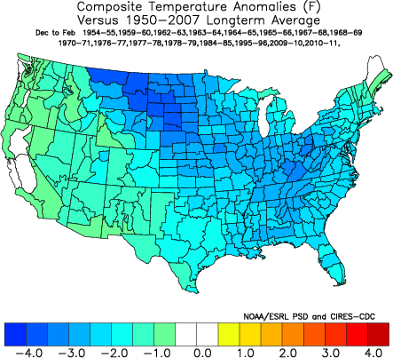
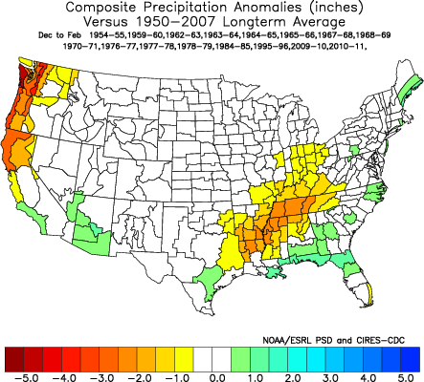
Strong Negative NAO
NAO Index < -1.0
NoCoNY cool, normal precip.
Four days in DJF!
Cool Temp.
Normal Precip.

Slide 36
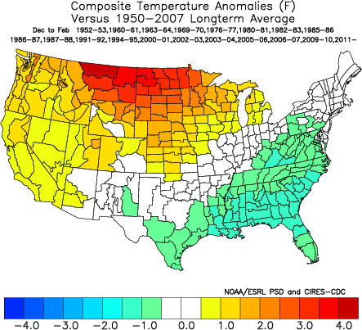
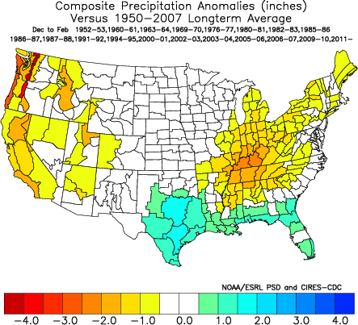
Strong Positive PNA
PNA Index > 0.5
NoCoNY normal temp but dry
Most of DJF 2011-12
Cool Temp.
Normal Precip.

Slide 37
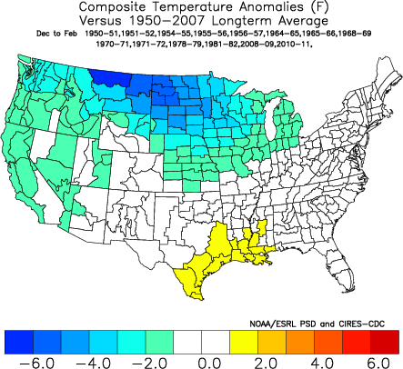
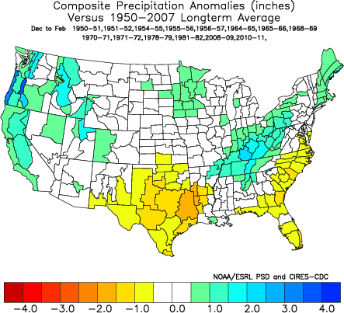
Strong Negative PNA
PNA Index < -0.5
NoCoNY normal
March 2012 – July 2014
Normal Temp.
Normal Precip.

Slide 38
Summary
Oscillations making it warm in NoCoNY
++ El Niño, + La Niña, + NAO,
Oscillations making it warm in NNY
++ El Niño, ++ La Niña, + La Niña, +AO, +NAO
Oscillations making it cool in NoCoNY
+ El Niño, - AO, -NAO
Maybe 2016-2017 will be a more “normal” winter …

Slide 39
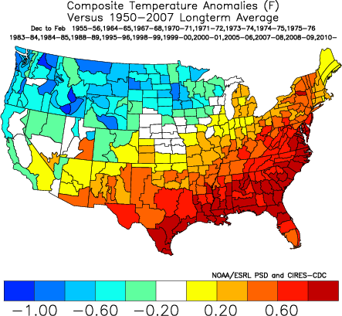
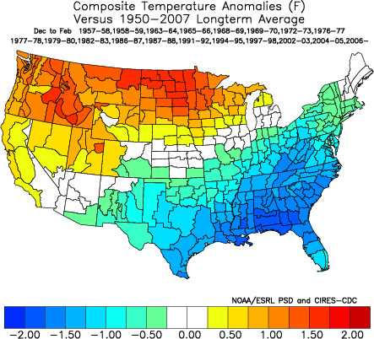
Temperature Effects
La Niña
+AO
+NAO
+PNA
Current
El Niño
-AO
-NAO
-PNA

Slide 40
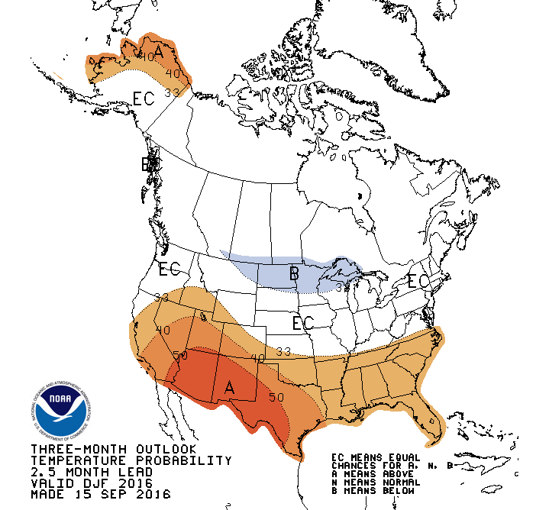
Temperature Effects
http://www.cpc.ncep.noaa.gov/products/predictions/long_range/seasonal.php?lead=1
NOAA thinks its going to be a normal winter for us!
La Niña
+AO
+NAO
+PNA
Current
El Niño
-AO
-NAO
-PNA

Slide 41
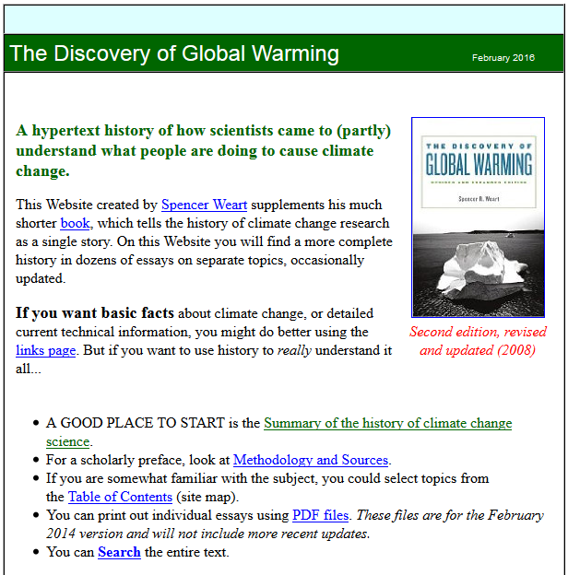

Climate Change
Enhanced greenhouse effect due to CO₂
Discovery of Global Warming
From the American Institute of Physics website
https://www.aip.org/history/climate/index.htm

Slide 42
Climate Change
Enhanced greenhouse effect due to CO₂
Discovery of Global Warming
1820 Joseph Fourier
Sunlight penetrates atmosphere, but doesn’t leave as light
Heat has to escape somehow as “invisible radiation” … IR
1886 Svante Arrhenius
Reducing CO₂ by half could cool Europe 4° – 5° C
Could this explain the ice ages? How?
1896 Arvid Högbom
Doubling CO₂ would warm earth by 5° – 6° C
But we could never do that … the oceans absorb too much!
1938 Guy Stewart Callendar
CO2 had increased by 10% since early 19th century
This explained the observed warming since then

Slide 43
IPCC
Intergovernmental Panel on Climate Change
Established in 1988
World Meteorological Organization (WMO)
UN Environment Programme (UNEP)
Mandate
“The role of the IPCC is to assess on a comprehensive, objective, open and transparent basis the scientific, technical and socio-economic information relevant to understanding the scientific basis of risk of human-induced climate change, its potential impacts and options for adaptation and mitigation.”
http://www.ipcc.ch/about/about.htm

Slide 44
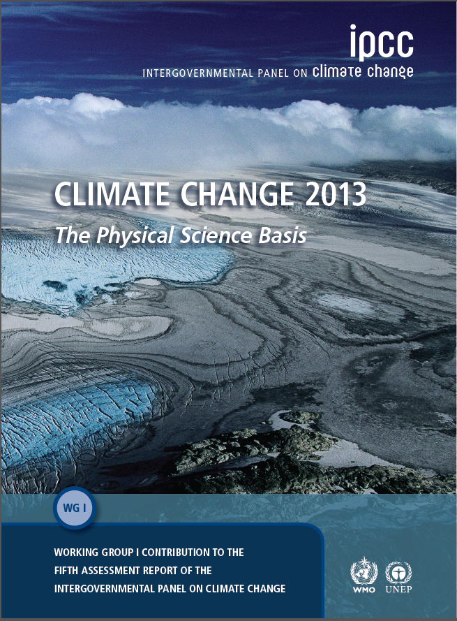
IPCC
5th Assessment (AR5)
Released 2013
WGI = 1535 pages!
available on line
ipcc-wg1.ucar.edu/wg1
available in print
Cambridge U. Press

Slide 45

IPCC Climate Drivers
Greenhouse Gases: CO₂, CH₄, H₂O, NO_{x}
CO₂
NO_{X}
Grey Bars = Natural Variability
CH₄
Com-bined rate of change

Slide 46

AR5 WGI Atmospheric Changes
CO₂ increasing steadily … 80 ppm since 1960
Red & blue different data sets
Rate of CO₂ change mostly due to seasons

Slide 47


NOAA & National Climatic Data Ctr.
Global Climate Change Indicators
http://www.ncdc.noaa.gov/indicators/

Slide 48

IPCC ARF WGI
Explaining the past
Natural forcing not sufficient for temp. rise observed.
Volcanic Eruptions

Slide 49

AR5 WGI Atmospheric Changes
CH₄ flattened for a while
Thawing of arctic wetlands increasing CH₄
Red, green & blue different data sets
Rate of CH₄ change mostly due to seasons

Slide 50

AR5 Greenhouse Gases
Getting worse through 2010

Slide 51

AR5 Anthropogenic Gases
Getting worse through 2010 …
FOLU = Forestry & Other Land Use

Slide 52

IPCC ARF WGI
Radiative Forcing 1750 - 2005
Cooling
Warming
Ozone in stratosphere absorbs UV, ozone in troposphere is a greenhouse gas (GHG)
Carbon Dioxide
Methane
Buildings increase surface albedo relative to forests
Aerosols (particles) reflect sunlight AND increase cloud cover (eg. Contrails)
Solar radiation has increased since 1750 (Little Ice Age end)

Slide 53

IPCC ARF
Continued Warming
What we’re committed to by past behavior!

Slide 54

IPCC ARF
Effects of Changing Mean
Does not mean it never gets cold!

Slide 55

IPCC AR5
Climate Change Projections, WGI
http://www.climatechange2013.org/images/report/WG1AR5_Chapter12_FINAL.pdf

Slide 56
IPCC AR5
Climate Change Projections, WGI
Best Case Scenario: Warming less than 2°C & easing through 21st Century
http://www.climatechange2013.org/images/report/WG1AR5_Chapter12_FINAL.pdf

Slide 57
IPCC AR5
Climate Change Projections, WGI
Good Scenario: Warming greater than 2°C (<7) & worsening through 21st Century
http://www.climatechange2013.org/images/report/WG1AR5_Chapter12_FINAL.pdf

Slide 58
IPCC AR5
Climate Change Projections, WGI
Bad Scenario: Warming greater than 2°C (<11) & worsening through 21st Century
http://www.climatechange2013.org/images/report/WG1AR5_Chapter12_FINAL.pdf

Slide 59
IPCC AR5
Climate Change Projections, WGI
Worst Scenario: Warming greater than 2°C (<13) & worsening through 21st Century
http://www.climatechange2013.org/images/report/WG1AR5_Chapter12_FINAL.pdf

Slide 60

IPCC Changes Since 1850
Global Average Temperature
Global Average Sea Level
mostly thermal expansion
Northern Hemisphere Snow Cover

Slide 61

IPCC ARF WGI
Temperature increasing on all scales
Sea Ice Changes
only since 1979
note Antarctic
due to glacial flow?

Slide 62

Antarctic Ice Sheet
East on continent
West on submerged continent

Slide 63
Antarctic Ice Sheet
East on continent
West on submerged continent

Slide 64

Antarctic Ice Sheet
East
East on continent
West on submerged continent
West

Slide 65





Sea Level Rise
Sea level increases due to melting
Greenland 6.55 m
Antarctic Peninsula: 0.46 m
West Antarctic Ice Sheet 8.06 m
East Antarctic Ice Sheet 64.8 m
All other ice fields & glaciers 0.45 m
Total 80.3 m
Ice shelves present in Antarctica, few in Greenland

Slide 66




IPCC ARF
Sea Level Rise
https://www.cresis.ku.edu/data/sea-level-rise-maps
http://ossfoundation.us/projects/environment/global-warming/sea-level-rise
http://www.geo.arizona.edu/dgesl/research/other/climate_change_and_sea_level/sea_level_rise/sea_level_rise.htm

Slide 67

Sea Level Rise Maps
http://www.geo.arizona.edu/dgesl/research/other/climate_change_and_sea_level/sea_level_rise/sea_level_rise_old.htm#images

Slide 68

Sea Level Rise Maps
http://www.geo.arizona.edu/dgesl/research/other/climate_change_and_sea_level/sea_level_rise/sea_level_rise_old.htm#images

Slide 69

Sea Level Rise Maps
http://www.geo.arizona.edu/dgesl/research/other/climate_change_and_sea_level/sea_level_rise/ sea_level_rise_old.htm#images

Slide 70

Sea Level Rise Maps
http://www.geo.arizona.edu/dgesl/research/other/climate_change_and_sea_level/sea_level_rise/ sea_level_rise_old.htm#images

Slide 71

Sea Level Rise Maps
Possible if Greenland melts!
http://www.geo.arizona.edu/dgesl/research/other/climate_change_and_sea_level/sea_level_rise/sea_level_rise_old.htm#images

Slide 72

Sea Level Rise Maps
Possible if Greenland melts!
http://www.geo.arizona.edu/dgesl/research/other/climate_change_and_sea_level/sea_level_rise/sea_level_rise_old.htm#images

Slide 73

Union of Concerned Scientitsts
Confronting Climate Change in the U.S. Northeast: Science, Impacts and Solutions
http://www.ucsusa.org/global_warming/

Slide 74

UCC Northeast US
Climate of New York State

Slide 75

UCC Northeast US
Snow cover decreasing
Com-bined rate of change

Slide 76
What to Do?
Complex system hard to model
99% of scientific experts agree
Could be global disaster for your great (great) grandkids
It’s THE global issue your (great) grandkids will deal with!

Slide 77

Causes vs. Impacts
Cumulative CO₂ Emissions:
Most from 1st world
Disease Consequences:
99% in 3rd world
88% in children under 5
Patz et al, EcoHealth 4, (Springer-Verlag: New York), pp. 397-405, 2007

