Slide 1
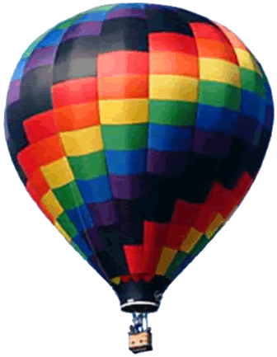
SOAR 2018: Galaxies
Aileen A. O’Donoghue Priest Associate Professor of Physics

Slide 2
Galaxies
9/4/18
Milky Way Galaxy Contents & Motions
9/11/18
Milky Way Environment & the Local Group
9/18/18
Other Galaxies & Clusters of Galaxies
9/25/18
Expansion, History & Evolution of the Universe

Slide 3
SOAR: Galaxies
The Milky Way Galaxy: Contents & Motion
Aileen A. O’Donoghue Priest Associate Professor of Physics

Slide 4
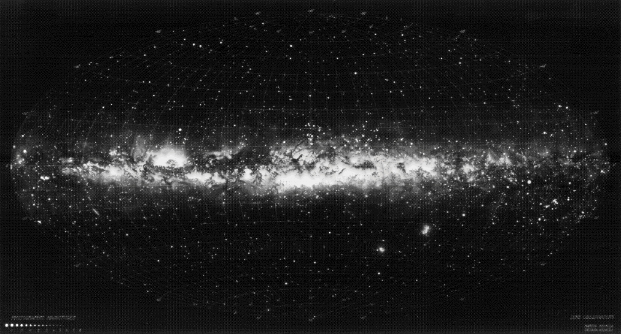
The Milky Way
The optical sky: stars, gas & dust
Procyon
Pollux
Vega
Antares
Castor
Orion
Magellanic Clouds

Slide 5
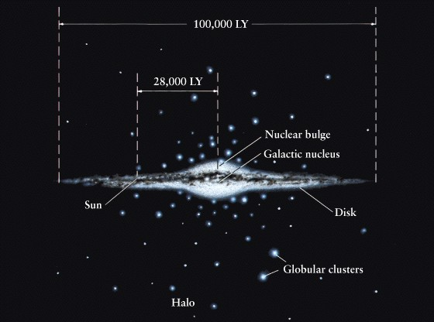
The Milky Way
Disk with nuclear bulge and halo 100 kly across
You are here.

Slide 6
Milky Way Stellar Populations
Population I – Stars in halo (most old)
Poplulation II – Stars in disk (many young)
Population I halo
Population II disk

Slide 7
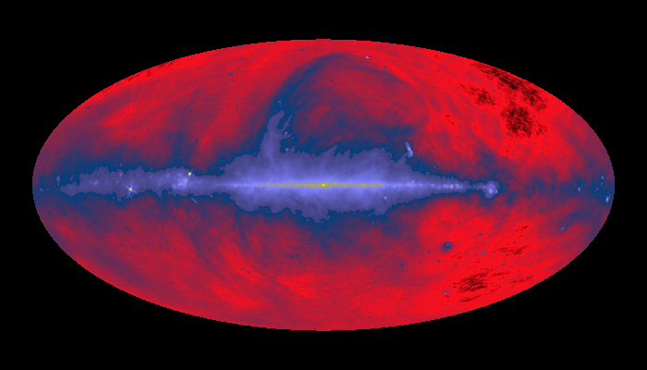
The Milky Way
The radio broadband sky: warm gas
Nearby gas bubble
Hydrogen in disk plane
Orion Nebula
Large Magellanic Cloud

Slide 8
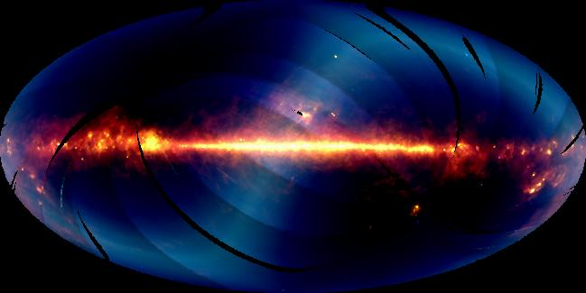
The Milky Way
The IR sky: warm gas & glowing dust
Zodiacal Light
Orion Nebula
Large Magellanic Cloud

Slide 9
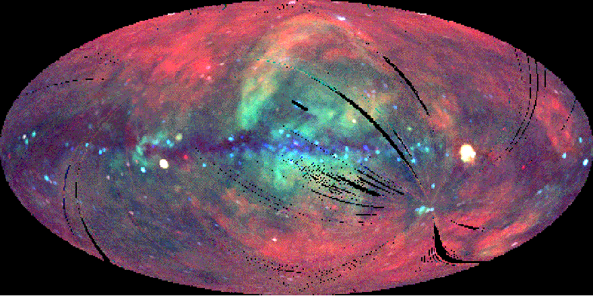
The Milky Way
The X-ray sky: HOT gas & black holes
Red = low energy
Green = moderate energy
Blue = high energy
Supernova remnant kyr old
Black hole candidate in Cygnus
Large Magellanic Cloud

Slide 10
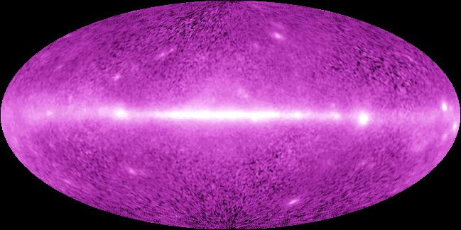
The Milky Way
The γ-ray sky: Extreme energy events
Stars colliding, falling into black holes, exploding

Slide 11
Contents of the Milky Way
Stars ~ 100 billion – 500 billion
Nebulae
Clouds of gas and dust
Emission Nebulae (eg, Lagoon, Trifid, Eagle, Orion)
Heated, glowing gas,
RED due to Balmer α
Reflection Nebulae (eg. Trifid)
Dust & cool gas
Blue for same reason sky is blue
Dark Nebulae (eg. Horsehead, Coalsack)
Dust & cold gas
Black because it blocks light from nebulae & stars beyond
Stellar Remnants
Planetary Nebulae and Supernova Remnants

Slide 12
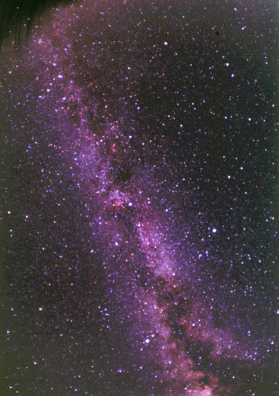
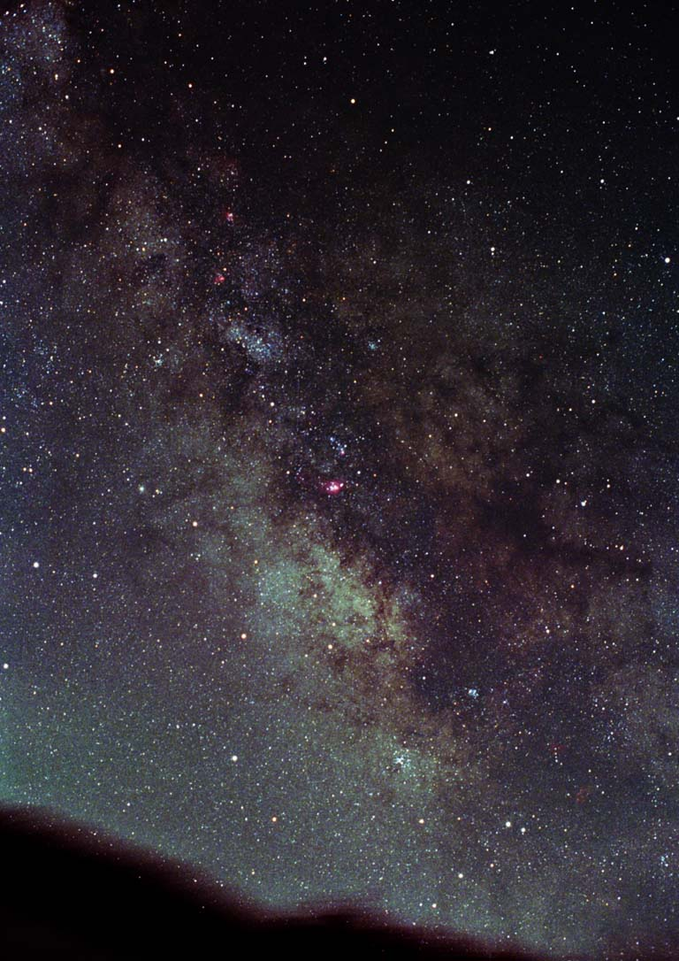
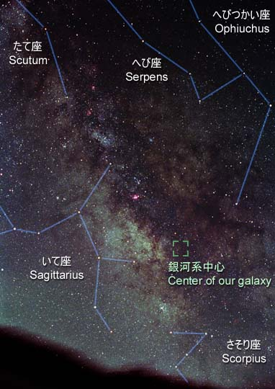
The Milky Way
Stars + bright & dark gas clouds

Slide 13
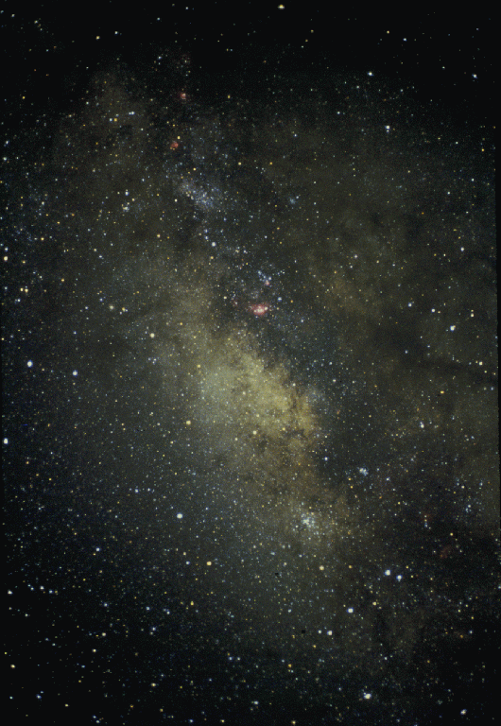
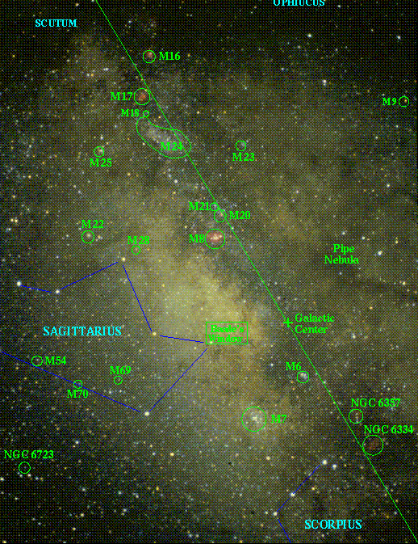
Bright Nebulae
The Galactic Center
M8: Lagoon Nebula
M20: Trifid Nebula
M16: Eagle Nebula
M17: Omega Nebula
M24: Sag. Star Cloud
M6: Butterfly Cluster
M7: Ptolemy’s Cluster
Mentioned in 138 BCE

Slide 14
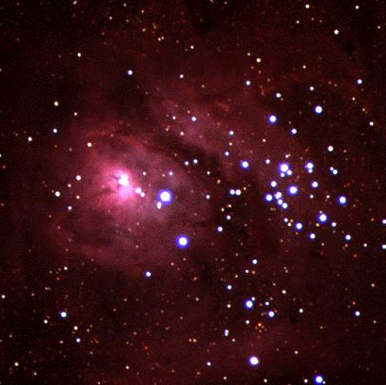
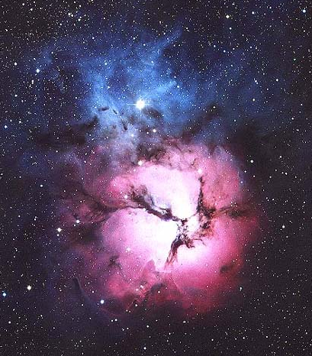
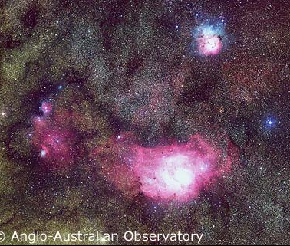
Lagoon & Trifid
Lagoon Nebula
Emission
Neighborhood of Galactic Center
Reflection Nebula
Emission Nebula
Trifid Nebula

Slide 15
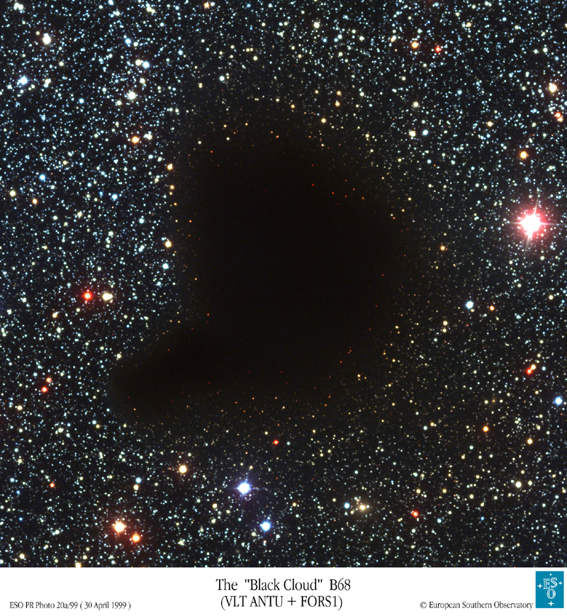
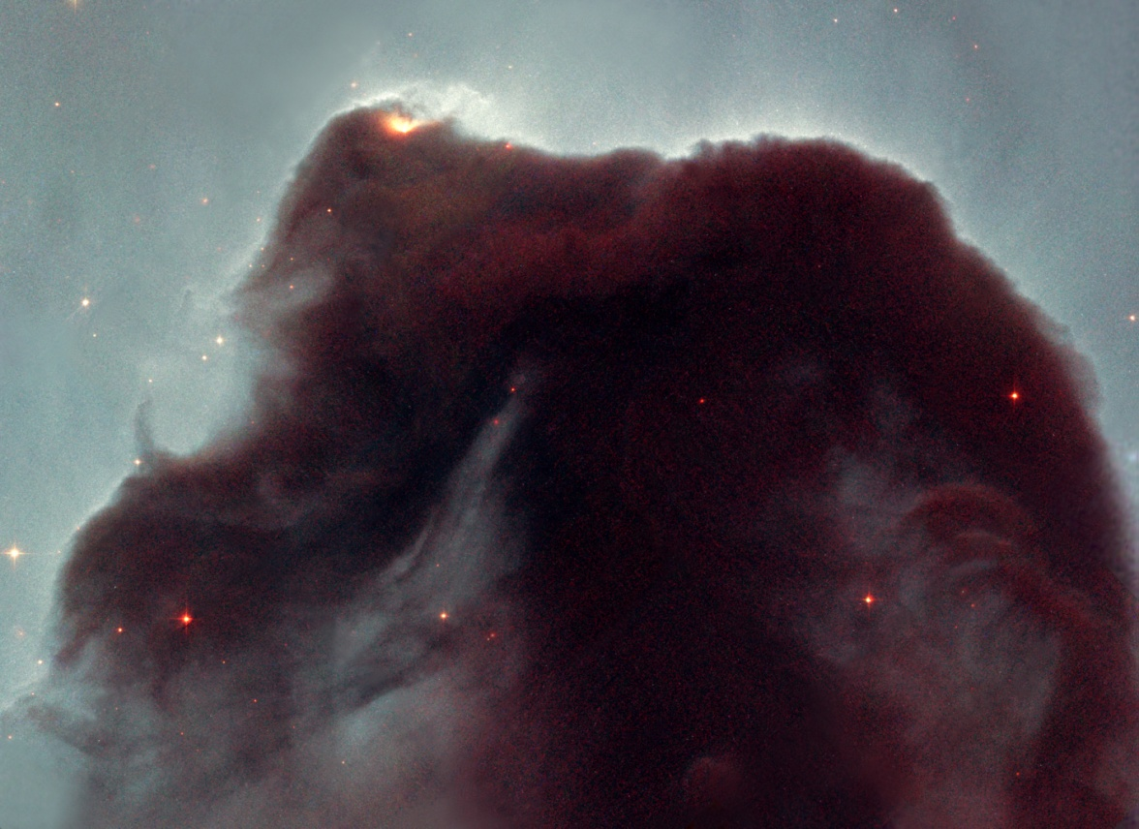
Dark Nebulae
Horsehead & Barnard’s Nebula
Dust & cool gas blocking background light

Slide 16
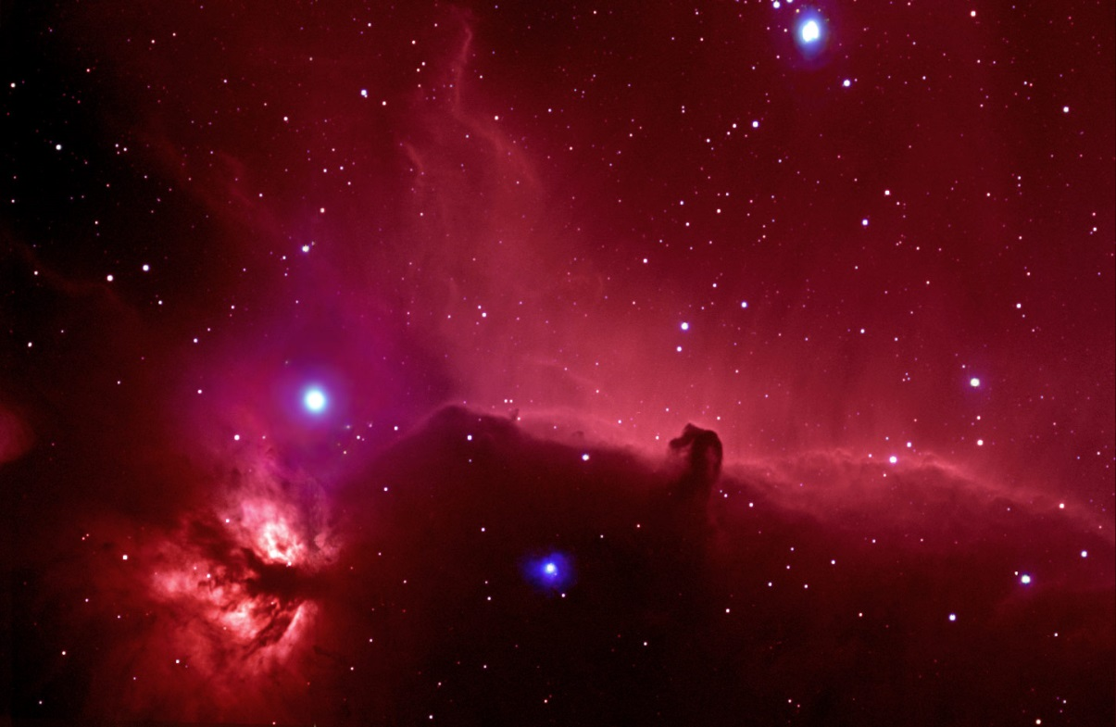
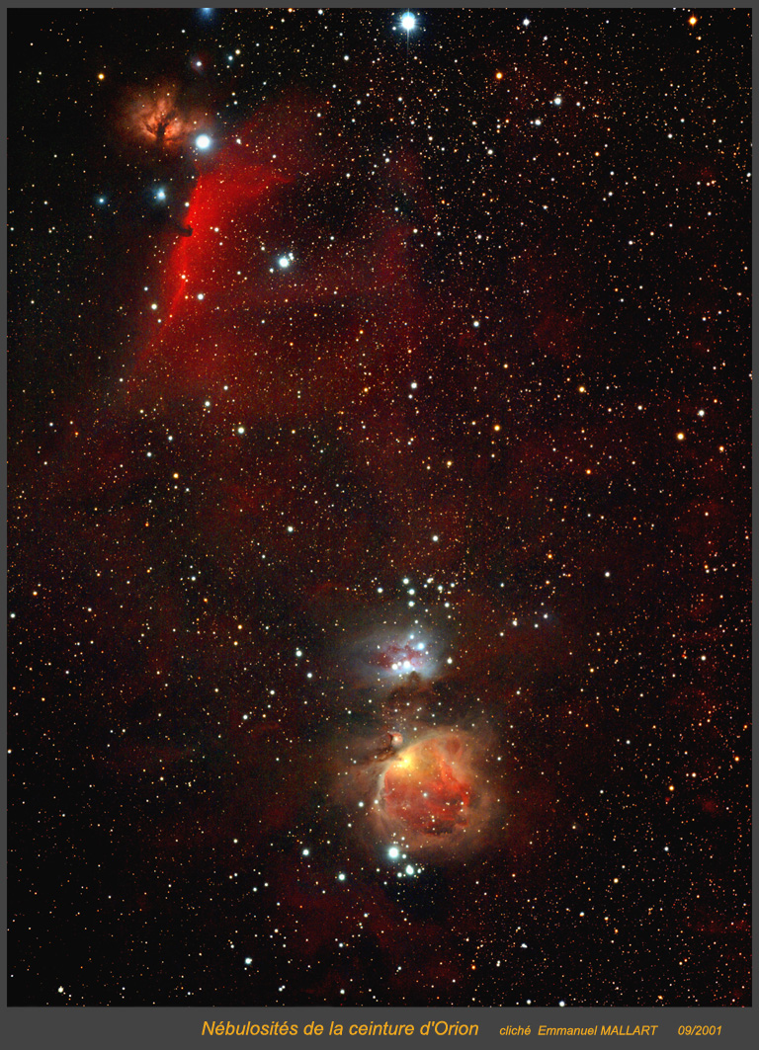
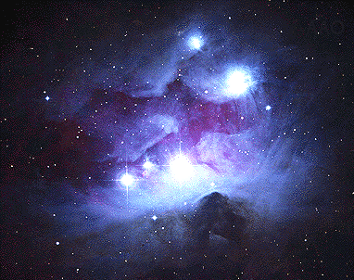
Orion Nebulae … 1300 ly away
ε Orionis: Alnilam
ζ Orionis: Alnitak
Horsehead Nebula
Blue = Reflection Nebula
Flame Nebula
Dark = Running Man Nebula Light blocked by cool gas & dust

Slide 17
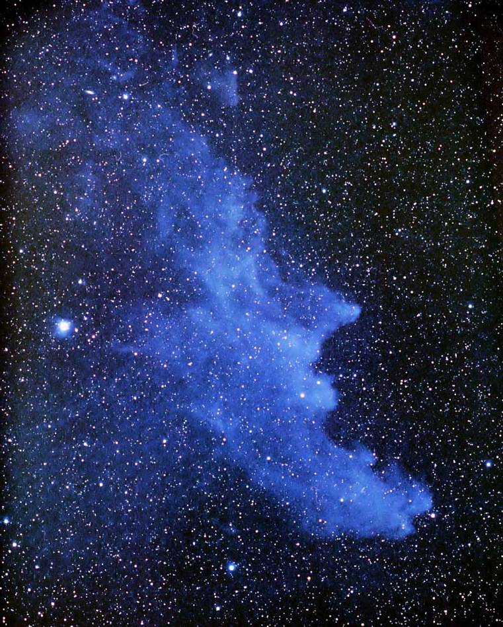
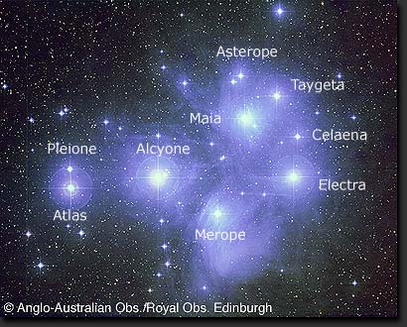
Reflection Nebulae
Dust reflecting light from stars
Blue due to not scattering red light
100 ly away
375 ly away
Witch’s Head Nebula
Nebulosity and the Pleiades

Slide 18
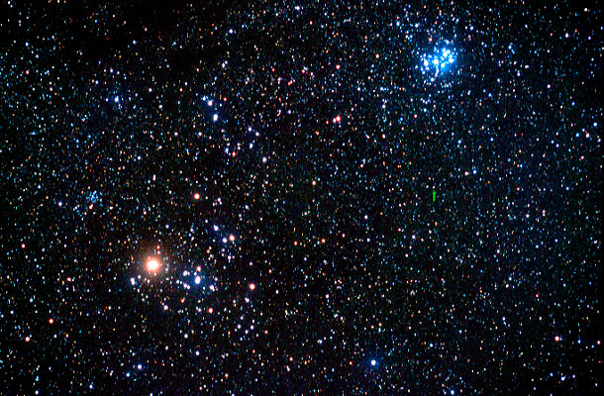
Star Clusters
Open (Galactic Clusters)
Mostly blue stars ⇒ young population
Stars born in “litters” from cloud complexes
Open clusters become less dense in time
10’s to 1000’s of stars
Pleiades: 375 ly away 100 My old
NGC 1647
α Tauri: Aldebaran
Hyades: 151 ly away 660 My old

Slide 19
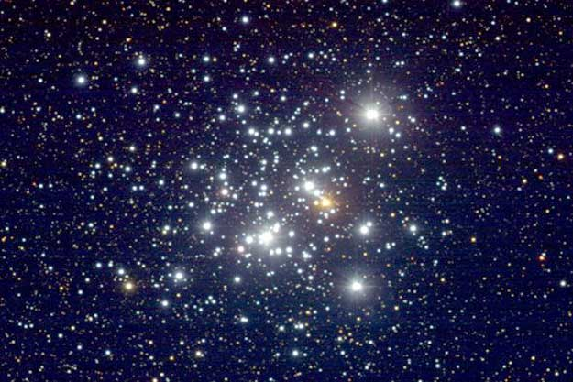
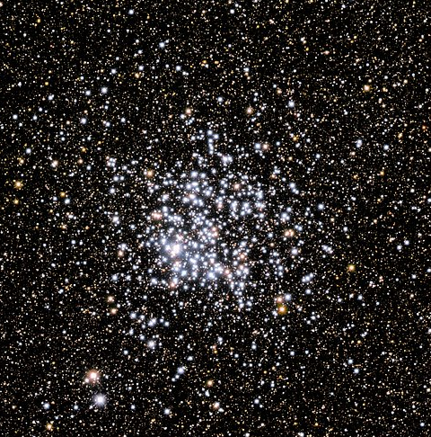
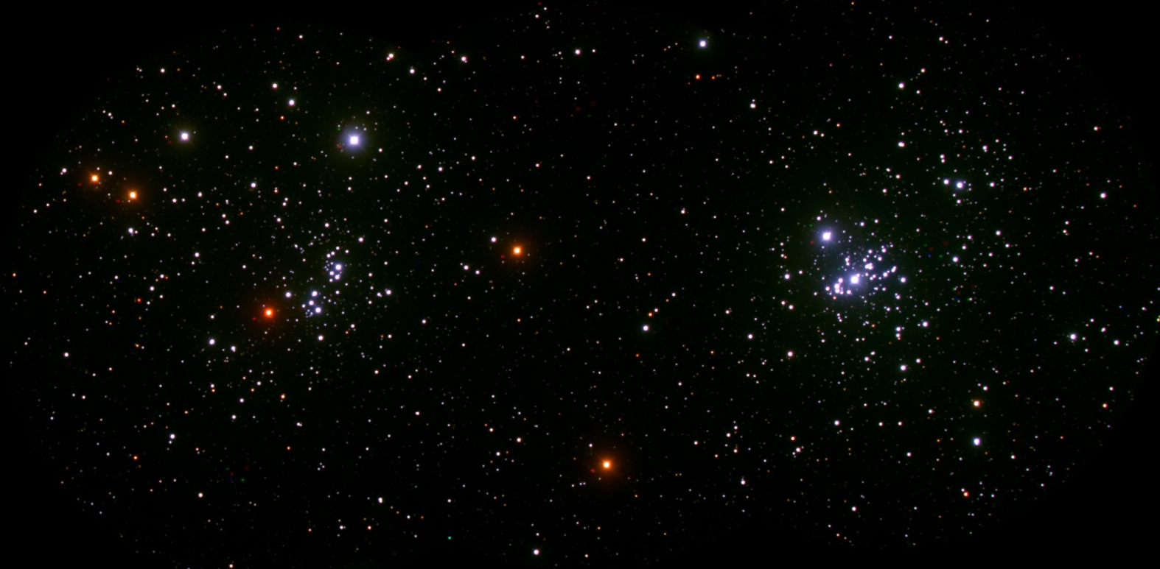
Open Clusters
7500 ly away, 7.1 My old
M11 Wild Duck, Scutum
Jewel Box in Crux
h and Chi Persei
5000 ly away, 250 My old
7000 ly away, few 100 ly apart (physical double) 5.6 (h) & 3.2 (chi) My old

Slide 20
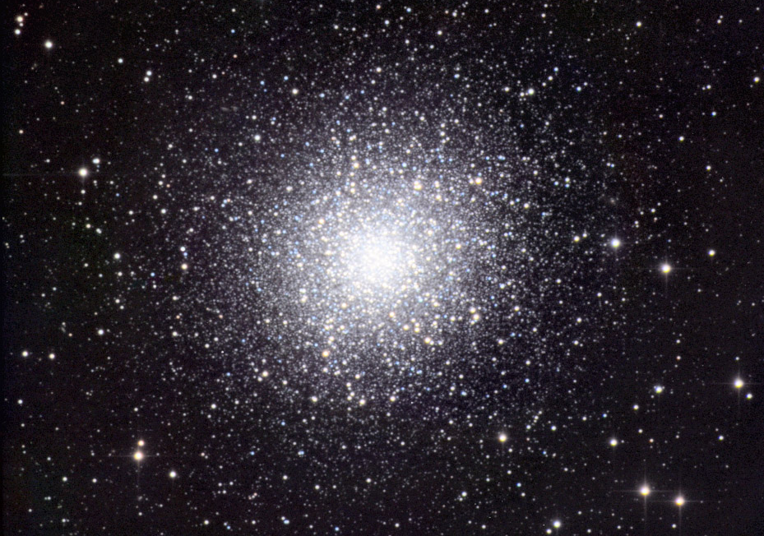
Star Clusters
Globular Clusters
Mostly red stars ⇒ old population
Spherical orbits about MW center
Thousands to millions of stars
22,200 ly away
M13 in Hercules ≈ 100,000 stars

Slide 21
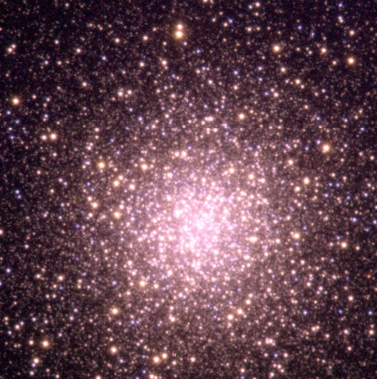
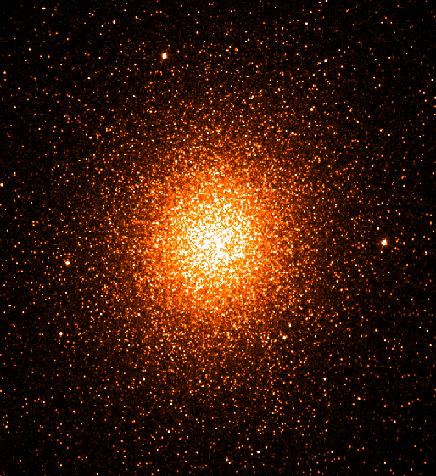
Globular Star Clusters
M3 Canis Venatici ≈ ½ million stars
Omega Centauri ≈ millions of stars
34,000 ly away
15,800 ly away

Slide 22
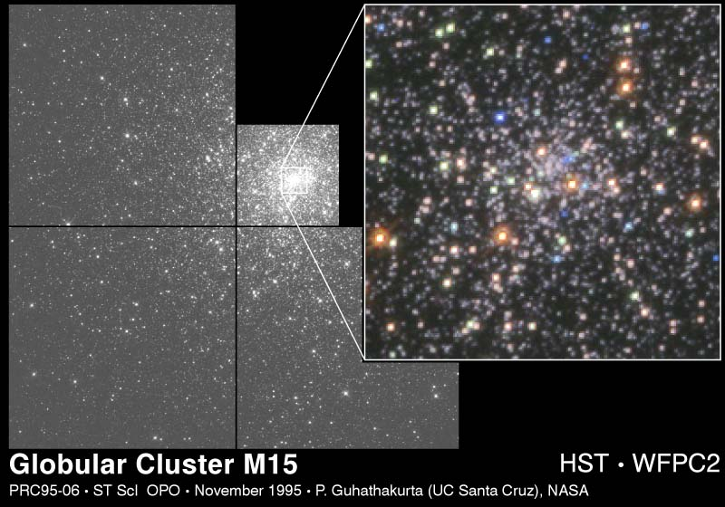
Globular Clusters
M15 in Pegasus
Stars falling into a black hole?
32,000 ly away

Slide 23
Age of the Milky Way
Oldest stars in NGC 6397 ~ 13.4 ± 0.8 by
But the galaxy is older than the stars!
Berillium Age
⁴Be only made in supernovae
presence of ⁴Be in stars indicates >2nd generation
amount of ⁴Be in stars determines generation
amount of ⁴Be in oldest stars gives age of galaxy when stars were formed
Oldest stars in NGC 6797
formed 200-300 million years after 1st stars
Total age of MW = 13.6 ± 0.8 by

Slide 24
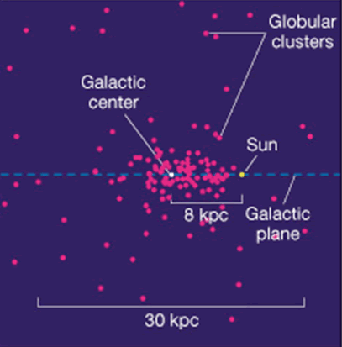
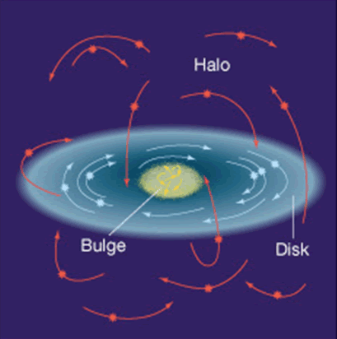
The Milky Way
Globular clusters give sun’s position & motion
Galactic year ~ 225 million years (Sol is 22)
Sol crosses galactic plane every 33 Myr

Slide 25
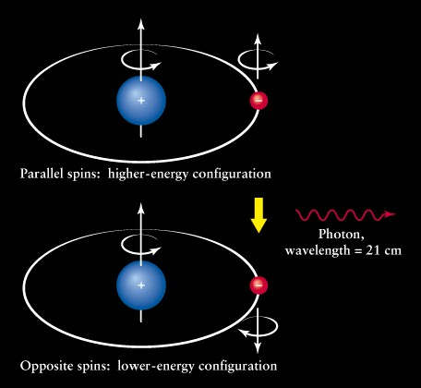
The Milky Way
Cold hydrogen “spin flip” transition gives 21-cm line
(radio band)

Slide 26
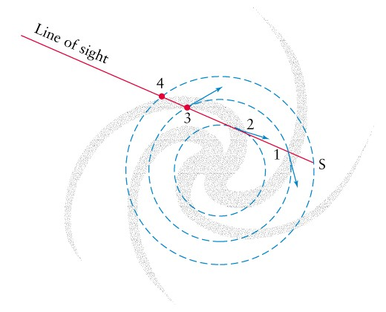
The Milky Way
Different spiral arms give different red and blue shifts of 21-cm line

Slide 27
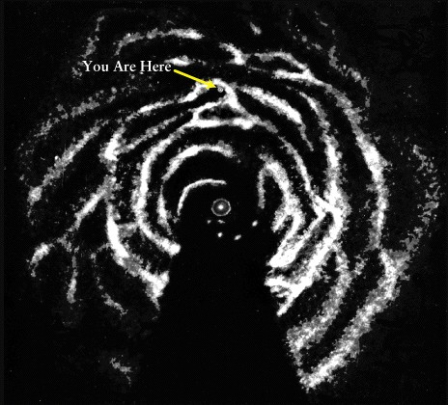
The Milky Way
Orion Arm

Slide 28
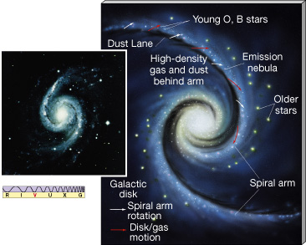
The Milky Way
Spiral Arms are active!

Slide 29
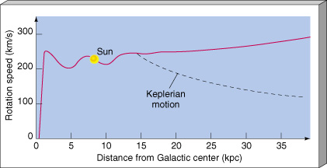
Rotational Velocity of MW
Stars not on “Keplerian” orbits
Kepler determined solar system orbits
Indicates galactic mass in halo …
Glowing matter does not supply enough mass!
Dark Matter (what?) must be there
MACHOs? WIMPs?
MAssive Compact Halo Objects
Weakly Interacting Massive Particles

Slide 30
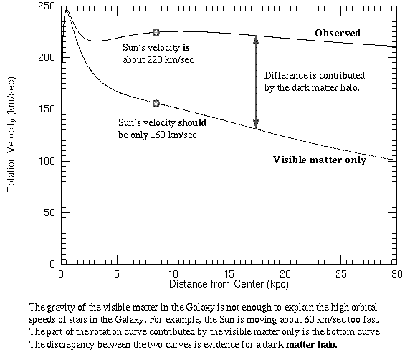
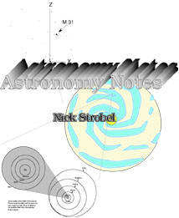
Rotational Velocity of MW
Rotation Curve Figures from Nick Strobel’s Astronomy Notes at
Stars outside core rotate too fast for the observed mass of the galaxy!
www.astronomynotes.com

Slide 31
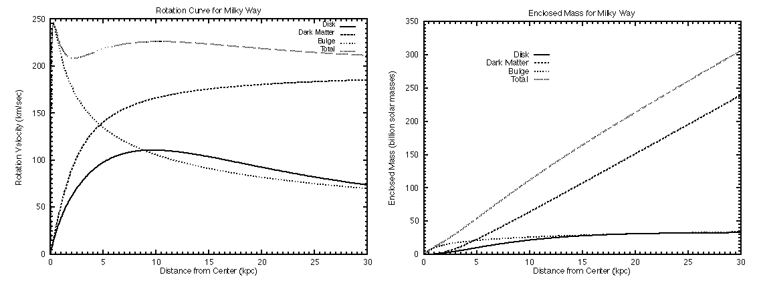
Rotational Velocity of MW
Galactic Rotation Curve
Due to all the matter … bright & dark
90% of galaxy’s mass is DARK MATTER!
90% of UNIVERSE’S mass is DARK MATTER!
Total
Total
Bulge
Dark Matter
Dark Matter
Disk
Bulge
Disk

Slide 32
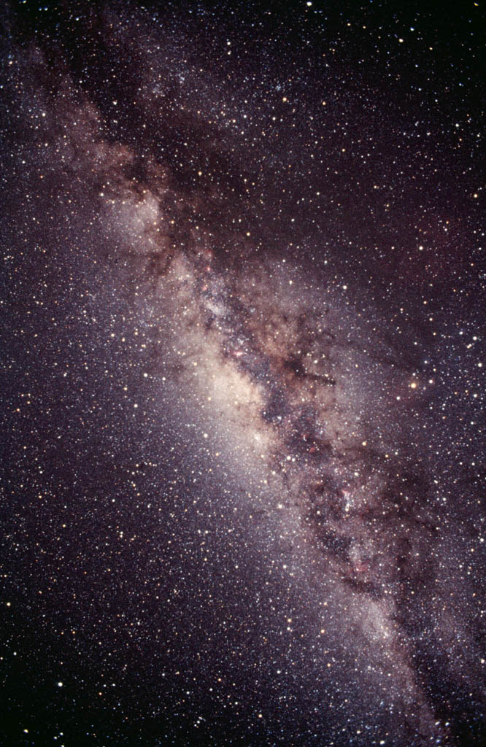
The Galactic Center
What is everything orbiting?
Wild Duck Cluster
Eagle Nebula
OmegaNebula
Trifid Nebula
Lagoon Nebula

Slide 33
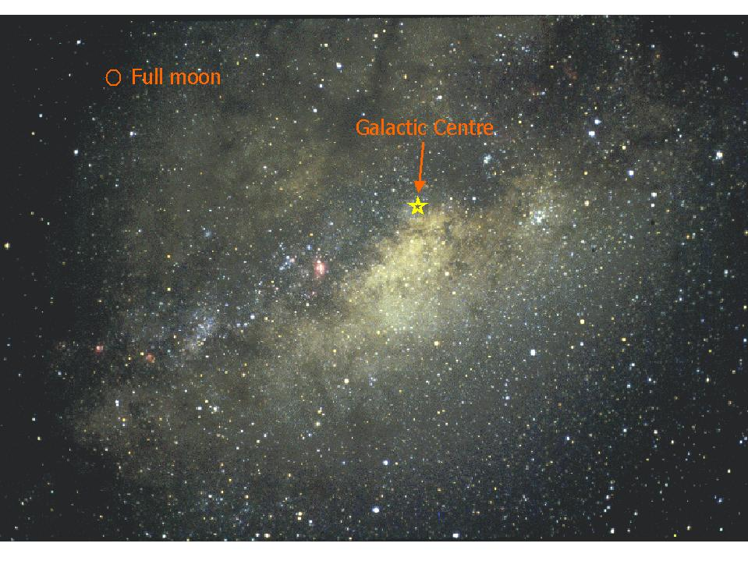
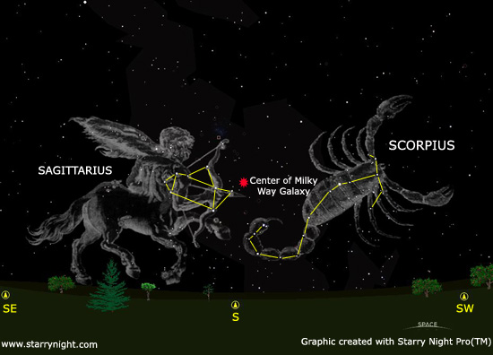
The Galactic Center
Toward Sagittarius

Slide 34
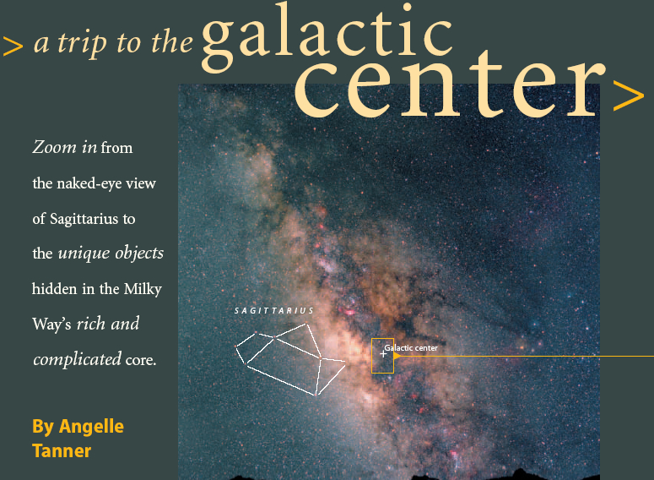
A Trip to the Galactic Center
Angelle Tanner, Sky & Telescope, April 2003

Slide 35
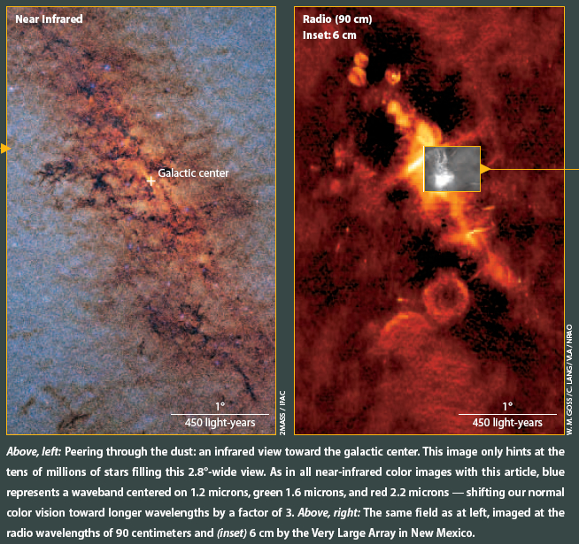
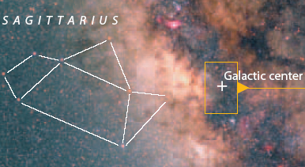
A Trip to the Galactic Center
Different features seen at different wavelengths of radiation: IR shows heated dust, radio shows e⁻ caught in magnetic fields

Slide 36
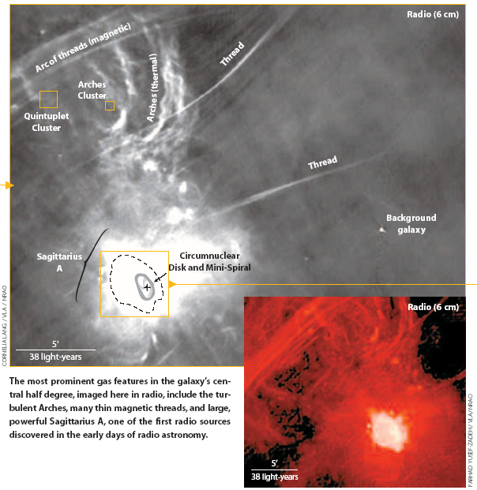
A Trip to the Galactic Center

Slide 37
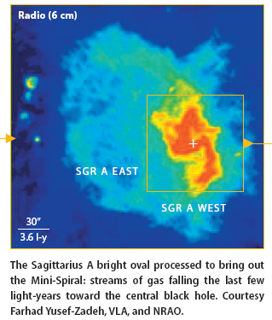
A Trip to the Galactic Center

Slide 38
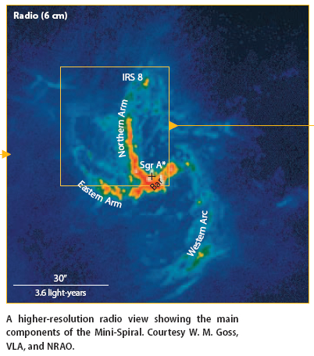
A Trip to the Galactic Center
Sgr A* is a bright, compact, so far unresolved radio source

Slide 39
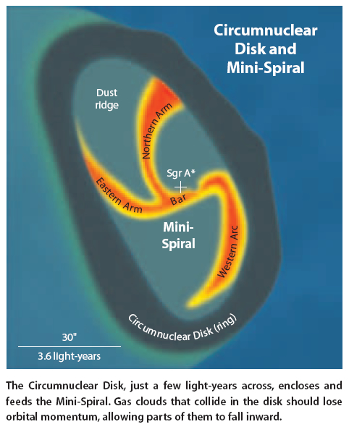
A Trip to the Galactic Center
Model of the galactic Center

Slide 40


A Trip to the Galactic Center
Right:

Slide 41

A Trip to the Galactic Center

Slide 42

A Trip to the Galactic Center
“SO-16 swung a mere 60 AU from the black hole!

Slide 43


A Trip to the Galactic Center
Mass needed in center of orbits = 2.6 million times the mass of Sol!
https://phys.org/news/2017-08-stars-orbiting-supermassive-black-hole.html

Slide 44


A Trip to the Galactic Center
Mass needed in center of orbits = 2.6 million times the mass of Sol!
https://www.eso.org/public/usa/news/eso1151/
16-year-long study tracks stars orbiting Milky Way black hole

Slide 45

A Trip to the Galactic Center
Gas cloud ripped apart falling into black hole.
https://www.eso.org/public/usa/news/eso1332/
Position of cloud changing … shape can’t be discerned
2013
2010
2006

