Slide 1
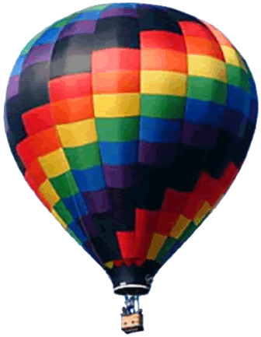
SOAR 2018: Galaxies
Aileen A. O’Donoghue Priest Associate Professor of Physics

Slide 2
Galaxies
9/4/18
  Milky Way Galaxy Contents & Motions
9/11/18
  Milky Way Environment & the Local Group
9/18/18
  Other Galaxies & Clusters of Galaxies
9/25/18
  Expansion, History & Evolution of the Universe

Slide 3
SOAR: Galaxies
Other Galaxies, Clusters and Superclusters
Aileen A. O’Donoghue Priest Associate Professor of Physics

Slide 4
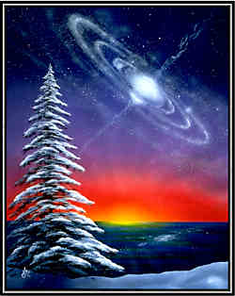
Galaxies
Normal Galaxies
  Spirals
    Disk + Central Bulge
  Barred Spirals
    Disk + Bar + Central Bulge
  Ellipticals
    All Bulge (no disk), little gas
Peculiar Galaxies
    Irregular Galaxies
    Starburst Galaxies
    Interacting Galaxies
    Ring Galaxies
“Snow Spiral” Joy Day
http://www.glassnebula.com/prints.shtml

Slide 5
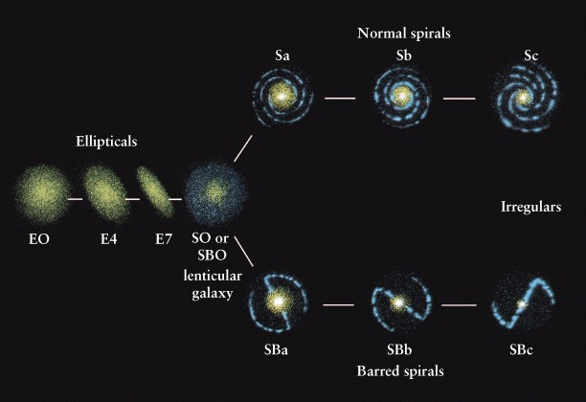
Normal Galaxies
Hubble’s Tuning fork diagram
Showing evolution? Showing conditions of origin?

Slide 6
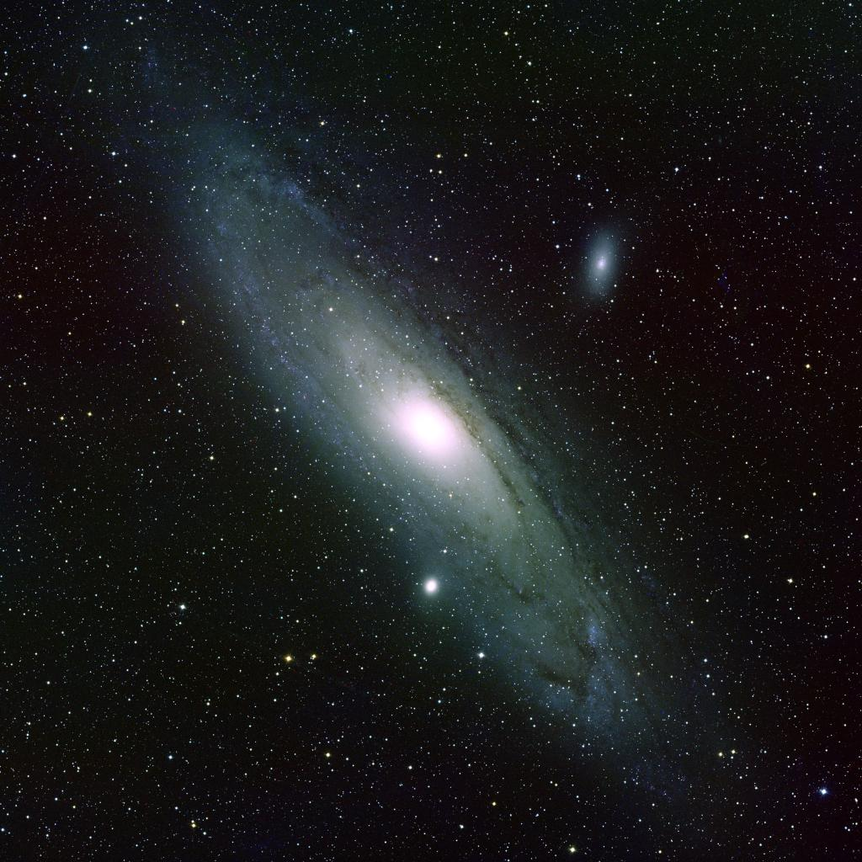
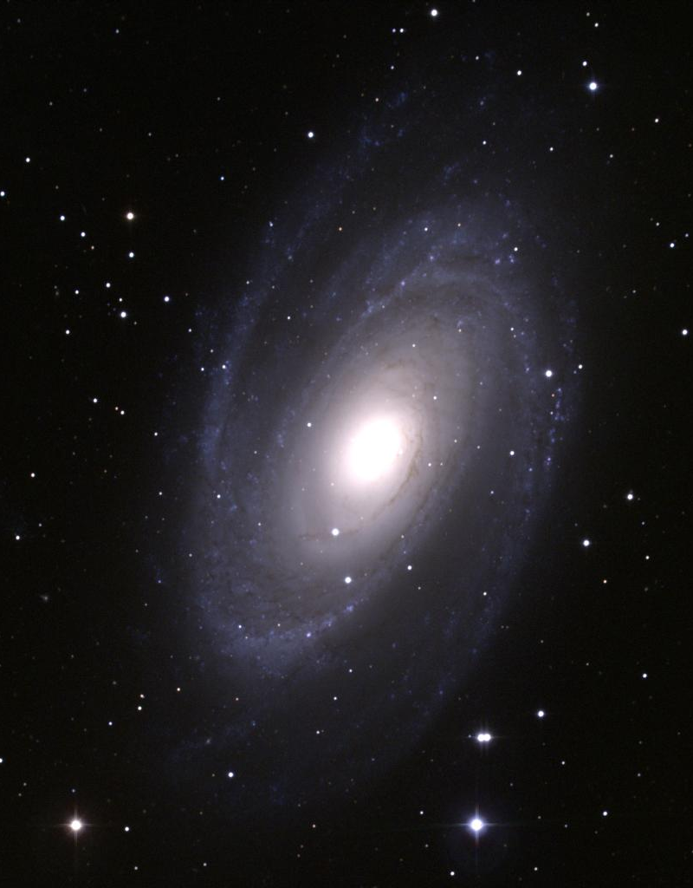
Normal Spirals (S)
Andromeda Companion M110 (NGC 205), E5/6
M81, Sb in Ursa Major
Andromeda Companion M32, E2
Andromeda Galaxy M31, Sb

Slide 7
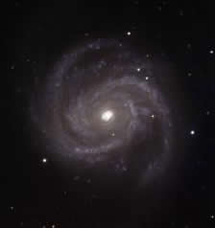
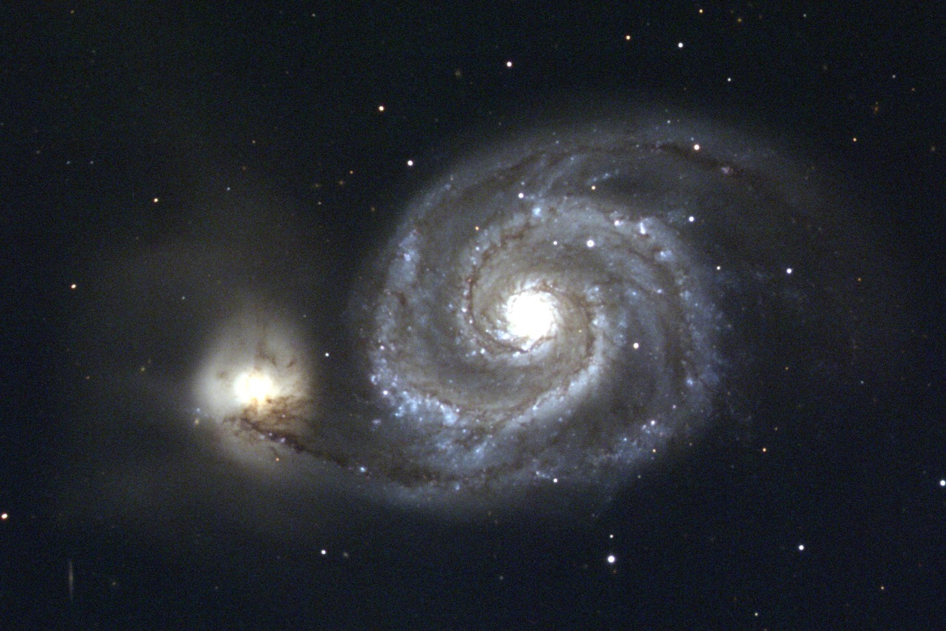
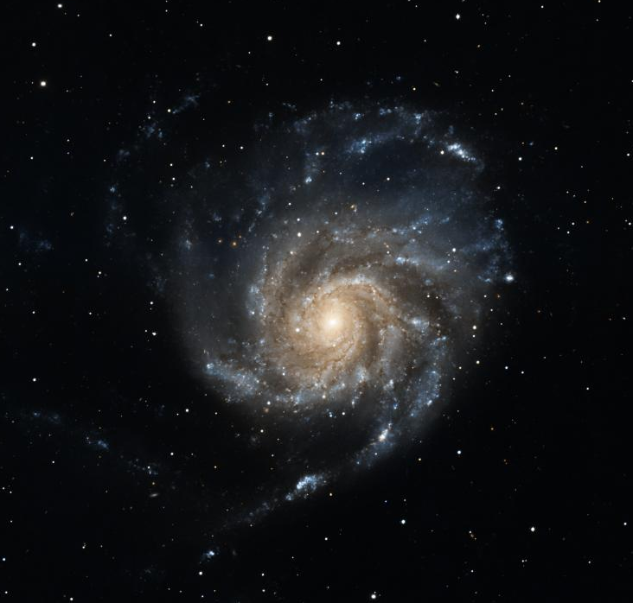
Normal Spirals (S)
M100 in Coma Berenices, Sc
M51 Companion NGC 5195, Irregular
Whirlpool Galaxy M51 in Canes Venatici, Sc
M101 in Ursa Major, Sc

Slide 8
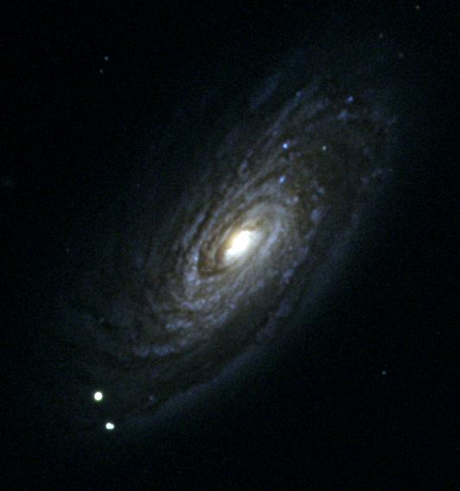
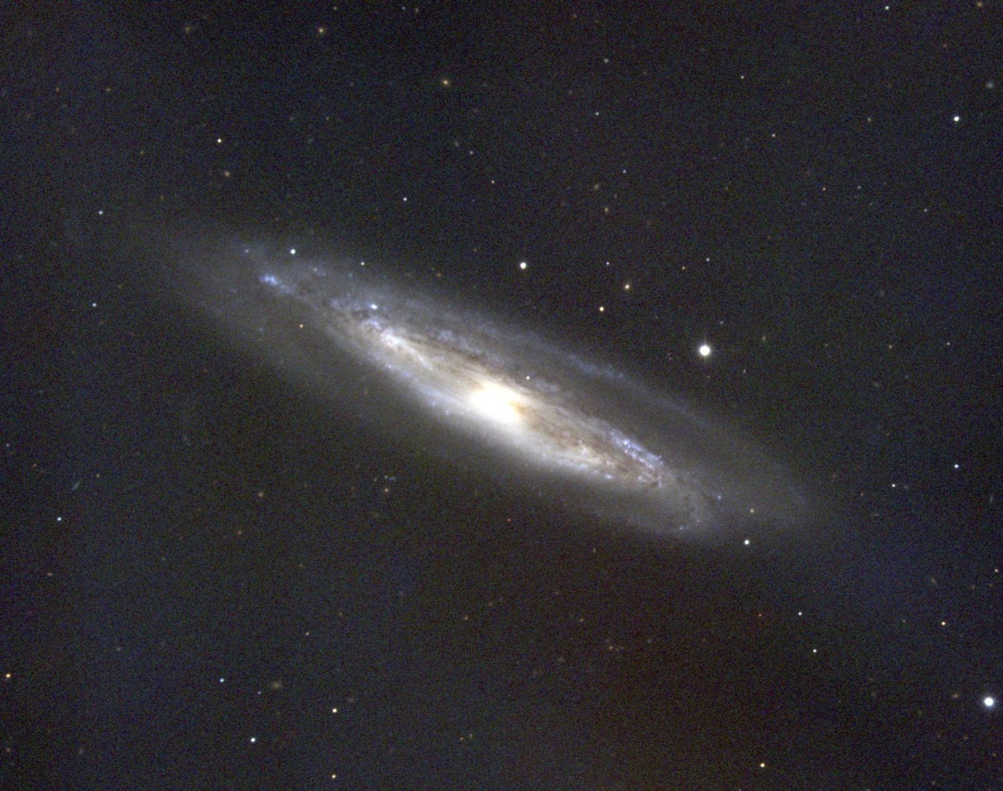
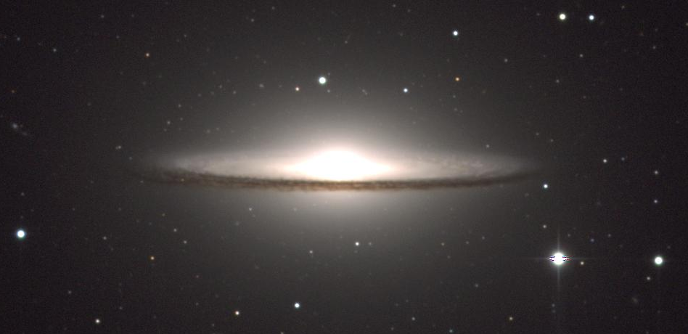
Normal Spirals (S)
M90, Sc
M98, Sb
Both in Coma Berenices
Did it recently gobble up a companion dusty dwarf galaxy?
Dust along galactic disk
Sombrero Galaxy M104 in Virgo, Sa/Sb

Slide 9
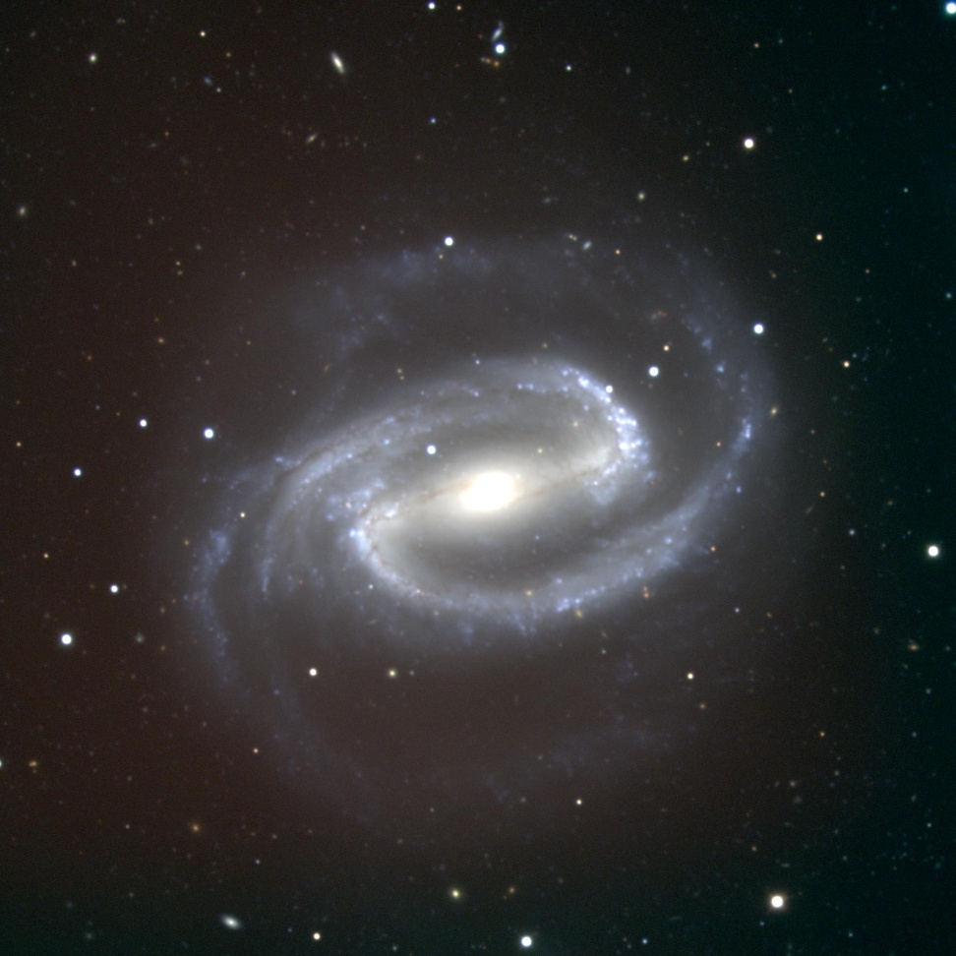
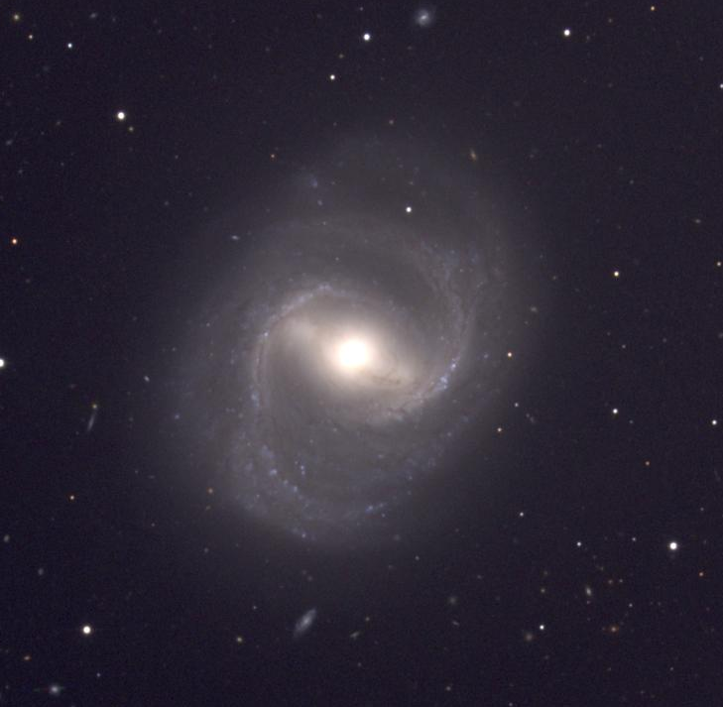
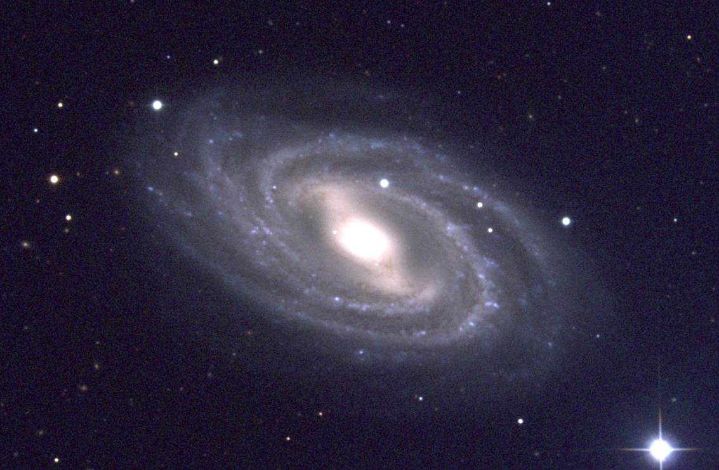
Barred Spirals (SB)
NGC 1300 in Eridanus, SBc
Milky Way is barred
M91 in CBr, SBb
M109 in UMa, SBc

Slide 10
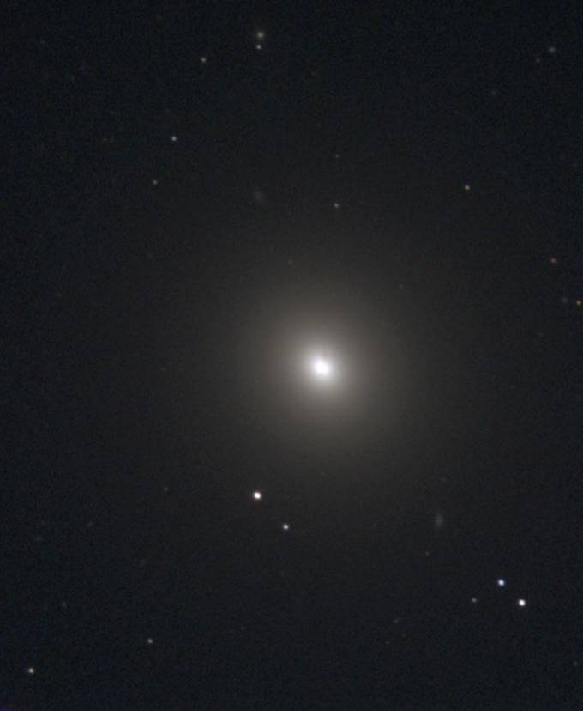
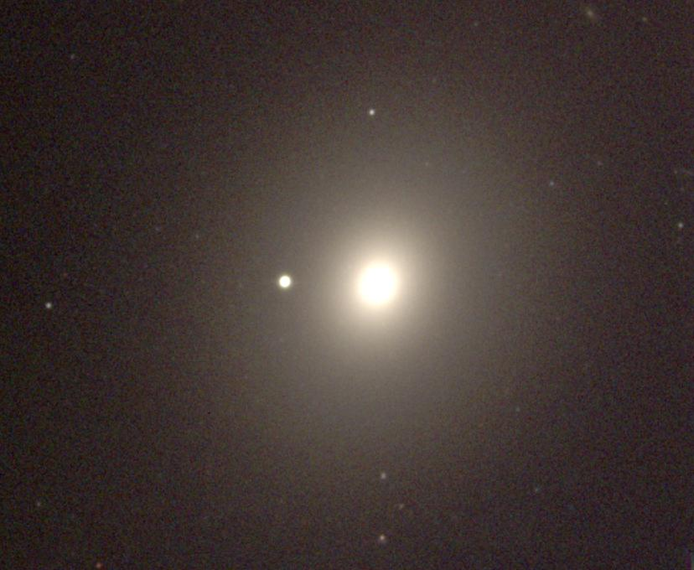
Ellipticals
M84, E1
Largest & smallest galaxies
Little gas
  little star formation
  reddish star population
M42 in Virgo, E4
Foreground Star in Milky Way galaxy

Slide 11
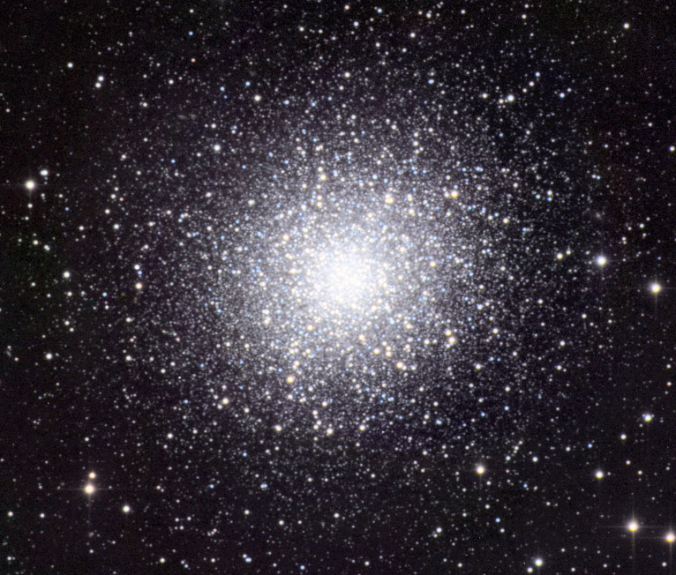
Star Clusters vs. Galaxies
Star cluster: individual stars visible
Galaxy: no individual stars visible
M42 in Virgo, E4
Foreground Star in Milky Way galaxy
Globular Cluster M13

Slide 12
Peculiar Galaxies
Starburst Galaxies
  galaxies undergoing burst in star formation
    due to recent mergers?
    youngest galaxies
Interacting Galaxies
  Colliding galaxies
    show tidal disruption & streams
  Ring galaxies (MW?)
    results of recent face-on collision?
Radio Galaxies
Quasars

Slide 13
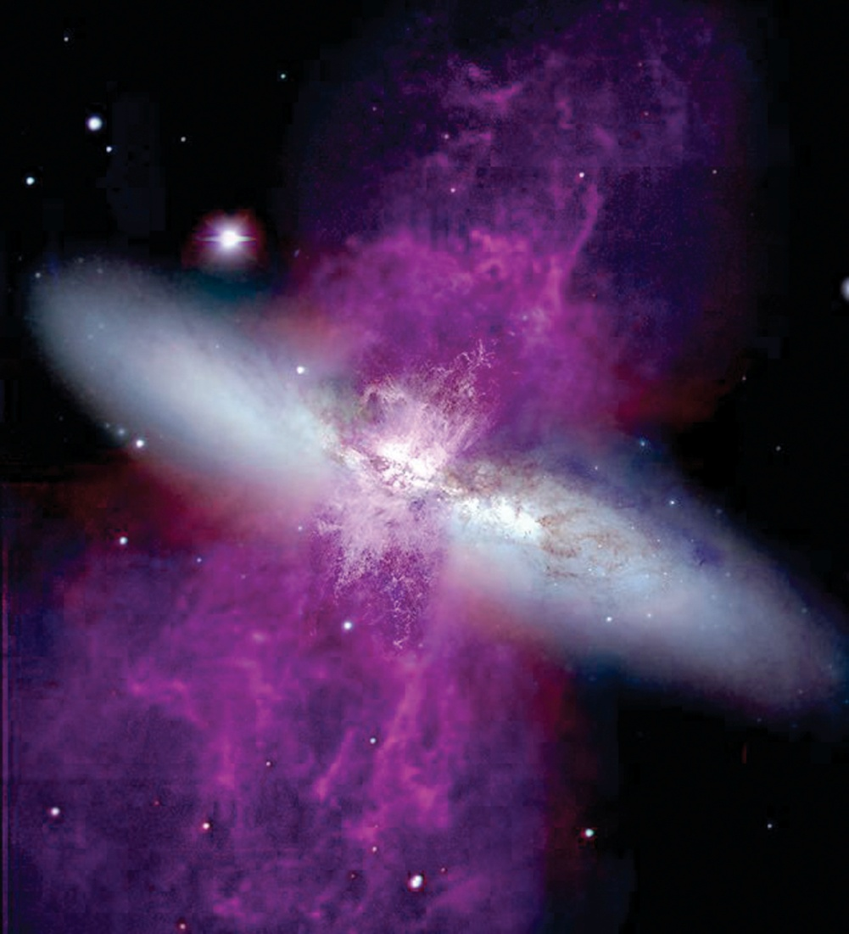
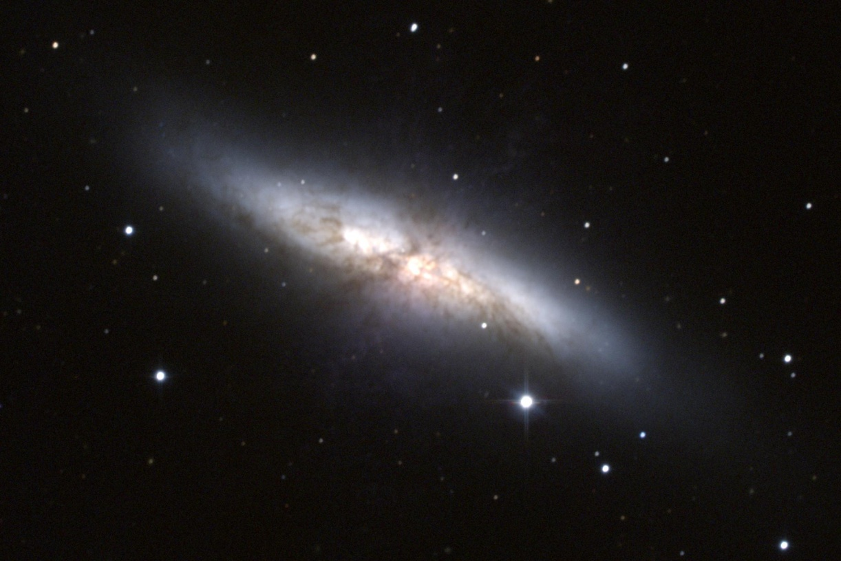
Starburst Galaxies
Undergoing bursts of star formation
M82 in UMa shows hot supergalactic wind from star formation (due to merger?)
M84, E1
Purple indicates ionized H and N observed by HST

Slide 14
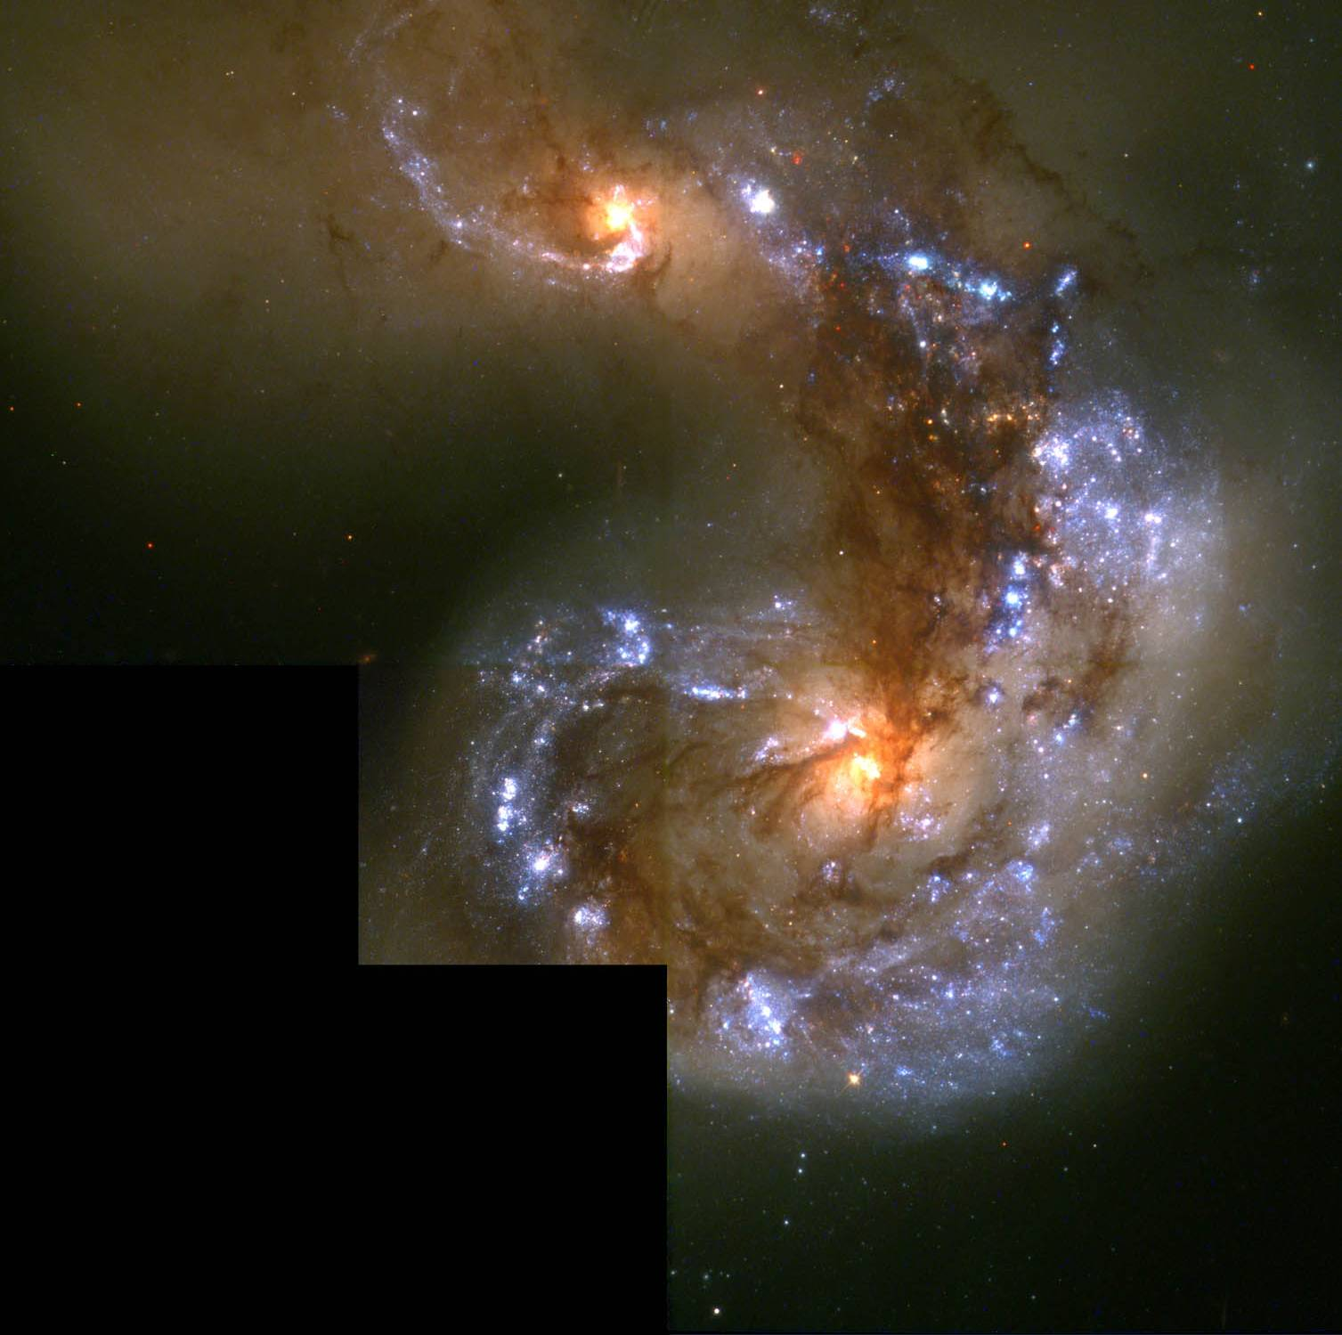
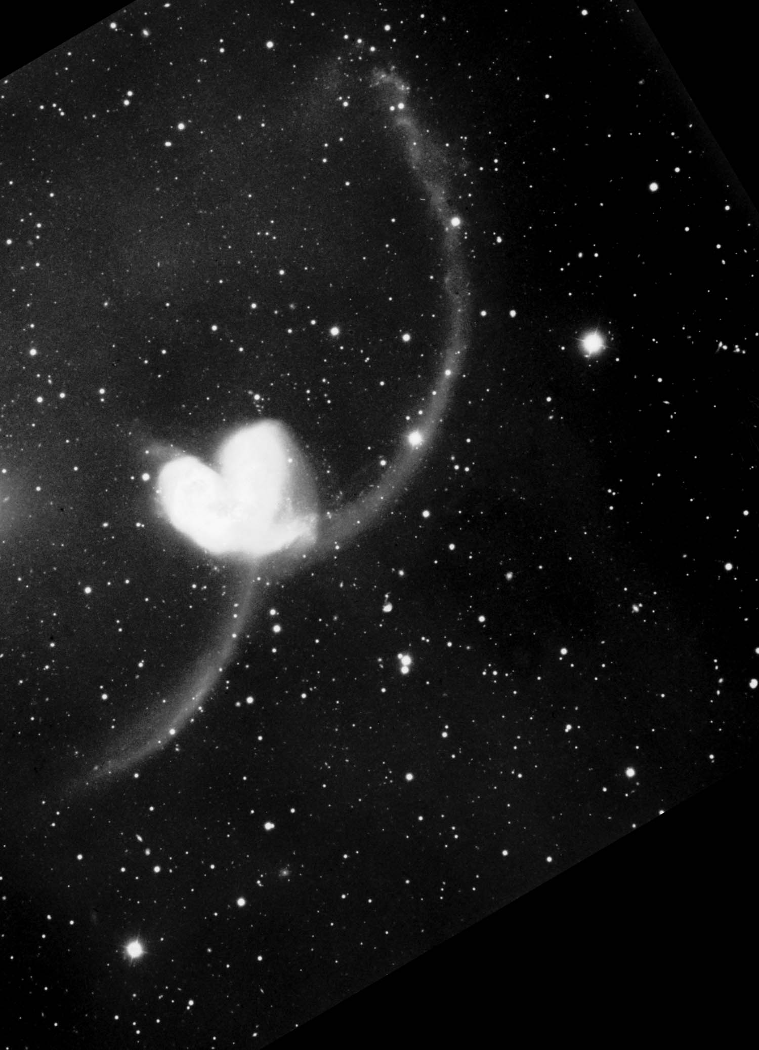
Interacting Galaxies
Antenna Galaxies
Blue ⇒ hot young stars ⇒ star formation ⇒ disturbed clouds
NGC 4308 & 4309: The Antenna Galaxies

Slide 15
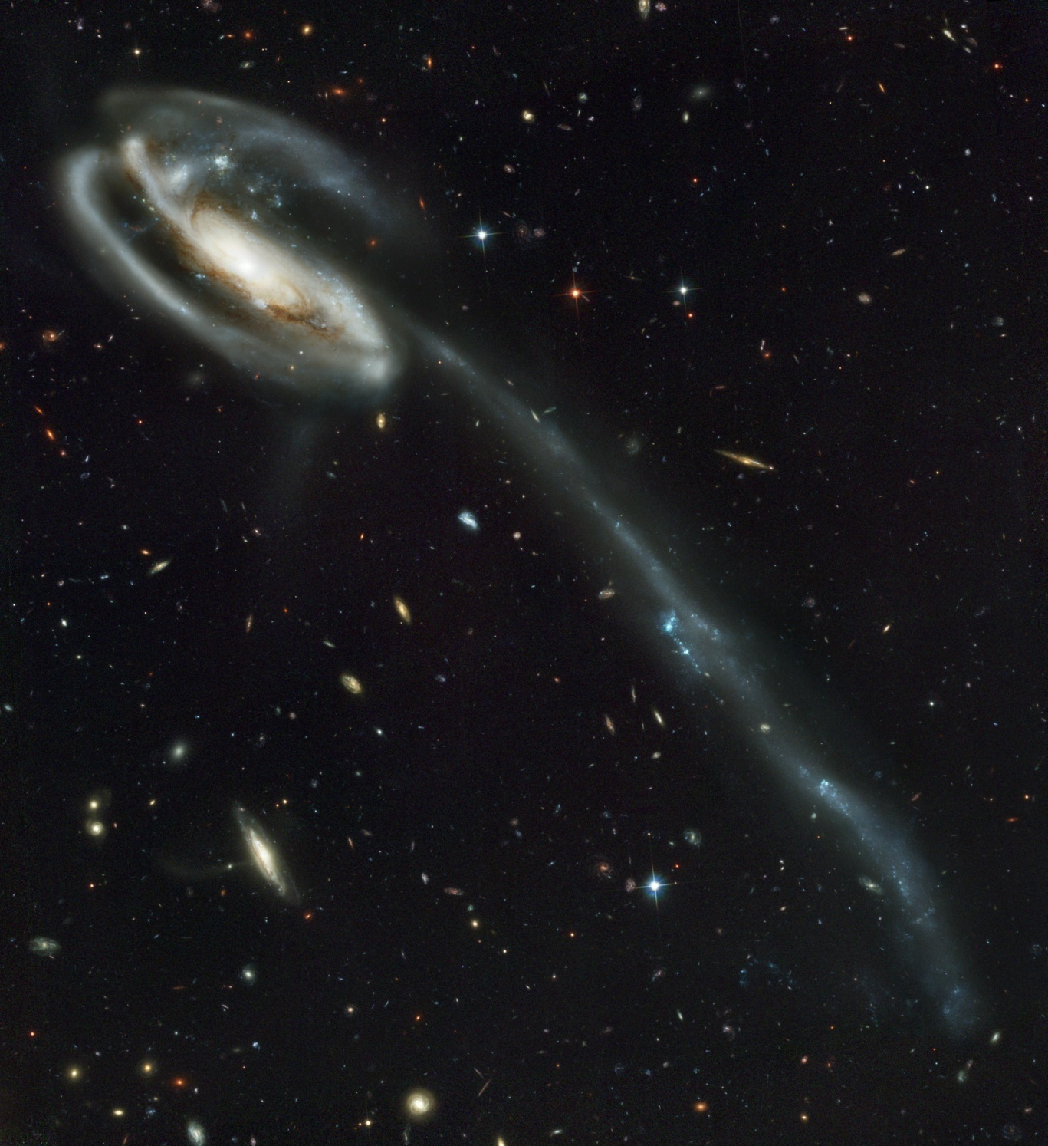
Interacting Galaxies
Antenna Galaxies
Arp 188 Tadpole Galaxy

Slide 16
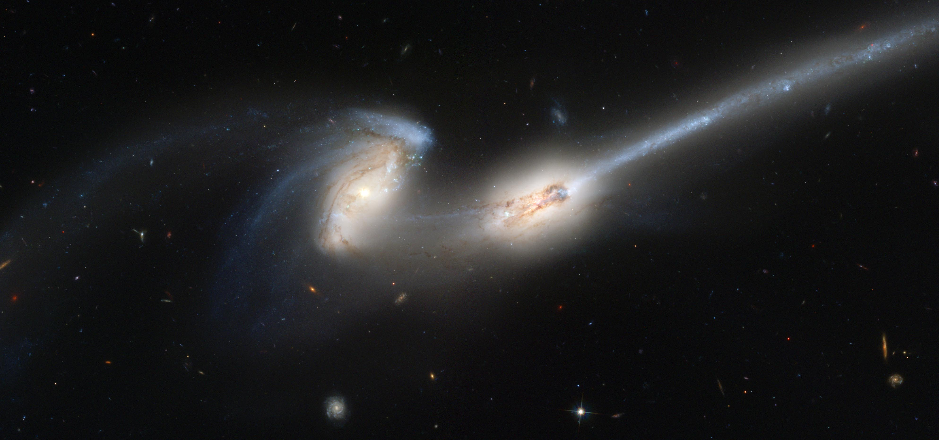
Interacting Galaxies
Antenna Galaxies
NGC 4676: The Mice

Slide 17
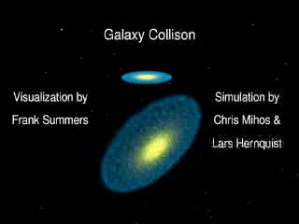
Interacting Galaxies
Numerous galactic collisions seen by HST
  stars don’t collide
  galactic gas halos collide & interact
    waves & shocks cause star formation
    blue stars indicate galactic interaction

Slide 18
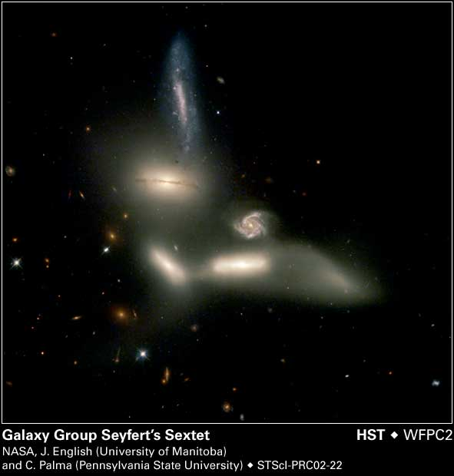
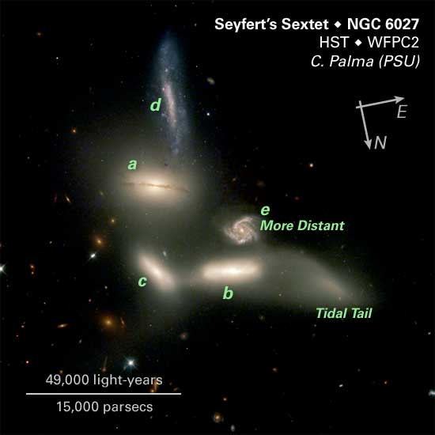
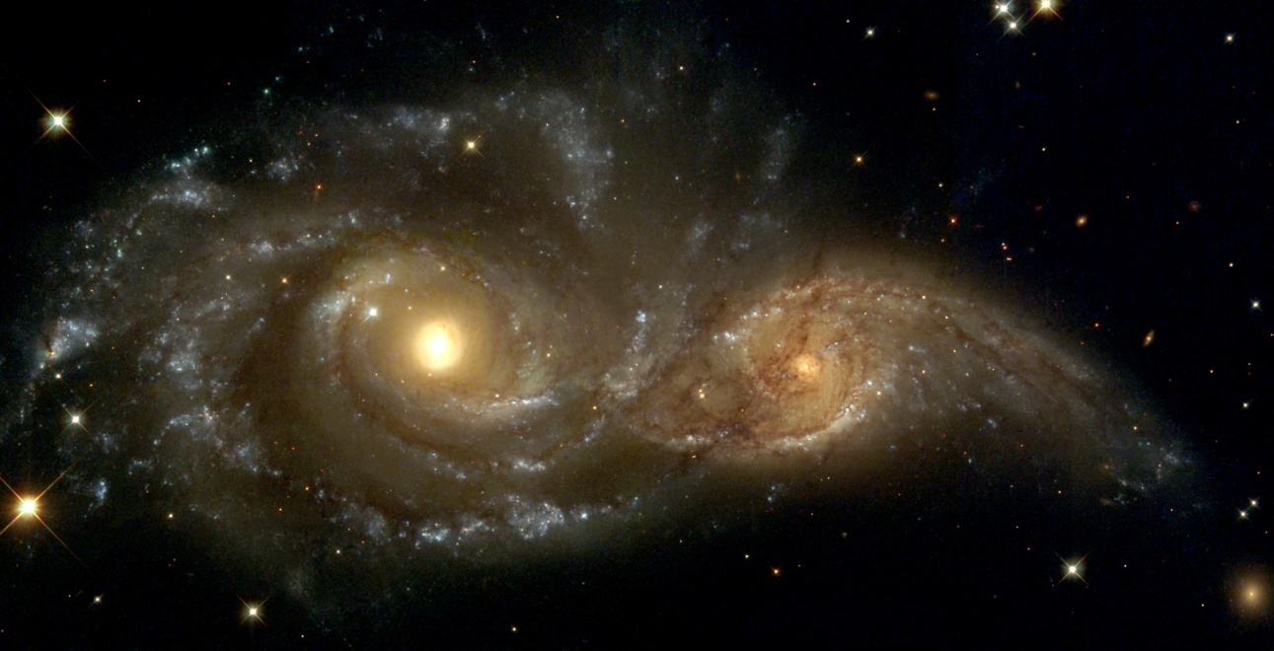
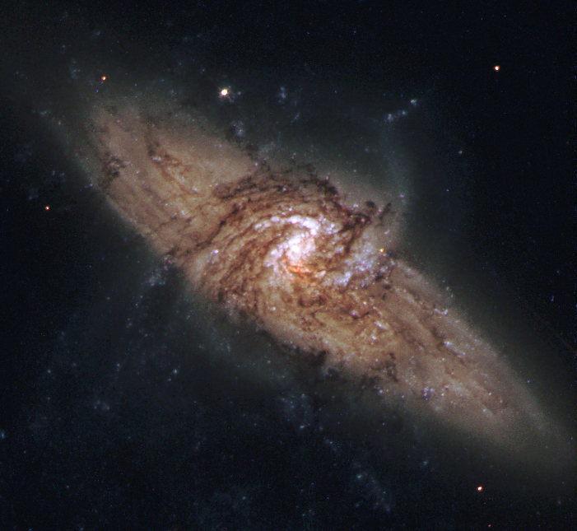
Interacting Galaxies
Superpositions and Grazing Encounters
NGC 3314: Aligned galaxies in Hydra
NGC 2207 & IC 2163: Grazing Encounter in CMi
Merging Galaxies in Serpens

Slide 19
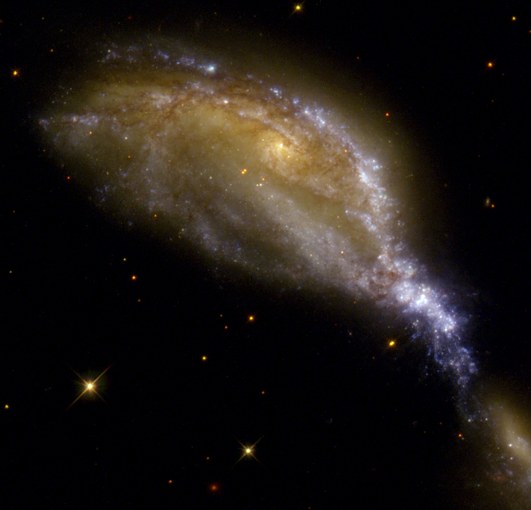
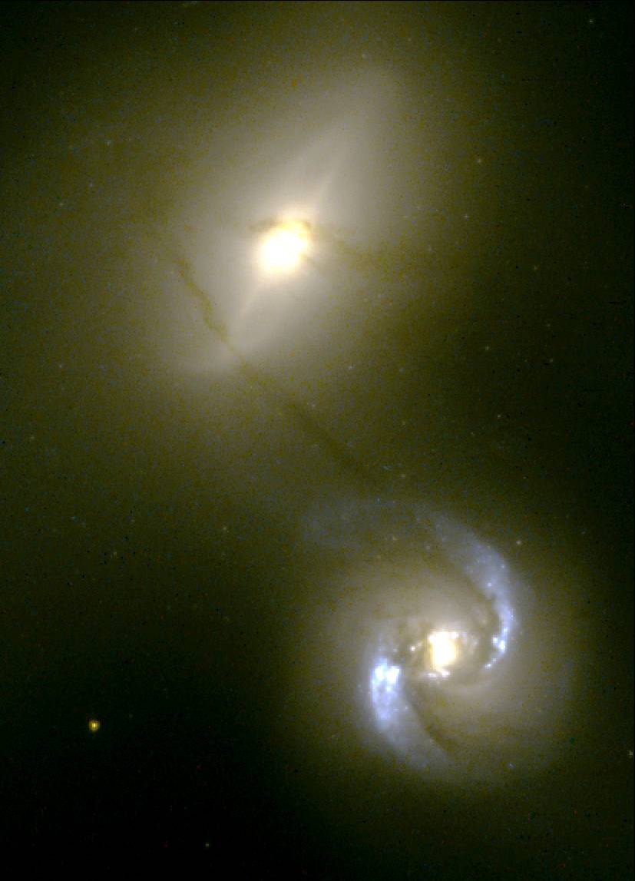
Interacting Galaxies
Collisions
NGC 1409 with “matter pipeline” to NGC 1410
NGC 6745: “Bird’s eye view of colliding galaxies”

Slide 20
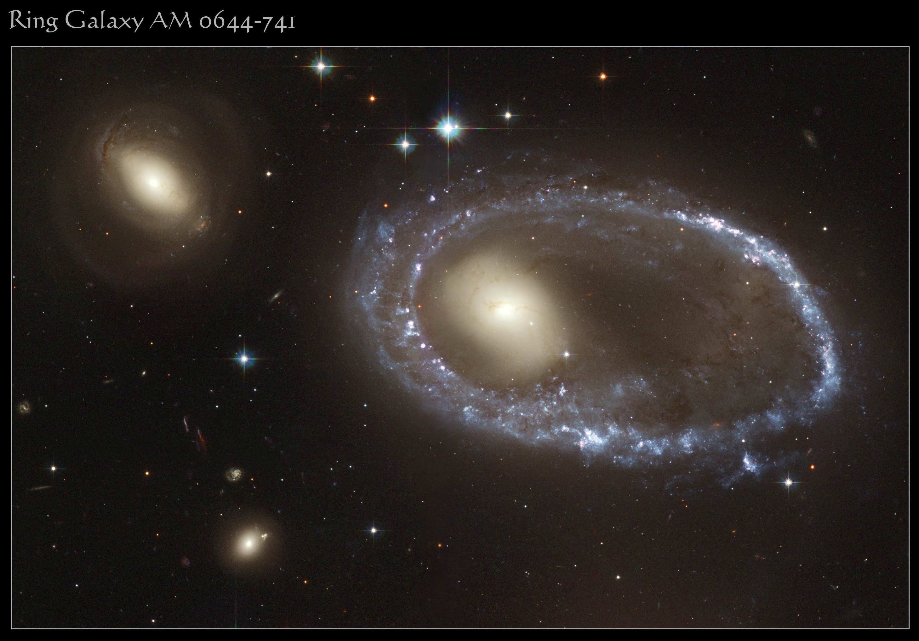
Interacting Galaxies
Ring Galaxies
AM 0644-741 in Volans

Slide 21
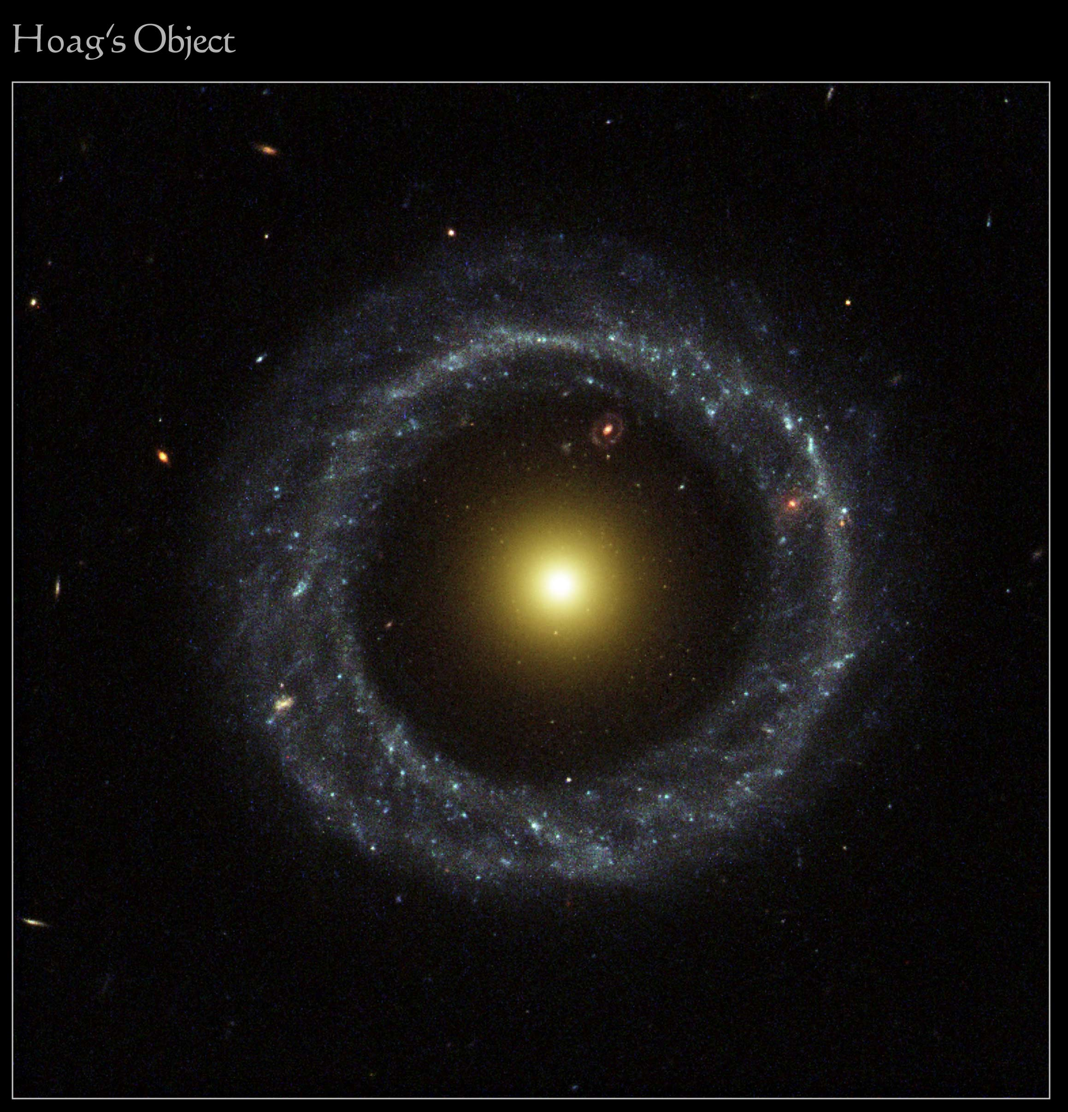
Interacting Galaxies
Ring Galaxies
Hoag’s Object in Serpens

Slide 22
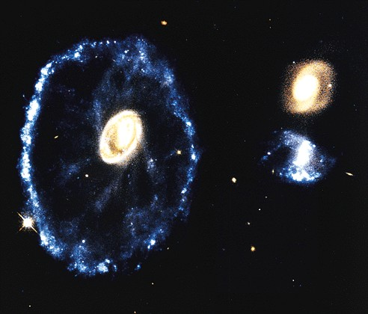
Interacting Galaxies
Ring Galaxies
Cartwheel Galaxy in Sculptor

Slide 23
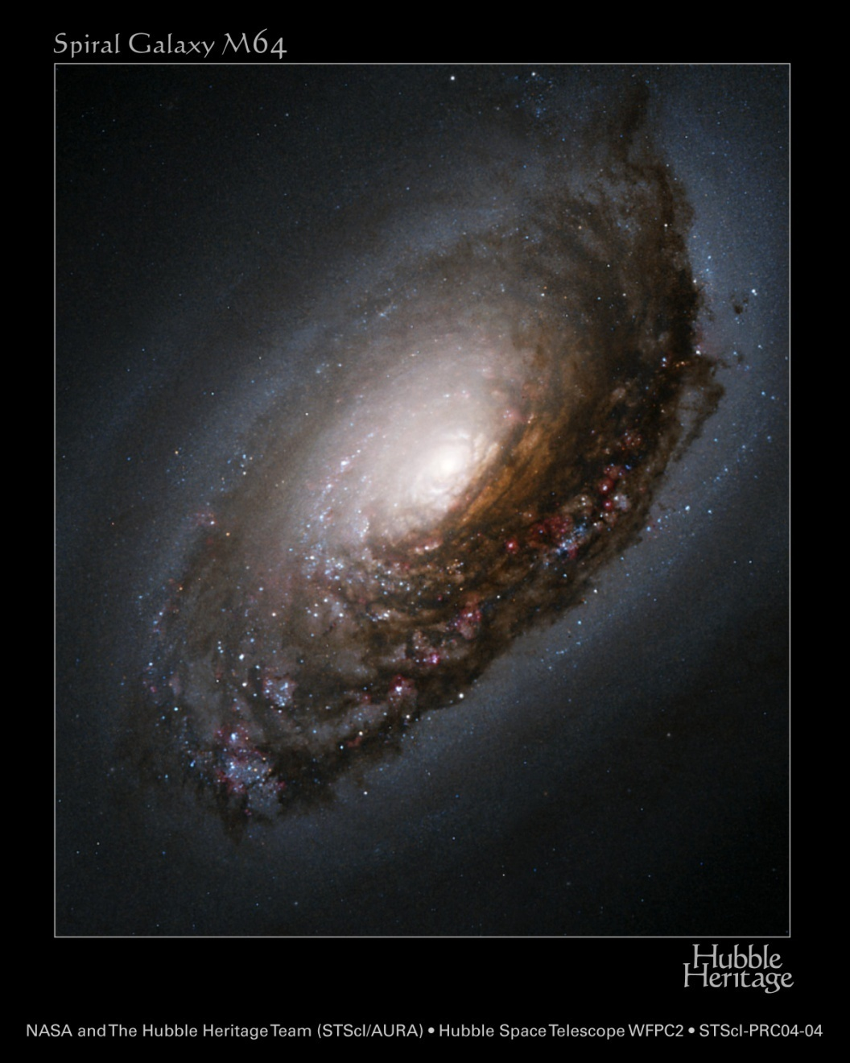
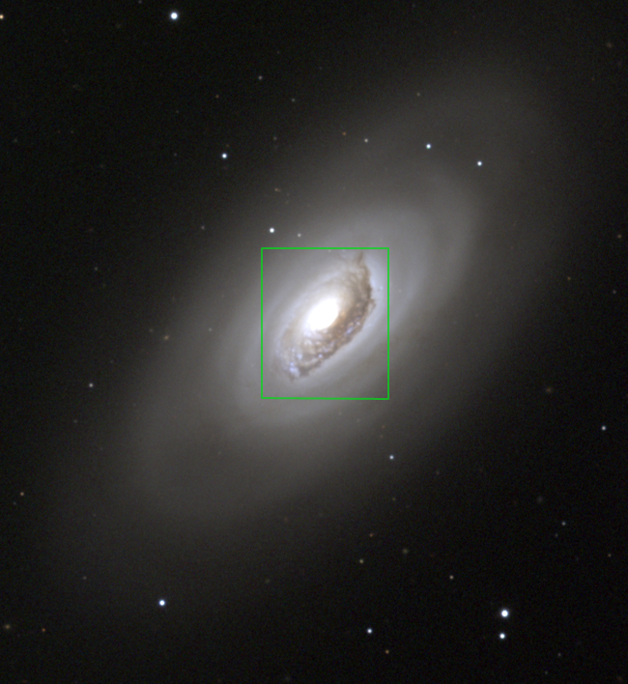
Peculiar Galaxies
The Black Eye Galaxy, a dusty elliptical
  … Did it just eat a dwarf?
M64 in CBr

Slide 24
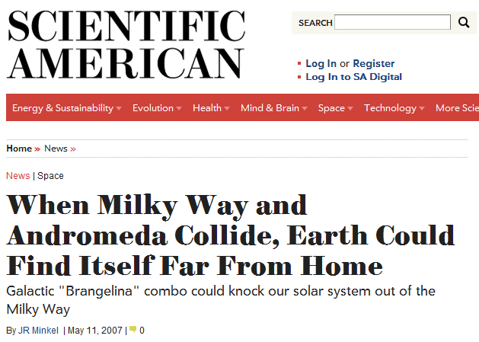
Peculiar Galaxies
Milky Way and Andromeda to collide!
http://www.scientificamerican.com/article.cfm?id=when-milky-way-and-andromeda-collide-earth-could-find-itself-far-from-home

Slide 25
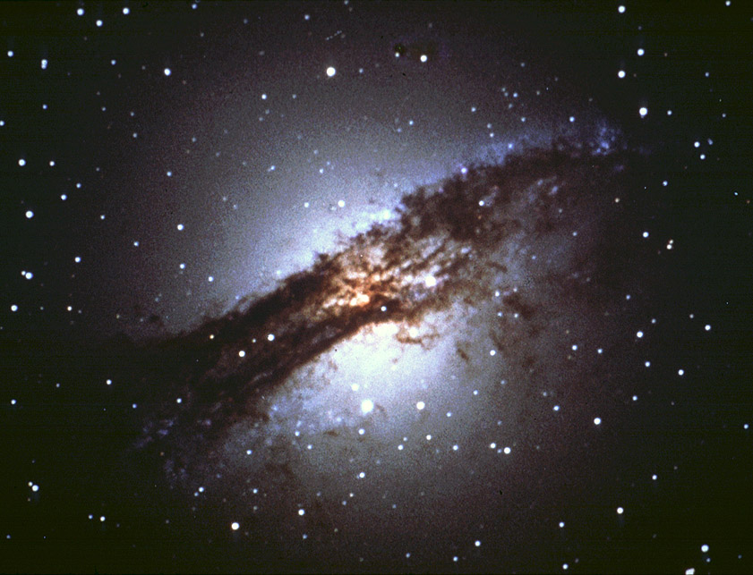
Peculiar Galaxies
Centaurus A, a dusty elliptical
  … Did it just eat a spiral?
NGC 5128

Slide 26
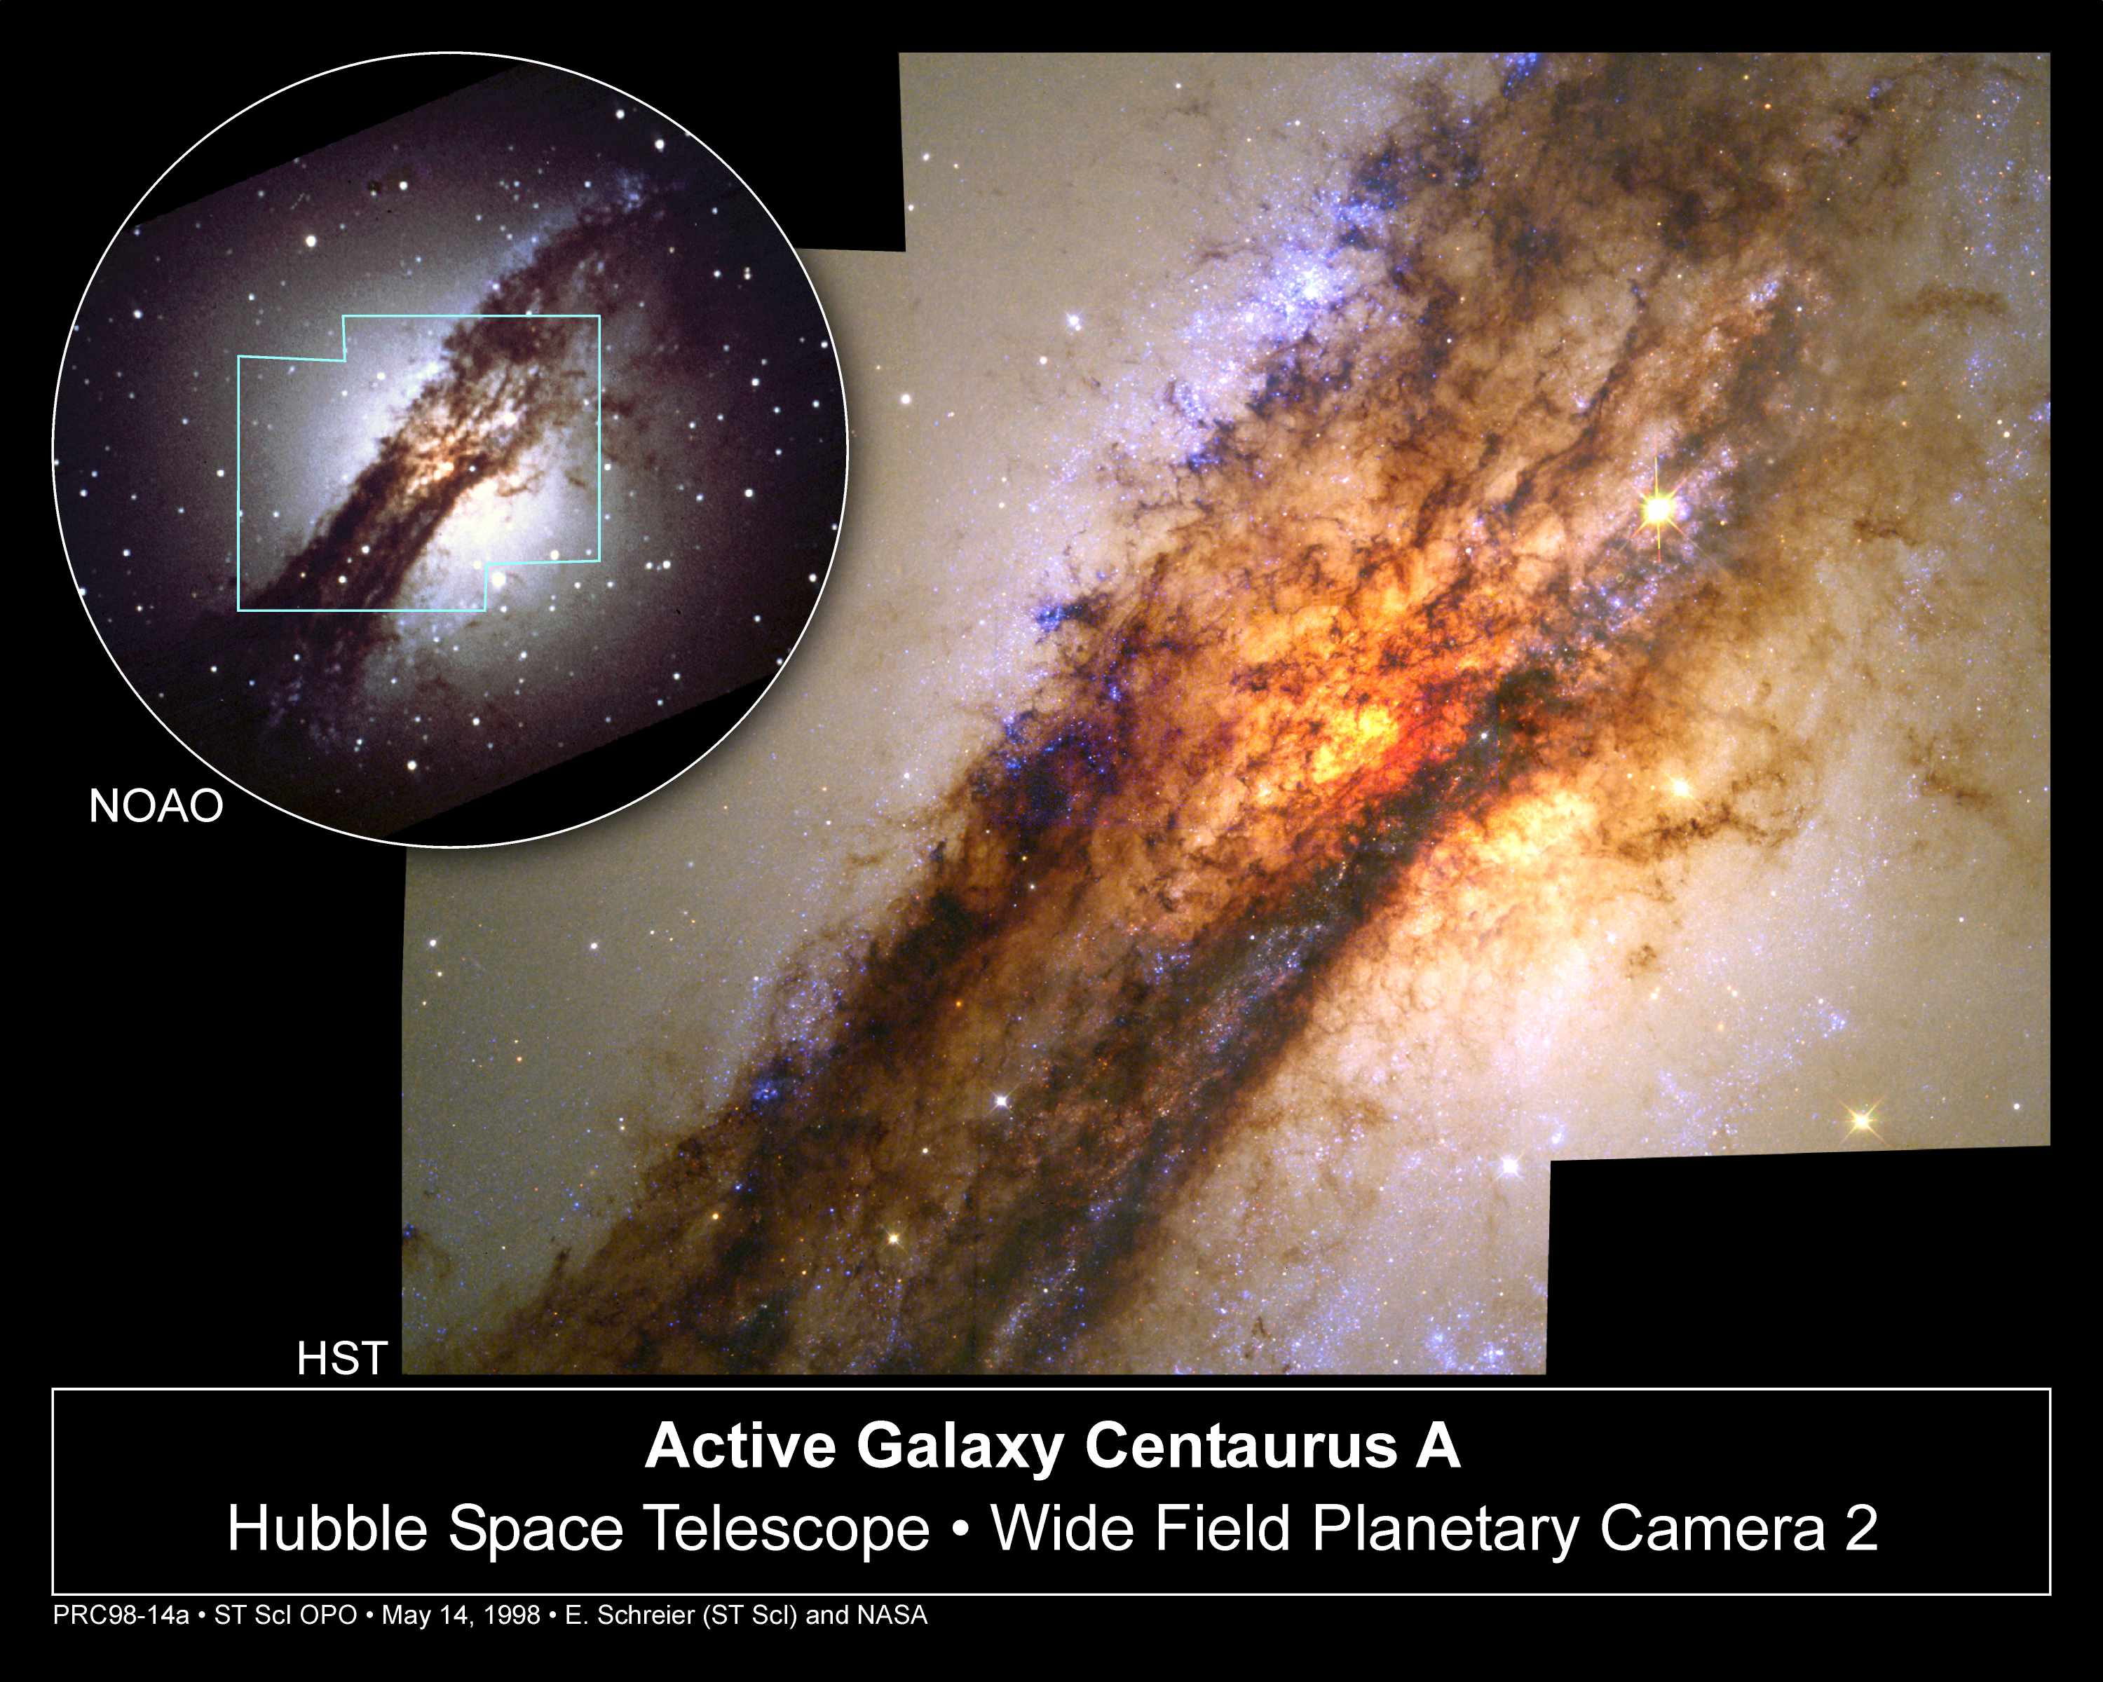
Centaurus A: Ground & HST

Slide 27
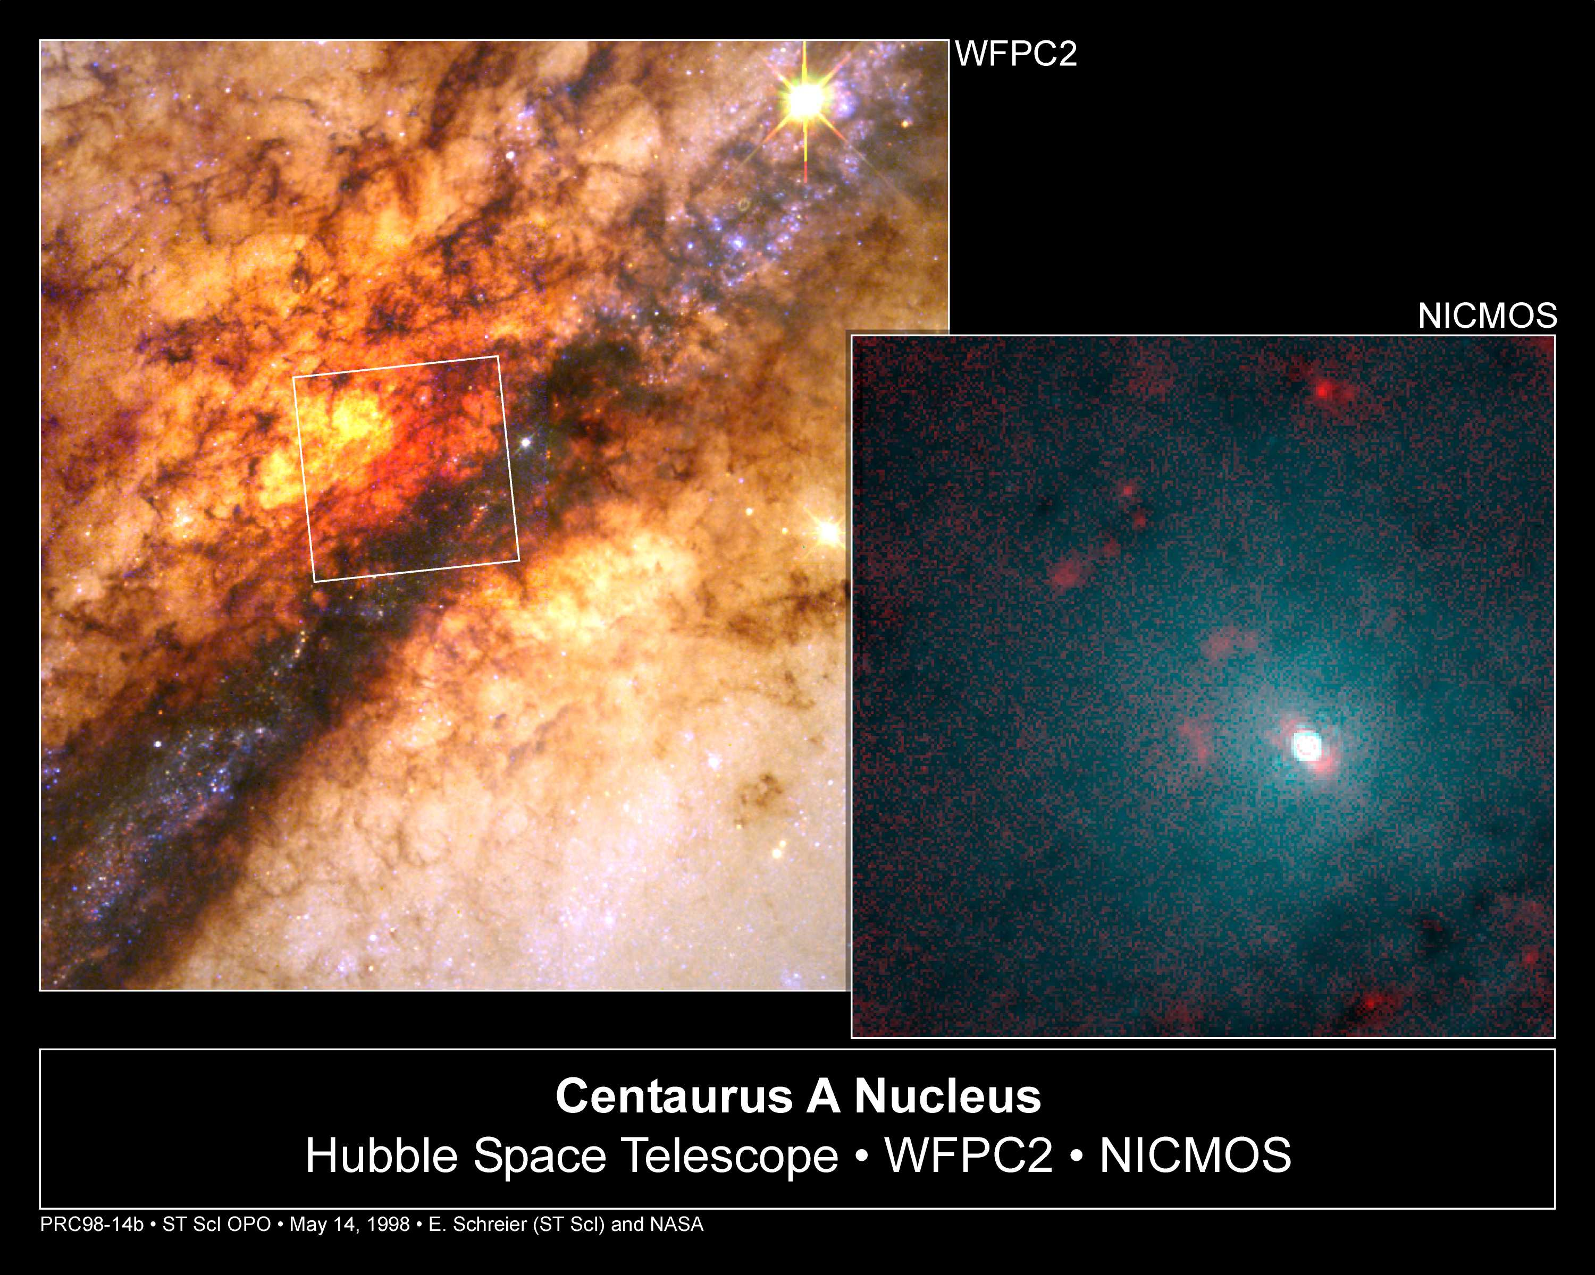
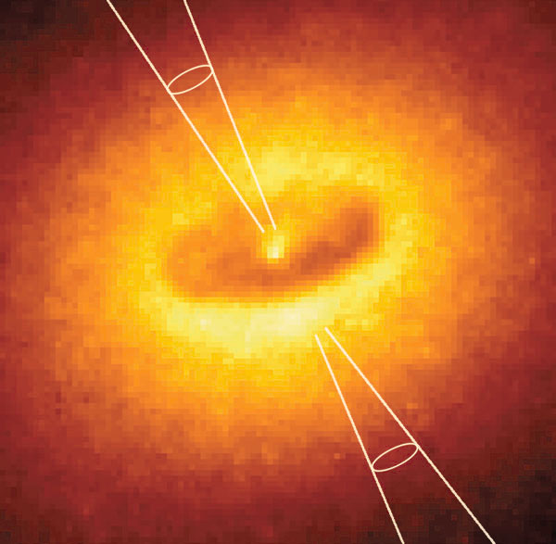
Centaurus A: Visible & IR
Tilted white disk 130 ly in diameter may be hiding 1GM_{Sol} Black Hole
1GM_{Sol} = 1 billion times the mass of Sol
Illustration of inner disk with jets heating red blobs

Slide 28
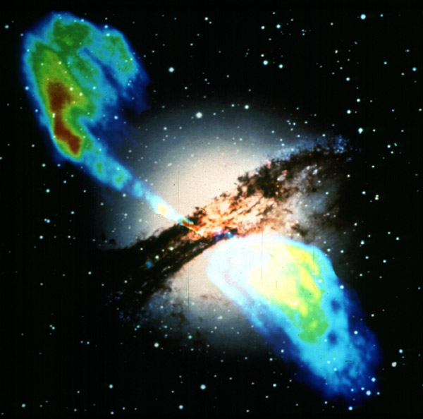
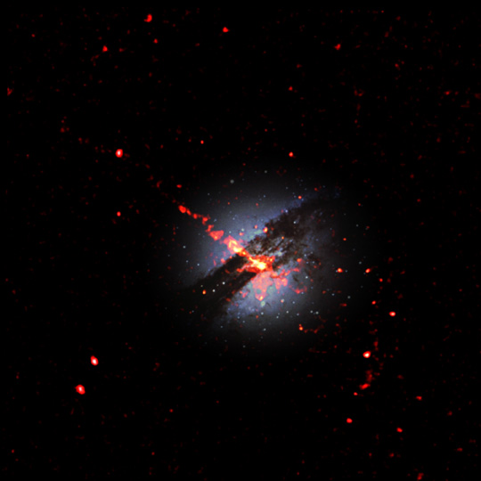
Centaurus A: Radio & X-Ray
VLA and Chandra Observations
Radio image shows jets from inner disk
X-Ray image shows jets from inner disk

Slide 29
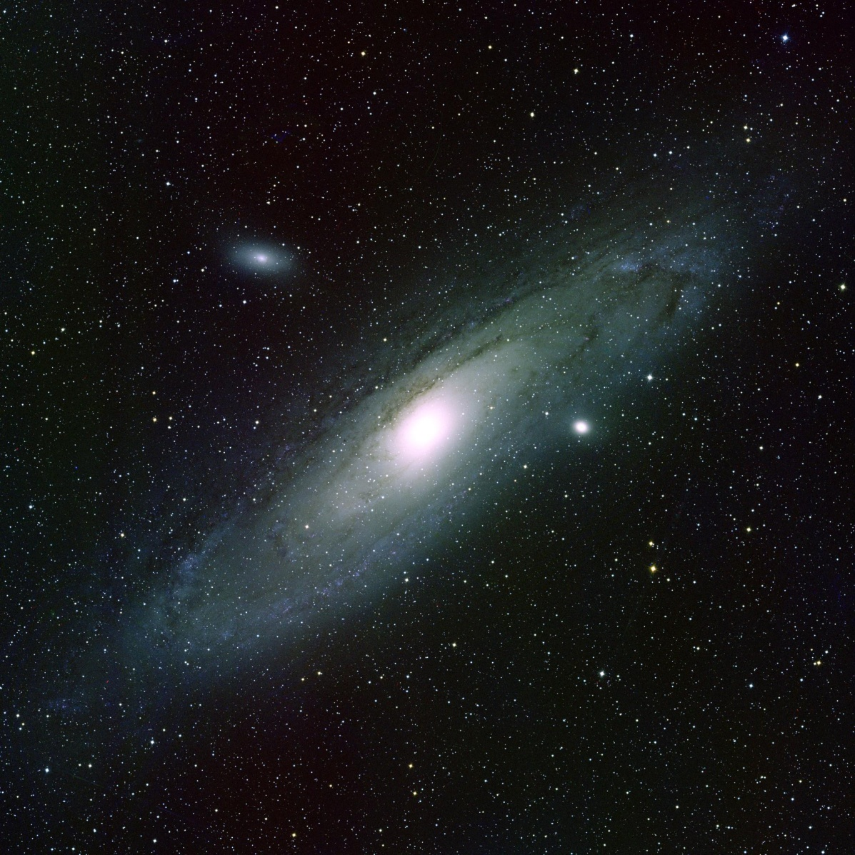

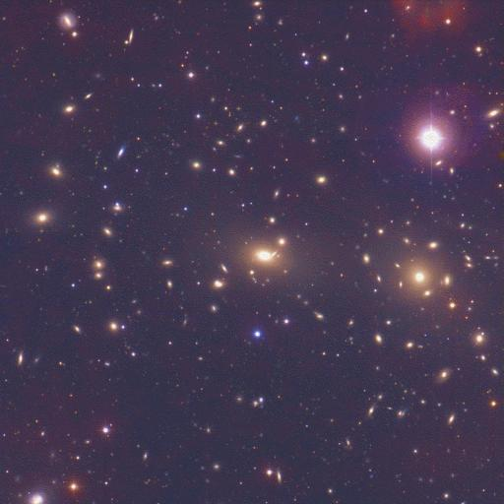
Radio Astronomy
VLA Observations of galaxies in clusters
  Galaxies – stars bound by gravity
    Milky Way ~ 300 Billion stars (like Andromeda)
  Clusters – galaxies bound by gravity
Images from NOAO
Coma Cluster of Galaxies
Andromeda Galaxy
Dots are galaxies
Dots are stars and nebulae

Slide 30
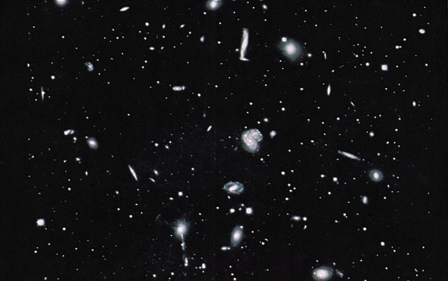
Clusters of Galaxies
Hundreds to thousands of galaxies gravitationally bound.

Slide 31
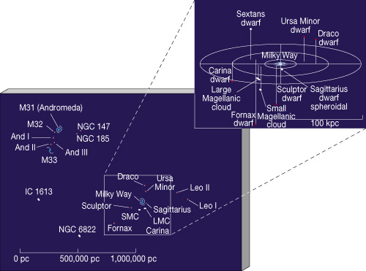
Clusters of Galaxies
Sol is in the “Local Group” part of Virgo Supercluster

Slide 32
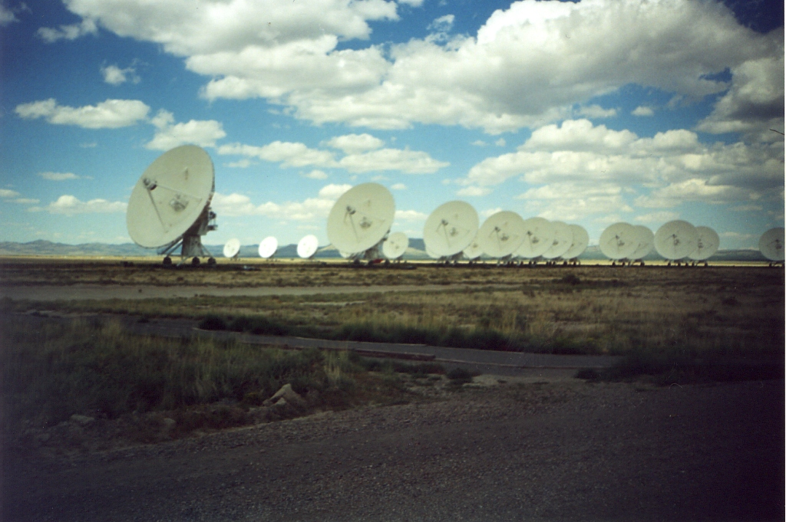

VLA Radio Telescope
Where “Ellie” heard the signal of another civilization …
Contact, The Movie

Slide 33
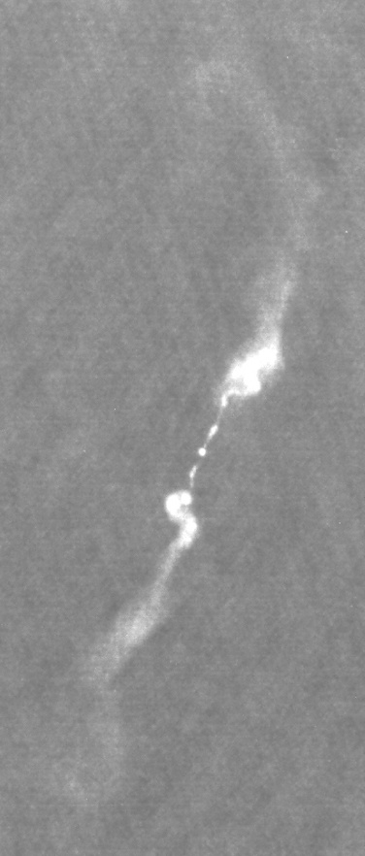
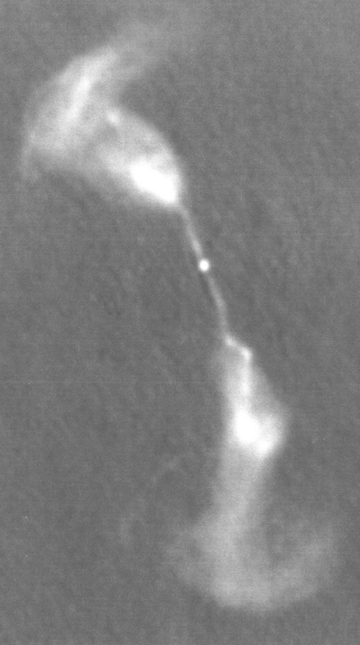
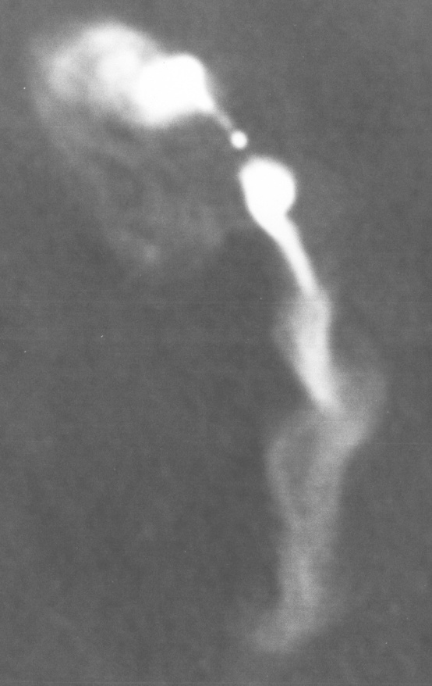


Radio Galaxies
Wide Angle Tailed Radio Galaxies
  C-shaped radio emissions
  shaped by “winds” due to smaller clusters of galaxies merging together …
  Even galaxies clusters are still evolving!
~ 500,000 ly

Slide 34
What’s Shining?
Synchrotron Radiation
  e⁻ spiraling along magnetic field lines
Radiate due to acceleration (centripetal acceleration)
Frequency of radiation
Energy of electron
∝

Slide 35



Radio Galaxies
Attached to cD galaxies
  cluster Dominant galaxies
    HUGE ellipticals in centers of galaxy clusters
      got big by eating neighbors
      some not done … two nuclei
~ 500 kly

Slide 36


Radio Galaxies
3C 75
  Dual radio galaxies
    two radio sources from same galaxy
      two nuclei

Slide 37


Radio Galaxies
3C 75
  Cluster in X-ray emission
    shows two nuclei, lumpy gas distribution

Slide 38


Quasars
Quasi-Stellar Objects
  VERY bright radio sources
  star-like optical companion
  highly redshifted spectra
    moving away FAST!
    among most distant objects
Quasar 3C 273

Slide 39

Quasars
Active Galactic Nuclei

Slide 40


Quasars
Due to supermassive black holes?
Jets seen end-on?

Slide 41



The Arecibo Pisces-Perseus Supercluster Survey: An Undergraduate ALFALFA Team (UAT) Project
Aileen O’Donoghue (SLU), Rebecca Koopmann (Union), Martha Haynes (Cornell), Michael Jones (Cornell), David Craig (WTAMU), Gregory Hallenbeck (Union), Jessica Rosenberg (GMU) and Aparna Venkatesan (USF)
Background Image: https://apod.nasa.gov/apod/ap110712.html

Slide 42

The APPS Survey
The Pisces-Perseus Supercluster
  Location, Morphology, Extent
  Why is it interesting?
Current Knowledge
  21 cm Survey and ALFALFA
APPSS
  What we seek to learn
  Observation strategy

Slide 43

Pisces-Perseus Supercluster
From Perseus through Pisces to Pegasus

Slide 44

Pisces-Perseus Supercluster
From Perseus through Pisces to Pegasus

Slide 45

Major Clusters in PPS
Perseus Cluster (NGC 1275, Abell 426)
Pisces Cluster (NGC 383 Group)
Pegasus I (NGC 7619 & 7626)
Pegasus II
Abell 194
Abell 262
Abell 347
Abell 426
NGC 891
NGC 507
Chandra view of Perseus Cluster Center (NGC 1275)
http://chandra.harvard.edu/photo/2014/perseus/

Slide 46
Pisces-Perseus Supercluster
First noticed by Bernheimer in 1932
  “I have found between the constellations Perseus and Pegasus a number of clusters of analgalactic nebulæ which seem to form subsystems of an extended metagalactic cloud.”
  Bernheimer, W. E. (1932). Nature 130, 132
Supported by Chincarini & Rood, 1976
  Study of Pegasus I and Pegasus II clusters.
    Pegasus I in large cloud of galaxies, Pegasus II more distant
  Bernheimer, W. E. (1932). Nature 130, 132
A “Supercluster”, Gregory, Laird & Tifft, 1981
  Recessional velocity = cz = 5327 km/s
  Bimodal distribution of galaxy position angles (pa) shows clusters & superclusters influenced galaxy formation so they must have formed before galaxies

Slide 47
Pisces-Perseus Supercluster
21 cm survey by Haynes, Giovanelli et al.
  (6 papers, 1985 - 1993)
  WHG 1993*: Paper V: Main Supercluster Ridge
  (22^{h} ≤ α ≥ 4^{h} and +33.5 < δ < +39.5)
    Ridge: significant overdensity of galaxies at 5000 km/s
    50h⁻¹ Mpc from Perseus to Pegasus Clusters
    5h⁻¹ – 10h⁻¹ deep, parallel to sky
    Variety of galaxy densities
    Proximity, orientation, density contrast
    ⇒ high visibility in sky projection
    ⇒ high visibility in velocity cone
  For H₀ = 73 km/s/Mpc, Length ≈ 37 Mpc, Depth ≈ 6 Mpc
  *Wegner, G., Haynes, M. P., & Giovanelli, R. 1993 AJ 105, 1251 (PP5)

Slide 48

Pisces-Perseus Supercluster
The PPS Area
  Large density contrasts, voids in front and back
Sky Positions of AGC Galaxies (All Velocities)
+50°
7,679 Galaxies
Abell 426
Abell 262
NGC7331
Abell 347
NGC 507
NGC 383
Declination
Abell 2634
+20°
4^{h}
22^{h}
Right Ascension
0
  Wegner, G., Haynes, M. P., & Giovanelli, R. 1993 AJ 105, 1251 (PP5)

Slide 49

Pisces-Perseus Supercluster
The PPS Cone: V_{helio} ~ 5,000 km/s
7,679 Galaxies
  Interesting due to galaxies in variety of local densities at very similar distances.
22^{h}
10,000 km/s
4^{h}
5,000 km/s
  Wegner, G., Haynes, M. P., & Giovanelli, R. 1993 AJ 105, 1251 (PP5)

Slide 50
Pisces-Perseus Supercluster
The PPS Ridge
  ~37 Mpc Long
Sky Positions of AGC Galaxies (All Velocities)
+50
7,679 Galaxies
4,549 Galaxies
Declination (degrees)
+20
4^{h}
0
22^{h}
Right Ascension (degrees)
  Wegner, G., Haynes, M. P., & Giovanelli, R. 1993 AJ 105, 1251 (PP5)

Slide 51

Pisces-Perseus Supercluster
The PPS Ridge Cone: PPS v_{helio} ~ 5,000 km/s
  Ridge area sharpens density contrast.
4,549 Galaxies
22^{h}
10,000 km/s
4^{h}
5,000 km/s
  Wegner, G., Haynes, M. P., & Giovanelli, R. 1993 AJ 105, 1251 (PP5)

Slide 52


ALFALFA PPS Results
Saintonge et al 2008
  α.40 in Declination band 26° < δ < 28° , 22^{h} < α < 3h
    488 Detections
    436 Extragalactic Objects
      62% New HI Detections
      59% New redshift measurements
      Mostly M_{HI} > 10⁸ M☉
5 of these 6 galaxies are satellites of the NGC672/IC1727 system

Slide 53


ALFALFA PPS Results
Saintonge et al 2008 (26° < δ < 28° , 22^{h} < α < 3h)
  ALFALFA NOT going to fill in low end of mass function
5 of these 6 galaxies are satellites of the NGC672/IC1727 system
  ⇒ ALFALFA not going to reveal many new dwarf galaxies
  Voids should contain many dwarfs!

Slide 54
Extending ALFALFA
Arecibo L-Band Wide Observations
  Seek low-mass galaxies within cz = 7,000 km/s
  ⇒ Extend low-mass end of mass function
  ⇒ Increase knowledge of PPS galaxies
      Greater sample for morphology segregation
      Peculiar velocities reveal dark matter distribution
      ΛCDM ⇒ Void should have more dwarfs
Three Preliminary Fall Programs
  Verifying ALFALFA detections (Codes 1 and 4)
  Identify real Code 3’s
  Test SDSS & GALEX photometry target selection

Slide 55

Extending ALFALFA
Arecibo L-Band Wide Observations
  Seek low-mass galaxies within cz = 7,000 km/s
  ⇒ Extend low-mass end of mass function

Slide 56

APPSS
Obtaining PPS Galaxy Spectra at Arecibo
  L-Band Wide (LBW) Observations
    5-minute ON-OFF strategy
    Expect to detect M_{HI} ≥ 10⁸ M⊙ at distance of PPS
  Jones & Koopmann, 2015, (after Erdoğdu et al. 2006, MNRAS, 373, 45)

Slide 57


Pisces-Perseus Supercluster
Separate “watershed” from Laniakea
http://www.nature.com/nature/journal/v513/n7516/full/nature13674.html
A slice of the Laniakea
supercluster in the supergalactic
equatorial plane.
RB Tully et al. Nature 513 , 71-73 (2014) doi:10.1038/nature13674

