Slide 1


SOAR: Lives of Stars
Star Birth
Aileen A. O’Donoghue Henry Priest Professor of Physics

Slide 2
The Lives of Stars
Star Birth: 9/10/26
  Nuclear Explosions Contained by Gravity
The Deaths of Small Stars: 9/17/26
  Planetary Nebulae and White Dwarfs
Deaths of Large Stars: 9/24/26
  Supernovae, Neutron Stars and Black Holes
Black Holes: 10/1/26
  Spaghettification

Slide 3
Outline
Nebulae
Interstellar Cloud Collapse
  Star & planet formation theory
  Star regions observed
Nuclear Fusion in Stars
  Fusion Power
  Fusion Products and Life

Slide 4
Outline
Nebulae
Interstellar Cloud Collapse
  Star & planet formation theory
  Star regions observed
Nuclear Fusion in Stars
  Fusion Power
  Fusion Products and Life

Slide 5
Nebulae
Fuzzy blurs
Gas & dust clouds, star clusters, galaxies
  Messier Objects
    Charles Messier in 1781
    “uninteresting” non-comets
    eg. M31 = Andromeda Galaxy, M42 = Orion Nebula
  NGC Objects
    New General Catalog by Dreyer 1888
    all Messier objects + additional objects

Slide 6
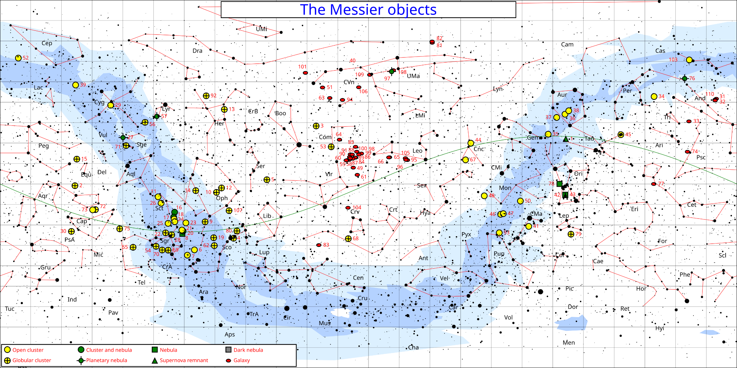
Nebulae
+80°
Fuzzy blurs
Gas & dust clouds, star clusters, galaxies
  Messier Objects
    Charles Messier in 1781
    “uninteresting” non-comets
    eg. M31 = Andromeda Galaxy, M42 = Orion Nebula
  NGC Objects
    New General Catalog by Dreyer 1888
    all Messier objects + additional objects
+60°
Milky Way Galaxy
+40°
+20°
0°
West
Celestial Equator
East
-20°
-40°
-60°
Messier Catalog 1781

Slide 7
Nebulae
+80°
Fuzzy blurs
Gas & dust clouds, star clusters, galaxies
  Messier Objects
    Charles Messier in 1781
    “uninteresting” non-comets
    eg. M31 = Andromeda Galaxy, M42 = Orion Nebula
  NGC Objects
    New General Catalog by Dreyer 1888
    all Messier objects + additional objects
Most nebulae & star clusters found along Milky Way
+60°
+40°
Center of the MW Galaxy
+20°
0°
Virgo Cluster of Galaxies
-20°
-40°
Southern limit of Messier’s view from Paris
-60°
Messier Catalog 1781

Slide 8
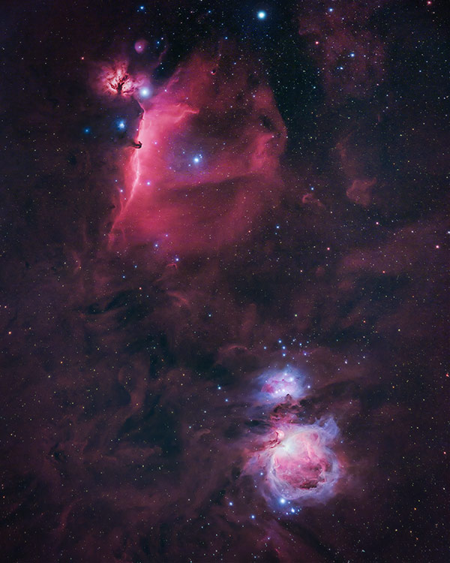
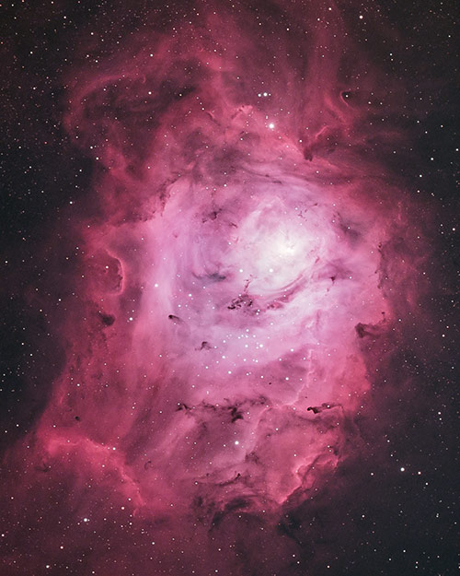
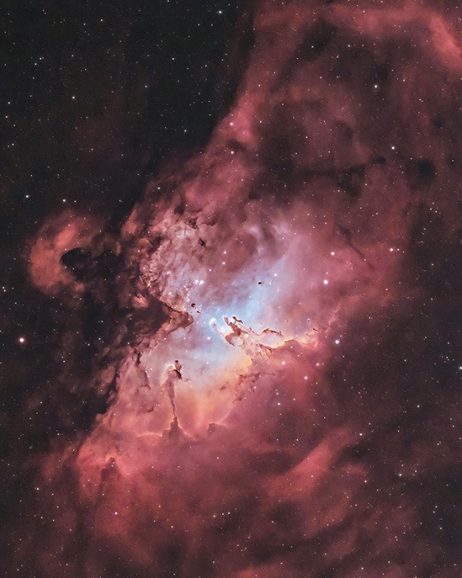
Types of Gaseous Nebulae
Emission (bright) Nebulae
  Glowing clouds of gas
  Show Emission lines
  Heated by nearby stars, embedded stars
    often associated with star clusters
  eg. Orion, Lagoon, Trifid, Eagle, N. Am., …
https://astrobackyard.com/orion-nebula/
https://astrobackyard.com/m8-lagoon-nebula/
https://astrobackyard.com/m16-eagle-nebula/

Slide 9
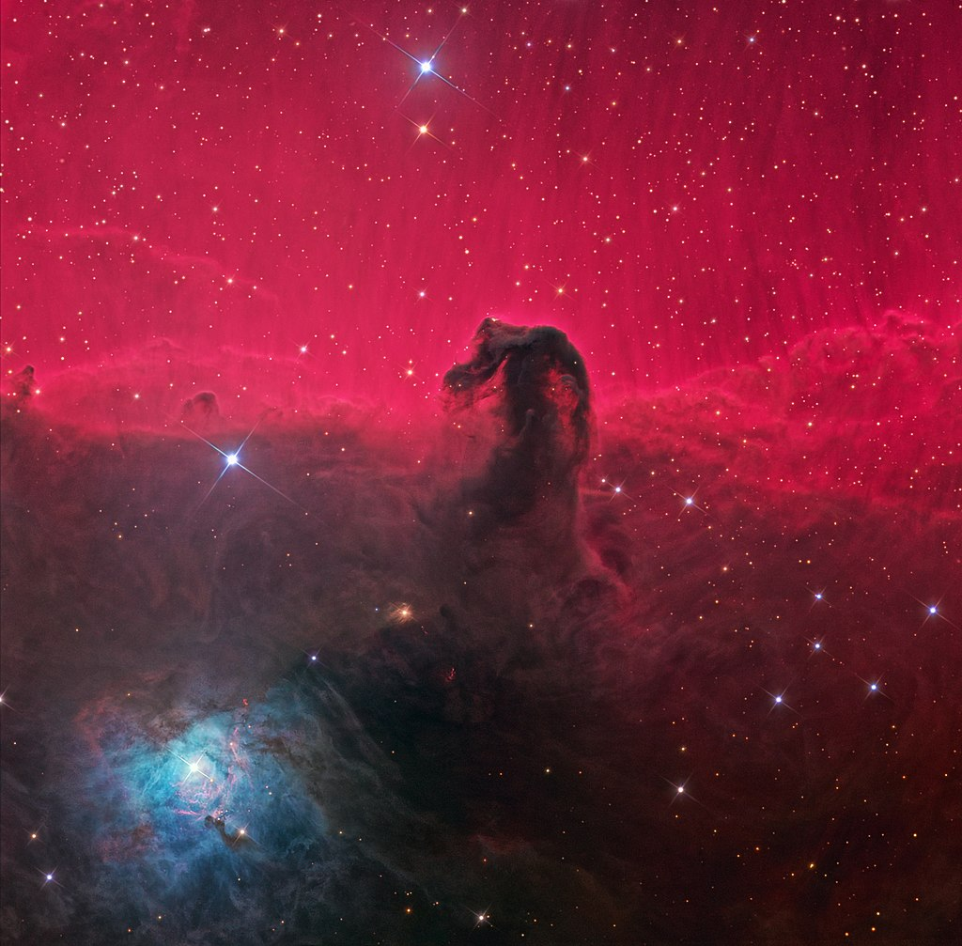
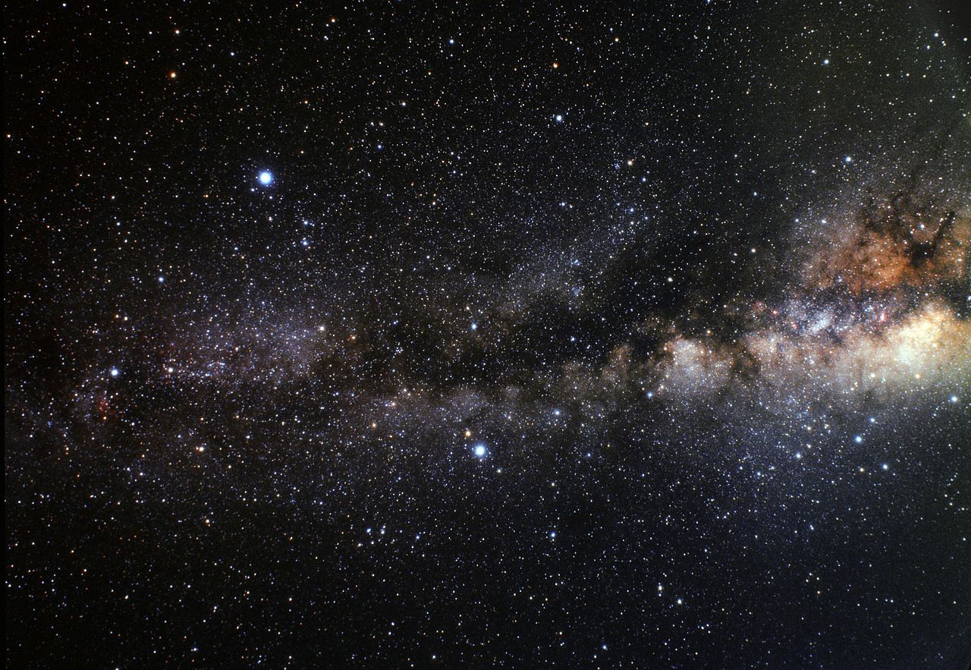
Types of Gaseous Nebulae
Absorption Nebulae
  Dark clouds blocking light from behind
  Cool gas not heated by stars
  e.g. Horsehead, Coal Sack, Great Rift
https://en.wikipedia.org/wiki/Horsehead_Nebula
https://en.wikipedia.org/wiki/Great_Rift_(astronomy)

Slide 10
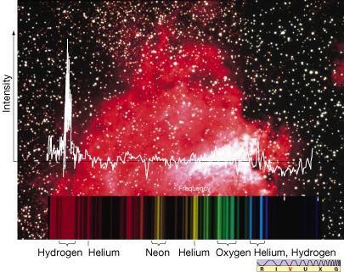
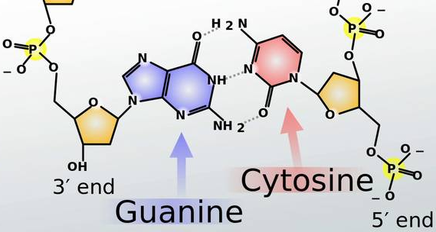
Emission & Absorption Nebulae
Show spectral lines
  composition can be determined
  some complex molecules found
    10²⁸ fifths of alcohol in Orion
    amino acid guanine in Orion
https://study.com/academy/lesson/guanine-structure-definition-quiz.html

Slide 11
Outline
Nebulae
Interstellar Cloud Collapse
  Star & planet formation theory
  Star regions observed
Nuclear Fusion in Stars
  Fusion Power
  Fusion Products and Life

Slide 12
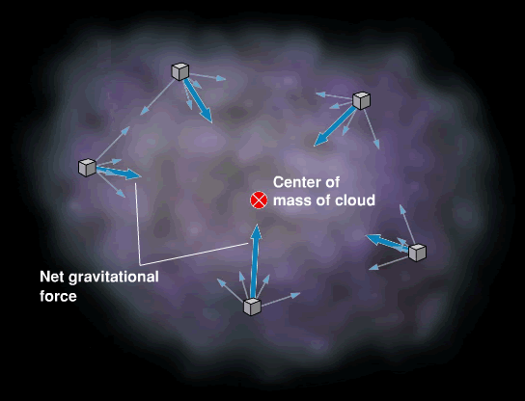
Interstellar Clouds
Mostly Hydrogen
Some heavy elements, molecules
All atoms attracted to others by gravity

Slide 13
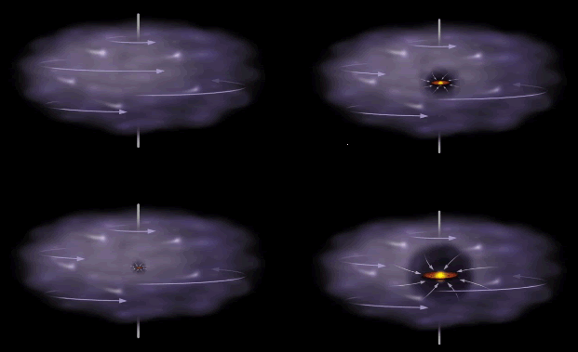
Cloud Collapse
Collapse heats center of cloud
  Core becomes protostar
Cloud begins rotating
  Disk forms around center

Slide 14
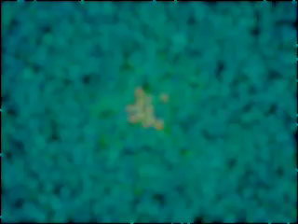
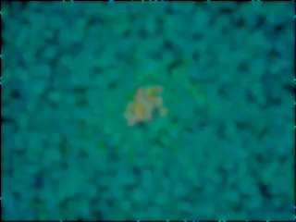
Cloud Collapse
Face on
Edge on
Colors indicate density

Slide 15
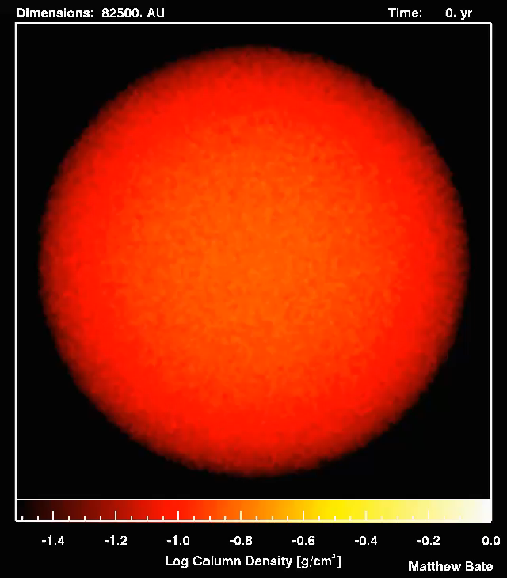

Cloud Collapse
UK Astrophysical Fluids Facility
www.ukaff.ac.uk

Slide 16
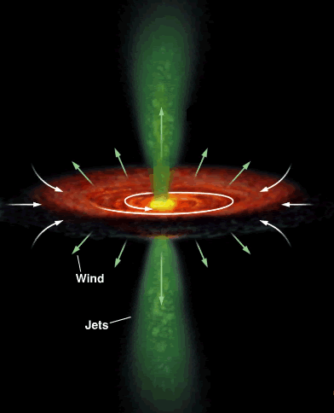
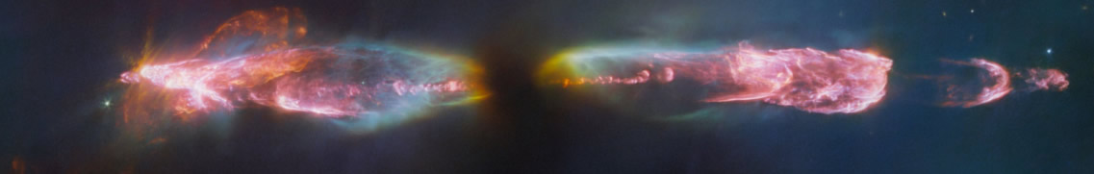
Protostar: T-Tauri Stage
Heat causes outflow
  UV & X-ray radiation
  charged particles
Accretion disk
forces flow along axis
  Herbig-Haro objects
  T-Tauri Stars
HH 211 APOD 9/19/23
https://apod.nasa.gov/apod/ap230919.html

Slide 17
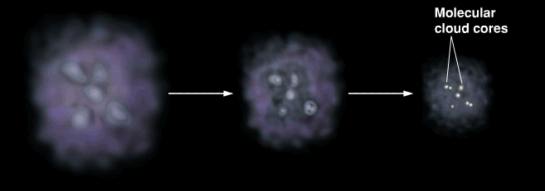
Cloud Collapse
Collapses under own gravity
  some thump initiates collapse
  denser regions collapse faster
    cloud fragments

Slide 18
Protostar: T-Tauri Stage
Heat causes outflow
  UV & X-ray radiation
  charged particles
Accretion disk
forces flow along axis
  Herbig-Haro objects
  T-Tauri Stars
HH 211 APOD 9/19/23
https://apod.nasa.gov/apod/ap230919.html

Slide 19
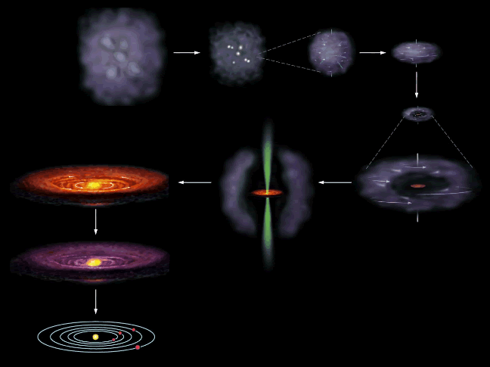
Cloud Collapse
Star formation
  At 10 million K protostar becomes star
    Hydrogen begins fusing to Helium
    Stellar wind clears remaining gas
  Planets & Protoplanets remain

Slide 20
Cloud Collapse to solar system

Slide 21
Outline
Nebulae
Interstellar Cloud Collapse
  Star & planet formation theory
  Star regions observed
Nuclear Fusion in Stars
  Fusion Power
  Fusion Products and Life

Slide 22
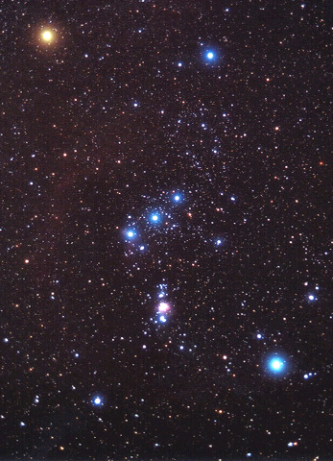
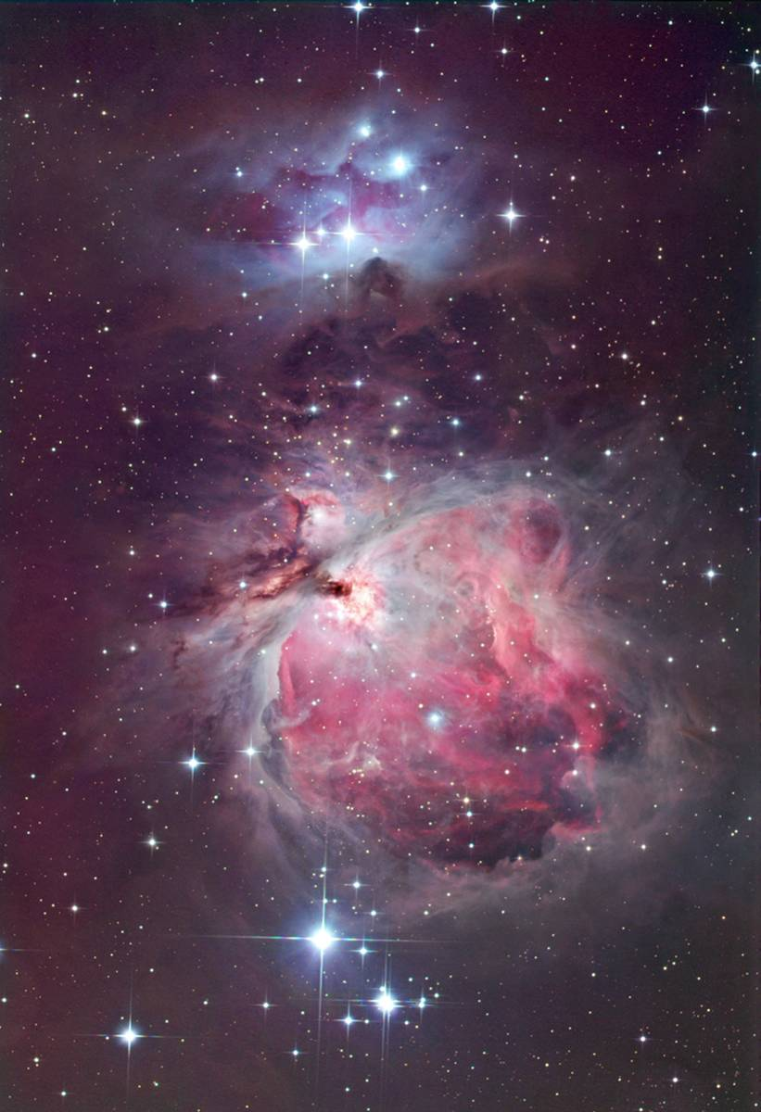
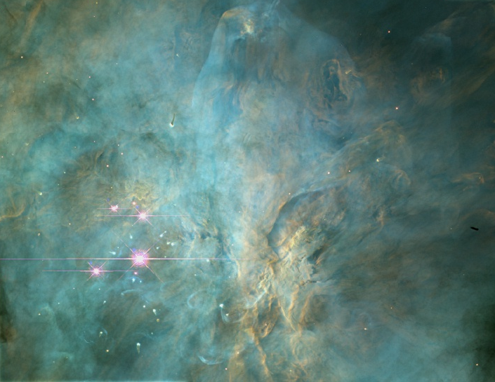
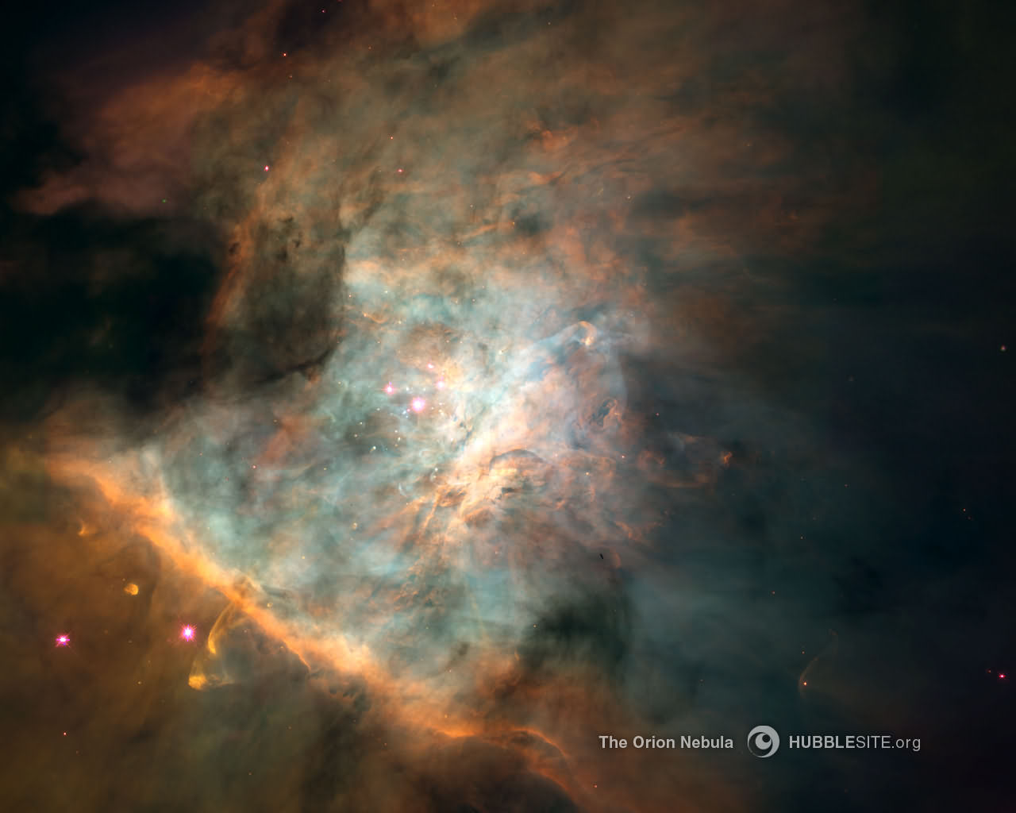
Star Birth Region
Great Nebula in Orion
Giant, hot, young stars illuminate nebula
Thick, dusty disks protect forming stars & planetary systems

Slide 23
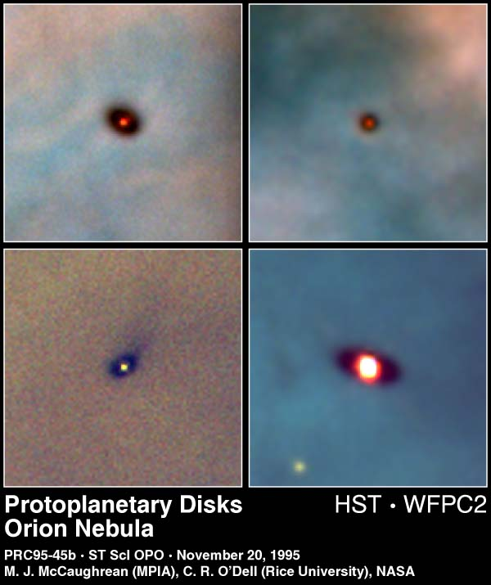
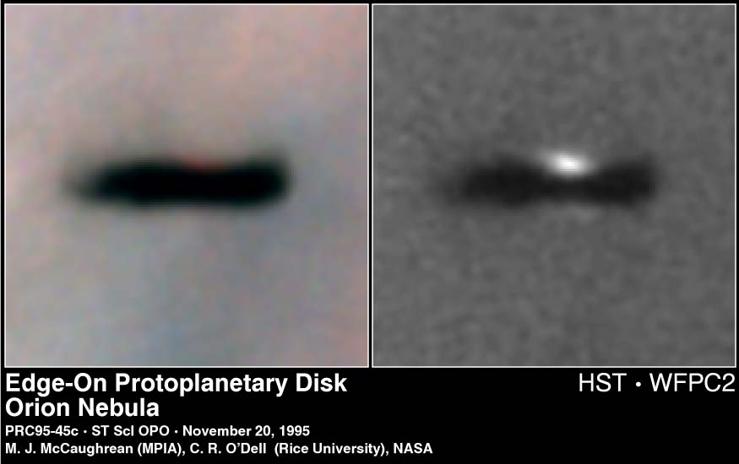
Star Birth in Orion

Slide 24
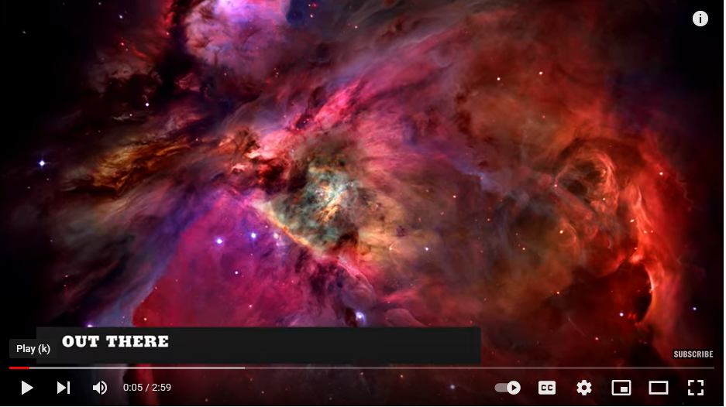
Star Birth in Orion
NY Times Video
https://www.youtube.com/watch?v=Q7MG-LahuX4

Slide 25
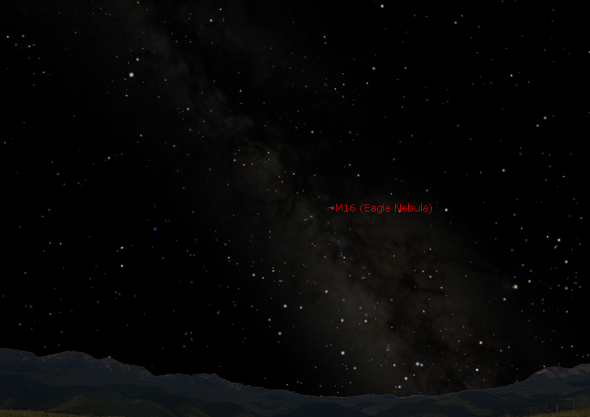
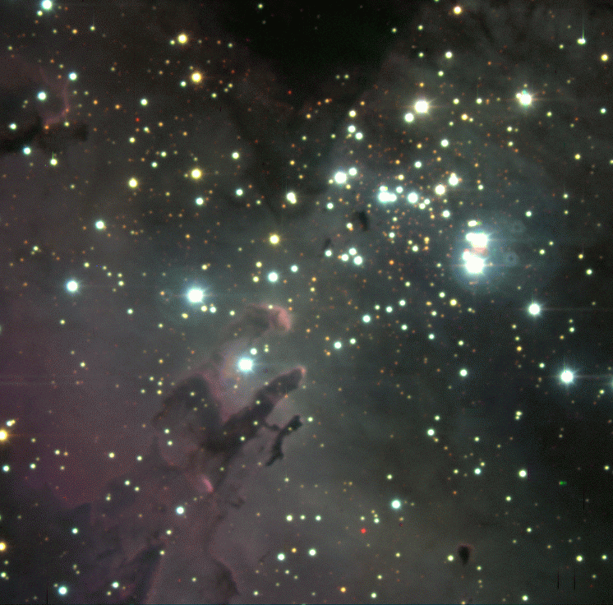
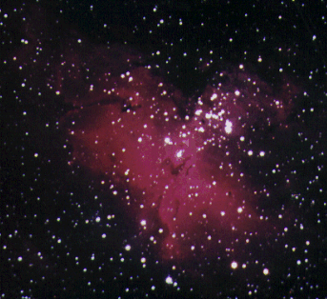
Starbirth In The Eagle Nebula
Tarazed
Altair
Aquila
Delphinus
Ophiuchus
Antares
Sagittarius (The Teapot)
Scorpius
Canton’s southern sky at 9 pm, September 15 or 7 pm, October 15

Slide 26
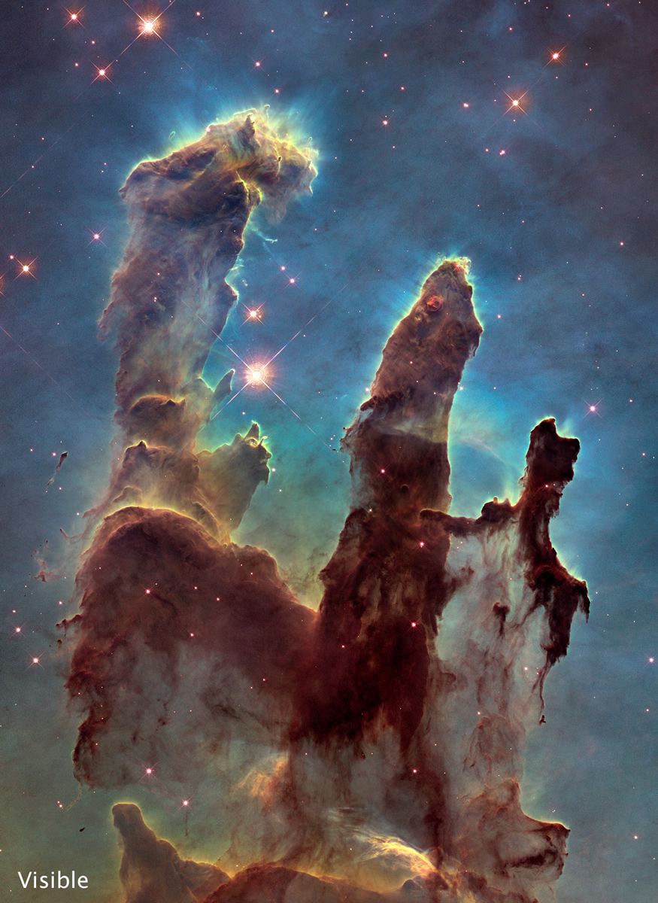
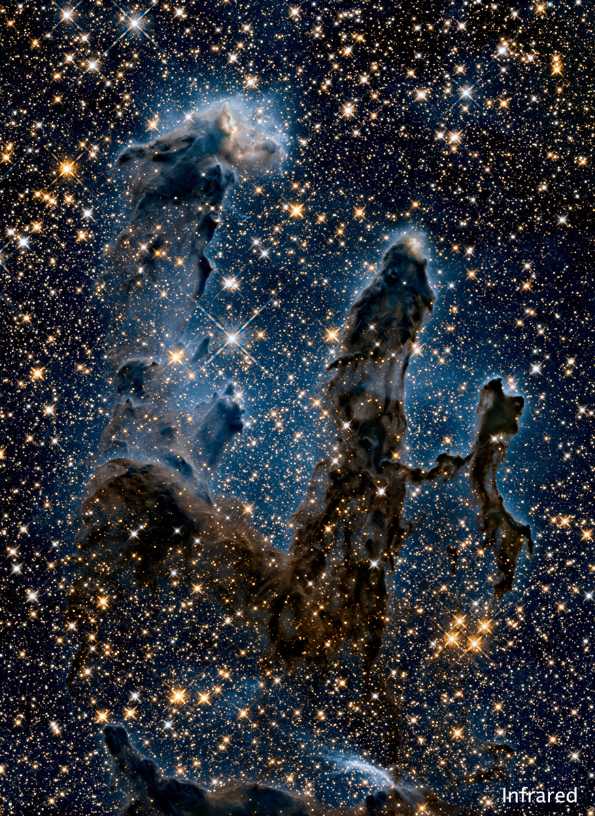
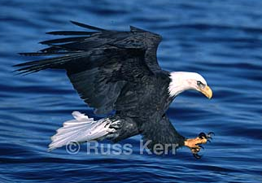
Starbirth In The Eagle
“Pillars of Creation”
IR
Image from Russ Kerr’s Majesty of Birds website:www.magestyofbirds.com

Slide 27
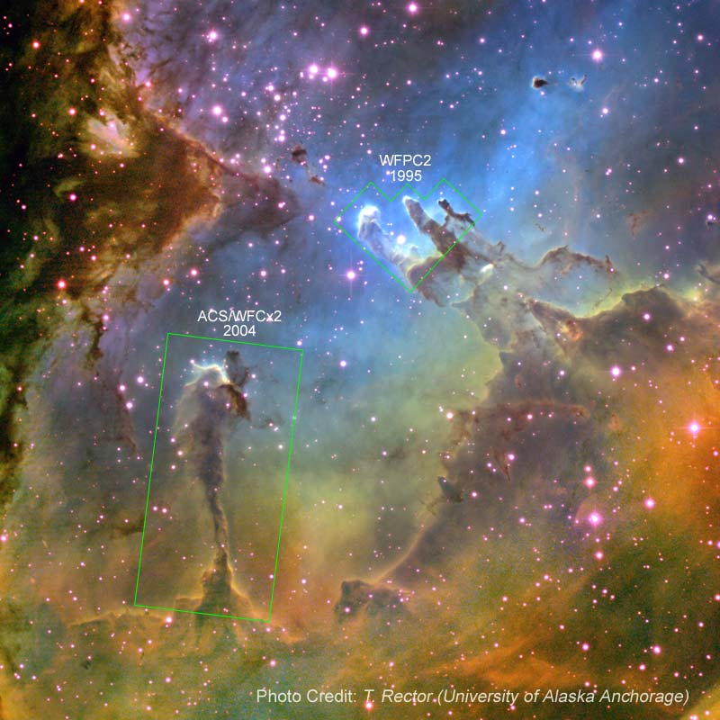
Eagle Nebula

Slide 28
Eagle Nebula

Slide 29
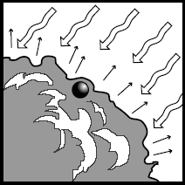
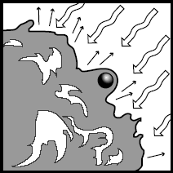
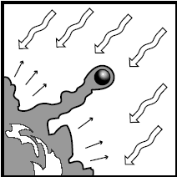
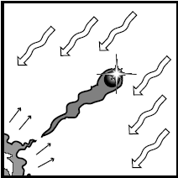
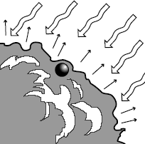
EGG = Evaporating Gaseous Globule
Ultraviolet light and stellar wind (charged particles) from “sibling” star beyond image.
The surface of a molecular cloud is illuminated by intense
ultraviolet radiation from nearby hot stars. The radiation
evaporates material off of the surface of the cloud.
As the cloud is slowly eaten away by the ultraviolet
radiation, a denser than average globule of gas begins to
be uncovered
The EGG has now been largely uncovered. The shadow of
the EGG protects a column of gas behind it, giving it a fingerlike
appearance.
Eventually the EGG may become totally separated from
the molecular cloud in which it formed. As the EGG itself
slowly evaporates, the star within is uncovered and may
appear sitting on the front surface of the EGG.

Slide 30
Outline
Nebulae
Interstellar Cloud Collapse
  Star & planet formation theory
  Star regions observed
Nuclear Fusion in Stars
  Fusion Power
  Fusion Products and Life

Slide 31
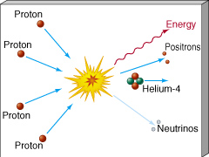
What Makes A Star?
Nuclear Fusion
  Light elements combine to make heavier elements.
Hydrogen fuses to Helium

Slide 32
positron ... antimatter
Gamma ray ... becomes sunlight
Hydrogen
to
Helium
Gamma ray ... becomes sunlight
positron ... antimatter

Slide 33
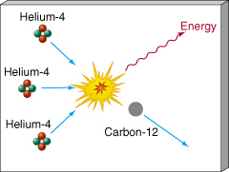
What Makes A Star?
Nuclear Fusion
  Light elements combine to make heavier elements.
Helium fuses to Carbon, Oxygen, Nitrogen …

Slide 34
Outline
Nebulae
Interstellar Cloud Collapse
  Star & planet formation theory
  Star regions observed
Nuclear Fusion in Stars
  Fusion Power
  Fusion Products and Life

Slide 35
Fusion Releases Energy
Mass of 4 H atoms = 4 x 1.007940 amu
= 4.031760 amu
Mass of 1 He atom = 4.002602 amu
Difference (loss) = 0.029158 amu
= 0.7 % of H
0.7% of mass DISAPPEARS!
Where does it go?
E = mc²
Energy!

Slide 36
Energy Of Fusion: Solar Power
Convert 1 kg of H to He:
  0.7% ( = 7 grams) becomes energy
  by E = mc²,
  (0.007 kg)x(3.0 x 10⁸ m/s)² = 630 trillion joules
  = 175 million kWhr
  Fusing 1 kg of Hydrogen to Helium would yield 175 MILLION kWhr of energy!!!!
  1 kWhr (kilo-Watt-hour) = 3.6 x 10⁶ J (Joules) = power to lift 1 kg of water 224 miles!!

Slide 37
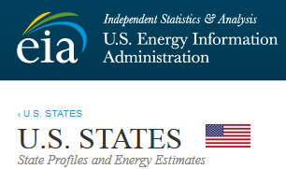
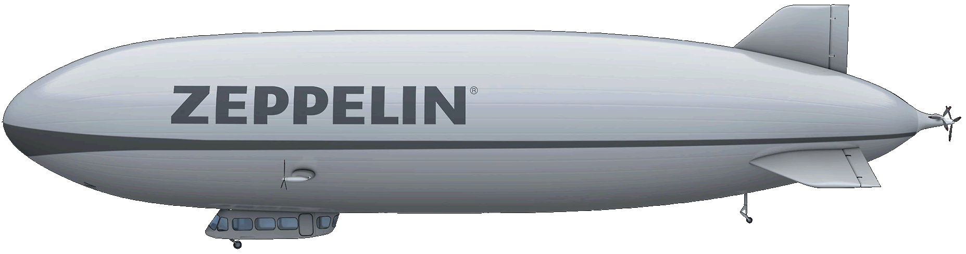
Energy Of Fusion: Solar Power
  1 kg of H to He = 175 x 10⁶ kWhr
  NY 2021 Fossil Fuel use = 2375 x 10¹² BTU
  1 kilowatt hour = 3,412 British Thermal Units
  1 kg H = 11.112 m³ at STP, Hindenburg carried 200,000 m³
  ... that’s not very much hydrogen!!

Slide 38

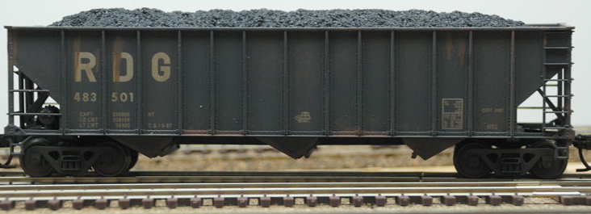
Energy Of Fusion: Solar Power
  2021: NY got 5.7 Trillion BTU from Coal
  1 kilowatt hour = 3,412 British Thermal Units
  1 ton of coal yields 1,927 kWhr
  That’s 8,670 100-ton train cars of coal!

Slide 39


Energy Of Fusion: Solar Power
  2021: NY got 5.7 Trillion BTU from Coal
  2021: NY used 866,930 million tons of coal
  Let’s work to develop fusion so we can use one ton of hydrogen instead!!
  That’s 8,670 100-ton train cars of coal!

Slide 40
Outline
Nebulae
Interstellar Cloud Collapse
  Star & planet formation theory
  Star regions observed
Nuclear Fusion in Stars
  Fusion Power
  Fusion Products and Life

Slide 41
Products Of Stellar Fusion
Early universe was 75% H, 25% He
All other elements are the products of stars!

Slide 42
What Makes A Star?
Nuclear Fusion
  Light elements combine to make heavier elements.
Everything we’re made of (except hydrogen) came from the stars!!
Helium fuses to Carbon, Oxygen, Nitrogen …

Slide 43
What Makes A Star?
Nuclear Fusion
  Light elements combine to make heavier elements.
Everything we’re made of (except hydrogen) came from the stars!!
YOU are Star-stuff!!
Helium fuses to Carbon, Oxygen, Nitrogen …

Slide 44
Substance Of Life
Life requires H, C, O, & N
  All elements of life came from stars that lived AND DIED before the sun formed.
  Sun is a 2nd or 3rd generation star
    1st stars were pure hydrogen and helium)
“We are the matter of the cosmos contemplating itself.”
- Carl Sagan

Slide 45
Exploring the STARS!
The Adventure Continues!

