Slide 1


SOAR: Lives of Stars
Lives & Deaths of Small Stars
Aileen A. O’Donoghue Henry Priest Professor of Physics

Slide 2
The Lives of Stars
Star Birth: 9/10/26
  Nuclear Explosions Contained by Gravity
Lives & Deaths of Small Stars: 9/17/26
  Planetary Nebulae and White Dwarfs
Deaths of Large Stars: 9/24/26
  Supernovae, Neutron Stars and Black Holes
Black Holes: 10/1/26
  Spaghettification

Slide 3
Outline
Review Star Birth
Star life on the Main Sequence
  Fusion & Thermodynamic Balance
  The Sun
    Sunspots, Solar Wind, Solar Storms, Aurorae
Death Throes: Red Giant Stages
Planetary Nebulae & White Dwarf Stars

Slide 4
Outline
Review Star Birth
Star life on the Main Sequence
  Fusion & Thermodynamic Balance
  The Sun
    Sunspots, Solar Wind, Solar Storms, Aurorae
Death Throes: Red Giant Stages
Planetary Nebulae & White Dwarf Stars

Slide 5
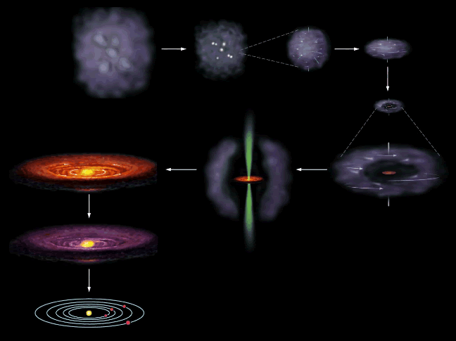
Cloud Collapse to solar system

Slide 6
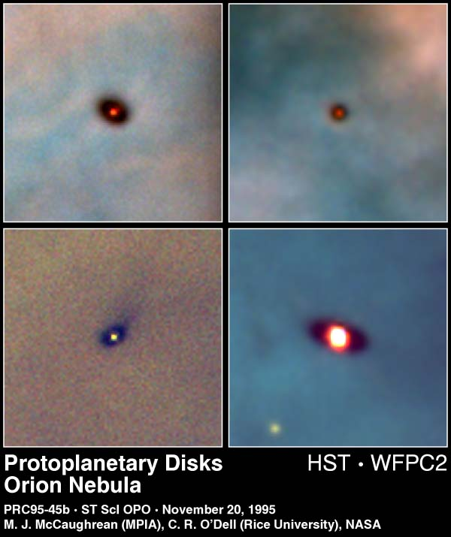
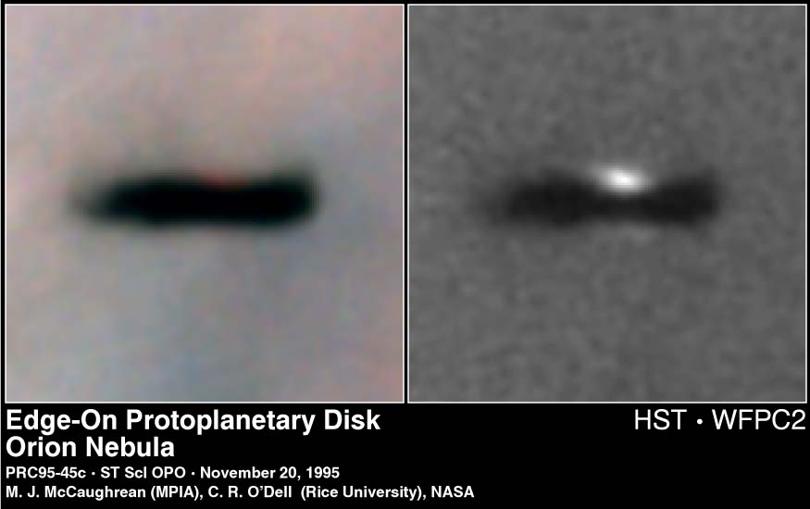
Star Birth in Orion

Slide 7
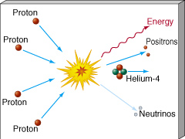
What Makes A Star?
Nuclear Fusion
  Light elements combine to make heavier elements.
Hydrogen fuses to Helium

Slide 8
Energy Of Fusion: Solar Power
  1 kWh = 3.6 million Joules = power to lift 1 liter of water 224 miles!!
Convert 1 kg of H to He:
  0.7% ( = 7 grams) becomes energy
  by E = mc²,
  (0.007 kg)x(3.0 x 10⁸ m/s)² = 630 trillion Joules
  = 175 million kWh
  Fusing 1 kg of Hydrogen to Helium would yield 175 MILLION kWh of energy, worth $22.7 million at 13¢/kWh

Slide 9
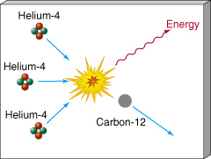
What Makes A Star?
Nuclear Fusion
  Light elements combine to make heavier elements.
Helium fuses to Carbon, Oxygen, Nitrogen …

Slide 10
What Makes A Star?
Nuclear Fusion
  Light elements combine to make heavier elements.
Everything we’re made of (except hydrogen) came from the stars!!
YOU are Star-stuff!!
Helium fuses to Carbon, Oxygen, Nitrogen …

Slide 11
Substance Of Life
Life requires H, C, O, & N
  All elements of life came from stars that lived AND DIED before the sun formed.
  Sun is a 2nd or 3rd generation star
    1st stars were pure hydrogen and helium)
“We are the matter of the cosmos contemplating itself.”
- Carl Sagan

Slide 12
Outline
Review Star Birth
Star life on the Main Sequence
  Fusion & Thermodynamic Balance
  The Sun
    Sunspots, Solar Wind, Solar Storms, Aurorae
Death Throes: Red Giant Stages
Planetary Nebulae & White Dwarf Stars

Slide 13
Main Sequence Life
Hydrostatic Equilibrium Fusing H to He
  Gravity pulling inward
    weight of upper layers tries to compress star
  Pressure of heated gas pushing outward
    nuclear explosion tries to expand star
    balance lost when fuel runs out
Gravity
Ultimately, gravity will win!
Pressure

Slide 14

Sol
Fusion core is ~ 25% of radius
  99% of energy from inner 24% of Sun
R_{Sol} = 696,000 km
R_{Sol} = 433,000 miles
fusion core
R_{fusion} = 108,000 km
R_{fusion} = 67,000 miles
R_{Earth} = 3,960 miles
Not to scale!
So scale it!
R_{fusion} ≈ 17 R_{Earth}
Sun fuses the mass of the Earth every 316,298 years

Slide 15
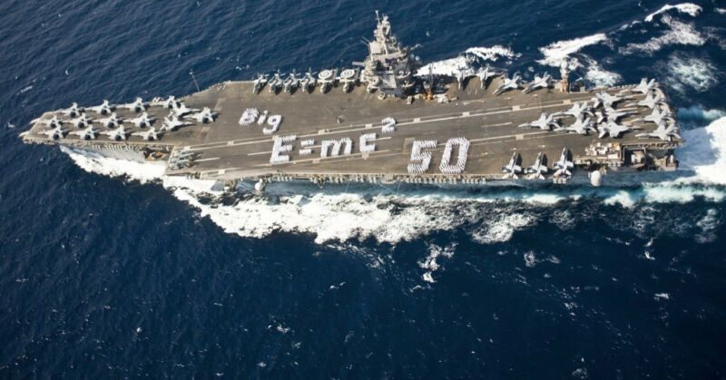
The Sun
A nuclear explosion
contained by gravity.
fusion core
17 Earths wide
Sol turns 45 Aircraft Carrier masses of H to pure energy each second ... every second!

Slide 16
The Sun
G2 V – normal dwarf, 5800K
  Small compared to giants
  Big compared to most stars
  Youngish – 5 by old < ½ age of universe
  Lots of metals in its spectrum (eg. Fe)
Data
  R☉ = 6.96 x 10⁵ km (~ 700,000km) = 109R⊕
  M☉ = 1.99 x 10³⁰ kg = 333,333M⊕
  L☉ = 3.90 x 10²⁶ W

Slide 17
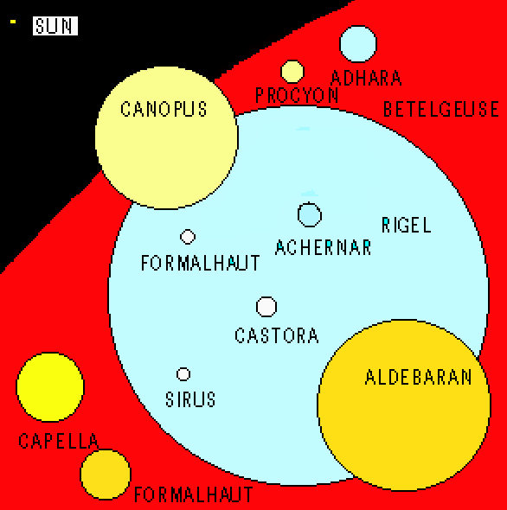
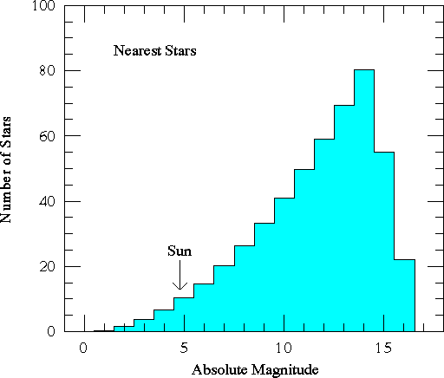
The Sun
Large compared to most stars
Small compared to largest stars

Slide 18
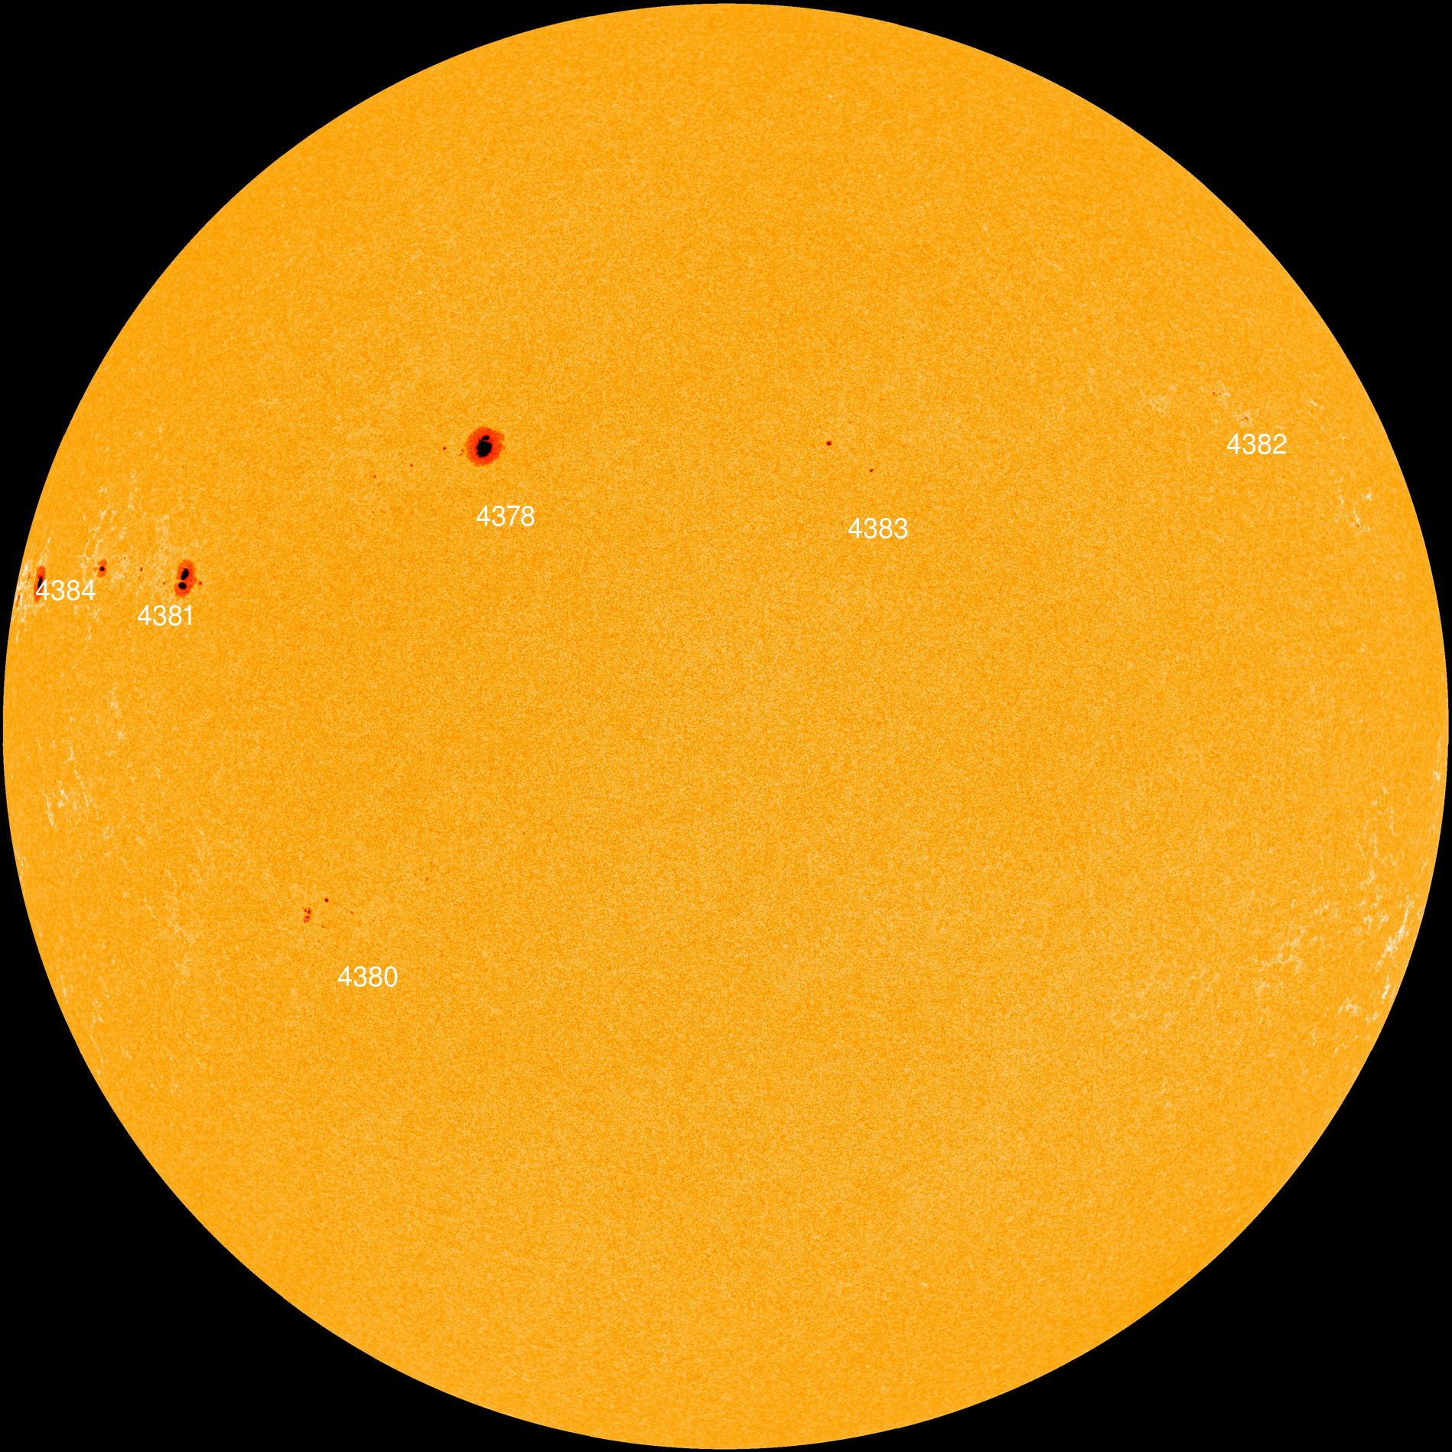
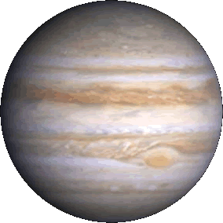
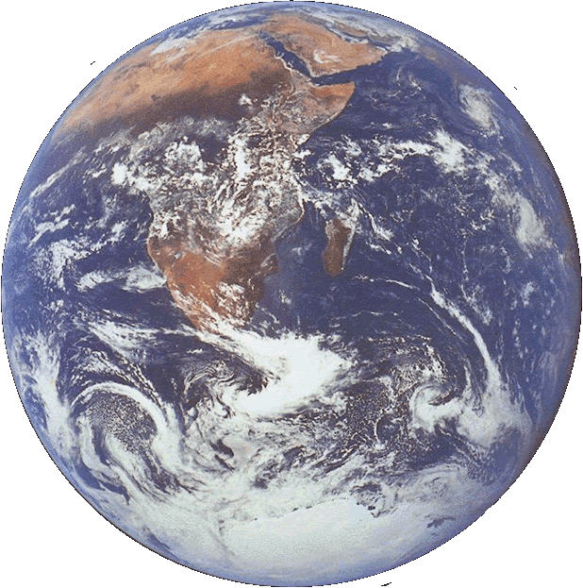

The Sun Today
Earth is 1/100 the diameter of Sol
Jupiter is 1/10 the diameter of Sol
They’re HUGE!
Current Solar Images from NASA
Some Sunspots!

Slide 19
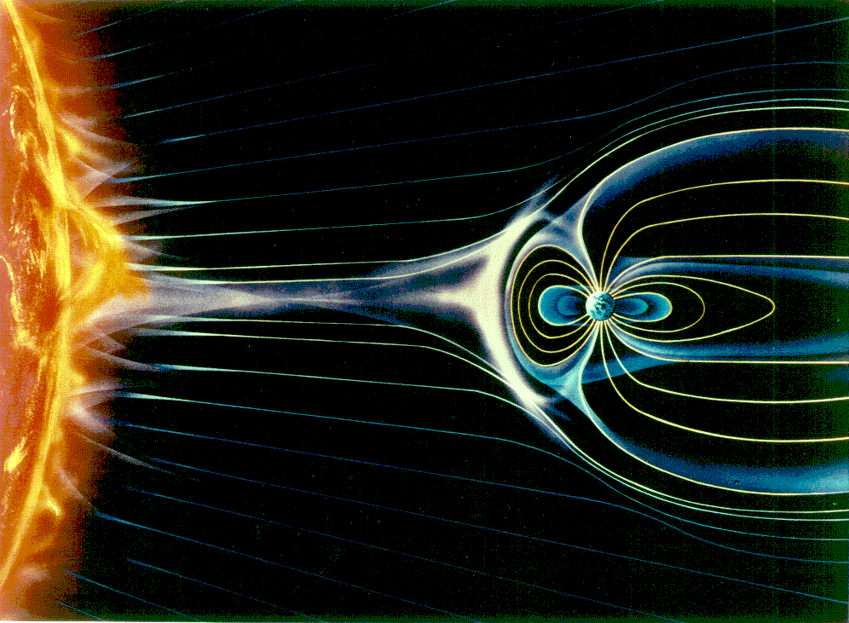
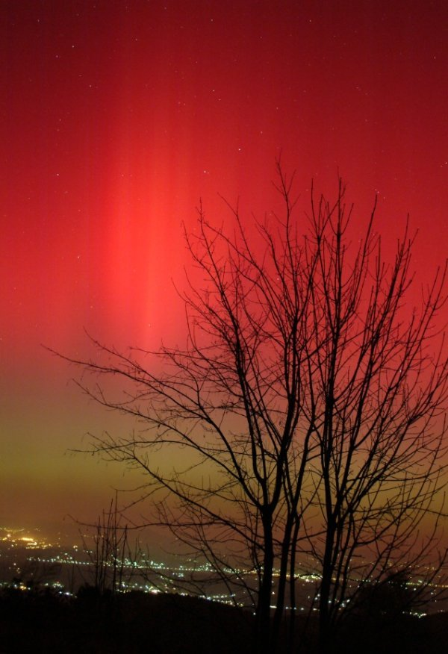
Solar Wind
Charged particles from Sun’s surface
  Stars = nuclear explosions contained by gravity!
Steered to poles by Earth’s mag. field
  Can cause aurora by colliding with atmosphere
Aurora on 11/20/03, Zagreb, Croatia. Photo by Hrvoje Horvat
www.spaceweather.com

Slide 20
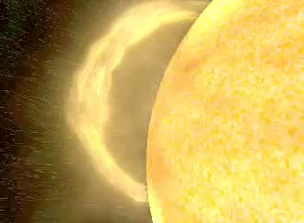
Solar Wind
Charged particles from Sun’s surface
  Stars = nuclear explosions contained by gravity!
Steered to poles by Earth’s mag. field
  Can cause aurora by colliding with atmosphere
Aurora on 11/20/03, Zagreb, Croatia. Photo by Hrvoje Horvat
www.spaceweather.com

Slide 21
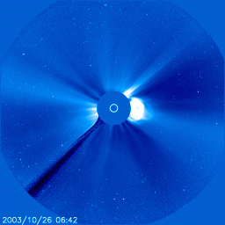
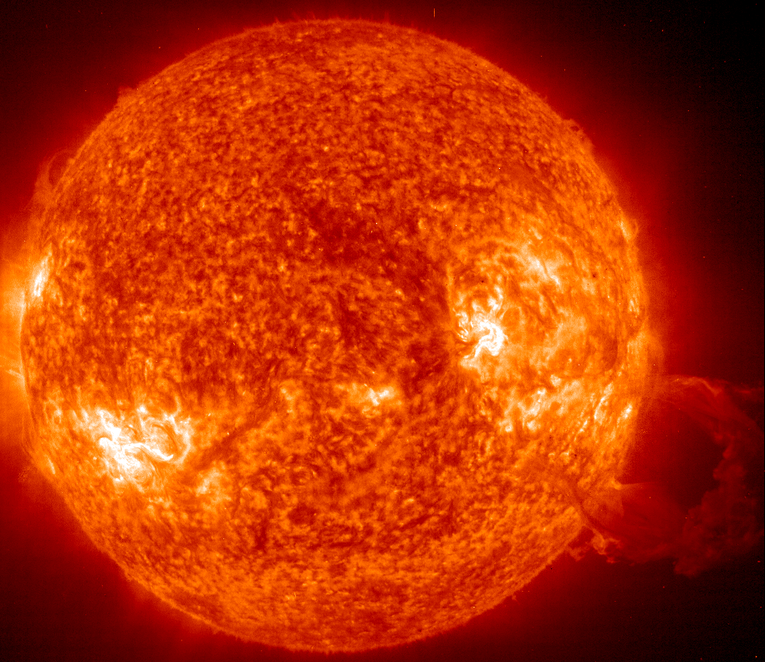
Coronal Mass Ejections: Solar Storms
Extreme UV Image
Associated with giant spots and auroral displays
Size of Earth ≈ 1/100 Size of Sol
CME and Comet October 9, 2024, 10:06 pm EDT

Slide 22
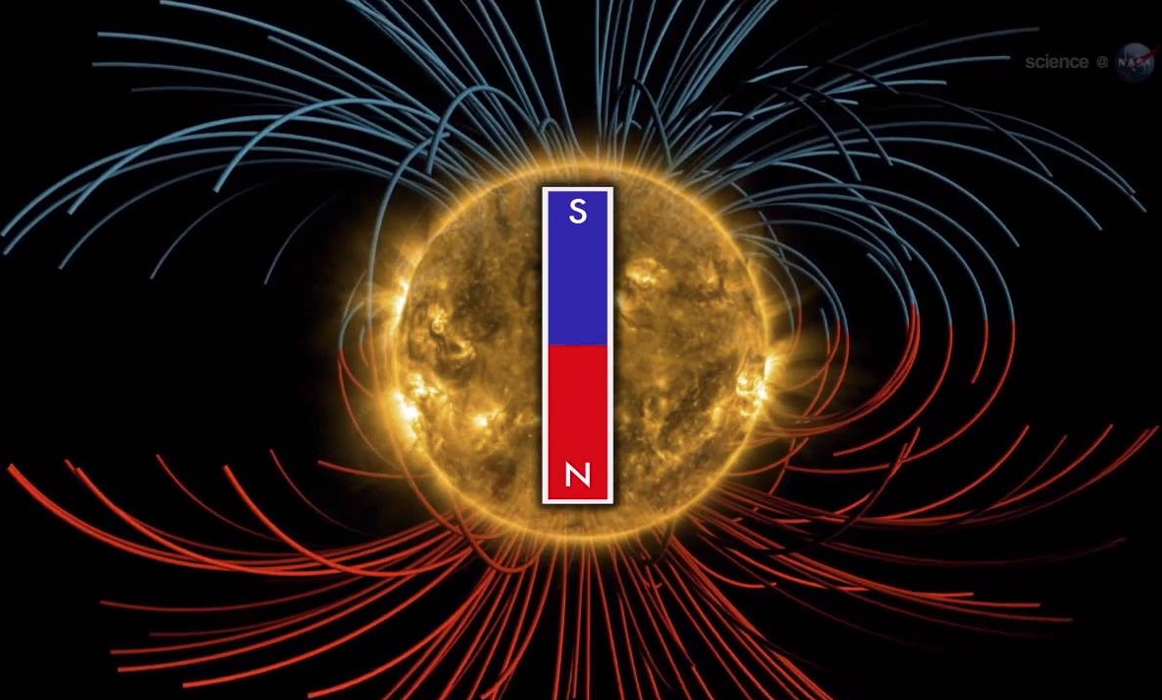
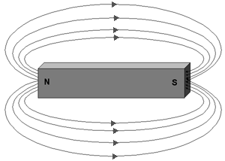
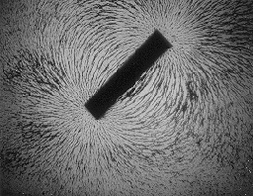
Sol’s Magnetic Field
Field of a bar magnet
  Lines go from north to south (by definition)

Slide 23
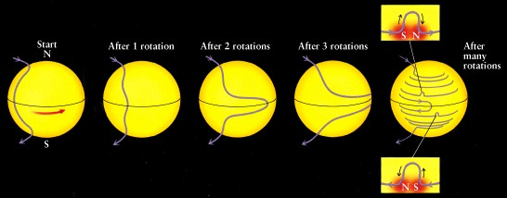
Sunspots from Magnetic Field
Sun has differential rotation
  Equator rotates in about 24 days
  Poles rotate in about 30 days
Magnetic field lines wrap up

Slide 24
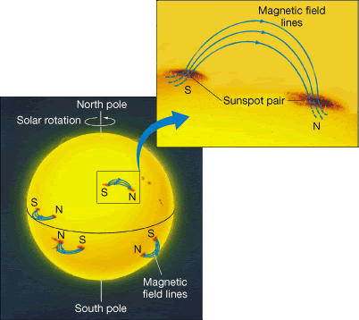
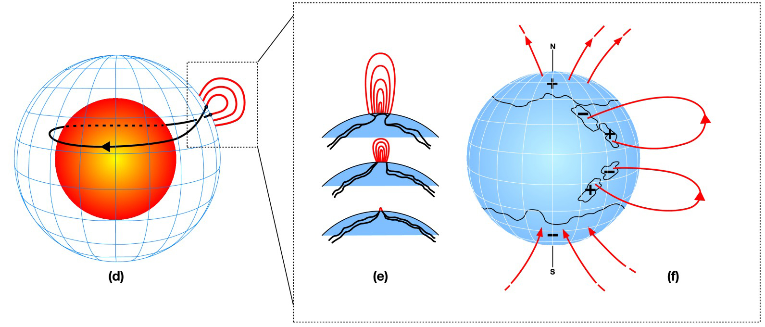
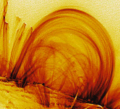
Sunspots: Magnetic Hernias
Wrapped magnetic field bulges out from surface
  charged particles travel up along field lines
    removes energy from surface, cooling it
    Sunspots are darker than surroundings

Slide 25
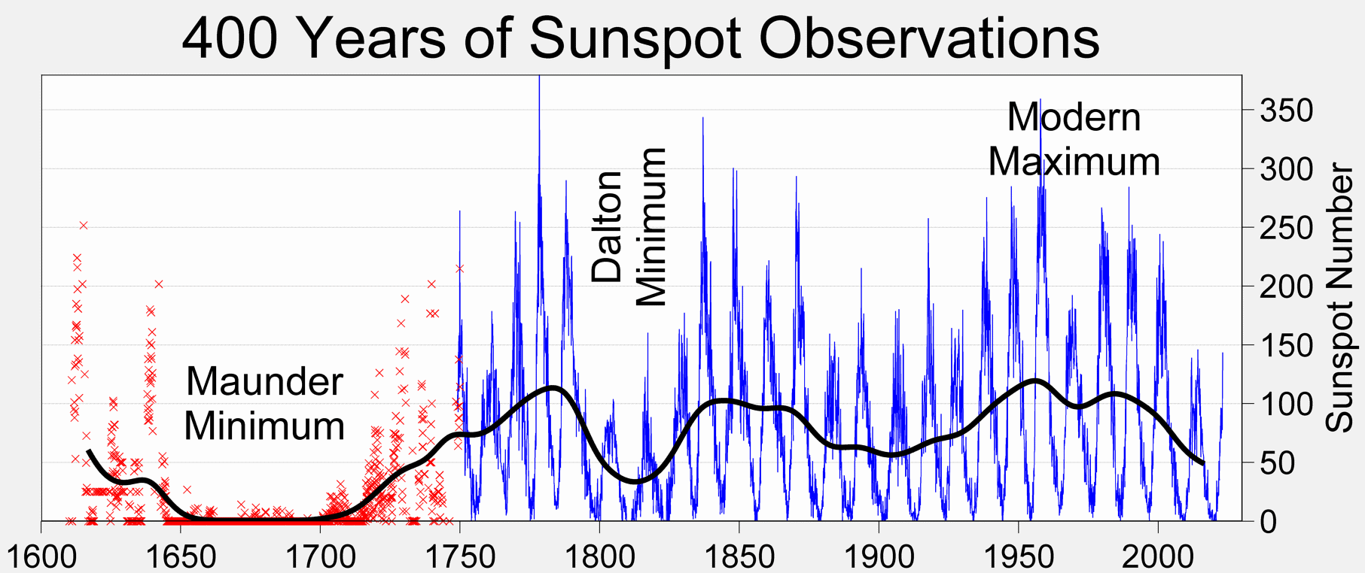
Sunspot Cycle
Sunspot number varies over 11-yr cycle
  Fairly Constant except for Maunder Minimum
    Cold in Europe
    Canals in Holland froze regularly
Link with Sunspots in debate

Slide 26
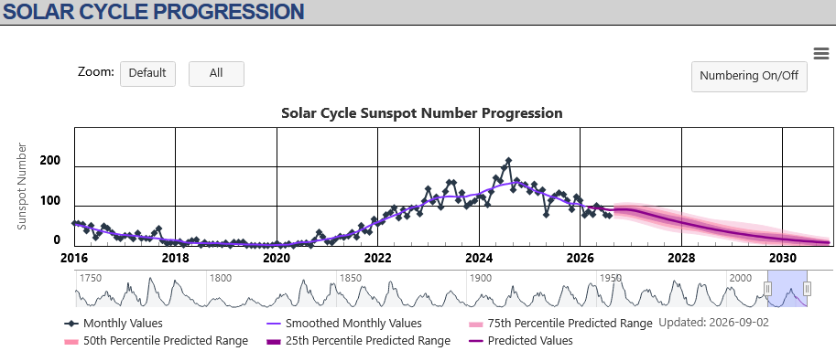
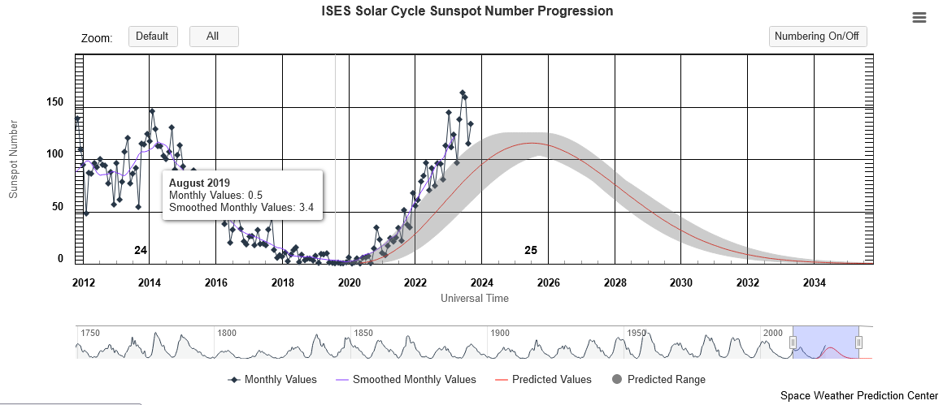
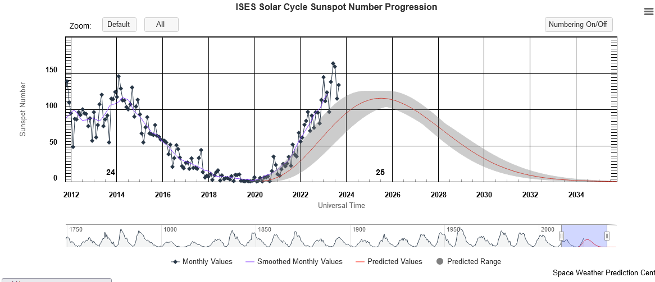
Sunspot Cycle # 25
We’re past Solar Max 2024-2026
  Another dud of a Solar Max
https://www.swpc.noaa.gov/products/solar-cycle-progression

Slide 27
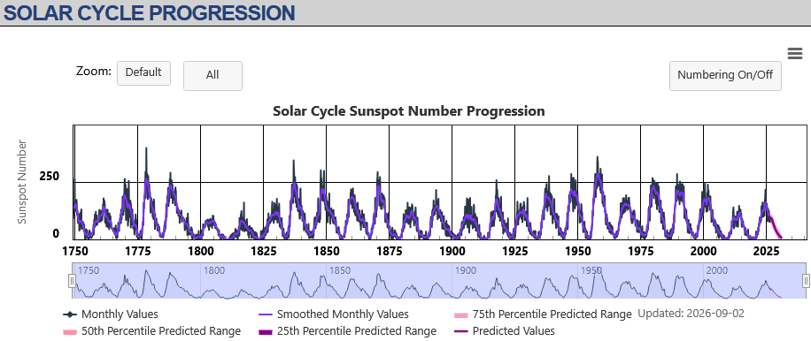
Sunspot Cycle # 25
We’re past Solar Max 2024-2026
  Another dud of a Solar Max
Another Dalton Minimum?
Low maxima this century
https://www.swpc.noaa.gov/products/solar-cycle-progression

Slide 28
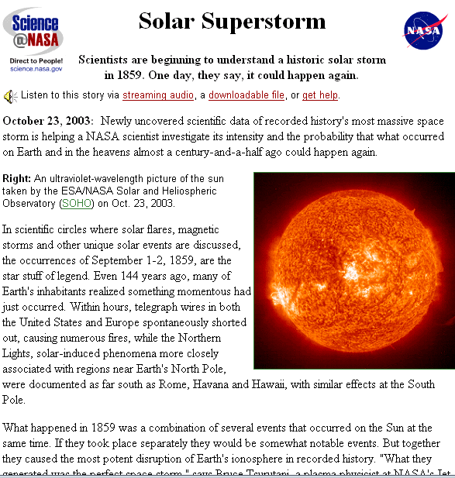
Solar Storm History
September 1859
  Telegraph wires shorted out in US & Europe
    Caused fires
  Auroral displays in N & S
  What would happen today?
Science@NASA: www.science.NASA.gov
http://www.cnn.com/

Slide 29
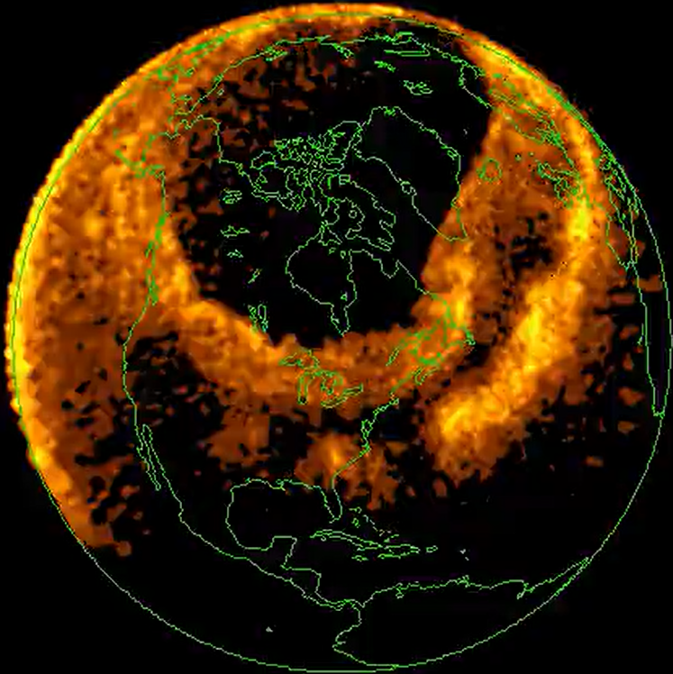
Solar Storm History
September 1859
  Telegraph wires shorted out in US & Europe
    Caused fires
  Auroral displays in N & S
  What would happen today?
March 13, 1989
Science@NASA: www.science.NASA.gov
Aurora causes Quebec blackout!
http://www.cnn.com/
https://www.astronomy.com/science/the-aurora/html

Slide 30
Outline
Review Star Birth
Star life on the Main Sequence
  Fusion & Thermodynamic Balance
  The Sun
    Sunspots, Solar Wind, Solar Storms, Aurorae
Death Throes: Red Giant Stages
Planetary Nebulae & White Dwarf Stars

Slide 31
First Red Giant Stage
Core fusion stops
⇒ He Core contracts under gravity
⇒ Shell of H around core keeps fusing
 adds He to core, increasing mass & gravity
 further heats H shell, increasing fusion & heat
⇒ Fusing shell heats envelope
⇒ Envelope expands
⇒ Outer surface cools
⇒ Outer surface turns red
A Red Giant Is Born!

Slide 32
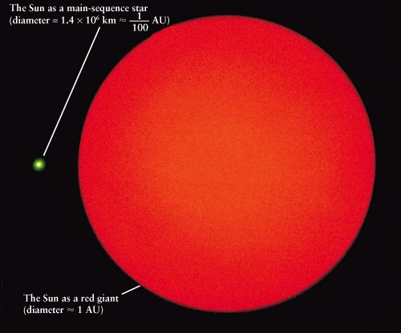
Sol as a Red Giant
Sol as red giant will engulf ☿and ♀
Expanding outer layers
Hydrogen fusing shell heating outer layers
Shrinking He core becoming degenerate electron gas
Sol may engulf Earth

Slide 33
Core of a Red Giant
Degenerate e⁻ gas
  atoms packed as close as possible
    electron clouds packed together
    all space squeezed out from between atoms
Normal Gas
Atom
Degenerate e⁻ Gas
  does not expand on heating
No heat release valve!!
  keeps absorbing heat from fusing H shell
  at 100 Million K, He fusion begins
    entire core begins fusion at same time
    ⇒ Core explodes!
Helium Flash

Slide 34
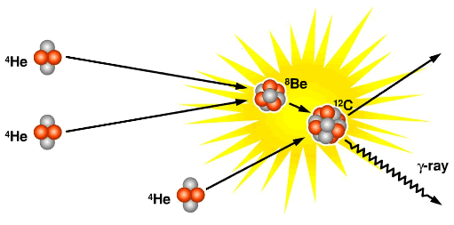
Helium “Flash”
Core heats to ~100 million K
  Helium fusion begins in entire core at once
  Core explodes within star
    Not seen from outside star
    Core becomes normal gas fusing He to C, O, N

Slide 35
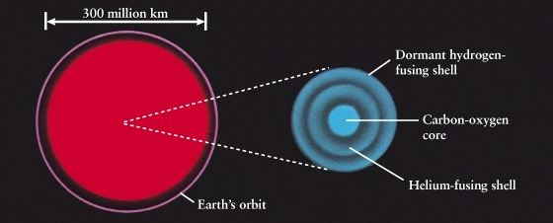
Post He-Flash Stars
Helium fuses to C and O (and some N)
  the carbon in your tongue came from one of these that died before the sun formed!
Star shrinks slightly, lasts ~100 million yr.

Slide 36
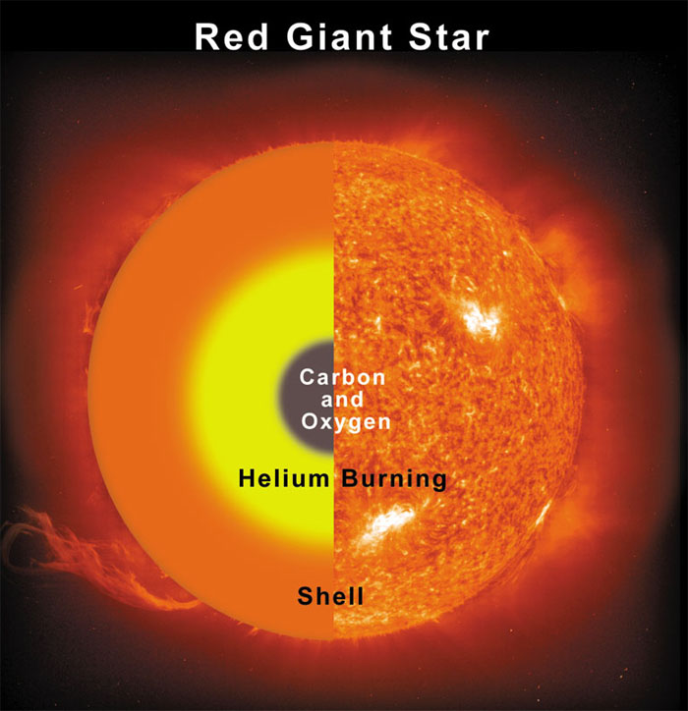
2nd Red Giant Stage
Helium fusion has built C & O core
  C & O core is a degenerate e⁻ gas
    Can’t fuse
    He-fusing shell forms
    Outer layers swell
    2nd Red Giant Stage
      Lasts ~ a few million
      more years
  Outer layers heated
    Swell away from core
    No Carbon flash!
https://ffden-2.phys.uaf.edu/webproj/212_spring_2015/Katie_Aikens/Katherine_Aikens/StellarEvolution.html

Slide 37
Outline
Review Star Birth
Star life on the Main Sequence
  Fusion & Thermodynamic Balance
  The Sun
    Sunspots, Solar Wind, Solar Storms, Aurorae
Death Throes: Red Giant Stages
Planetary Nebulae & White Dwarf Stars

Slide 38
Planetary Nebula
Outer star layers continue expanding
  He fusing shell runs out of fuel
    sputters, pushing thermal waves through star
  C-O core exposed as outer layers expand
    stellar winds from core sculpt outer layers
    UV from core ionizes & illuminates layers
Outer layers become Planetary Nebula
  He, C, O, N blown into ISM (InterStellar Medium)
Core left as White Dwarf Star
  Carbon – Oxygen degenerate e⁻ gas
  1 cm³ would weigh a ton on Earth

Slide 39
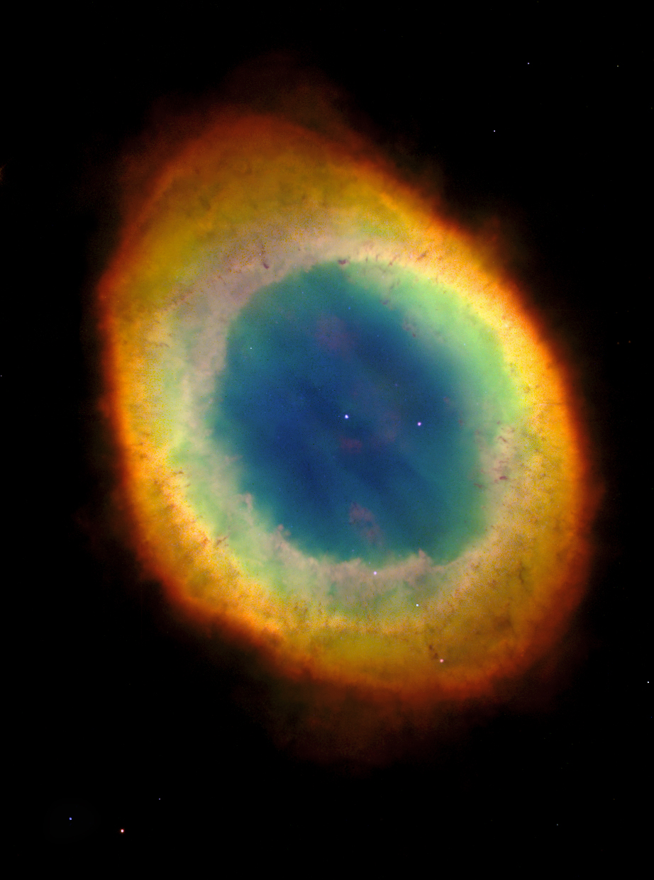
Planetary Nebulae
κ
ι
N. Am. and Pelican Nebulae
Deneb
δ
Northern Coalsack
Sadr
Vega
ε
Cygnus
Lyra
η
Sheliak
ζ
Sulafat
Cygnus X-1
Ring Nebula
Veil Nebula
Alberio
Summer Triangle
Vulpecula
Dumbbell Nebula
Sagitta
Delphinus
Altair
Tarazed
Aquila
Scutum
Wild Duck
Ring Nebula in Lyra
Eagle Nebula

Slide 40
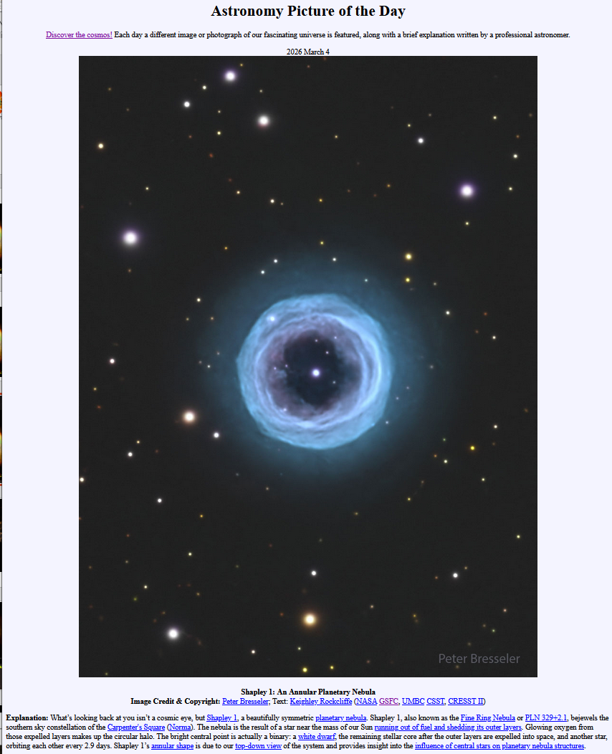
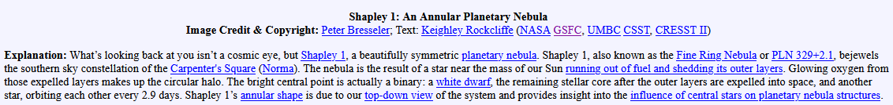
Planetary Nebulae
κ
ι
3/4/26 Astronomy Picture of the Day
N. Am. and Pelican Nebulae
Deneb
δ
Northern Coalsack
Sadr
https://apod.nasa.gov/apod/
Vega
ε
Cygnus
Lyra
η
Sheliak
ζ
Sulafat
Cygnus X-1
Ring Nebula
Veil Nebula
Alberio
Summer Triangle
Vulpecula
Dumbbell Nebula
Sagitta
Delphinus
Altair
Tarazed
Aquila
White Dwarf & Companion Star orbit each other every 2.9 days within planetary nebula!
Scutum
Wild Duck
Ring Nebula in Lyra
Eagle Nebula

Slide 41
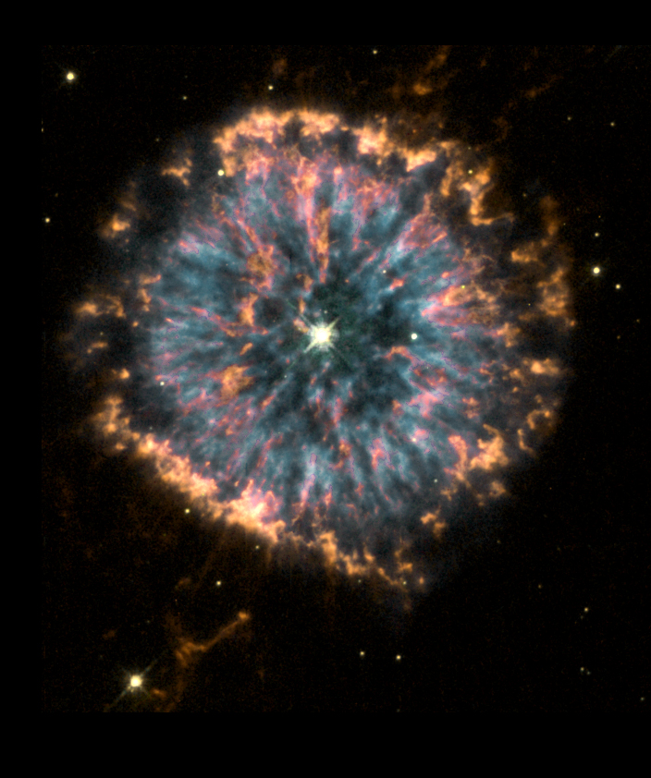
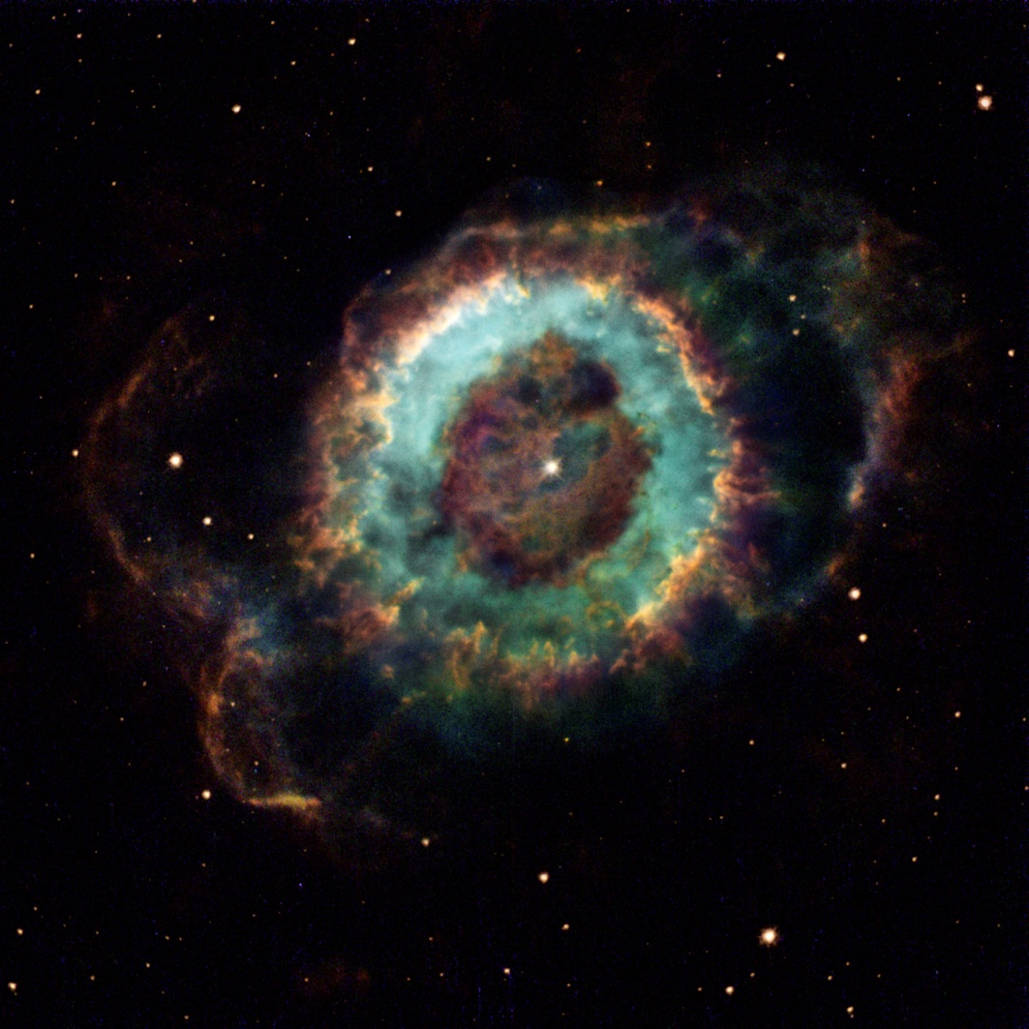
Planetary Nebulae
NGC 6369
NGC 6751

Slide 42
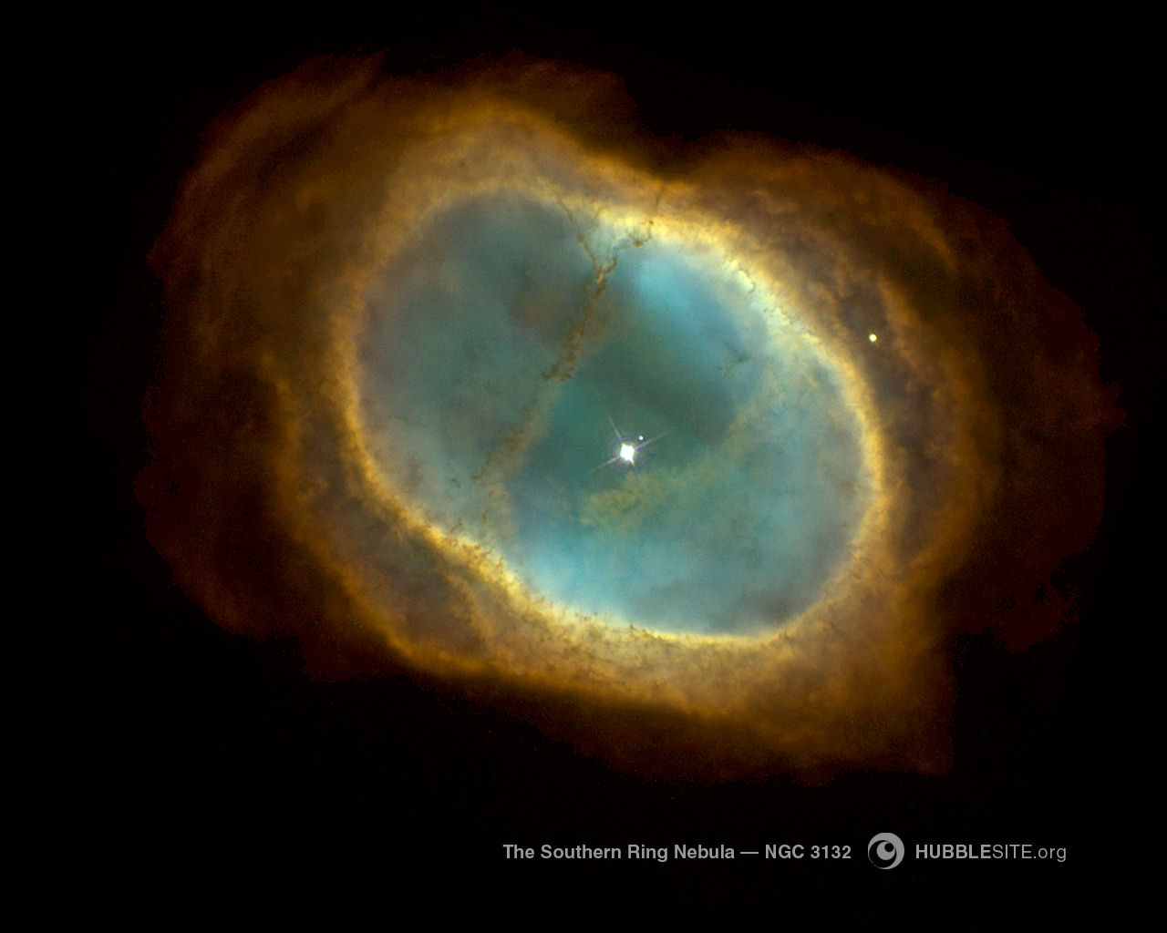
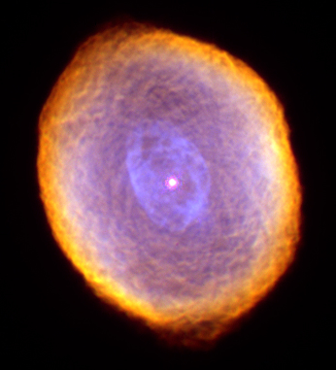
Planetary Nebulae
Spirograph Nebula
The Southern Ring Nebula

Slide 43
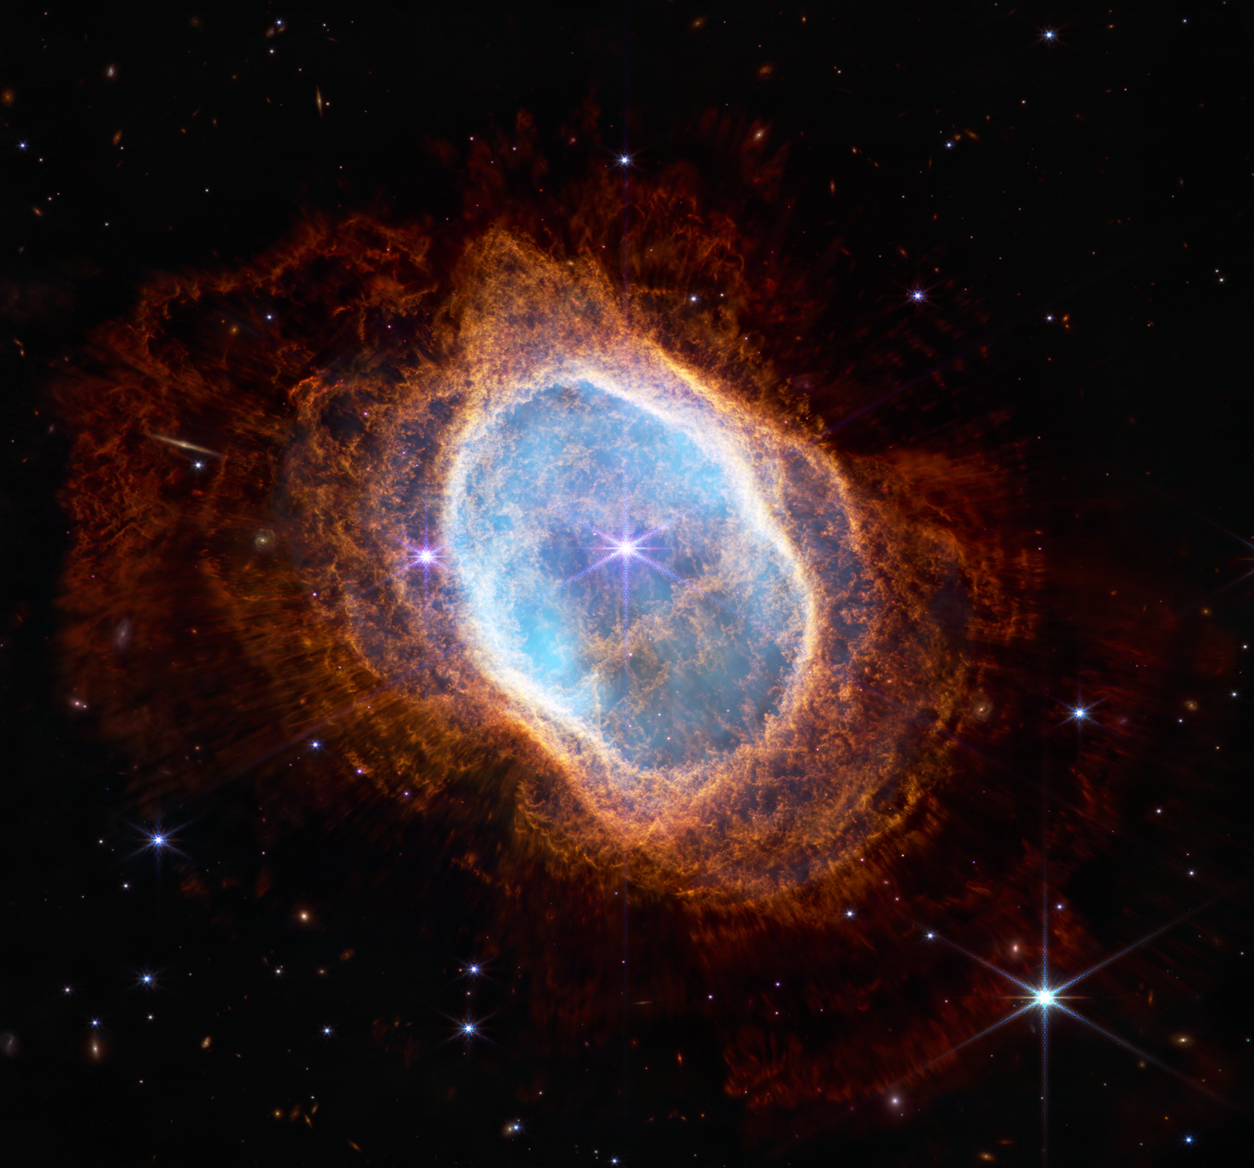
Planetary Nebulae
White dwarfs can have normal stars as companions!
Bright star orbits white dwarf, “stirs” nebula
Spirograph Nebula
The Southern Ring Nebula
White Dwarf = abandoned core
JWST NIRCam (Near IR Camera) Image

Slide 44
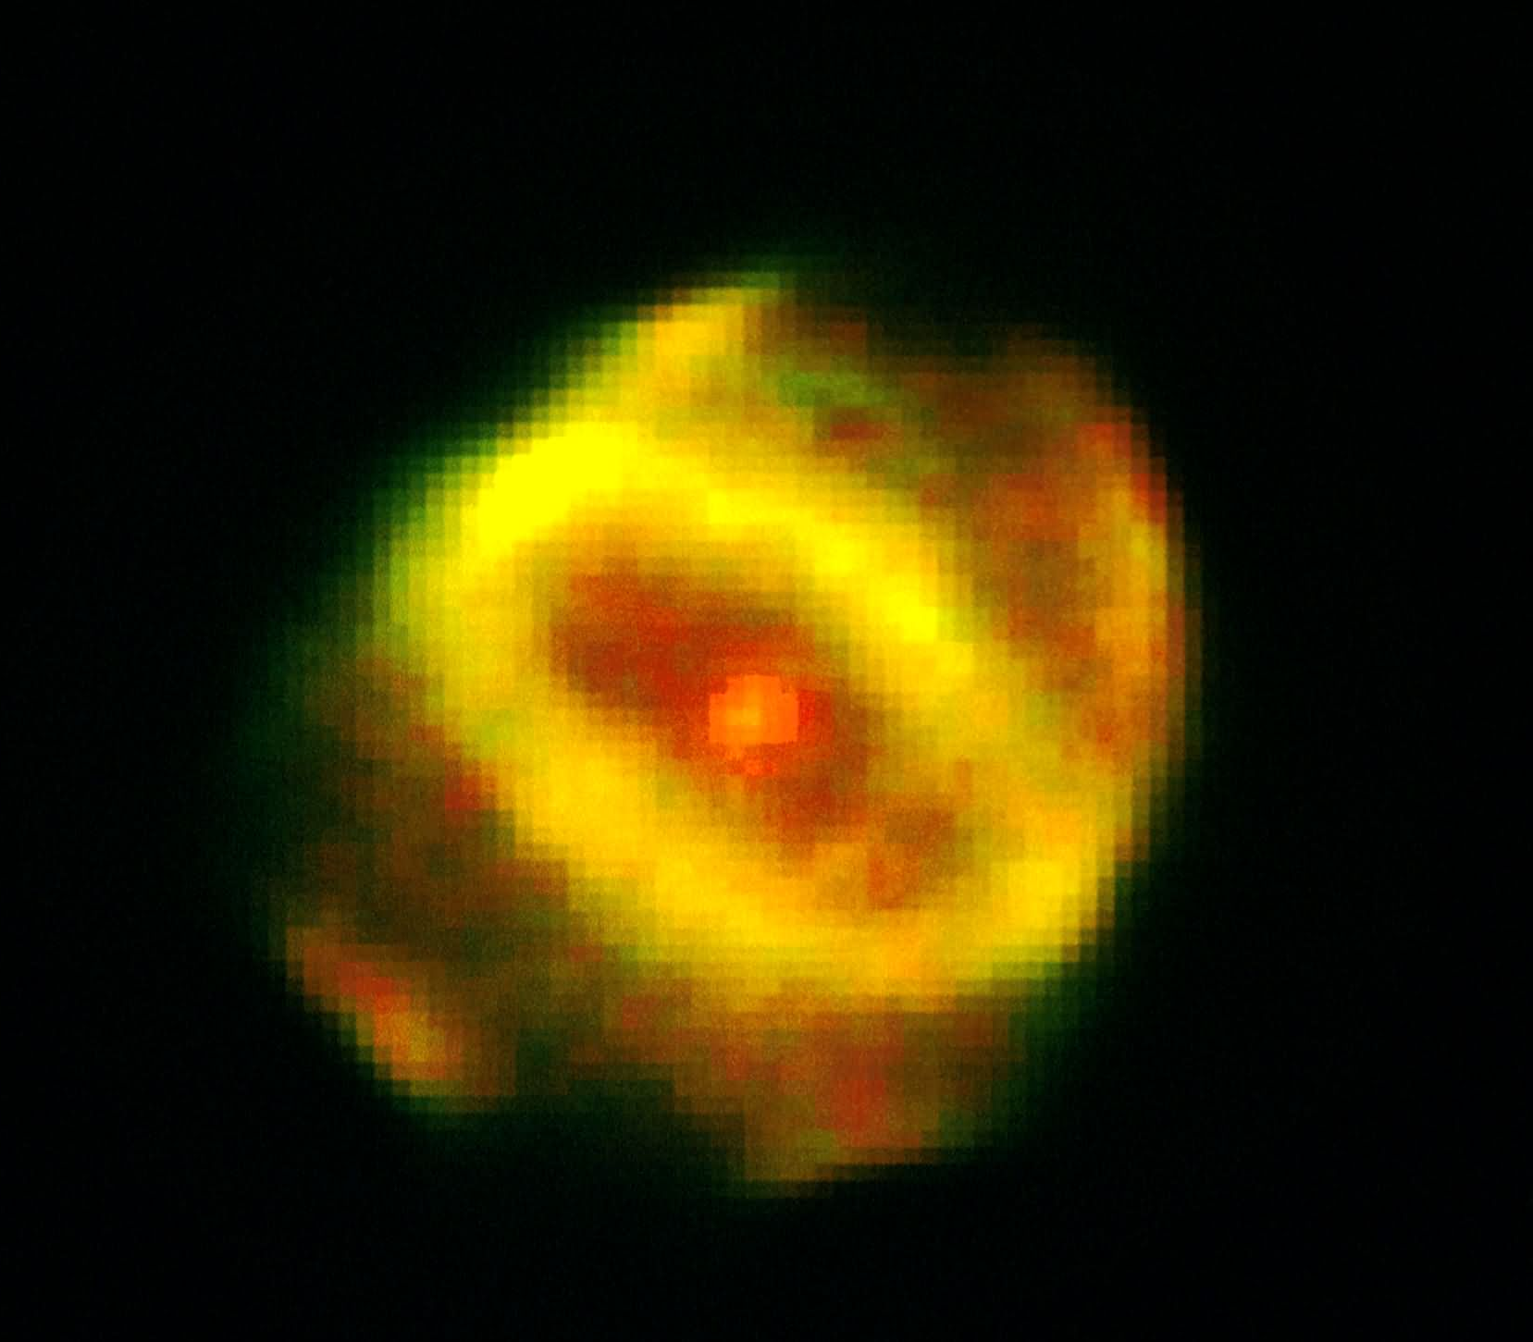
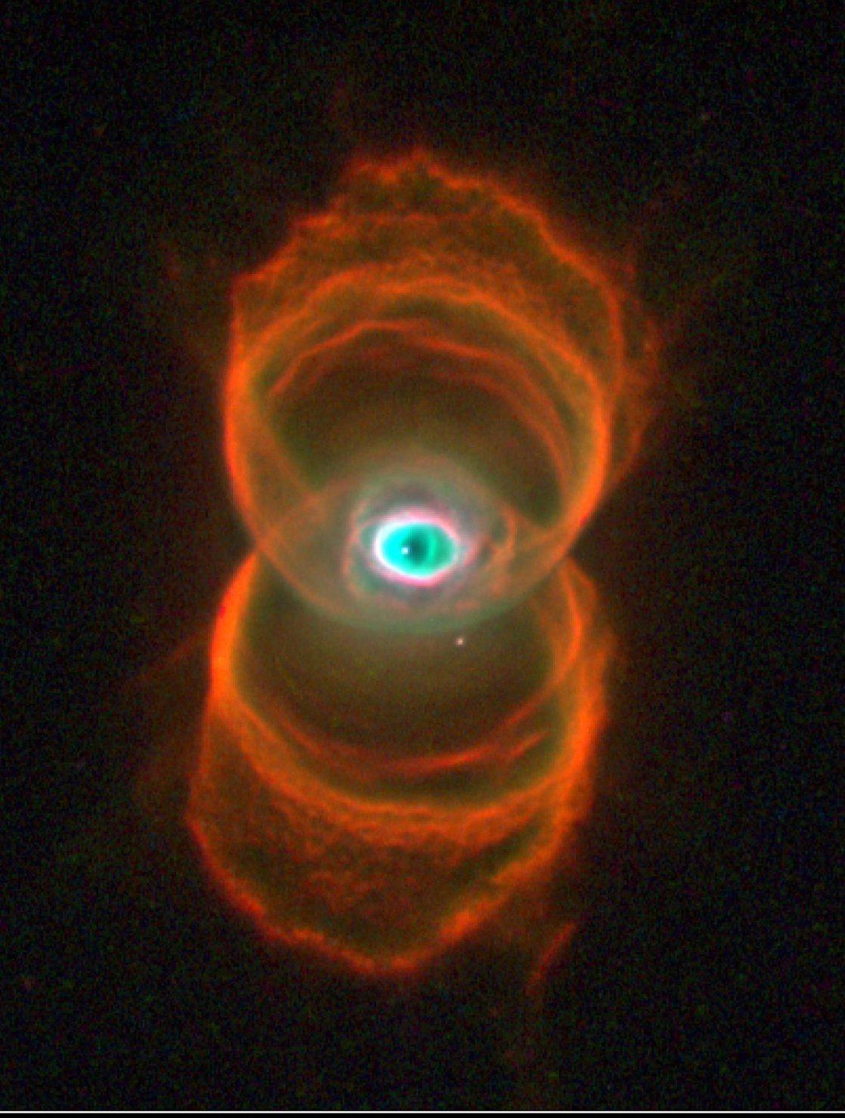
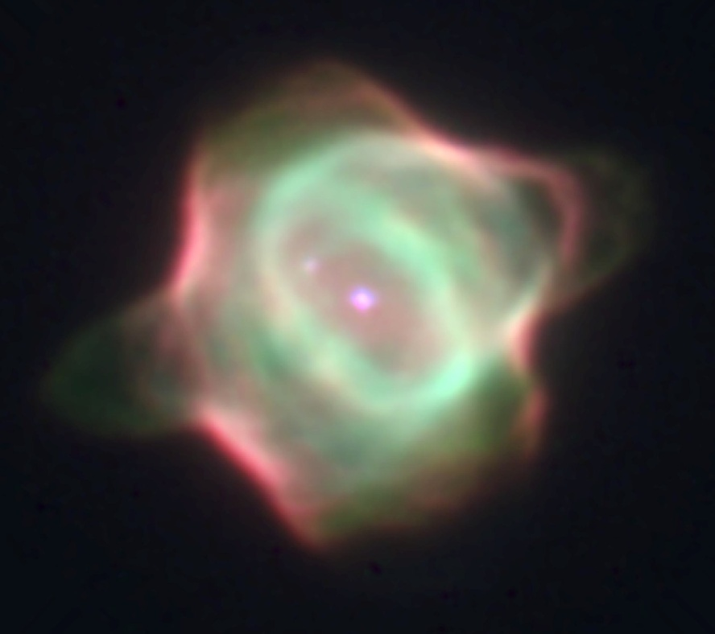
Planetary Nebulae
Hen 1357
Hourglass Nebula
Stingray Nebula

Slide 45
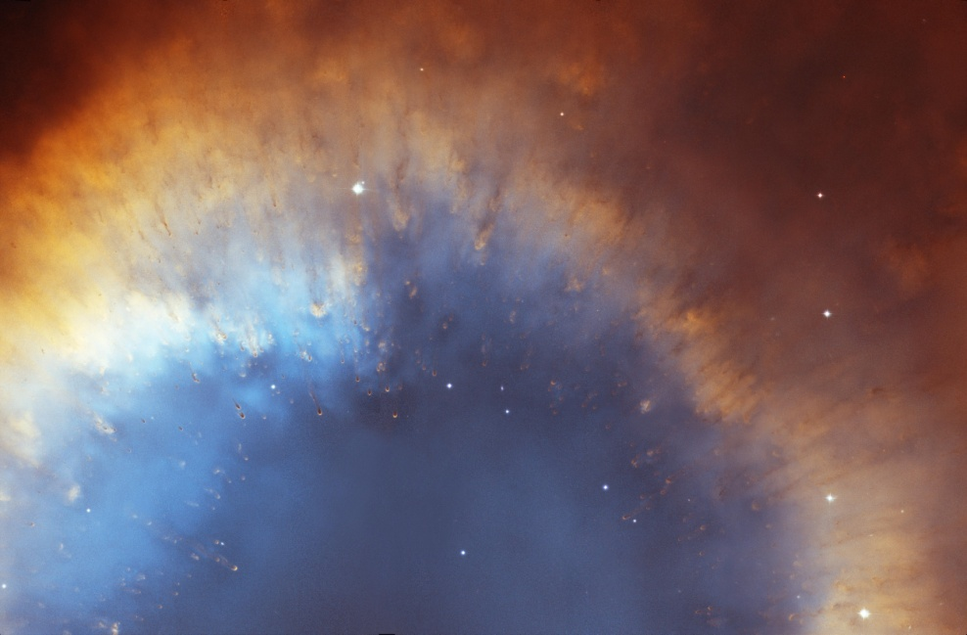
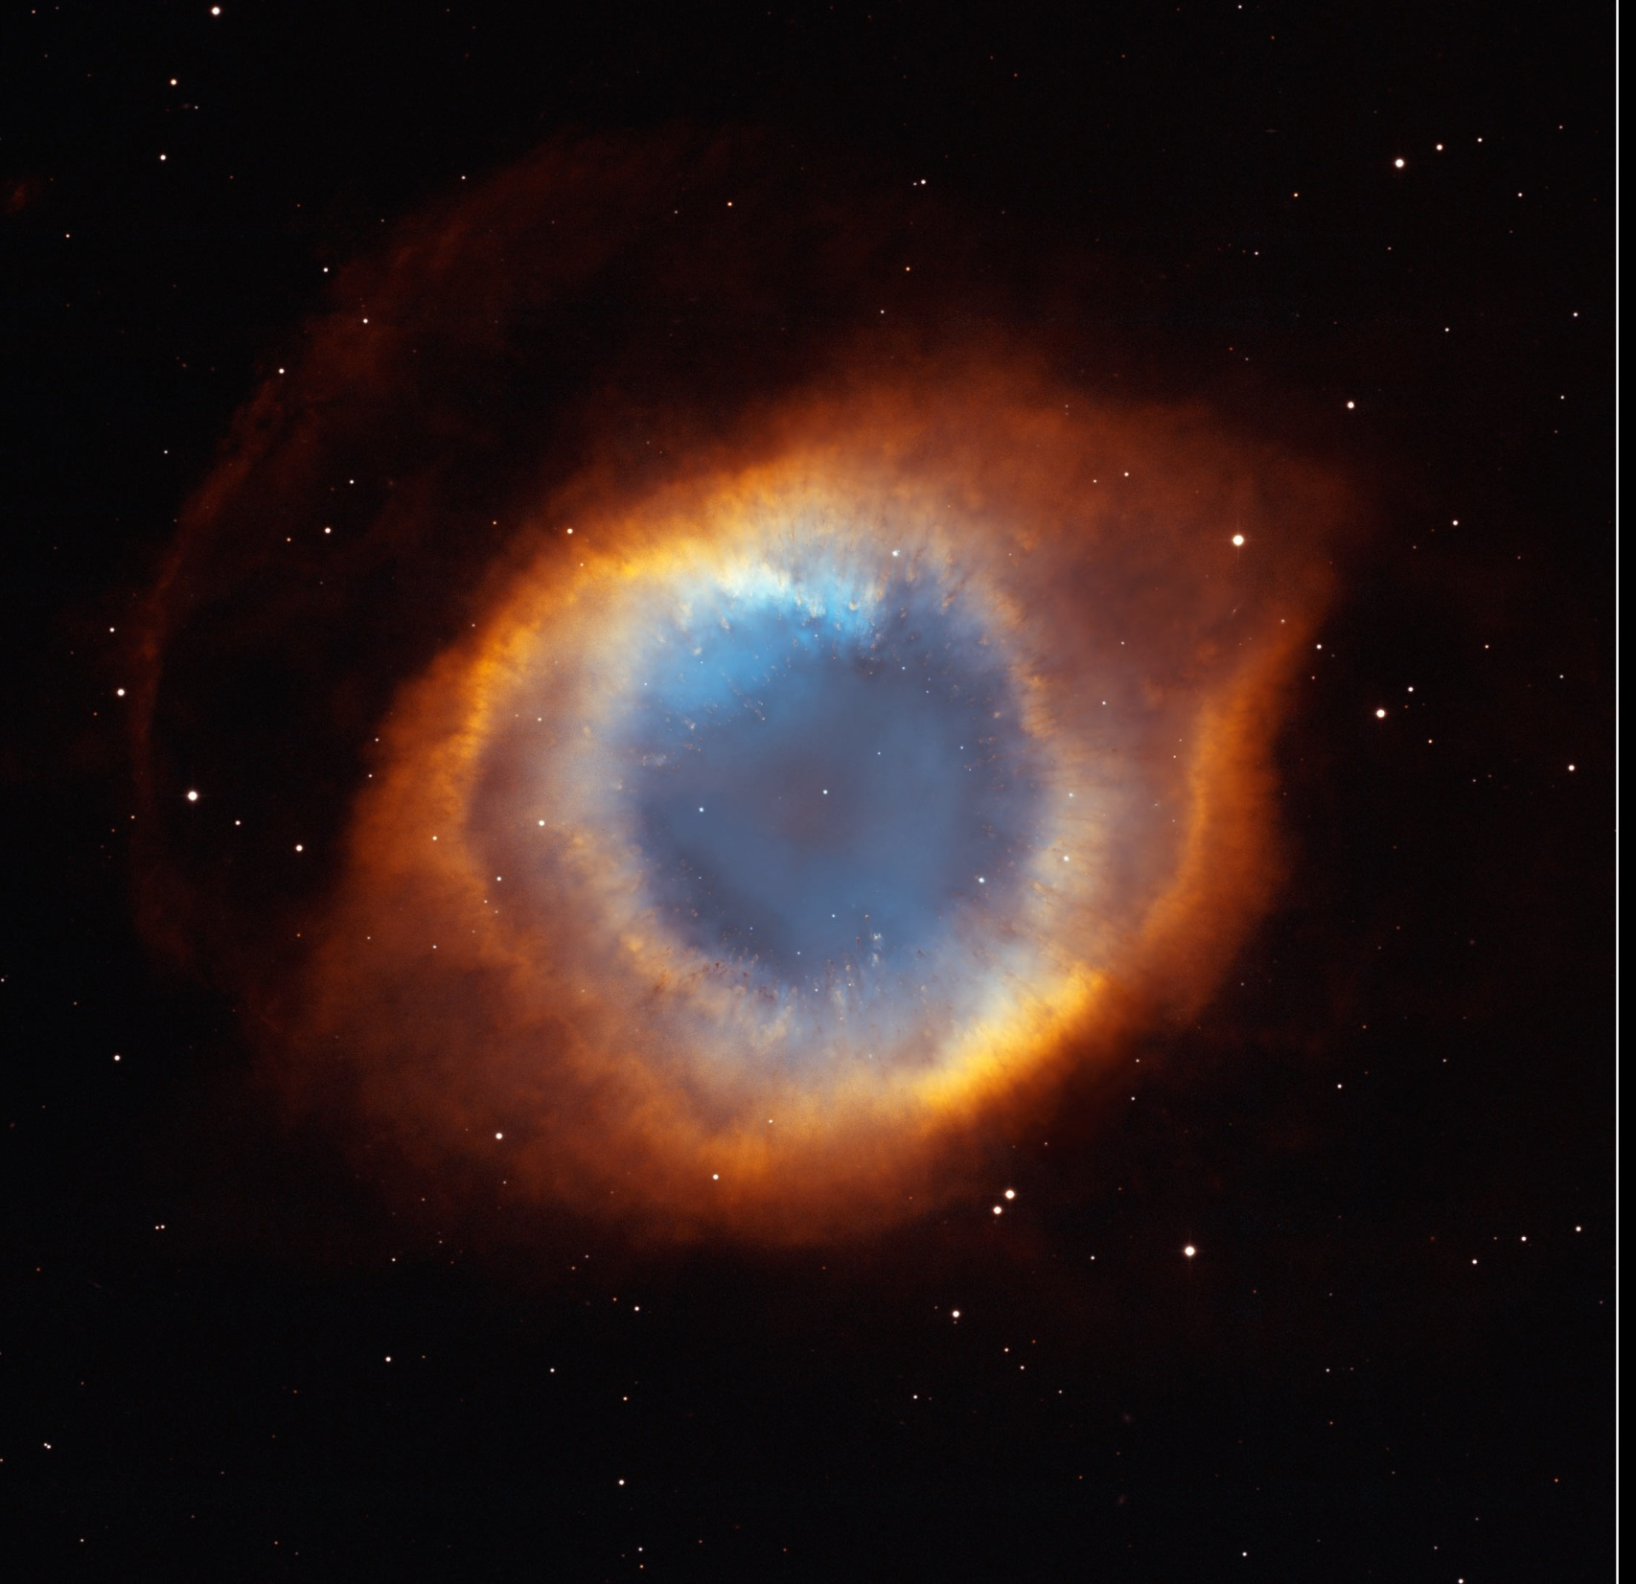
Planetary Nebulae
Helix Detail
Helix Nebula

Slide 46
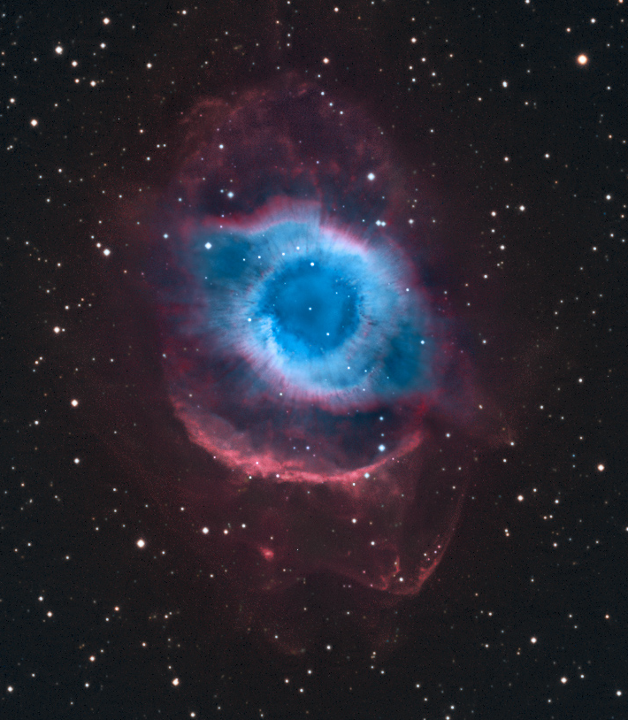
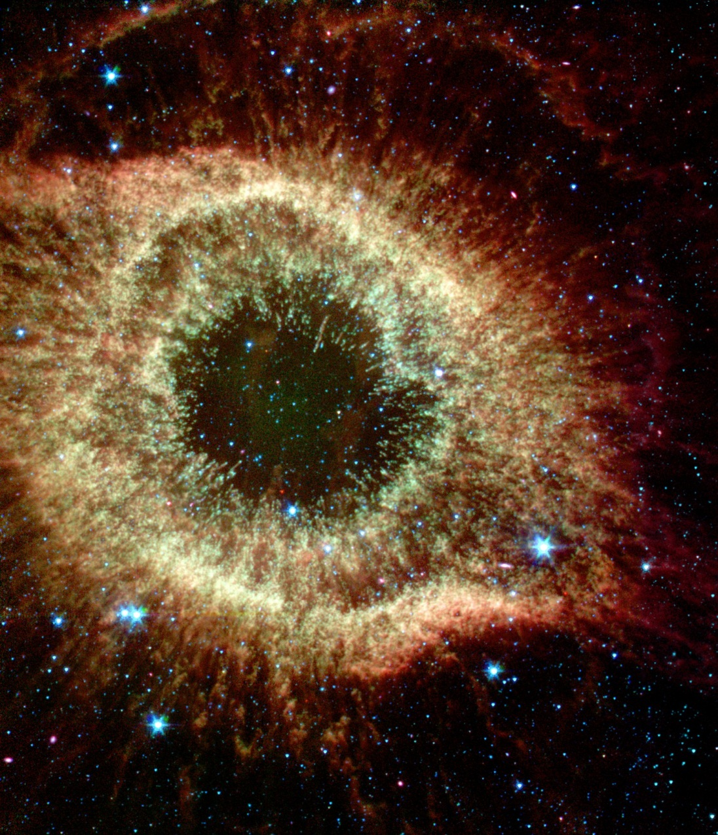
Planetary Nebulae
Helix Nebula in Aquarius
IR (Spitzer) image

Slide 47
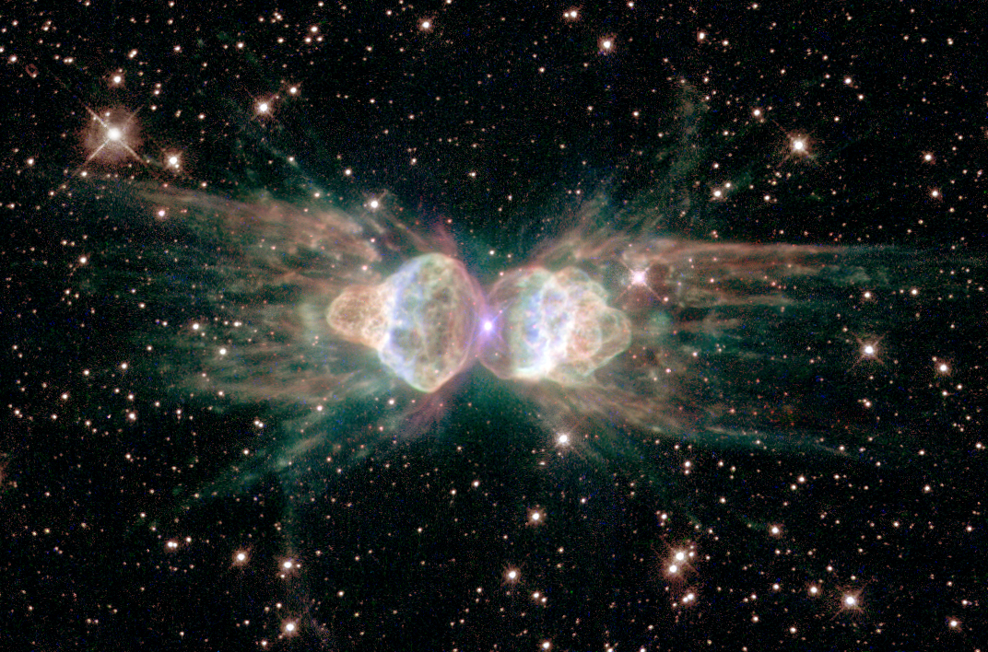
Planetary Nebulae
Ant Nebula

Slide 48



Planetary Nebulae
Egg Nebula
Butterfly Nebula
Rotten Egg Nebula
The carbon & nitrogen atoms you’re made of were once in one of these!!!

Slide 49

Planetary Nebulae
We are all made of star stuff!
NGC 6826

Slide 50

Planetary Nebulae
Our ancient ancestors …
We are all made of star stuff!
NGC 6826

Slide 51
Exploring the STARS!
The Adventure Continues!

