Slide 1
Time
Clock Time
  the position of the mean sun at TZ center
    eg. 12 pm = transit of mean sun (avg. of analemma)
  Mean Solar Day = 24:00:00 (hours:min:sec of time)
Solar Time
  the position of the sun wrt the observer
    eg. Noon = sun transits
  Solar Day varies as shown by analemma
Sidereal Time
  the position of  wrt the observer
    eg. 0^{h} Local Sidereal Time (LST) =  transits
    Sidereal time = R.A. on the meridian
  Sidereal Day = 23:56:00

Slide 2
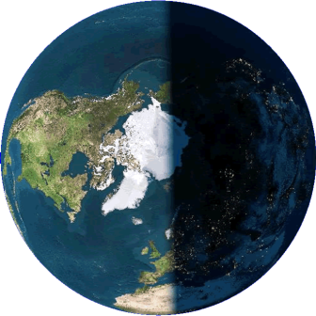
The Sidereal Day
Sidereal Day: 360° rotation puts star back on meridian
to distant star
~1° along orbit
to distant star
to sun

Slide 3
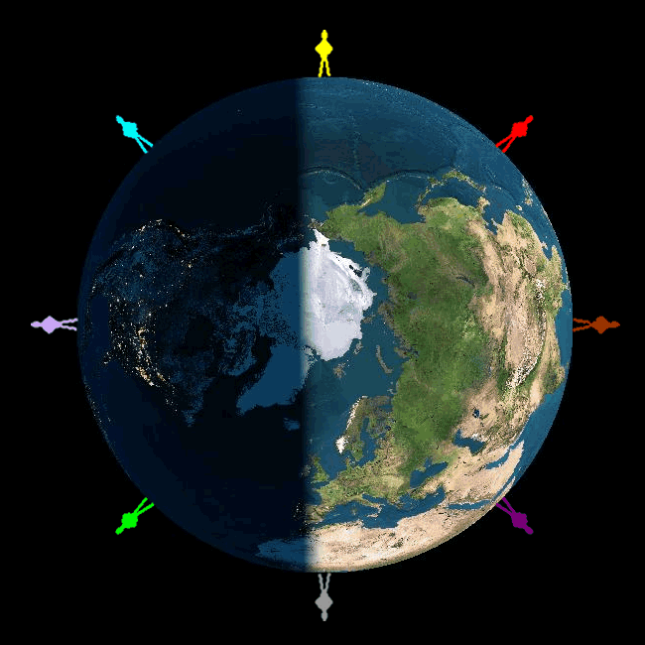
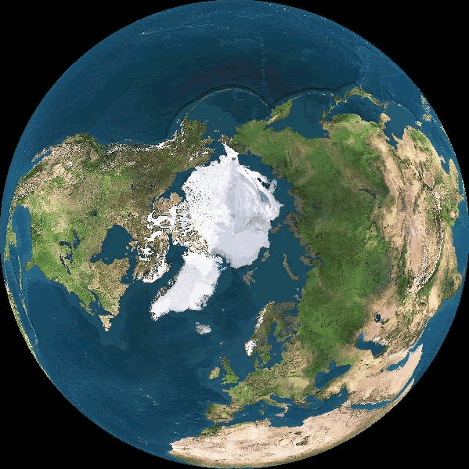
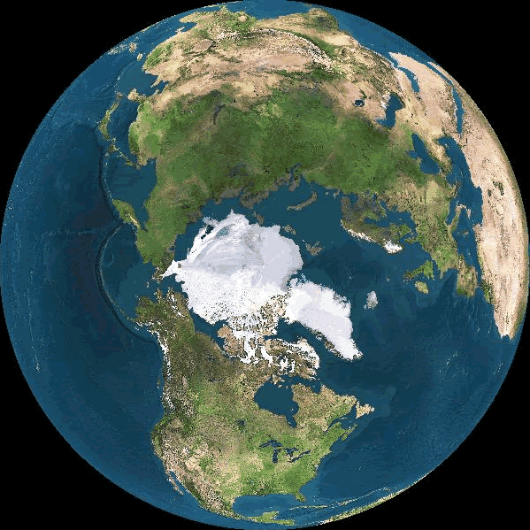
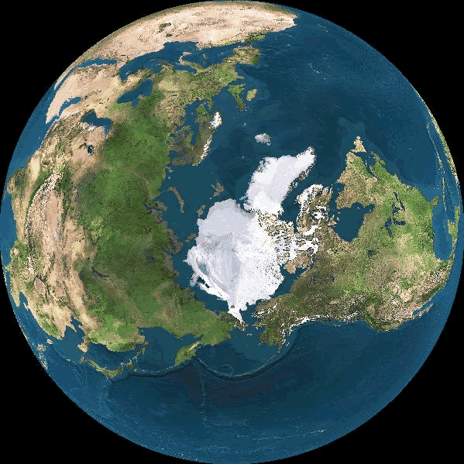
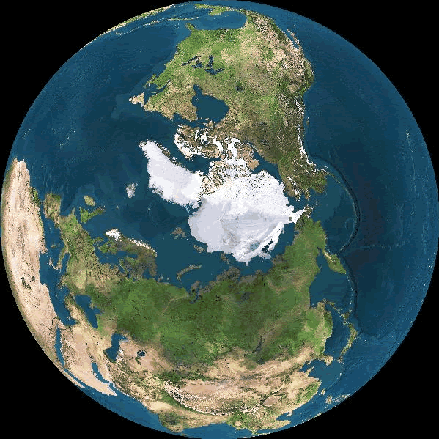
Time
Sidereal Time
  Position of the stars with respect to the observer
  Right Ascension on observer’s meridian

It’s 0^{h} LST
0^{h}
It’s 18^{h} LST

6^{h}
18^{h}

It’s 6^{h} LST
12^{h}
It’s 6^{h} LST


Slide 4
The Solar Day
Solar Day: 361° rotation puts sun back on meridian
to distant star
~1°
to sun
~1° along orbit
to distant star
to sun

Slide 5
Time
Solar Time
  Position of sun with respect to observer
6 pm
12 am
12 pm
To Sol
6 am

Slide 6
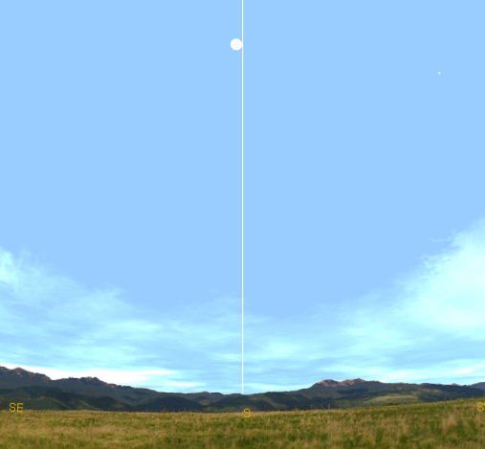


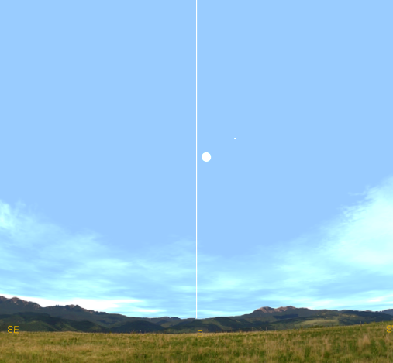










The Sun at Noon
Noon ⇒ Sun on meridian
Sun’s position varies: the Analemma
Observer's Meridian (due south)
6/25/07
6/25/07
5/26/07
5/26/07
7/30/07
7/30/07
4/26/07
4/26/07
8/29/06
8/29/06
3/27/07
3/27/07
9/28/06
9/28/06
2/27/07
2/27/07
10/28/06
10/28/06
1/26/07
1/26/07
11/27/06
12/27/06
11/27/06
12/27/06

Slide 7
The Sun at Noon
Noon ⇒ Sun on meridian
Sun’s position varies: the Analemma
Observer's Meridian (due south)
Analemma

Slide 8
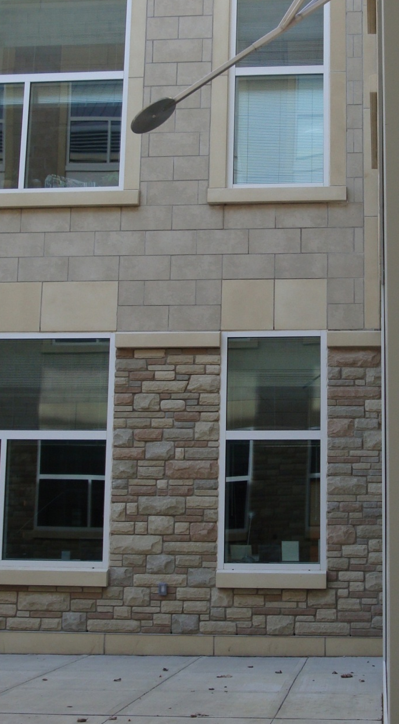
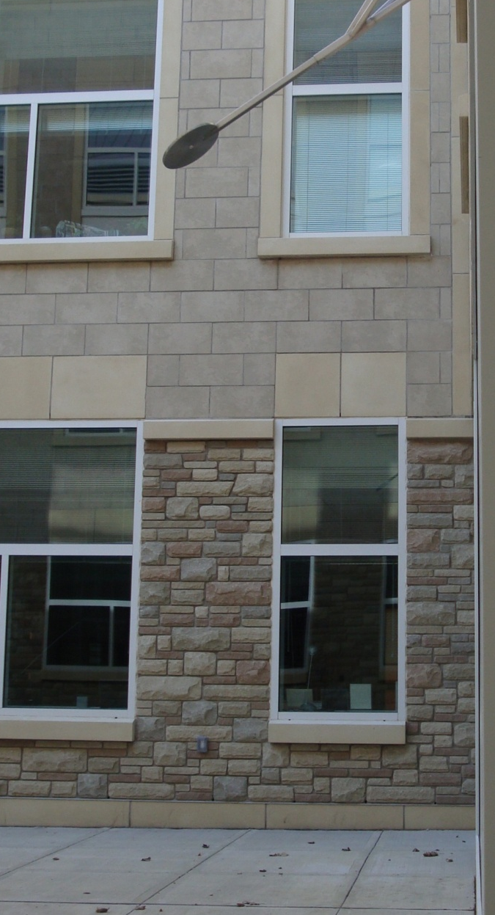
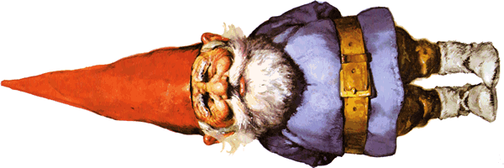
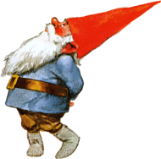
JHS Solar Window
Equinox Sun
Summer Sun
Style
Gnomon
λ’
H = 1.314 m
Winter Sun
λ’
Noon sun on an equinox
λ’ = 90° - latitude λ’ = 90° - 44.6° λ’ = 45.4°
h = 3.835 m
Figure 1: The JHS style showing the altitude of the sun on an equinox.
Figure 2: A comparison of the altitude of the sun on the solstices to that on an equinox.

Slide 9
JHS Solar Window
Equinox Sun
Summer Sun
Winter Shadow
The shadow of the gnomon scribes hyperbolas across the window. These are the red tape lines on the inside of the window.
Winter Sun
Equinox Shadow
Summer Shadow

Slide 10
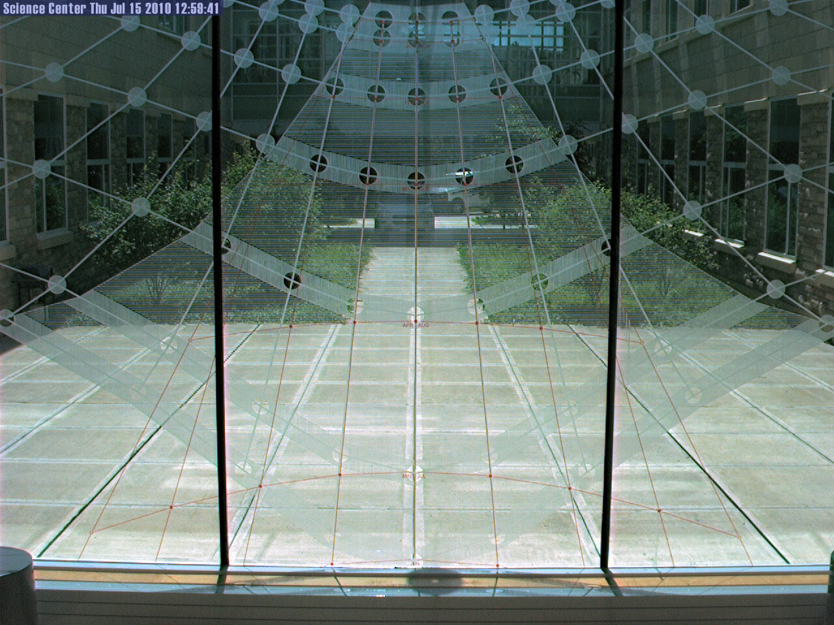
JHS Solar Window

Slide 11
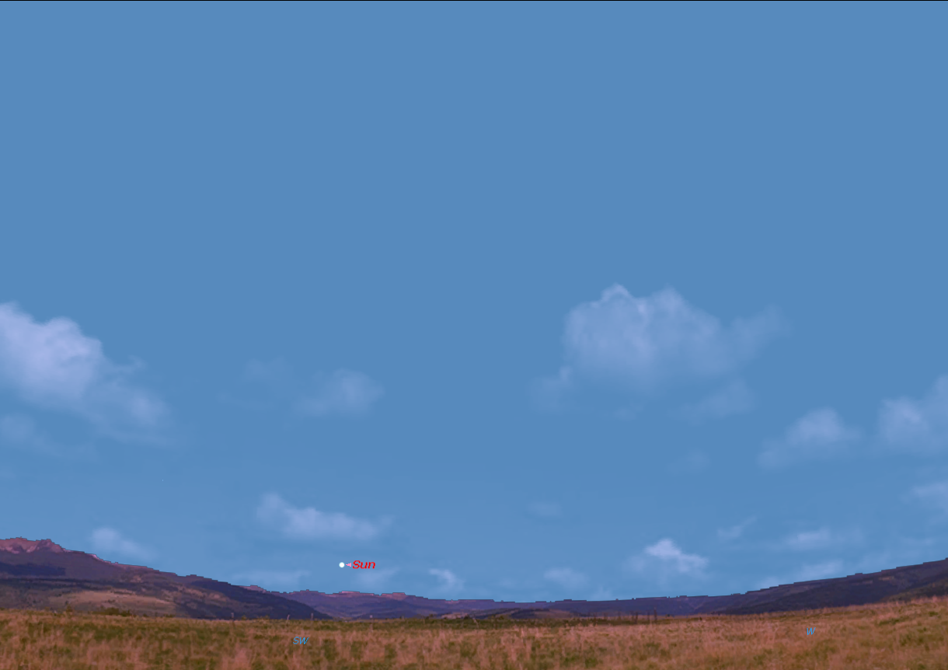
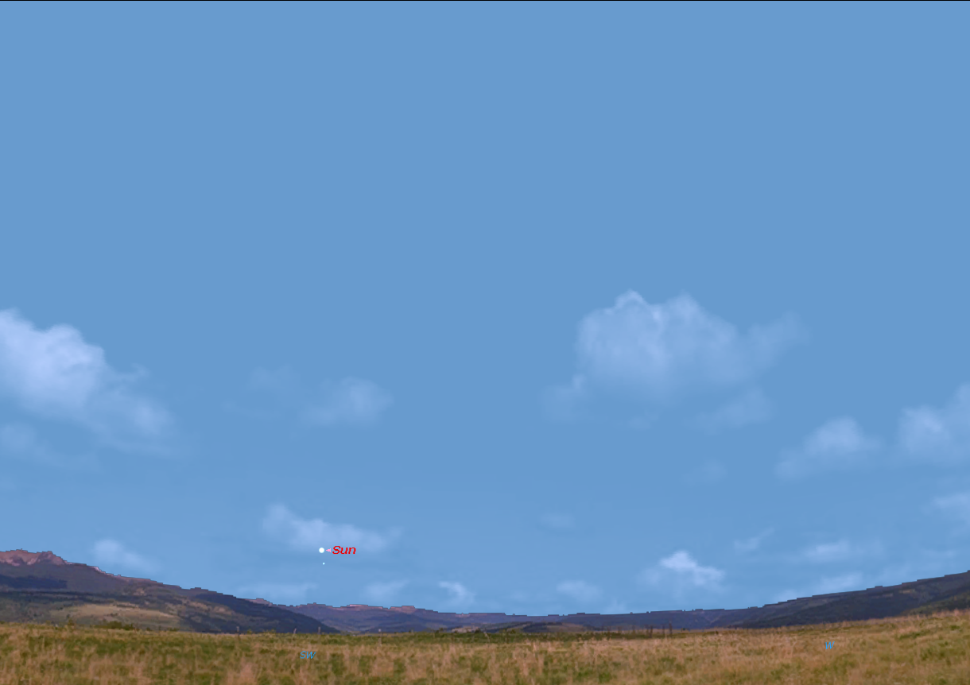
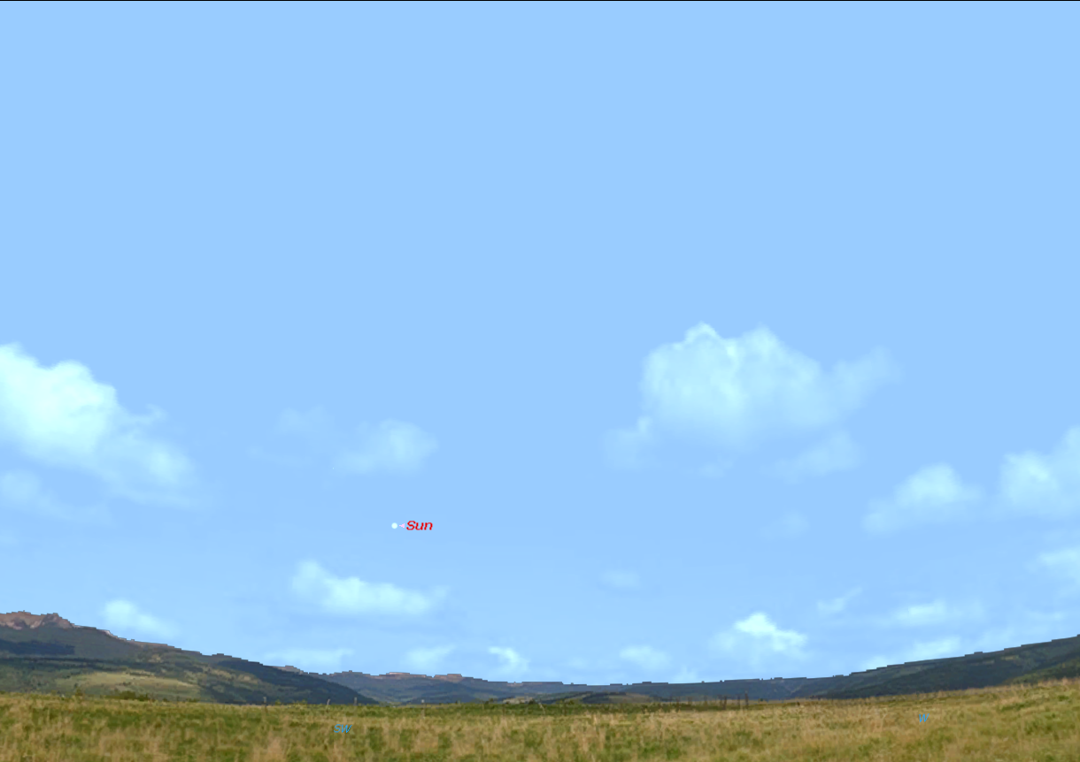








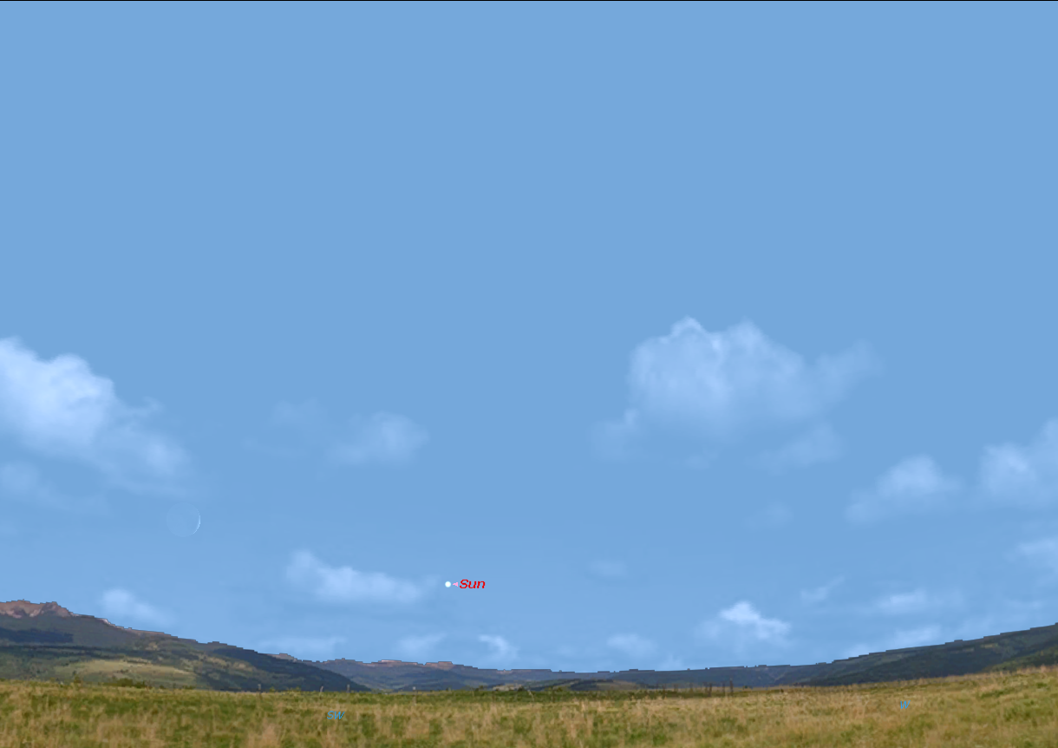
Why is the earliest sunset on December 7, 2012?
Sun position at 3:30 pm EST through the year
7/7/10
6/7/10
8/7/10
5/7/10
4/7/10
9/7/10
3/7/10
10/7/10
2/7/10
11/7/10
Analemma closest to horizon in early December
1/7/10
12/7/9

Slide 12
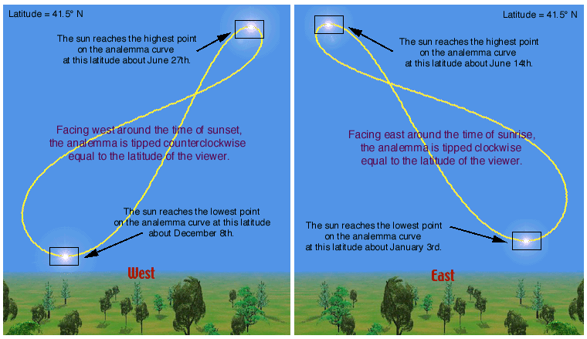
The Analemma
Varies time of sunrise & sunset
  Earliest sunset on about December 8
  Latest sunrise on about January 3

