Slide 1
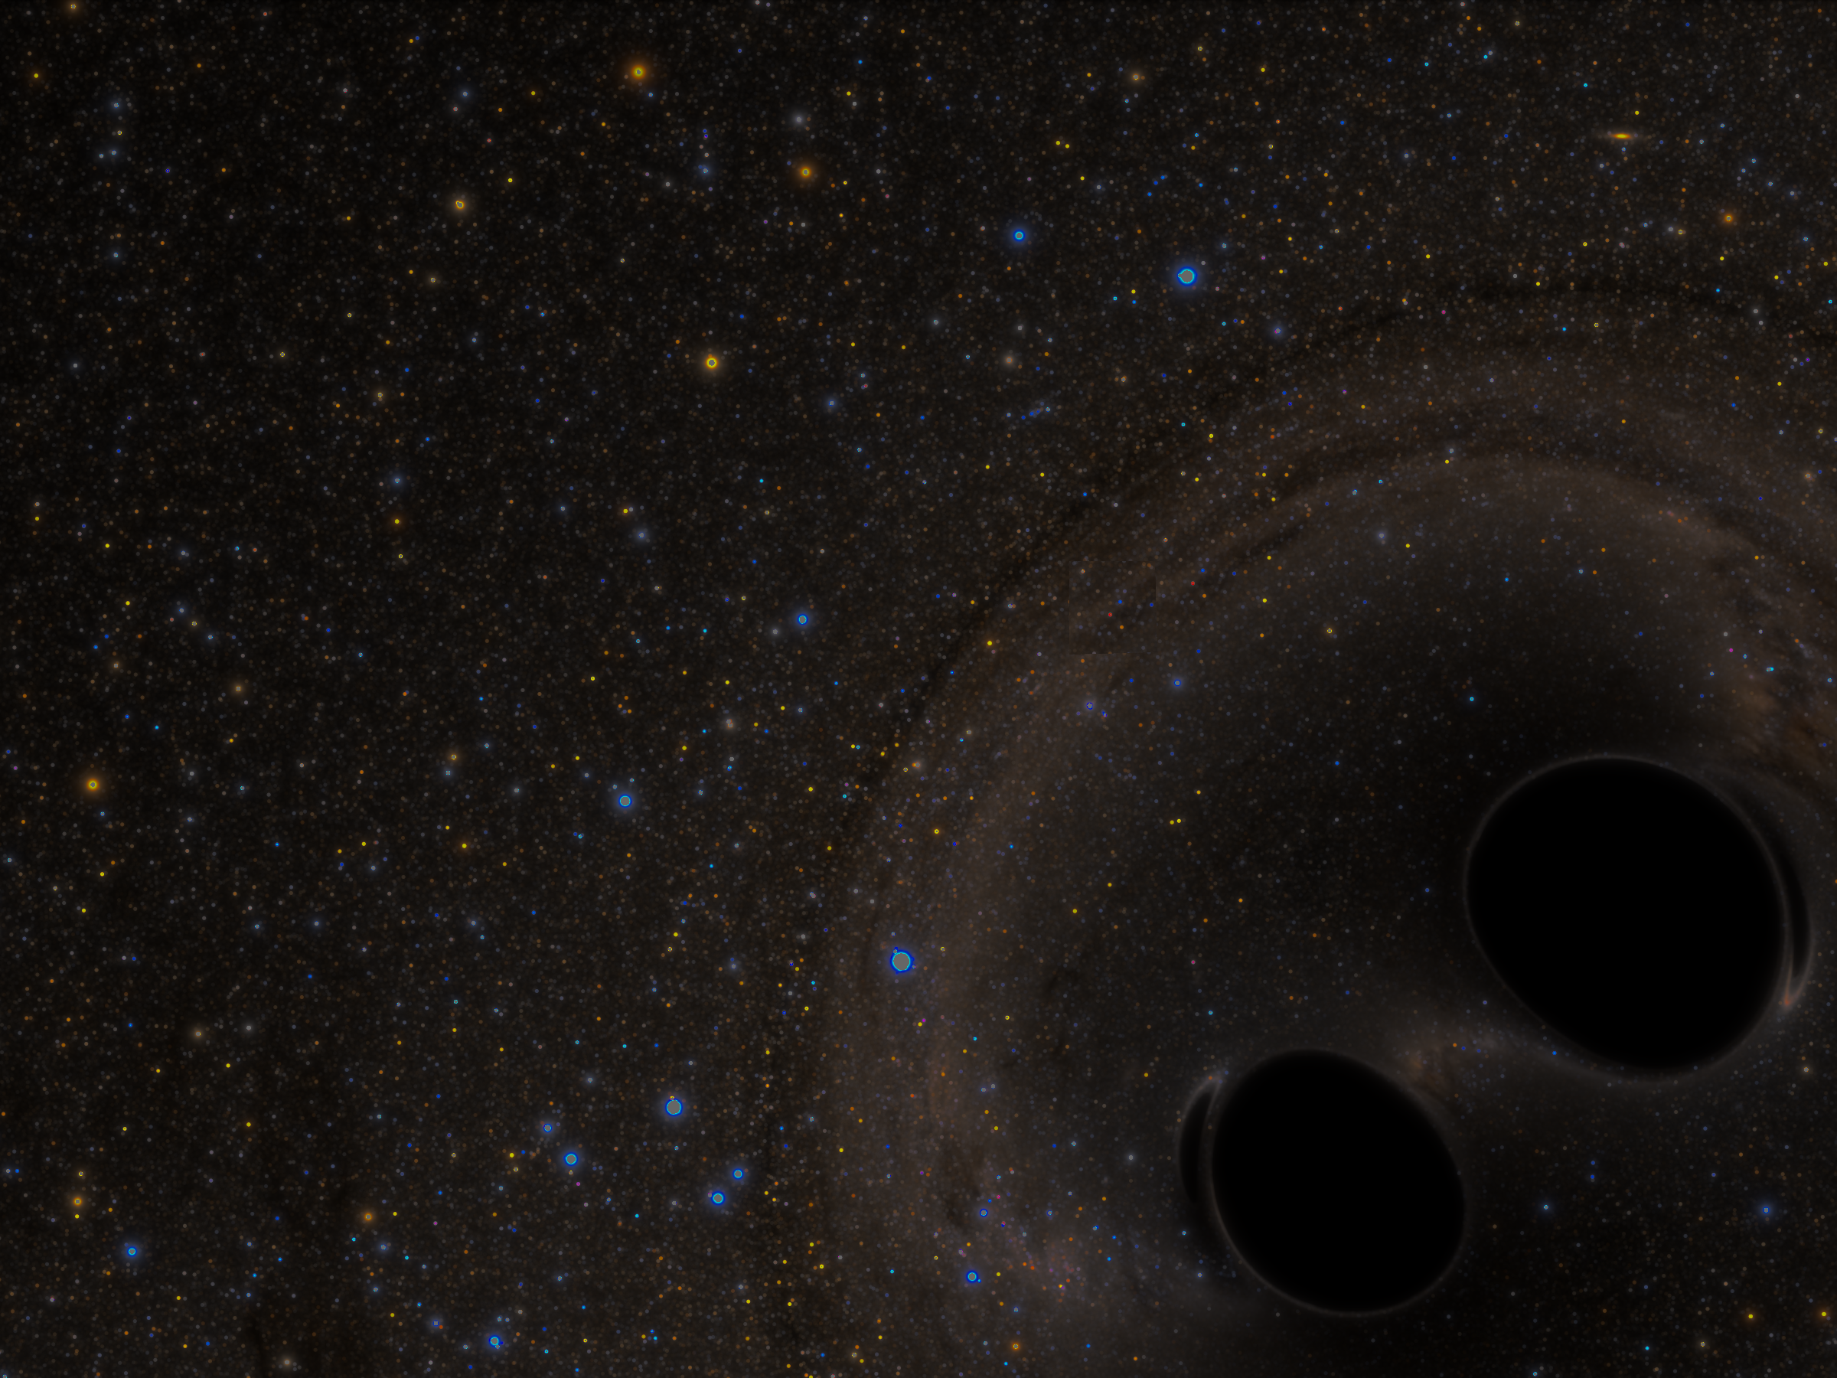

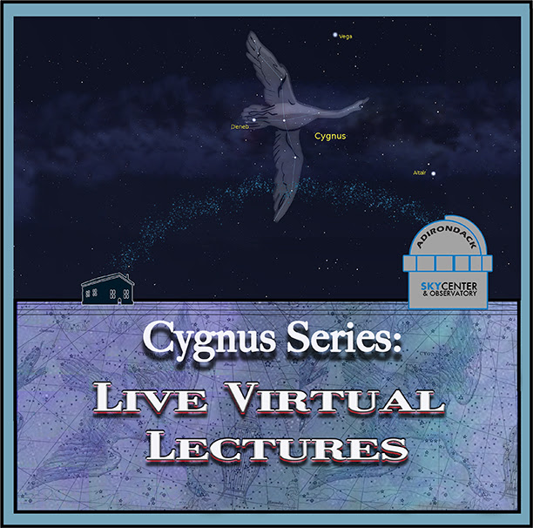

Einstein, Gravity, and Multimessenger Astronomy
Dr. Aileen A. O’Donoghue
Henry Priest Professor of Physics
© Copyright, Dr. Aileen A. O’Donoghue, St. Lawrence University

Slide 2
Einstein, Gravity, & Multimessenger Astro
Part 1: Einstein (8/7/2020)
  Einstein’s universe very different from Newton’s
  Spacetime is a “fabric” or “fluid” that ripples
Part 2: Gravity (9/11/2020)
  Gravitational Waves: Ripples in Spacetime
  LIGO: How to Detect the Ripples
Part 3: Multimessenger Astronomy (10/9/20)
  Detecting Gravitational Waves
  Also Detecting Electromagnetic Waves

Slide 3
Einstein, Gravity, & Multimessenger Astro
Part 1: Einstein (8/7/2020)
  Einstein’s universe very different from Newton’s
  Spacetime is a “fabric” or “fluid” that ripples
Part 2: Gravity (9/11/2020)
  Gravitational Waves: Ripples in Spacetime
  LIGO: How to Detect the Ripples
Part 3: Multimessenger Astronomy (10/9/20)
  Detecting Gravitational Waves
  Also Detecting Electromagnetic Waves

Slide 4
Newton’s Universe
Space and time are independent & static
  nothing alters the dimensions of space
  nothing alters the flow of time
Matter and energy are distinct & separate
  a rock is matter that can be weighed
    can be melted or vaporized but the “stuff” remains
  it can have energy
    raised, it gains potential energy
    dropped, it gains kinetic energy

Slide 5
Einstein’s Universe
Space and time not independent
= spacetime
  both altered by motion
  both altered by gravity
Matter and energy are same stuff
  matter can become energy
    stars shine by doing this!
  energy can become matter
    the Big Bang did this

Slide 6
Stuff of Einstein’s Universe
Symmetries
  Matter
  Energy
  Space
  Time
Different forms of the same “stuff”. Matter-energy related by E = mc²
Space (meters)
Both constructs of this universe providing “grid” where matter & energy interact.
1 m
1 s
Time (seconds)
Space (meters)

Slide 7
Stuff of Einstein’s Universe
Super-symmetry
  Matter
  Energy
  Space
  Time
All the same stuff … “Quantum Foam”
Space (meters)
1 m
1 s
Same stuff as in the centers of black holes.
Time (seconds)
We don’t yet know its physics.
Space (meters)

Slide 8
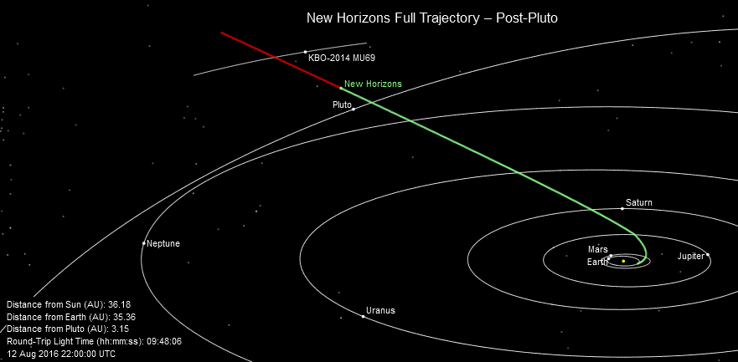
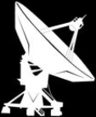
Space and Time: Newton
  “Gravity is an attractive force between massive bodies.”
  - Isaac Newton, 1687
  Works really well!! New Horizons got to Pluto using Newton’s laws!

Slide 9
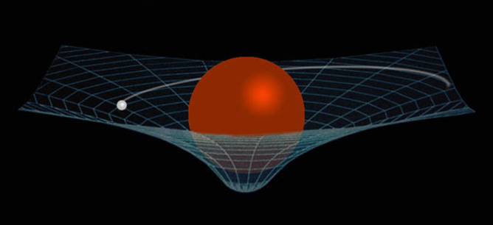
Spacetime: Einstein
  “Mass tells space how to curve, space tells mass how to move.”
  - Albert Einstein, 1915
  … and mass tells time how to flow …
Gravity slows time!
  the GPS system must account for this!

Slide 10
Spacetime: Einstein
  “Mass tells space how to curve, space tells mass how to move.”
  - Albert Einstein, 1915
  … and mass tells time how to flow …
Warp should be in 3-D … but I can’t draw that!
Gravity slows time!
  the GPS system must account for this!

Slide 11
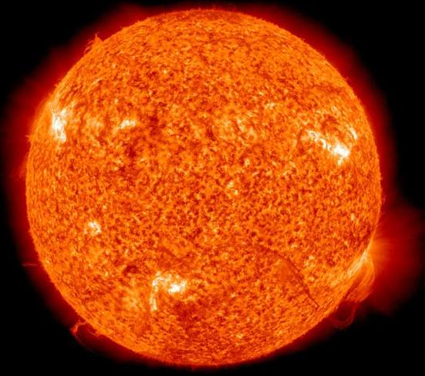
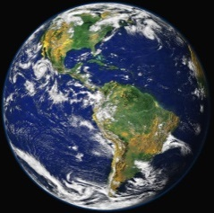
Spacetime: Einstein
Space also tells light how to bend …
  positions of stars seem to change behind Sun
Apparent position of star visible during eclipse
Light ray from star in Newton’s universe
First observed by Arthur Eddington in 1919!
Light ray from star in Einstein’s universe

Slide 12
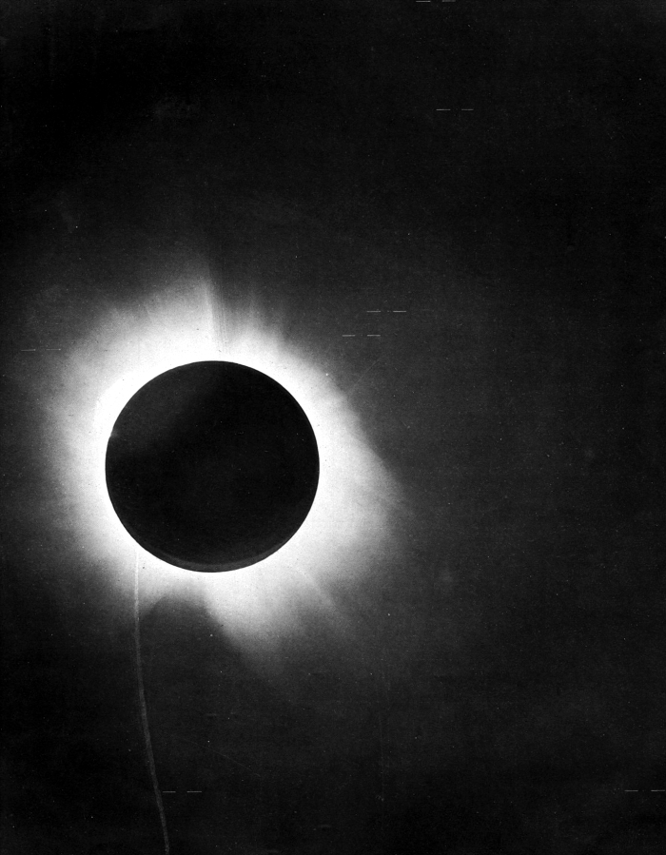
Spacetime: Einstein
Stars with positions deflected by the presence of the sun.
Space also tells light how to bend …
  positions of stars seem to change behind Sun
Apparent position of star during eclipse
Light ray from star in Newton’s universe
First observed by Arthur Eddington in 1919!
Light ray from star in Einstein’s universe

Slide 13
Spacetime: Einstein
Space is a fabric (in 3D, a “fluid”)
… something not nothing!!
⇒ Gravitational disturbances will propagate
  Gravitational waves
    move at c = 300,000 km/s = 186,000 mi/s
    the fabric of space contracting and expanding
    nothing reflects, refracts or absorbs them

Slide 14
Spacetime: Einstein
Space is a fabric
… something not nothing!!
⇒ Gravitational disturbances will propagate
  Gravitational waves
    move at c = 300,000 km/s = 186,000 mi/s
    the fabric of space contracting and expanding
    nothing reflects, refracts or absorbs them
    shaped by the physics that creates them
Spacetime ripples!!
Can we detect the ripples?

Slide 15
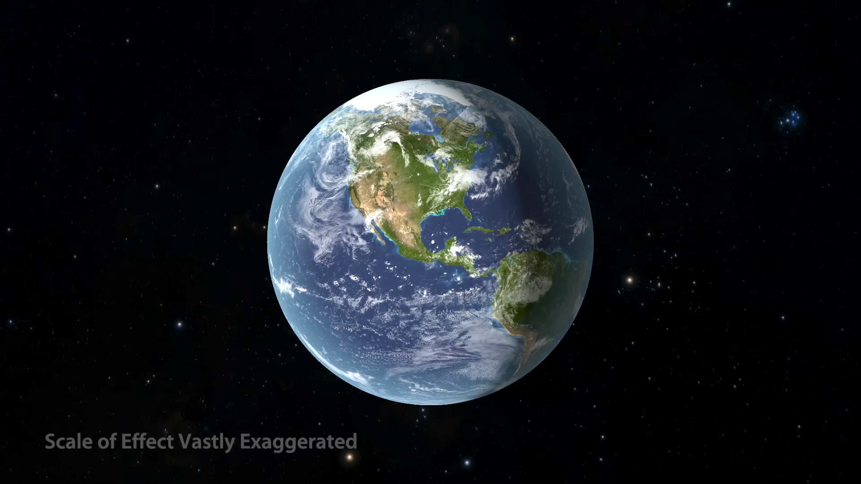
Spacetime Rippling Earth
How can we detect the ripples?

Slide 16
Einstein, Gravity, & Multimessenger Astronomy
The adventure continues ...
Questions? Comments?

