Slide 1
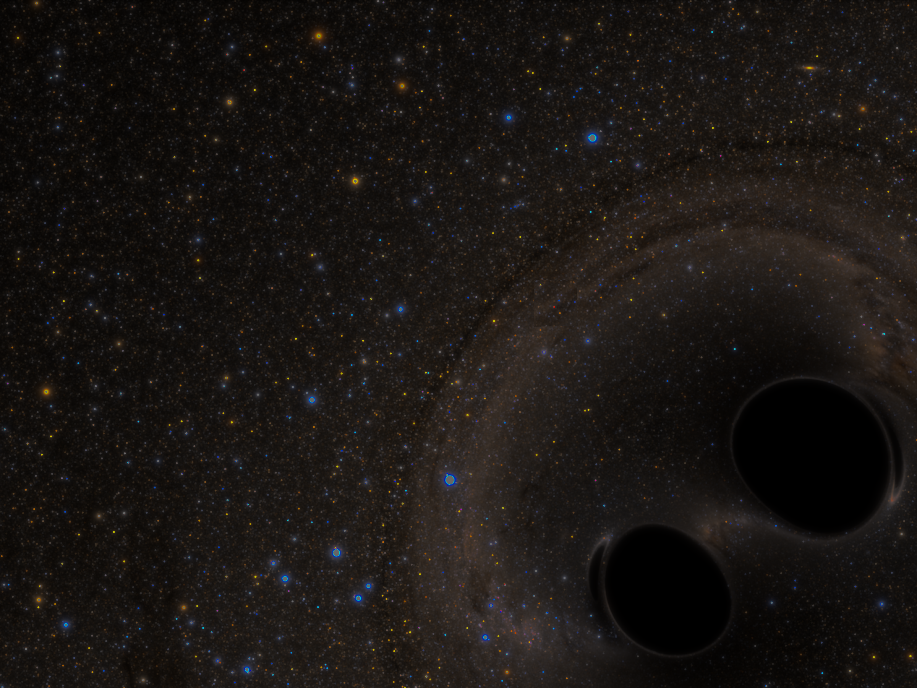

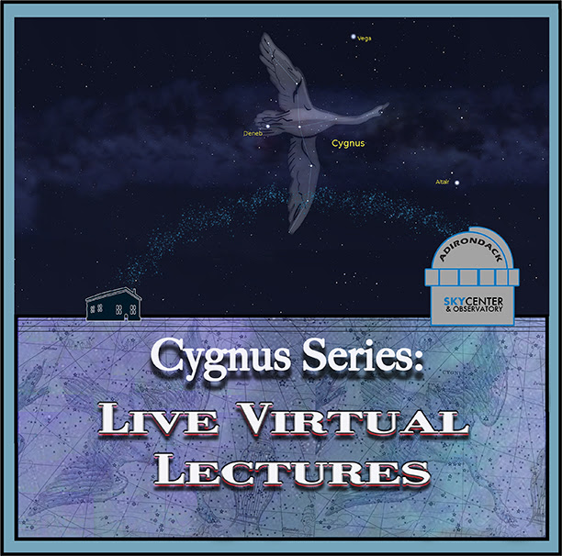

Einstein, Gravity, and Multimessenger Astronomy
Dr. Aileen A. O’Donoghue
Henry Priest Professor of Physics
© Copyright, Dr. Aileen A. O’Donoghue, St. Lawrence University

Slide 2
Einstein, Gravity, & Multimessenger Astro
Part 1: Einstein (8/7/2020)
  Einstein’s universe very different from Newton’s
  Spacetime is a “fabric” or “fluid” that ripples
Part 2: Gravity (9/11/2020)
  Gravitational Waves: Ripples in Spacetime
  LIGO: How to Detect the Ripples
Part 3: Multimessenger Astronomy (10/9/20)
  Detecting Gravitational Waves
  Also Detecting Electromagnetic Waves

Slide 3
On 8/7, there was
Einstein
© Copyright, Dr. Aileen A. O’Donoghue, St. Lawrence University

Slide 4
Spacetime: Einstein
Space is a fabric
… something not nothing!!
⇒ Gravitational disturbances will propagate
  Gravitational waves
    move at c = 300,000 km/s = 186,000 mi/s
    the fabric of space contracting and expanding
    nothing reflects, refracts or absorbs them
    shaped by the physics that creates them
Spacetime ripples!!
How can we detect the ripples?

Slide 5
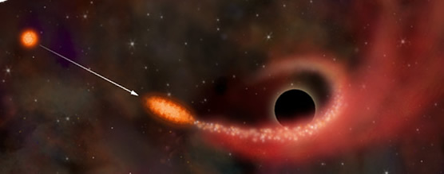
Creating Gravitational Waves
Dramatic changes in large masses
  Supernovae
    Giant stars exploding … mass converted to energy
  Massive bodies falling into black holes
    Neutron stars (≲ 3 M⊙, ≲ 20 km)
  Massive collisions
    Neutron stars merging to create black holes
    Mergers of black holes

Slide 6
Then on 9/11, there was
Gravity
© Copyright, Dr. Aileen A. O’Donoghue, St. Lawrence University

Slide 7
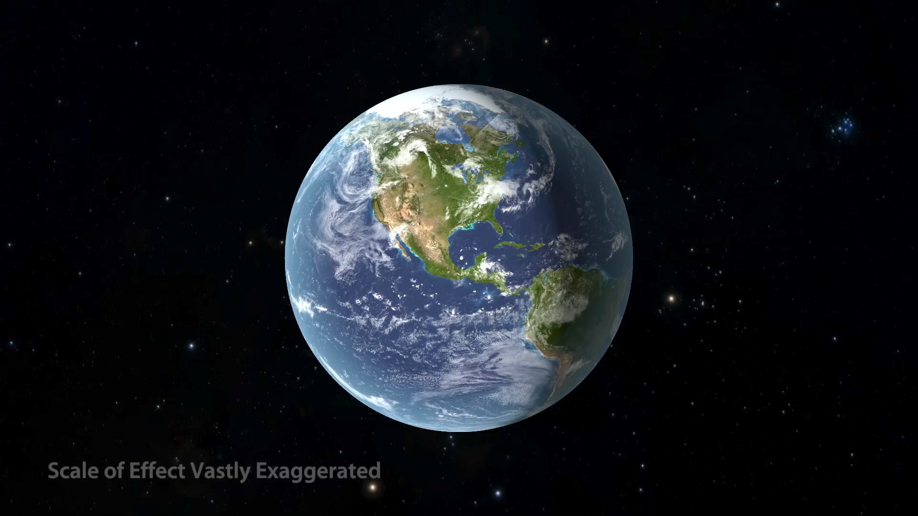
Effects of a Gravitational Wave

Slide 8
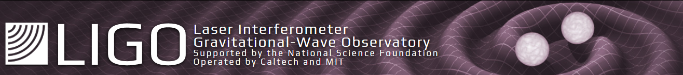
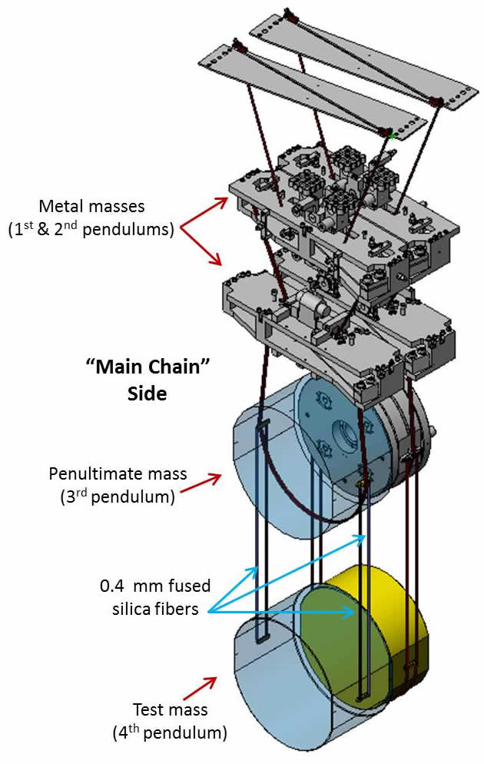
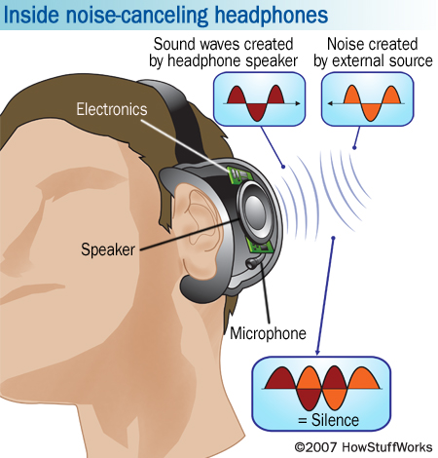
Measures changes in path length down to
10⁻¹⁹m =
0.0000000000000000001 m =
1/10,000th D_{proton}!
Lots of vibrations means
  Active and passive damping required

Slide 9
Gravitational Waves Detected!!
  First detection
    5:51 am on September 14, 2015
      Announced on February 11, 2016
  First Multimessenger Detection
    8:41 am EDT on August 17, 2017
      LIGO and Fermi γ-Ray Satellite
... First what Detection?

Slide 10
Today it’s on to
Multimessenger Astronomy
© Copyright, Dr. Aileen A. O’Donoghue, St. Lawrence University

Slide 11
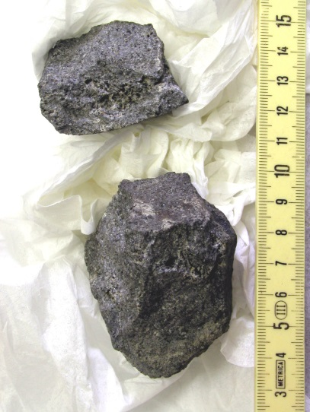
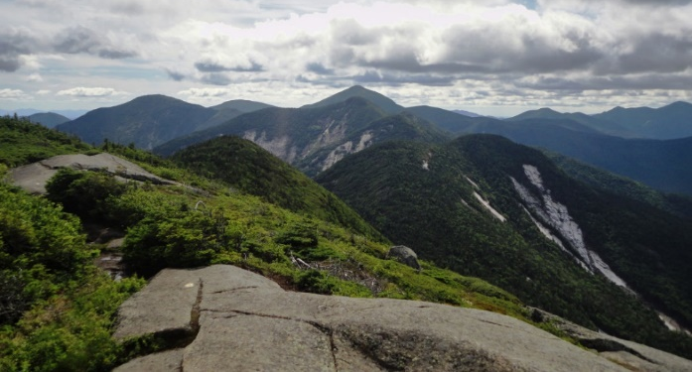
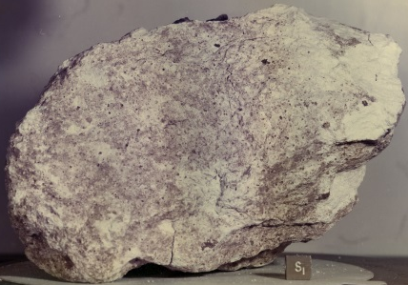
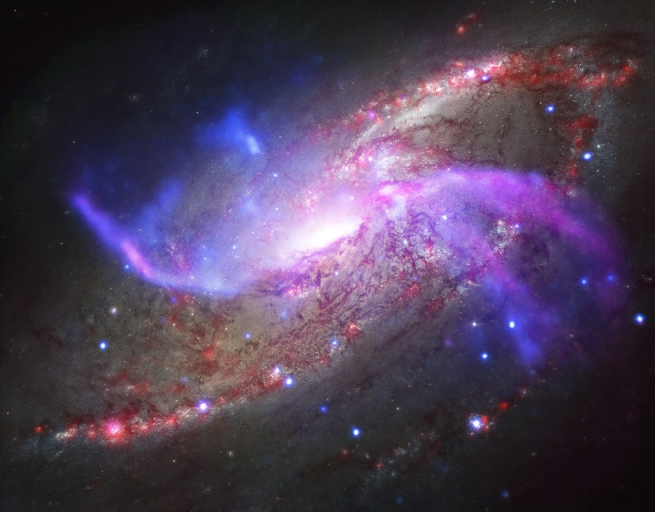
What We’ve Known
Information about the universe
  Material
    Earth
    Moon Rocks
    Meteorites
  Electromagnetic Radiation
    Visible
    Radio
    Infrared
    Ultraviolet
    X-Rays
    γ-Rays
Mt. Marcy from Gothics
Meteorite from Vesta lava flow
https://rootsrated.com/stories/the-10-best-day-hikes-in-the-adirondack-high-peaks
Apollo 16 Anorthosite
M 106
Visible (Hubble)
Radio (JVLA)
X-Ray (Chandra)
Infrared (Spitzer)
What can ripples teach us?
www.jpl.nasa.gov/spaceimages/

Slide 12
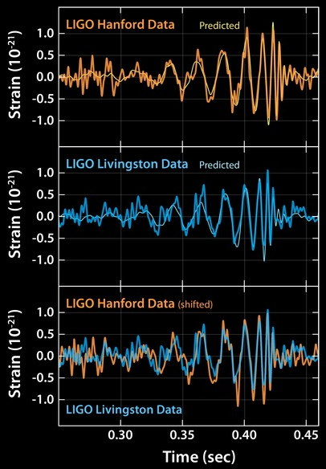
The First Detection
  5:51 am 9/14/15
    Livingston signal arrived 7 ms before Hanford signal
  Shape of signals predicted by theory
  Calculations show
    Merger of black holes in southern hemisphere sky

Slide 13
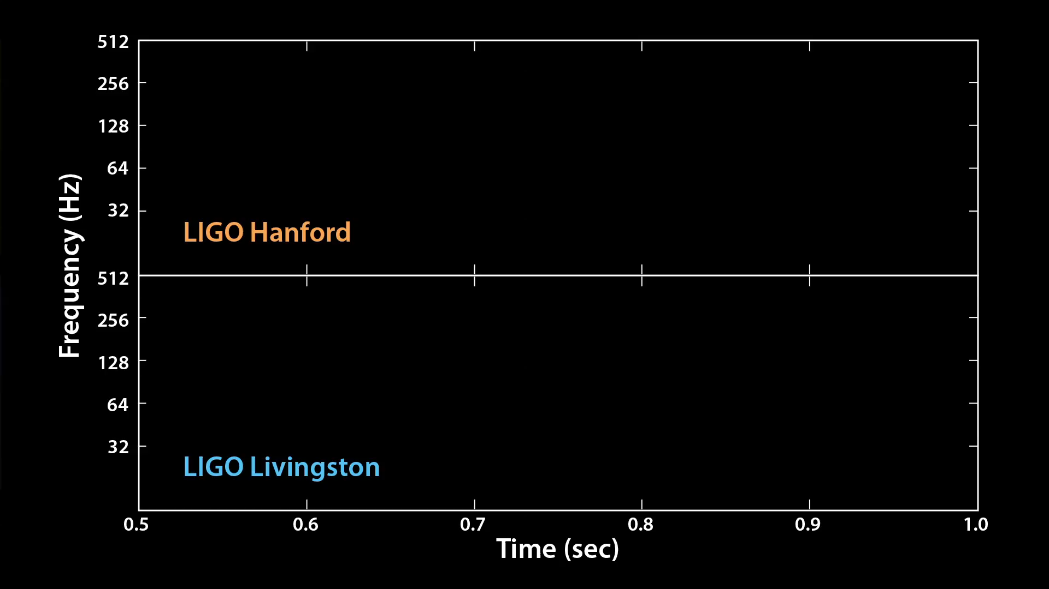
The Event ”Chirped”
Notes:
In the first two runs of the animation, the sound-wave frequencies exactly match the frequencies of the gravitational waves. The second two runs of the animation play the sounds again at higher frequencies that better fit the human hearing range. The animation ends by playing the original frequencies again twice.
As the black holes spiral closer and closer in together, the frequency of the gravitational waves increases. Scientists call these sounds "chirps," because some events that generate gravitation waves would sound like a bird's chirp.

Slide 14
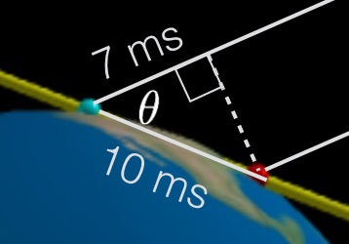
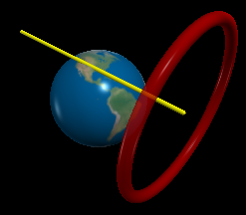
The Detection
  5:51 am 9/14/15, LA 7 ms before WA
    Trigonometry indicates direction …
    But signal can come from any direction
      doesn’t have to come from the sky!!

Slide 15
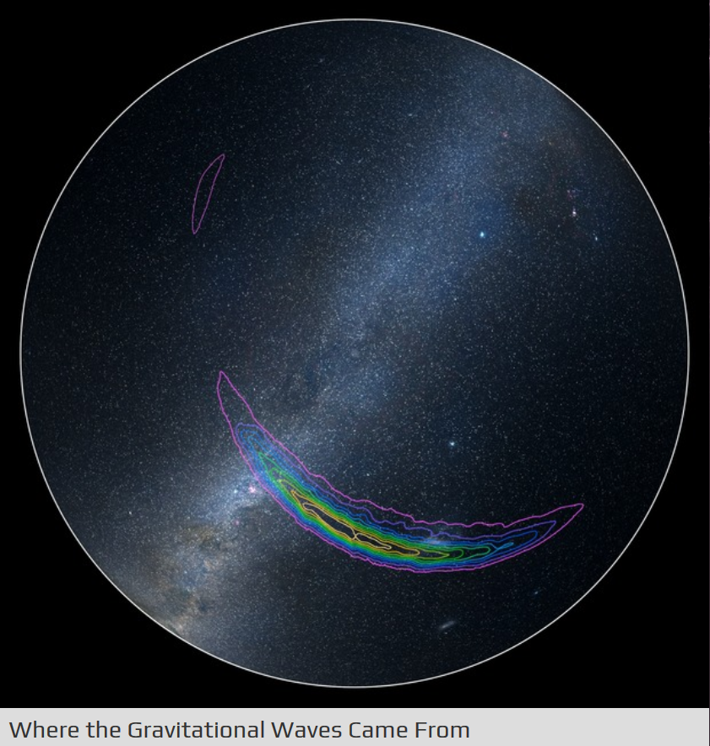
Resolution improving as more GW interferometers are built.
The Detection
  5:51 am 9/14/15, LA 7 ms before WA
    Trigonometry indicates direction …
    But signal can come from any direction
      doesn’t have to come from the sky!!
Orion Nebula
Sirius
90% confidence contour
Canopus
NGC 3572
10% confidence contour
LMC
SCP
SMC

Slide 16
The Event
  Merger of 2 black holes
    29 & 36 times more massive than the Sun (M☉)
      3 M☉ converted into energy of gravitational waves!
      E = mc² = 3M⊙c²=(3 x 1.99 x 10³⁰ kg)(3 x 10⁸ m/s)²
      E = 5.4 x 10⁴⁷ J = 1.5 x 10⁴¹ kWhr
      E = total output of the Sun over 4.5 trillion years!
      1.3 billion years ago
        First fungi appear on land on Earth
    Merged black hole has about 62 M☉
15,000,000,000,000,000,000,000,000,000,000,000,000,000.0 kWhr
At 6.5¢/kWhr that’s $9.75 x 10^{39!}

Slide 17
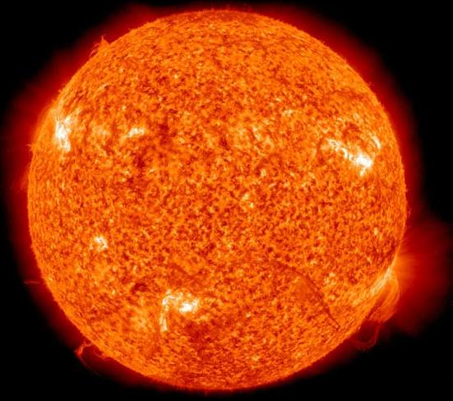
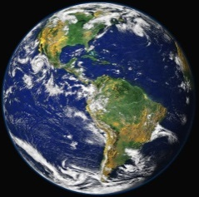
Spacetime: Einstein
Space tells light how to bend …
  positions of stars seem to change behind Sun
Apparent position of star visible during eclipse
Light ray from star in Newton’s universe
First observed by Arthur Eddington in 1919!
Light ray from star in Einstein’s universe

Slide 18
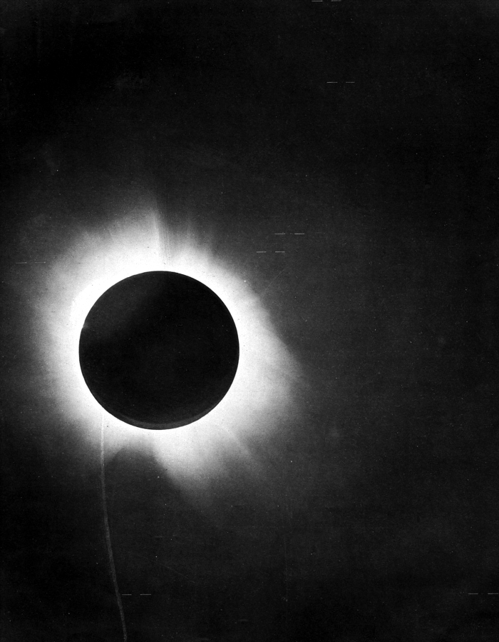
Spacetime: Einstein
Stars with positions deflected by the presence of the sun.
Space also tells light how to bend …
  positions of stars seem to change behind Sun
Apparent position of star during eclipse
Light ray from star in Newton’s universe
First observed by Arthur Eddington in 1919!
Light ray from star in Einstein’s universe

Slide 19
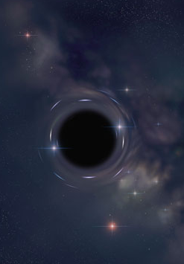
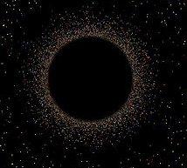
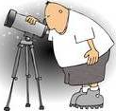
Gravity Bends Path of Light
Light can “orbit” black holes
Star
For a 1 Solar Mass Black Hole
Star light
r_{Light Sphere}= 4500 m
Star’s image

Slide 20
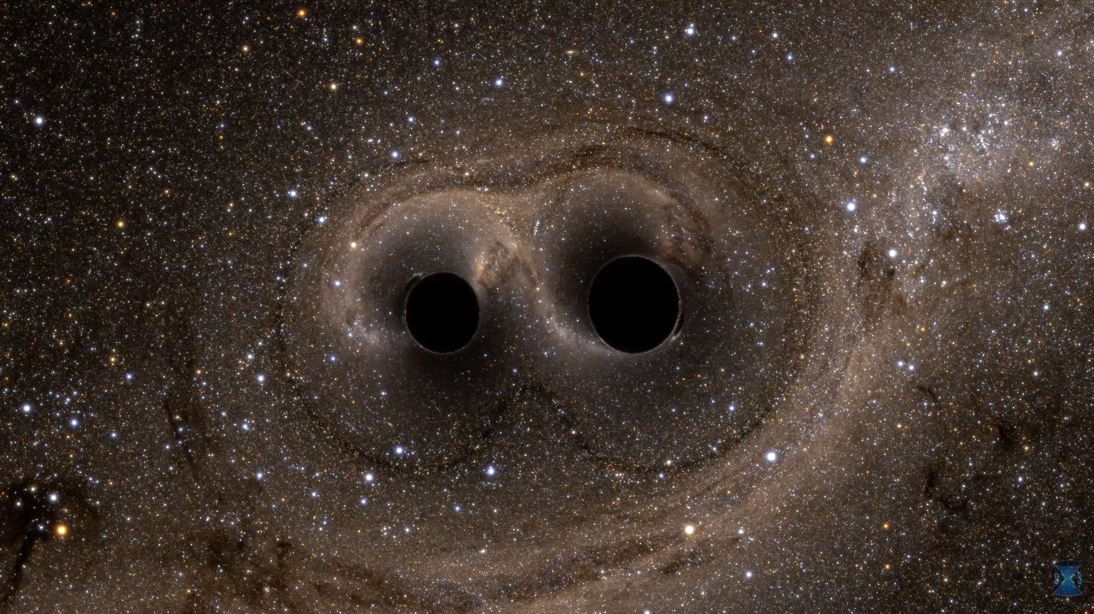
And God was there!

Slide 21
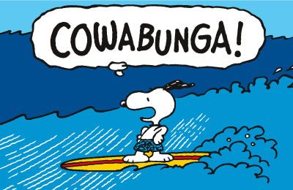
In 1.3 billion years since black holes merged,
life on Earth evolved into plants, fish, reptiles, and mammals that became humans.
Humans discovered gravity waves & built LIGO just in time to detect the jiggle!!

Slide 22
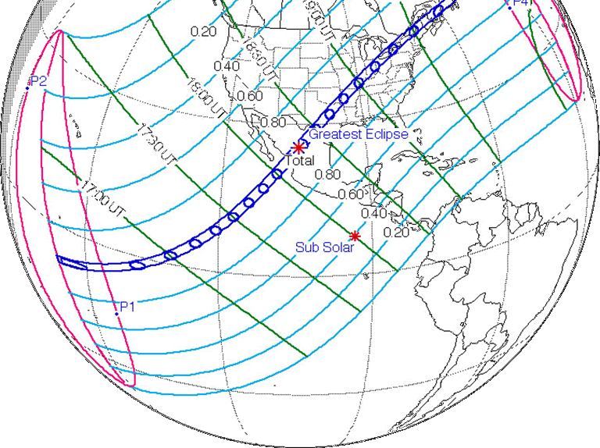
Speaking of Eclipses …
April 8, 2024
  Another Total Solar Eclipse across N. Am.!
https://eclipse.gsfc.nasa.gov/SEdecade/SEdecade2021.html

Slide 23
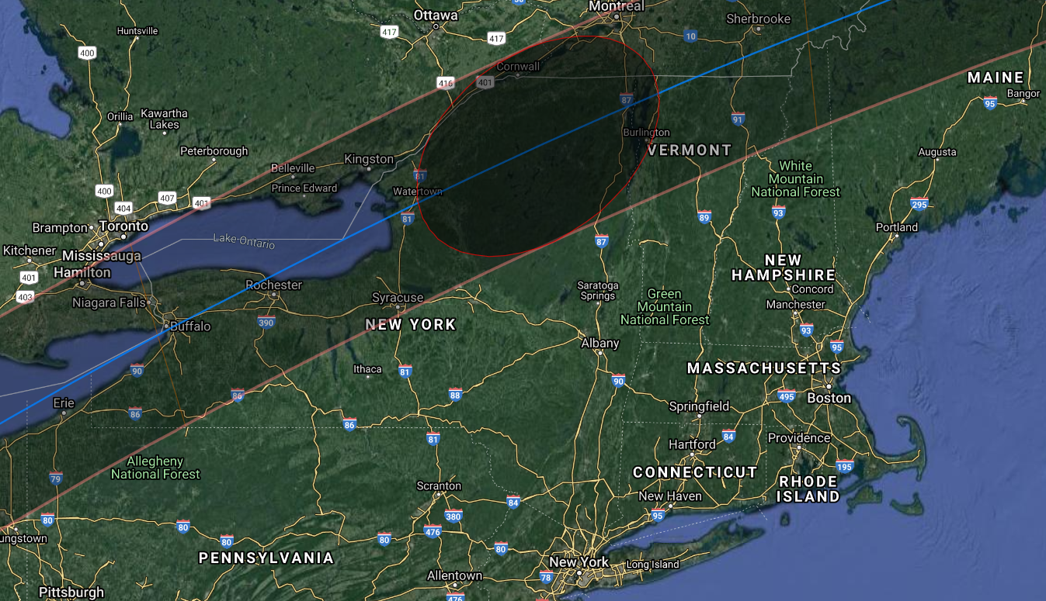
Speaking of Eclipses …
April 8, 2024
  Another Total Solar Eclipse across N. Am.!
http://xjubier.free.fr/en/site_pages/solar_eclipses/TSE_2024_GoogleMapFull.html
ASCO
http://xjubier.free.fr/en/site_pages/solar_eclipses/TSE_2024_GoogleMapFull.html?Lat=44.25475&Lng=-74.47086&Zoom=7&LC=1

Slide 24
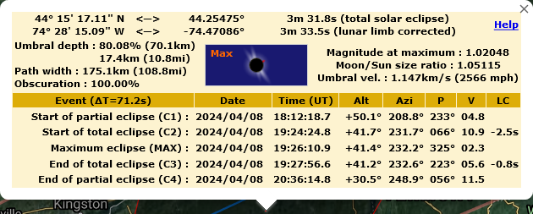
Speaking of Eclipses …
April 8, 2024
  Another Total Solar Eclipse across N. Am.!
http://xjubier.free.fr/en/site_pages/solar_eclipses/TSE_2024_GoogleMapFull.html
ASCO
http://xjubier.free.fr/en/site_pages/solar_eclipses/TSE_2024_GoogleMapFull.html?Lat=44.25475&Lng=-74.47086&Zoom=7&LC=1

Slide 25
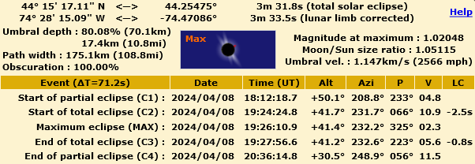
Speaking of Eclipses …
April 8, 2024
  Another Total Solar Eclipse across N. Am.!
3 minutes, 31.8 s of totality!
http://xjubier.free.fr/en/site_pages/solar_eclipses/TSE_2024_GoogleMapFull.html
ASCO
3:24:25
3:27:57
But it’s on April 8 ...
LC = limb correction
http://xjubier.free.fr/en/site_pages/solar_eclipses/TSE_2024_GoogleMapFull.html?Lat=44.25475&Lng=-74.47086&Zoom=7&LC=1

Slide 26
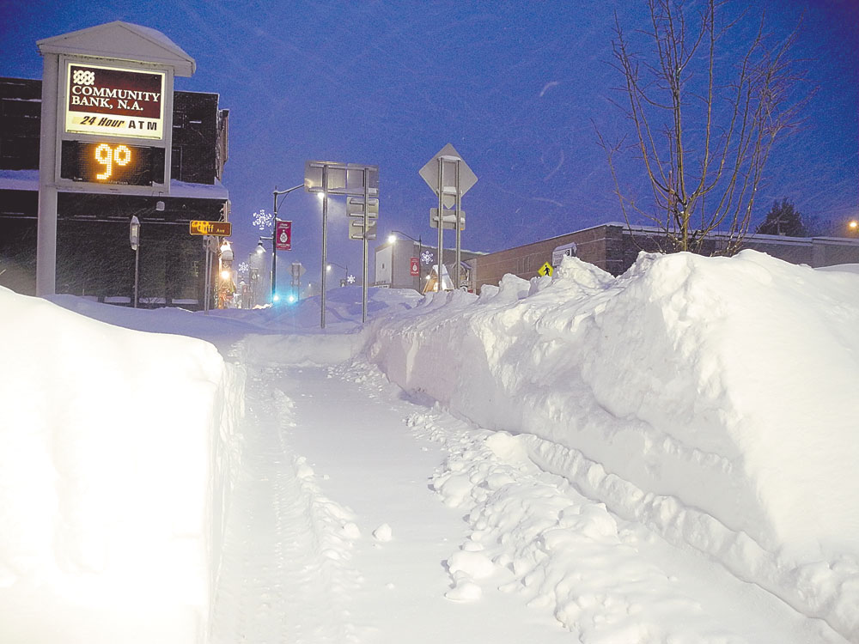

Speaking of Eclipses …
Tupper Lake in April ...
April 8, 2024
  Another Total Solar Eclipse across N. Am.!
3 minutes, 31.8 s of totality!
http://xjubier.free.fr/en/site_pages/solar_eclipses/TSE_2024_GoogleMapFull.html
ASCO
3:24:25
3:27:57
But it’s on April 8 ...
But it will get very dark!!
LC = limb correction
https://www.adirondackdailyenterprise.com/news/local-news/2017/03/digging-it/
http://xjubier.free.fr/en/site_pages/solar_eclipses/TSE_2024_GoogleMapFull.html?Lat=44.25475&Lng=-74.47086&Zoom=7&LC=1

Slide 27
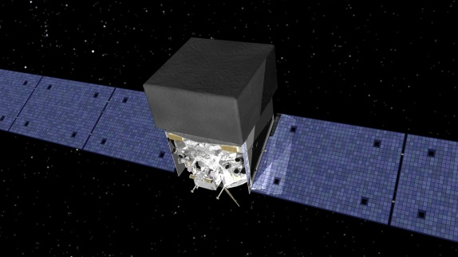
Multi-messenger Astronomy
GW170817: 8:41 am EDT
  LIGO detected gravitational wave
  1.74 s later, Fermi Satellite detected γ–rays
    Gamma-Ray Burst (GRB)
    Neutron star merger
    Produced Earth-mass of Au!
Event discovered independently by two completely different messengers!
Observations by >70 telescopes followed
  including neutrinos ... a 3rd messenger!
A new era in astronomy!
https://fermi.gsfc.nasa.gov/

Slide 28
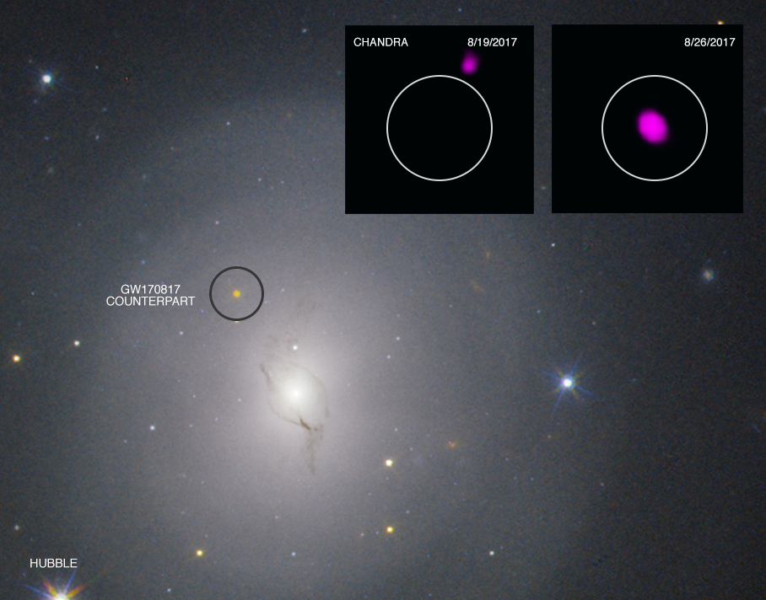
Multi-messenger Astronomy
GW170817: 8:41 am EDT
  LIGO detected gravitational wave
  1.74 s later, Fermi Satellite detected γ–rays
    Gamma-Ray Burst (GRB)
    Neutron star merger
    Produced Earth-mass of Au!
Event discovered independently by two completely different messengers!
Observations by >70 telescopes followed
  including neutrinos ... a 3rd messenger!
A new era in astronomy!
https://fermi.gsfc.nasa.gov/
https://chandra.si.edu/photo/2017/2nstars/

Slide 29
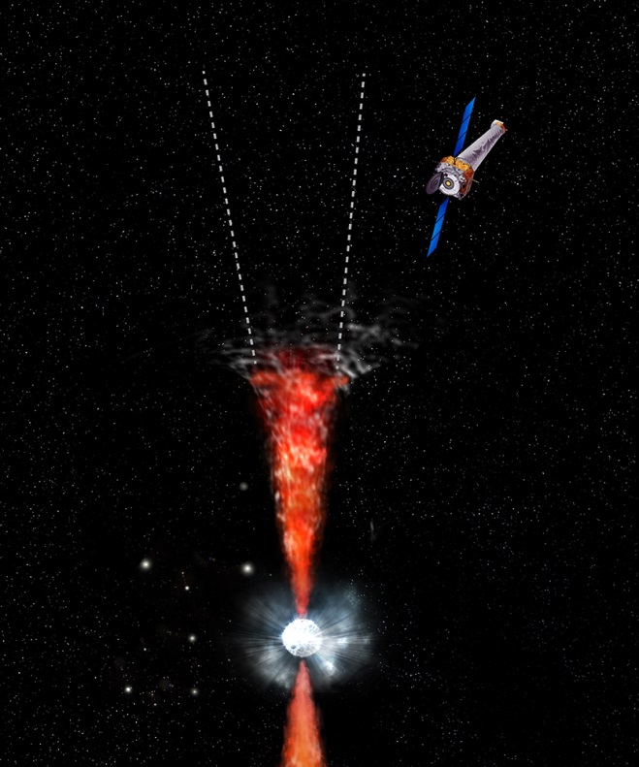
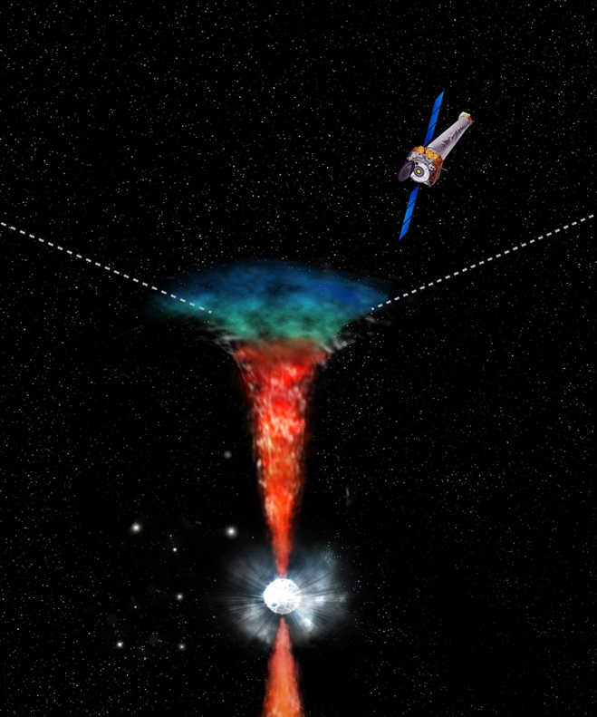
Multi-messenger Astronomy
GW170817: 8:41 am EDT
  LIGO detected gravitational wave
  1.74 s later, Fermi detected γ–rays
    Neutron star merger
    In NGC 4993
    Produce Earth-mass of Au!
Event discovered independently by two completely different messengers!
Observations by >70 telescopes followed
  including neutrinos!
A new era in astronomy!
Chandra view
https://fermi.gsfc.nasa.gov/
Jet initially invisible to Chandra
Jet widened due to colliding with sur-rounding material
https://chandra.si.edu/photo/2017/2nstars/

Slide 30
Multi-messenger Astronomy
This is the first time astronomers have all of the necessary pieces of information of neutron stars merging — from the production of gravitational waves followed by signals in gamma rays, X-rays, optical and infrared light, that all agree with predictions for a short GRB viewed off-axis.
Quote from https://chandra.si.edu/photo/2017/2nstars/

Slide 31
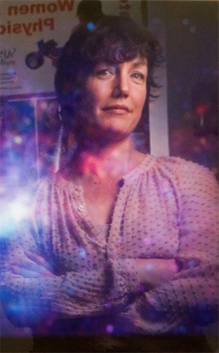
Multi-messenger Astronomy
According to PI Daryl Haggard (McGill)
"This is a big deal because it's an entirely new level of knowledge. This discovery allows us to link this gravitational wave source up to all the rest of astrophysics, stars, galaxies, explosions, growing massive black holes, and of course neutron star mergers."
https://chandra.si.edu/blog/node/659

Slide 32
Multi-messenger Astronomy
Spacetime
  Is, in truth, a “fluid” that ripples
  What else will we learn from the ripples?
The adventure continues ...

