Slide 1

Solar Eclipse in Alexandria Bay April 2024
Dr. Aileen A. O’Donoghue
March 30, 2024
© Copyright, Dr. Aileen A. O’Donoghue, St. Lawrence University

Slide 2

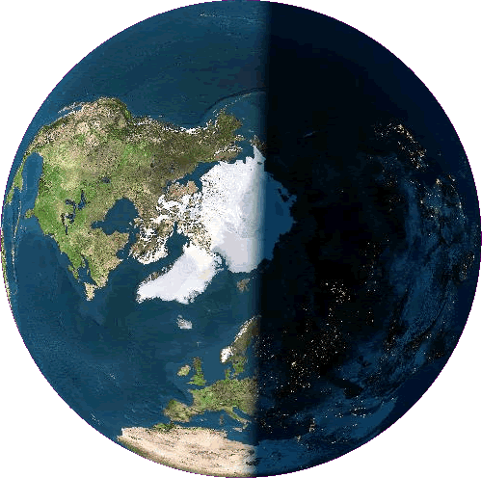
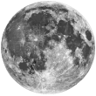
Solar Eclipse
Moon’s shadow falls on Earth
Moon and Sun aligned in Earth’s sky
Penumbra partial eclipse
Umbra total eclipse
Penumbra
Umbra

Slide 3

Lunar Eclipse
Earth’s shadow falls on Moon
Earth and Sun aligned in Moon’s sky
Penumbra partial eclipse
Umbra total eclipse
Penumbra
Umbra

Slide 4
Sizes and Distances
Earth
diameter ≈ 8,000 miles
circumference ≈ 25,000 miles
Moon
diameter ≈ 2,000 miles (¼ Earth’s) ≈ ½° on sky
distance from Earth ≈ 240,000 miles
Sun
diameter ≈ 865,000 miles ≈ 400 Moon’s ≈ ½° on sky
distance from Earth ≈ 93,000,000 miles
≈ 30 Earth diameters
≈ 400 Moon Distances
Sun is 400 times bigger and 400 times farther than Moon

Slide 5
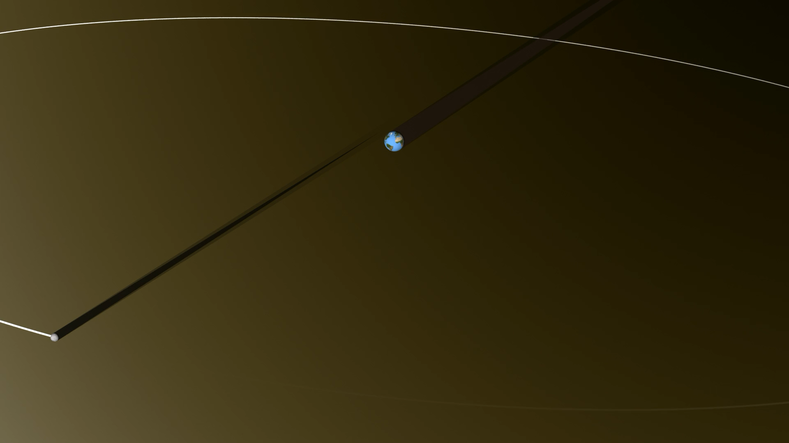
Eclipse Viewed from Space
Moon moves ~ 2500 mph in orbit (W to E)
Earth rotates ~ 1000 mph at equator
Moon appears to move ~ 1500 mph

Slide 6
Eclipse Viewed from Space
Moon moves ~ 2500 mph in orbit (W to E)
Earth rotates ~ 1000 mph at equator
Moon appears to move ~ 1500 mph

Slide 7
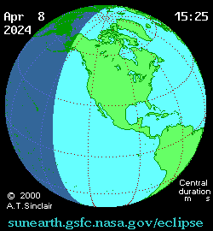
Eclipse Viewed from Space
Moon’s shadow moves from west to east!
Moves faster at higher latitudes
Umbra takes 1 hour & 31 minutes from hitting coast of Mexico to leaving coast of New Brunswick
18:07:20 to 19:38:17 UT

Slide 8
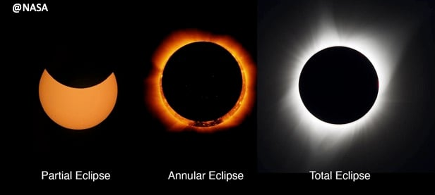
Types of Eclipse
Amount of Sun covered by Moon
Partial (August 2017, October 2023)
Annular (May 1994, October 2023 in west)
Total April 8, 2024

Slide 9
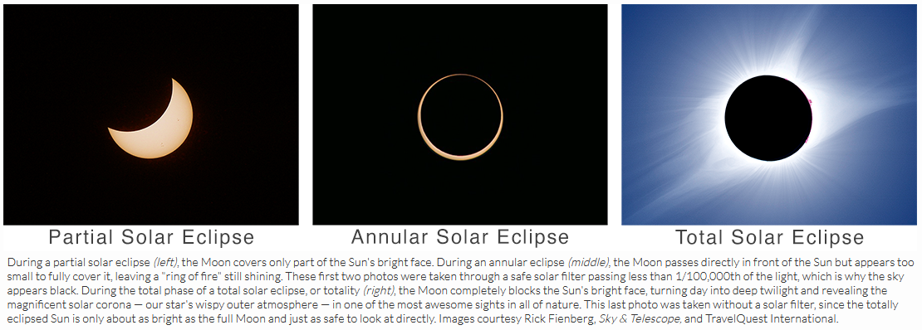
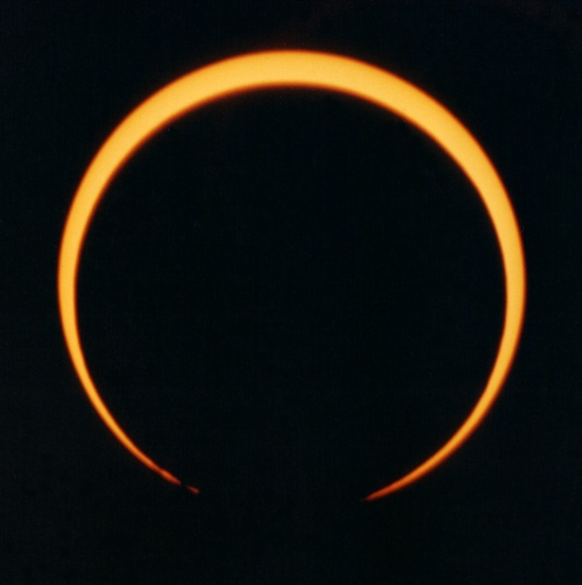
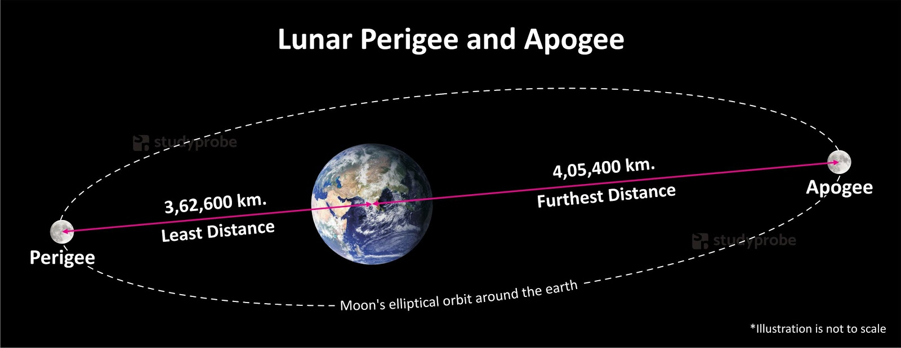
Annular Solar October 14, 2023
Moon at apogee ... farthest from Earth
Too small to cover entire Sun
Annular in Western US
NoCoNY on May 10, 1994
Photo by Jeff Miller from SLU campus 1:34 pm 5/10/1994
252,088 miles
225,623 miles
https://www.studyprobe.in/2020/03/lunar-perigee-and-apogee.html

Slide 10
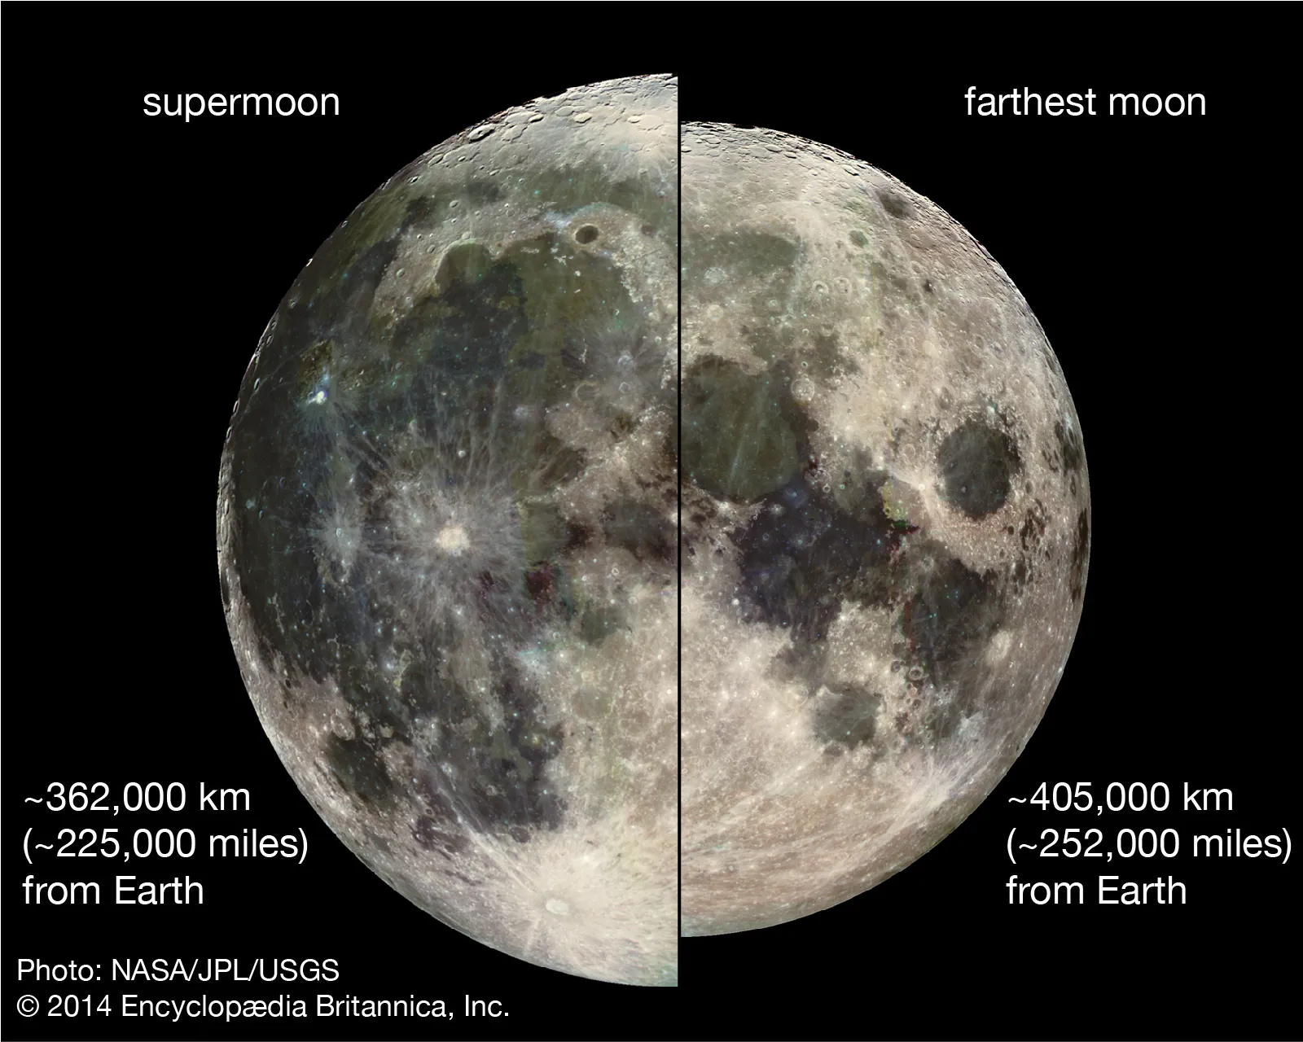
Super Moon & Micro Moon
April 8 has Super New Moon ... covers Sun!
Full Moon will be a Micro Moon!
S
Super Full Moon
September & October 2024
Micro Full Moon
February & March 2024

Slide 11
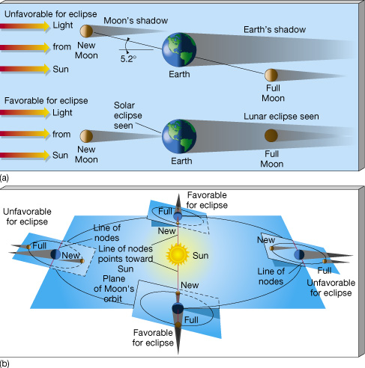
Solar Eclipse Conditions
Unfavorable for eclipses
Moon’s orbit tilted 5.2° from Earth’s`
1. New Moon (between Earth and Sun)
2. Moon on Node (crossing Earth’s orbit)
3-D View
Line of nodes: Moon’s orbit crosses Earth’s
Nodes: Moon’s orbit crosses Earth’s
Line of nodes must point toward Sun for eclipses to occur!

Slide 12
Total Solar Eclipses on Earth
Occur about every year and a half
Eclipses in same location
Generally about 400 years apart
Last totality in Alex Bay on May 15, 831
1193 years ago!!!

Slide 13
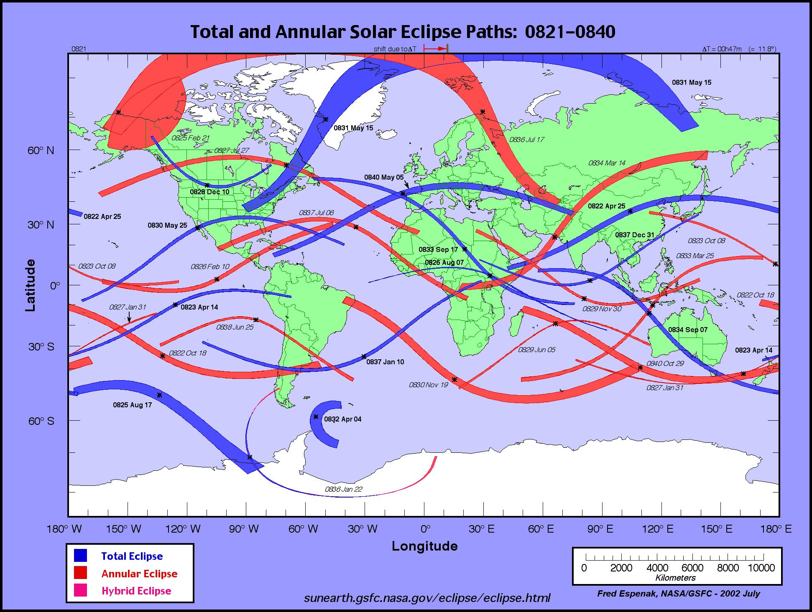
Total Solar Eclipses on Earth
Occur about every year and a half
Eclipses in same location
Generally about 400 years apart
Last totality in Alex Bay on May 15, 831
1193 years ago!!!
Last total eclipse in Alex Bay on May 15, 831!
https://eclipse.gsfc.nasa.gov/SEatlas/SEatlas.html

Slide 14
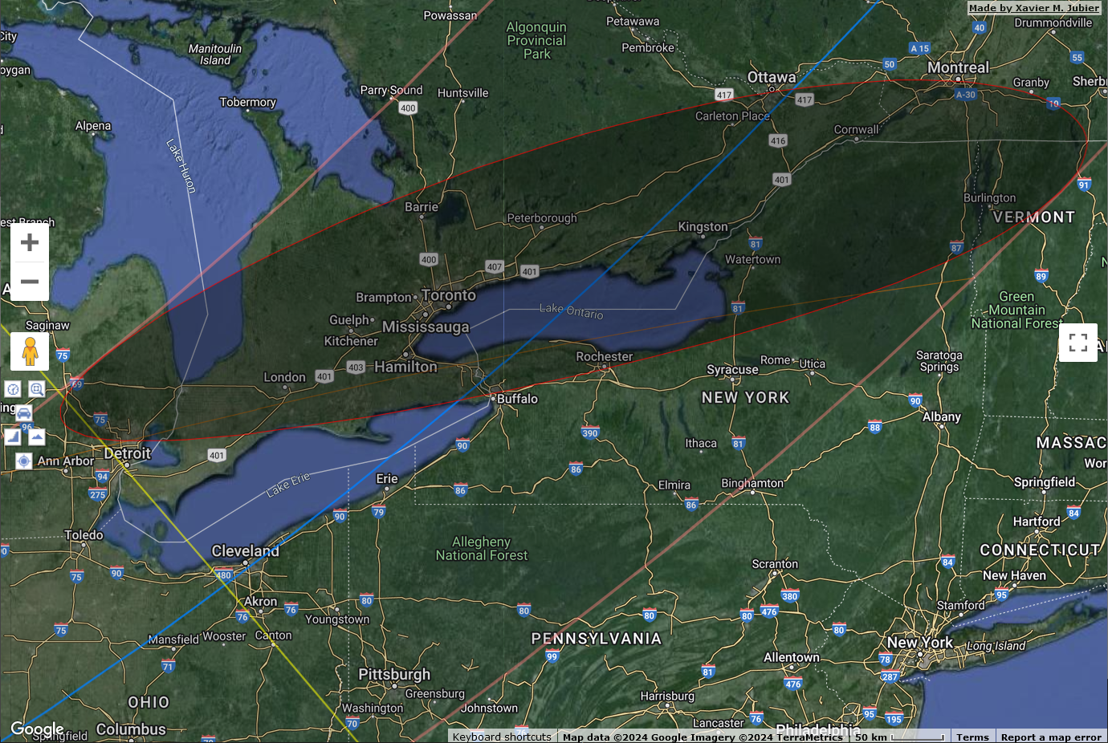
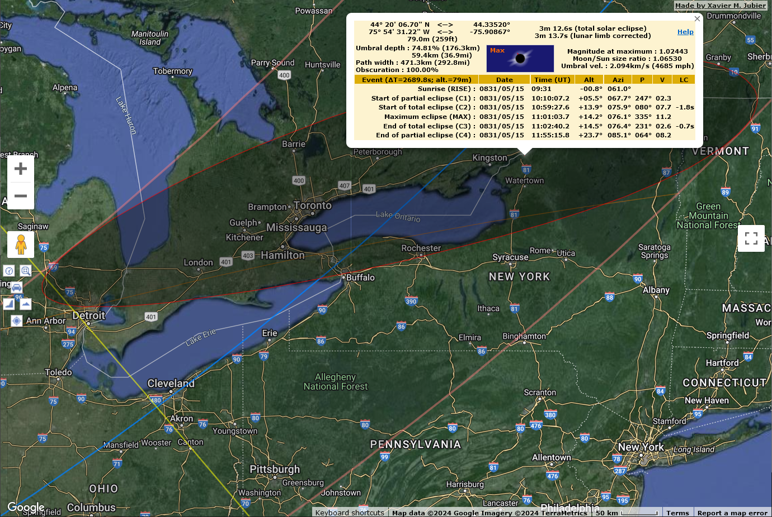
Total Solar Eclipses on Earth
Occur about every year and a half
Eclipses in same location
Generally about 400 years apart
Last totality in Alex Bay on May 15, 831
1193 years ago!!!
Took place near sunset!
Last total eclipse in Alex Bay on May 15, 831!
3 minutes 13 seconds of totality in 831.

Slide 15
Total Solar Eclipses on Earth
Occur about every year and a half
Eclipses in same location
Generally about 400 years apart
Last totality in Alex Bay on May 15, 831
1193 years ago!!!
This year’s totality on April 8, 2024

Slide 16
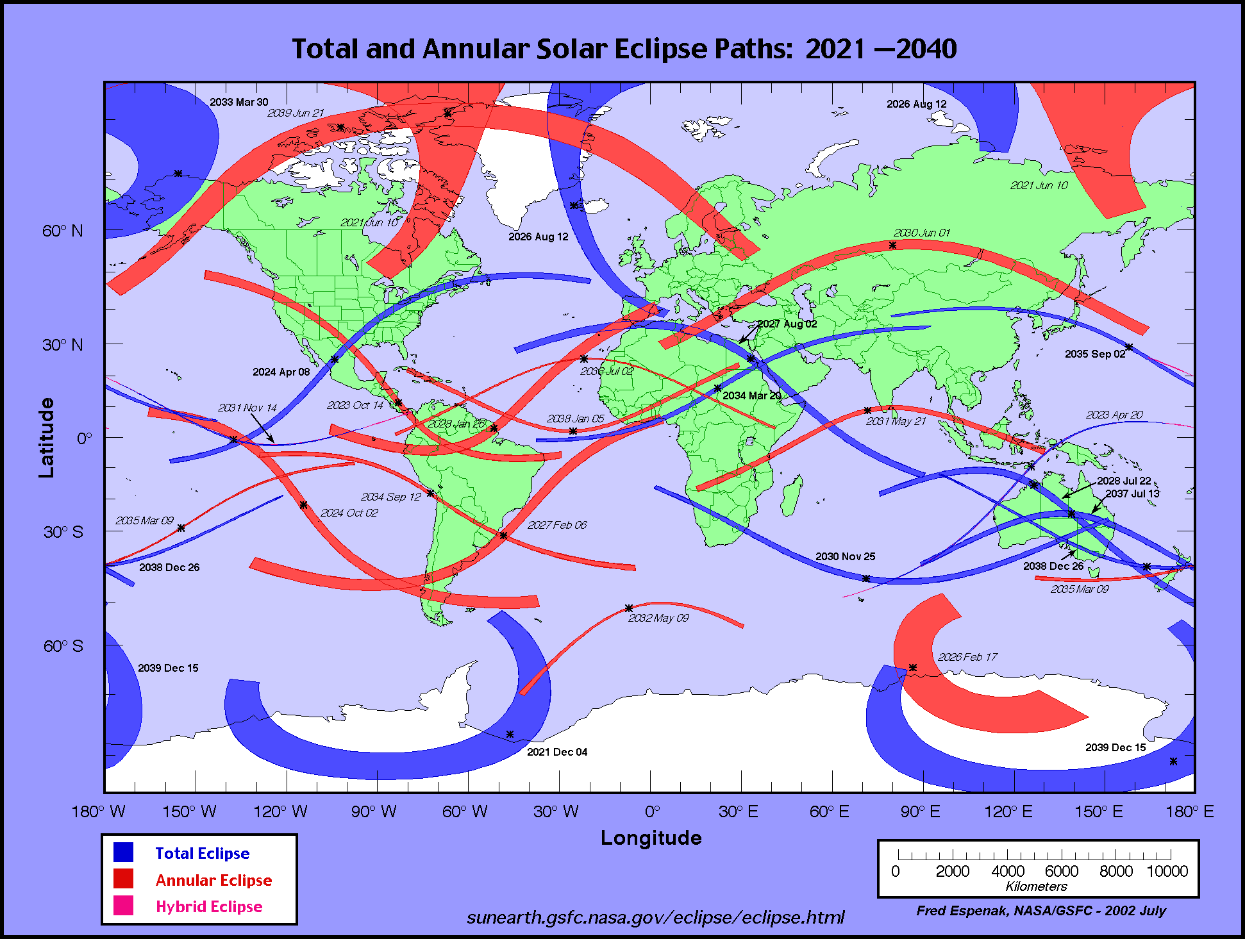
Total Solar Eclipses on Earth
Occur about every year and a half
Eclipses in same location
Generally about 400 years apart
Last totality in Alex Bay on May 15, 831
1193 years ago!!!
This year’s totality on April 8, 2024
More on this one in a minute!
Total eclipse in Alex Bay on April 8, 2024!
https://eclipse.gsfc.nasa.gov/SEatlas/SEatlas.html

Slide 17
Total Solar Eclipses on Earth
Occur about every year and a half
Eclipses in same location
Generally about 400 years apart
Last totality in Alex Bay on May 15, 831
1193 years ago!!!
This year’s totality on April 8, 2024
Next totality in Alex Bay on August 2, 2399
375 years from now!
April’s eclipse is a once in 1,568 years ... once in more than 16 - 20 lifetimes event!

Slide 18
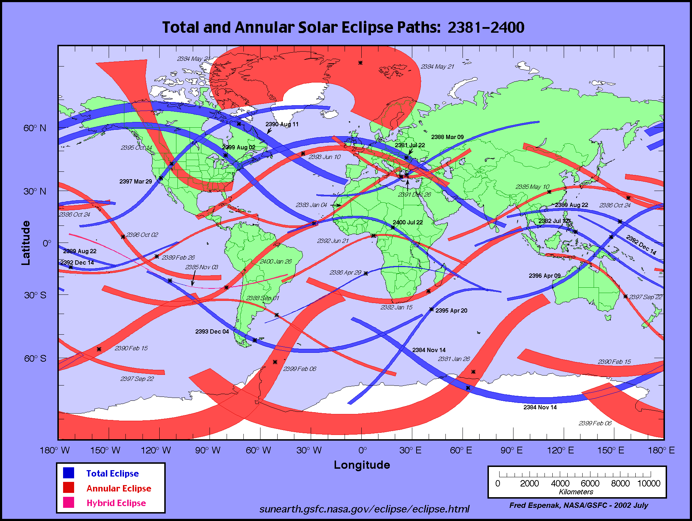
Total Solar Eclipses on Earth
Occur about every year and a half
Eclipses in same location
Generally about 400 years apart
Last totality in Alex Bay on May 15, 831
1193 years ago!!!
This year’s totality on April 8, 2024
Next totality in Alex Bay on August 2, 2399
375 years from now!
Next total eclipse in Alex Bay on August 2, 2399!
https://eclipse.gsfc.nasa.gov/SEatlas/SEatlas.html

Slide 19
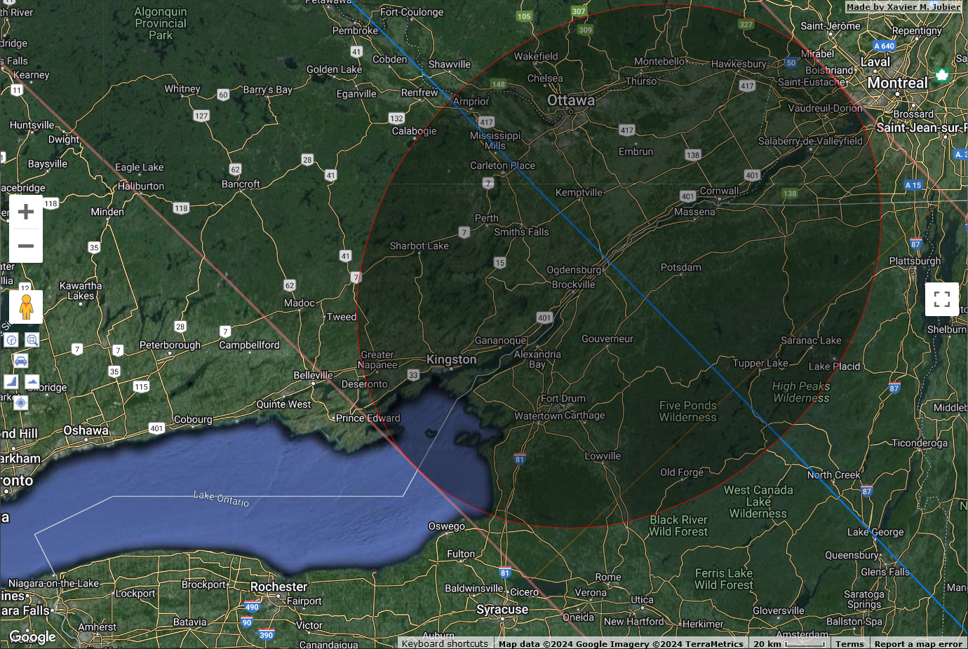
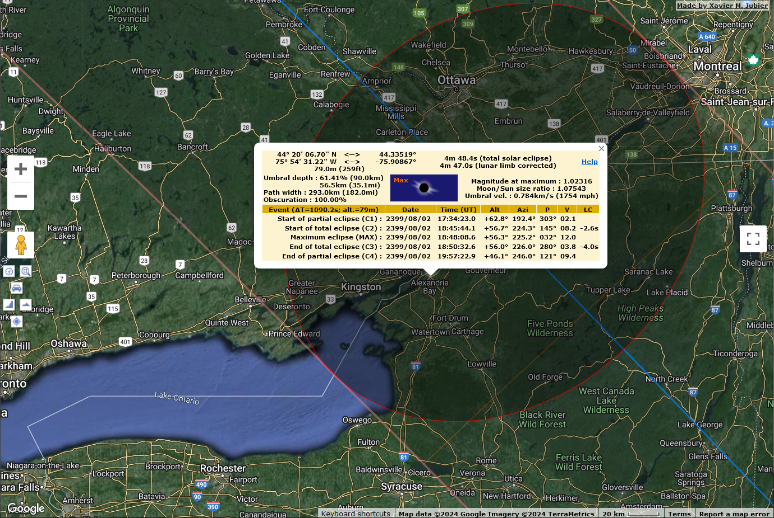
Total Solar Eclipses on Earth
Occur about every year and a half
Eclipses in same location
Generally about 400 years apart
Last totality in Alex Bay on May 15, 831
1193 years ago!!!
This year’s totality on April 8, 2024
Next totality in Alex Bay on August 2, 2399
375 years from now!
4 minutes 48 seconds of totality!
All of NoCoNY in Totality in 2399!
Next total eclipse in Alex Bay on August 2, 2399!

Slide 20
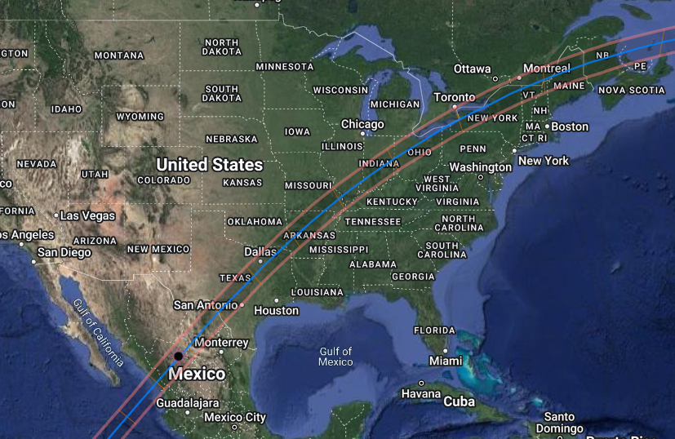
Total Solar April 8, 2024
Total in east, partial in west
http://xjubier.free.fr/en/site_pages/solar_eclipses/TSE_2024_GoogleMapFull.html
Path of Maximum
1^{h}31^{m} to cross continent

Slide 21
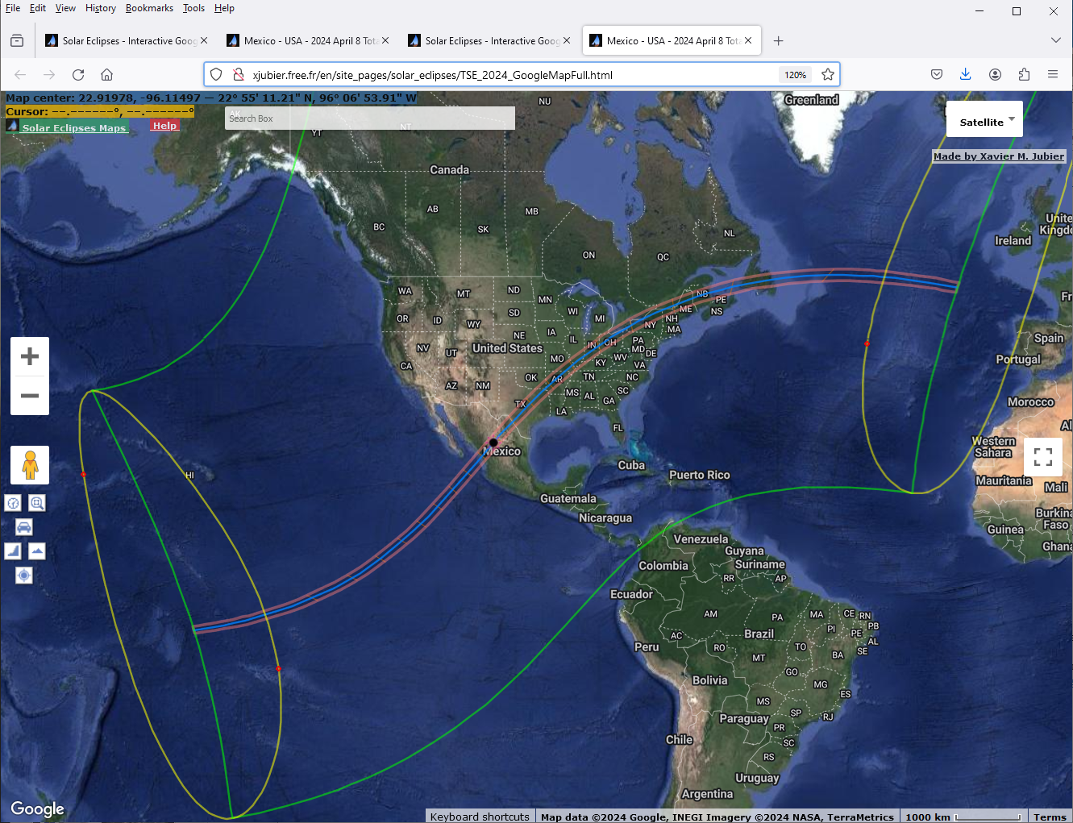
Total Solar April 8, 2024
Total in east, partial in west
http://xjubier.free.fr/en/site_pages/solar_eclipses/TSE_2024_GoogleMapFull.html
Interactive Google Map
Path of Maximum
Google “xjubier interactive eclipse map”
1^{h}31^{m} to cross continent
http://xjubier.free.fr/en/site_pages/solar_eclipses/TSE_2024_GoogleMapFull.html

Slide 22
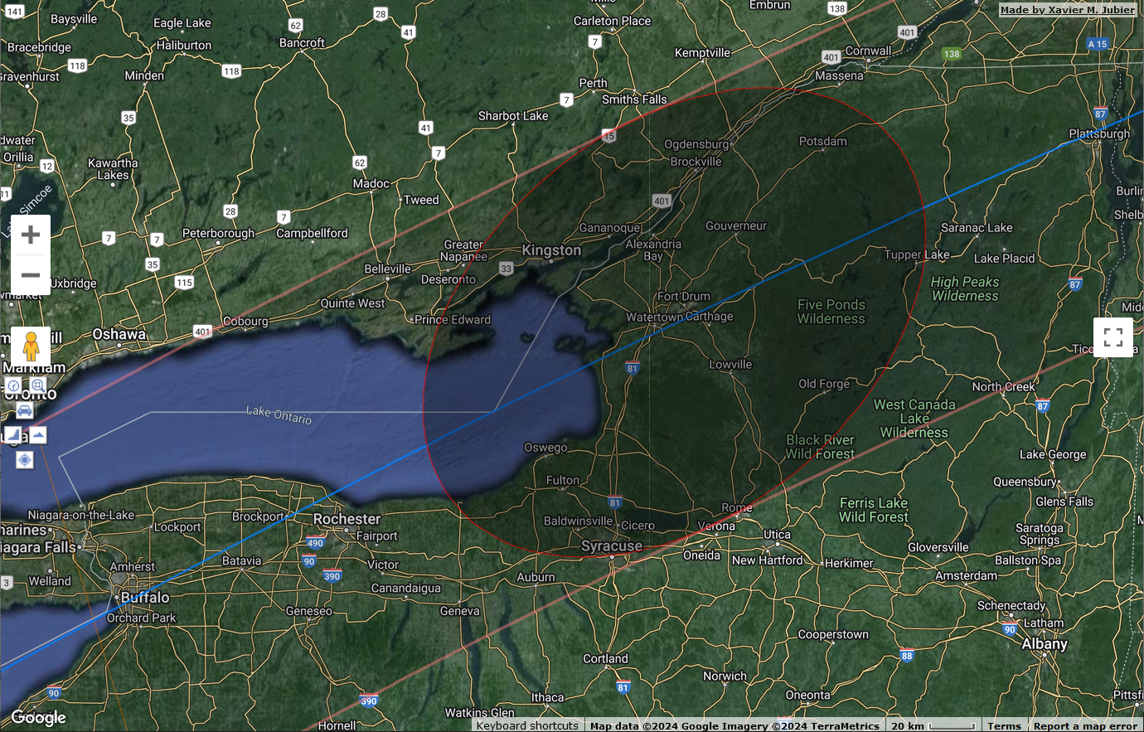
Total Solar April 8, 2024
Zoom to Soccer Field West Penalty Spot
http://xjubier.free.fr/en/site_pages/solar_eclipses/TSE_2024_GoogleMapFull.html
http://xjubier.free.fr/en/site_pages/solar_eclipses/TSE_2024_GoogleMapFull.html

Slide 23
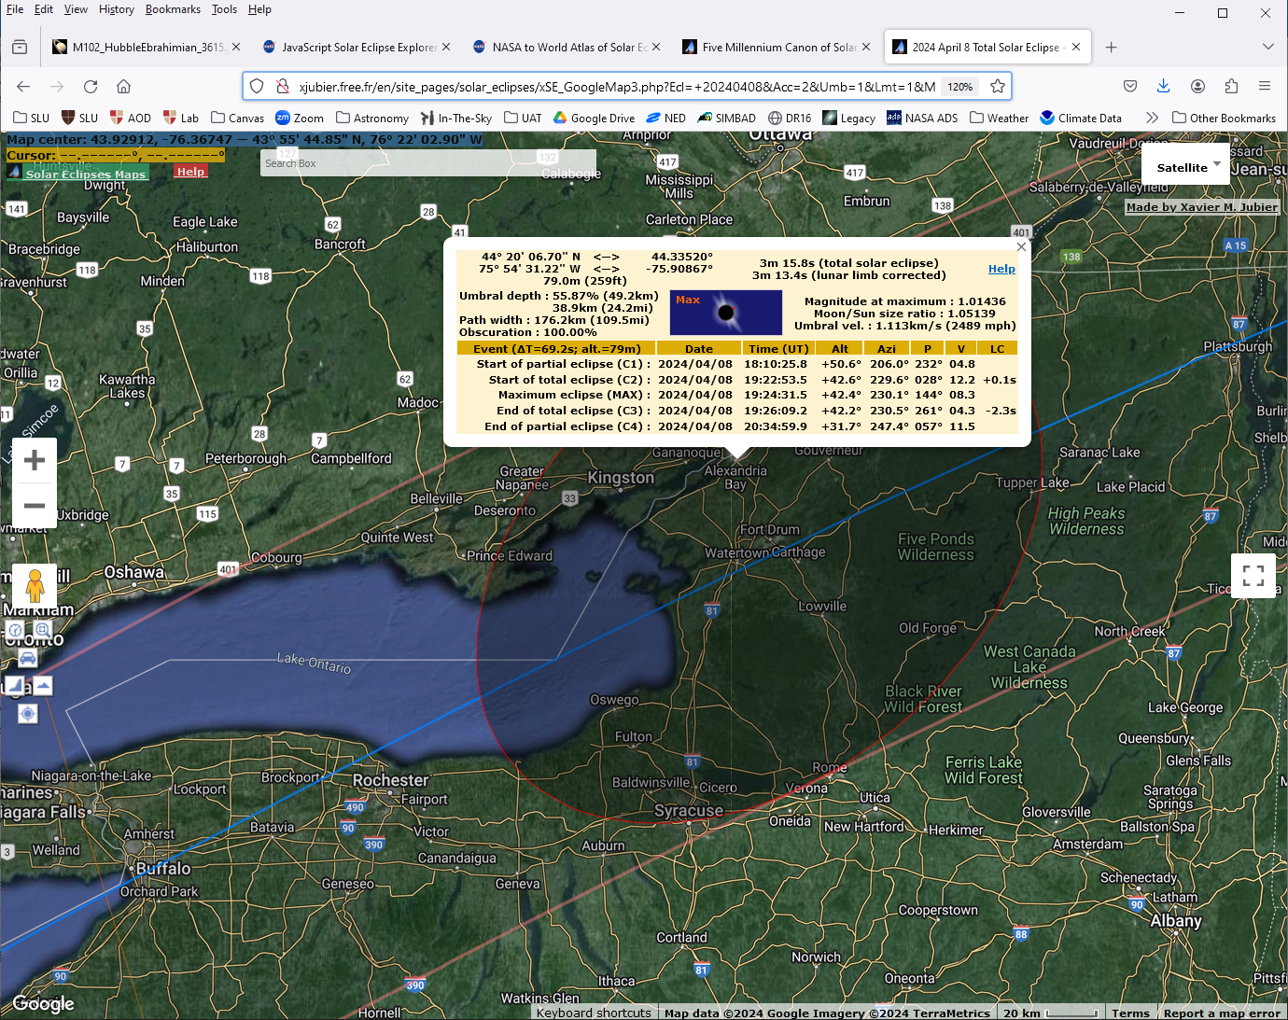
Total Solar April 8, 2024
Zoom to Soccer Field West Penalty Spot
Time (EDT) = UT – 4 ⇒ 18:10:26 UT = 14:10:26 = 2:10:26 pm
Umbra 110 mi wide
3 min 16 s of totality
2:10:26 pm Partial Eclipse Begins
3:22:54 pm Total Eclipse Begins
3:24:32 pm Moon Centered on Sun
3:26:09 pm Total Eclipse Ends
4:35:00 pm Partial Eclipse Ends
http://xjubier.free.fr/en/site_pages/solar_eclipses/TSE_2024_GoogleMapFull.html
http://xjubier.free.fr/en/site_pages/solar_eclipses/TSE_2024_GoogleMapFull.html

Slide 24
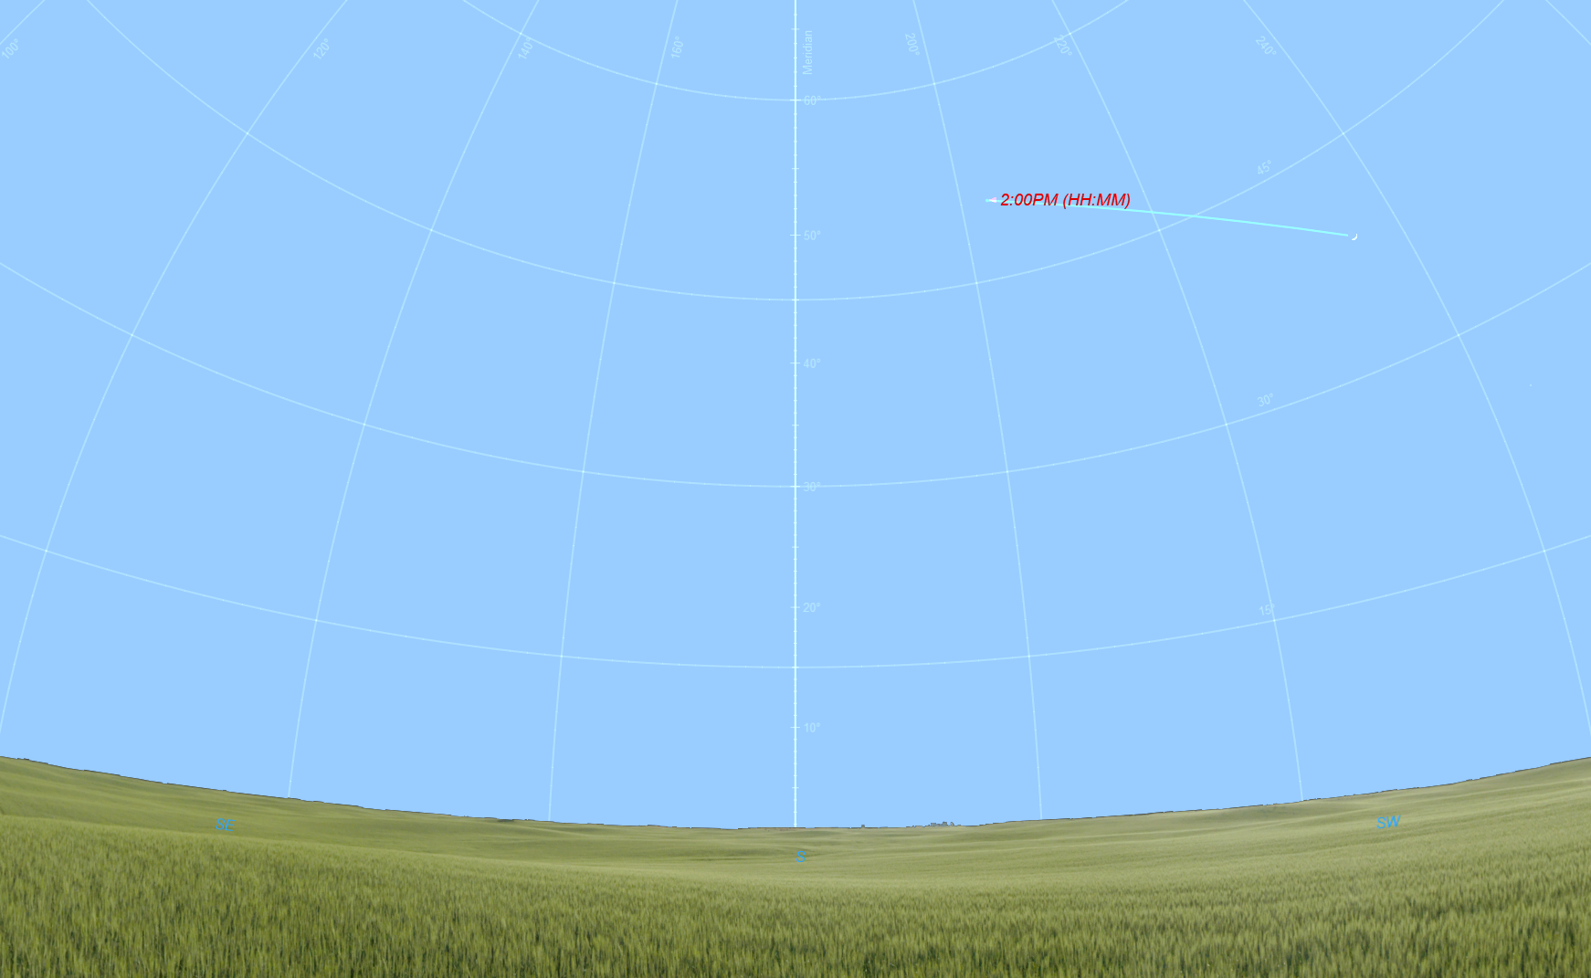
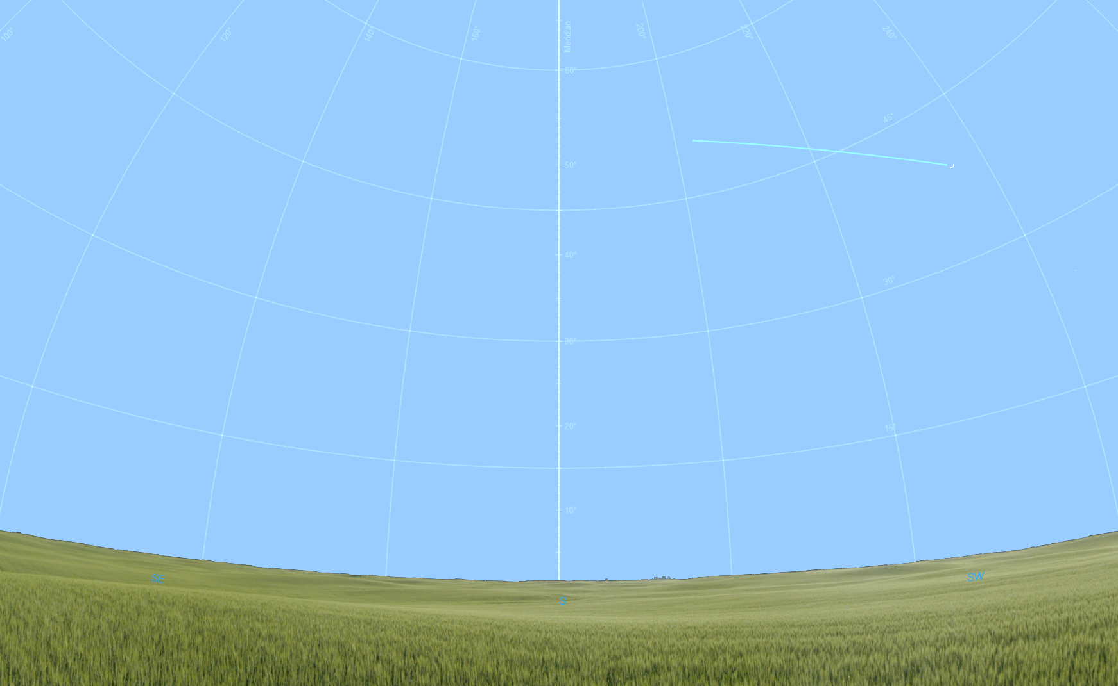
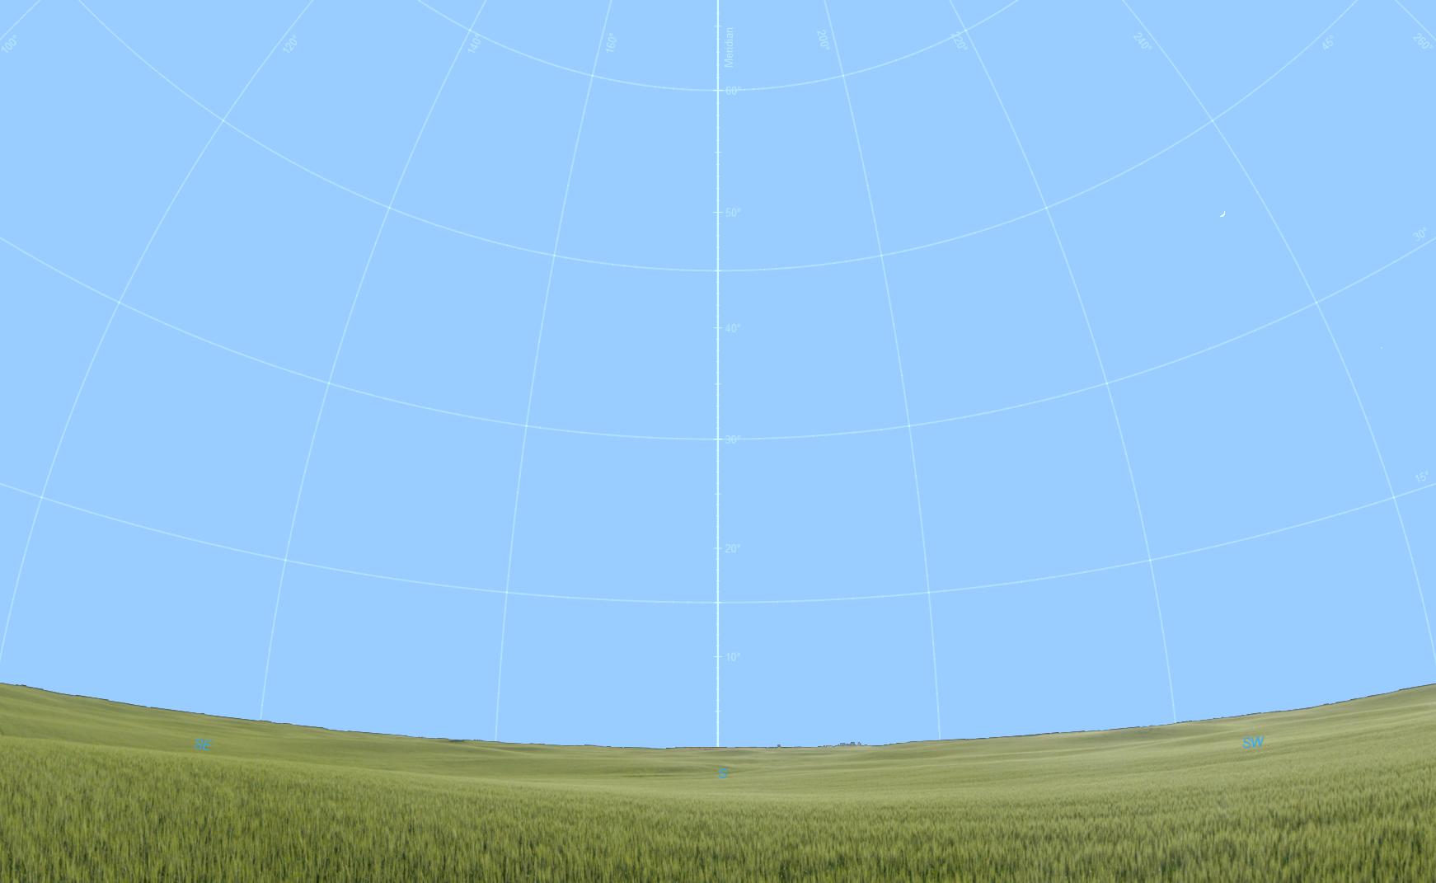
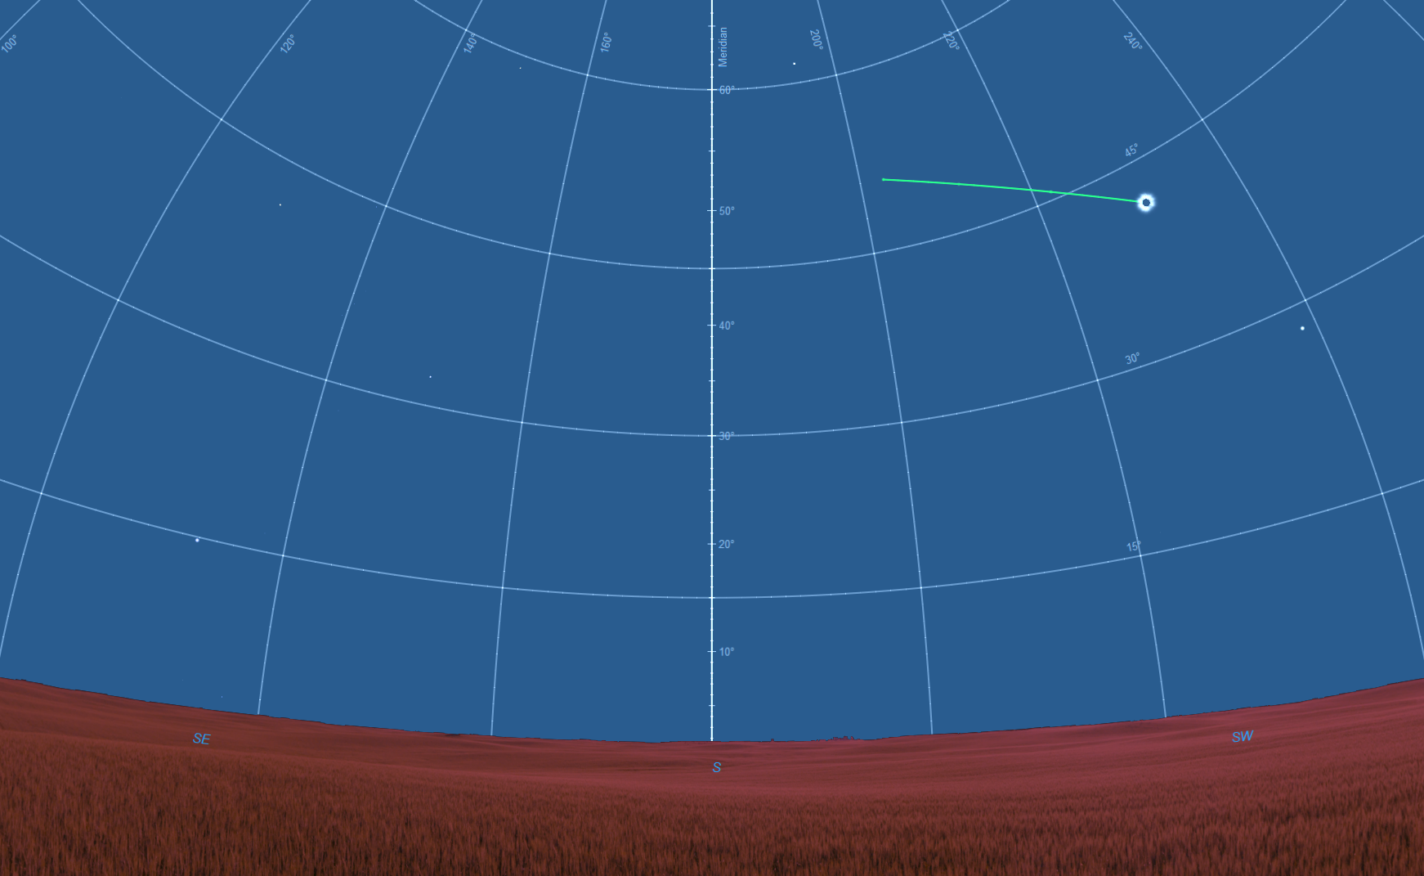
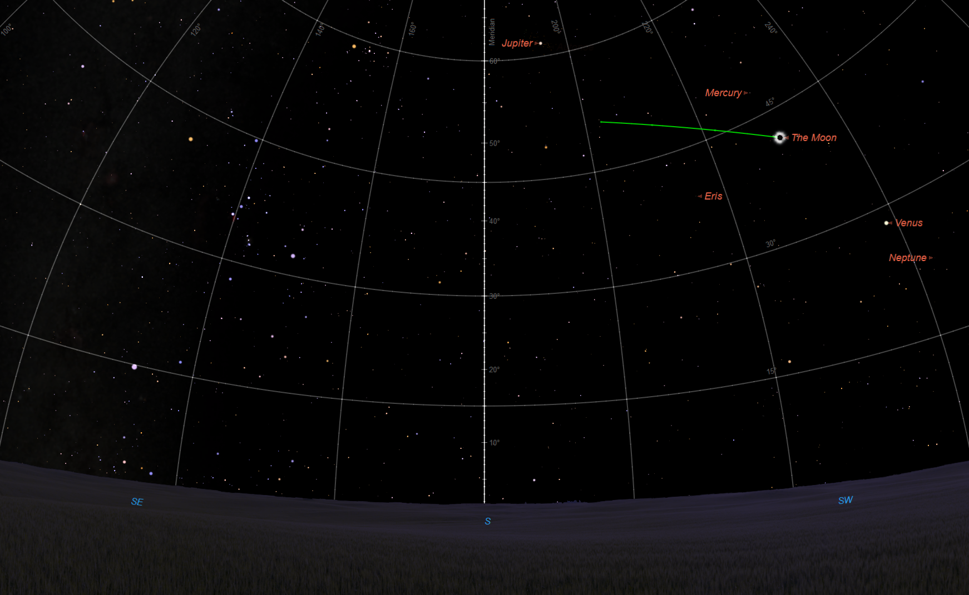
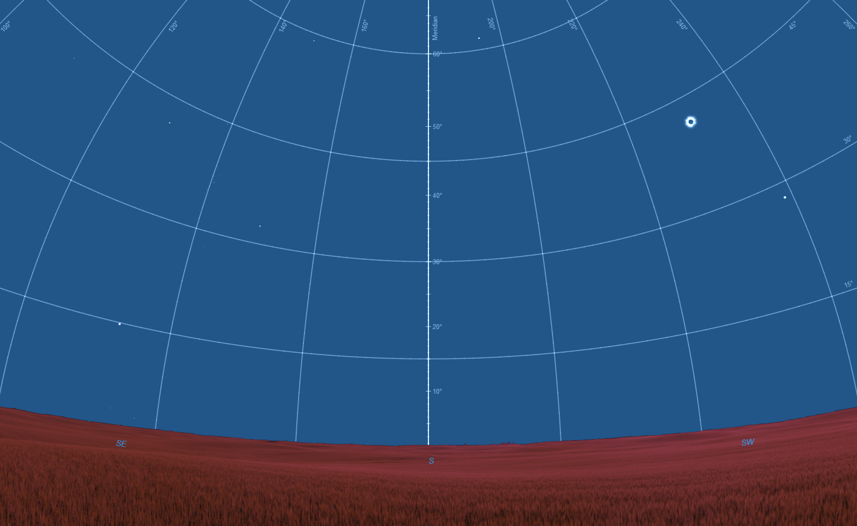
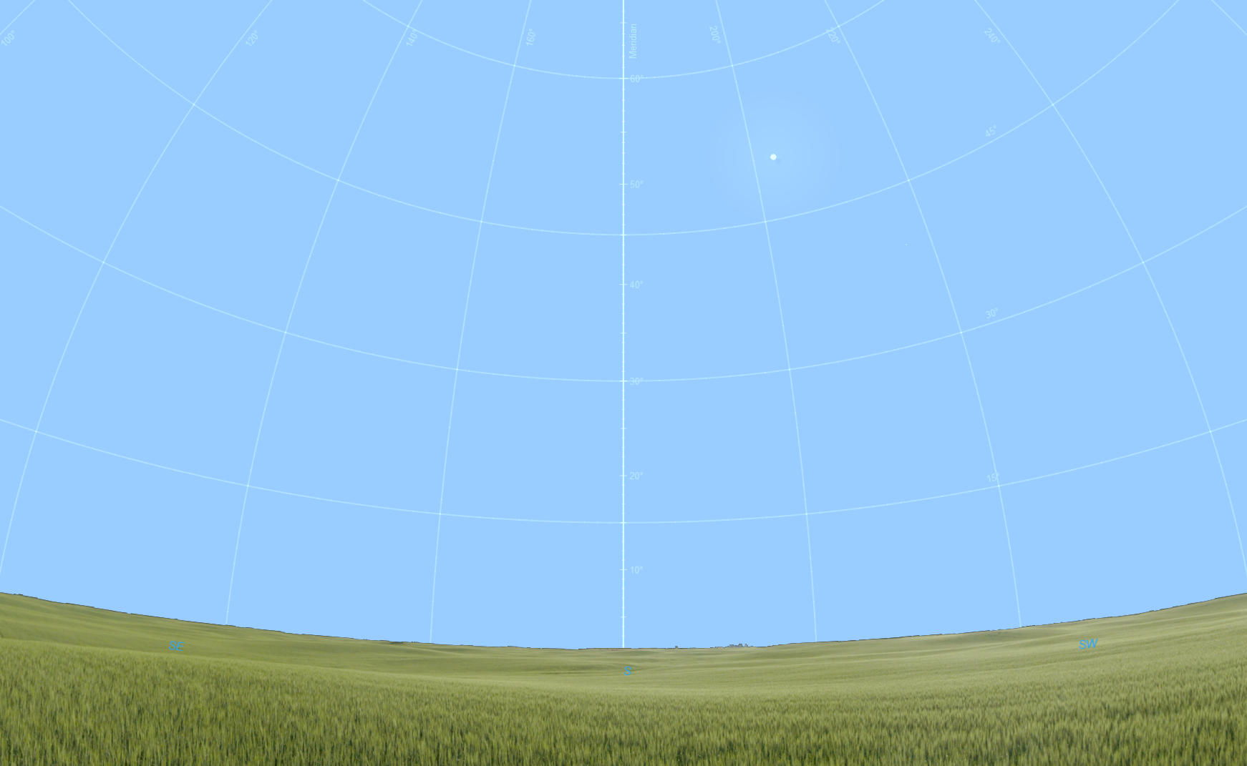
Where to look in the Sky
Sun will start ~50° above SSW horizon
will move right & lower during eclipse
View at 2:00 pm, April 8, 2024
Partial eclipse begins at 2:11 pm
Sun
Moon
45°
20°
30°
10°
15°
Fist at arm’s length
SE
SW
South

Slide 25
Where to look in the Sky
Sun will start ~50° above SSW horizon
will move right & lower during eclipse
View at 3:25 pm, April 8, 2024
Total eclipse from 3:22:54 – 3:26:09 pm
Jupiter
Mercury
Betelgeuse
Center of totality 3:24:32 pm
45°
Venus
Rigel
30°
10°
Sirius
15°
Fist at arm’s length
SE
SW
South

Slide 26
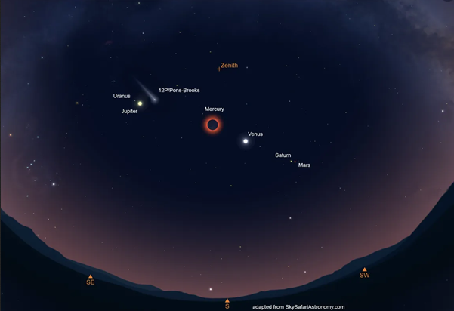
Where to look in the Sky
Sun will start ~50° above SSW horizon
will move right & lower during eclipse
https://www.astronomy.com/observing/a-comet-will-be-visible-during-the-2024-total-solar-eclipse/
We may get to see a comet!
View at 3:25 pm, April 8, 2024
Total eclipse from 3:22:54 – 3:26:09 pm
Jupiter
Mercury
Betelgeuse
Center of totality 3:24:32 pm
45°
Venus
Rigel
30°
Comet 12P/Pons-Brooks may be visible near Jupiter
10°
Simulated view from South Texas from Astronomy Magazine.
Sirius
15°
Fist at arm’s length
SE
SW
South

Slide 27
Where to look in the Sky
Sun will start ~50° above SSW horizon
will move right & lower during eclipse
View at 3:45 pm, April 8, 2024
Partial eclipse ends at 4:35:29 pm
Partial phase after totality at 3:45 pm
45°
30°
Eclipse ends at 4:35 pm
10°
15°
Fist at arm’s length
SE
SW
South

Slide 28

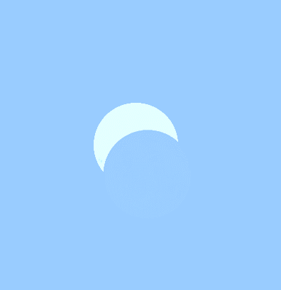
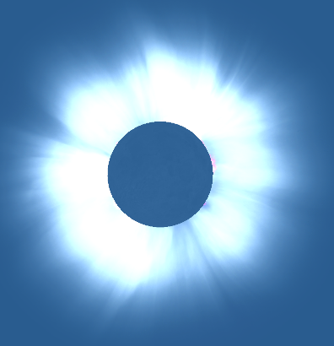


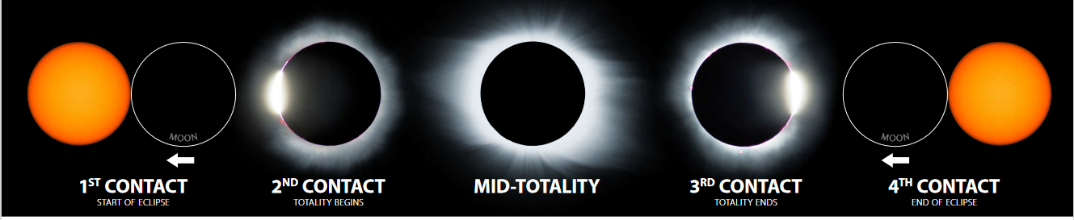
What We’ll See
Stages of the Eclipse
Moon will move up and left across Sun
2:10:25
3:00:00
3:24:31
4:00:00
4:35:00
3:22:54
3:24:31
3:26:09
No eclipse glasses needed!!

Slide 29
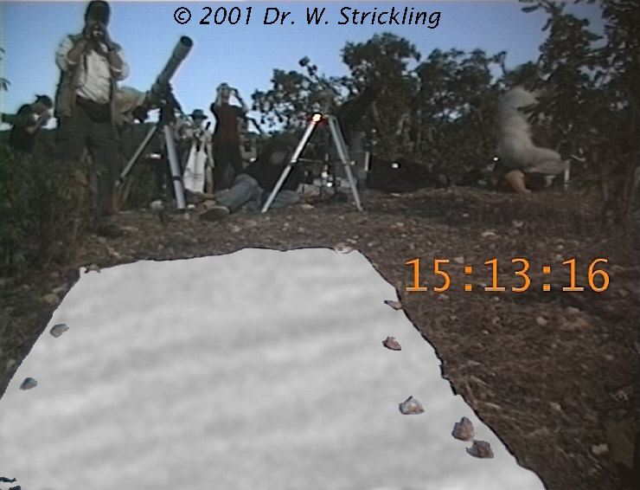
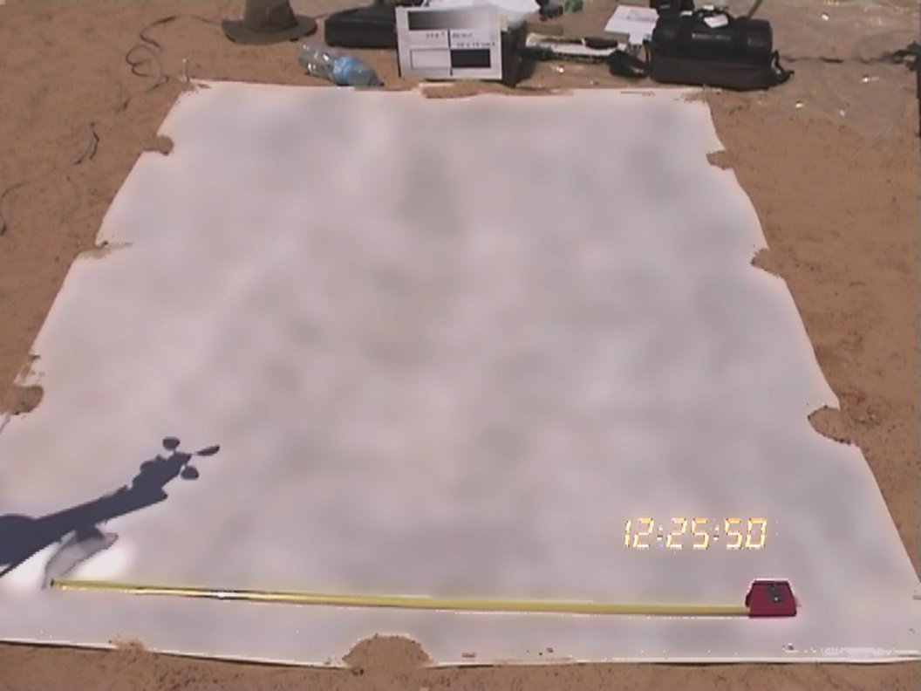
What We’ll See
Just Before Totality
Shadow Bands appear on ground & walls
Due to air turbulence affecting light
Like patterns on the bottom of a pool
We’re on the bottom of an ocean of air!!
https://www.strickling.net/shadowbands.htm

Slide 30
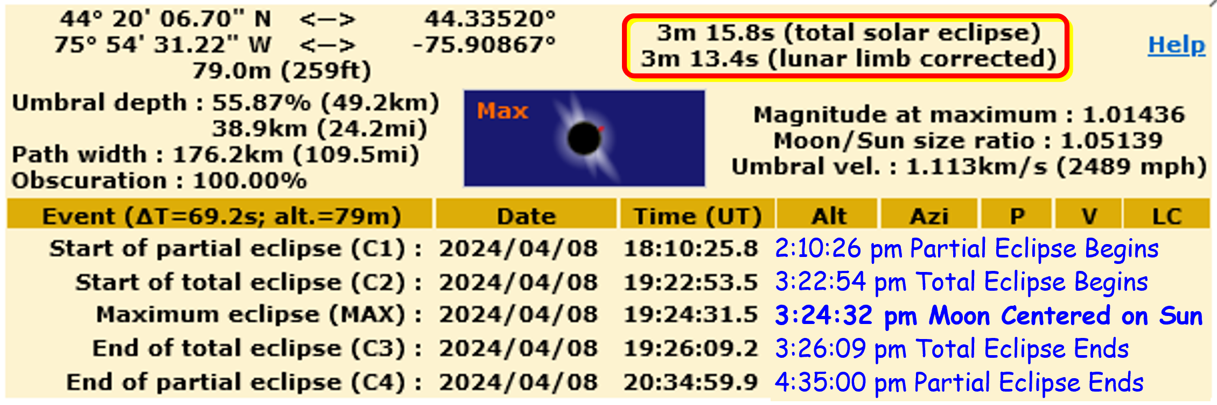
Eclipse Features
Partial Phases from 2:11 pm – 3:15 pm
Light won’t noticeably dim until ~3:15 pm
But the light will seem “weird”
Totality approaching ~ 3:15 pm – 3:22 pm
“In the five minutes before totality, you can really get a feel for how earth-shatteringly frightening this event must have been to ancient people who had no idea what was going on. We can truly believe that people could have been frightened to death!”
- Experience of Totality on eclipse2024.org
Those folks in 831!!

Slide 31
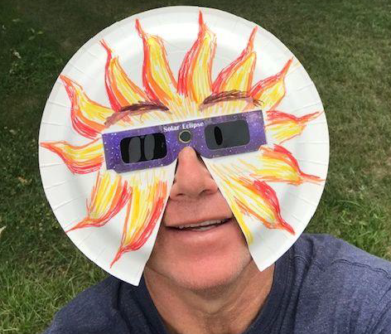

Viewing the Eclipse
Partial Phases (like no eclipse)
Eclipse glasses
Make paper plate masks for kids:
https://mynasadata.larc.nasa.gov/lesson-plans/solar-eclipse-safety-activity
Handouts and paper plate templates available after talk.

Slide 32
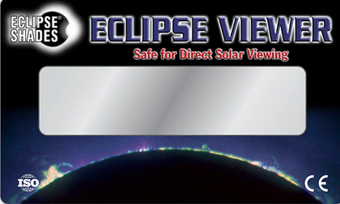
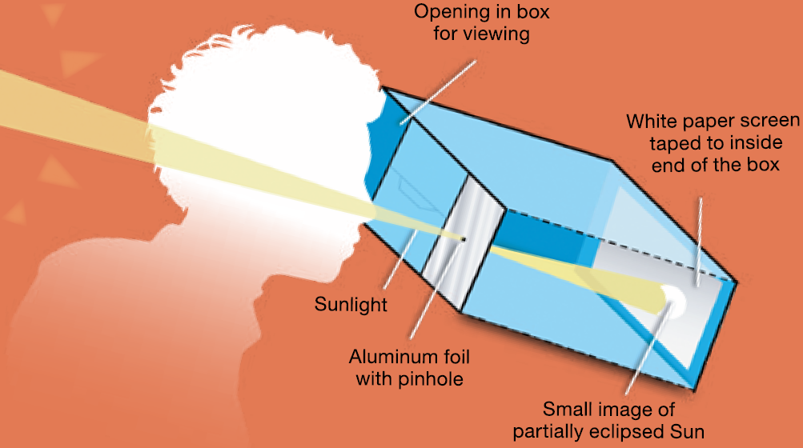
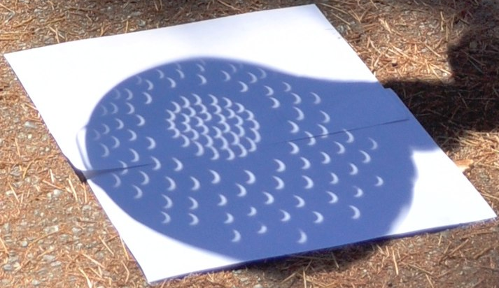
Viewing the Eclipse
Partial Phases (like no eclipse)
Eclipse glasses & viewers
Must be used properly
Glasses available at Kinney’s
Don’t use old ones ... from 2017
Pinhole Cameras
Every small hole projects an image of the Sun
Colander Eclipse Viewing
Cereal Box Eclipse Viewer
https://science.nasa.gov/learn/heat/resource/october-14-2023-annular-eclipse-fact-sheet/?category=annular_eclipse_activities
https://commons.wikimedia.org/wiki/File:Colander_eclipse_viewing_05_%28cropped%29.jpg

Slide 33
Eclipse Features
Totality approaching ~ 3:15 pm – 3:22 pm
Sky surrounding Sun darkens quickly
Will change as you watch from deep blue to black
Rosters crow, insects chirp, dogs bark
Temperature cools, wind picks up
Moon’s umbra approaches at 2,489 mph!
“If you look to the west, you'll see a beautiful black curtain rising up out of the Earth, with hints of sunset-orange north and south of it, while off to the east, the sky at the horizon is still rather light” eclipse2024.org

Slide 34
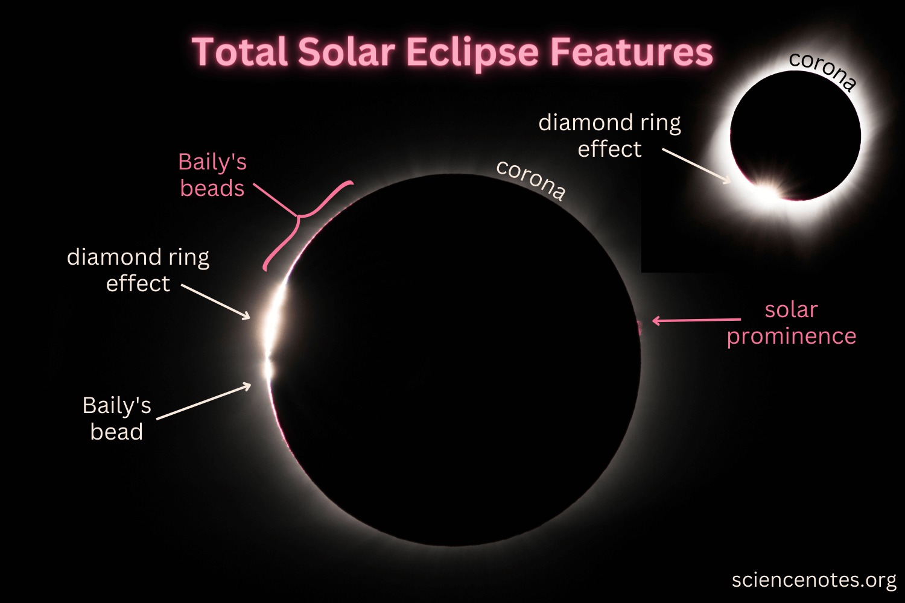
Eclipse Features
Totality arriving ~ 3:22 – 3:22:53 pm
As last crescent of Sun shrinks to zero
Sun’s Corona starts becoming visible (not through glasses)
Baily’s beads appear as Sunlight shines through lunar valleys
Diamond Ring effect for 2 – 3 seconds as totality begins!

Slide 35
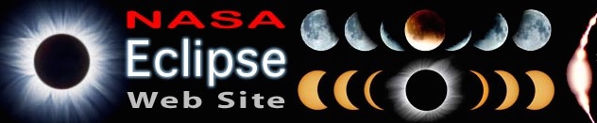
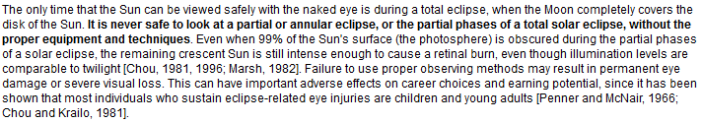
Viewing the Eclipse
During Totality ONLY
Totally eclipsed Sun ⇒ No Eclipse Glasses
From 3:22:54 to 3:26:09pm
Between “diamond ring” events
Stars and Seven Planets will be visible
Mercury, Venus, Mars, Jupiter, Saturn, Uranus
Sun’s Corona will be visible
... and Earth!!
https://eclipse.gsfc.nasa.gov/SEhelp/safety2.html

Slide 36
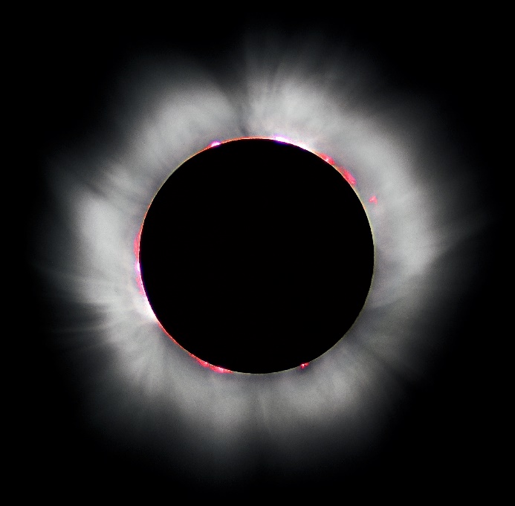
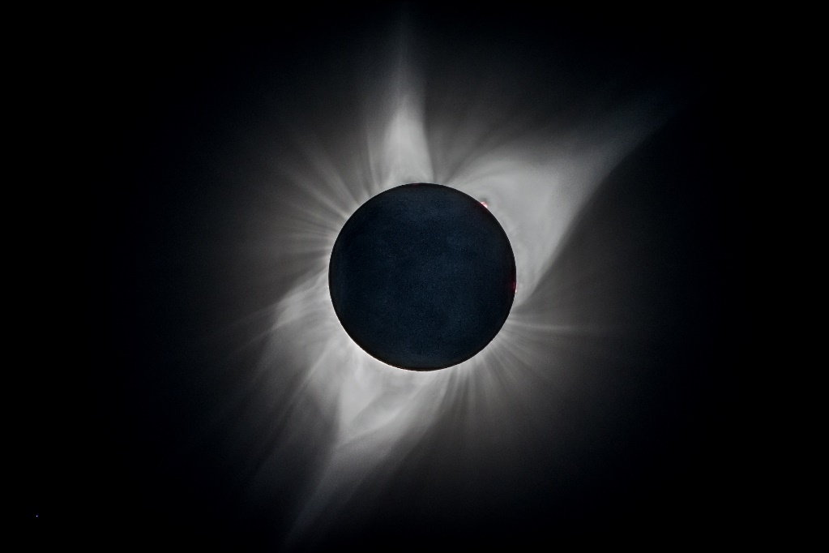
Experience of totality
No eclipse glasses after Diamond Ring
Sun’s Corona
Outer atmosphere of Sun
Hottest part of atmosphere > 1,000,000 degrees
Sun is a nuclear explosion contained by gravity!
Extends millions of miles from Sun
Dynamic, different in each eclipse!
Luc Viatour Europe 1999
Bernd Thaller USA 2017
https://lucnix.be/index.php?/search/6232
https://www.flickr.com/people/44296132@N06

Slide 37
Experience of Totality
Can be life-changing
“It will look to you as though someone has painted the sky a deep bluish-purplish-black, has cut an impossibly black, perfectly circular hole in it with a pair of scissors, and then smeared radiant, glowing, shimmering cotton candy around that hole.”
- Experience of Totality on eclipse2024.org

Slide 38
Experience of Totality
… Ten years from now, you'll still be able to imagine this sight in your mind - so burn it in there now, while you can.”
- Experience of Totality on eclipse2024.org
Watch it in real time!
Let professionals (ASCO) take photos!
Taking photos can distract you from the event!
We have only 3 minutes of totality … in our lives!

Slide 39
End of Totality
You'll know when totality is finally coming to an end, because the western sky will brighten dramatically. The shadow is racing along to the next group of eagerly-awaiting victims to the east, and your time is sadly coming to an end. The right side of the Sun's black disk will brighten a little, you may see prominences or chromosphere again
Just like that, the corona will dim, the diamond ring will flash into view on the right side of the Sun's disk (and it's time again for your eclipse glasses to go back on!), … the beads will come back, and it will be over..

Slide 40
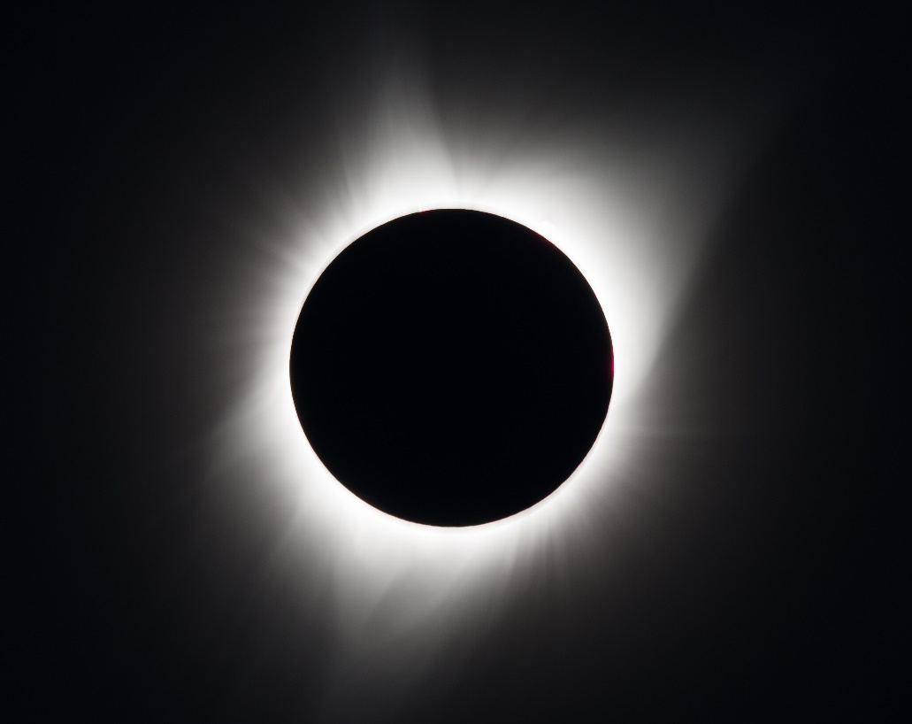
Total Eclipse of 2024
Help everyone in NoCoNY
View eclipse safely & joyfully
It’s an a amazing experience
Help kids to view eclipse safely
Help visitors to
view & enjoy eclipse
Help visitors to
enjoy NoCoNY!

Slide 41
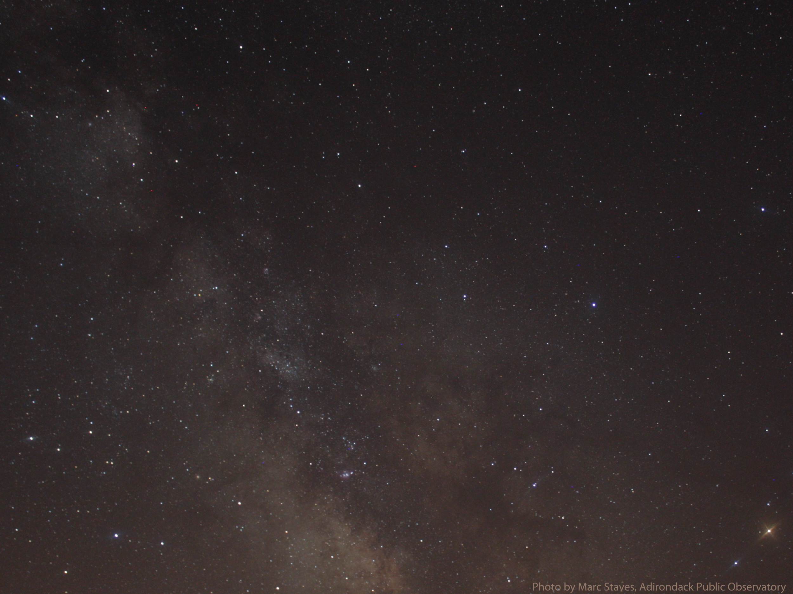
The adventure continues ...

