Slide 1


Introductions & Logistics
IGNATIAN SILENT RETREAT
Fr. Chris Corbally, B.J.A. & Dr. Aileen O’Donoghue, S.K.P.J.G.P.
September 24 – 26, 2021

Slide 2
Introductions
Chris & Aileen
Silence
  Savor the silence
Conferences
  We don’t take attendance!
  Ask questions as they come, take away what you can
Stargazing
  By the pool
Touching Base
  Small group sharing sessions on Saturday afternoon
  And catch us as you can, Aileen: (315) 267-6397
The music is not in the notes,
but in the silence between.
Wolfgang Amadeus Mozart

Slide 3
First Evening: The Gift of Darkness
IGNATIAN SILENT RETREAT
Fr. Chris Corbally, B.J.A. & Dr. Aileen O’Donoghue, S.K.P.J.G.P.
September 24 – 26, 2021

Slide 4
The Wisdom of Solomon
“The Lord created me at the beginning of his work,
The first of his acts of long ago.
Ages ago I was set up, at the first, before the beginning of the Earth.
When he established the heavens, I was there.”
.
.
.
Proverbs 8:22-23, 27

Slide 5
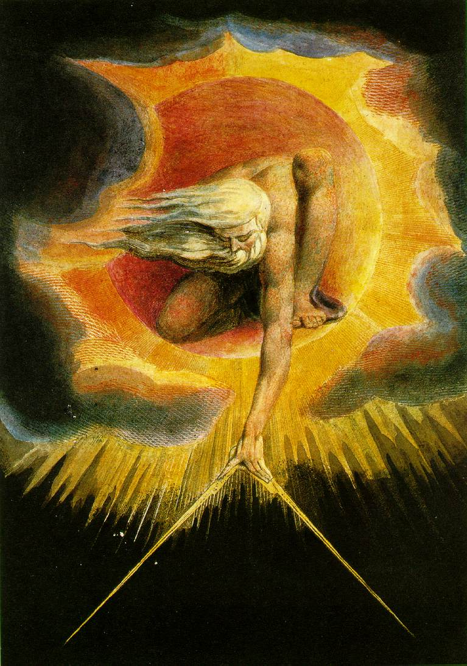
“In the beginning
when God Created
the heavens
and the Earth,
the Earth was a formless void and darkness covered the face of the deep”
Genesis 1:1

Slide 6
In the Beginning …
What Started It?
At t = 0 seconds
  Time began
  Space began
  Universe began
Physics Doesn't Know!
What DOES physics know?
  All galaxies are moving away from us
  More distant galaxies moving away faster
  Entire universe glows in microwaves

Slide 7
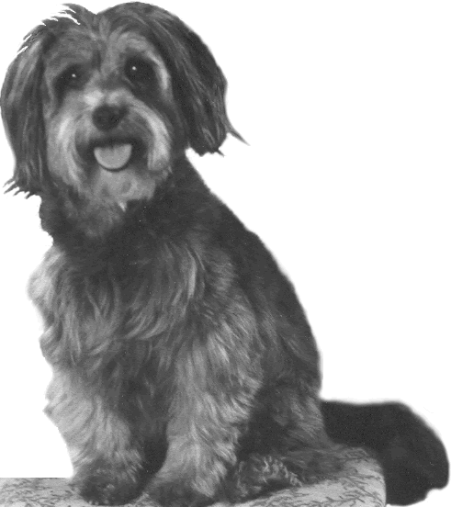
In the Beginning …
What DO we know?
  All galaxies are moving away from us
  More distant galaxies moving away faster
Queerbungle Cosmology
QB’s separated by meters
-1
0
1
2
3
Distances Double in 1 sec
Left QB Moved at 1 m/s
Right QB Moved at 3 m/s
-2
-1
0
1
2
3
4
5
6

Slide 8
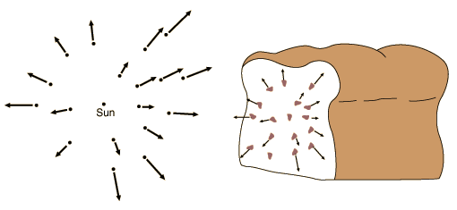
In the Beginning …
Expansion of the Universe
  All galaxies are moving away from us
  More distant galaxies moving away faster
… The universe is like a raisin bread!
Raisins move with dough, not through it.
Galaxies move with space, not through it!

Slide 9
In the Beginning …
Expansion of the Universe
  All galaxies are moving away from us
  More distant galaxies moving away faster
Space, itself, is expanding!
Raisins move with dough, not through it.
Galaxies move with space, not through it!

Slide 10
In the Beginning …
Current Cosmological Theory
  Use equations to “run time backwards”
    Universe gets smaller, denser, hotter
    Can go back to 10⁻⁴³ sec after Big Bang
Observations support Theory
  Early universe is glowing ball of energy seen as Cosmic Microwave Background
… So what have we learned?

Slide 11
In The Beginning There Was …
At t=10⁻⁴³ Seconds There Was …
LIGHT

Slide 12
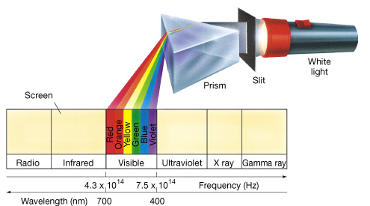
The Big Bang
After 10⁻⁴³ seconds
  Time and Space began expanding
  The Universe contained Time, Space & Energy
The energy was in the form of electromagnetic radiation …light

Slide 13
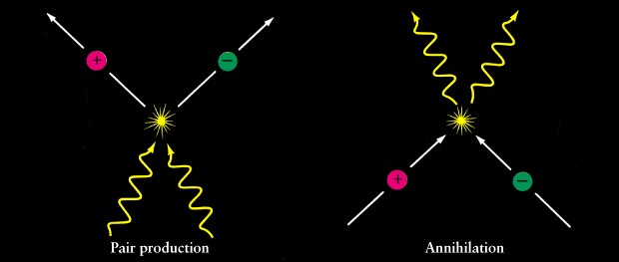
The Expansion of the Universe
The universe cooled as it expanded
  Particles “condensed” out of the light
  Light & Matter are the same stuff …
All matter is “frozen” energy!
Energy
is
Matter
E=mc²
Light becomes Particles …
Particles become Light …

Slide 14
The Early Universe
Universe was a sea of light and particles
  Protons, neutrons, electrons …
Universe was uniformly bright
  Light coming from reactions everywhere …
  The universe was opaque
After a few hundred thousand years of cooling, atoms began to form …

Slide 15
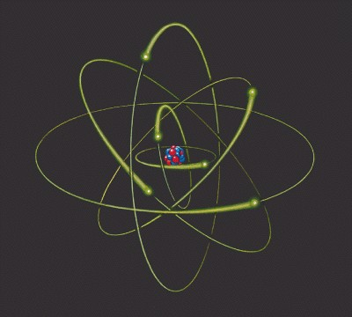
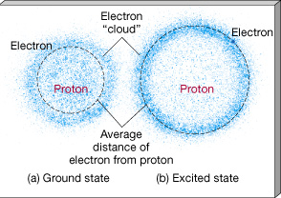
Atoms
Nucleus of Protons (+) and Neutrons (0)
Surrounding cloud of Electrons (-)
Electrons’ “orbits” or “clouds” determined by their energy

Slide 16
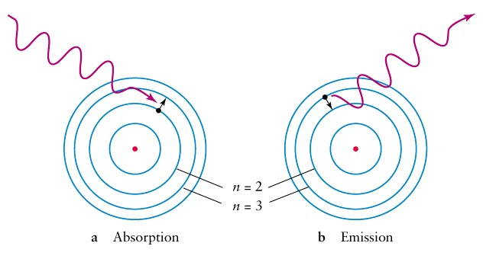
Atoms & Light
Atoms Absorb and Emit Light
  To change electron energy
    Light energy = energy change
Not all light can interact with every atom

Slide 17
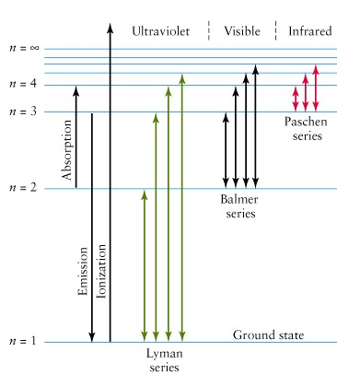
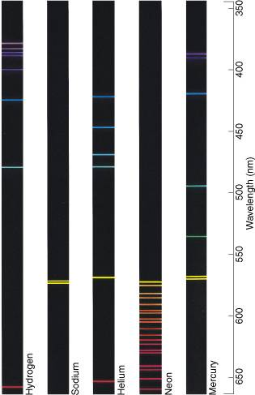
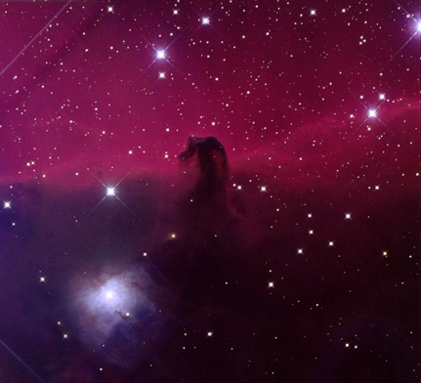
Atoms & Light
Each element emits & absorbs a unique spectrum
Balmer Spectrum of Hydrogen
δ
γ
β
α
Red in astronomical images is Balmer Alpha
Lyman Spectrum of Hydrogen in Ultraviolet

Slide 18

Atoms & Light
Each element emits & absorbs a unique spectrum
Photons interact with every ion
Only a few photons interact with atoms
ions: nuclei & electrons
atoms
Sees closest ion
Sees across universe
Most photons don’t interact ⇒ observer sees across universe

Slide 19
The First Night
500,000 years after the Big Bang …
Atoms of Hydrogen (75%) and Helium (25%)
  Absorbed some light
  Most light traveled freely without interacting with any matter.
    Universe became transparent
…darkness fell for the first time.

Slide 20
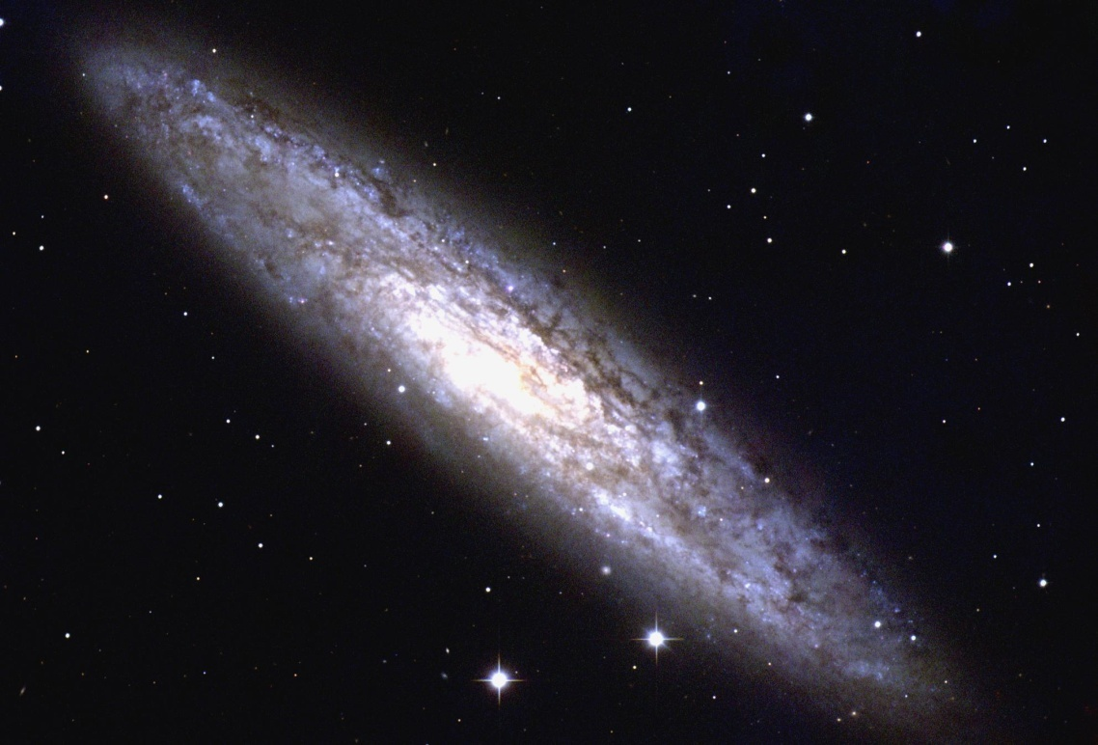
The Cosmos’ Gift of Darkness
Required the “freezing” of the Big Bang Energy into atoms … matter … us.
We are here
Requires us to be away from Galactic Nucleus or star cluster
NGC 253 (NOAO)
Darkness is not nothing …
… it’s something!

Slide 21
Darkness As Something
The Principle and Foundation of St. Ignatius
We are created to share in God’s love and life for eternity. The experience of this love is manifested in our response of praise, reverence and service, that is, loving God with all our heart all our mind and all our will.
All of God’s created cosmos is intended to reveal this sharing of God’s life and love.
… the night is God’s creature.
cf. John Veltri, S.J., www.sentex.net/~jveltri

Slide 22
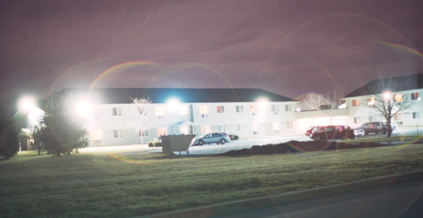
Darkness Eludes Us
Outdoor lighting tries to DISPEL THE DARKNESS!
Deprives us of the night
the stars
the dark …

Slide 23
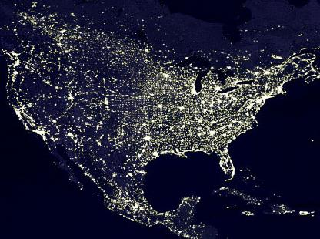
Darkness Eludes Us
Potsdam, NY
Tucson

Slide 24
Seeking Darkness
Astronomers and Monastics
  Seek what daylight hides
    Stars, nebulae, galaxies …
    God of the vast darkness …
“And night to night declares knowledge.”
Psalm 19

Slide 25
Seeking In The Darkness
The Dark Night
St. John of the Cross
One dark night,
fired with love’s urgent longings
ah, the sheer grace –
I went out unseen,
my house being now all stilled.

Slide 26
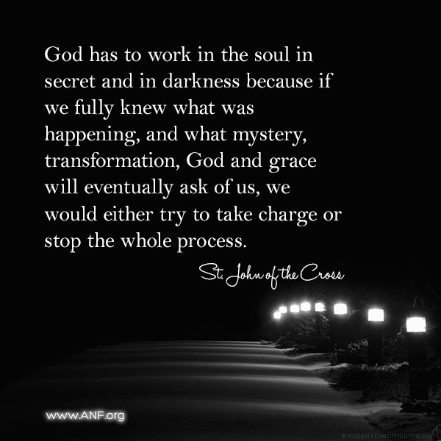
Seeking In The Darkness
The Dark Night
St. John of the Cross
One dark night,
fired with love’s urgent longings
ah, the sheer grace –
I went out unseen,
my house being now all stilled.

Slide 27
Beginning Retreat: Seek The Darkness
Sit with darkness …
What can you see there that you can’t see in the daylight?
Know that the frozen energy of the Big Bang you’re sitting on allows the darkness to exist …
Seek to comprehend that the darkness came into being through the Word and is not separate from God’s creative Love …

Slide 28
In the beginning …
there was the Word;
The Word was in God’s presence,
and the Word was God.
The Word was present to God
from the beginning
Through the Word
all things came into being,
And apart from the Word
nothing came into being
that has come into being.
…not even the darkness!

