Slide 1


Saturday Afternoon: The Substance of Ourselves
IGNATIAN SILENT RETREAT
Fr. Chris Corbally, B.J.A. & Dr. Aileen O’Donoghue, S.K.P.J.G.P.
September 24 – 26, 2021

Slide 2
Evening Came …
“As the universe expanded and cooled, darkness descended,

Slide 3
…And Morning Followed
“Then light dawned anew with the formation of the first stars.
Each star is a nuclear furnace where matter is coaxed into releasing a little of the energy it inherited from the primordial fireball.”
Timothy Ferris
The Creation of the Universe

Slide 4
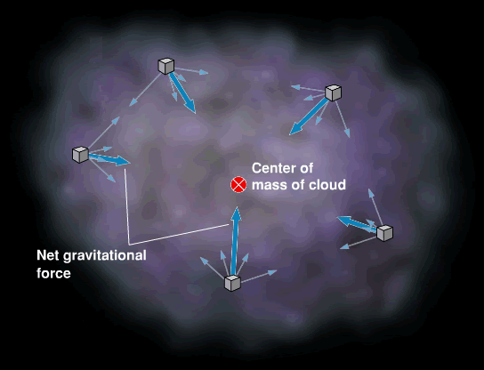
The Lives of Stars
Form from clouds of gas (and dust)
Gravity pulls all matter together
Knots form and compress to stars
Takes tens of millions of years

Slide 5
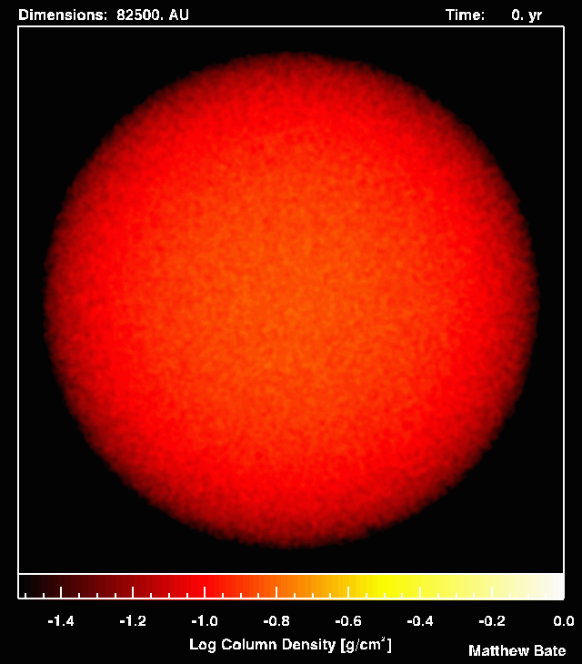
The Lives of Stars
Form from clouds of gas (and dust)
Gravity pulls all matter together
Knots form and compress to stars
Takes tens of millions of years

Slide 6
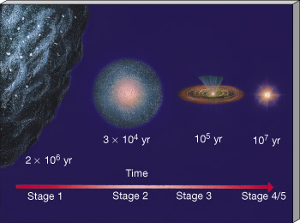
The Lives of Stars
Interstellar cloud fragments collapse under gravity to form stars.

Slide 7
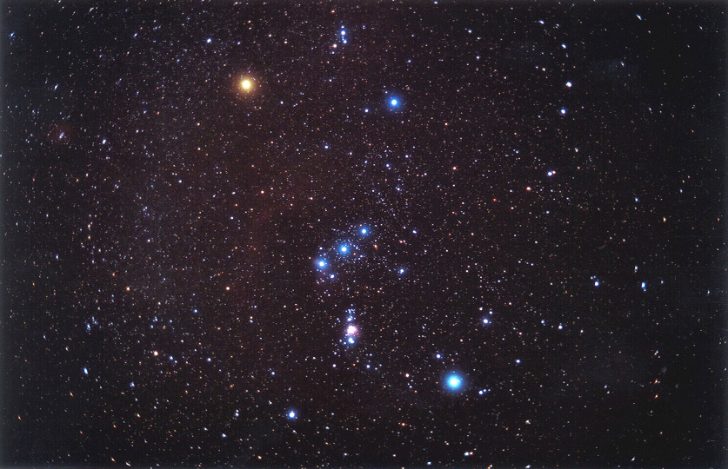
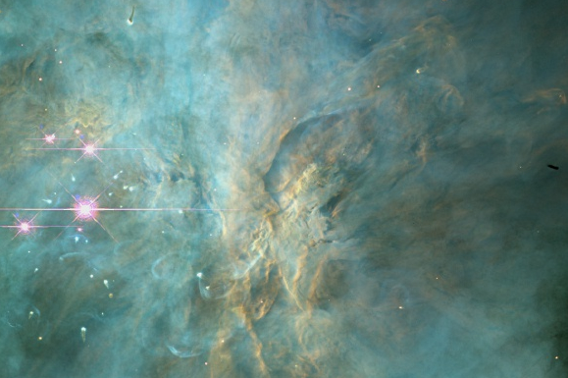
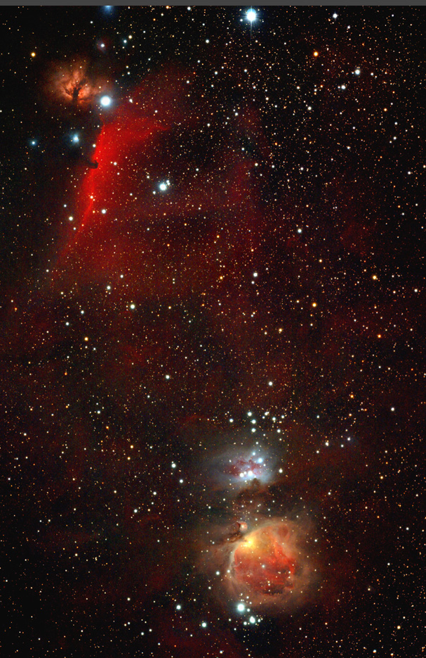
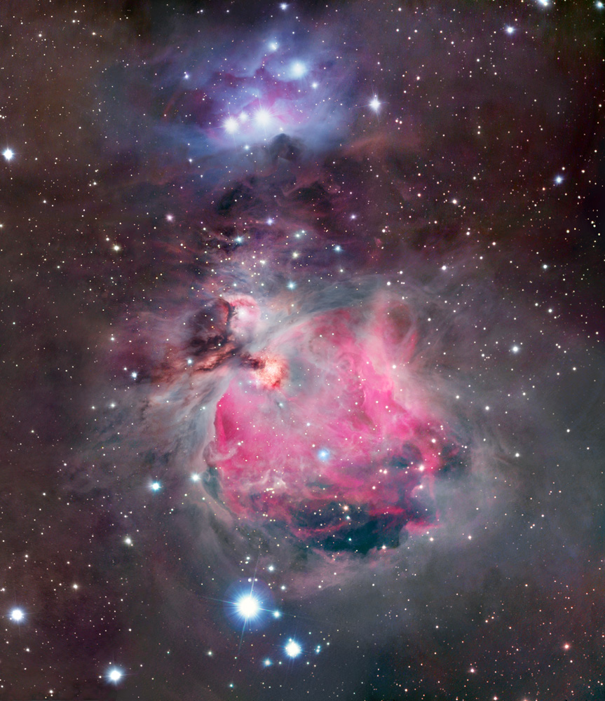
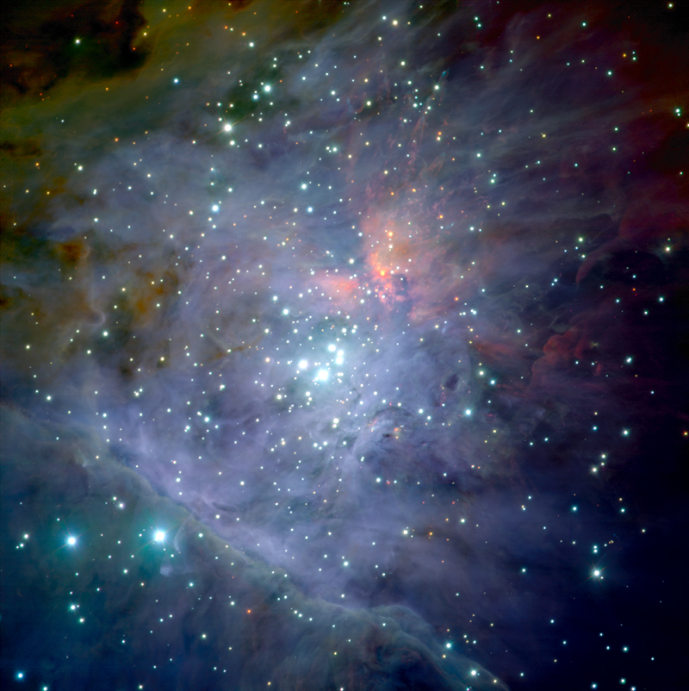
Starbirth Regions
Orion Nebula
Hot, giant stars illuminate nebula … lots of UV!
Thick, dusty disks protect forming stars & planetary systems

Slide 8
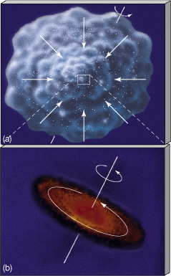
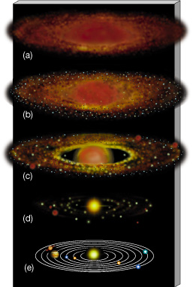
Solar System Formation
Planets form from debris around star.

Slide 9
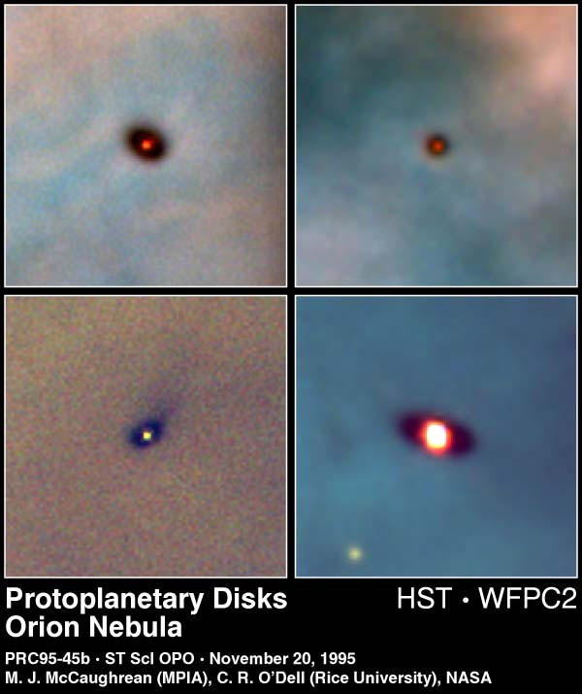
Forming Solar Systems
Disks of gas and dust surrounding forming stars form planets, moons, etc.

Slide 10
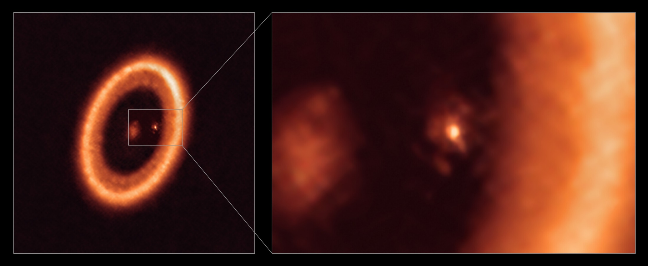
Forming Planets
PDS 70 in Centaurus (370 ly away)
Image in microwaves (ALMA, 2006)
Moon forming around a Jupiter-like Planet 65 AU from star!

Slide 11
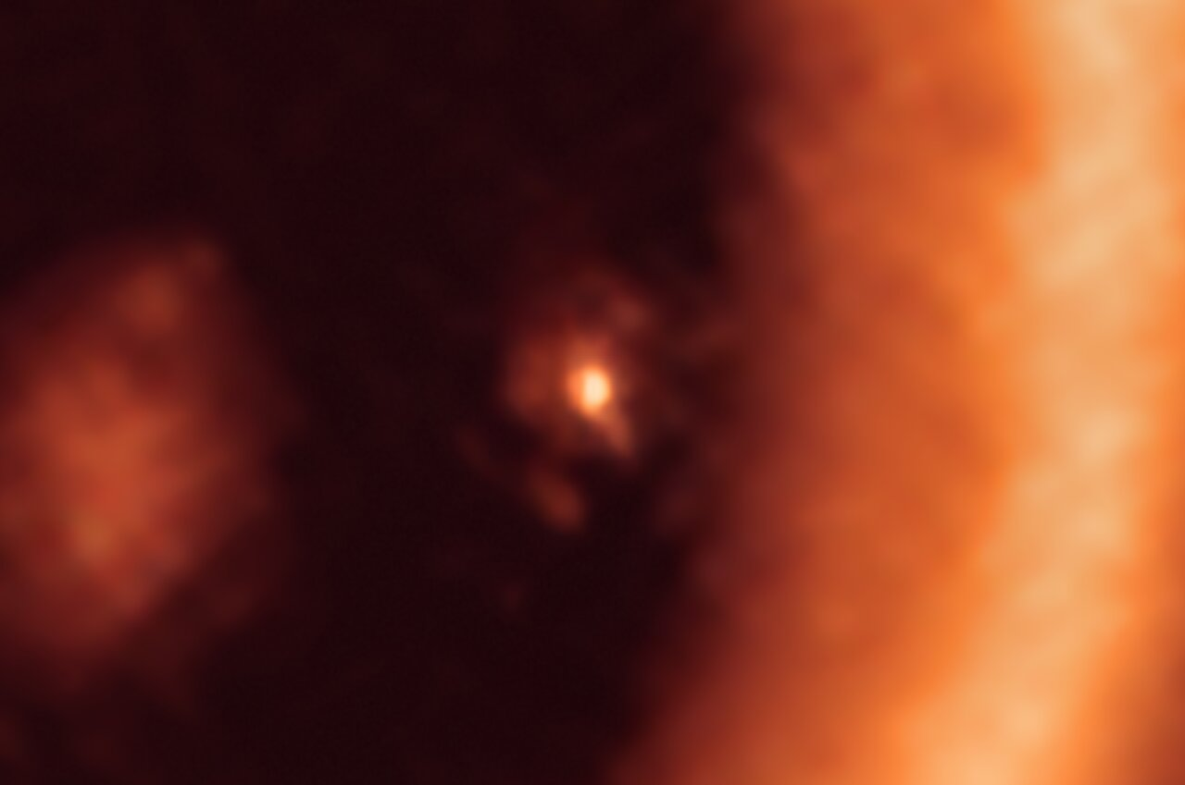
Forming Planets
PDS 70 in Centaurus (370 ly away)
Image in microwaves (ALMA, 2006)
Sun-sized star forming
Planet
Moon-forming disk
Moon forming around a Jupiter-like Planet 65 AU from star!

Slide 12
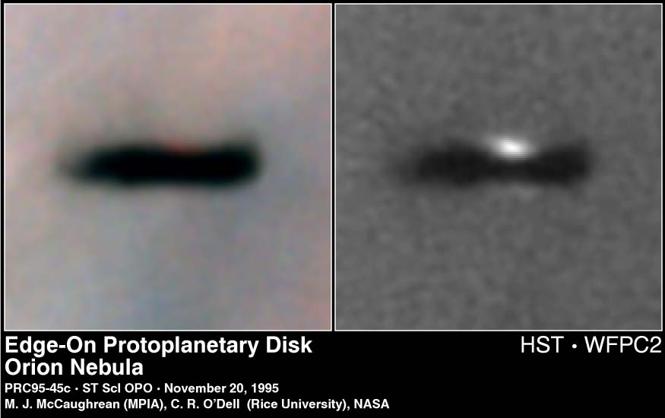
Forming Solar Systems
Disks of gas and dust surrounding forming stars seen edge-on in Orion

Slide 13
The Lives of Stars
Form from clouds of gas (and dust)
Gravity pulls all matter together
Knots form and compress to stars
Takes tens of millions of years
Shine by nuclear fusion
Four hydrogen atoms become one helium
Release huge amounts of energy
Fuse 1 kg of H to He, 0.7% becomes energy
1kg H → He gives 175 million kWhr of Energy!
in Tucson, 1 kWhr = 5.9¢ ⇒ 1 kg H = $10.3 million!

Slide 14
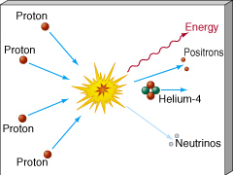
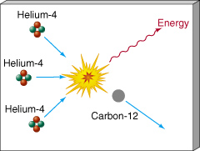
What Makes A Star?
Nuclear Fusion
Light elements fuse to heavier elements.
Hydrogen fuses to Helium
Helium fuses to Carbon, Oxygen, Nitrogen …
© Copyright, Dr. Aileen O’Donoghue, St. Lawrence University

Slide 15
positron ... antimatter
Gamma ray ... becomes sunlight
Hydrogen
to
Helium
Gamma ray ... becomes sunlight
positron ... antimatter

Slide 16

Solar Power
1 m = 10 J
Sol as a living star
4H → He : m_{helium} = 0.007 (4m_{hydrogen})
7 g of each fused kg become energy:
Solar Luminosity is L☉ = 3.828 x 10²⁶ W
m_{4 H} = 6.694 x 10⁻²⁹ kg
1 liter = 1 kg = 10 N
The Sun fuses 6 billion kg of H per second!

Slide 17
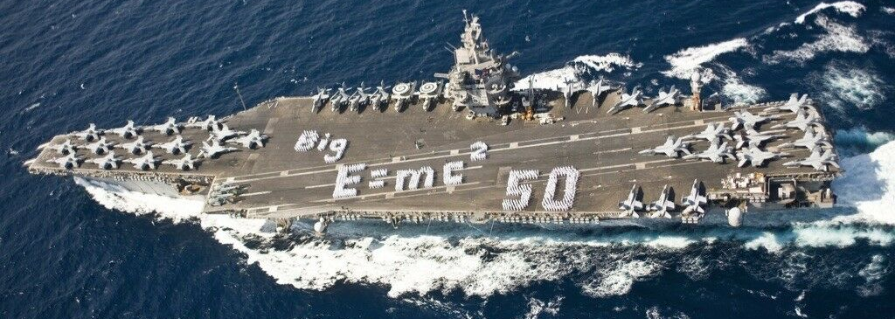
Solar Power
Sol as a living star
5.984 x 10⁹ kg of H is fused each second
USS Enterprise (CVN-65) mass = 9.478 x 10⁷ kg
0.7% of the H becomes energy (0.007 x 6313)
The sun converts 45 aircraft carrier masses of Hydrogen completely to energy each second!

Slide 18
Products Of Stellar Fusion
Early universe was 75% H, 25% He
All other elements are the products of stars!

Slide 19
Substance of the Cosmos
Element abundance in the universe:
H, He, O, C, Ne, Fe, Ni, Si …
All elements of life came from stars that lived AND DIED before the sun formed.
Sun is a 2nd or 3rd generation star
1st stars were pure hydrogen and helium)
“We are the matter of the cosmos contemplating itself.”
- Carl Sagan

Slide 20
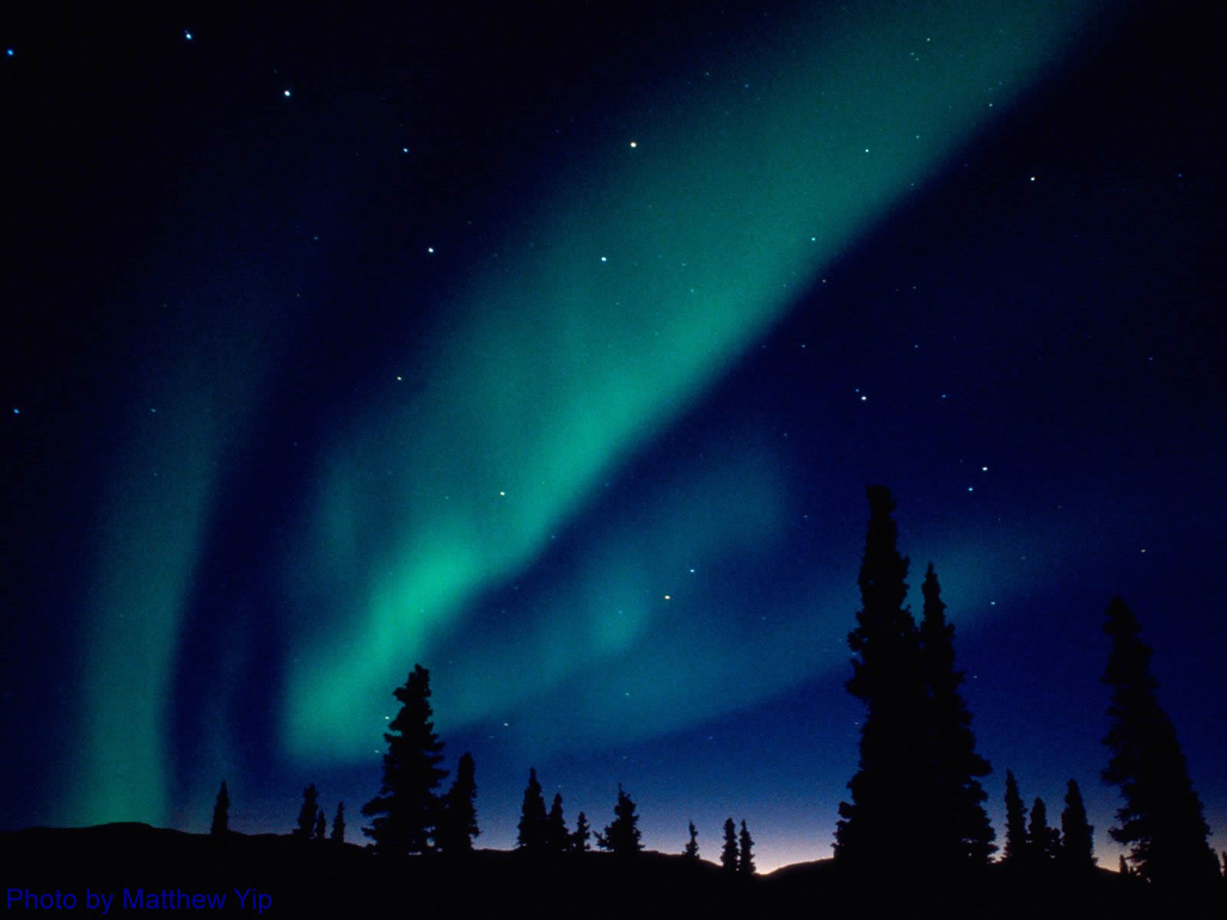
Interstellar Medium
Ancient stars enriched the ISM with the products of their fusion by
Stellar Winds
Stars constantly blow particles into space
Solar wind & storms cause aurorae on Earth
Deaths as Planetary Nebulae
Deaths as Supernovae

Slide 21
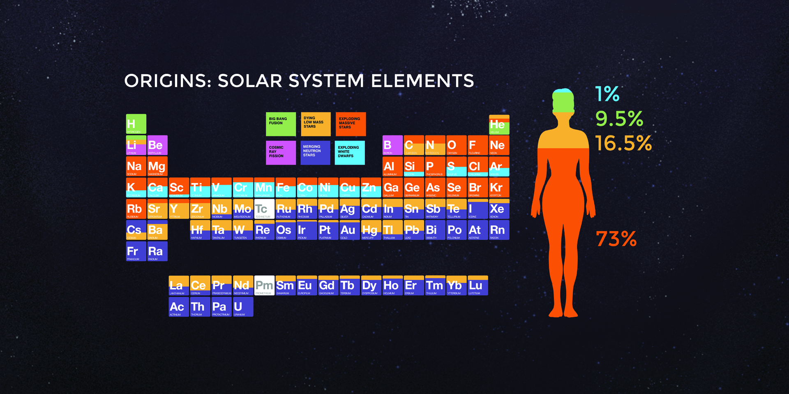
Substance of Ourselves
Cosmic Origins of the Elements
H, He, Li From the Big Bang
C, N from sun-sized stars
We’re Mostly Made of Massive Exploded Stars!

Slide 22
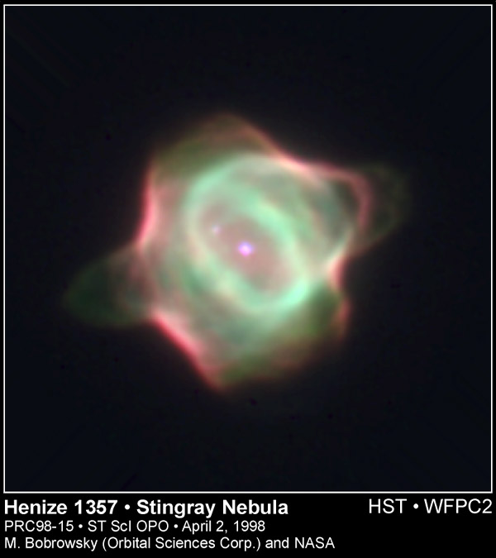
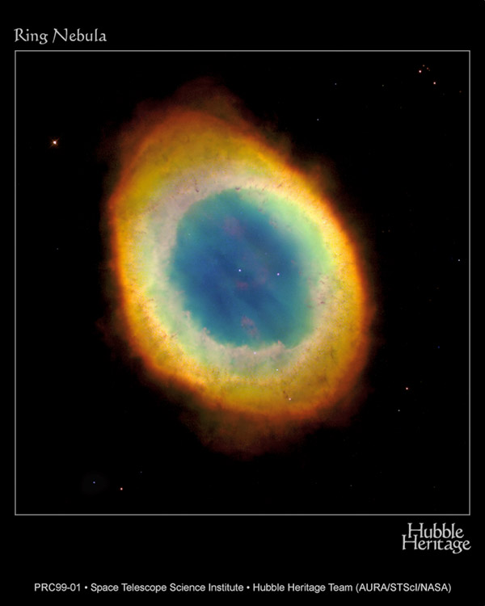
Planetary Nebulae
The source of common heavy elements C, N, Ba, Hg, Pb, etc.

Slide 23
Planetary Nebulae
The source of common heavy elements C, N, Ba, Hg, Pb, etc.
The carbon forming your lungs and the nitrogen (78%) in the air you breathe … were blown out of a sun-sized star more than 5 billion years ago. Your breath is older than the Earth and Sun!

Slide 24
Substance of Ourselves
Cosmic Origins of the Elements
O, Ne, Na from giant stars
Ca, Fe, Cu from exploding white dwarf stars
We’re Mostly Made of Massive Exploded Stars!

Slide 25
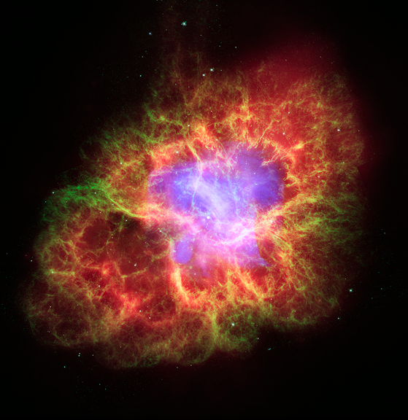
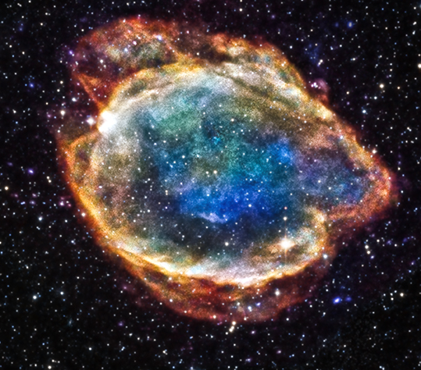
Supernova Explosions
The source of heavy elements
O, Ne, Na, Ca, Fe, Cu …
https://chandra.harvard.edu/photo/2006/crab/
https://chandra.harvard.edu/photo/2015/g299/
Exploded WD
Exploded Giant Star
Crab Nebula, 1054
G299.2-2.9, c. 2400 BCE

Slide 26
Supernova Explosions
The source of heavy elements
O, Ne, Na, Ca, Fe, Cu …
https://chandra.harvard.edu/photo/2006/crab/
https://chandra.harvard.edu/photo/2015/g299/
The oxygen you breathe and iron in your blood, carrying it to your brain are cosmic ash from the explosions of giant & white dwarf stars!
Crab Nebula, 1054
G299.2-2.9, c. 2400 BCE
© Copyright, Dr. Aileen O’Donoghue, St. Lawrence University

Slide 27
Substance of Ourselves
Cosmic Origins of the Elements
Ag, Au, I from merging neutron stars
We’re Mostly Made of Massive Exploded Stars!

Slide 28
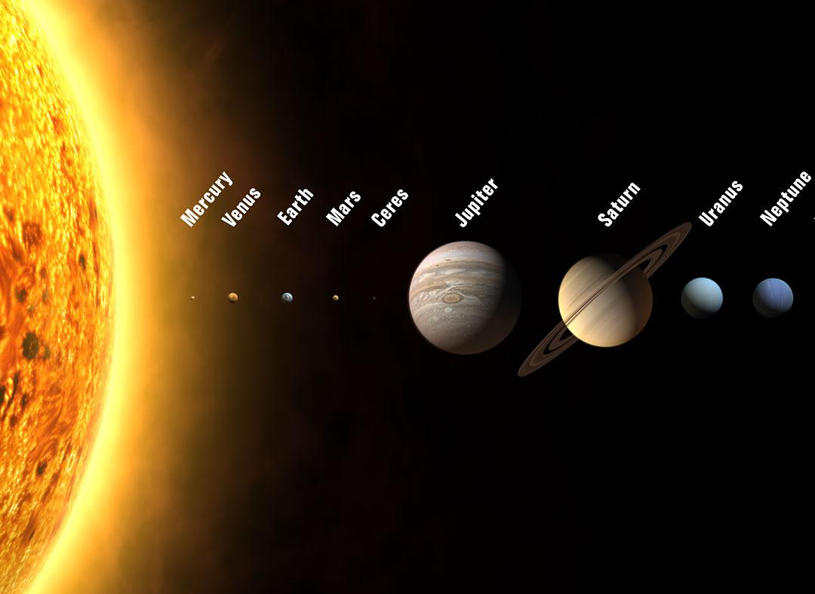
Substance of Worlds
The sun and all the planets formed from the same cloud of “used” star stuff enriched with heavy elements by previous generations of stars.

Slide 29
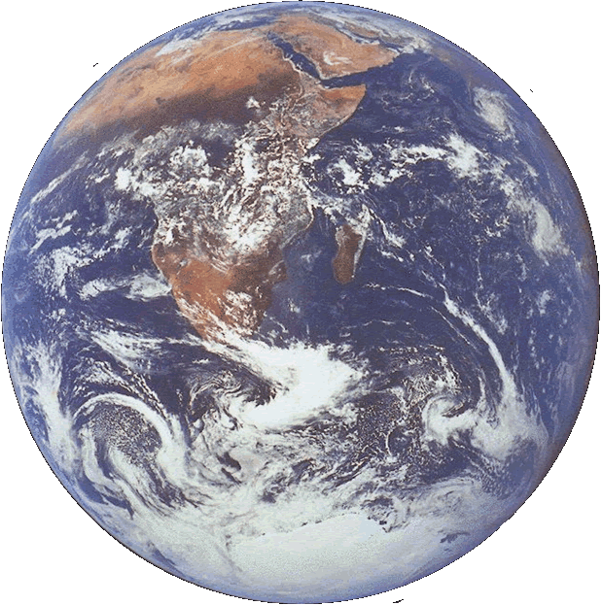
Earth
Life arose on Earth because
water from volcanoes
& comets condensed
into oceans that
Absorbed CO₂
from the early atmosphere
Allowed life to arise
protected from sun’s radiation
Regulate the temperature of entire planet
is available as solid, liquid, & gas
life freed oxygen and formed the ozone layer
Pond scum polluted the entire atmosphere with oxygen!

Slide 30

Substance of Earth
Element abundance in Earth’s crust:
O, Si, Al, Fe, Ca, Na, K, Mg, Ti, H, …
Crust of silicate minerals
Tucson mountains
Pinal Schist
… Metamorphosed mica
… Si, Al, K
We walk on the stuff of stars!

Slide 31

Substance of Earth
“In our own sun there are 700 oxygen atoms, 400 carbon atoms and 2 calcium atoms for every million atoms of hydrogen;

Slide 32
Substance of Earth
“… these heavier atoms were created in stars antecedent to our sun, stars that illuminated the younger galaxy with a brilliant blue light.

Slide 33
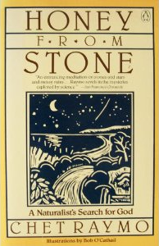
Substance of Earth
“One hundred septillion (10²⁶) hydrogen nuclei were processed in the interiors of Vega-like stars to create the pebble in my hand.”
- Chet Raymo, Honey From Stone
© Copyright, Dr. Aileen O’Donoghue, St. Lawrence University

Slide 34
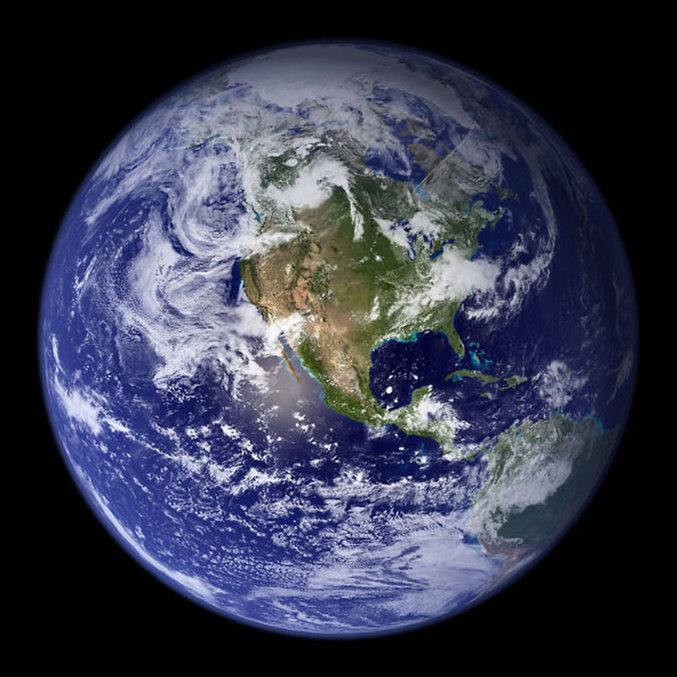
Substance of Earth
Quiz: This world is unique for
CO₂ in the atmosphere
Solid H₂O on poles
Sticks

Slide 35
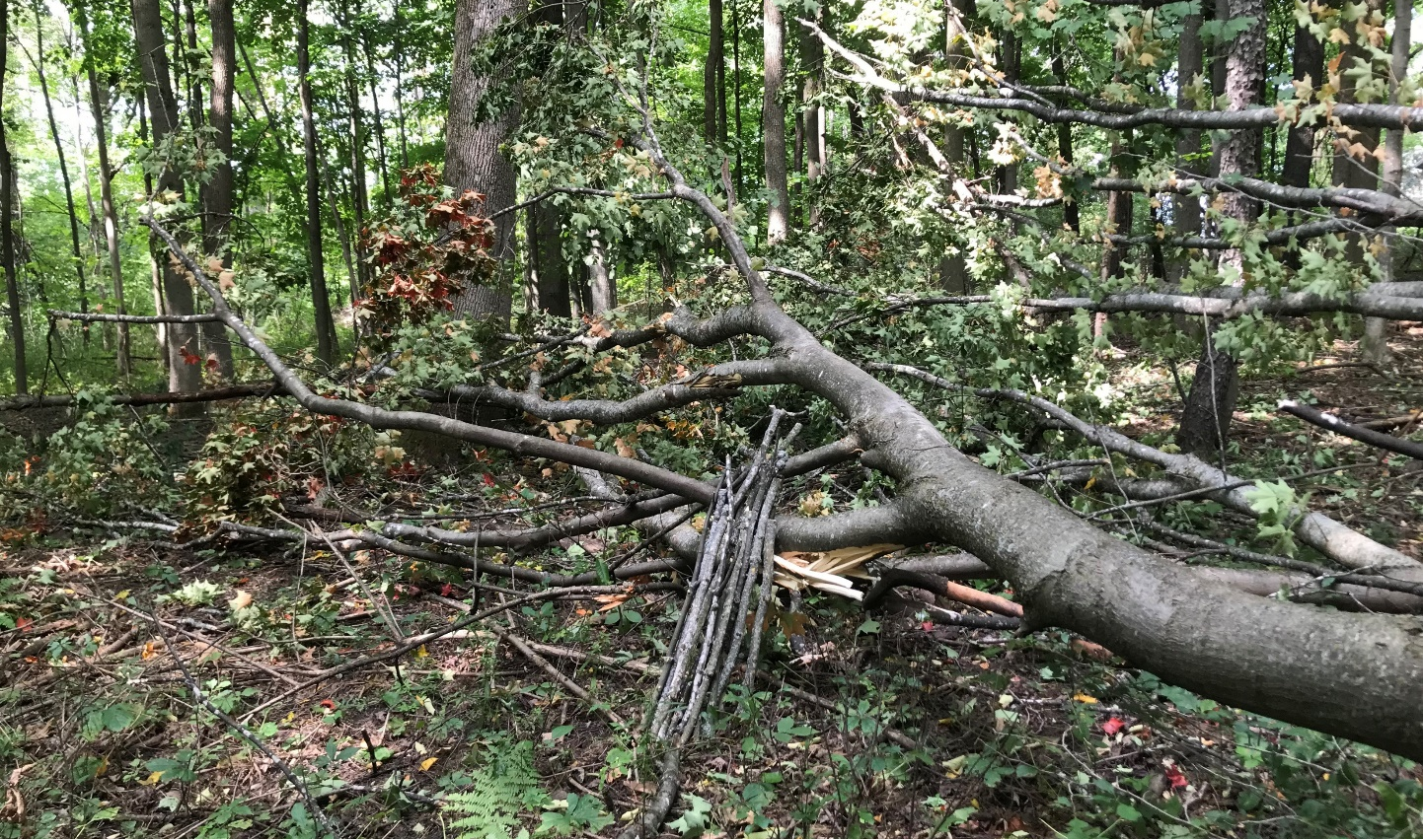
Substance of Earth
Quiz: This world is unique for
CO₂ in the atmosphere
Solid H₂O on poles
Sticks

Slide 36
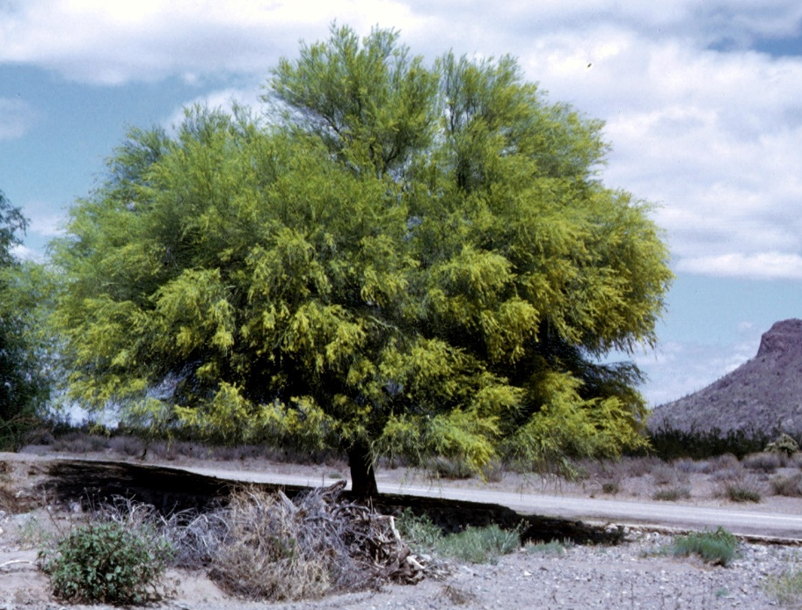

The Substance of Trees
How Do Trees Make Themselves?
What do they build themselves from?
https://statesymbolsusa.org/symbol-official-item/arizona/state-tree/palo-verde
The trees are making wood out of air!

Slide 37

The Substance of Trees
Gifts of a wind-fallen sugar maple
https://statesymbolsusa.org/symbol-official-item/arizona/state-tree/palo-verde
The sticks were air a few years ago!
If trees make wood from air, what can God make of you?

Slide 38

Earth
“… then God formed the earthling from the dust of the ground, breathed into it the breath of life, and the earthling became a living being …”
Genesis 2:7

Slide 39
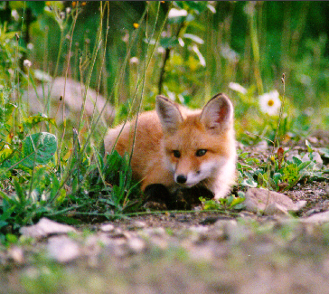
Earth Mother
“The Earth is at the same time mother,
she is mother of all that is natural,
mother of all that is human.
She is the mother of all,
For contained in her
are the seeds of all.

Slide 40
Earth Mother
“It is in so many ways fruitful.
All creation comes from it.
Yet it forms not only the basic
raw material for humankind,
but also the substance of the incarnation of God’s son.”
Hildegard of Bingen

Slide 41
Wisdom
“When God established the heavens I was there,
when God drew a circle
on the face of the deep,
when God made firm the skies above,
when God established
the fountains of the deep …

Slide 42
Wisdom
“when God marked out
the foundations of the Earth,
then I was beside God,
like a master worker,
and I was daily God’s delight,
rejoicing with God always,
rejoicing in God’s inhabited world
and delighting in the human race.”
(Proverbs 8:22-31)

Slide 43
The Substance of Yourself
This weekend, try to
feel & rejoice in your physical substance
the actual atoms forged in stars,
incorporated into planet Earth.
breathe the cosmic wind moving through you,
rocks, plants, and all other beings how is the matter, itself, inspirited?
find a rock to hold & bring on Sunday
Seek God in the substance of yourself

