Slide 1


Saturday Evening: Beneath the Surface
IGNATIAN SILENT RETREAT
Fr. Chris Corbally, B.J.A. & Dr. Aileen O’Donoghue, S.K.P.J.G.P.
September 24 – 26, 2021

Slide 2
Power Points will be available at http://myslu.stlawu.edu/ ~aodo/spirituality/AZ2021
http://myslu.stlawu.edu/~aodo/spirituality/AZ2021
By next weekend.

Slide 3
The Incarnation
“The Word was coming into the world –
Was in the world –
and though the world was made
through the Word,
the world didn’t recognize it.
Though the Word came to its own realm,
the Word’s own people didn’t accept it.
And the Word became flesh
and stayed for a little while among us;”
John 1:9-11,14
The Inclusive New Testament

Slide 4
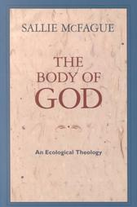
Inspirited Bodies
“As we are inspirited bodies – living, loving, thinking bodies – so, imagining God in our image (for how else can we model God?), we speak of her as the inspirited body of the entire universe, the animating, living spirit that produces, guides and saves all that is.”
Sally McFague,
The Body of God (p.20)

Slide 5
Bodies Interacting: Forces
Defined by Isaac Newton
Stuff Coasts
(it takes a force to change motion)
Stopping takes as much force as starting
Force changes an object’s velocity
(speed or direction)
Straight ahead at same speed easiest
Stuff pushes back
(forces are always mutual and equal)
Same force acts on both objects
If we knew the position and velocity of every particle in the universe at one time, we could predict their motions forever!

Slide 6
Newton’s Universe
Space and time are independent & static
nothing alters the dimensions of space
nothing alters the flow of time
Matter and energy are distinct & separate
a rock is matter that can be weighed
can be melted or vaporized but the “stuff” remains
it can have energy
raised, it gains potential energy
dropped, it gains kinetic energy

Slide 7
Einstein’s Universe
Space and time not independent
= spacetime
both altered by motion
both altered by gravity
Matter and energy are same stuff
matter can become energy
stars shine by doing this!
energy can become matter
the Big Bang did this

Slide 8
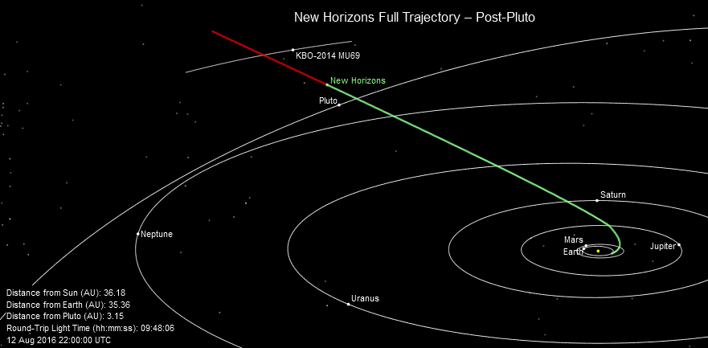
Gravity acts Across Space: Newton
“Gravity is an attractive force between massive bodies.”
- Isaac Newton, 1687
Works really well!! New Horizons got to Pluto using Newton’s laws!

Slide 9
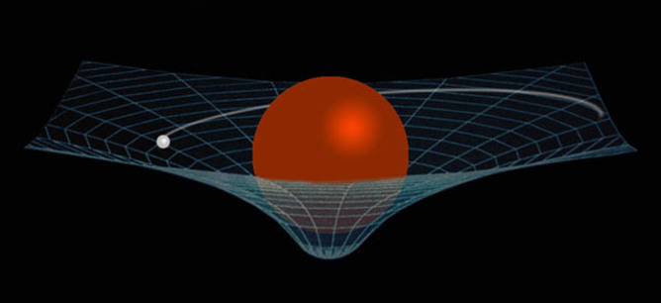
Spacetime: Einstein
“Mass tells space how to curve, space tells mass how to move.”
- Albert Einstein, 1915
… and mass tells time how to flow …
Gravity slows time!
the GPS system must account for this!

Slide 10
Spacetime: Einstein
“Mass tells space how to curve, space tells mass how to move.”
- Albert Einstein, 1915
… and mass tells time how to flow …
Warp should be in 3-D … but I can’t draw that!
Gravity slows time!
the GPS system must account for this!

Slide 11
Spacetime: Einstein
Space is a fabric (in 3D, a “fluid”)
… something not nothing!!
⇒ Gravitational disturbances will propagate
Gravitational waves
move at c = 300,000 km/s = 186,000 mi/s
the fabric of space contracting and expanding
nothing reflects, refracts or absorbs them

Slide 12
Spacetime: Einstein
Space is a fabric (in 3D, a “fluid”)
… something not nothing!!
⇒ Gravitational disturbances will propagate
Gravitational waves
move at c = 300,000 km/s = 186,000 mi/s
the fabric of space contracting and expanding
nothing reflects, refracts or absorbs them
shaped by the physics that creates them
Spacetime ripples!!
Can we detect the ripples?

Slide 13
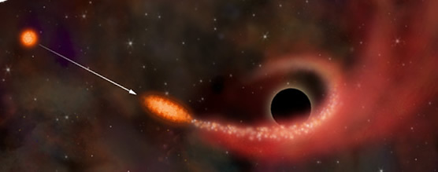
Gravitational Waves
Dramatic changes in large masses
Supernovae
Giant stars exploding … mass converted to energy
Massive bodies falling into black holes
Neutron stars (≲ 3 M⊙, ≲ 20 km)
Massive collisions
Neutron stars merging to create black holes
Mergers of black holes

Slide 14
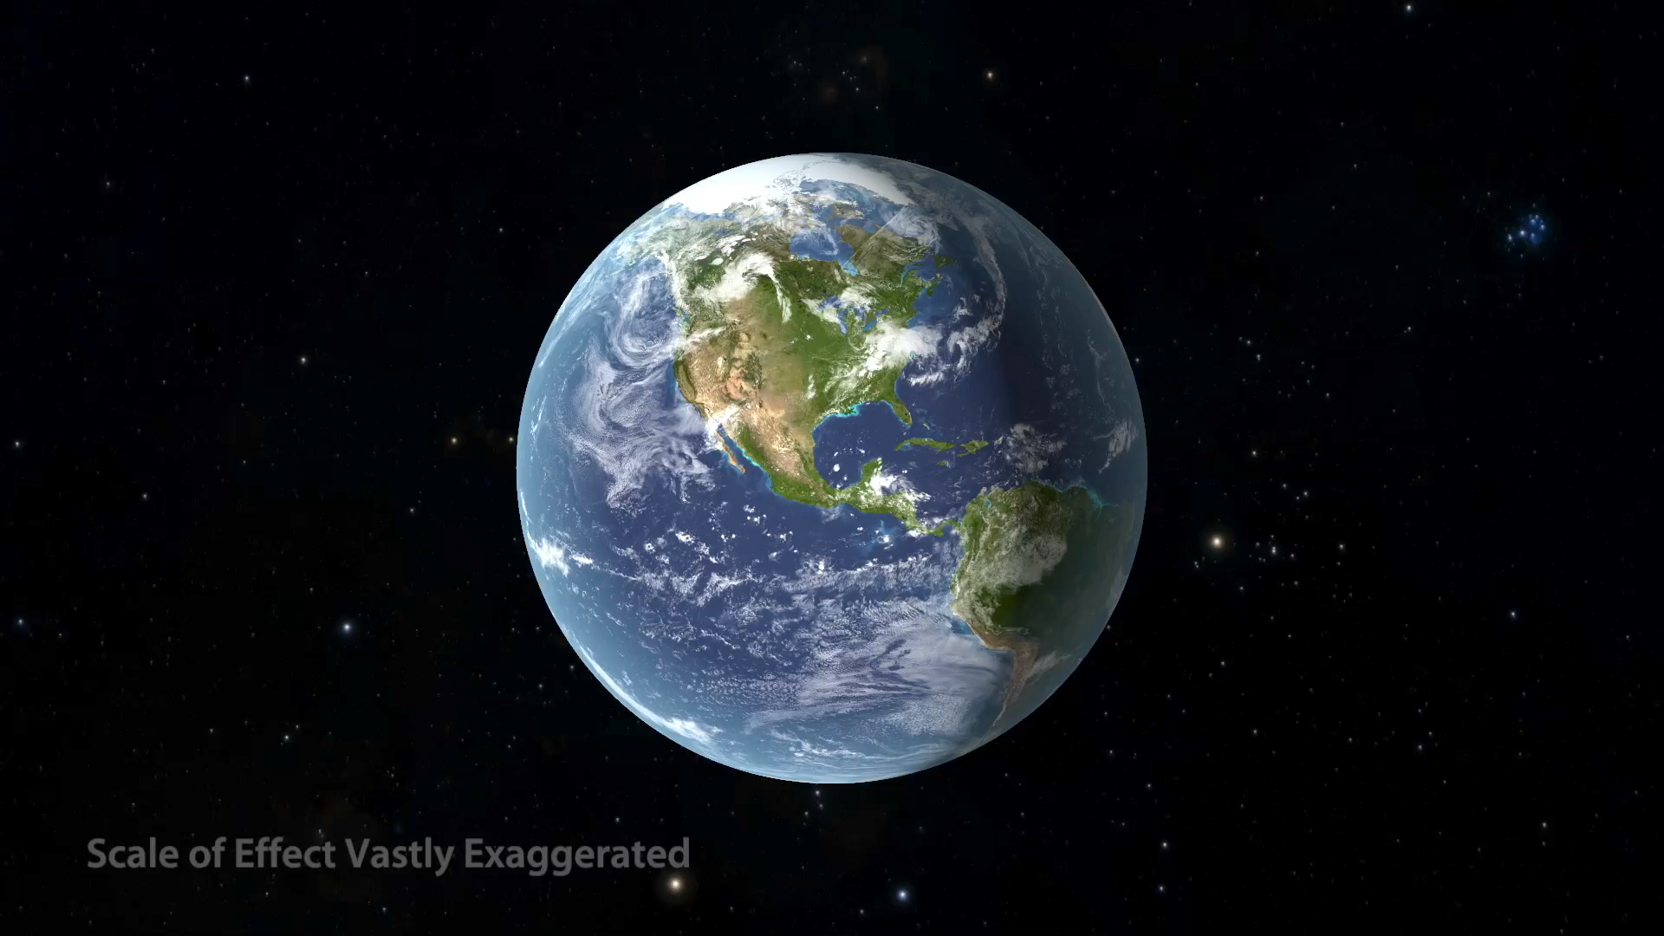
Gravitational Waves

Slide 15
Detecting Gravitational Waves
Interferometers
“Interference” = addition of waves
+
+
=
=
Constructive Interference
Destructive Interference

Slide 16
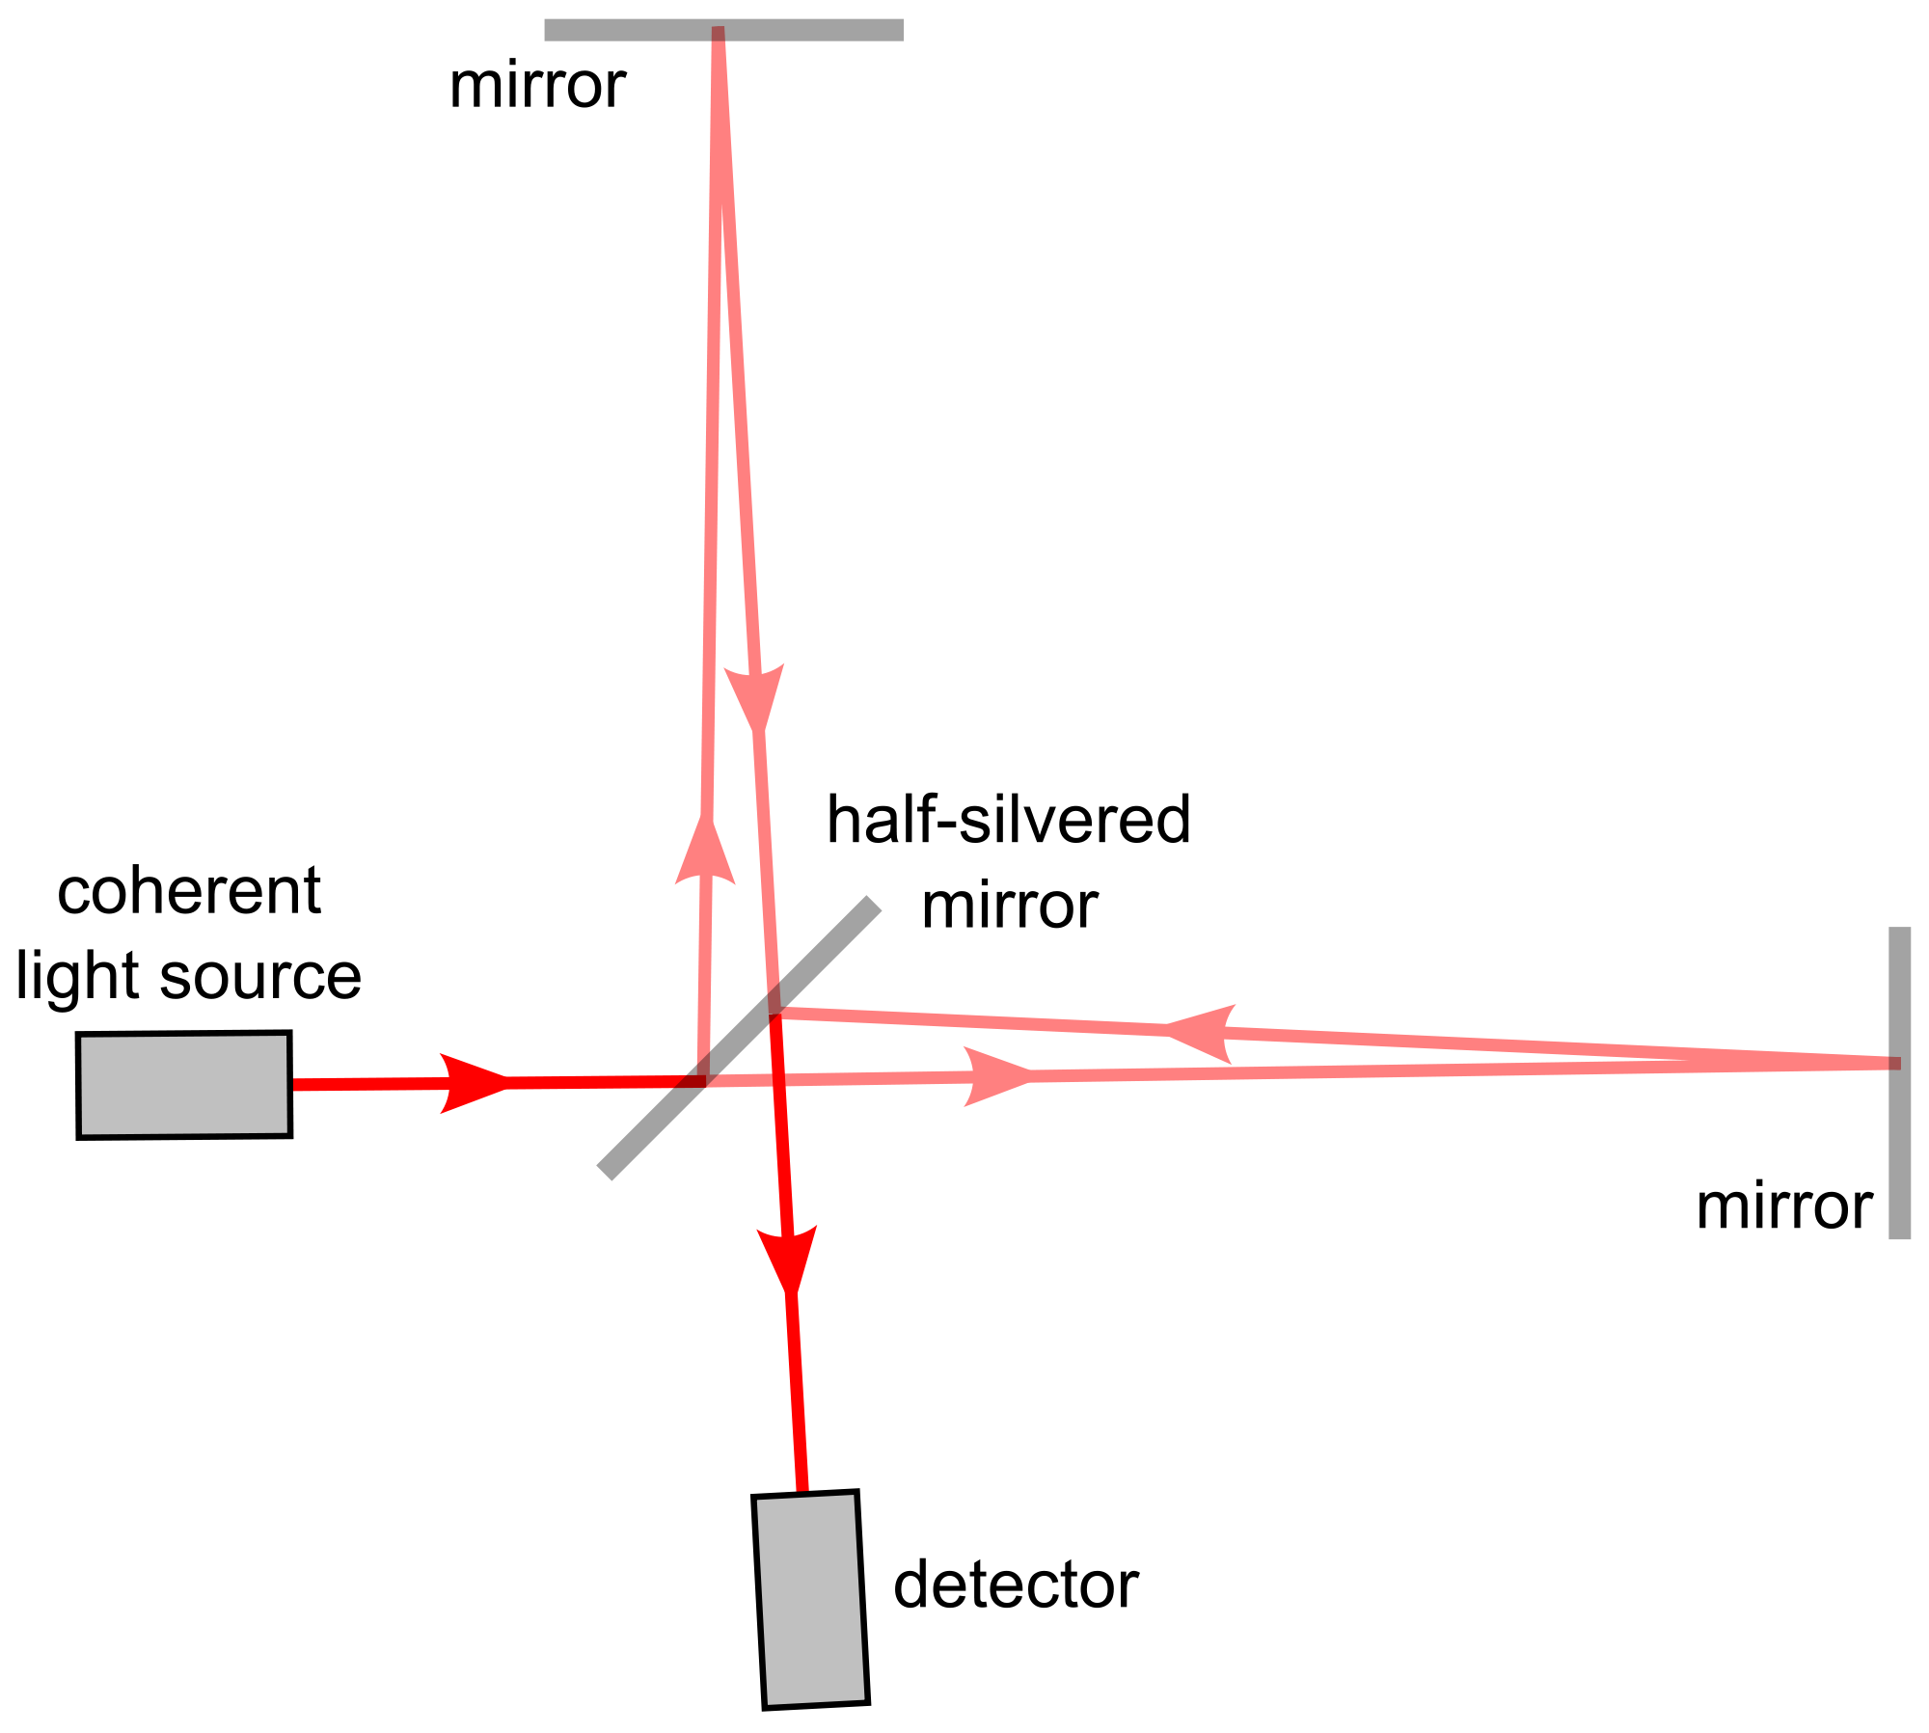
Detecting Gravitational Waves
Interferometers
Send a beam of light in two directions
(peaks & troughs aligned)
Beams travel different distances:
difference = nλ ⇒ constructive
difference ≠ nλ ⇒ destructive
λ = wavelength

Slide 17

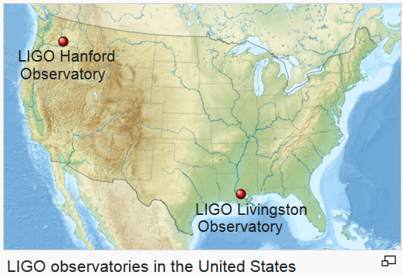
Laser Interferometer Gravitational Wave Observatory
Two distant locations
Detectors not aligned
BOTH must detect
wave within appropriate
time interval …
(≤ 10 milliseconds)
https://en.wikipedia.org/wiki/LIGO

Slide 18
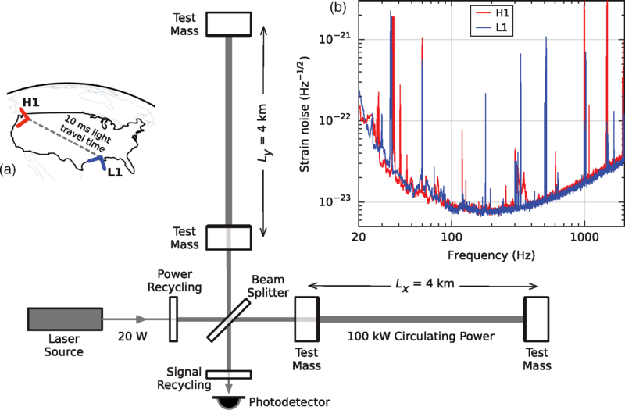
Each detector has mirrors (“Test Masses”) suspended at the ends of 4 km long, perpendicular arms.
Detectors have different orientations as shown by ∟’s.
Beams reflect between mirrors 280 times ⇒ actual path traveled by each beam is 1120 km!

Slide 19
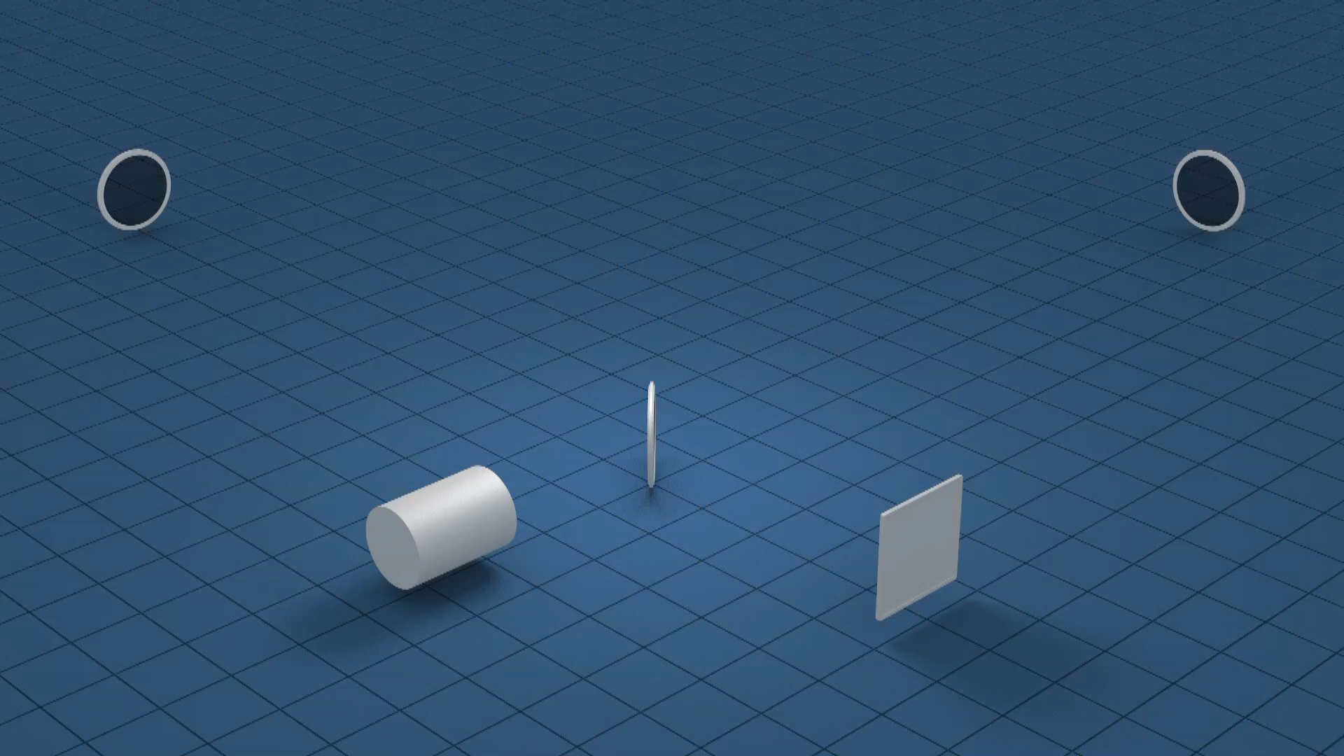

Slide 20
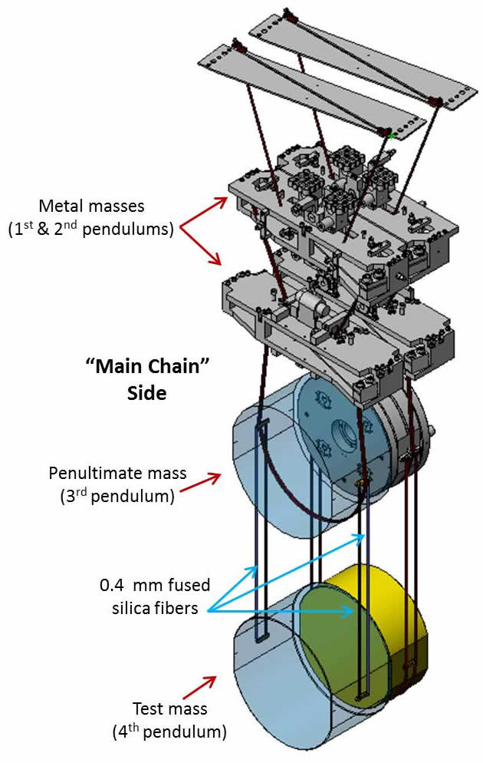
Measures changes in path length down to
10⁻¹⁹m =
0.0000000000000000001 m =
1/10,000th D_{proton}!
BUT …
Lots of “normal” vibrations
Earthquakes
Trucks on roads
Jogging staff members ….

Slide 21
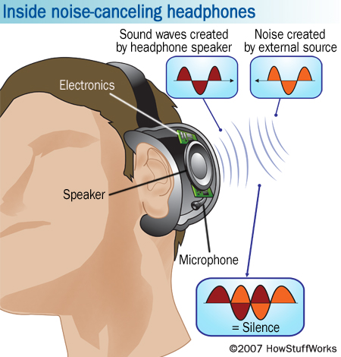
Seismic Isolation System
Active damping
Like noise-canceling headphones
Create destructive interference!

Slide 22
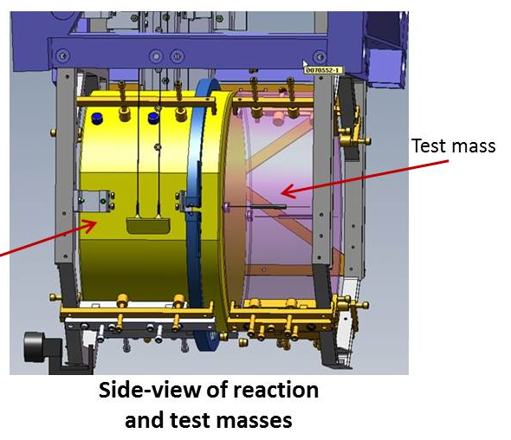
Seismic Isolation System
Passive damping
Quad = 4 stage pendulum
40 kg masses
absorb vibrations not canceled
0.4 mm glass fibers
don’t respond to temp. variations

Slide 23
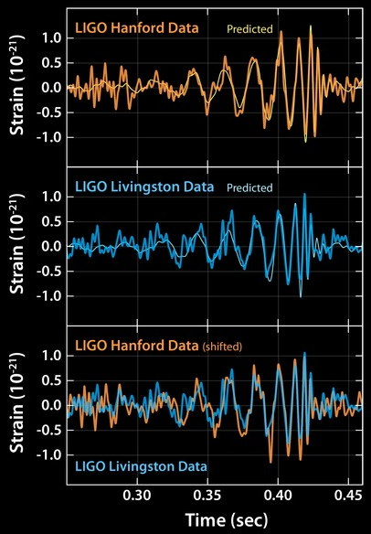
The First Detection
5:51 am 9/14/15
Livingston signal arrived 7 ms before Hanford signal
Shape of signals predicted by theory
Calculations show
Merger of black holes in southern hemisphere sky

Slide 24
The Event
Merger of 2 black holes
29 & 36 times more massive than the Sun (M☉)
3 M☉ converted into energy of gravitational waves!
E = mc² = 3M⊙c²=(3 x 1.99 x 10³⁰ kg)(3 x 10⁸ m/s)²
E = 5.4 x 10⁴⁷ J = 1.5 x 10⁴¹ kWhr
E = total output of the Sun over 4.5 trillion years!
1.3 billion years ago
First fungi appear on land on Earth
Merged black hole has about 62 M☉
15,000,000,000,000,000,000,000,000,000,000,000,000,000.0 kWhr
At 5.9¢/kWhr that’s $8.85 x 10^{39!}

Slide 25
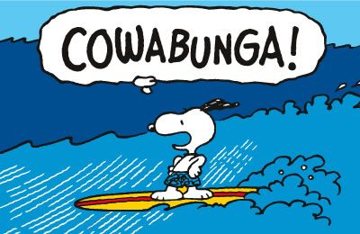
In 1.3 billion years since black holes merged,
life on Earth evolved into plants, fish, reptiles, and mammals that became humans.
Humans discovered gravity waves & built LIGO just in time to detect the jiggle!!

Slide 26
The Fabric of Our Souls
Spacetime is a fabric
Gravity can ripple the fabric
LIGO can detect the ripples
What if our souls are a fabric
God can ripple the fabric of our souls
Prayer can detect the ripples
But we have to learn how …

Slide 27
The Fabric of Our Souls
1 Kings, Chapter 19
Then the LORD said: Go out and stand on the mountain before the LORD; the LORD will pass by. There was a strong and violent wind rending the mountains and crushing rocks before the LORD—but the LORD was not in the wind; after the wind, an earthquake—but the LORD was not in the earthquake;
after the earthquake, fire—but the LORD was not in the fire; after the fire, a light silent sound.
When he heard this, Elijah hid his face in his cloak and went out and stood at the entrance of the cave.

Slide 28
The Fabric of Our Souls
In Einstein’s Universe …
Elijah’s light silent sound
Ripples in the fabric of our souls
=

Slide 29
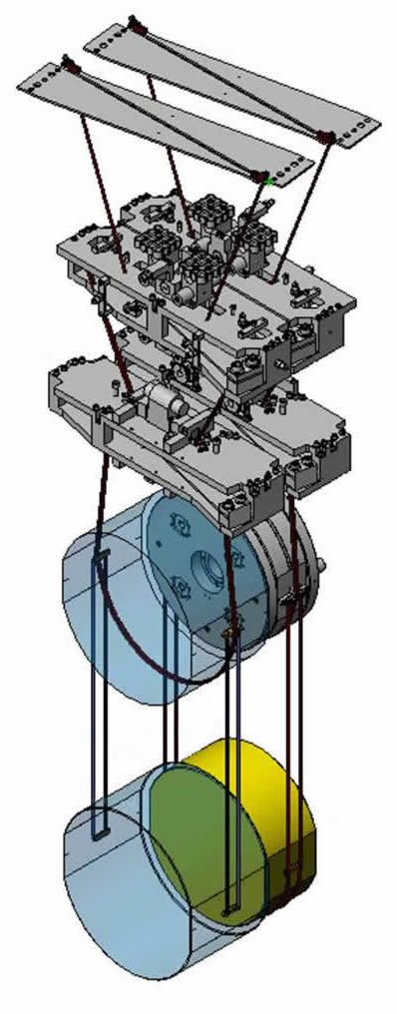
The Fabric of Our Souls
Detecting the ripples
Give time to listening = prayer
Isolate our “mirrors” from
Stresses
Anxieties
Planning
other distractions … noise …
Wait …
LIGO
Funding to detection = 31 years!

Slide 30
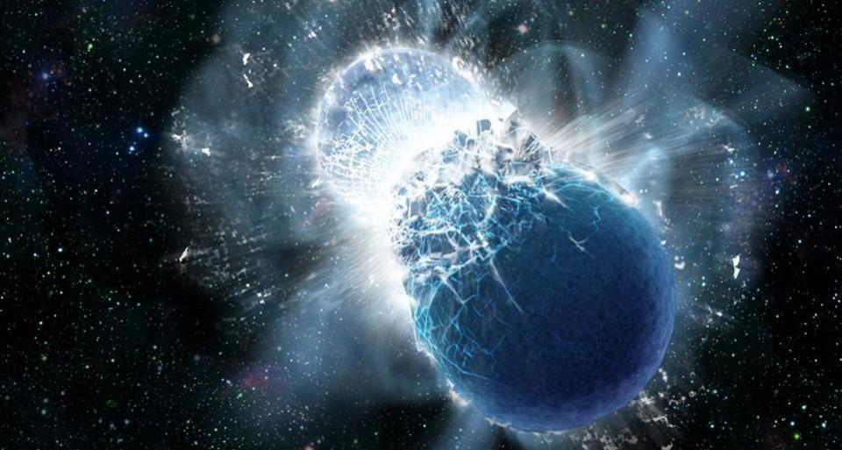
Second Detection: 8:41 am EDT 8/17/17
LIGO detected gravitational wave
1.74 s later, Fermi Satellite detected γ–rays
Gamma-Ray Burst (GRB)
Neutron star merger
Produced Earth-mass of Au! ( + Ag + I + … )

Slide 31
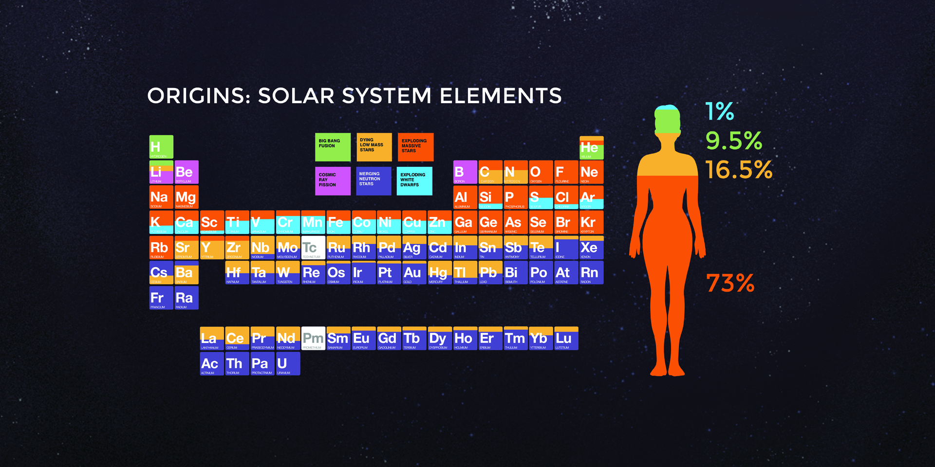
Substance of Ourselves
Cosmic Origins of the Elements
Ag, Au, I from merging neutron stars
Origin of the iodine controlling your metabolism!
We’re Mostly Made of Massive Exploded Stars!

Slide 32
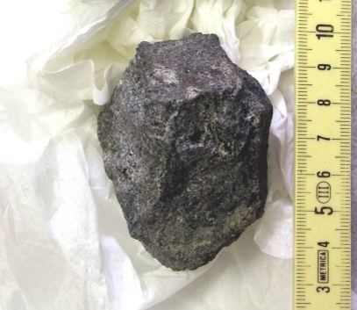
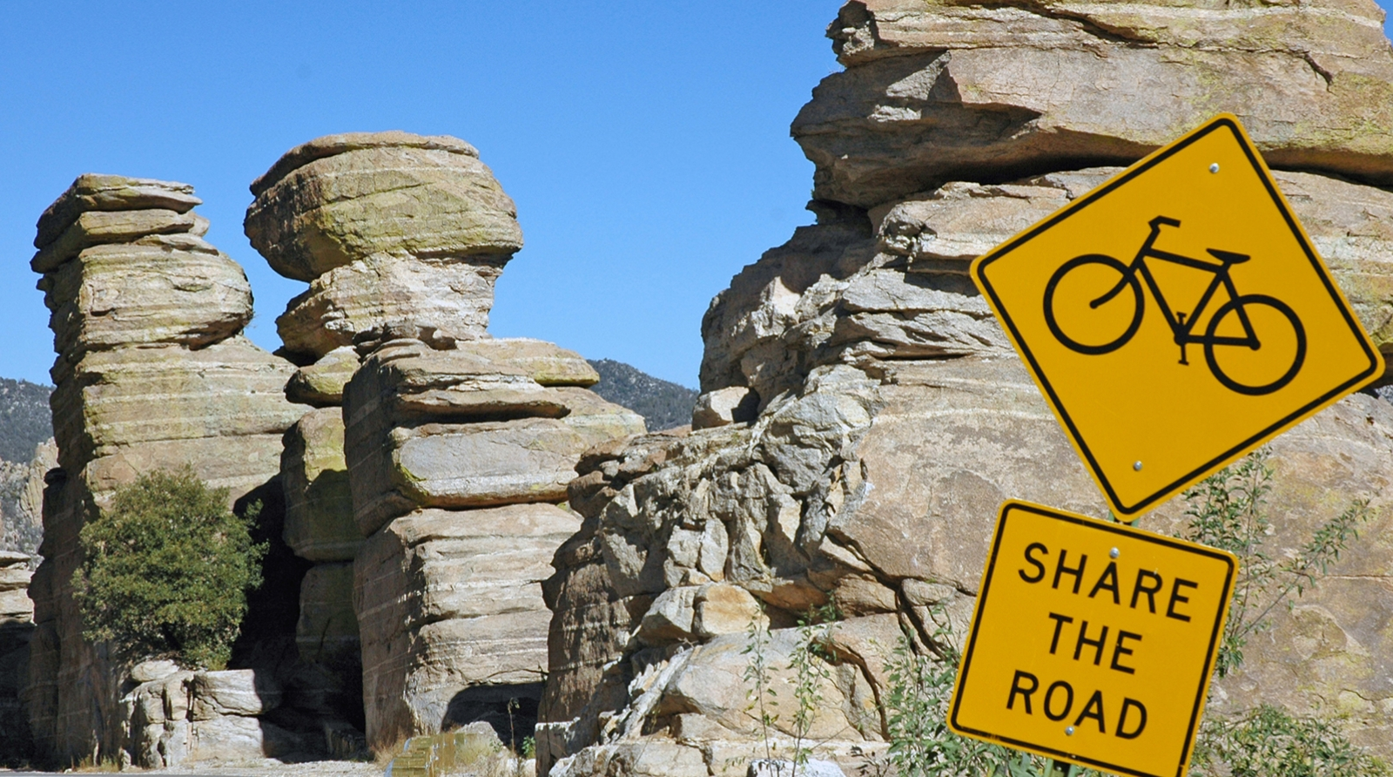
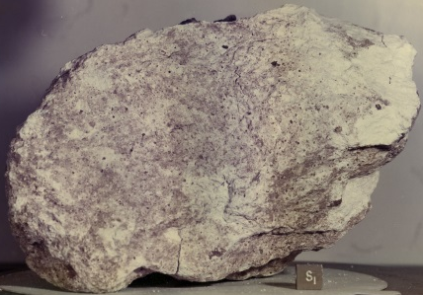
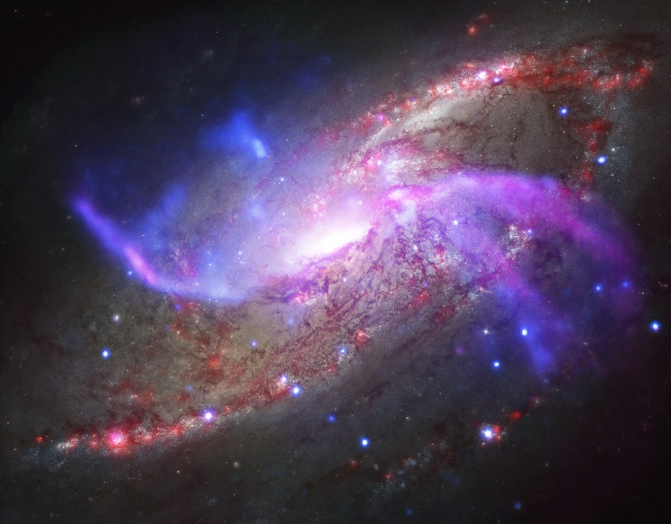
What We Knew Before LIGO
Information about the universe
Material
Earth
Moon Rocks
Meteorites
Electromagnetic Radiation
Visible
Radio
Infrared
Ultraviolet
X-Rays
γ-Rays
https://www.visittucson.org/
Meteorite from Vesta lava flow
Apollo 16 Anorthosite
M 106
But what IS light?
Visible (Hubble)
Radio (JVLA)
X-Ray (Chandra)
Infrared (Spitzer)
www.jpl.nasa.gov/spaceimages/

Slide 33
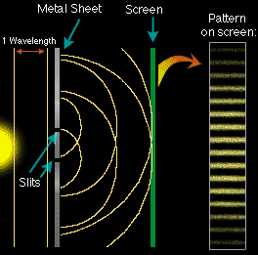
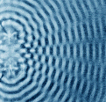
Light Interacts As A Wave
Light shows interference (addition of waves) and diffraction (bending around corners) like water waves.
+
+
=
=
crest + trough = zilch!
Stripes between almost touching fingers!
trough + trough
But that’s not ALL light is …
crest + crest

Slide 34
Particles and Waves
Waves vs. Particles passing through slits
incoming waves
incoming particles
Waves add crest to crest & trough to trough (constructive ⇒ light spots)
Particles pile up under each slit.
Waves add crest to trough (destructive ⇒ dark spots)
Sequence of bright and dark spots.
Two bright spots.

Slide 35
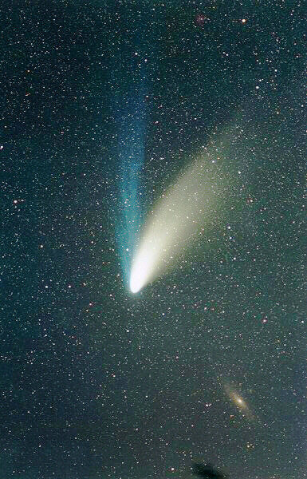
Light Acts As A Particle
Light pushes dust out of the solar system like a stream of particles.
Ion tail shaped by solar magnetic field.
Dust tail shaped by sunlight pushing dust away from the sun.
Hale-Bopp APOD 4/1/97

Slide 36
Wave-Particle Duality
Light is a wave AND a particle!
Exists as both natures …
until it interacts with matter.
Manifests one nature
appropriate to the interaction.
Becomes a particle hitting comet dust.
Becomes a wave passing through a slit.
How can it be BOTH at ONCE?
We don’t know … but it is!

Slide 37
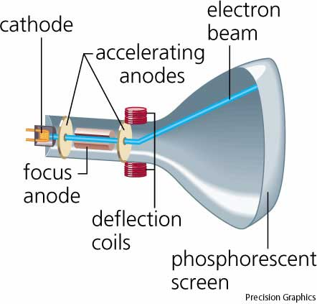
Wave-Particle Duality
Electrons act like particles
sweeping e⁻ beam creates TV pictures
e⁻’s collide with phosphorescent molecules
knock molecules into excited state
light emitted when molecule falls to lower state

Slide 38



Wave-Particle Duality
Electrons act like waves
Quantum Tunneling
Energy barrier (insulator)
reflects particles
waves penetrate
waves exist everywhere … can find position beyond barrier
like oranges spontaneously
leaving fruit bowl
but oranges are too big!
… only subatomic particles do this!
Used in Flash memory (cell phones!)
High energy
Lower energy

Slide 39
Wave-Particle Duality
Matter is a wave AND a particle!
Exists as both natures …
until it interacts with matter.
Manifests one nature
appropriate to the interaction.
Becomes a particle hitting TV screen.
Becomes a wave in Flash memory.
How can it be BOTH at ONCE?
We don’t know … but it is!

Slide 40
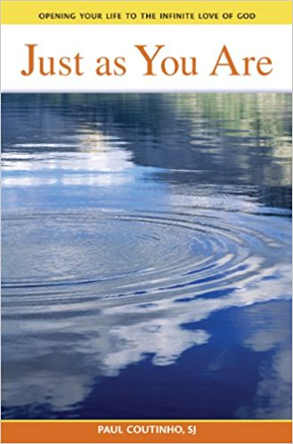
Sin-Grace Duality
But amazingly, when we find our root sin, we will also find our root grace. Our root grace is the same energy of our root sin channeled in a positive direction. The root sin and the root grace are linked.
-Paul Coutinho, SJ, Just as You Are
How can they share a root?
We don’t know … but they do!

Slide 41
Wave-Particle Duality
“The essential marvel of the divine milieu is the ease with which it assembles and harmonizes within itself qualities which appear to us to be contradictory.”
Pierre Teilhard de Chardin
The Divine Milieu
OK … light & electrons are weird … but what about normal matter?

Slide 42
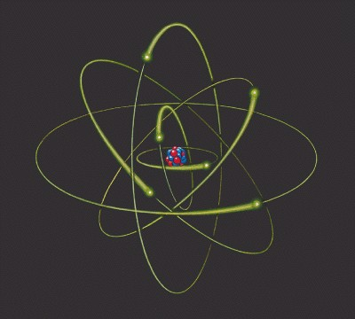
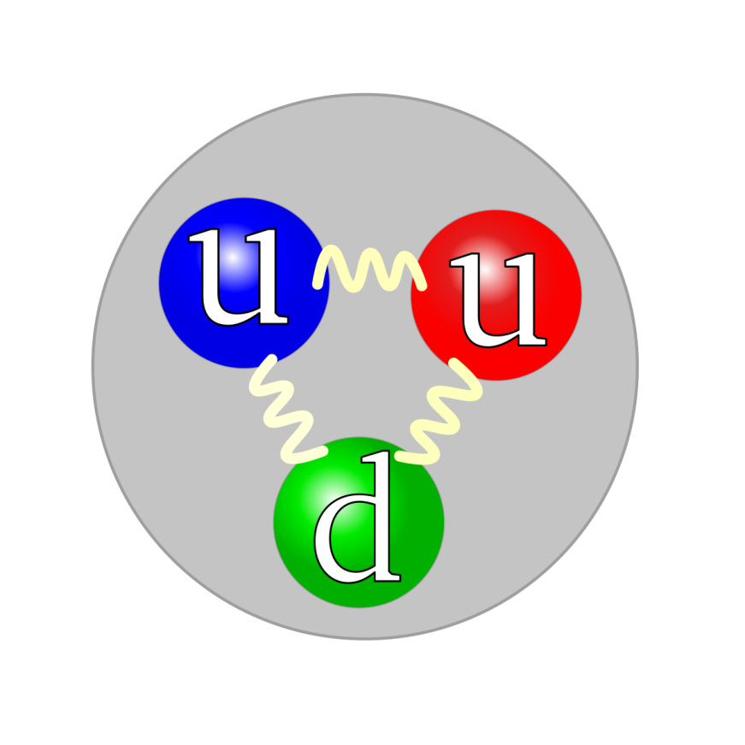
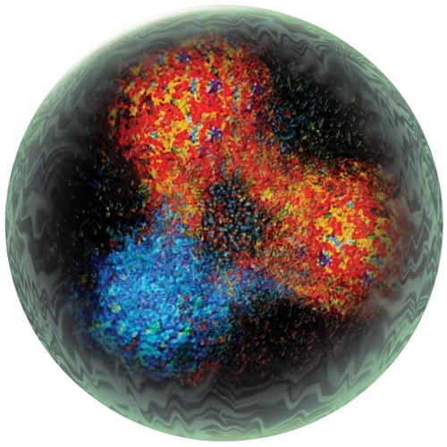
The Structure Of Matter
… at the Subatomic Scale
Protons & Neutrons in Nucleus are made of Quarks held together dynamically by the exchange of gluons.
Gluons are active, like springs.
… but fuzzier

Slide 43
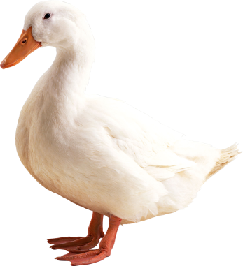
Quarks: Fundamental Constituents of Matter
Quark! Quark!
Quarks cannot exist alone
Decay if alone
Carry 1/3 or 2/3 of an electric charge
Exist only in relationship to other quarks to create protons, neutrons, atoms, …, all matter (rocks, water, ducks, us!)
Matter, at its most fundamental level, must exist in relationship to exist at all!

Slide 44

Beatrice Bruteau: God’s Ecstacy
God exists as “The One.”
Absolute,
Infinite,
Necessary to all other existence,
Exists in every possible way of being …
God, the Ground of All Being, must exist in relationship to exist at all.

Slide 45
God: The Ground of All Being
Beatrice Bruteau
“Being is really Be-ing; it is not really a noun but a verb. ... To-exist is dynamic, not static.”
“Dynamic be-ing means more-being, being more. Endlessly more. Every kind of “more.”
Being must be both one and many.”

Slide 46
God’s Ecstasy
Beatrice Bruteau
“The Trinity is both one and many; Being is present there as Persons; the Persons are necessary and infinite; the Persons are both enstatic and ecstatic; and the Persons are Being-communicating”
The Universe is God’s Ecstasy

Slide 47
Hymn to Matter
Teilhard de Chardin
“I bless you, matter, and you I acclaim: not as the pontiffs of science or the moralizing preachers depict you, debased, disfigured … but as you reveal yourself to me today, in your totality and your true nature.

Slide 48

Hymn to Matter
Teilhard de Chardin
I acclaim you as the divine milieu, charged with creative power, as the ocean stirred by the Spirit, as the clay molded and infused with life by the incarnate Word.”
Sunrise on the St Lawrence in the 1000 Islands
https://beautysurroundsyou.photoshelter.com

Slide 49
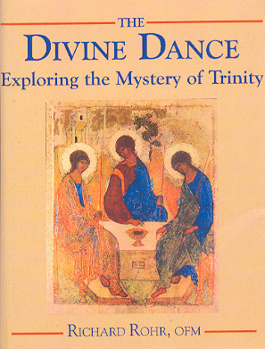
Trinity
Perichoresis = Dancing
Developed by “Eastern Fathers”
Didymous the Blind (313-398)
Basil the Great (329-379)
Gregory of Nazianzus (325-389)
“Whatever is going on in God is a flow that’s like a dance
and God is not a dancer,
God is the dance, itself.”
- Richard Rohr

Slide 50
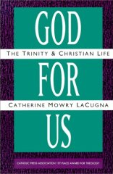
Perichoresis: Divine Dance
Relationship is the theology of the Trinity
God for us – Father: Total Giving
God with us – Son invites us into the dance
God within us – Holy Spirit allows someone else to love through us – participation in God
“Whatever is happening in God cannot be just an inner, hidden secret. It has to be reflected in the outer universe”
- Catherine LaCugna

Slide 51
So what have we learned?
The universe dances.
God IS the dance.
So dance!

Slide 52
My Dancing Day
Traditional English Carol (c. 1400-1700)
Tomorrow shall be my dancing day, I would my true love would so chance To see the legend of my play, To call my true love to my dance
Then was I born to a virgin pure. From her I took fleshy substance. Thus was I knit to human nature To call my true love to my dance.
In a manger laid and wrapped I was, So very poor this was my chance. Betwixt an ox and a silly poor ass To call my true love to my dance.
Then later on baptized I was. The holy ghost on me did glance. The Father’s voice heard from above, To call my true love to my dance.
Sing O my love, O my love, my love, my love, my love,
This have I done for my true love.

Slide 53
Dance with the Universe
Darkness is something (not nothing)
Everything is made of stars
Trees make wood out of air
Spacetime is something and it ripples
God ripples the fabric of our souls
Light & Matter are waves and particles
God and quarks must exist in relationship in order to exist at all
God is the dance of the Universe …

Slide 54
Dance with the Universe
In every heartbeat, breath, and thought, matter and energy interact to give you life
Breathe in the universe, breathe out love!
God is in it all!

