Slide 1
God’s Grandeur, Machines, World-Heart
Christopher Corbally, SJ
with thanks to
Prof. Aileen O’Donoghue St. Lawrence University
Ignatian Silent Retreat
September 2021
Notes:
The 90” where AOD and CC were on the eve of 9/11.

Slide 2
God’s Grandeur
THE WORLD is charged with the grandeur of God.
It will flame out, like shining from shook foil;
It gathers to a greatness, like the ooze of oil
Crushed. Why do men then now not reck his rod?
Generations have trod, have trod, have trod;
And all is seared with trade; bleared, smeared
with toil;
And wears man’s smudge and shares man’s smell: the soil
Is bare now, nor can foot feel, being shod.

Slide 3
God’s Grandeur
And for all this, nature is never spent;
There lives the dearest freshness deep down
things;
And though the last lights off the black West went
Oh, morning, at the brown brink eastward,
springs—
Because the Holy Ghost over the bent
World broods with warm breast and with ah!
bright wings.
Gerard Manley Hopkins

Slide 4
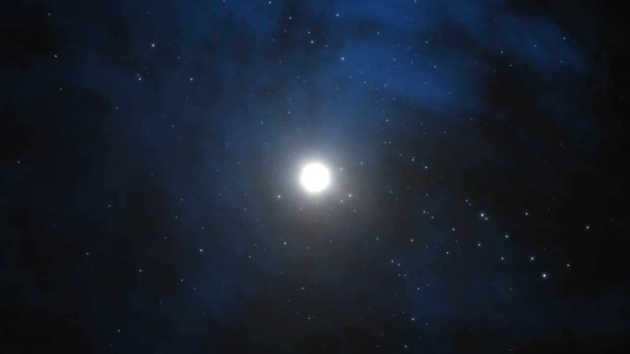
Supernova

Slide 5
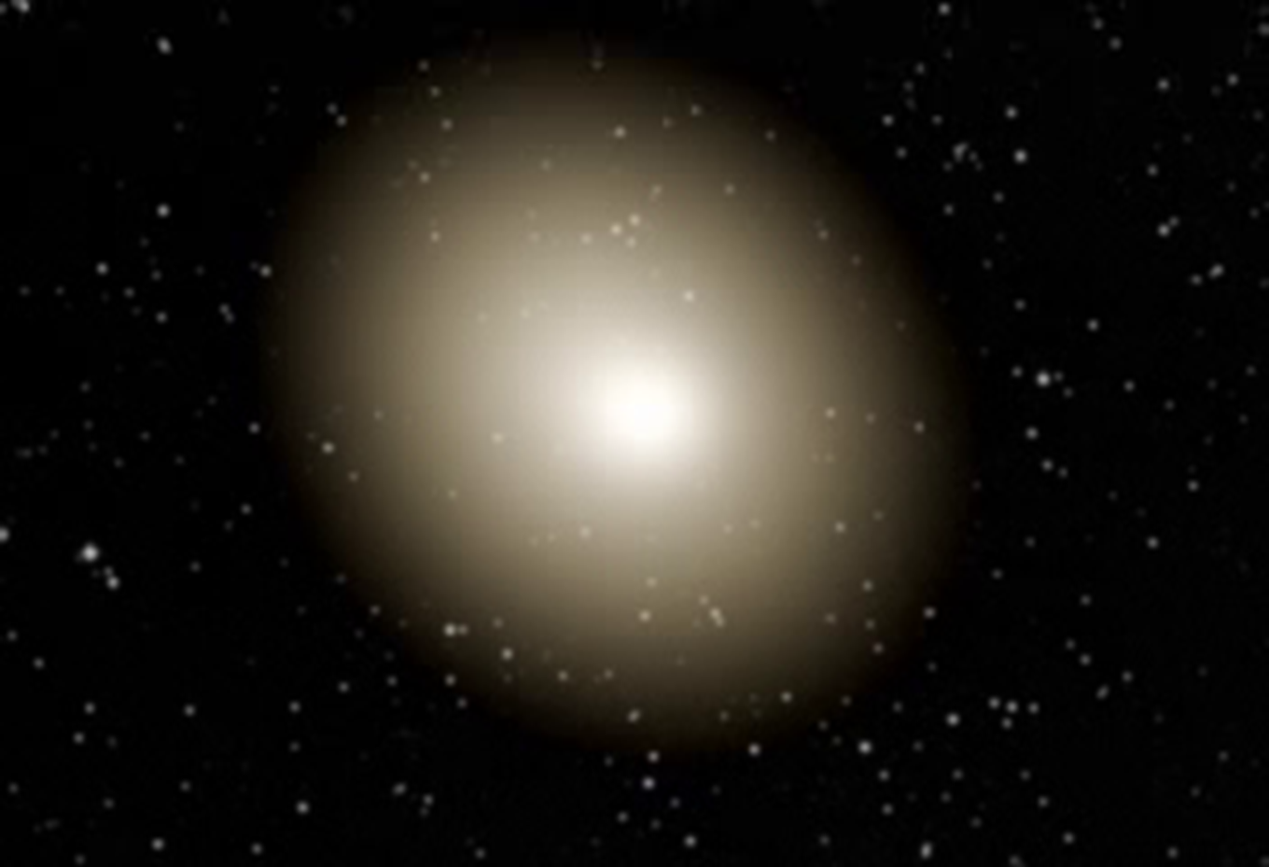
Supernovae
ONLY way to fuse heavy elements … source of all the
iron, zinc, copper, iodine,etc in our bloodstreams,
gold, silver, bronze, tin, etc. in our jewelry (and teeth!)
mercury, lead, molybdenum etc in our machines.

Slide 6
Machines
Made of elements from supernovae
ashes of giant stars that died before the sun was born
one may have initiated the sun’s formation with shock waves
Created by human minds
Created by human vision
Created by human toil …
Machines are not foreign to the universe!

Slide 7
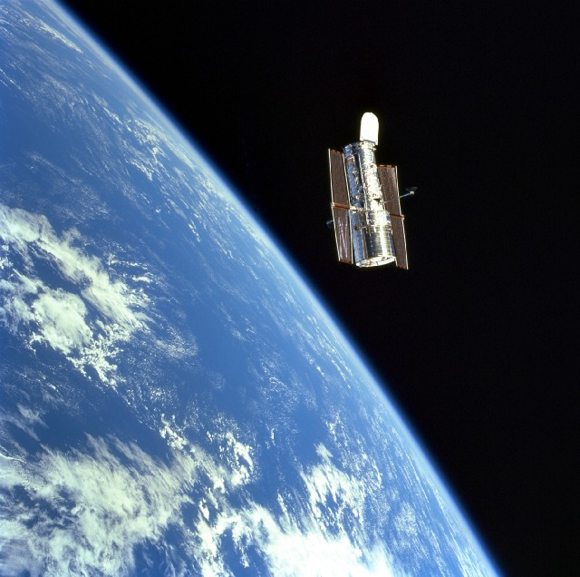
Machines Show Us The Universe: HST 2002

Slide 8
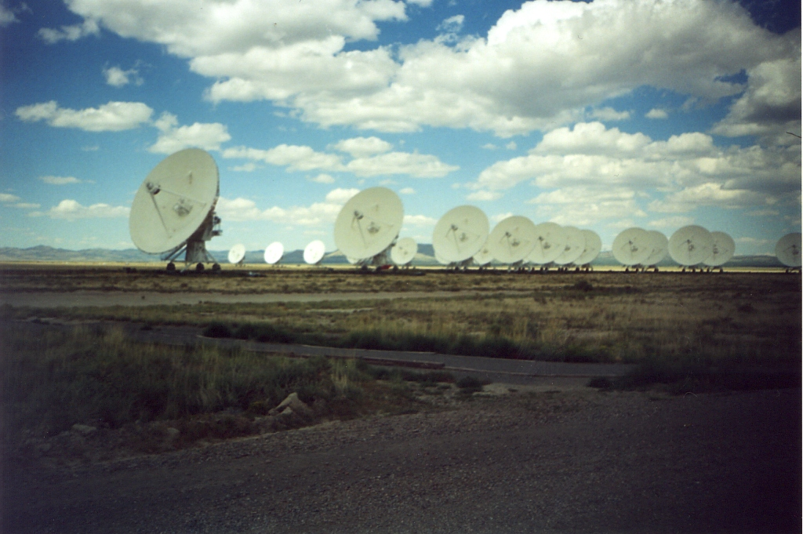
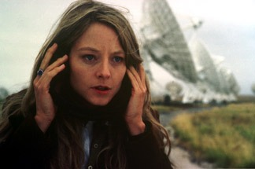
VLA Radio Telescope
Where “Ellie” heard the signal of another civilization …
Contact, The Movie
Notes:
Jill Tarter (SETI) not Ellie, but Carl Sagan himself.

Slide 9
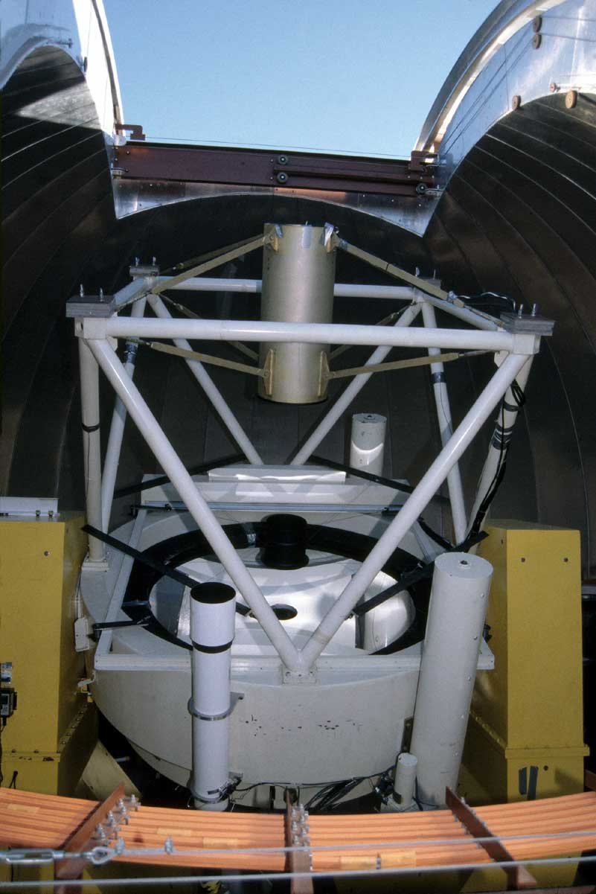
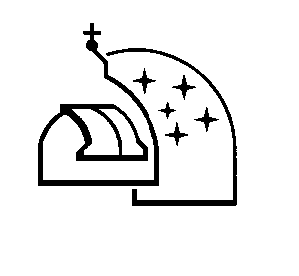
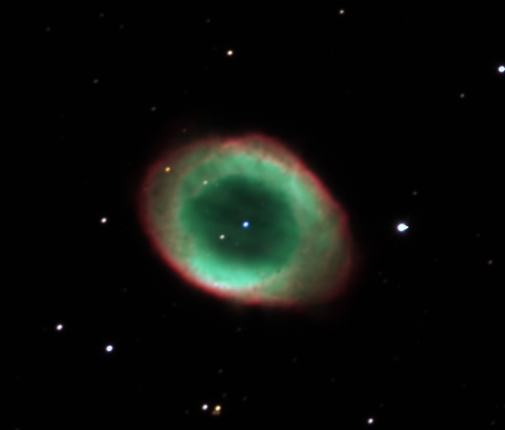
Vatican Advanced Technology Telescope
"Our scientific knowledge of the physical evolution of the universe, and our very limited knowledge of the origin of humans within it, might provide an opportunity to enrich our relationship to God as creator, if only we get loose of our idolatries.“
Dr. George Coyne, S. J., Emeritus Director

Slide 10
Machines
Bless our lives
science
healthcare
“I am alive because of machines testing and refrigerating blood”
transportation
sanitation
communication
But the blessings of machines can be hidden

Slide 11
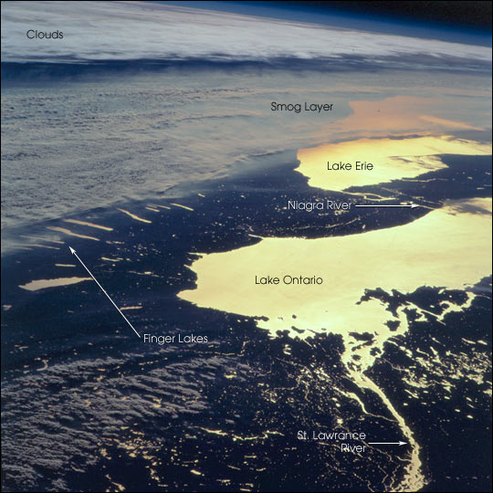
Pollution Hides Blessings
Rochester
Thousand Islands

Slide 12
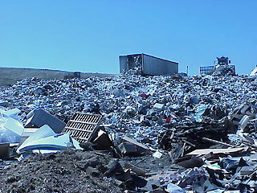
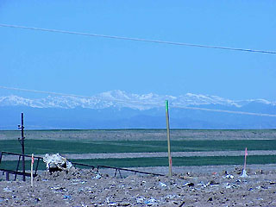
Dumps Hide Blessings
Denver, Colorado
Mt. Evans

Slide 13
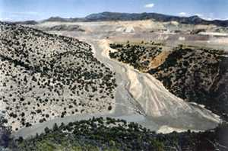
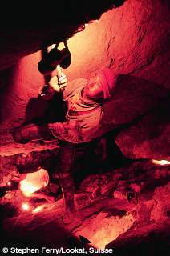
Mining Hides Blessings
Arizona
Bolivia

Slide 14
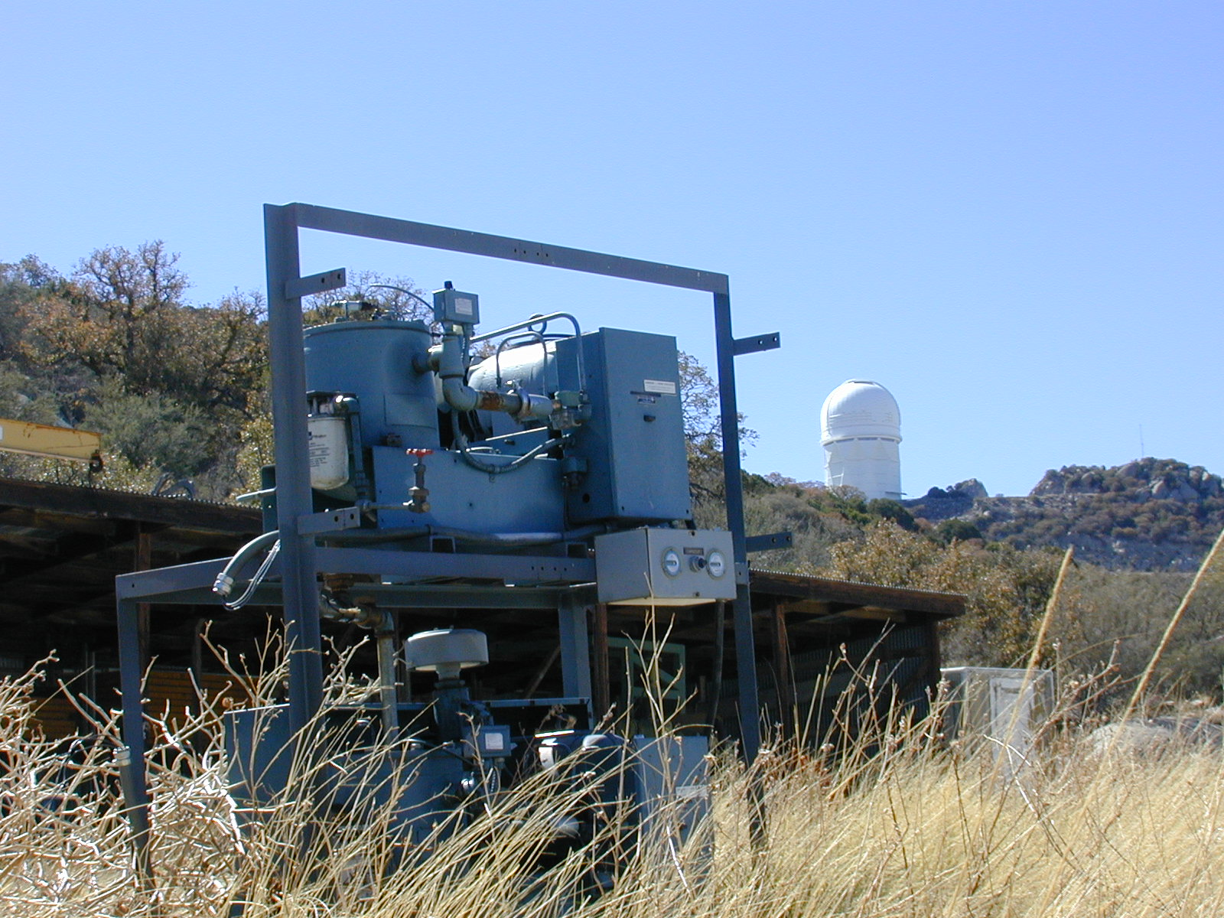
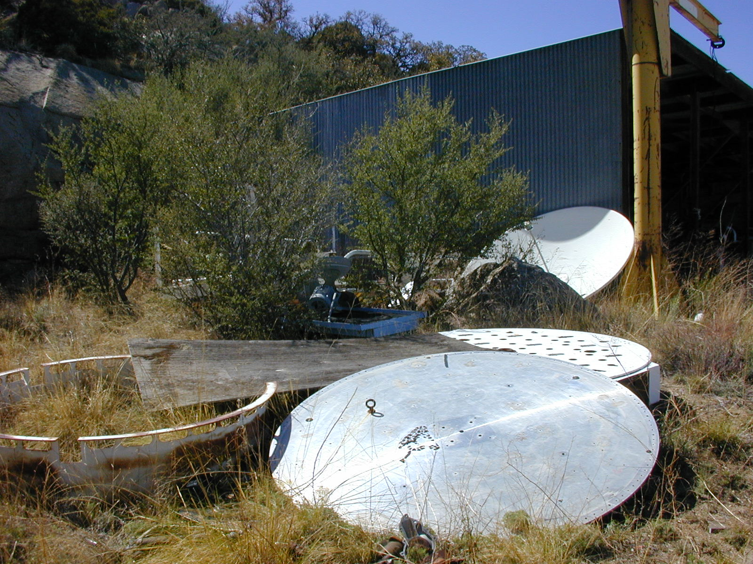
But Blessings Lurk
Behind the junk ...
Within the junk …
Notes:
One person’s junk is another’s treasure!

Slide 15
Machines
Seen as evil …
“Our intellectual journals are full of gloomy tracts that depict a society debased by technology. Our health is being ruined, … , our landscape despoiled, and our social institutions laid waste”
Samuel Florman
Blaming Technology

Slide 16
Machines
Seen as evil …
“Atomism, or the machine model, reduces all living things to their most basic chemical compounds, so that we and all other organisms are ‘nothing but’ the chemicals in our bodies.”
Sallie McFague
The Body of God

Slide 17
Seeing Junk Anew
… “Imagine God as the living awareness in the space between the atoms … Is God immanent or transcendent, internal or external, composed or compassionate? Like the question of whether the atom is a wave or a particle, the answer is: yes.”
Tom Mahon
The Spirit in Technology

Slide 18
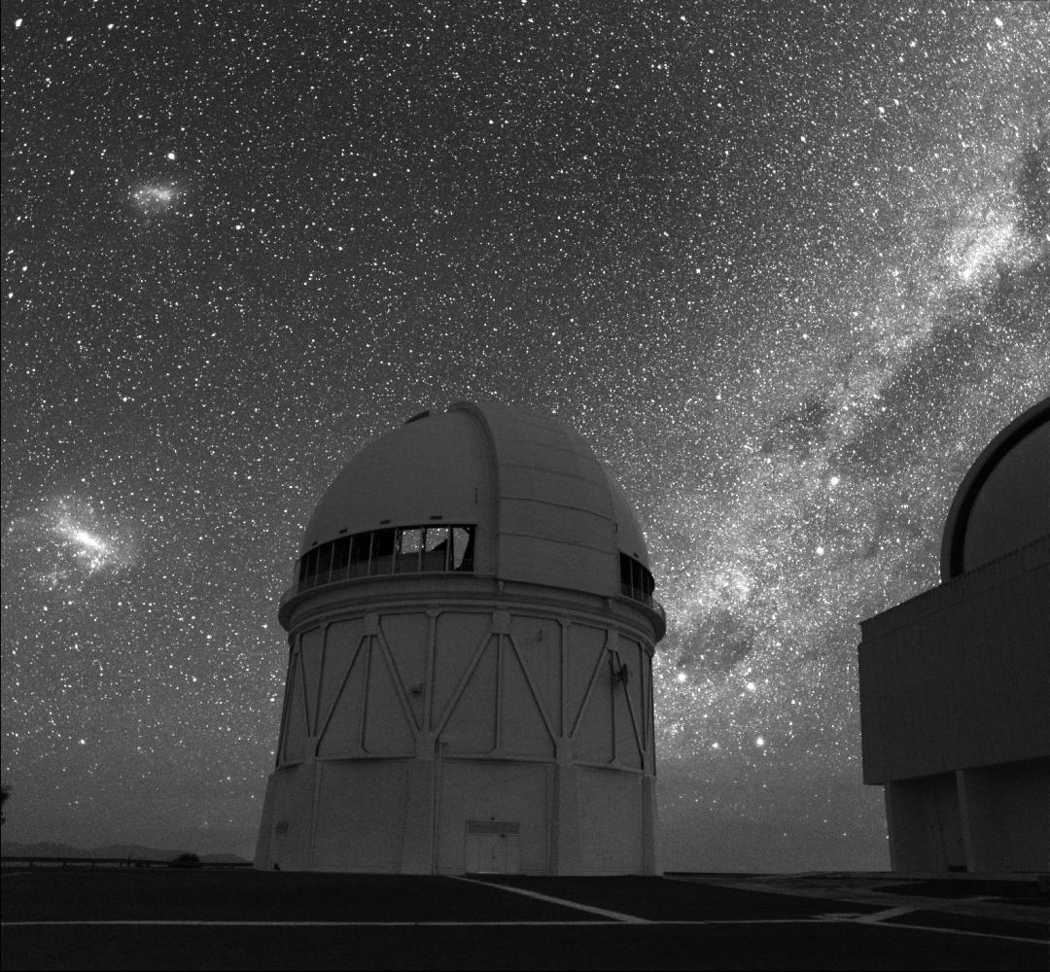
Southern Sky from CTIO
SMC
α Cen
1.5 m telescope
β Cen
LMC
AOD observes here!
α
β
Southern Cross (Crux)
δ
γ
4 m telescope
Cerro Tololo Interamerican Observatory La Serena, Chile

Slide 19
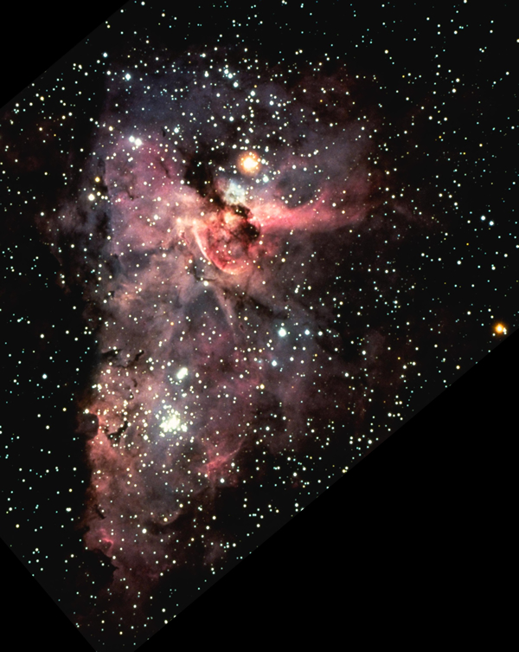
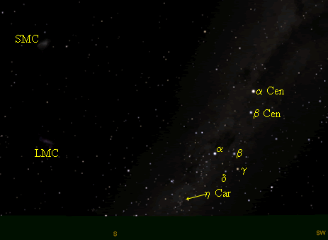
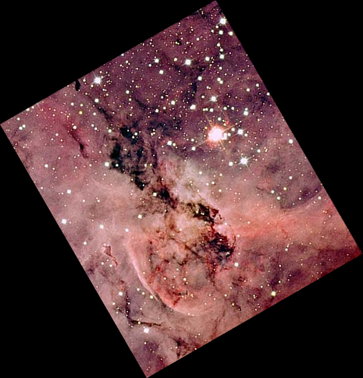
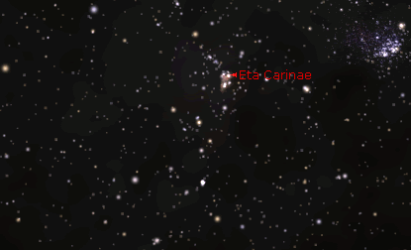
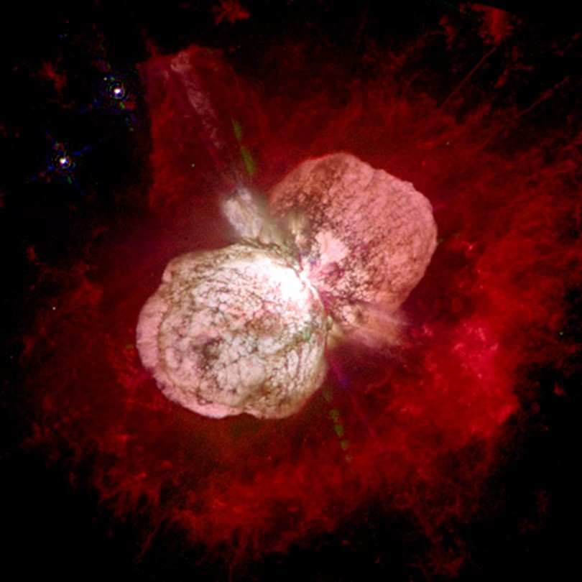
Starry Night View
Cerro Tololo Interamerican Observatory La Serena, Chile
Notes:
HST (NASA / ESA / Nathan Smith (U.Cal, Berkeley)

Slide 20
Eta Carinae
A star (or twins) 100 times the mass of Sol …in death throes

Slide 21
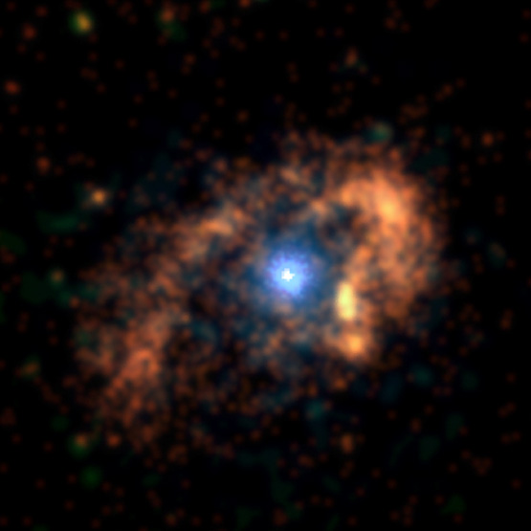
η Car
A star (or twins) surrounded by a torus of x-ray emitting gas
2 light years 3000 x Pluto’s orbit

Slide 22

At the Heart of Matter a World-heart
Eta Carinae
the Heart of a God.
Teilhard de Chardin
Notes:
From IR images & spectra -> 15 M(sun) in equatorial torus, perhaps from outer shell of a binary, constraining the newly rejected atoms/gas as a balloon inside a napkin ring.
Explosion seen in 1843, making eta Car the 2nd brightest object; distance 8,000 l.yr. As LBV, could go SN anytime.

Slide 23
Seeing Machines Anew
Teilhard’s Christ …
“Glorious Lord Christ: The divine influence secretly diffused and active in the depths of matter…”
Is also diffused and active in machines!

Slide 24
Hymn To Matter
“Blessed be you, mighty matter, irresistible march of evolution, reality ever newborn; you who, by constantly shattering our mental categories, force us to go ever further and further in our pursuit of truth.”

Slide 25
Hymn To Matter
“Blessed be you, universal matter, immeasurable time, boundless ether, triple abyss of stars and atoms and generations: you who by overflowing and dissolving our narrow standards of measurement reveal to us the dimensions of God.

Slide 26
Hymn To Matter
“Blessed be you, impenetrable matter: you who, interposed between our minds and the world of essences, cause us to languish with the desire to pierce through the seamless veil of phenomena.”
Teilhard de Chardin

Slide 27
Seeing Machines Anew
Can you find Christ in metals?
Rusted Iron
Radioactive Uranium?
Can you find Christ in machines?
Parked cars?
Garbage trucks?
Bulldozers?
Sit with the Christ in machines …

