Slide 1


Sunlight, Starlight & Grace
The Cosmos Within
Dr. Aileen A. O’Donoghue
July 8 – 13, 2019

Slide 2
Starlight and Grace
“Through the Word
all things came into being,
and apart form the Word
nothing came into being
that has come into being.
In the Word was life,
and that life was humanity’s light –
a Light that shines in the darkness,
a Light that the darkness has never overtaken.”

Slide 3
Seeing the Light
(Almost) All we know of the universe is from light.
Light of all wavelengths falls everywhere all the time, filled with information.
We must learn to see the light …

Slide 4
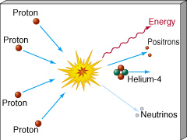
Source of the Light
Nuclear Fusion
Light elements combine to make heavy elements.
Hydrogen fuses to Helium
Stars are nuclear explosions contained by gravity!

Slide 5
Fusion Releases Energy
Mass of 4 H atoms = 4 x (1.007940 amu)
= 4.031760 amu
Mass of 1 He atom = 4.002602 amu
Difference (loss) = 0.029158 amu
= 0.7 % of H
0.7% of mass DISAPPEARS!
Where does it go?
E = mc²
Energy!

Slide 6
Energy Of Fusion: Star Power
Convert 1 kg of H to He:
0.7% ( = 7 grams) becomes energy
by E = mc²,
(0.007 kg)x(3.0 x 10⁸ m/s)² = 630 trillion joules
= 175 x 10⁶ kWhr
Fusing 1 kg of hydrogen to helium yields 175 MILLION kWhr of energy!!!!

Slide 7
Energy Of Fusion: Bring it Home
1 kg of H to He = 175 x 10⁶ kWhr
MA 2017 Fossil Fuel Energy Use = 301 x 10⁹ kWhr
Fusing 5,483 kg of H to He could replace Massachusetts’ fossil fuel energy for 1 year! (at 100% efficiency)
Fusing 66 kg of H to He could replace Massachusetts’ coal energy for 1 year
https://www.eia.gov/state/seds/seds-data-complete.php?sid=US#Consumption

Slide 8
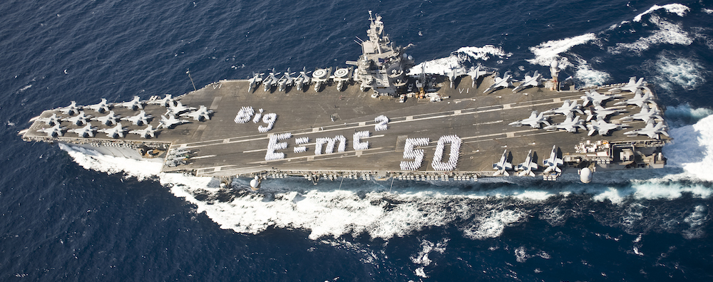
Energy Of Fusion: Power of Sol
Total Luminosity = 3.83 x 10²⁶ W
Energy from one fusion = 8.94 x 10⁻¹² J
1 W = 1 J/sec
Sun fuses = 5.98 x 10¹¹ kg of H/sec
598,000,000,000 kg/sec
That’s 6070 aircraft carriers of H per sec …
… and 5483 kg would supply MA for a year!

Slide 9
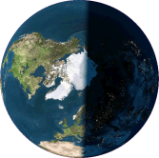
Abundance of Sol’s Energy
Emitted power = expanding spheres of energy 1 second thick
Energy spreads over surface of sphere 1 second thick
r_{Sol} = 93 million miles
Energy falling on entire Earth
= 0.0000005% of what Sun emits!
5 10-millionths of Sun’s Energy powers Earth!

Slide 10
God’s Love is as Abundant as Sunlight
“Are not five sparrows sold for two pennies? Yet not one of them is forgotten in God's sight. But even the hairs of your head are all counted. Do not be afraid; you are of more value than many sparrows.”
Luke 12:6-7

Slide 11
The Breadth Of The Spectrum
Different types of light arise from
different energies
different processes
different objects
Energy
Planck’s Constant h = 6.623 X 10⁻³⁴ J-s
Planck’s Constant
Frequency of the light
TINY!! This is why quantum effects are hard to study!
0.0000000000000000000000000000000006623 J-s

Slide 12
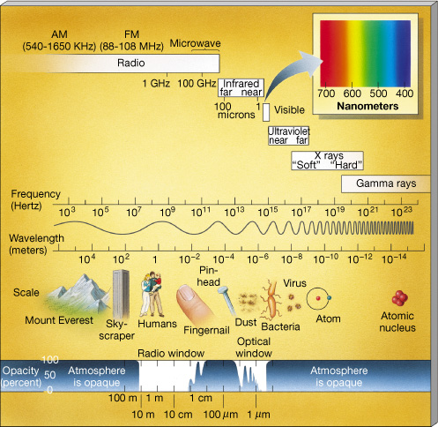
The EM* Spectrum
High Energy ⇒ high frequency, short wavelength
Microwaves are short radio waves
*ElectroMagnetic

Slide 13
Timeline Of Observatories
1609 First Telescope
1880 First Photos (of Orion Nebula)
1937 First Radio Telescope
1961 First Gamma-Ray Detection In Orbit
1965 First X-Ray Telescope In Orbit
1983 First Imaging IR Telescope In Orbit
1978 First Imaging X-Ray Observatory
1991 First Imaging γ-ray Observatory
Telescopic views of the universe are still very new!

Slide 14
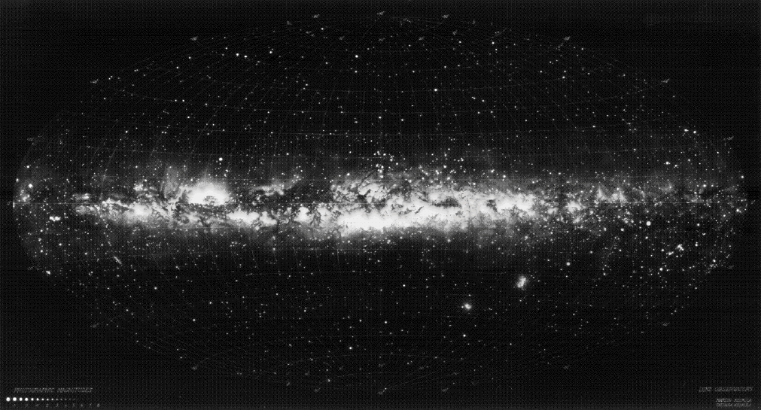
The Visible Sky
… stars, gas, & dust
Pollux
Castor
Vega
Antares
Procyon
Orion
Magellanic Clouds

Slide 15
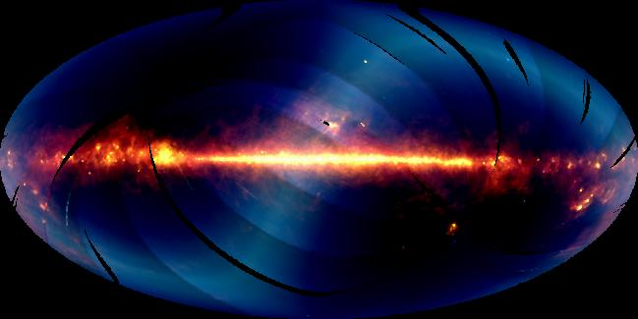
The Infrared Sky
… star formation & solar system dust
Solar system dust
Orion Nebula
Large Magellanic Cloud

Slide 16
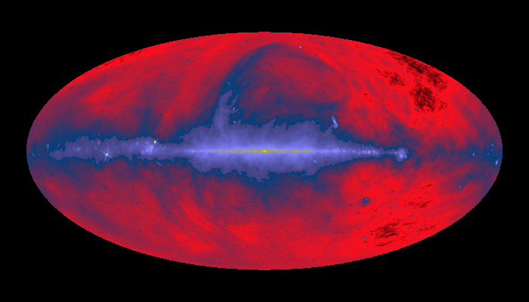
The Radio Sky
… atomic hydrogen & warm gas
Nearby gas bubble
Orion Nebula
Large Magellanic Cloud

Slide 17
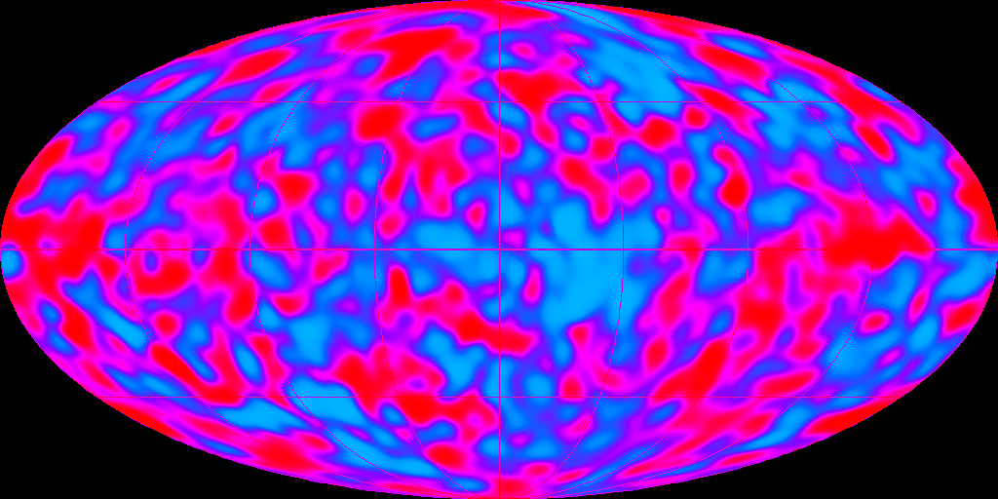
The Microwave Sky
The Echo of the Big Bang
Red = warmish
Blue = coolish
Differ by 1000ths of a degree!

Slide 18
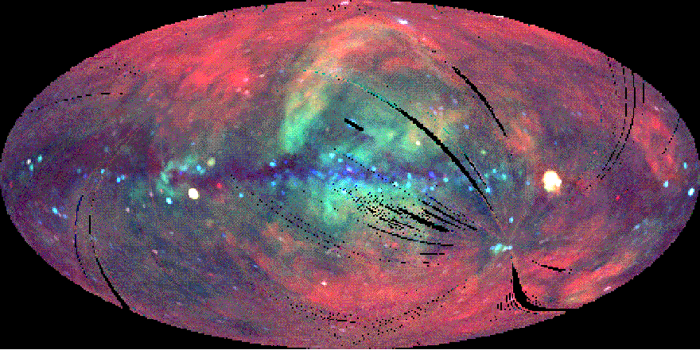
The X-Ray Sky
… very HOT gas halo
Red = low energy
Green = moderate energy
Blue = high energy
Supernova remnant kyr old
Black hole candidate in Cygnus
Large Magellanic Cloud

Slide 19
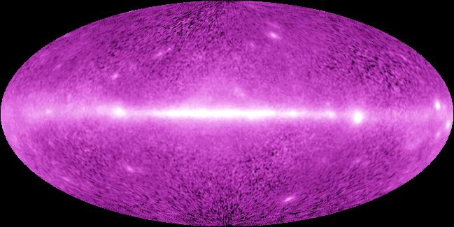
The γ-Ray Sky
… extremely energetic events
Stellar collisions, stars falling into black holes, stars exploding …

Slide 20
The Breadth of God’s Grace
“May Christ dwell in your hearts through faith, so that you , being rooted and grounded in love, will be able to grasp fully the breadth, length, height and depth of Christ’s love and, with all God’s holy ones, experience this love that surpasses all understanding, so that you may be filled with all the fullness of God. ”
Ephesians 3:18-19

Slide 21
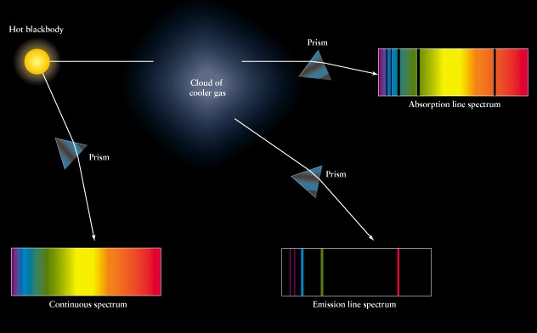
The Depth Of The Spectrum
Bright and Dark Lines Appear In Spectra
Absorption Spectrum: Opaque object seen through cloud of gas.
Continuous Spectrum: Glowing opaque object
Emission Spectrum: Glowing cloud of gas.

Slide 22
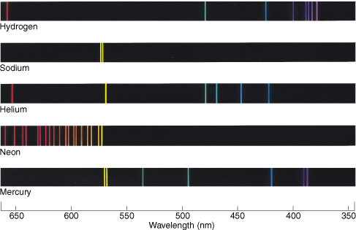
Spectral Lines
Each Element Emits Unique Set of Lines

Slide 23
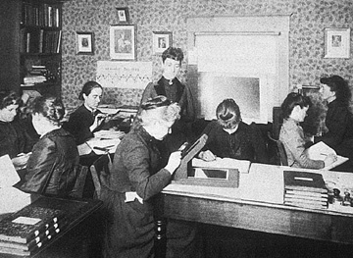
Spectra Of The Stars
Early spectra catalogued & analyzed mostly by women!
At Harvard College Observatory
Dava Sobel, The Glass Universe (New York: Viking)

Slide 24
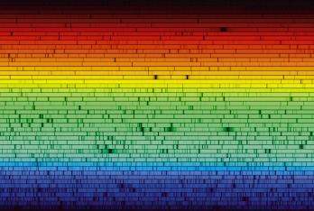
Spectra Of The Stars
The Solar Spectrum

Slide 25
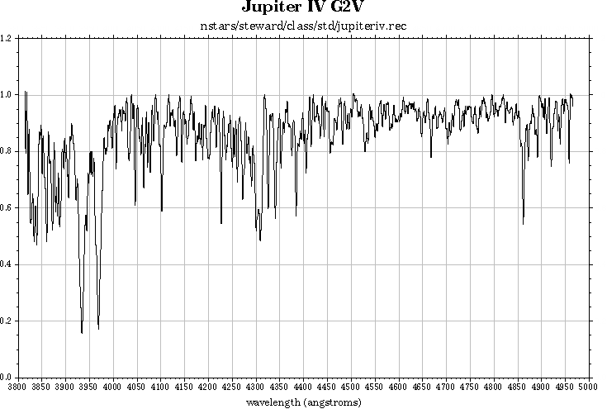
Spectra Of The Stars
The Spectrum Of the Sun (5800 °C)
Hydrogen Line
Calcium Lines

Slide 26
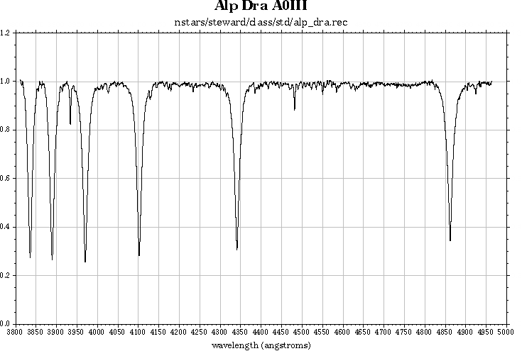
Spectra Of The Stars
The Spectrum Of Thuban (9800 °C)
Hydrogen Line
Calcium Line

Slide 27
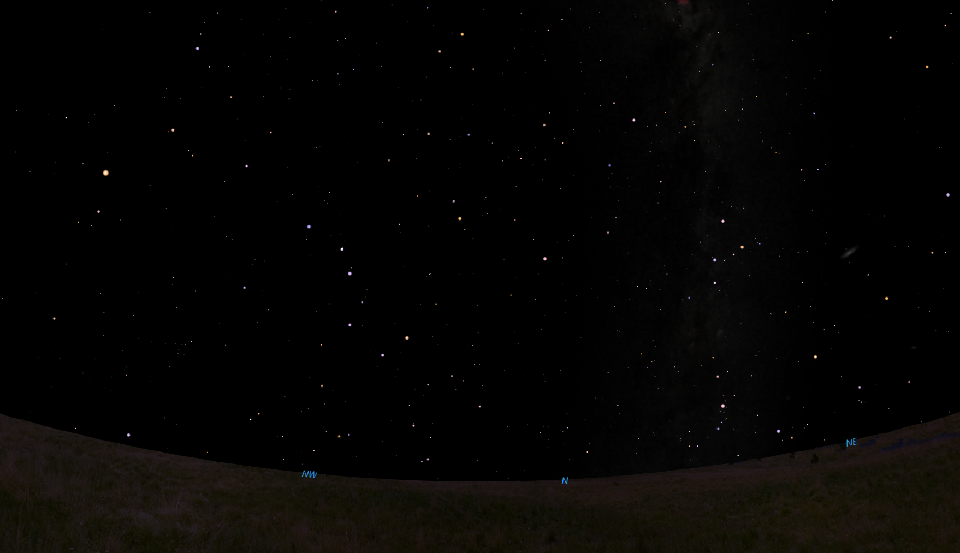
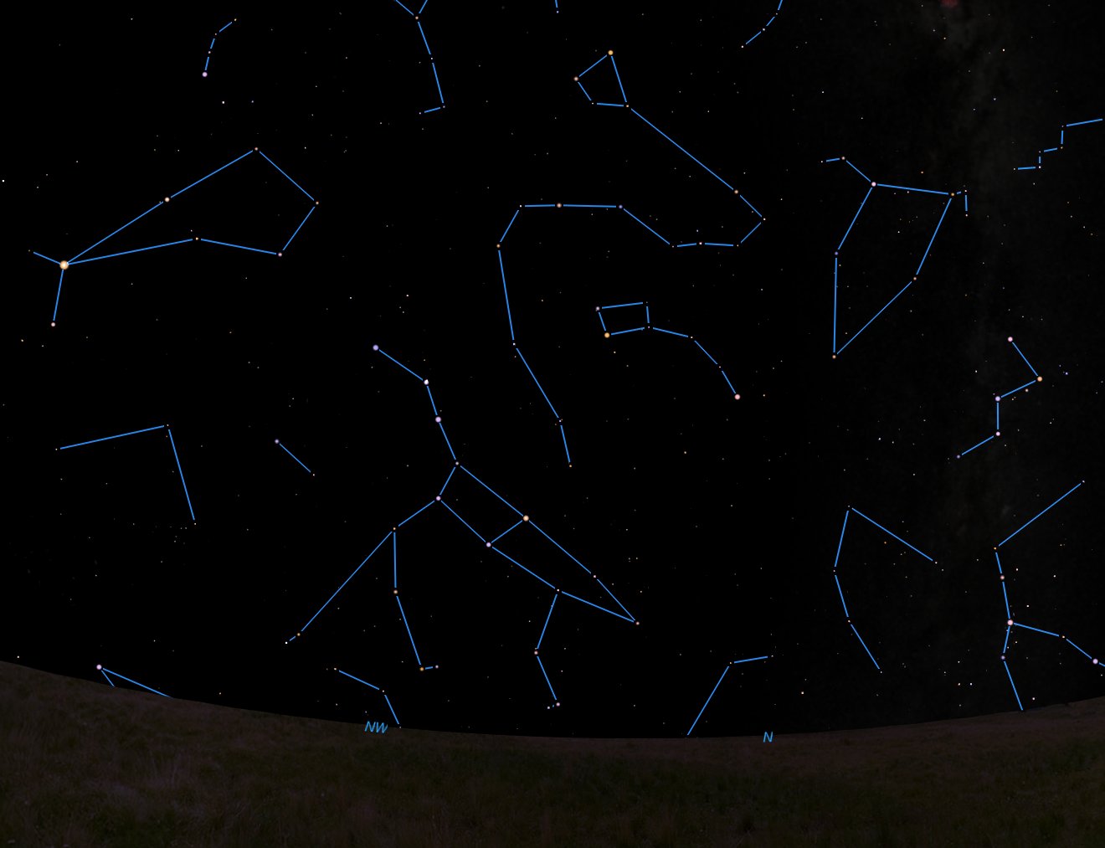
Thuban: α Draconis
Pole star in 2700 BCE, used by Egyptians
Arcturus
Boötes
Draco
Cepheus
Thuban
Little Dipper
Arc to Arcturus
Polaris
Cassiopeia
Coma Berenices
Pointers to Polaris
Big Dipper
Three Leaps of the Gazelle
1:00 am July 10, looking north northwest from Holyoke … during a blackout

Slide 28
Thuban: α Draconis
Pole star in 2700 BCE, used by Egyptians
Arcturus
Boötes
Draco
Cepheus
Thuban
Little Dipper
Arc to Arcturus
Polaris
Cassiopeia
Coma Berenices
Pointers to Polaris
Big Dipper
Three Leaps of the Gazelle
1:00 am July 10, looking north northwest from Holyoke … during a blackout

Slide 29
Spectra Of The Stars
Tell us
Chemical Composition
Helium first discovered in spectrum of the Sun!
Temperatures
3000K to 40,000K
First determined by Cecila Payne-Gaposchkin
(first PhD through HCO for anyone!)
Spectra tell us the chemistry and temperatures of the stars!
… but there’s MORE …

Slide 30
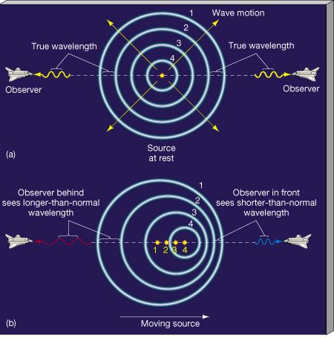
Doppler Shift
Waves are squashed or stretched by motion of the source …
✰ Horn of a passing car
Light of a moving
star or galaxy

Slide 31
Doppler Shift
We know the wavelength for no motion
Measure wavelength shift
Calculate velocity of object with respect to us
Really easy to measure!
Difference between proper and shifted wavelength
Speed of object
Speed of light
Proper wavelength

Slide 32
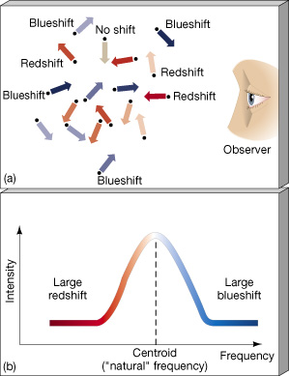
Spectral Lines
Breadth of Lines Gives Range of Speeds
Small stars: large range (wide lines)
Large stars: small range (narrow lines).
Spectra tell us the sizes of stars!

Slide 33
Spectra Of The Galaxies
Expansion of the Universe
All galaxy spectra are redshifted
⇒All galaxies are moving away
More distant galaxies more redshifted
⇒More distant moving faster

Slide 34
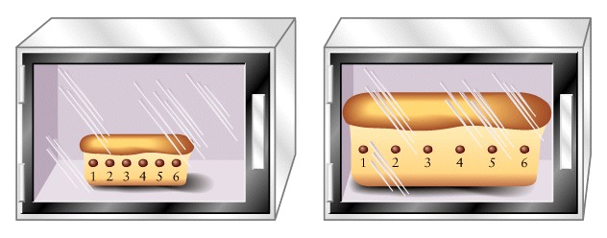
Spectra Of The Galaxies
Expansion of the Universe
As space expands, more distant objects move away faster.

Slide 35
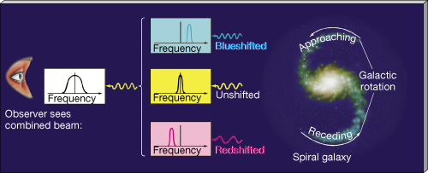
Spectra Of The Galaxies
Rotation creates red and blue shifts
Shift tells us rotational speed
Rotational speed tells us the mass of the galaxy by Newton’s laws!
Spectra tell us the masses of galaxies!

Slide 36
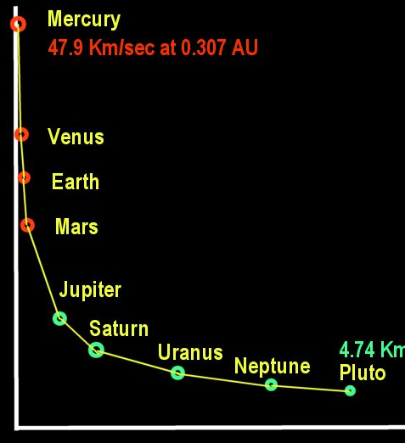
Galaxy Rotation Speeds
Orbital Speeds of the Planets
“Keplerian Velocities”
Kepler figured them out
Get smaller with distance
Explained by Newton
Speed
Distance from sun
http://www.ice-age-ahead-iaa.ca/s/planets.jpg

Slide 37
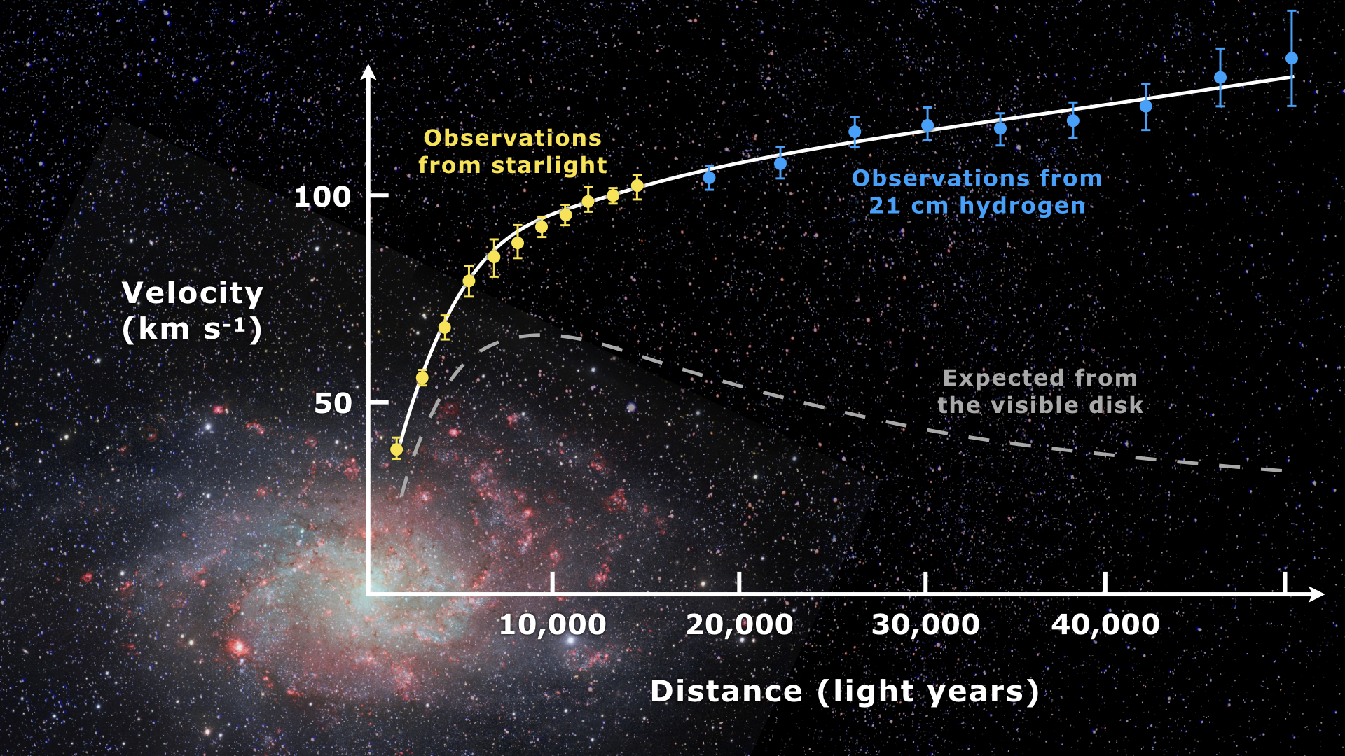
Galaxy Rotation Speeds
Outer stars orbit way too fast!!!

Slide 38
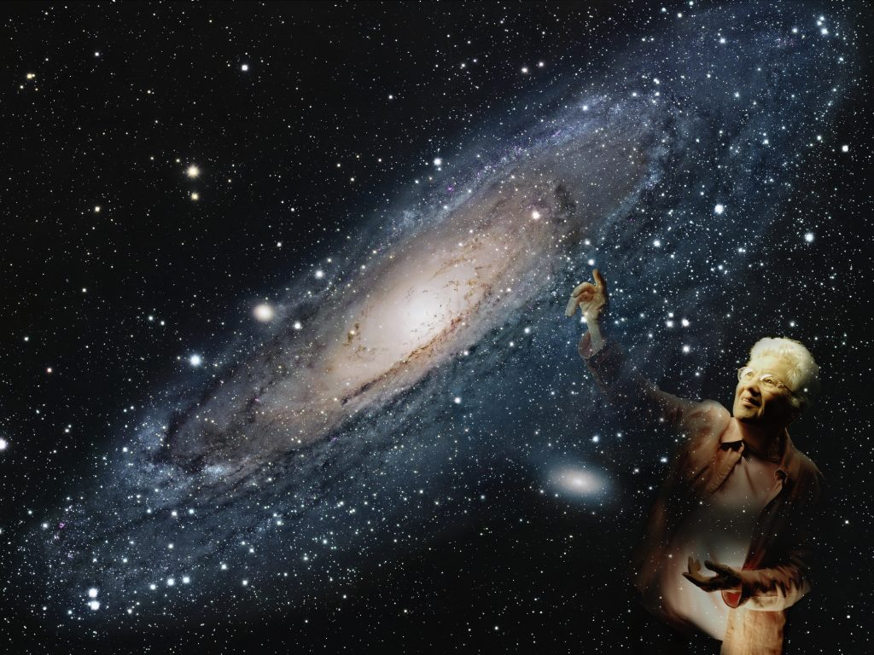
Galaxy Rotation Speeds
Galaxies have more mass than is visible
Discovered by Vera Rubin
⇒ 90% of the mass of
galaxies is invisible
Dark Matter

Slide 39
The Gift Of Starlight
The universe has been gratuitously showering us with information
about its objects, history, and origin since the Earth formed!
We only started finding this information in the past few centuries.
What else could we be missing?

Slide 40
God’s Gift Of Love
Ignatian 4th Week: Contemplation on the Love of God
4th Point: “God’s love shines down upon me like the light rays from the sun … Just as I see the sun in its rays, so God pours forth a sharing in divine life in all the gifts showered upon me. God’s delight and joy is to be with the ones called God’s children.”
-- David L. Fleming, S. J.
Draw Me Into Your Friendship

Slide 41
God’s Gifts of Grace
In your life, what is the
Abundance of God’s grace?
Gifts you might overlook?
Breadth of God’s grace?
Immanence to Transcendence
In a single flower and distant galaxies
Depth of God’s grace?
What must you look deeply to see?
God’s “hidden” actions?
Surprises … what’s your Dark Matter?

