Slide 1


The Substance of Ourselves
The Cosmos Within
Dr. Aileen A. O’Donoghue
July 8 – 13, 2019

Slide 2
Evening Came …
“As the universe expanded and cooled, darkness descended,

Slide 3
…And Morning Followed
“Then light dawned anew with the formation of the first stars.
Each star is a nuclear furnace where matter is coaxed into releasing a little of the energy it inherited from the primordial fireball.”
Timothy Ferris
The Creation of the Universe

Slide 4
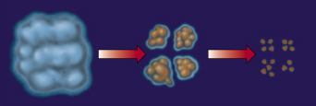
Starbirth
Interstellar clouds collapse under gravity and fragment into a cluster of denser clouds that continue collapsing.

Slide 5
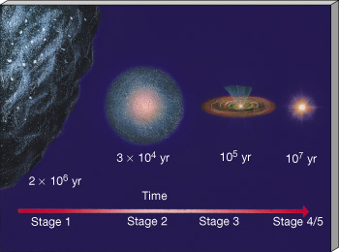
Starbirth
Interstellar cloud fragments collapse under gravity to form stars.

Slide 6
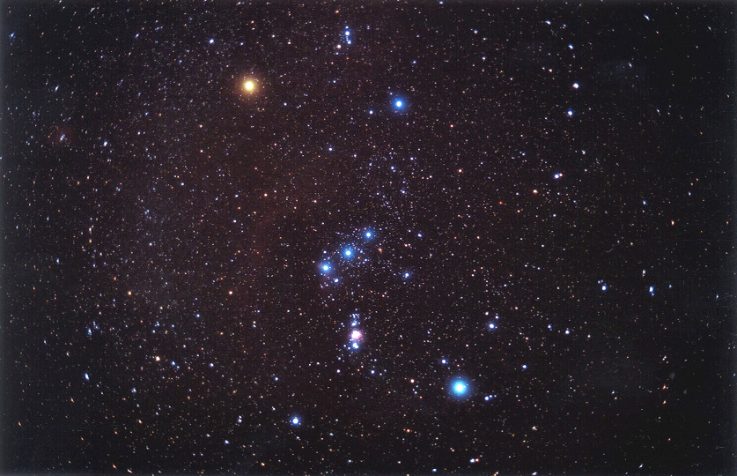
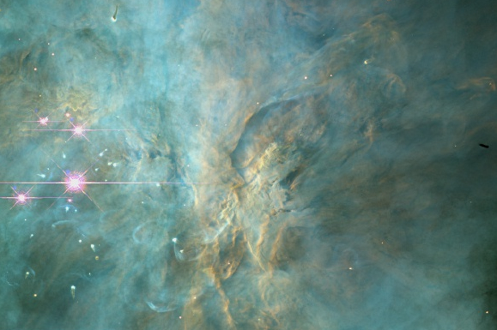
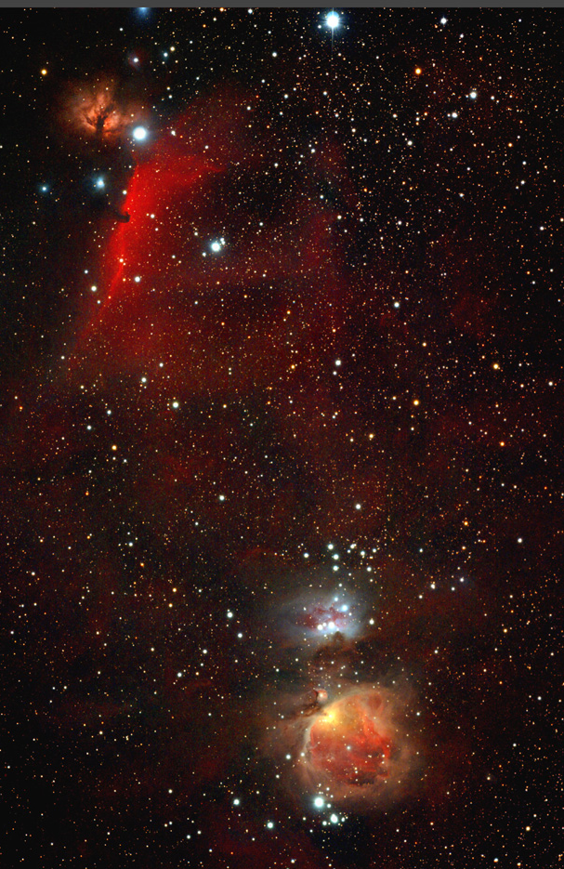
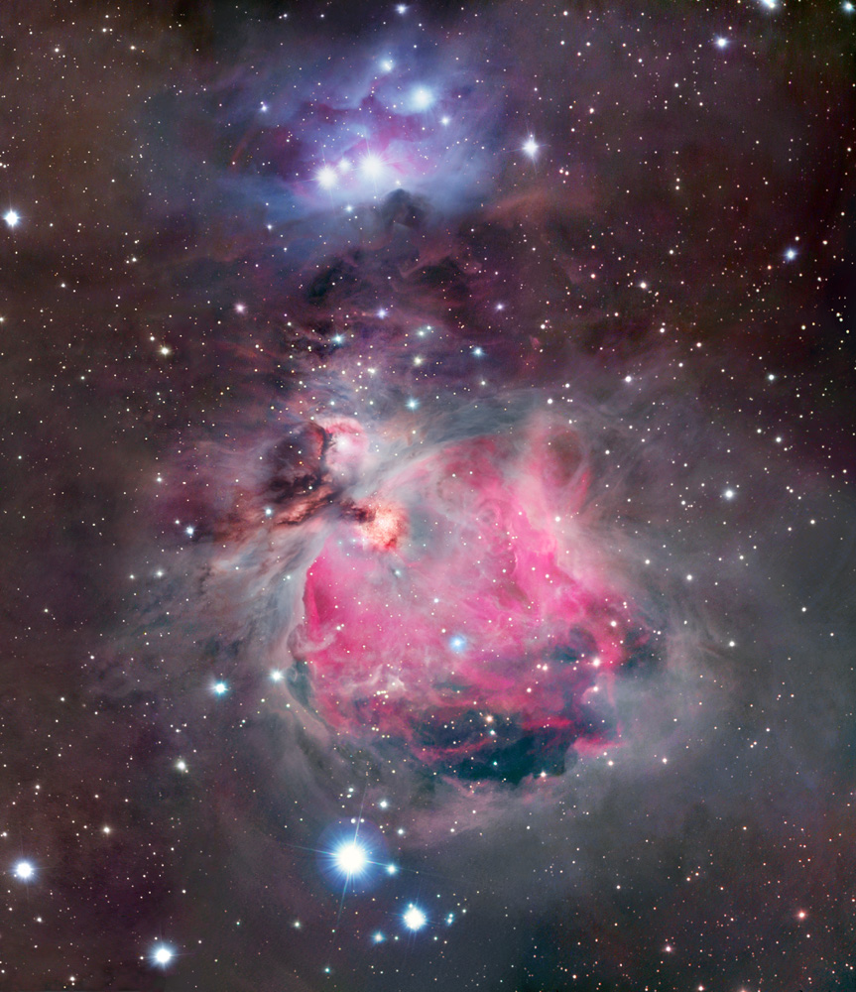
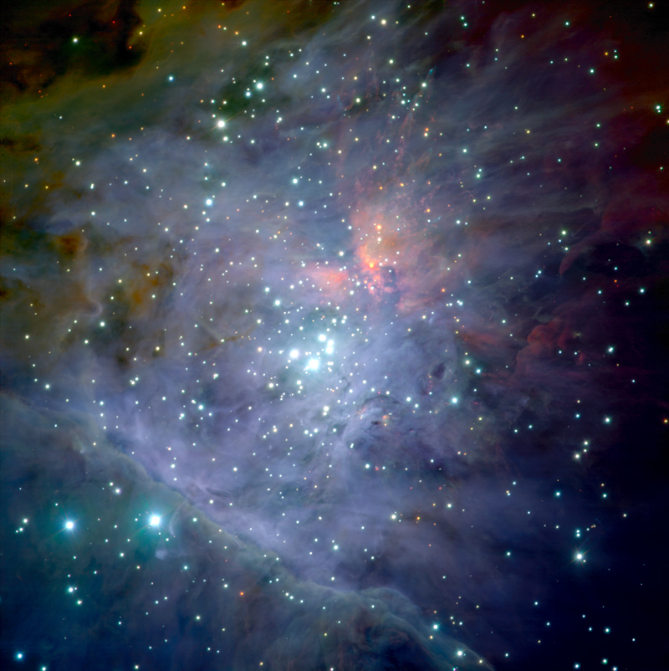
Starbirth Regions
Orion Nebula
Hot, giant stars illuminate nebula … lots of UV!
Thick, dusty disks protect forming stars & planetary systems

Slide 7
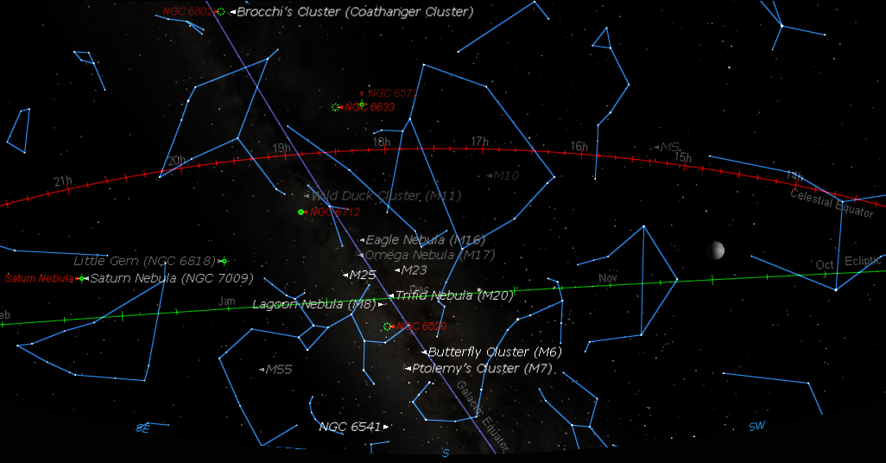
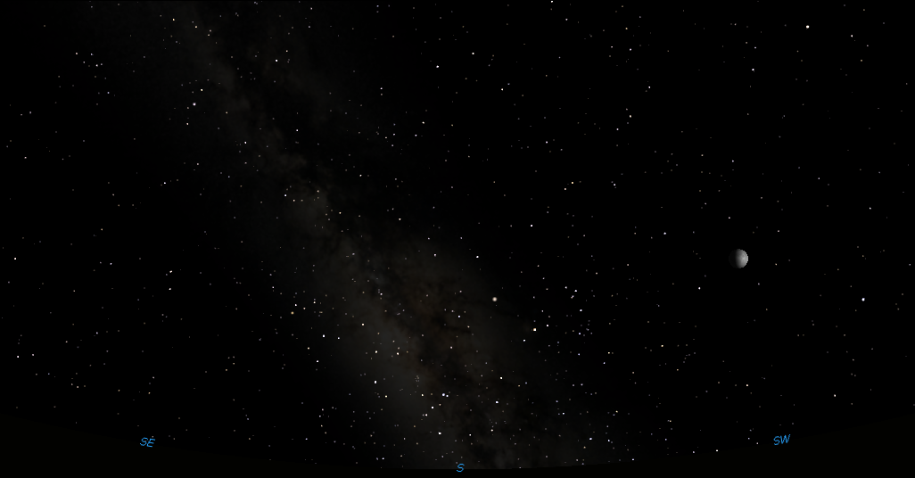
Starbirth In The Eagle Nebula
Tarazed
Altair
Aquila
Ophiuchus
Scutum
Zubeneschamali
The Teaspoon
Jupiter
Libra
Zubenel-genubi
Saturn
Antares
Brachium
The Teapot
Sagittarius
Scorpius
SE
SW
Holyoke’s southern sky at 11 pm, July 10, 2019
S

Slide 8
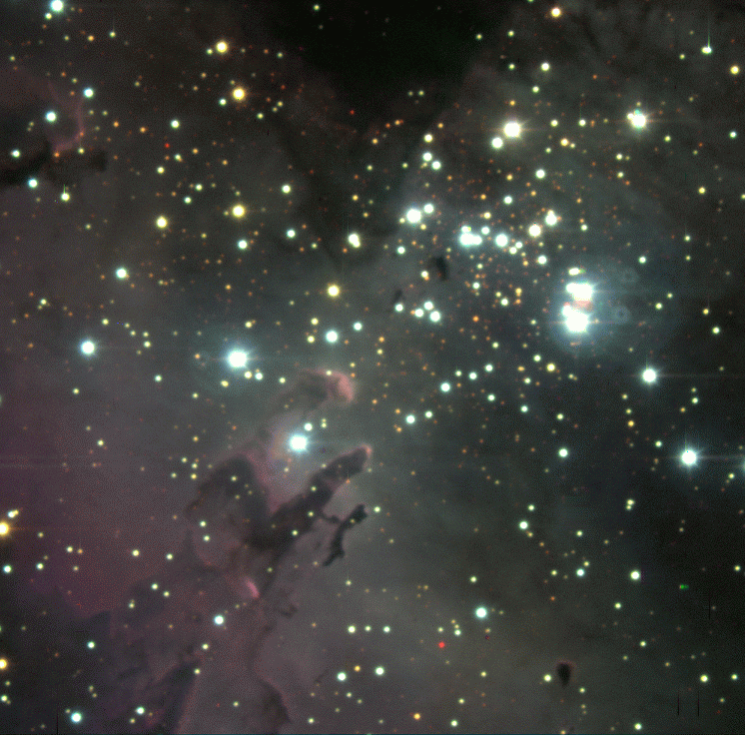
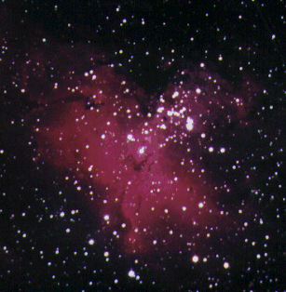
Starbirth In The Eagle Nebula
Tarazed
Altair
Aquila
Ophiuchus
Scutum
Zubeneschamali
The Teaspoon
Jupiter
Libra
Zubenel-genubi
Saturn
Antares
Brachium
The Teapot
Sagittarius
Scorpius
SE
SW
Holyoke’s southern sky at 11 pm, July 10, 2019
S

Slide 9
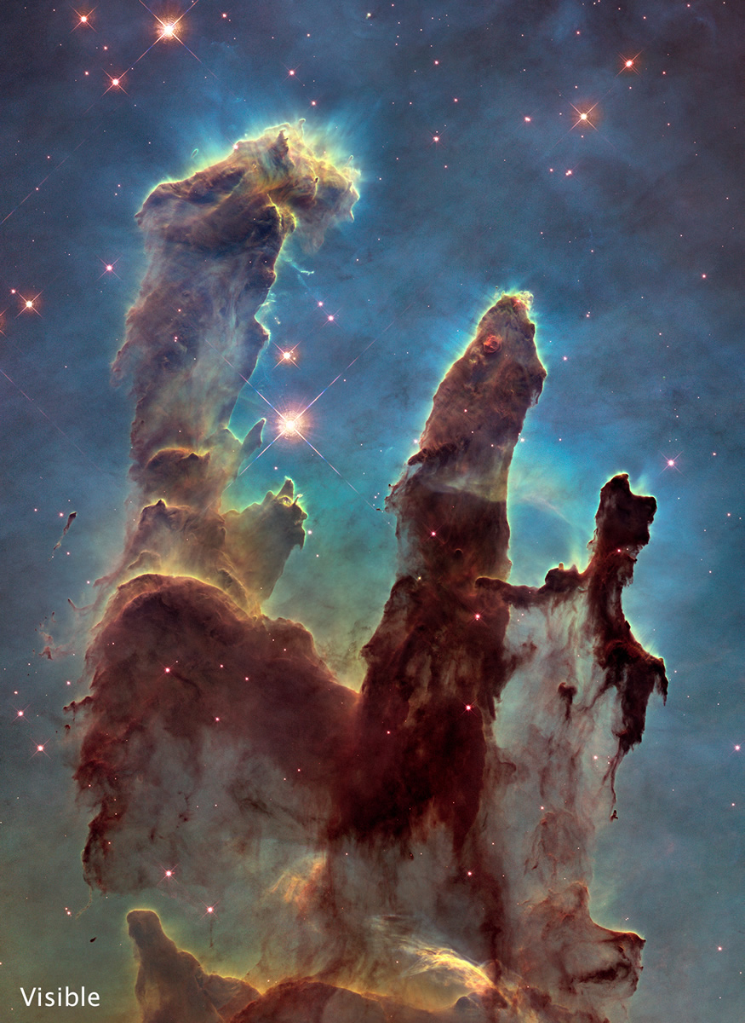
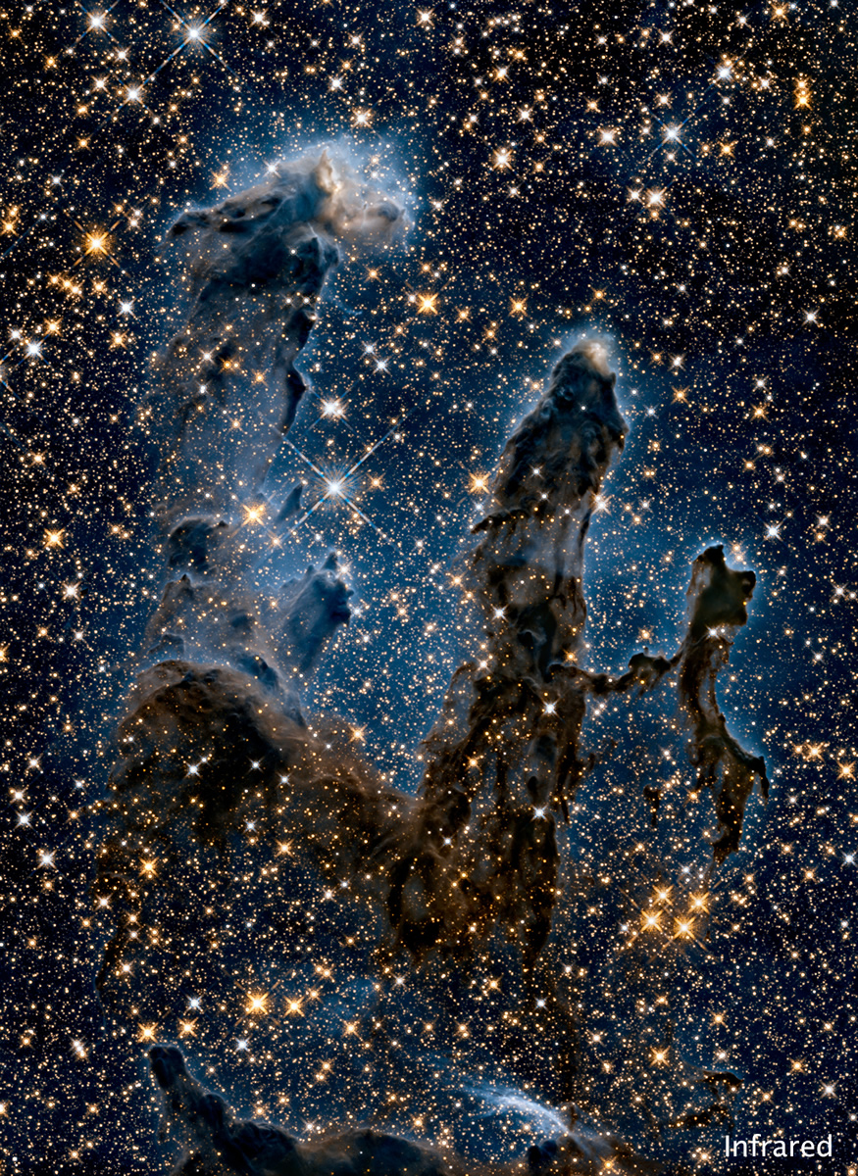
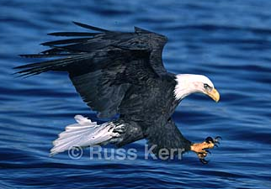
Starbirth In The Eagle
“Pillars of Creation”
Image from Russ Kerr’s Majesty of Birds website:www.magestyofbirds.com

Slide 10
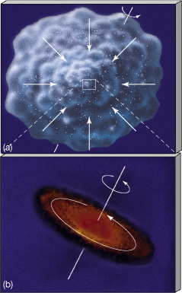
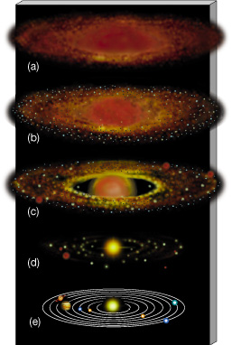
Solar System Formation
Planets form from debris around star.

Slide 11
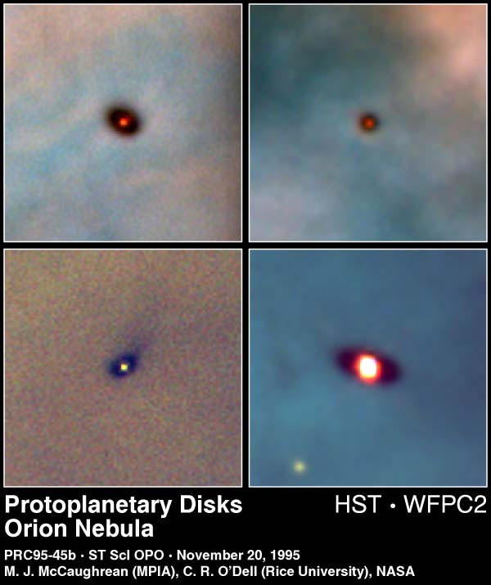
Forming Solar Systems
Disks of gas and dust surrounding forming stars form planets, moons, etc.

Slide 12
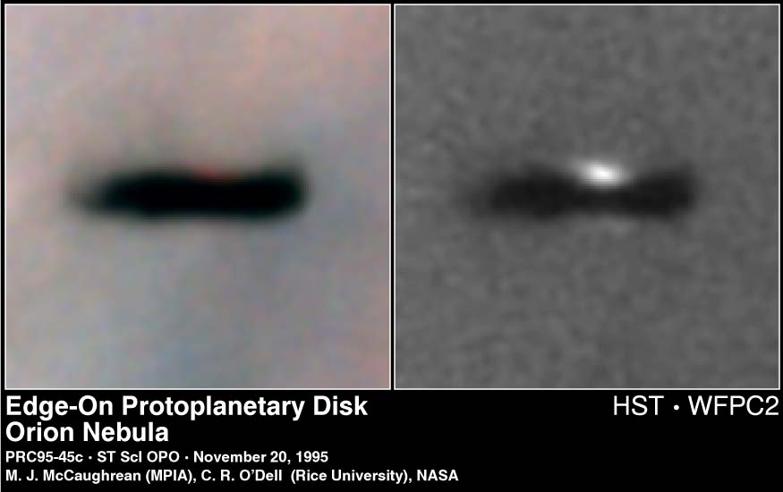
Forming Solar Systems
Disks of gas and dust surrounding forming stars seen edge-on in Orion

Slide 13
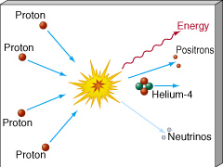
What Makes A Star?
Nuclear Fusion
  Light elements combine to make heavy elements.
Hydrogen fuses to Helium

Slide 14
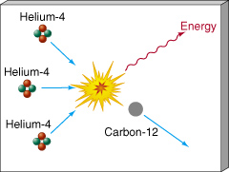
What Makes A Star?
Nuclear Fusion
  Light elements combine to make heavy elements.
Helium fuses to Carbon, Oxygen, Nitrogen …

Slide 15
Fusion Releases Energy
Mass of 4 H atoms = 4 x (1.007940 amu)
= 4.031760 amu
Mass of 1 He atom = 4.002602 amu
Difference (loss) = 0.029158 amu
= 0.7 % of H
Where does it go?
E = mc²
Energy!

Slide 16
Products Of Stellar Fusion
Early universe was 75% H, 25% He
All other elements are the products of stars!

Slide 17
Substance of the Cosmos
Element abundance in the universe:
H, He, O, C, Ne, Fe, Ni, Si …
  All elements of life came from stars that lived AND DIED before the sun formed.
  Sun is a 2nd or 3rd generation star
    1st stars were pure hydrogen and helium)
“We are the matter of the cosmos contemplating itself.”
- Carl Sagan

Slide 18
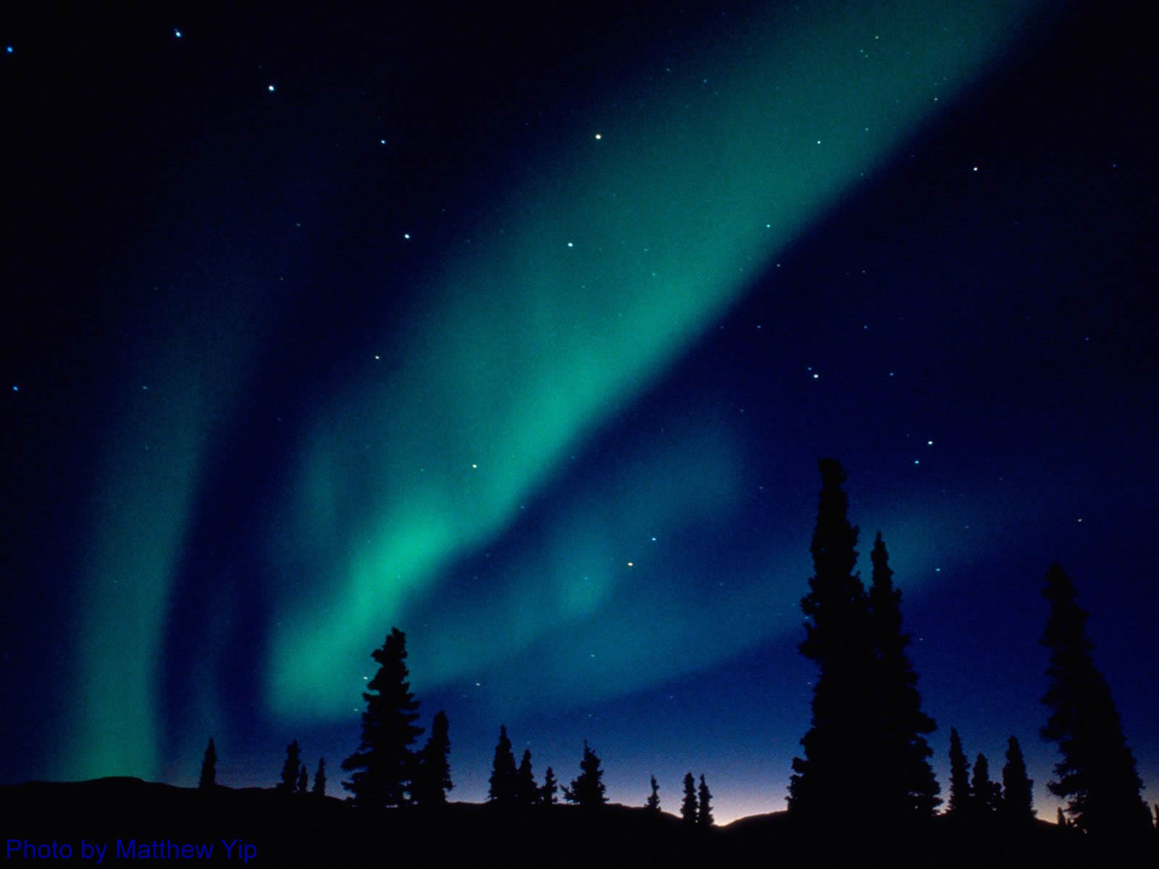
Interstellar Medium
Ancient stars enriched the ISM with the products of their fusion by
  Stellar Winds
    Stars constantly blow particles into space
    Solar wind & storms cause aurorae on Earth
  Deaths as Planetary Nebulae
  Deaths as Supernovae

Slide 19
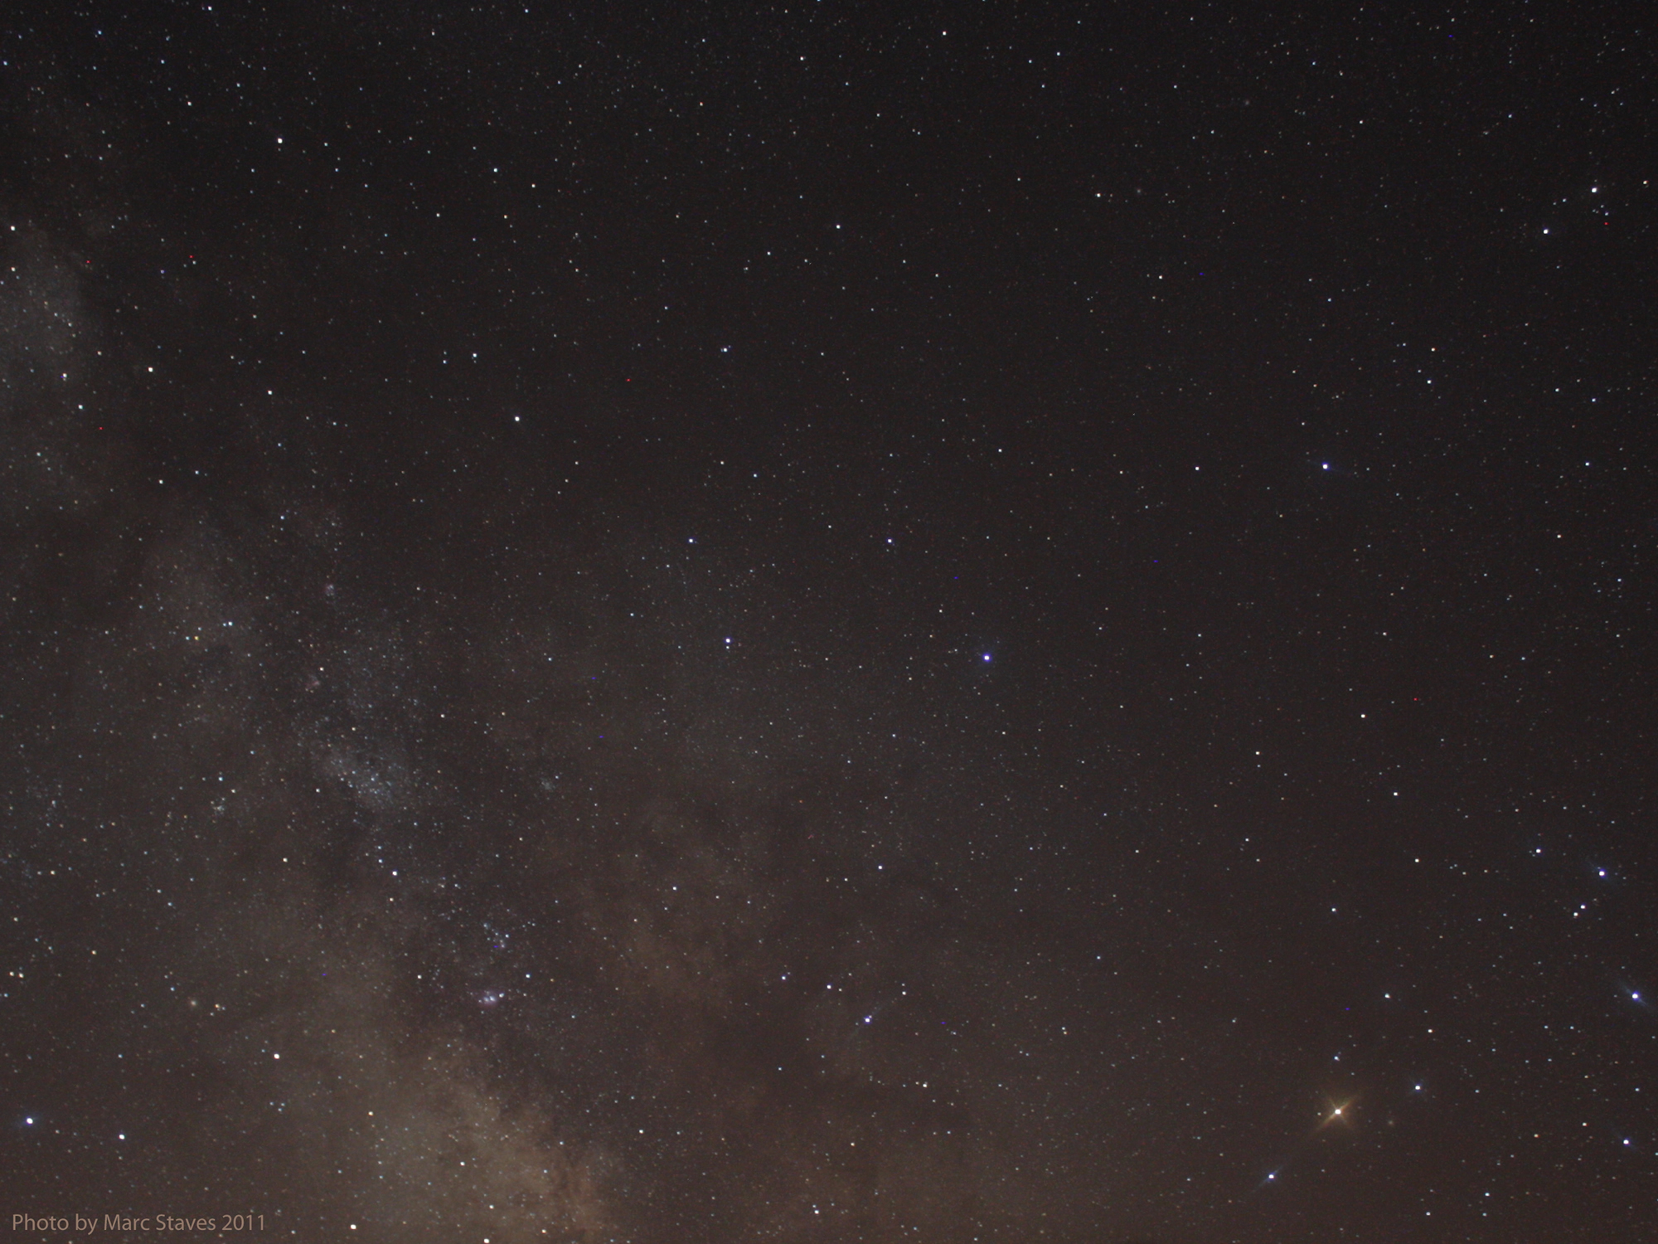
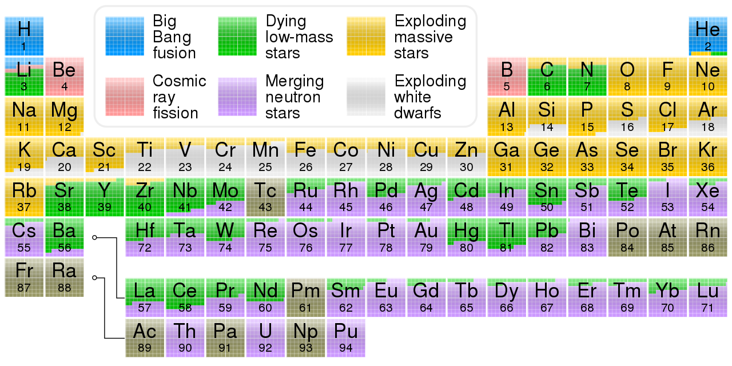
Origins of the Elements
H, He , some Li from Big Bang
  From the first 3 minutes of time!!

Slide 20
Origins of the Elements
C, N, Li, Sr, Sn, Ba, W, Hg, Ti, Pb …
  From the deaths of low-mass stars … Sol

Slide 21
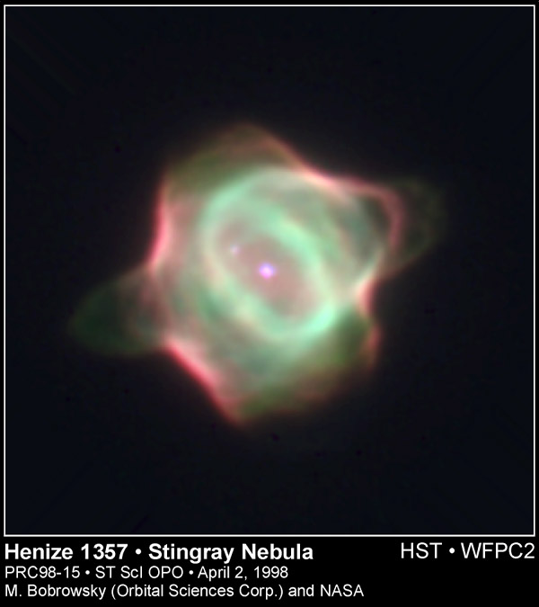
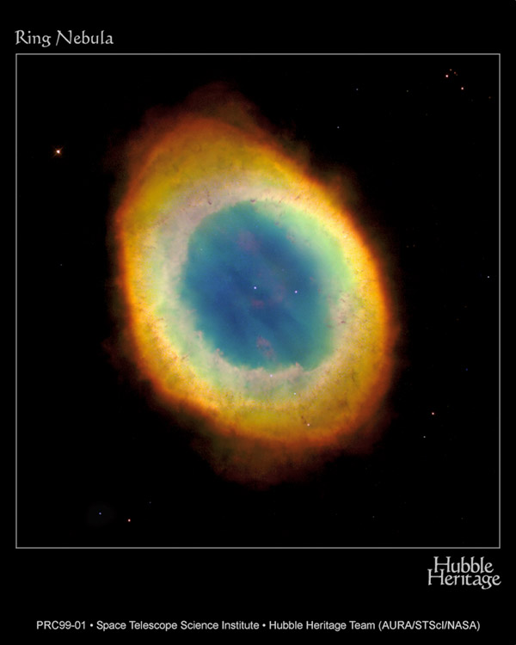
Planetary Nebulae
The source of carbon, nitrogen and assorted heavier elements (Sn, Ba, Hg, Pb …)

Slide 22
Planetary Nebulae
The source of carbon, nitrogen and assorted heavier elements (Sn, Ba, Hg, Pb …)
Your next breath will be 78% nitrogen … made by the explosion of a Sun-sized star more than 5 billion years ago. Your breath is older than the Earth and Sun!

Slide 23
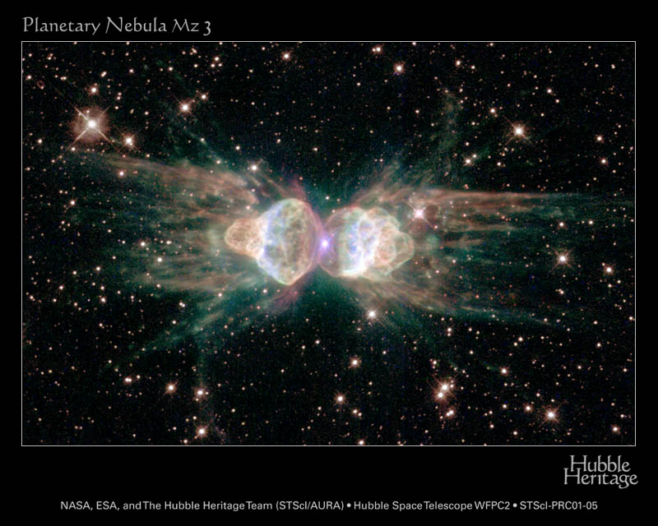
Planetary Nebulae

Slide 24
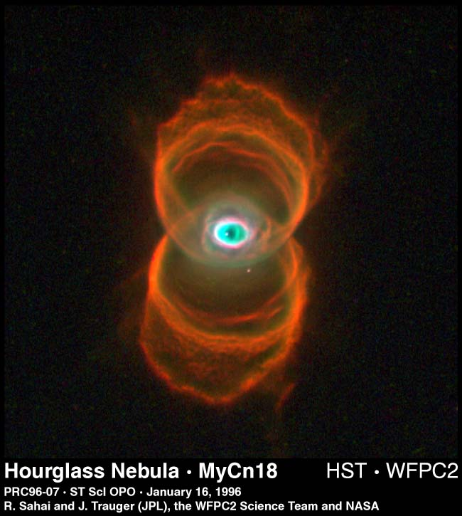
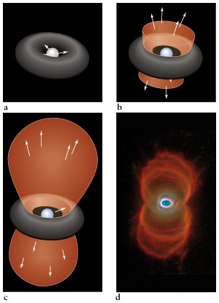
The Hourglass

Slide 25
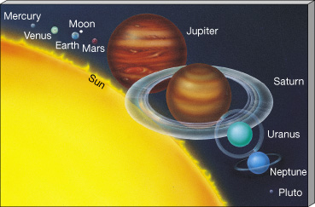
Planets And Moons
The sun and all the planets formed from the same cloud
of “used” star stuff
enriched with heavy elements by previous generations of stars.

Slide 26
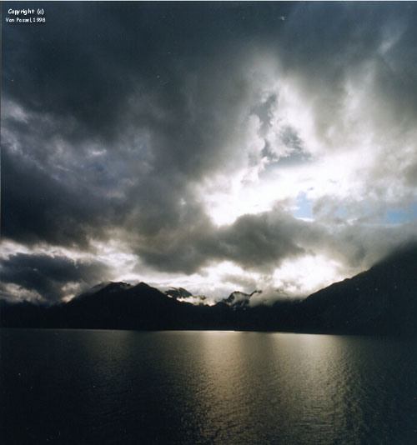
Earth
Life arose on Earth because
  water from volcanoes & comets condensed into oceans that
    Absorbed CO₂
    from the early atmosphere
    Allowed life to arise
    protected from sun’s radiation
    Regulate the temperature of entire planet
water is available as solid, liquid, & gas
oxygen was freed and formed the ozone layer

Slide 27
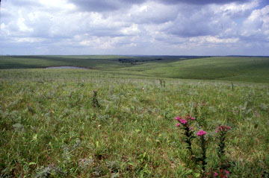
Earth
“… then God formed the earthling from the dust of the ground, breathed into it the breath of life, and the earthling became a living being …”
Genesis 2:7

Slide 28
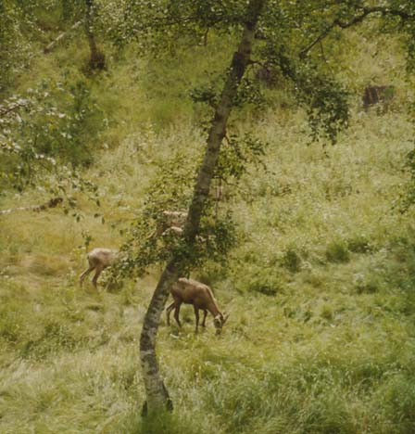
Earth Mother
“The Earth is at the same time mother,
she is mother of all that is natural,
mother of all that is human.
She is the mother of all,
For contained in her
are the seeds of all.

Slide 29
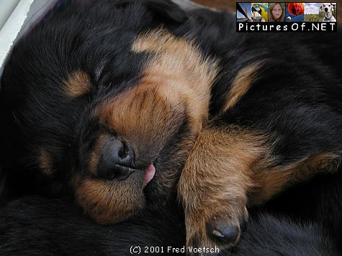
Earth Mother
“It is in so many ways fruitful.
All creation comes from it.
Yet it forms not only the basic
raw material for humankind,
but also the substance of the incarnation of God’s son.”
Hildegard of Bingen

Slide 30
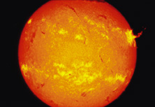
There is a Time For Every Purpose Under Heaven ..
“Lift up your eyes to the heavens,
and look at the Earth down below
for the heavens
will vanish like smoke,
and the earth will wear out
like a garment.”
Isaiah 51:6

Slide 31
There is a Time For Every Purpose Under Heaven ..
Stars use up their nuclear fuel and die
Death of a sun-sized star:
Core fusion stops
Star swells to Red Giant (Betelgeuse, Antares)
Becomes a Planetary Nebula
Ends as a White Dwarf

Slide 32
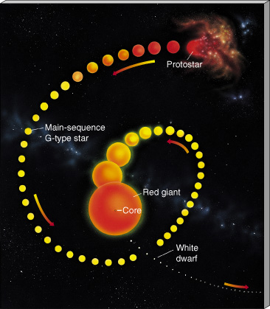
Star Death
The sun will become a Red Giant in about 5 By, a White Dwarf in about 7 By

Slide 33
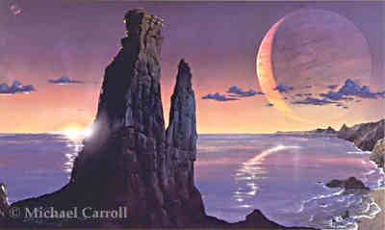
Europa 6 Billion AD
The ice of Europa will melt when the sun becomes a red giant and swells beyond the size of Earth’s orbit.
And all the elements we are made of will return to the stars …

Slide 34
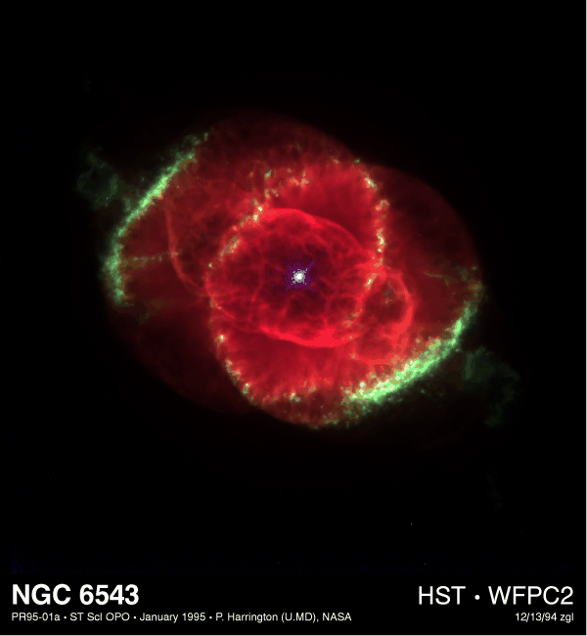
Planetary Nebulae
The elements we’re made of were once part of a planetary nebula …

Slide 35
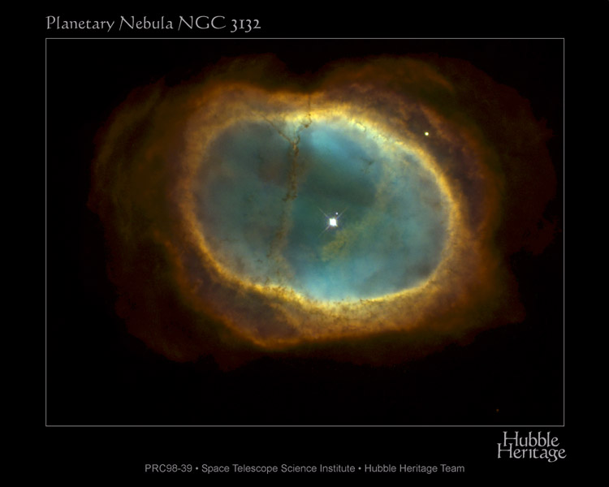
Planetary Nebulae
The elements we’re made of will again be part of a planetary nebula …

Slide 36
Evolution
“Thanks to imperfection, to the fractured symmetries that produce differences among the particles and forces, atoms in their variety could build themselves up into molecules, and molecules rise up in alliance as life, and life give birth to thought, and thought produce theories about the creation of the universe.

Slide 37
We see evidence from every direction that the universe is all of a piece and that it began as a single seed smaller than an atom. And in a very real sense, you and I were there. Every scrap of matter and energy in our blood and bones, and in the synapses of our thoughts can trace its lineage back to the origin of the universe ... as the Koran puts it:
'The universe is as close as the veins in our necks'"
--Timothy Ferris
The Creation of The Universe

Slide 38
Wisdom
“When God established the heavens I was there,
when God drew a circle
on the face of the deep,
when God made firm the skies above,
when God established
the fountains of the deep …

Slide 39
Wisdom
“when God marked out
the foundations of the Earth,
then I was beside God,
like a master worker,
and I was daily God’s delight,
rejoicing with God always,
rejoicing in God’s inhabited world
and delighting in the human race
(Proverbs 8:22-31)

Slide 40
The Substance of Yourself
Today, try to
  Feel & Rejoice in your physical substance
    the actual atoms forged in stars,
    incorporated into planet Earth.
    A cosmic wind moving through you, rocks, plants, and all other beings (you are renewed every 7 years!)
    how is the matter, itself, inspirited?
    breathe in, breathe out the stuff of stars
  Seek God in the substance of yourself

