Slide 1


Minerals & Machines
The Cosmos Within
Dr. Aileen A. O’Donoghue
July 8 – 13, 2019

Slide 2
God’s Grandeur
THE WORLD is charged with the grandeur of God.
It will flame out, like shining from shook foil;
It gathers to a greatness, like the ooze of oil
Crushed. Why do men then now not reck his rod?
Generations have trod, have trod, have trod;
And all is seared with trade; bleared, smeared
with toil;
And wears man’s smudge and shares man’s smell: the soil
Is bare now, nor can foot feel, being shod.

Slide 3
God’s Grandeur
And for all this, nature is never spent;
There lives the dearest freshness deep down
things;
And though the last lights off the black West went
Oh, morning, at the brown brink eastward,
springs—
Because the Holy Ghost over the bent
World broods with warm breast and with ah!
bright wings.
Gerard Manley Hopkins

Slide 4
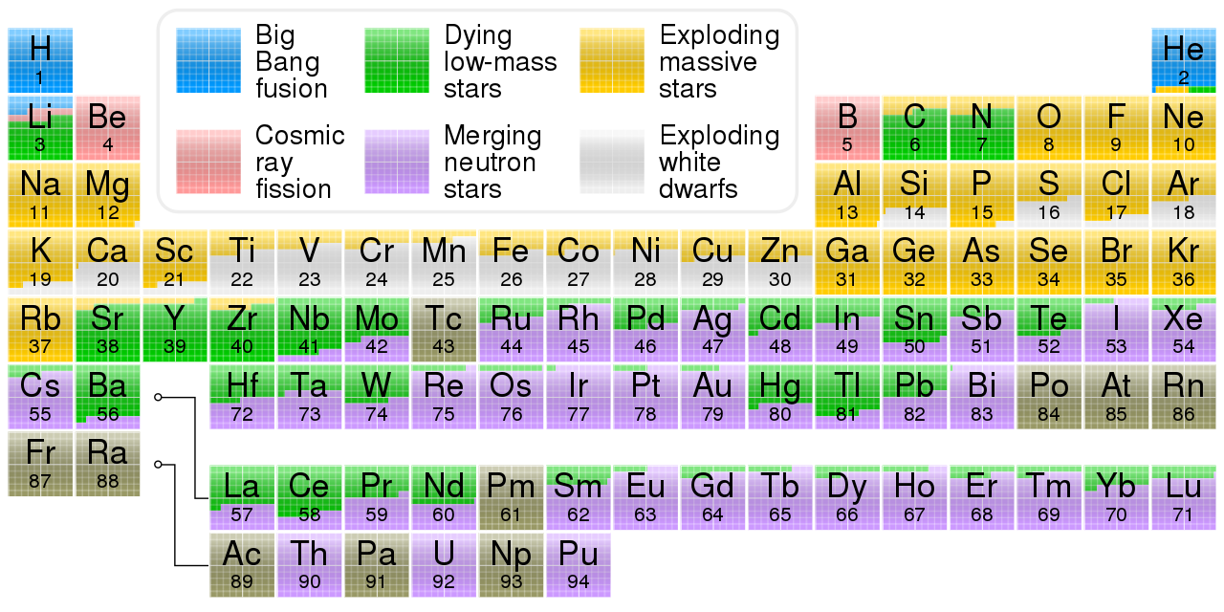
Origins of the Elements
H, He , some Li from Big Bang
  From the first 3 minutes of time!!

Slide 5
Origins of the Elements
C, N, Li, Sr, Sn, Ba, W, Hg, Ti, Pb …
  From the deaths of low-mass stars … Sol

Slide 6
Origins of the Elements
O,Ne, Na, Al, Si, S, Cl, Ca, Br …
  From the supernova deaths of GIANT stars
APOD 07/11/19

Slide 7
Origins of the Elements
The supernova of a giant star had to take place in order for …
  the oxygen in your next breath
  the salt on your food (NaCl)
  glass window panes (SiO₂)
  The calcium in your teeth
  “Rotten Egg” or sulfer smell (H₂S)
  Arsenic & Old Lace murders (As)
  Hopkins’ shook foil (Al)

Slide 8
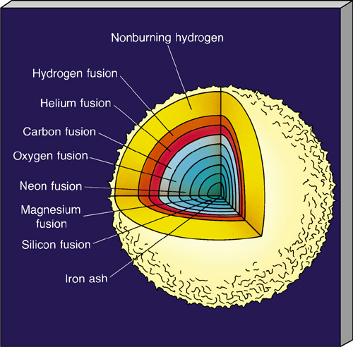
Giant Stars
Have layers fusing different elements

Slide 9
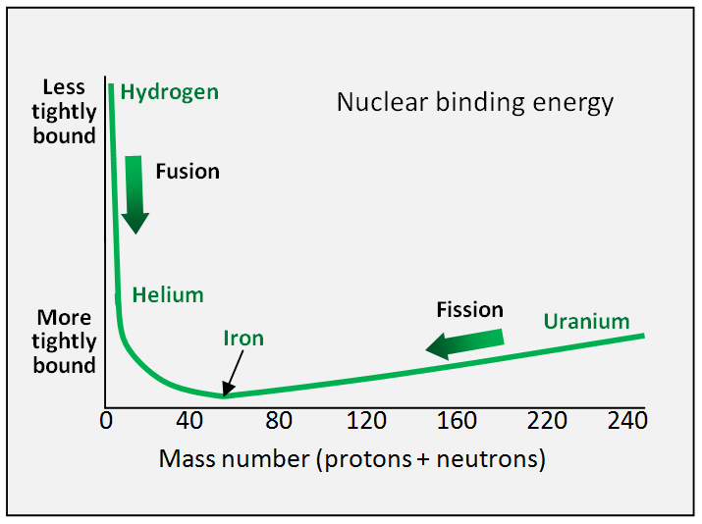
Iron – the most stable element
Fusion: Nuclei bind into heavier elements
Fission: Nuclei split into lighter elements
Iron absorbs energy in fusion and fission!

Slide 10
Iron
Iron is the most stable element
  ABSORBS energy in fusion
  ABSORBS energy in fission
When iron core begins to fuse
  energy is absorbed by reaction
  core cools … contracts
  outer layers begin to fall in
  star implodes … outer layers bounce off dense inner core
  star explodes …

Slide 11

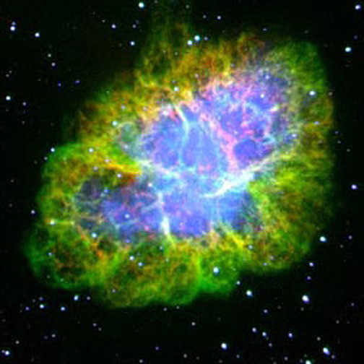
Crab Nebula
Capella in Auriga
Castor in Gemini
  Supernova Observed in 1054 by Chinese & Anazazi
Pollux in Gemini
M1
Aldebaran in Taurus
Procyon in Canis Minor
Rigel in Orion
Sirius in Canis Major

Slide 12
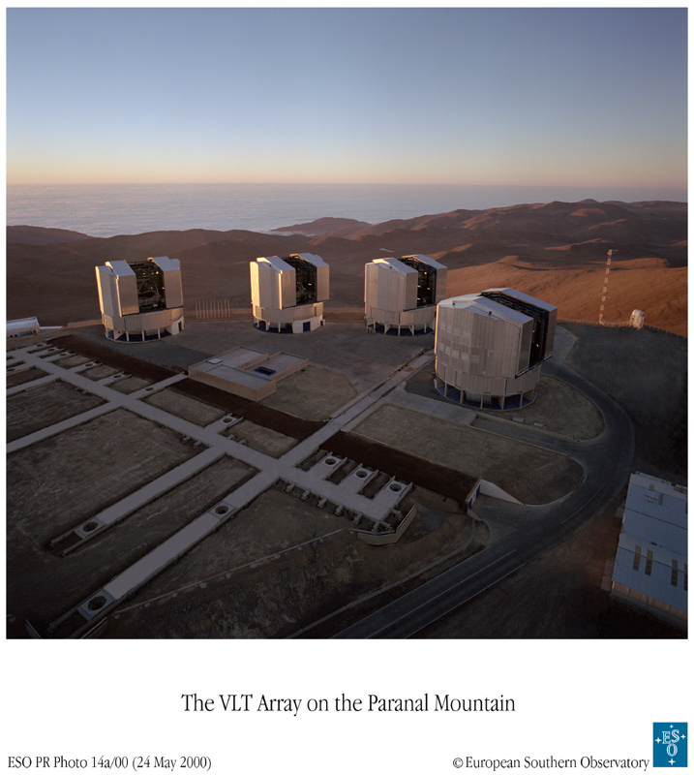
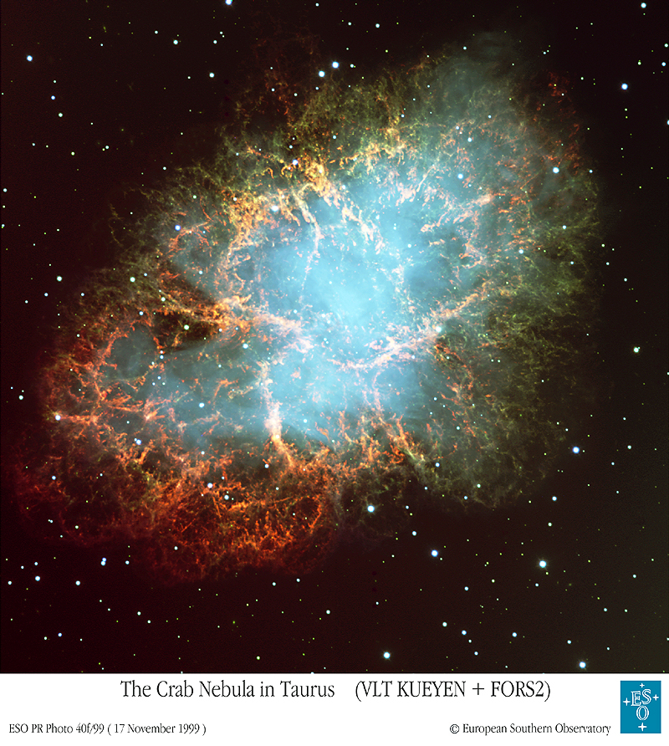
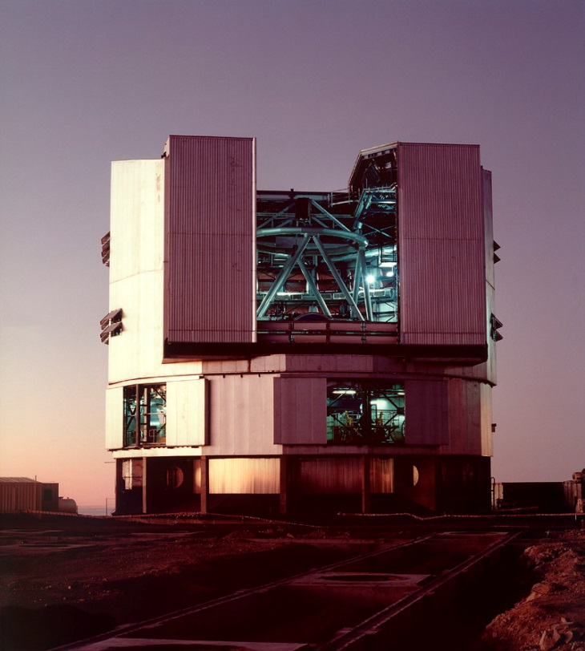
Crab Nebula
VLT Optical Image

Slide 13
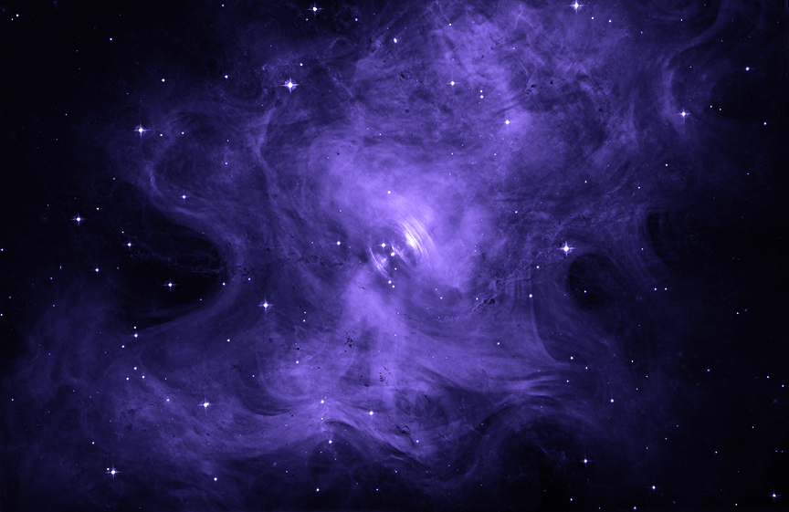
Crab Nebula in Optical
Core of exploded star is a super dense state of matter blasting energy & particles out along its magnetic axes …
… a neutron star

Slide 14
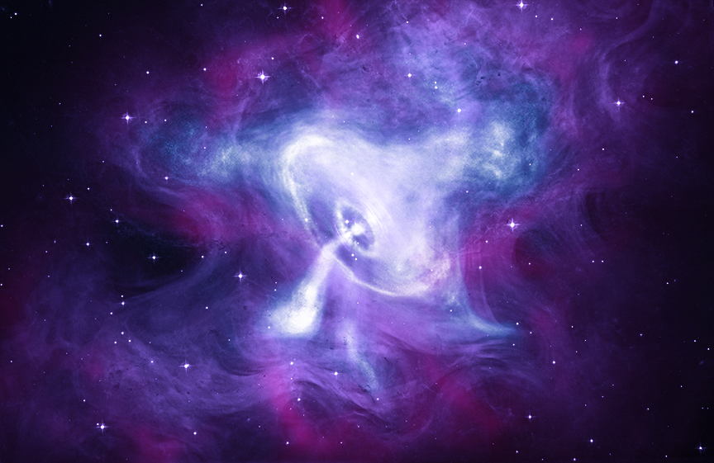
Crab Nebula in X-Ray, Optical, IR
It is still expanding …
still exploding!

Slide 15
Supernovae
Type 2 Supernovae
  Giant stars exploding
  Sources of O, Ne, Na, Al, Si, S, Cl, Ca ...
Type 1a Supernovae
  White dwarf stars exploding
  Sources of other elements

Slide 16
Origins of the Elements
O, Ne, Na, Al, Si, S, Cl, Ca, Br …
  From the supernova deaths of GIANT stars

Slide 17
Origins of the Elements
Ti, Cr, Mn, Fe, Co, Ni, Cu, Zn, …
  thermonuclear explosions of white dwarfs
… Got a nickel?

Slide 18
Type 1a Supernova
White Dwarf Stars
  Remnants of small stars (after P.N.)
  Explode if mass > 1.4 Solar Masses
Binary Stars
  One white dwarf (evolved star)
  One red giant (dying star)
  white dwarf takes matter from giant …

Slide 19
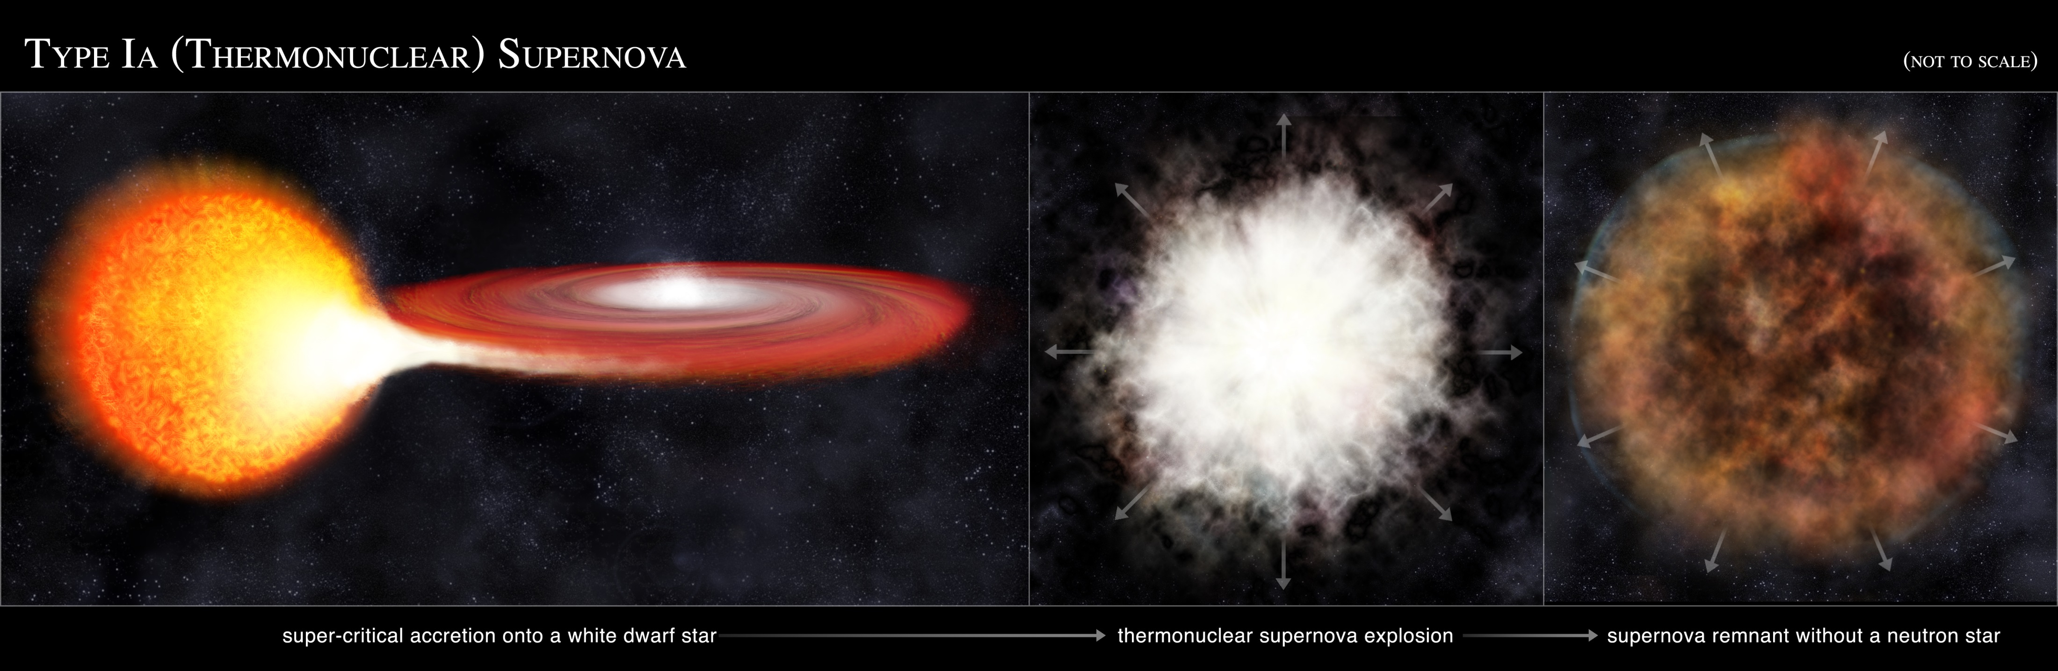
Type 1a Supernova
White Dwarf Stars
  Remnants of small stars (after P.N.)
  Explode if mass > 1.4 Solar Masses
Binary Stars
  One white dwarf (evolved star)
  One red giant (dying star)
  white dwarf takes matter from giant …

Slide 20
Type 1a Supernova
White Dwarf Stars
  Remnants of small stars (after P.N.)
  Explode if mass > 1.4 Solar Masses
Binary Stars
  One white dwarf (evolved star)
  One red giant (dying star)
  white dwarf takes matter from giant …
Type 1a Supernova
  Mass of WD goes over 1.4 Solar Masses

Slide 21
Type 1a Supernova
White Dwarf Stars
  Remnants of small stars (after P.N.)
  Explode if mass > 1.4 Solar Masses
Binary Stars
  One white dwarf (evolved star)
  One red giant (dying star)
  white dwarf takes matter from giant …
Type 1a Supernova
  Mass of WD goes over 1.4 Solar Masses

Slide 22
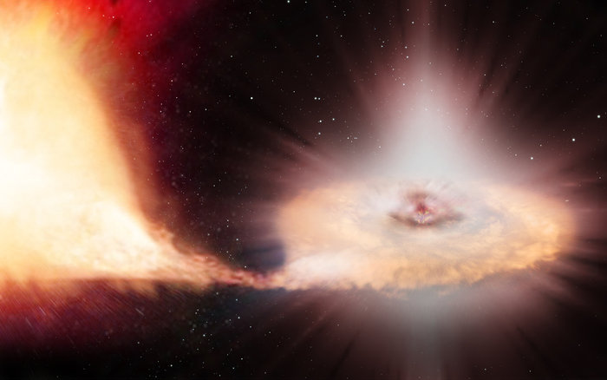
The iron in your blood, carrying the oxygen (from a type 2 SN) to your brain was made in one of these!!

Slide 23
“… Bathe yourself in the ocean of matter; plunge into it where it is deepest and most violent; struggle in its currents and drink of its waters.
“For it cradled you long ago in your preconscious existence; and it is that ocean that will raise you up to God.” - Teilhard de Chardin

Slide 24
Origins of the Elements
Elements from the BB & Exploding stars
… how are the heaviest elements made?

Slide 25
Origins of the Elements
Ag, I, Pt, Au, Th, U, Pu, …
  kilonovas … first observed in 2017!

Slide 26
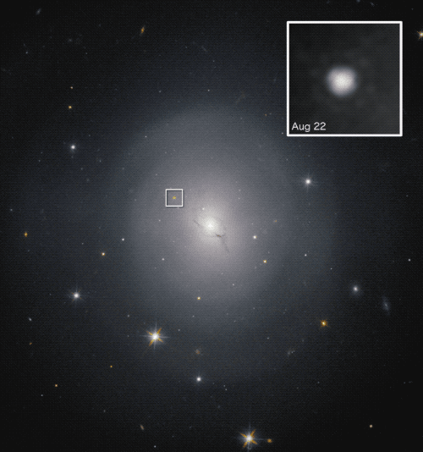
kilonovas
Observed on August 17, 2017
Faded in less than six days
NGC 4993
130 million ly away
⇒ This event occurred 75 million years before dinosaurs died out

Slide 27
kilonovas
Observed in
  Gravity waves
  Gamma rays, 1.7 sec later
  70 more telescopes
    over months!
  Discovered cause …
⇒ The cause had been predicted and was finally observed …

Slide 28
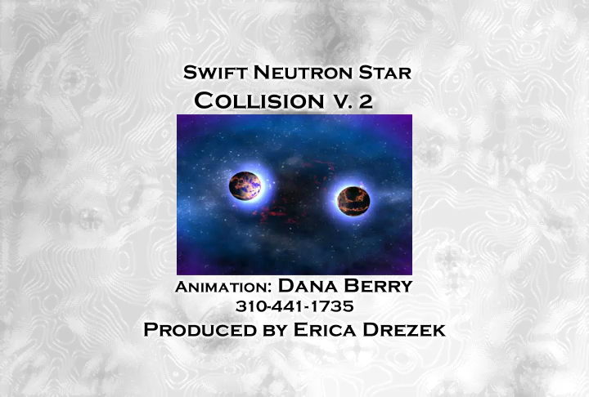
Animation of neutron star merger

Slide 29
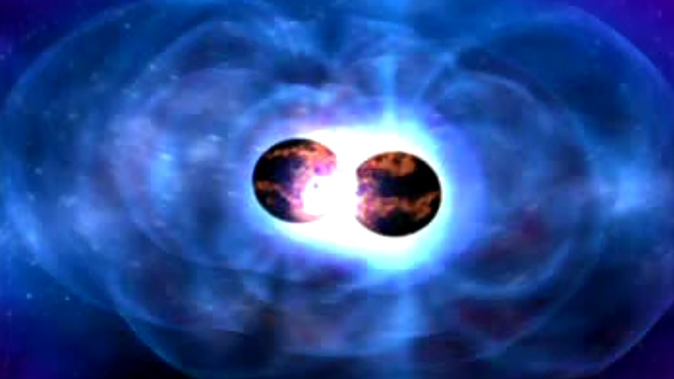
kilonovas
All the gold, platinum, and uranium in the solar system were likely produced
in a single kilonova
about 80 million years before the solar system formed …
do you wear a gold ring?

Slide 30
God’s Blessings
“For the LORD your God is bringing you into a good land, a land with flowing streams… a land whose stones are iron and from whose hills you may mine copper. You shall eat your fill and bless the LORD your God for the good land that he has given you.”
Deuteronomy 8:7,9,10
God has given us the elements from the deaths of stars …

Slide 31
Machines
  Made of elements from planetary nebulae, supernovae, & kilonovae …
    ashes of stars that died before the sun was born
    one may have initiated the sun’s formation with shock waves
  Created by human minds,
  Created by human vision,
  Created by human toil …
Machines are not foreign to the universe!

Slide 32
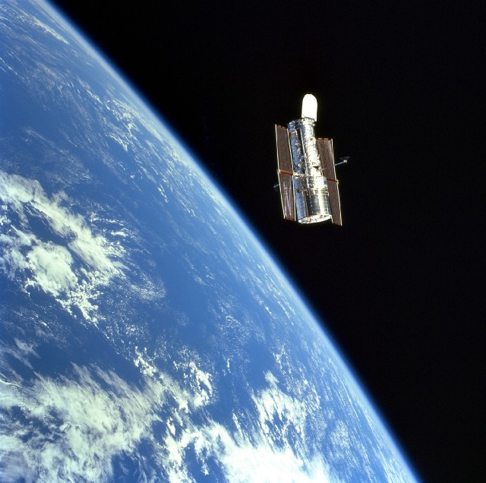
Machines Show Us The Universe: HST 2002

Slide 33
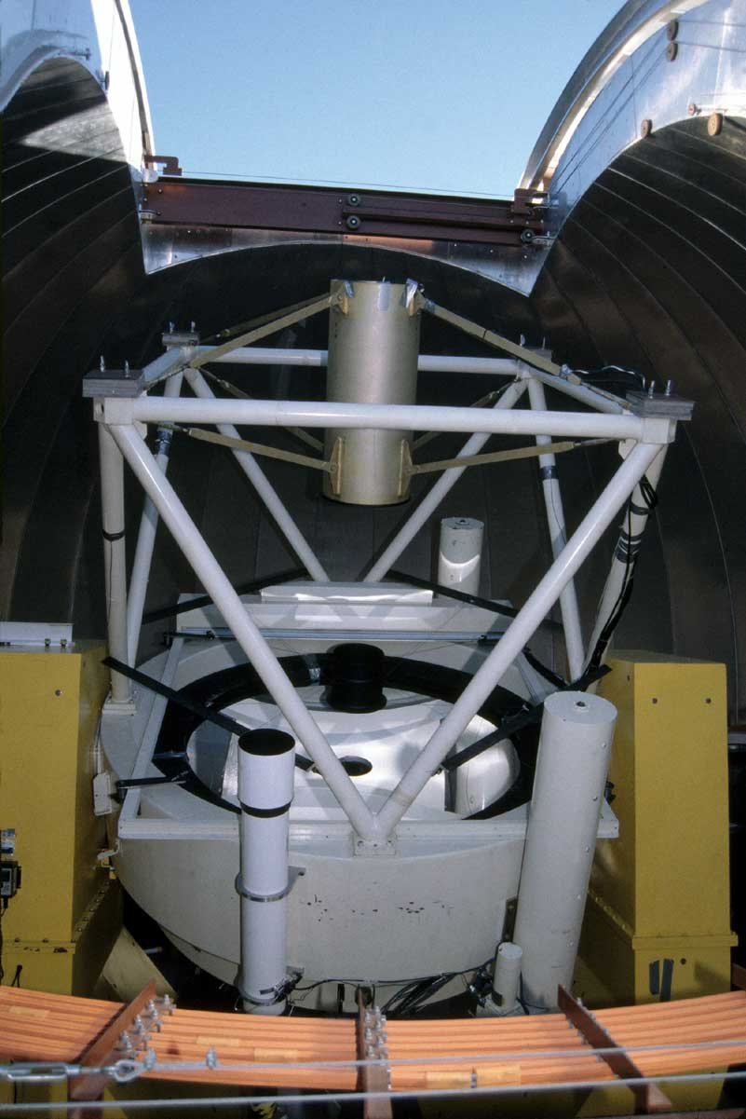

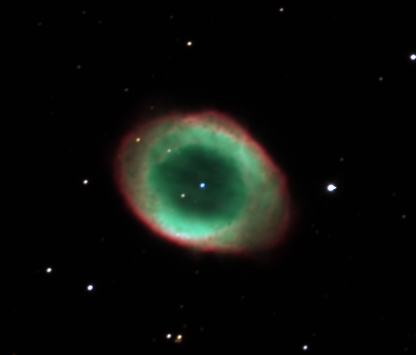
Vatican Advanced Technology Telescope
"Our scientific knowledge of the physical evolution of the universe, and our very limited knowledge of the origin of humans within it, might provide an opportunity to enrich our relationship to God as creator, if only we get loose of our idolatries.“
Dr. George Coyne, S. J., Director Emeritus

Slide 34
Machines
Bless our lives
  science
  healthcare
    I am alive because of machines testing and refrigerating blood
  transportation
  sanitation
  communication
But the blessings of machines can be hidden

Slide 35
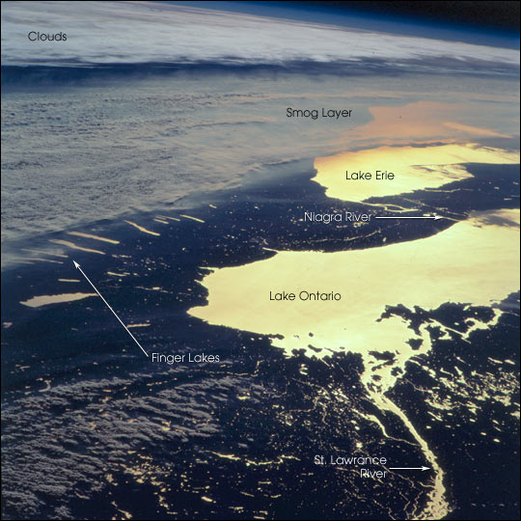

Pollution Hides Blessings
Rochester
Thousand Islands

Slide 36
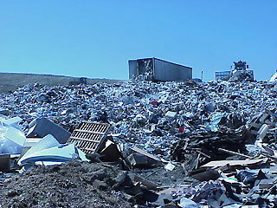
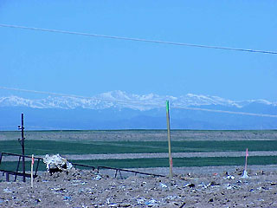
Dumps Hide Blessings
Denver, Colorado
Mt. Evans

Slide 37
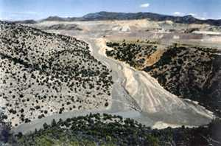
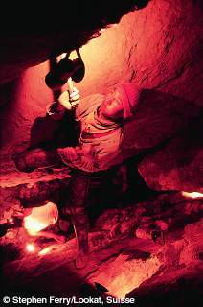
Mining Hide Blessings
Arizona
Bolivia

Slide 38
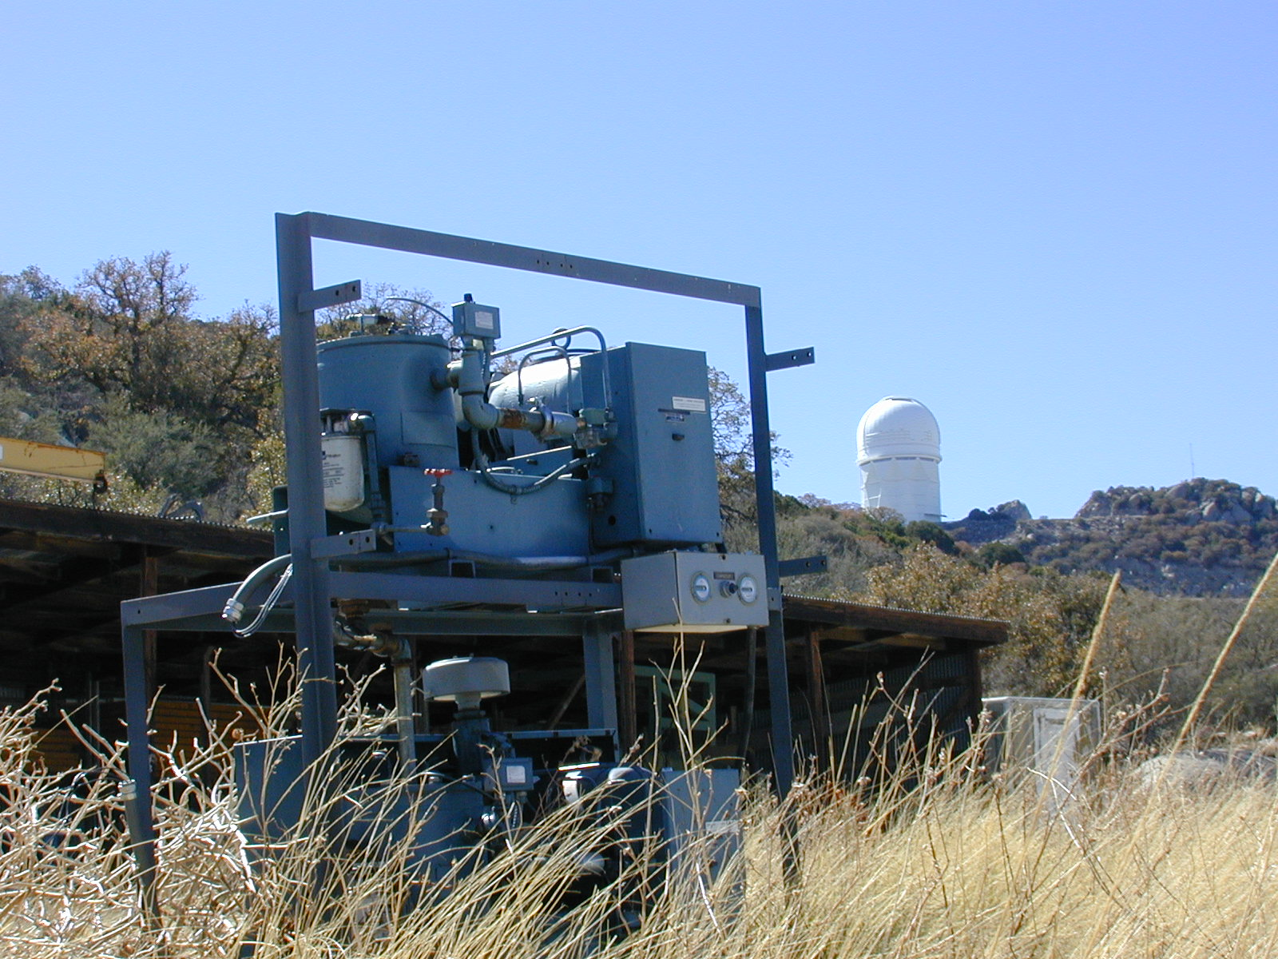
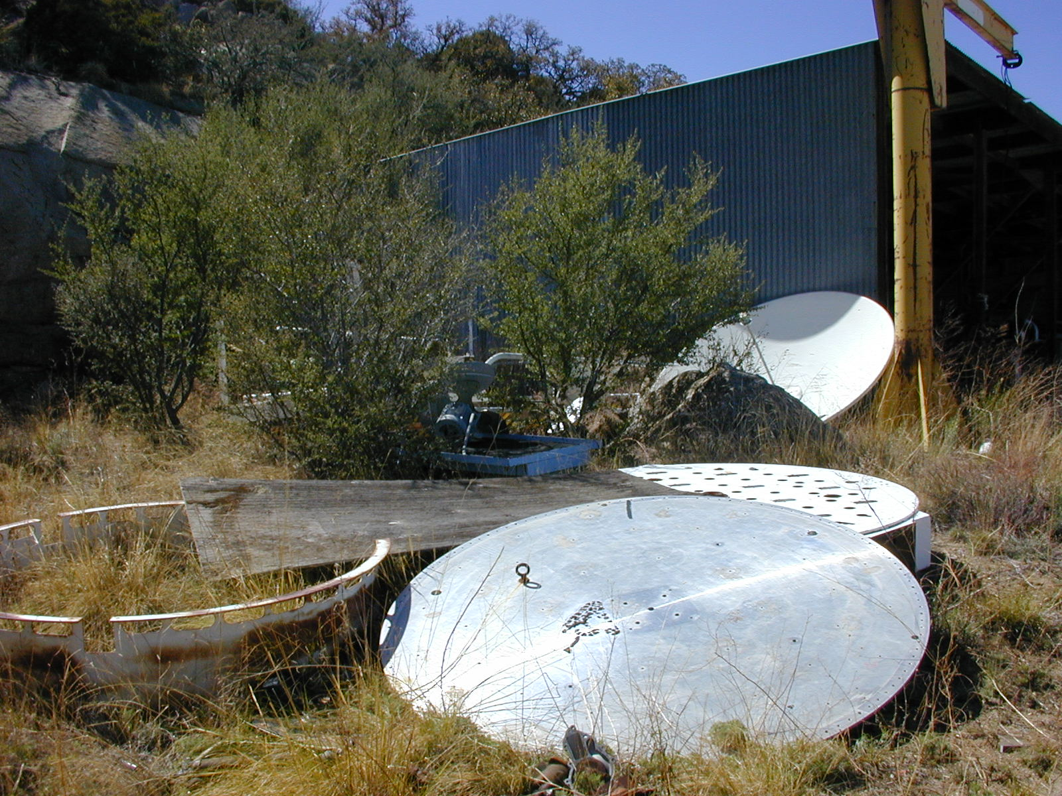
But Blessings Lurk
Behind the junk ...
Within the junk …

Slide 39
Machines
Seen as evil …
“Our intellectual journals are full of gloomy tracts that depict a society debased by technology. Our health is being ruined, … , our landscape despoiled, and our social institutions laid waste”
Samuel Florman
Blaming Technology

Slide 40
Machines
Seen as evil …
“Atomism, or the machine model, reduces all living things to their most basic chemical compounds, so that we and all other organisms are “nothing but” the chemicals in our bodies.”
Sallie McFague
The Body of God

Slide 41
Seeing Machines Anew
Teilhard’s Christ …
“Glorious Lord Christ: The divine influence secretly diffused and active in the depths of matter…”
Is also diffused and active in machines!

Slide 42
Hymn To Matter
“Blessed be you, mighty matter, irresistible march of evolution, reality ever newborn; you who, by constantly shattering our mental categories, force us to go ever further and further in our pursuit of truth.
Didn’t the first smart phones shatter our mental categories?

Slide 43
Hymn To Matter
“Blessed be you, universal matter, immeasurable time, boundless ether, triple abyss of stars and atoms and generations: you who by overflowing and dissolving our narrow standards of measurement reveal to us the dimensions of God.

Slide 44
Hymn To Matter
“Blessed be you, impenetrable matter: you who, interposed between our minds and the world of essences, cause us to languish with the desire to pierce through the seamless veil of phenomena.”
Teilhard de Chardin

Slide 45
Seeing Machines Anew
Can you find God in metals?
  Rusted Iron
  Radioactive Uranium?
Can you find God in machines?
  Junked cars
  Garbage trucks?
  Bulldozers?
Sit with God in machines …

