Slide 1


Roadkill & Redemption
The Cosmos Within
Dr. Aileen A. O’Donoghue
July 8 – 13, 2019

Slide 2
Genesis
“And God said, “Let the earth put forth vegetation, plants yielding seed, and fruit trees bearing fruit in which is their seed, each according to its kind, upon the earth.” And it was so. The earth brought forth vegetation, plants yielding seed … , and trees bearing fruit in which is their seed, each according to its kind. And God saw that it was good.
And there was evening and there was morning, the third day.
RSV

Slide 3
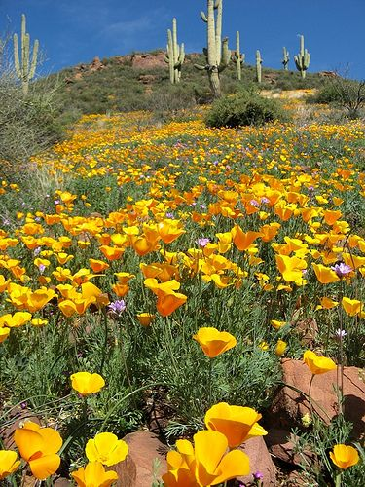
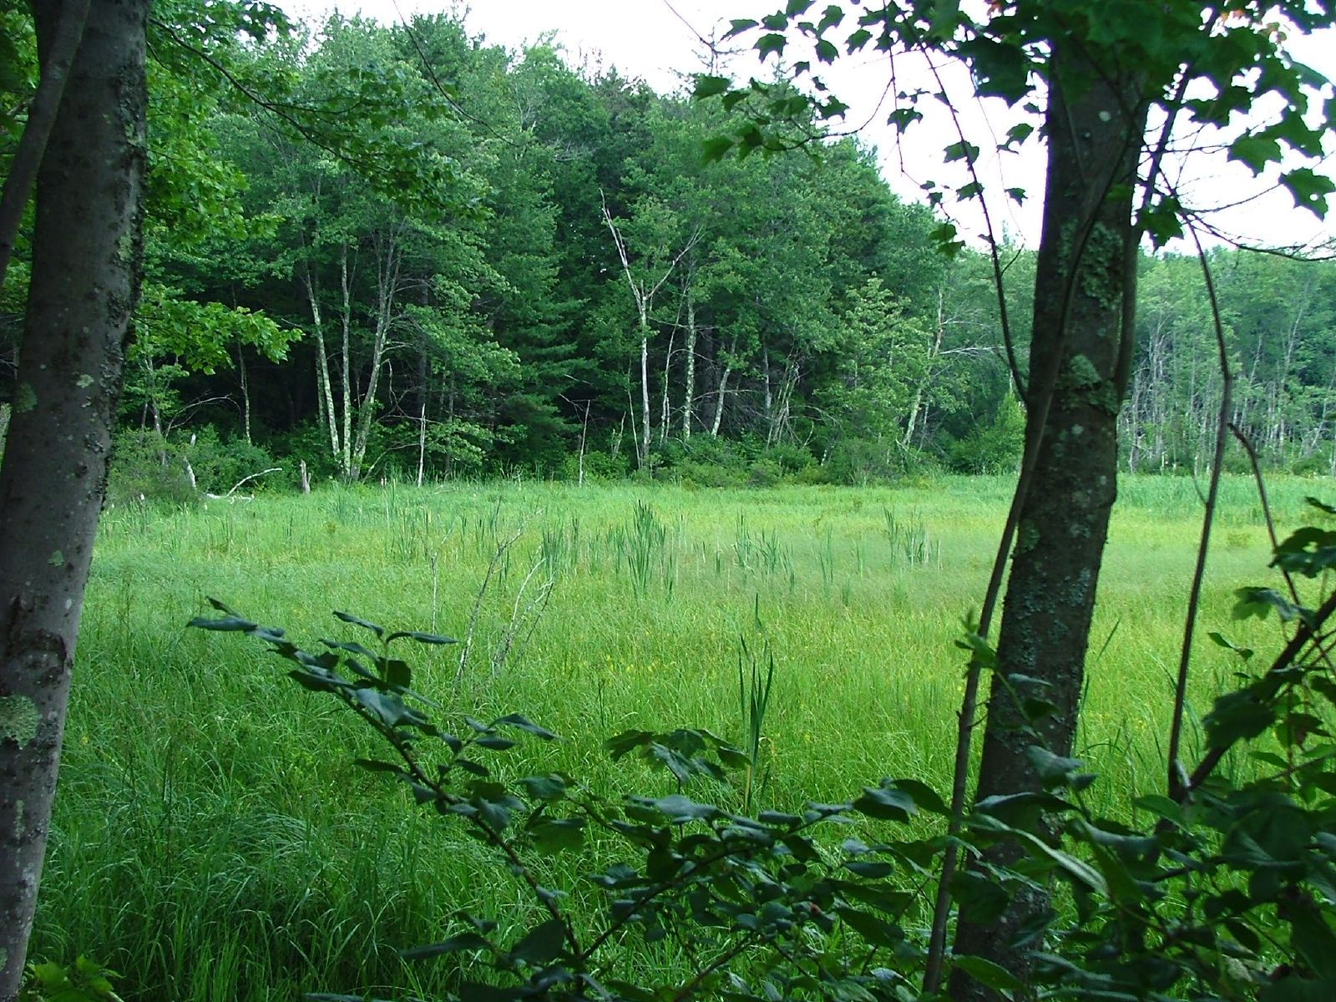
Plants Everywhere On Land

Slide 4
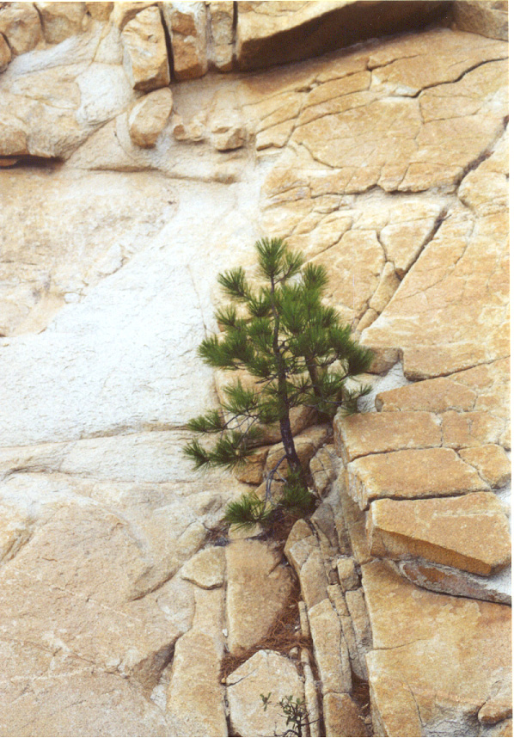
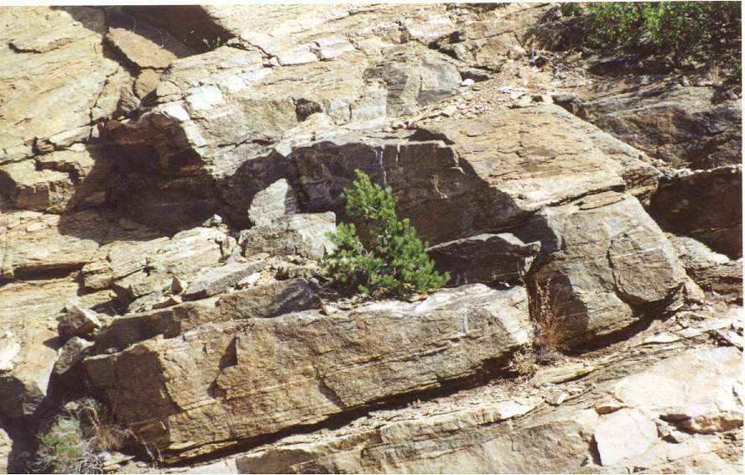
Trees From The Rocks

Slide 5
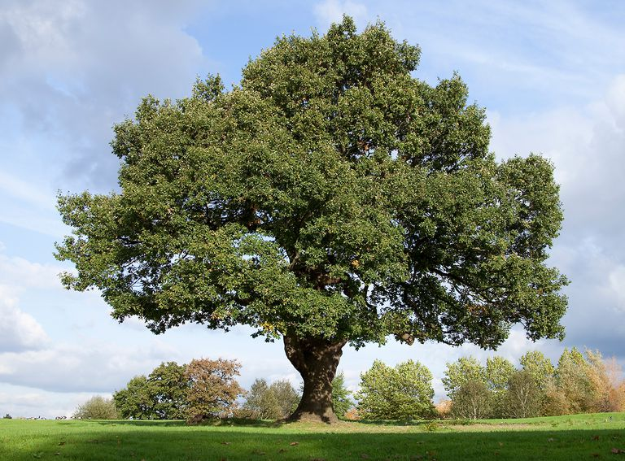
Trees everywhere!
Making their substance out of …
Air!

Slide 6
The Secret Work of Plants
Plants use water & sunlight
to make wood out of air!
Photosynthesis:
6CO₂ + 6H₂O + Light → C₆H₁₂O₆ + 6O₂
Sugar … becomes cellulose
So the plants make themselves out of light, water, and air (with the help of chlorophyll & nutrients)

Slide 7
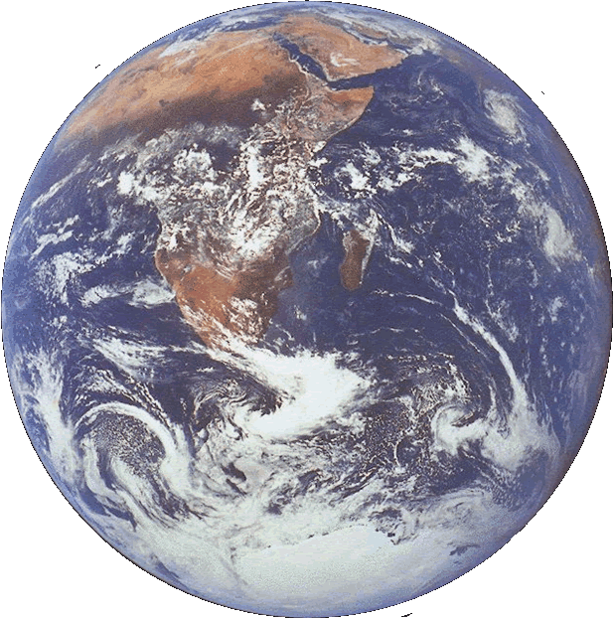
Quiz Question
The planet shown is unique for
A) Carbon Dioxide in its atmosphere
B) Solid water on its surface
C) Sticks
Sticks!
Yeah!
They’re amazing!

Slide 8
Genesis
“And God said, "Let the waters bring forth swarms of living creatures, and let birds fly above the earth across the dome of the sky." So God created the great sea monsters and every living creature that moves, of every kind, with which the waters swarm, and every winged bird of every kind. And God saw that it was good.
And there was evening and there was morning, the fifth day.

Slide 9
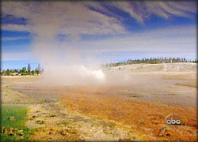
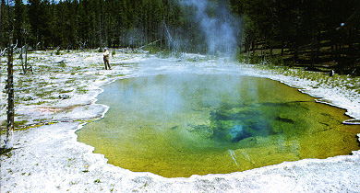
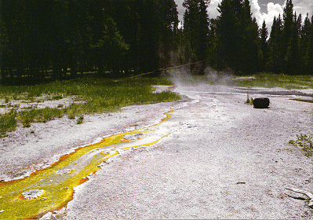
Life At High Temperature
Hot Springs in Yellowstone National Park
Cyanobacteria … the most ancient life on Earth

Slide 10
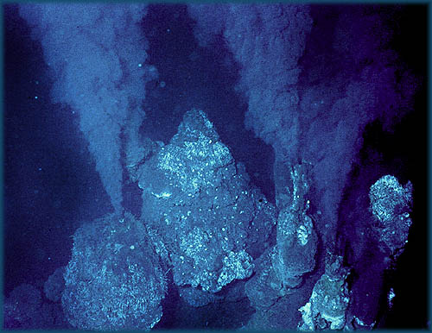
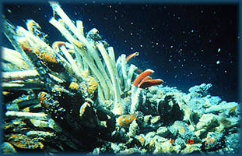
Life In The Dark
The Deep Sea Vents
Life utilizes minerals from Earth’s interior

Slide 11
Genesis
“And God said, "Let the earth bring forth living creatures of every kind: cattle and creeping things and wild animals of the earth of every kind." And it was so. God made the wild animals of the earth of every kind, and the cattle of every kind, and everything that creeps upon the ground of every kind. And God saw that it was good.”

Slide 12
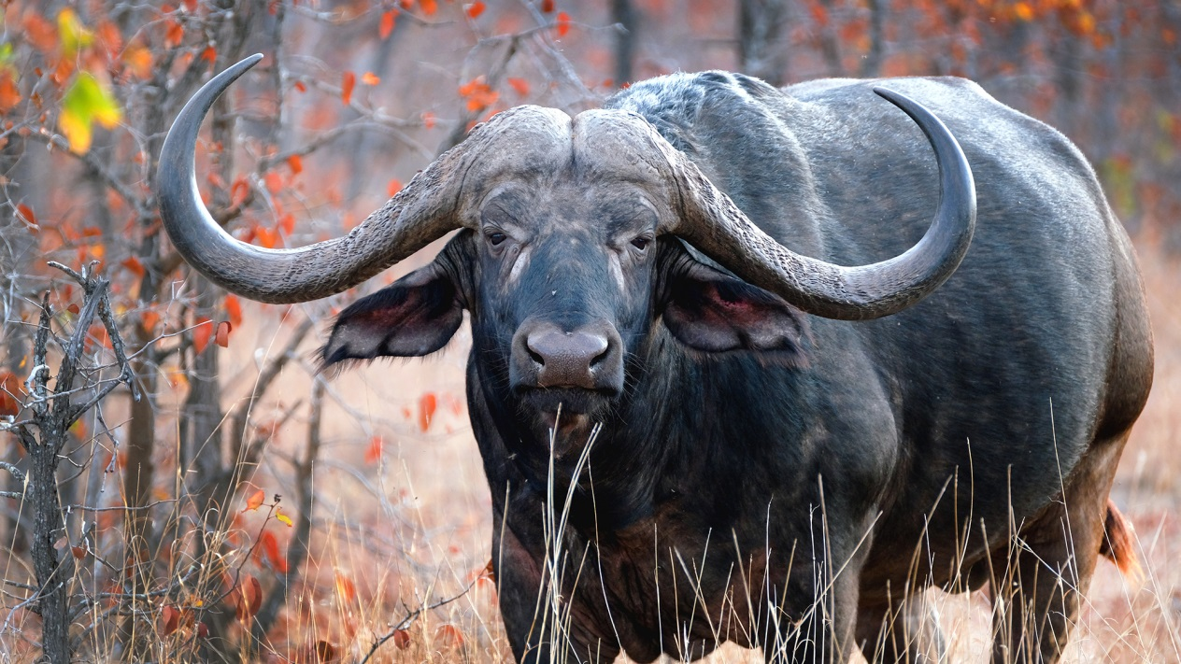
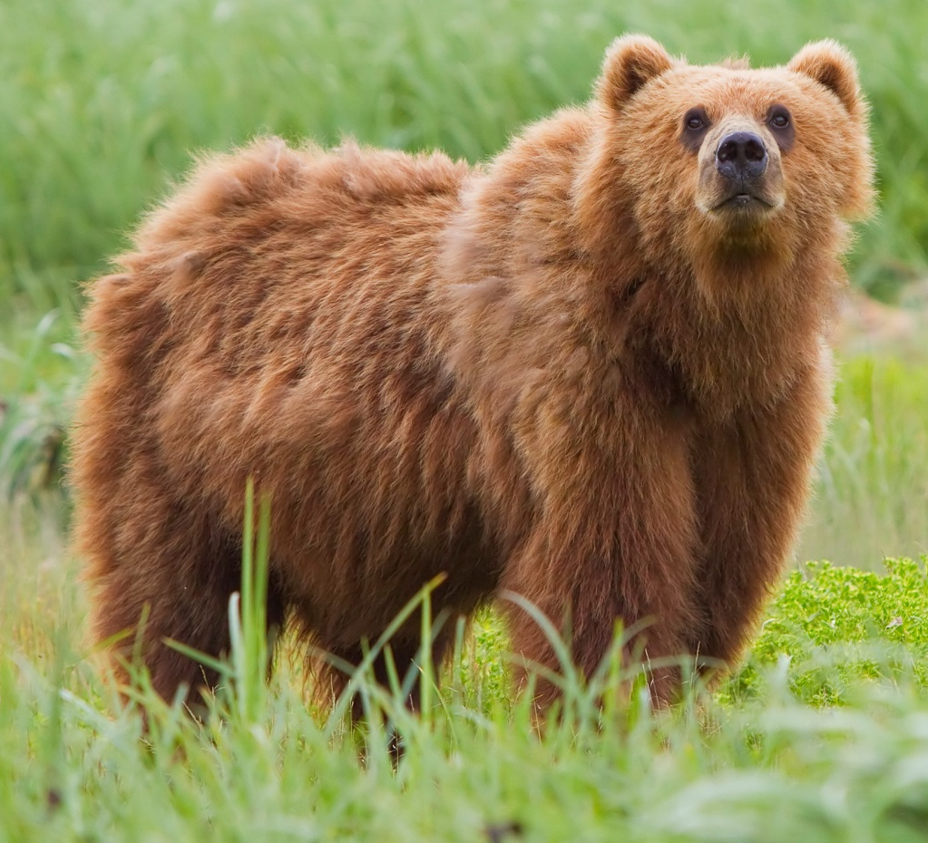
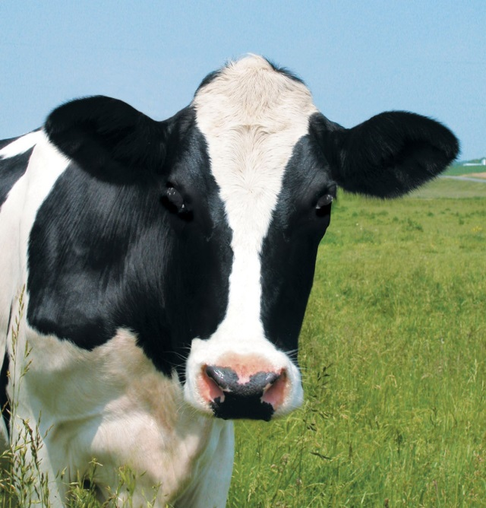
Megafauna
https://senalala.com/news/cape-buffalo/
https://en.wikipedia.org/wiki/Bear
http://animalia-life.club/other/holstein-cow-face.html

Slide 13
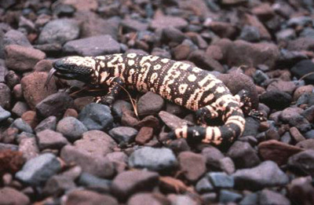
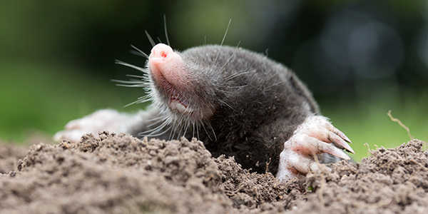
Creepy-Crawlies

Slide 14
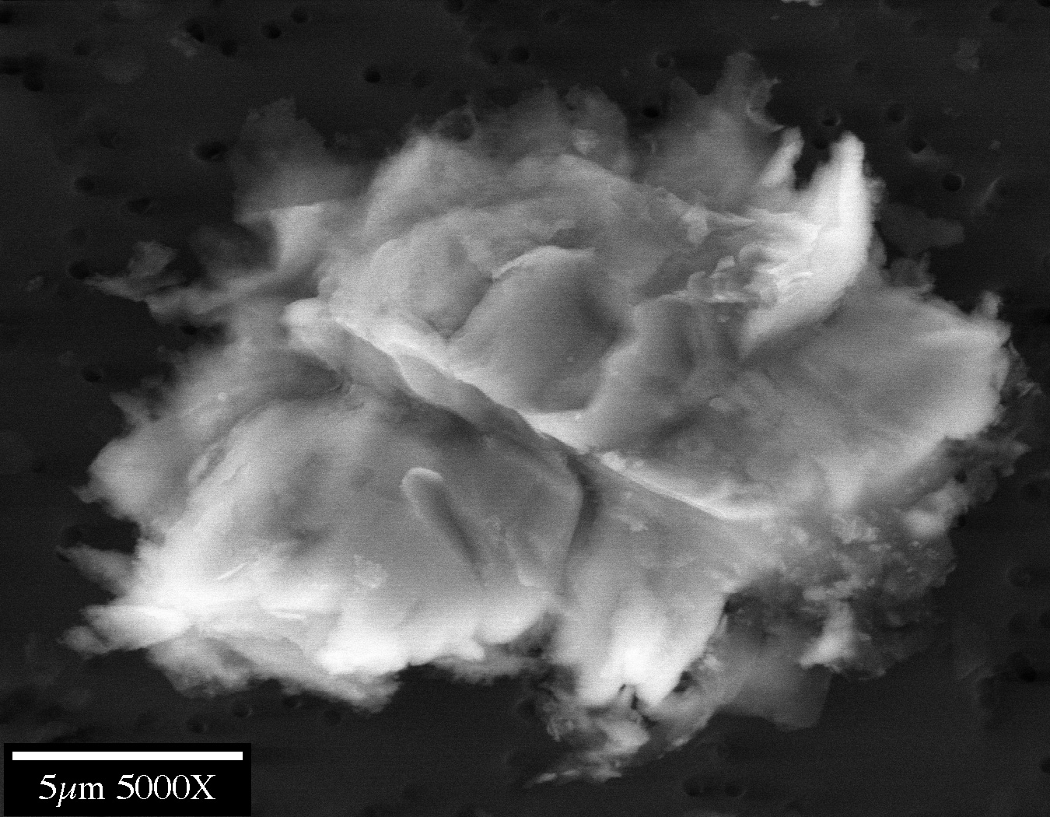
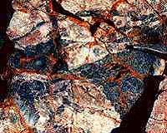
Abundance Of Life
Life survives in every ecosystem on Earth … even within ice and rocks!
Sulfide-digesting bacteria on rocks
Microbe from Antarctic Ice

Slide 15
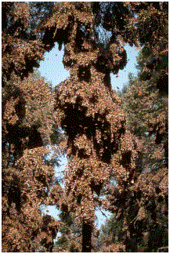
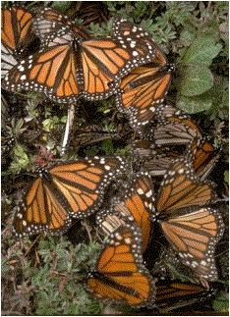
Life On The Trees

Slide 16
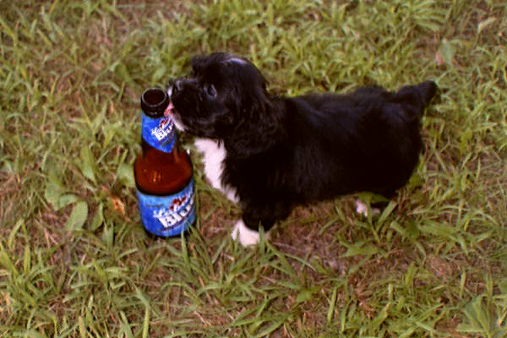
Given Hydrogen, Gravity & 15 Billion Years The Universe Made
Puppies!

Slide 17
Touching Earth
Whenever your feet touch Earth
you know they are touching
Where something has died
or been born.
Antler
Earth Prayers

Slide 18
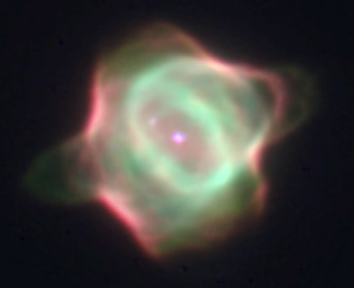
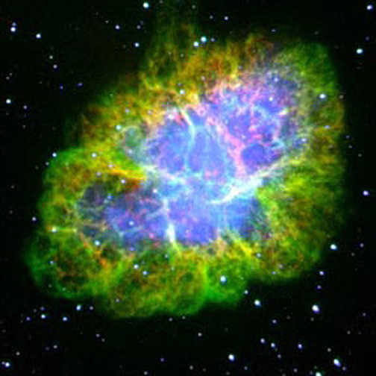
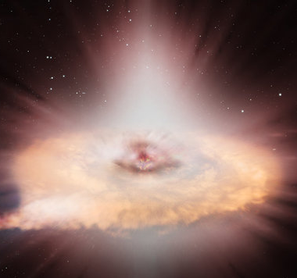
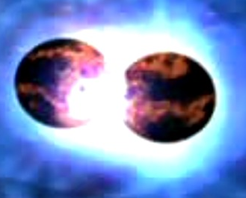
And all is from the stars
C & N from small stars (P.N.)
O & Ca from giant stars (S.N.)
Fe & Cu from exploding W.D.’s
Ag & U from colliding N.S.

Slide 19
Mass on the World
“… Over every living thing which is to spring up, to grow to flower, to ripen during this day say again the words: This is my Body.
Teilhard de Chardin

Slide 20
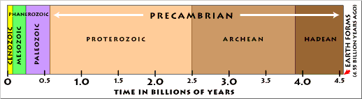
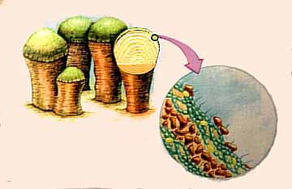
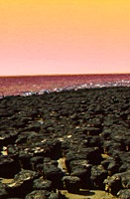
Life’s History
Earth is 4.5 by old
Now
Then
Earliest life 3.5 by ago: stromatolites (cyanobacteria)

Slide 21
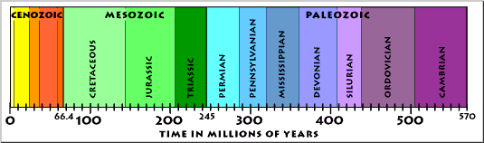
Life’s History
Evolution of complex life only in last 570 million years!
Most evolution has taken place ONLY in last 4% of the age of the universe!

Slide 22
Genesis
Then God said, "Let us make humankind in our image, according to our likeness; and let them have dominion over the fish of the sea, and over the birds of the air, and over the cattle, and over all the wild animals of the earth, and over every creeping thing that creeps upon the earth.“ So God created humankind in his image, in the image of God he created them; male and female he created them.

Slide 23
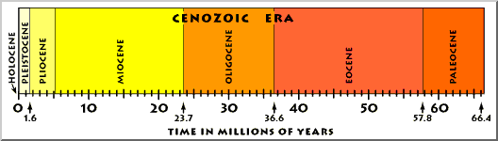
Human History
Humanoids appeared about a million years ago … 0.02% of Earth’s age,
0.007% of Universe’s age

Slide 24
Human History
Written human history covers about last 10,000 years (since the glaciers melted) 0.0002% of Earth’s age,
0.00007% of Universe’s age
If the history of the universe were a year, human history would take place in the last ½ minute before midnight on December 31!
… Christianity in the last 5 seconds!

Slide 25
Psalm 8
When I look at your heavens,
the work of your fingers,
the moon and the stars that
you have established;
what are human beings that
you are mindful of them,
mortals that you care for them?

Slide 26
But Wait! Don’t Order Yet …
Meteors have wiped out up to 90% of life on Earth …
A nearby supernova would destroy life on Earth with radiation …
The sun becoming a red giant will destroy life on Earth …

Slide 27
The Very Wonders Kill
The universe is not always gentle
meteors kill
volcanoes kill
solar radiation kills
animals must kill
to live

Slide 28
Genesis
“God saw everything that he had made, and indeed, it was very good. And there was evening and there was morning, the sixth day.”
But what about roadkill?

Slide 29
Even Roadkill Is Star Stuff!

Slide 30
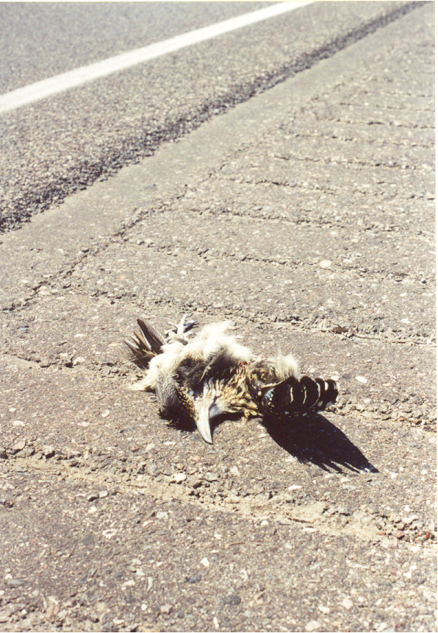
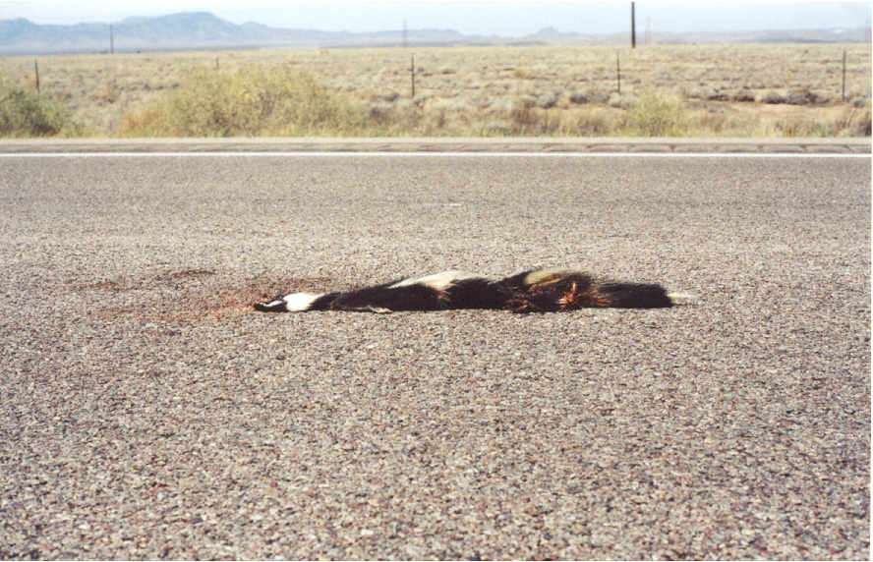
Roadkill: Inadvertent Death
“The Earth is full of your creatures”

Slide 31
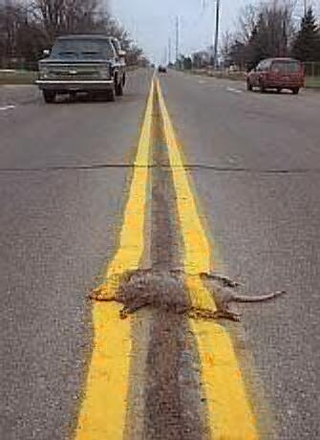
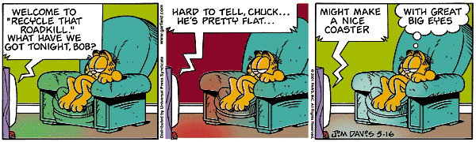
Roadkill
Life is so abundant …
We can waste it
And make fun of it.

Slide 32
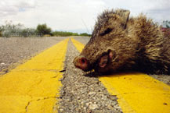
Is God Present in Roadkill?
Inadvertent, wasteful death
Caused by the gifts of metals,
machines
and minds.

Slide 33

Coping with Roadkill
What can we do about roadkill?
stop driving?
drive slower?
elevate all roads?
drive hovercraft?
As we work to reduce & eliminate it,
can we acknowledge and bless it?
Can we include it in the Christic Universe?

Slide 34
Reducing/Eliminating Roadkill
“The concern here is with the possibility of a theology of nature, that is, using the picture of reality coming to us from postmodern science as a way to reimagine the relationship between God and the world.”
Sally McFague
The Body of God

Slide 35
Reducing/Eliminating Roadkill
“…to consider ourselves as inspirited bodies, profoundly interrelated with all other such bodies and yet having the distinction of shared responsibility with God for the well being of our planet.”
Sally McFague
The Body of God

Slide 36
Acknowledging Roadkill
“Written into the very fabric of evolutionary E-mergence, at the cosmic, planetary, and human levels, is this paradox of creation and destruction.”
Diarmuid O’Murchu
Evolutionary Faith

Slide 37
Teilhard Blessing Roadkill
“My communion would be incomplete – would, quite simply, not be christian – if, together with the gains which this new day brings me, I did not accept, in my own name and in the name of the world, …

Slide 38
Blessing Roadkill
“… as the most immediate sharing in your own being, those processes, hidden or manifest, of enfeeblement, of aging, of death, which unceasingly consume the universe.”
Teilhard de Chardin
The Mass on the World

Slide 39
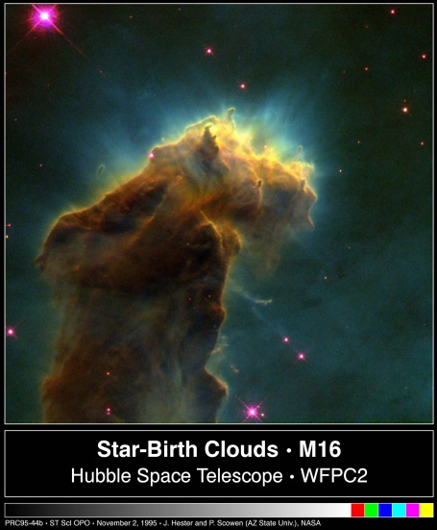
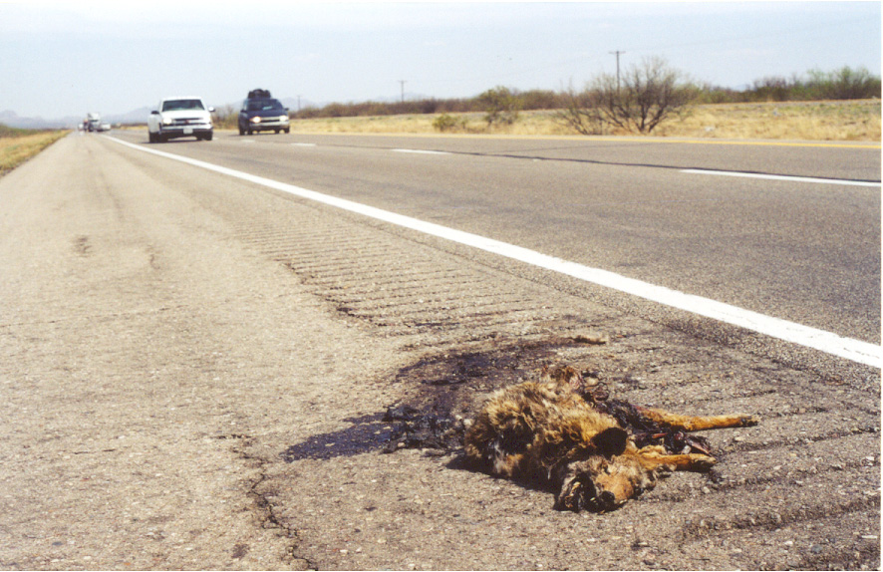
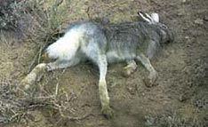
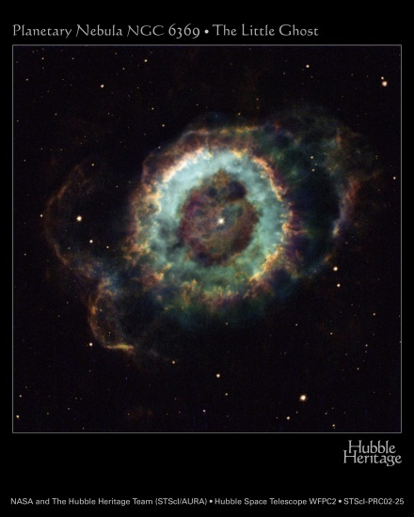
The Wonder Of Roadkill
“…yet not a single sparrow falls to the ground without your Abba God’s knowledge.”

Slide 40
Mass on the World
“… Over every living thing which is to spring up, to grow to flower, to ripen during this day say again the words:
This is my Body.
Teilhard de Chardin

Slide 41
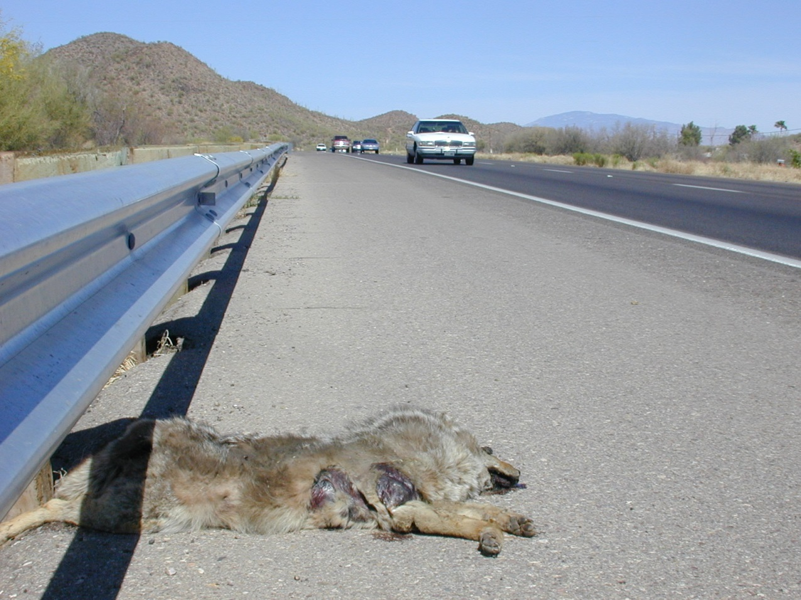
Finding God In Roadkill
“And over every death-force which waits in readiness to corrode, to wither, to cut down, speak again your commanding words which express the supreme mystery of faith:
This is my Blood.”

Slide 42
Loving The Universe …
Loving the reality of the universe
Loving all life
Loving the Earth
Loving the stars
Loving the light
Loving matter
Loving the darkness …

Slide 43
Loving God
“Matter and spirit: these were no longer two things, but two states of one and the same cosmic stuff.”
Teilhard de Chardin

