Slide 1

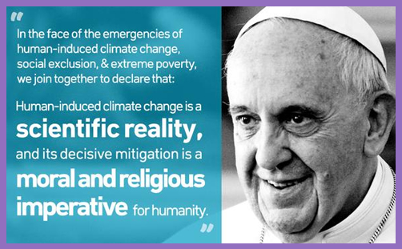

Climate Science behind
Aileen O’Donoghue St. Lawrence University

Slide 2
Laudato Si’
“A very solid scientific consensus indicates that we are presently witnessing a disturbing warming of the climatic system. In recent decades this warming has been accompanied b a constant rise in the sea level and, it would appear, by an increase of extreme weather events, even if a scientifically determinable cause cannot be assigned to each phenomenon.” (23)

Slide 3
Laudato Si, Chapter 1
Pollution & Climate Change
  Temperature and precipitation!
The Issue of Water
  Floods and droughts
Loss of Biodiversity
  animals & plants … and some human cultures
Decline in Quality of Life & Social Breakdown
  the first climate refugees are among us
Global Inequality
  who’s got the water?
Weak Responses
  and deliberate misinformation campaign
Variety of Opinions
  NOT on the science!!

Slide 4
Laudato Si, Chapter 1
Pollution & Climate Change
  Temperature and precipitation!
The Issue of Water
  Floods and droughts
Loss of Biodiversity
  animals & plants … and some human cultures
Decline in Quality of Life & Social Breakdown
  the first climate refugees are among us
Global Inequality
  who’s got the water?
Weak Responses
  and deliberate misinformation campaign
Variety of Opinions
  NOT on the science!!

Slide 5
Evidence of Climate Change
Instrumental Records
  Barometer; Torricelli in Italy, early 1600s
  Thermometer; Galileo in Italy, early 1600s
Proxy Records
  River & Lake levels
  Glaciers (advancing and retreating)
  Vegetation: tree rings & pollen
  Animal migrations (micro & macro)
  Ice Core Isotopes: ¹⁸O/¹⁶O, ²H/¹H
Climate has always changed … but this change is very rapid!

Slide 6
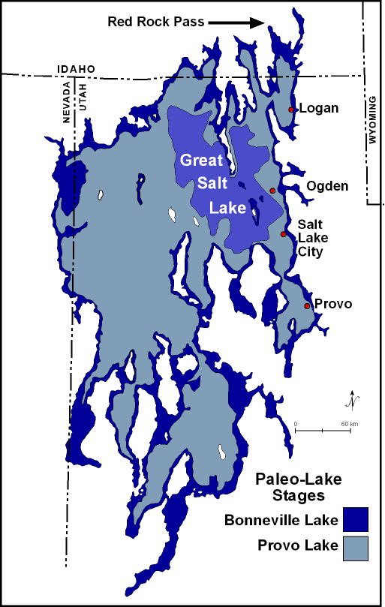
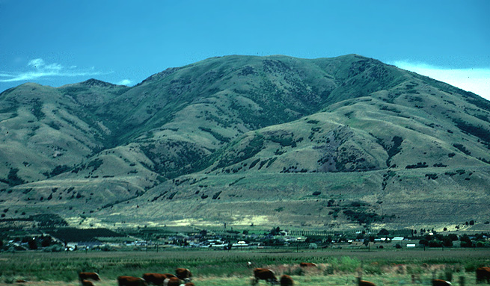
Evidence: Lake Shores, Cliffs
Old shorelines of Lake Bonneville, Utah are 700 to 1,000 feet higher than current lake
The “Benches”

Slide 7
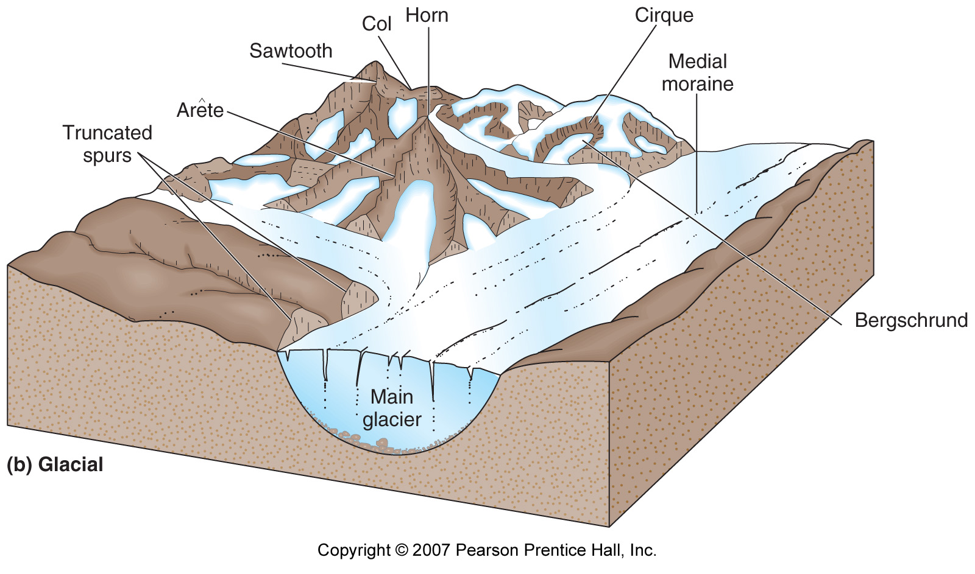
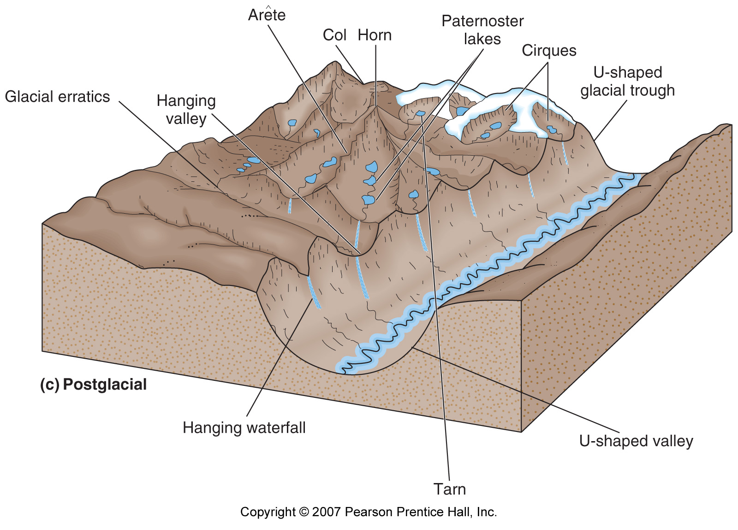
Evidence: Glacial Landscapes
Glaciers leave distinctive features

Slide 8
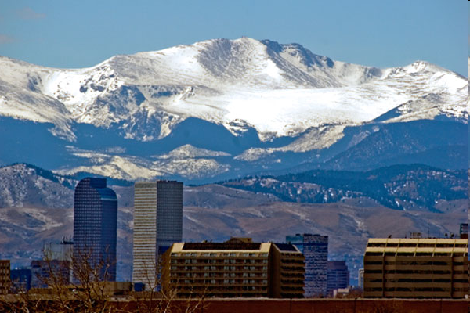
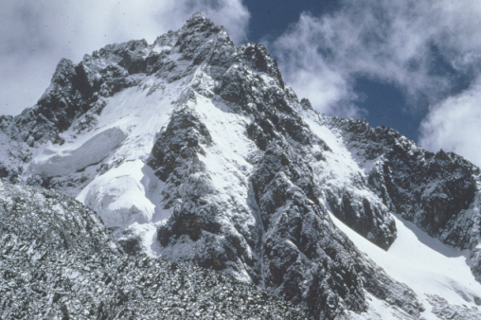
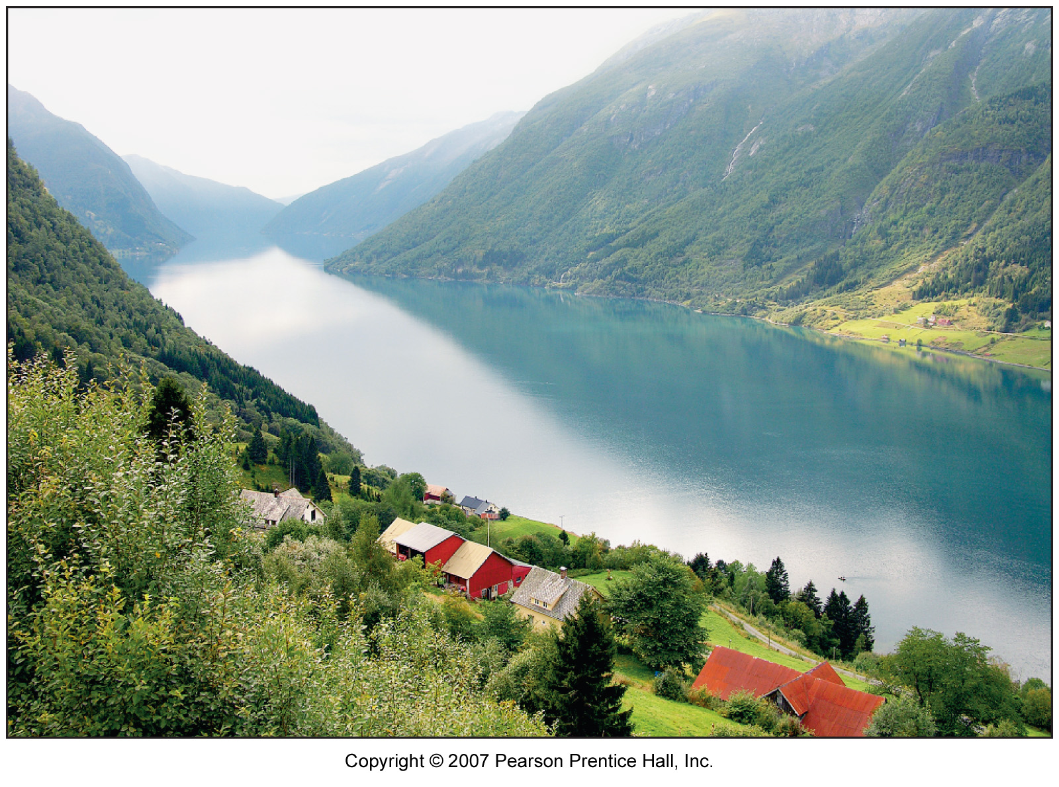
Evidence: Glacial Landscapes
Features due to ice erosion
Cirques on Mt. Evans outside Denver
Fjords of Norway: former glaciated valleys now flooded by the sea
Summit of Mount Kenya: glaciers may be gone in 50 years!

Slide 9
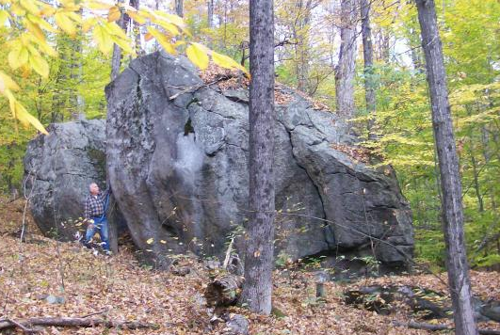
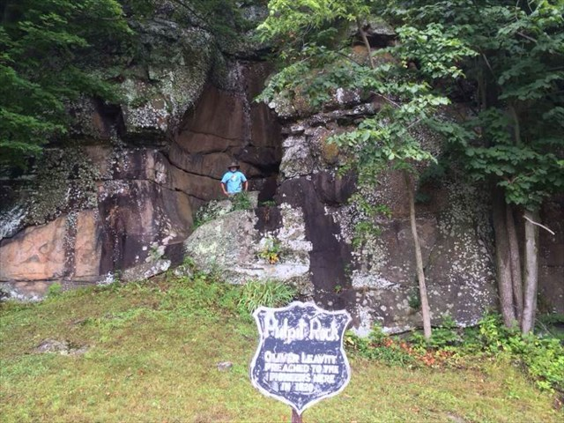
Evidence: Glacial Landscapes
Features due to ice erosion
Erratic boulders in Adirondacks dropped by glaciers … Sunday Rock among them!
Pulpit rock in Antwerp, NY was a pothole under a river while glaciers were melting!

Slide 10

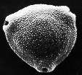
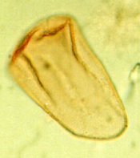
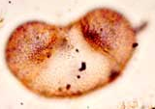
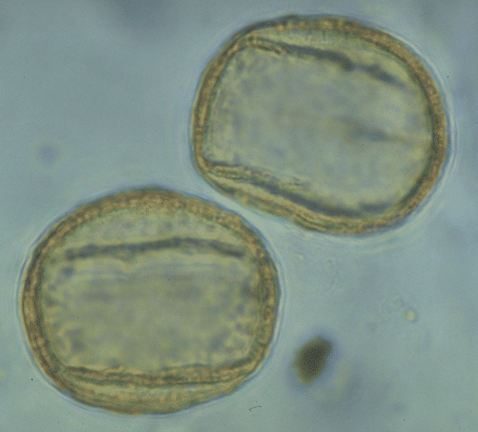
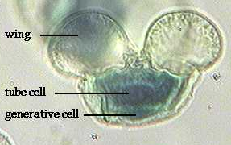
Evidence: Pollen
Palynology (pollen) from sediments
  Accumulated in peat bogs & lakes
  Must be independently dated (cross-matched or ¹²C)
  Local influences complicate records
    eg. Fire, flood, etc.
  Types of pollen vary in uniqueness
    eg. Pine pollen everywhere … even ice caps!
shrub
birch
sedge
spruce
oak
Pine

Slide 11
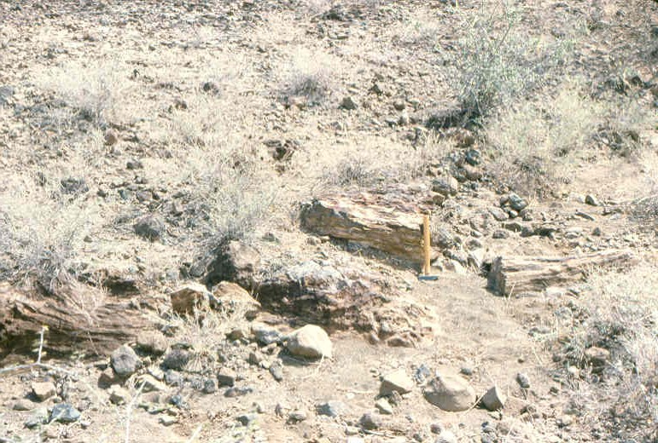
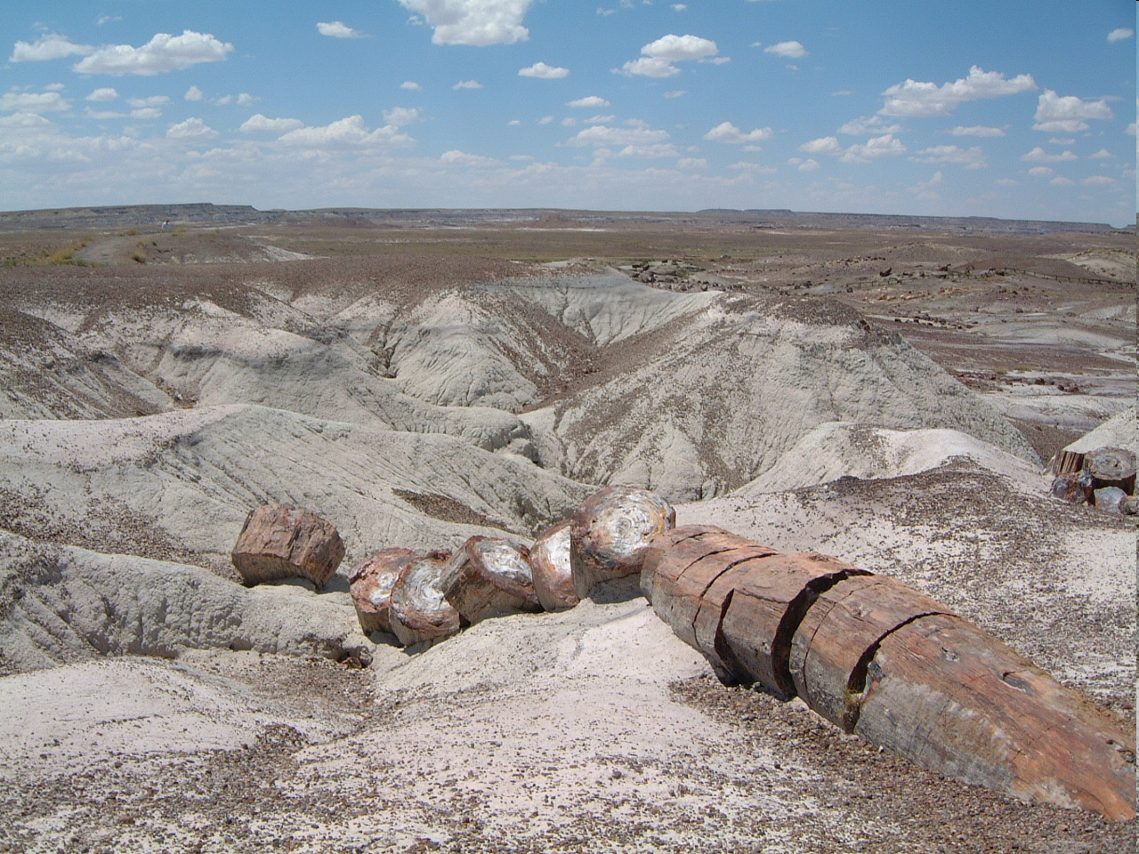
Evidence: Petrified Forests
Large trees turned to stone where it’s now desert
Northern Kenya where the current vegetation is annual grasses and thorny bushes.
Petrified Forest N.P., Arizona

Slide 12
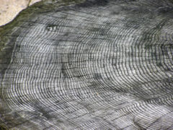
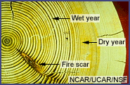
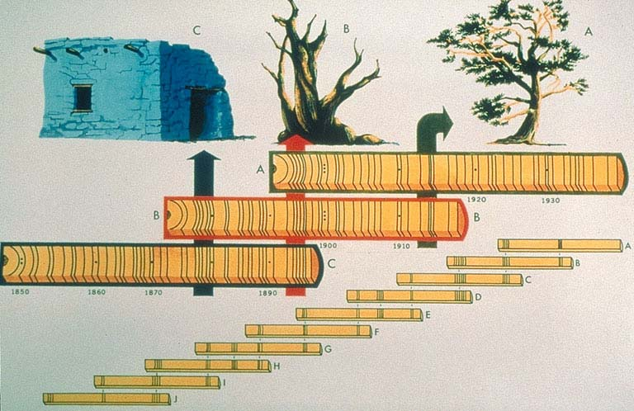
Plant Evidence: Tree Rings
Chronologies built up for entire regions from tree rings.
Rings in wood from ancient structures can be matched to known chronologies.
Wood is easily radiocarbon dated.

Slide 13
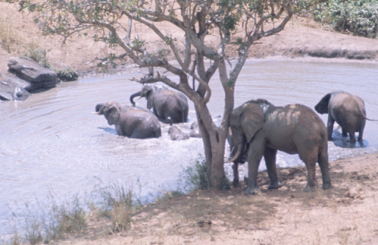

Animal Evidence: Macrofauna
Animals migrate to more suitable climates
Elephants highly mobile & adaptable to a wide range of environments
Rhinoceros from rock carvings in the Sahara; none live in the area today

Slide 14
American Institute of Physics
“The scientists who labored to understand Earth's climate discovered that many factors influence it. Everything from volcanoes to factories shape our winds and rains. The scientific research itself was shaped by many influences, from popular misconceptions to government funding, all happening at once. … for this sort of subject we need total history, including all the players — mathematicians and biologists, lab technicians and government bureaucrats, industrialists and politicians, newspaper reporters and the ordinary citizen.”
https://history.aip.org/climate/summary.htm

Slide 15
American Institute of Physics
Discovery of Greenhouse Warming
  1896 – Svante Arrhenius, Sweden
    Burning fossil fuels, thereby adding CO₂ to Earth’s atmosphere, humanity would raise average temp.
    Most thought “puny humanity” could not affect vast climate cycles governed by “balance of nature”.
  1930’s
    Measurements in US North Atlantic region showed it had warmed significantly in 50 years
    Thought to be “natural cycle”
    Guy S. Callendar claimed greeenhouse warming (English steam engineer & amateur scientist)
Callendar & others though it would be beneficial.

Slide 16
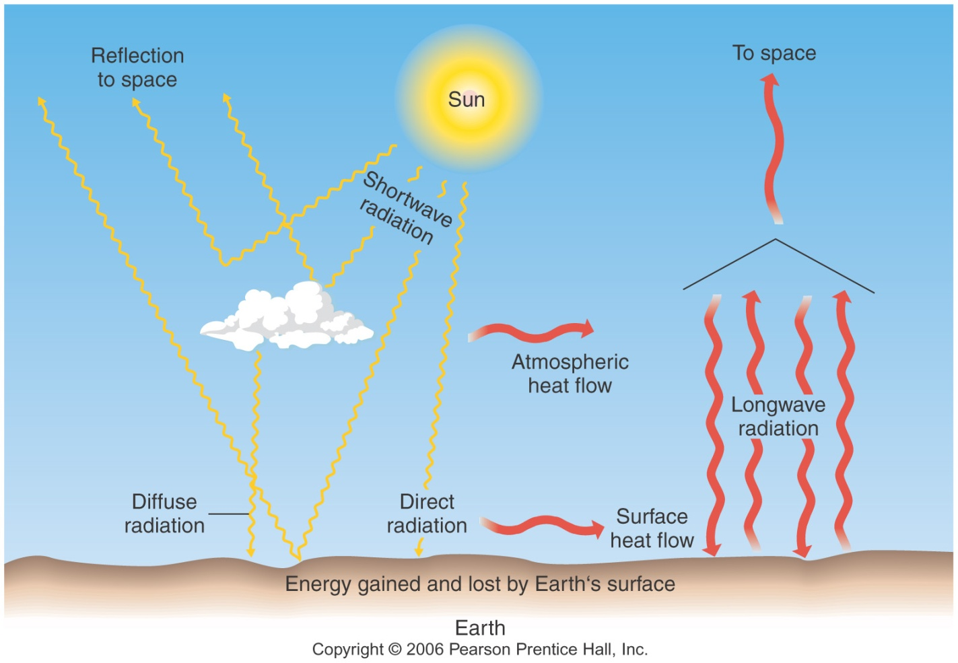
Greenhouse Effect
Earth absorbs visible light, radiates infrared
  IR radiation absorbed by some gases
    CO₂, CH₄, H₂0, etc.
    Increases energy of gases ⇒ increases temperature
IR absorbed by atmosphere heats air

Slide 17

American Institute of Physics
Discovery of Greenhouse Warming
  1950’s (Cold Wa)
    Military and government agencies funded studies into weather and geophysics for security & prestige
    The Scientific Debate
      Water (oceans) absorb CO₂
      Would human-produced CO₂ all be absorbed by oceans?
    International Geophysical Year: 7/1957-12/1958
      Charles Keeling funded to monitor CO₂
      Sensor on Mauna Loa
https://history.aip.org/climate/summary.htm

Slide 18
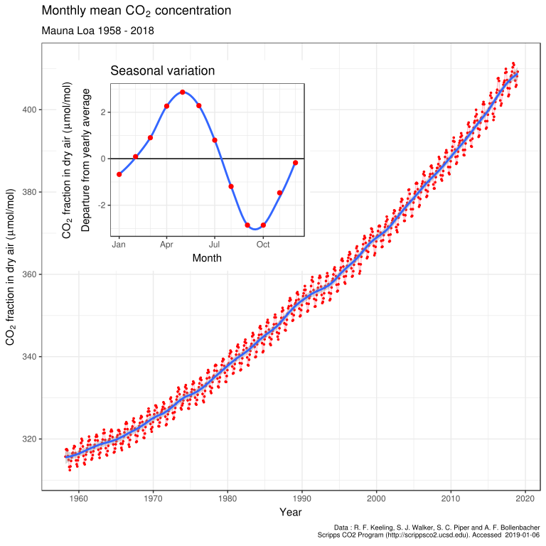
411 ppm
April
Sept.
Keeling Curve
316 ppm
1958
2018

Slide 19
Deep Climate History
Tree Rings go back ~ 1,000 years
Glacial deposits indicate climate changes
Need long time-scale records of climate
  Ice cores
    Antarctica (Vostok)
    Greenland (GISP)
    Mountain glaciers
  Deep Sea sediments

Slide 20
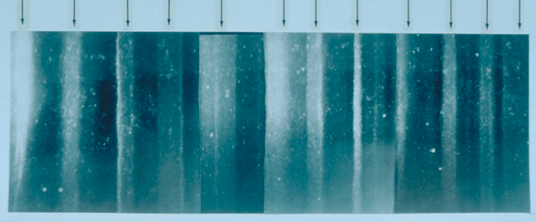
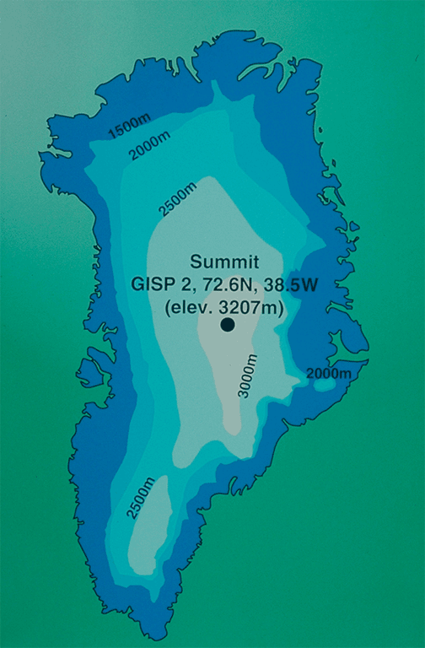
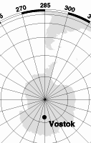
Isotope Evidence: Ice Cores
Vostok, Antarctica & Greenland Ice Cores
Greenland Ice Core Summers indicated by arrows.

Slide 21
Past Climates
Vostok, Antarctica & Greenland Ice Cores
  Show annual* variations of atmosphere
    Bubbles of air contain old atmosphere
      Variations in CO₂, CH₄ Give
        Comparisons to today,
        Correlations with temperature
    Ice crystals vary in composition
      Different Isotopes of Oxygen, Hydrogen, etc.
    Dust
      Volcanos, Impacts, Winds, Organic Matter
*Unclear annual layers ⇒ chronology reconstructed from other annual variables

Slide 22
Isotopes
Number of neutrons in nuclei varies
  eg. Oxygen 16 (¹⁶O) & 18 (¹⁸O)
  ¹⁸O heavier than ¹⁶O ⇒ harder to evaporate
    Ice Cores
      High ratio of ¹⁸O/¹⁶O for warm globe
      More ¹⁸O evaporates when it’s warm & falls as snow
    Deep Sea Sediments
      High ratio of ¹⁸O/¹⁶O for cool globe
      Less ¹⁸O evaporates when it’s cool so it stays in ocean
¹⁶O
¹⁸O
8 protons 8 neutrons
8 protons 10 neutrons
On average: 1 ¹⁸O for 1000 ¹⁶O

Slide 23
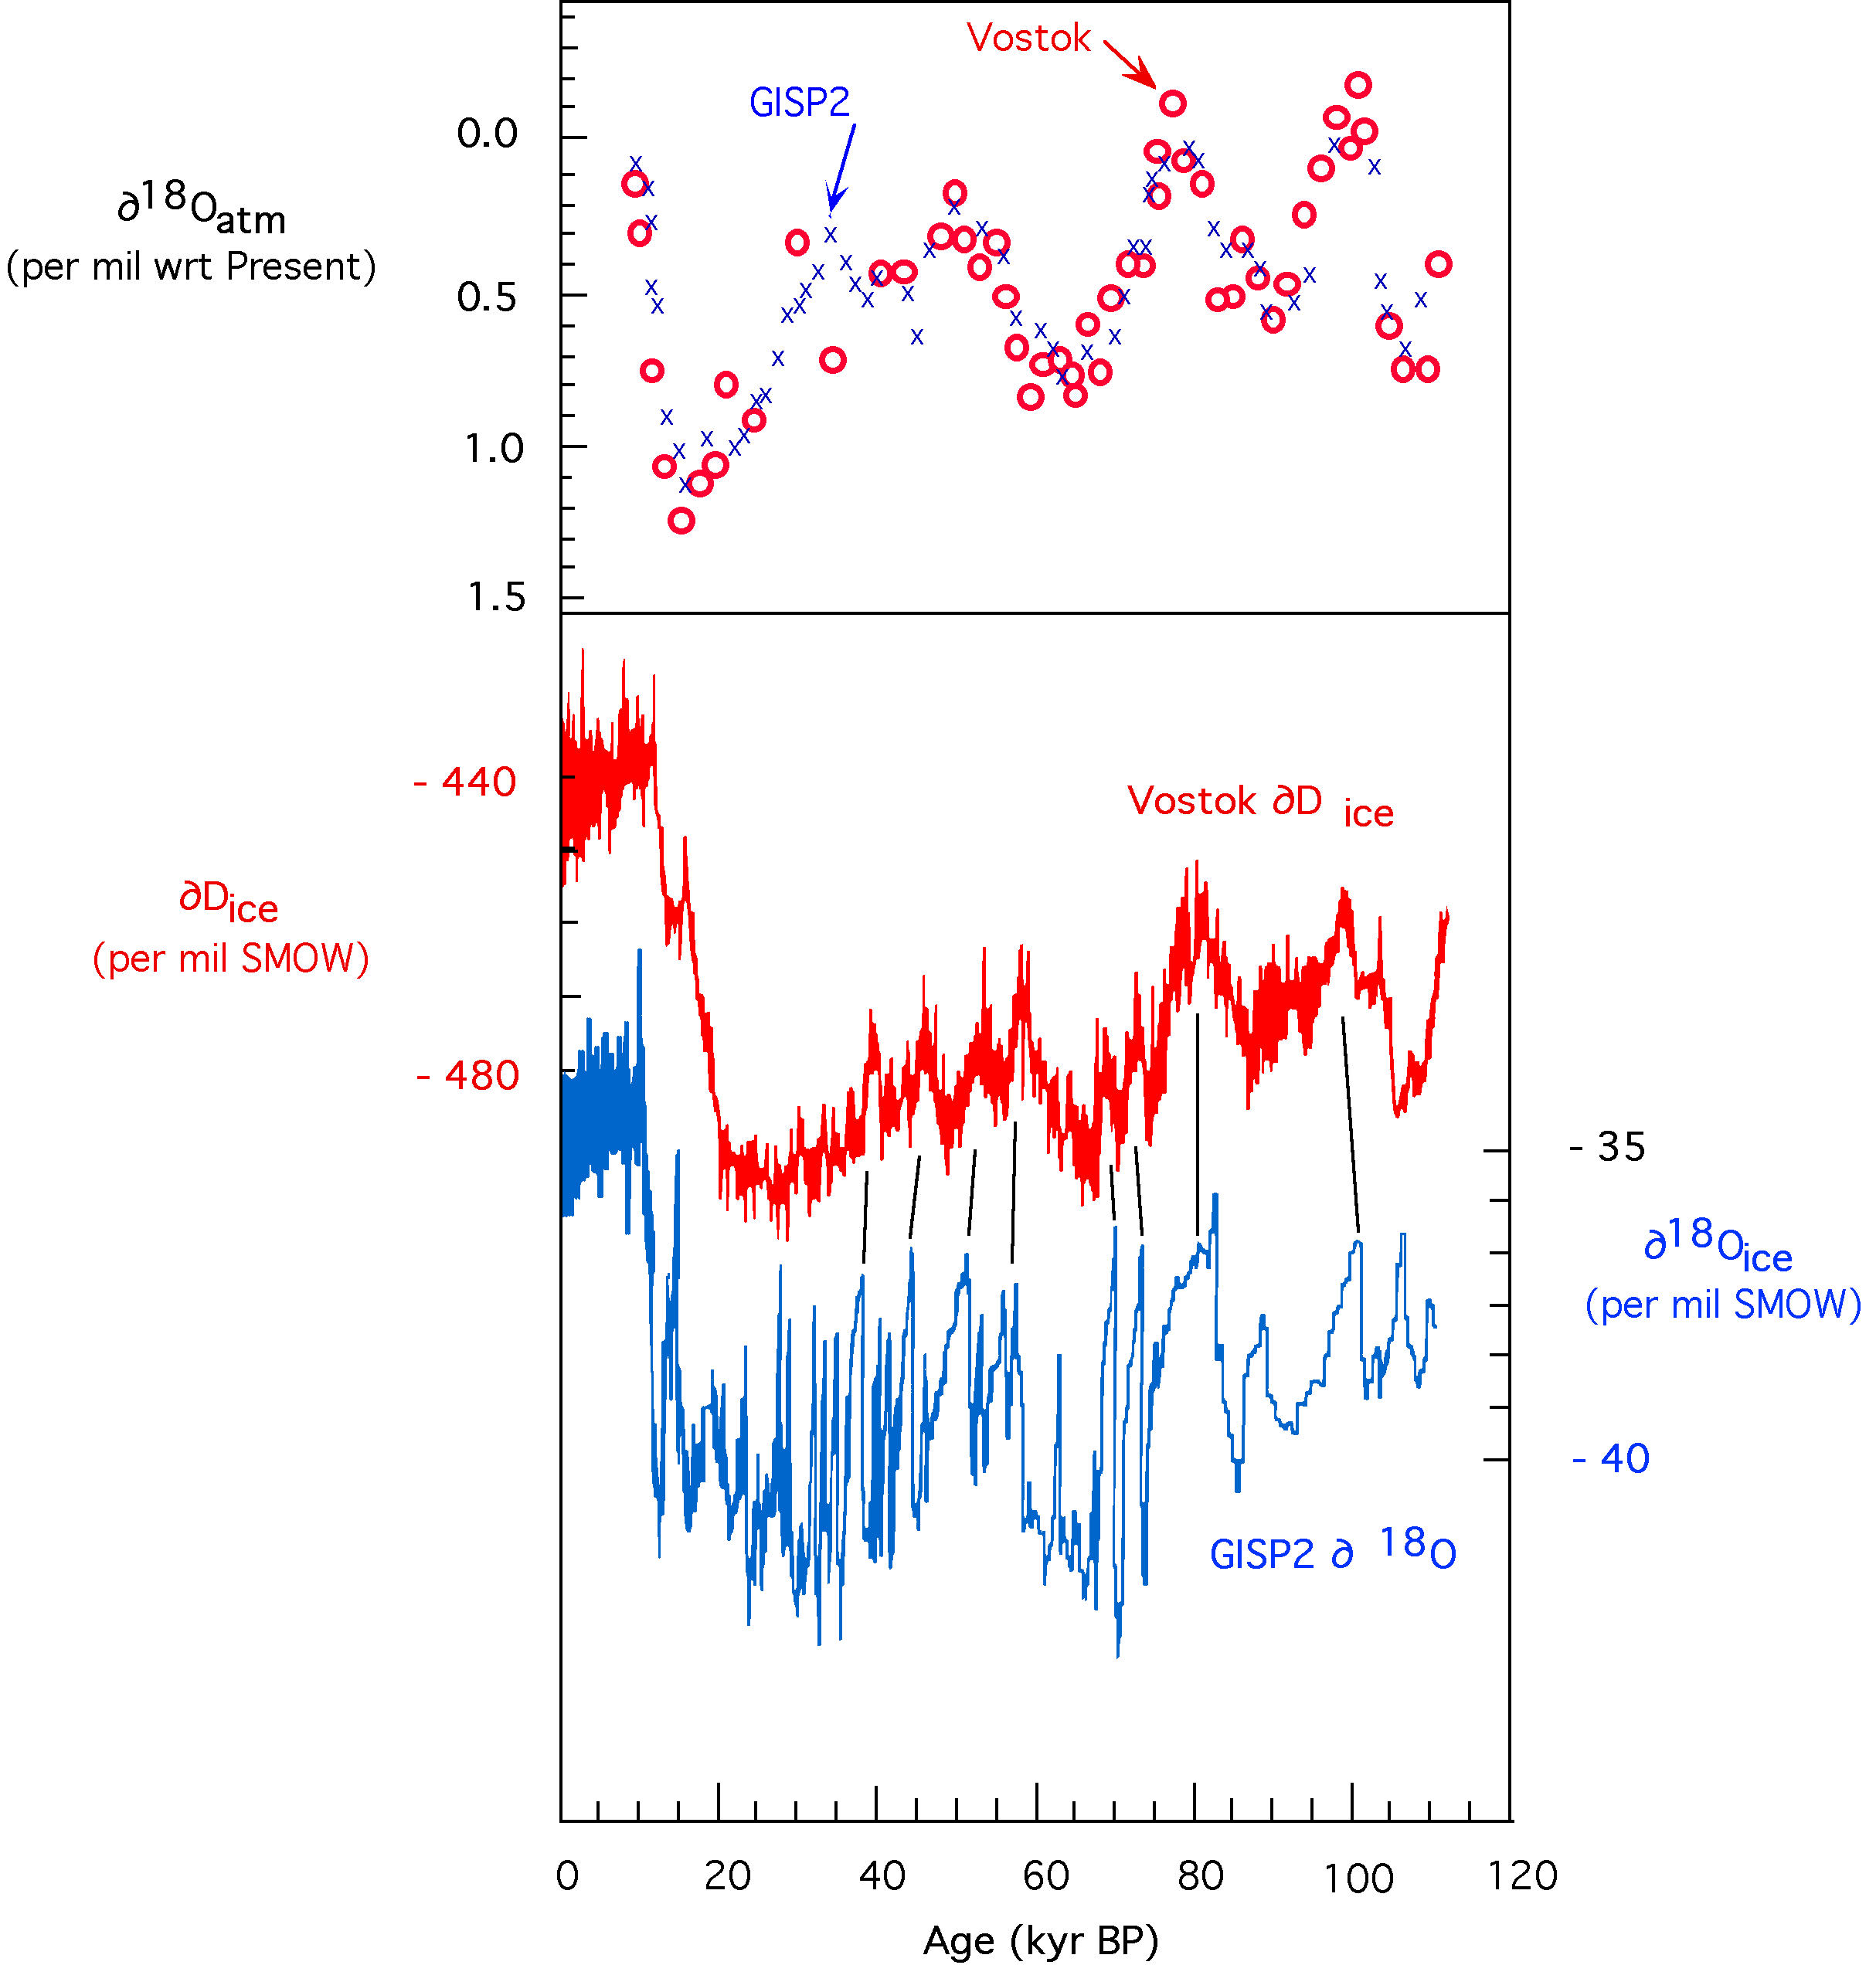
Isotopes
Variations in ice indicate temperature
  Higher ¹⁸O/¹⁶O in ice ⇒ warmer oceans
  Lower ¹⁸O/¹⁶O in ice ⇒ cooler oceans
²H/¹H
¹⁸O/¹⁶O
Arctic & Antarctic show same variations ⇒ variations are global

Slide 24
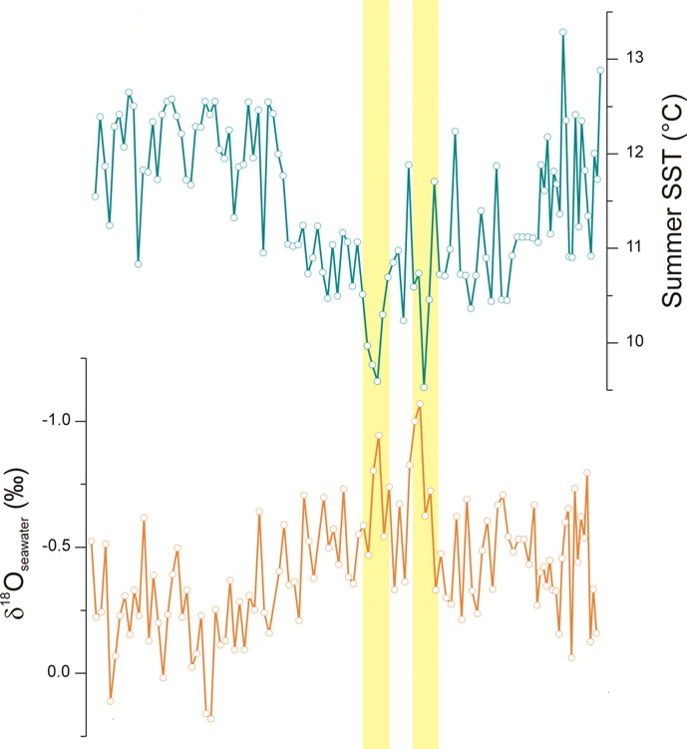

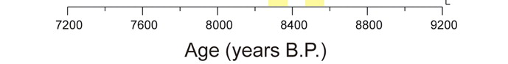
Isotopes
Sea floor sediment data
Sea Sediments
  Higher ¹⁸O/¹⁶O
  ⇒ cooler
  Lower ¹⁸O/¹⁶O
  ⇒ warmer
Sea surface temperature
¹⁸O/¹⁶O
C. R. W. Ellison et al., Science 312, 1929 -1932 (2006)

Slide 25
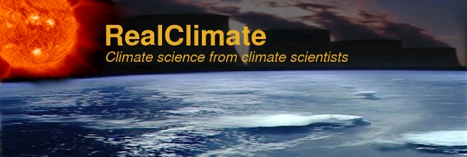
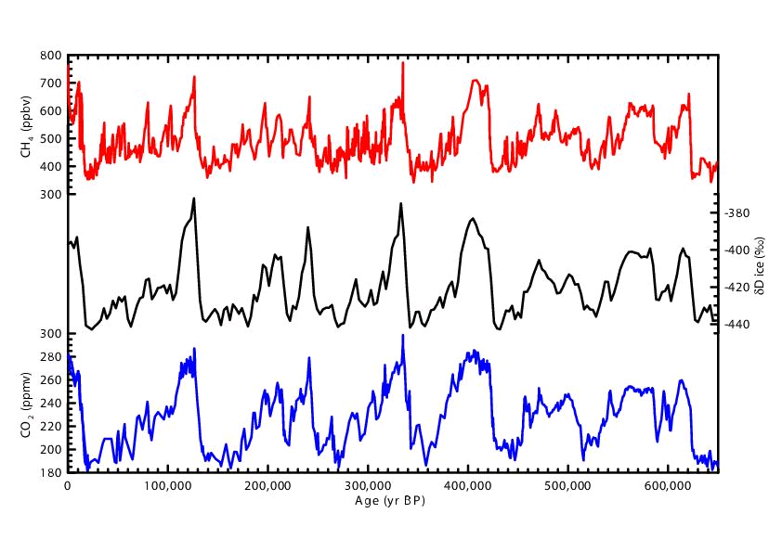
Isotopes
Variations track with GH gases
Methane
²H/¹H
Carbon Dioxide
now
then
www.realclimate.org/index.php?p=221

Slide 26
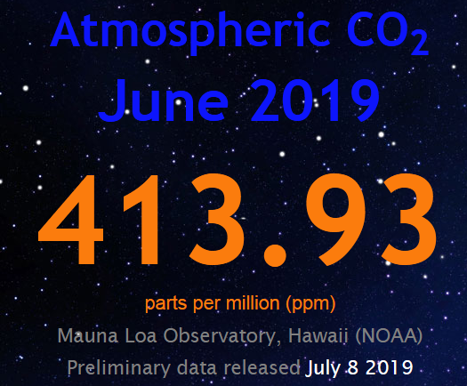

Isotopes
Variations track with GH gases
Methane
411
CO₂ at levels not seen in > 600,000 years!
400
²H/¹H
380
360
340
320
Carbon Dioxide
now
then
www.realclimate.org/index.php?p=221

Slide 27
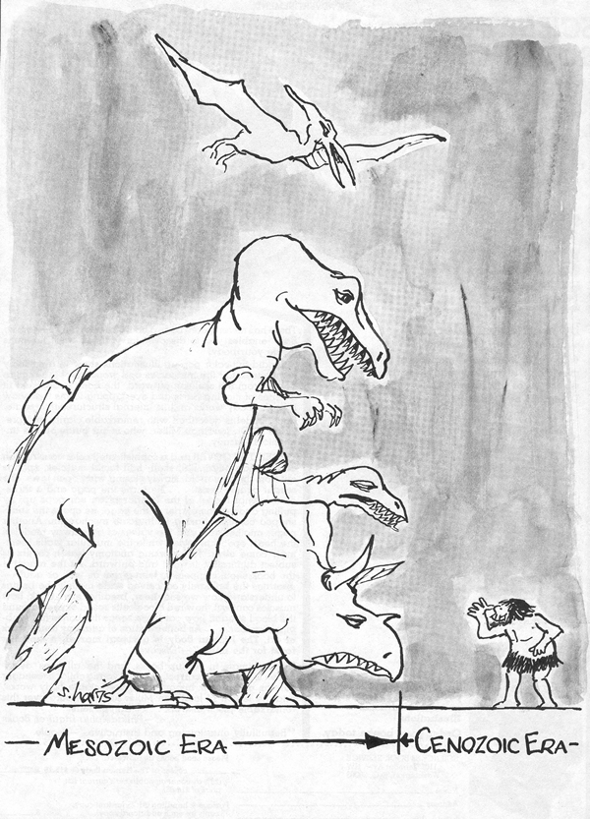
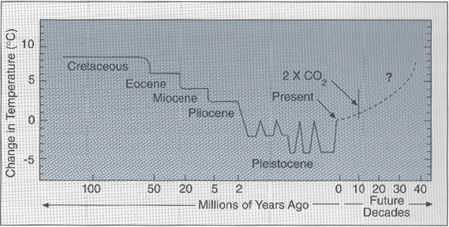
Climate History
Last 100My
  Marine & Terrestrial data
Dinosaurs
Much warmer in Mesozoic!
ice ages
Chicxulub Impact

Slide 28
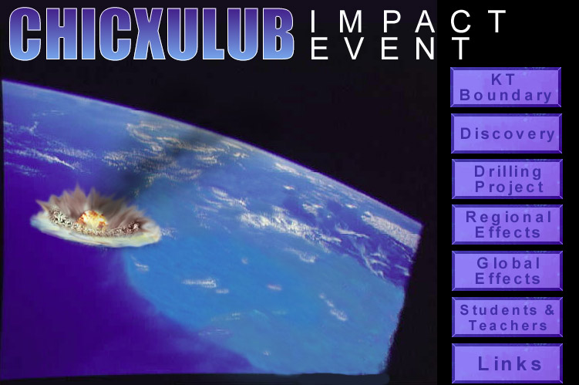
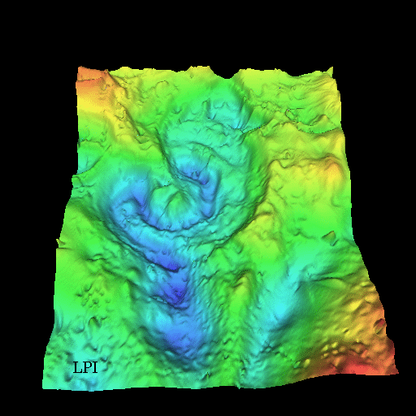
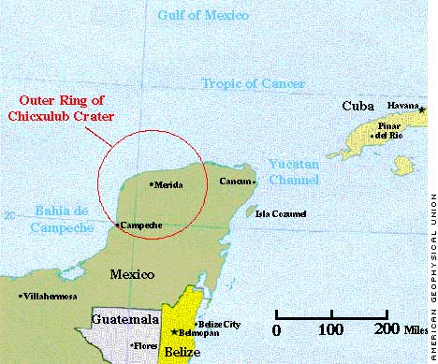
Chicxulub Impact ⇒ Climate Change
Demise of the dinosaurs?
Mapped by gravitational anomalies
On Edge of Yucatan Peninsula
http://www.lpl.arizona.edu/SIC/impact_cratering/Chicxulub/Chicx_title.html

Slide 29
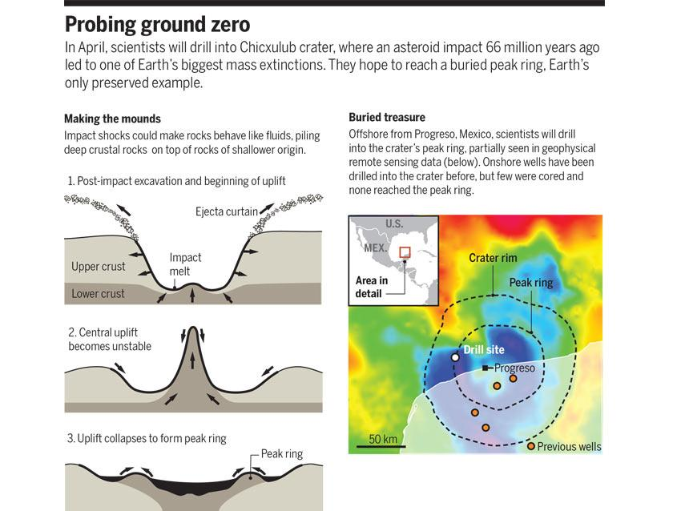
Chicxulub Impact
Demise of the dinosaurs?
Science Magazine, March 3, 2016
http://www.lpl.arizona.edu/SIC/impact_cratering/Chicxulub/Chicx_title.html

Slide 30
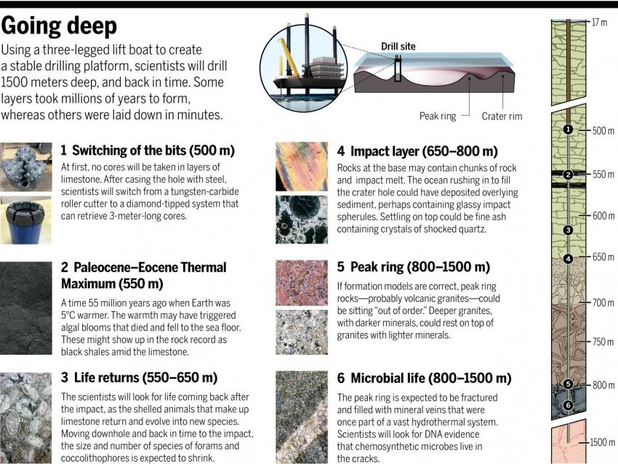
Chicxulub Impact
Demise of the dinosaurs?
Science Magazine, March 3, 2016
http://www.lpl.arizona.edu/SIC/impact_cratering/Chicxulub/Chicx_title.html

Slide 31
Climate History
Last 100My
  Marine & Terrestrial data
How will we feed > 7 billion people?
Dinosaurs
Much warmer in Mesozoic!
ice ages
Chicxulub Impact

Slide 32
Climate History – A Quick Summary
Mostly Earth has been warmer
Quaternary Period
  Pleistocene (last 2 m.y.) and Holocene (last 10 k.y.)
  Temperatures have fluctuated around cooler state.
Anthropocene?
Dinosaurs
ice ages
Much warmer in Mesozoic!

Slide 33
Laudato Si, Chapter 1
Pollution & Climate Change
  Temperature and precipitation!
The Issue of Water
  Floods and droughts
Loss of Biodiversity
  animals & plants … and some human cultures
Decline in Quality of Life & Social Breakdown
  the first climate refugees are among us
Global Inequality
  who’s got the water?
Weak Responses
  and deliberate misinformation campaign
Variety of Opinions
  NOT on the science!!

Slide 34
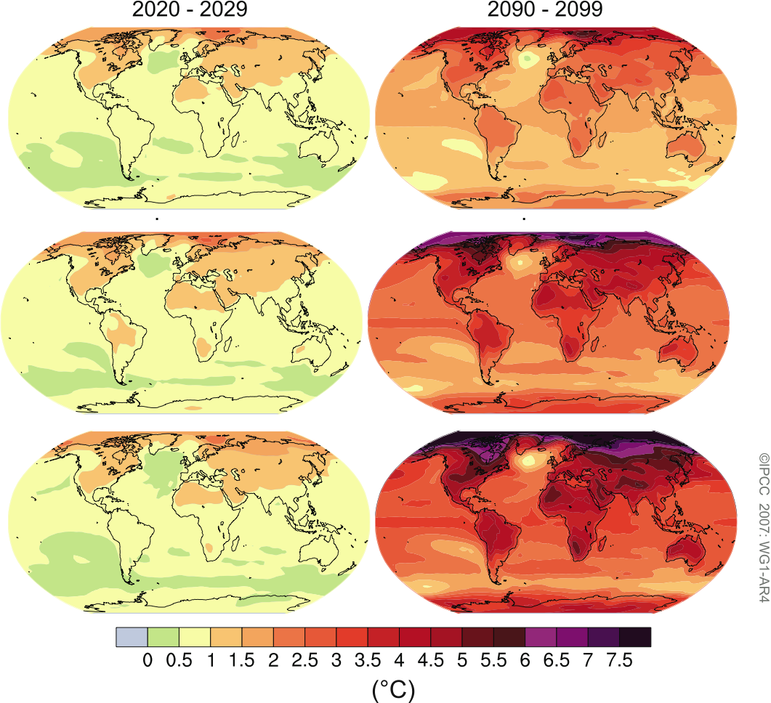
IPCC ARF World Impacts
Location of Changes
Best Case
Temperature changes not even across the world. The Arctic is already warming faster than the rest of Earth.
Likely Case
Worst Case

Slide 35
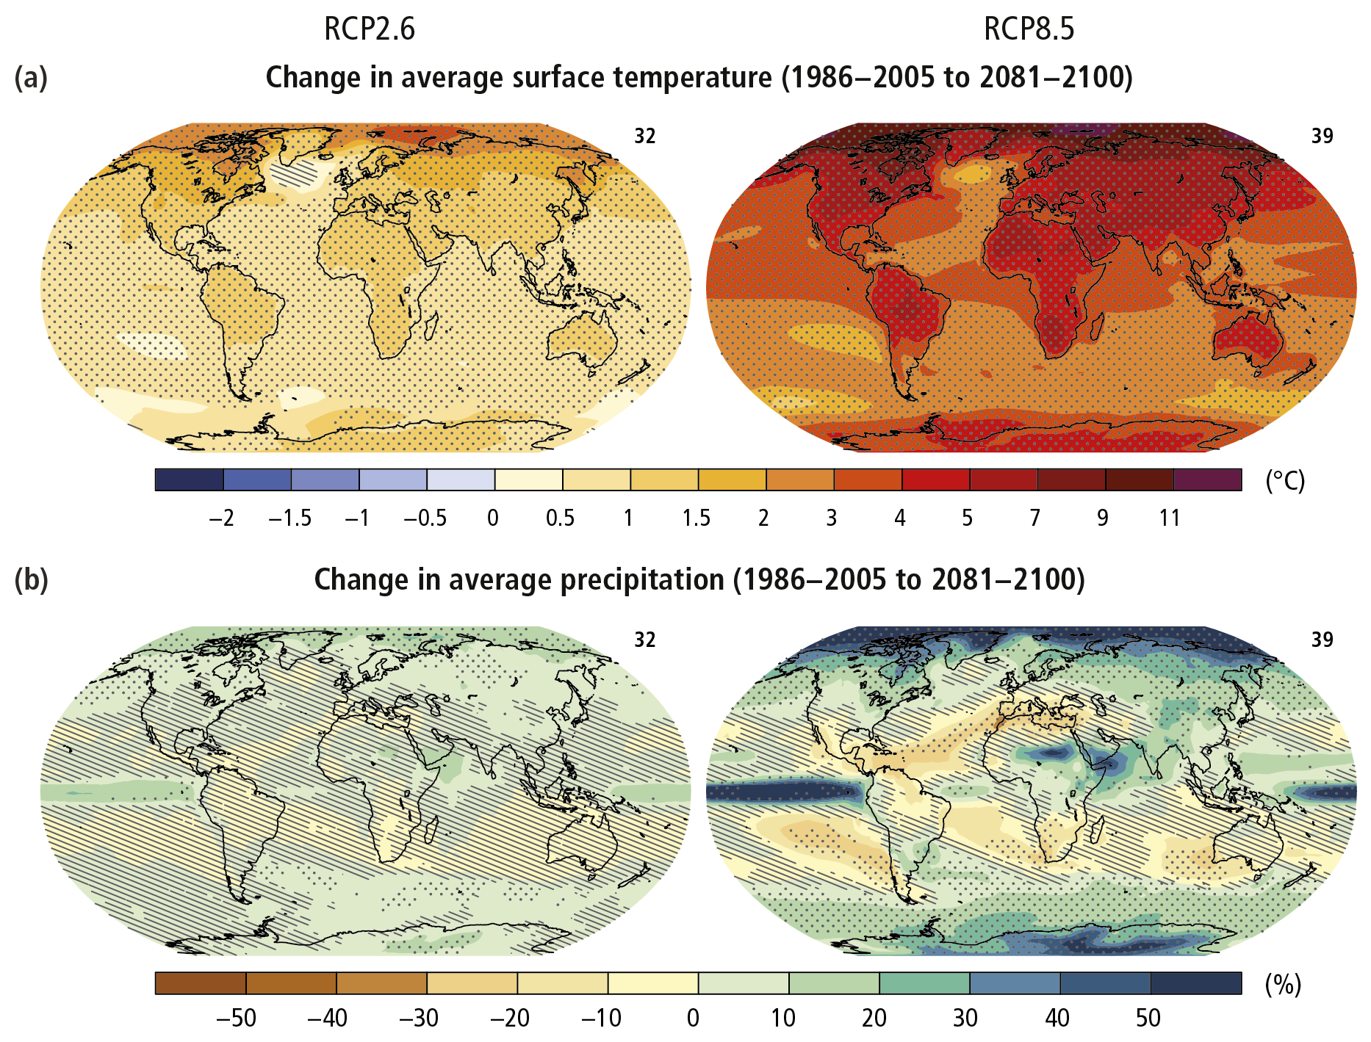
IPCC AR5
Temperature and Precipitation Changes
Best Case
Worst Case
Temperature
Precipitation: Floods & droughts

Slide 36
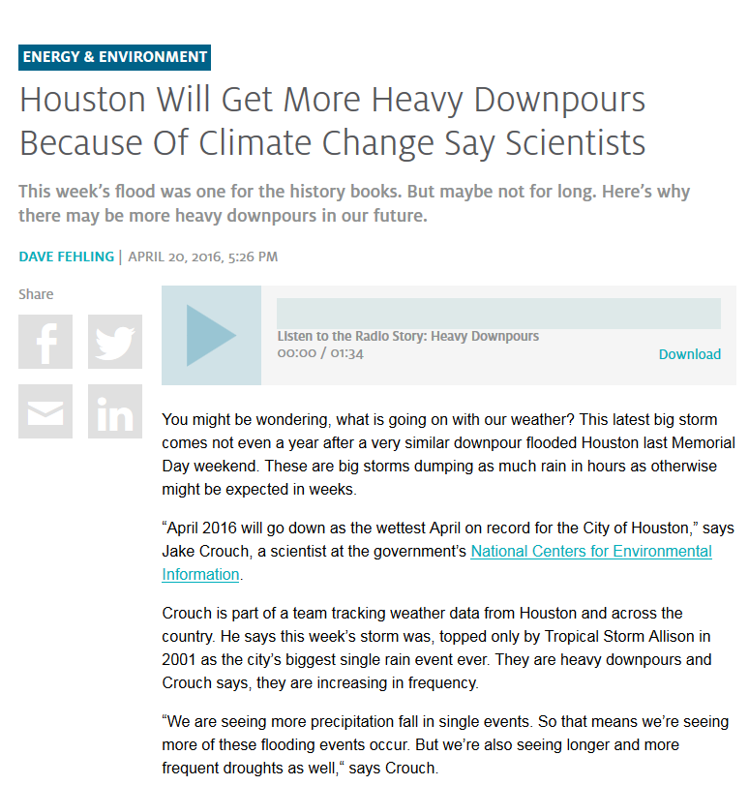
IPCC AR5
Houston Public Media News 88.7
Temperature and Precipitation Changes
Best Case
Worst Case
April 20, 2016
Temperature
Precipitation: Floods & droughts

Slide 37
Laudato Si, Chapter 1
Pollution & Climate Change
  Temperature and precipitation!
The Issue of Water
  Floods and droughts
Loss of Biodiversity
  animals & plants … and some human cultures
Decline in Quality of Life & Social Breakdown
  the first climate refugees are among us
Global Inequality
  who’s got the water?
Weak Responses
  and deliberate misinformation campaign
Variety of Opinions
  NOT on the science!!

Slide 38
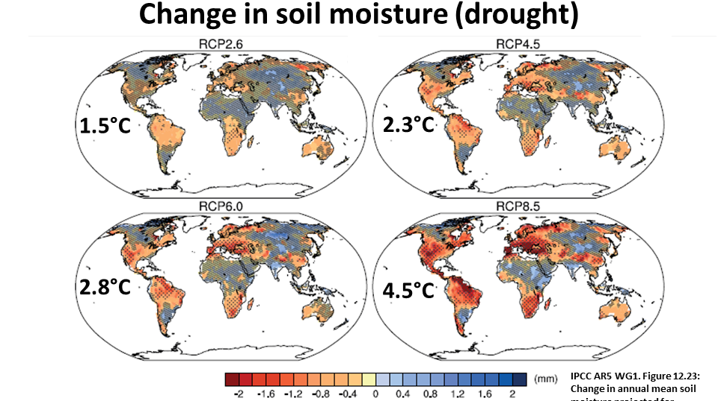
IPCC AR5
Drought
Best Case
Worst Case

Slide 39
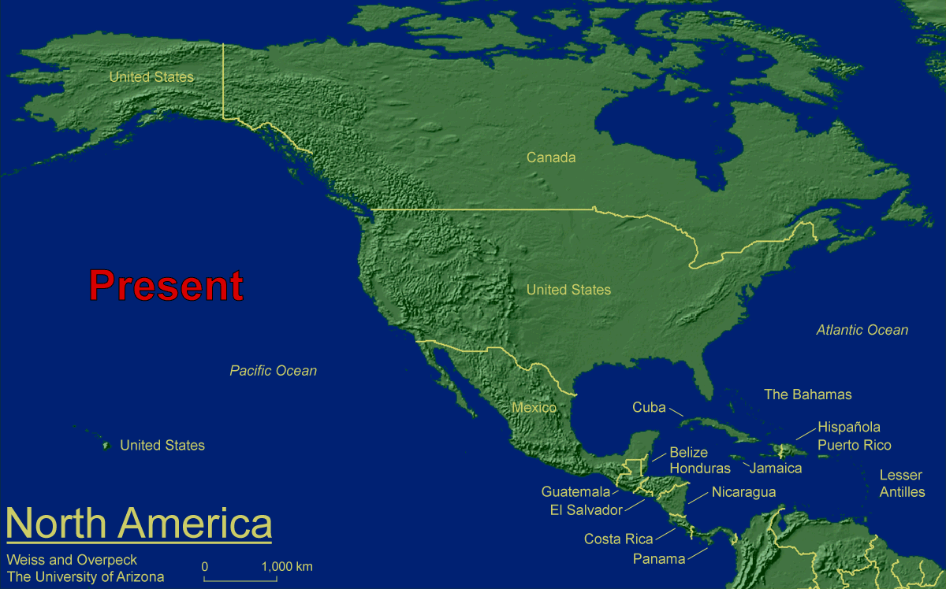

Seal Level Rise Maps

Slide 40
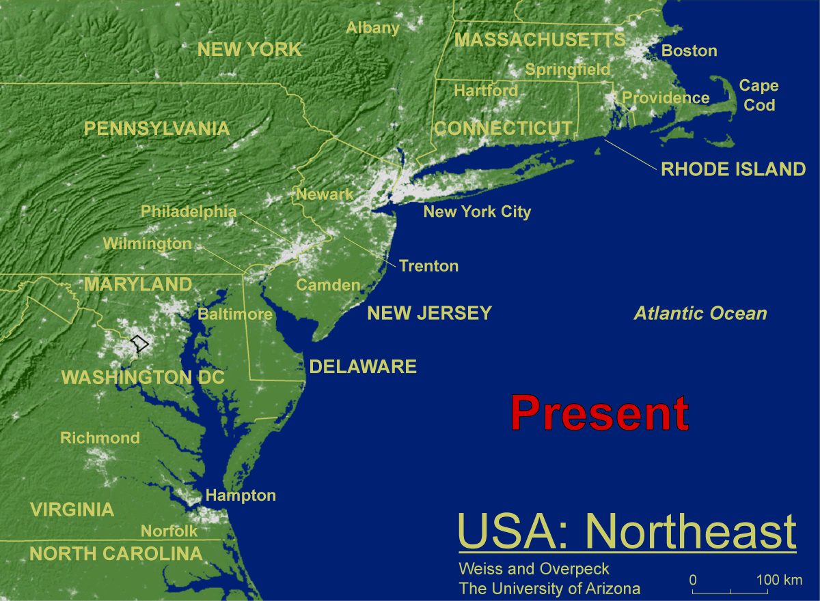
Seal Level Rise Maps

Slide 41
Laudato Si, Chapter 1
Pollution & Climate Change
  Temperature and precipitation!
The Issue of Water
  Floods and droughts
Loss of Biodiversity
  animals & plants … and some human cultures
Decline in Quality of Life & Social Breakdown
  the first climate refugees are among us
Global Inequality
  who’s got the water?
Weak Responses
  and deliberate misinformation campaign
Variety of Opinions
  NOT on the science!!

Slide 42
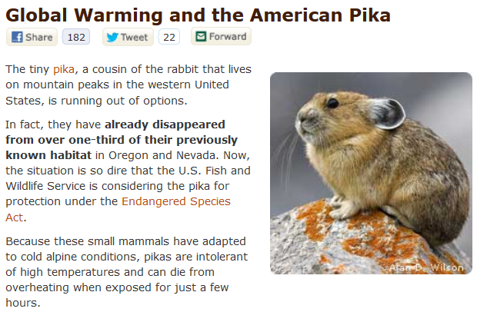
Laudato Si, Chapter 1
Pollution & Climate Change
  Temperature and precipitation!
The Issue of Water
  Floods and droughts
Loss of Biodiversity
  animals & plants … and some human cultures
Decline in Quality of Life & Social Breakdown
  the first climate refugees are among us
Global Inequality
  who’s got the water?
Weak Responses
  and deliberate misinformation campaign
Variety of Opinions
  NOT on the science!!

Slide 43
Laudato Si, Chapter 1
Pollution & Climate Change
  Temperature and precipitation!
The Issue of Water
  Floods and droughts
Loss of Biodiversity
  animals & plants … and some human cultures
Decline in Quality of Life & Social Breakdown
  the first climate refugees are among us
Global Inequality
  who’s got the water?
Weak Responses
  and deliberate misinformation campaign
Variety of Opinions
  NOT on the science!!

Slide 44
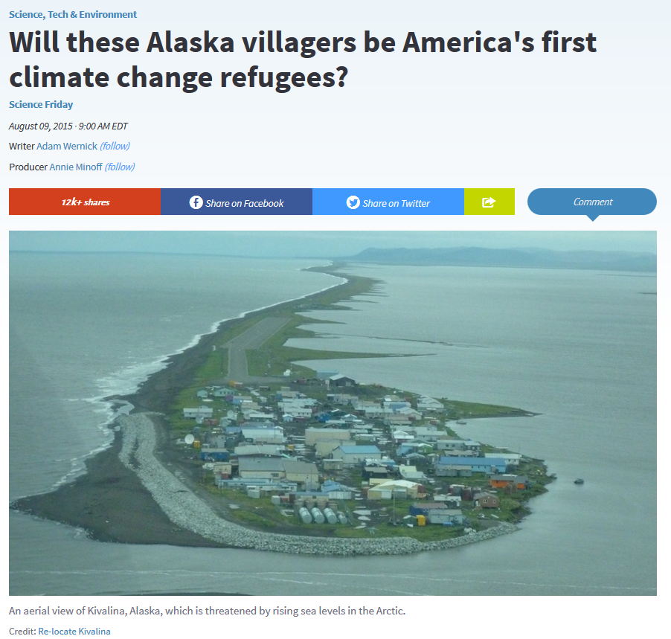
Climate Change Refugees
http://www.pri.org/stories/2015-08-09/will-residents-kivalina-alaska-be-first-climate-change-refugees-us

Slide 45
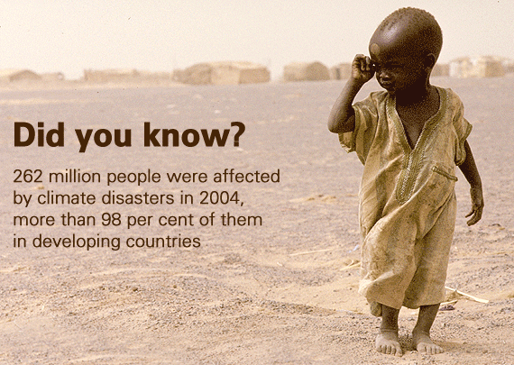
Climate Change Refugees
http://www.pri.org/stories/2015-08-09/will-residents-kivalina-alaska-be-first-climate-change-refugees-us

Slide 46
Laudato Si, Chapter 1
Pollution & Climate Change
  Temperature and precipitation!
The Issue of Water
  Floods and droughts
Loss of Biodiversity
  animals & plants … and some human cultures
Decline in Quality of Life & Social Breakdown
  the first climate refugees are among us
Global Inequality
  who’s got the water?
Weak Responses
  and deliberate misinformation campaign
Variety of Opinions
  NOT on the science!!

Slide 47
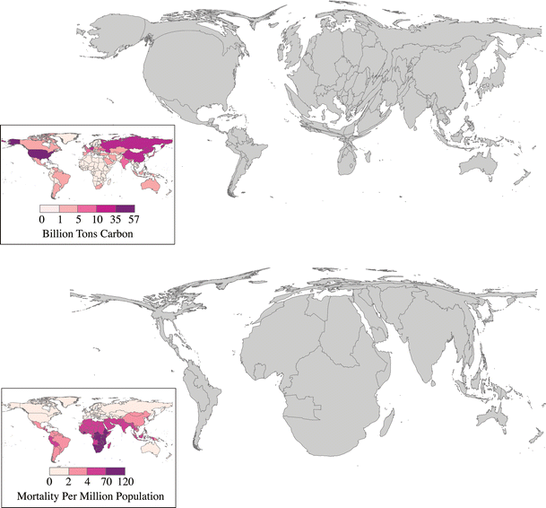
IPCC ARF
Location of Causes & Impacts:
Cumulative CO₂ emissions
A moral issue!
Health Effects
Deaths from malaria, malnutrition, diarrhea & inland flooding
Patz et al, EcoHealth 4, (Springer-Verlag: New York), pp. 397-405, 2007

Slide 48
Laudato Si, Chapter 1
Pollution & Climate Change
  Temperature and precipitation!
The Issue of Water
  Floods and droughts
Loss of Biodiversity
  animals & plants … and some human cultures
Decline in Quality of Life & Social Breakdown
  the first climate refugees are among us
Global Inequality
  who’s got the water?
Weak Responses
  and deliberate misinformation campaign
Variety of Opinions
  NOT on the science!!

Slide 49

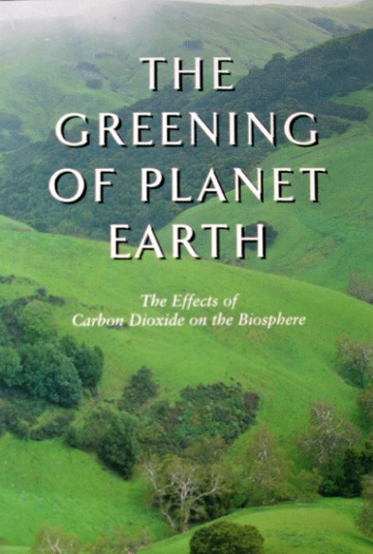
Denier Organizations
Denier Organizations
  Global Climate Coalition (1989-2002)
    Global warming real, too expensive to mitigate
    Environmentalism a plot to create world government
  Western Fuels Association
    Center for the Study of CO₂ & Global Change
    Greening Earth Society
      global warming good!
“… current CO₂ levels, which are 30 percent higher than in the pre-industrial era, have greatly enhanced the growth of trees and other plants … over the next century, (it) will increase crop yields by 30 to 40 percent, double the water-use efficiency of most of the earth's vegetation and possibly triple the productivity of forests.”

Slide 50



Denier Organizations
Denier Organizations
  Global Climate Coalition (1989-2002)
    Global warming real, too expensive to mitigate
    Environmentalism a plot to create world government
  Western Fuels Association
    Center for the Study of CO2 & Global Change
    Greening Earth Society
      global warming good!
“… current CO₂ levels, which are 30 percent higher than in the pre-industrial era, have greatly enhanced the growth of trees and other plants … over the next century, (it) will increase crop yields by 30 to 40 percent, double the water-use efficiency of most of the earth's vegetation and possibly triple the productivity of forests.”

Slide 51
Laudato Si, Chapter 1
Pollution & Climate Change
  Temperature and precipitation!
The Issue of Water
  Floods and droughts
Loss of Biodiversity
  animals & plants … and some human cultures
Decline in Quality of Life & Social Breakdown
  the first climate refugees are among us
Global Inequality
  who’s got the water?
Weak Responses
  and deliberate misinformation campaign
Variety of Opinions
  NOT on the science!!

Slide 52

How are we going to change our lifestyles to protect Earth and its creatures, including ourselves?

