Slide 1
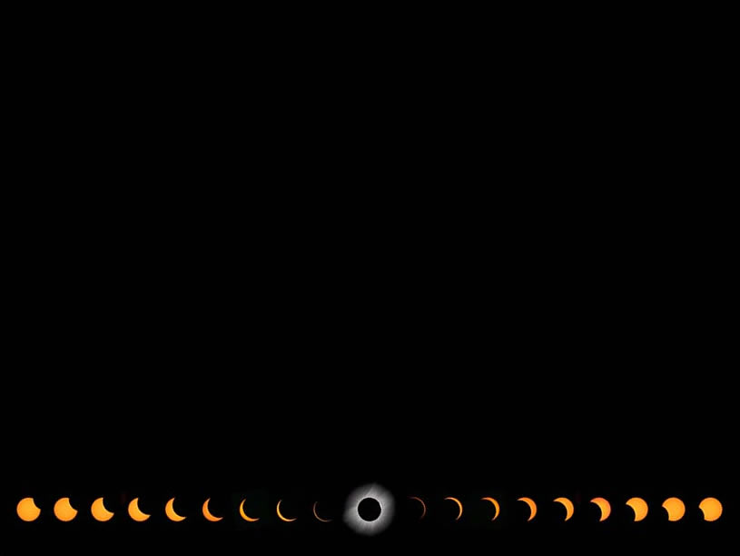



Announcements & Logistics
The Cosmos Within
Dr. Aileen A. O’Donoghue
August 19 – 21, 2017

Slide 2
My email aodonoghue@stlawu.edu
1st talk at http://myslu.stlawu.edu/~aodo/ spirituality/KS2017/1_Darkness.pptx
The Cosmos Within
Dr. Aileen A. O’Donoghue
August 19 – 21, 2017

Slide 3
Forces and Interactions
The Cosmos Within
Dr. Aileen A. O’Donoghue
August 19 – 21, 2017

Slide 4
The Incarnation
“The Word was coming into the world –
Was in the world –
and though the world was made through the Word,
the world didn’t recognize it.
Though the Word came to its own realm,
the Word’s own people didn’t accept it.
And the Word became flesh
and stayed for a little while among us;”
John 1:9-11,14
The Inclusive New Testament

Slide 5

Inspirited Bodies
“As we are inspirited bodies – living, loving, thinking bodies – so, imagining God in our image (for how else can we model God?), we speak of her as the inspirited body of the entire universe, the animating, living spirit that produces, guides and saves all that is.”
Sally McFague,
The Body of God (p.20)

Slide 6
Bodies Interacting: Forces
Defined by Isaac Newton
  Stuff Coasts
    (it takes a force to change motion)
    Stopping takes as much force as starting
  Force changes an object’s velocity
    (speed or direction)
    Straight ahead at same speed easiest
  Stuff pushes back
    (forces are always mutual and equal)
    Same force acts on both objects
If we knew the position and velocity of every particle in the universe at one time, we could predict their motions forever!

Slide 7
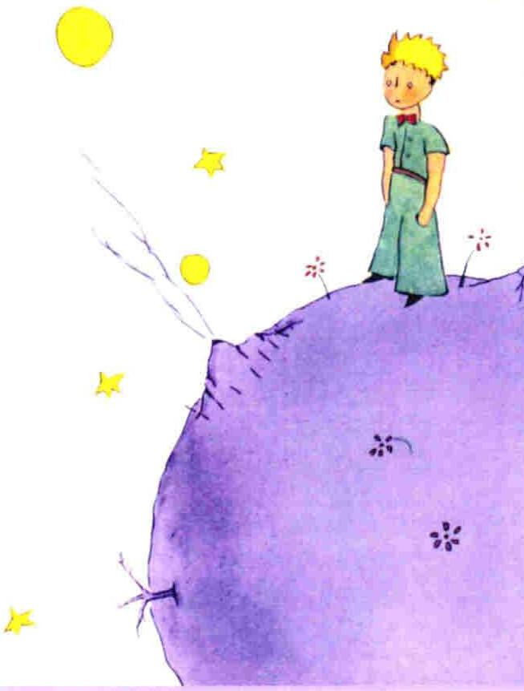
Gravity
All matter attracts all other matter …
Earth pulls on us, we pull on Earth just as hard!
We can see ourselves as either
  Stuck to Earth
    as it orbits the sun.
OR
  Orbiting the sun
    with Earth stuck to our feet.
Try to push it away!

Slide 8

Gravity: Fun with Your Mind!
Lie down on the grass
(or a chase lounge … maybe with a Gin & Tonic)
Look “up” at the stars …
Try to see yourself on the “bottom” of the Earth looking “down” at the stars held to the ground only by the bonds of gravity … which is the truth!
Weird? It gets weirder …

Slide 9
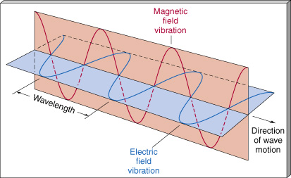
The Quantum Mechanical Universe
Light is an electromagnetic wave…

Slide 10
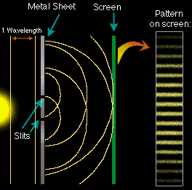
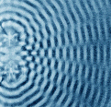
Light Interacts As A Wave
Light shows interference (addition of waves) and diffraction (bending around corners) like water waves.
+
+
=
=
crest + trough = zilch!
Stripes between almost touching fingers!
trough + trough
crest + crest

Slide 11
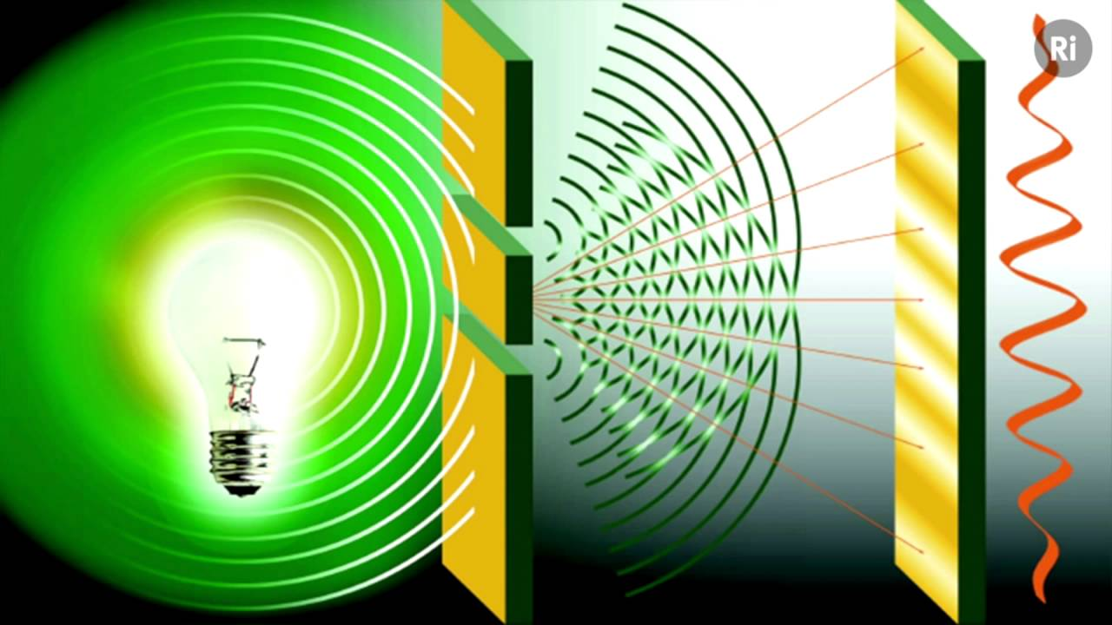
Light Interacts As A Wave
Light shows interference (addition of waves) and diffraction (bending around corners) like water waves.
+
+
=
=
Stripes between almost touching fingers!
But that’s not ALL light is …

Slide 12
Particles and Waves
Waves vs. Particles passing through slits
incoming waves
incoming particles
Waves add crest to crest & trough to trough (constructive ⇒ light spots)
Particles pile up under each slit.
Waves add crest to trough (destructive ⇒ dark spots)
Sequence of bright and dark spots.
Two bright spots.

Slide 13
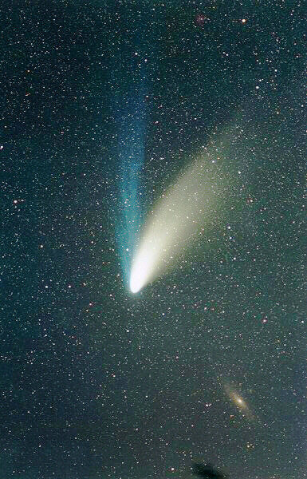
Light Acts As A Particle
Light pushes dust out of the solar system like a stream of particles.
Ion tail shaped by solar magnetic field.
Dust tail shaped by sunlight pushing dust away from the sun.
Hale-Bopp APOD 4/1/97

Slide 14
Wave-Particle Duality
Light is a wave AND a particle!
  Exists as both natures …
        until it interacts with matter.
  Manifests one nature
        appropriate to the interaction.
    Becomes a particle hitting comet dust.
    Becomes a wave passing through a slit.
How can it be BOTH at ONCE?
We don’t know … but it is!

Slide 15
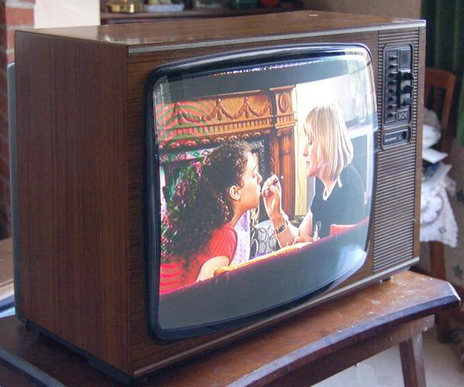
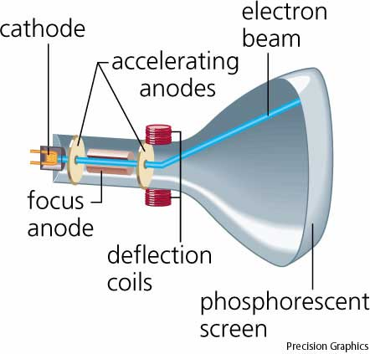
Wave-Particle Duality
Electrons act like particles (CRT’s)
  sweeping e⁻ beam creates TV pictures
    e⁻’s collide with phosphorescent molecules
    knock molecules into excited state
    light emitted when molecule falls to lower state

Slide 16



Wave-Particle Duality
Electrons act like waves
  Quantum Tunneling
    Energy barrier (insulator)
      reflects particles
      waves penetrate
High energy
        waves exist everywhere … can find position beyond barrier
        like oranges spontaneously
        leaving fruit bowl
        but oranges are too big!
        … only subatomic particles do this!
Lower energy

Slide 17
The Structure of Matter
Quantum Tunneling
  Tunneling probability
    tiny for even side
    Increases for lower
    energy on far side

Slide 18
The Structure of Matter
Flash Memory
  Storing (No Power)
    Both sides at same energy
          low probability of tunneling
          2/3 of charge leaks off in 100 years
            (Prob. of any e⁻ tunneling ~10⁻²³)
  Writing/Erasing (With Power)
    One side at lower power
          increase probability of tunneling
          2/3 of charge leaks off in μ-second
            (Prob. of any e⁻ tunneling ~10⁻⁵)

Slide 19
Wave-Particle Duality
Matter is a wave AND a particle!
  Exists as both natures …
        until it interacts with matter.
  Manifests one nature
        appropriate to the interaction.
    Becomes a particle hitting TV screen.
    Becomes a wave in Flash memory.
How can it be BOTH at ONCE?
We don’t know … but it is!

Slide 20
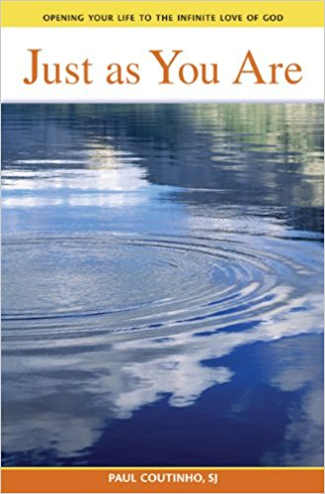
Sin-Grace Duality
But amazingly, when we find our root sin, we will also find our root grace. Our root grace is the same energy of our root sin channeled in a positive direction. The root sin and the root grace are linked.
-Paul Coutinho, SJ, Just as You Are
How can they share a root?
We don’t know … but they do!

Slide 21
Wave-Particle Duality
“The essential marvel of the divine milieu is the ease with which it assembles and harmonizes within itself qualities which appear to us to be contradictory.”
Pierre Teilhard de Chardin
The Divine Milieu

Slide 22
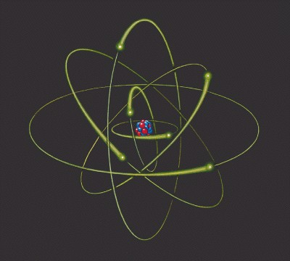
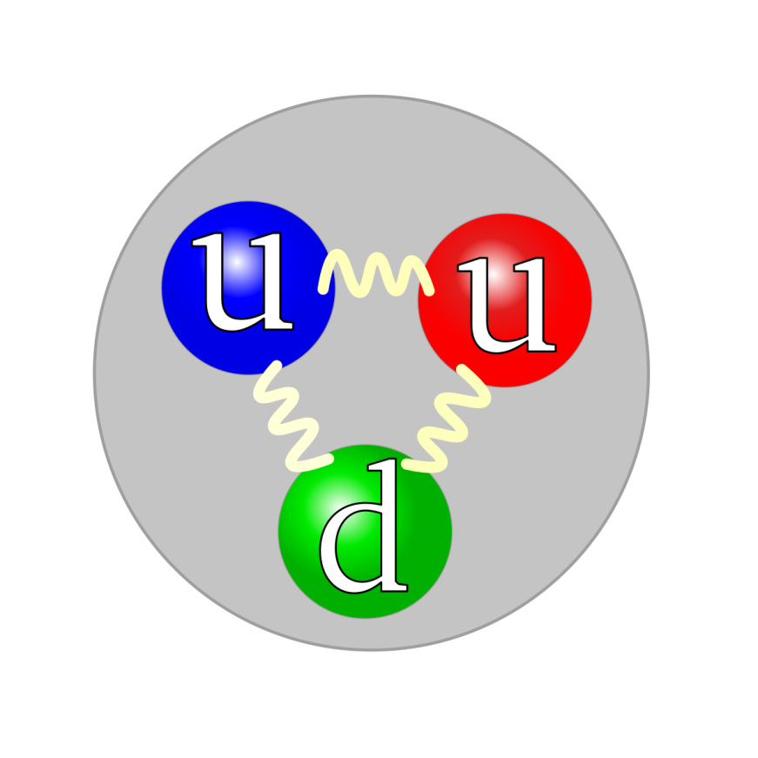
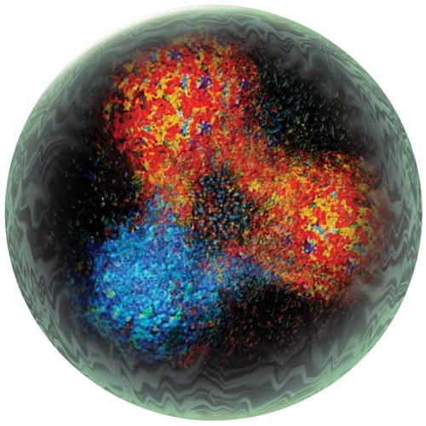
The Structure Of Matter
… at the Subatomic Scale
Protons & Neutrons in Nucleus are made of Quarks held together dynamically by the exchange of gluons.
Gluons are active, like springs.
… but fuzzier

Slide 23
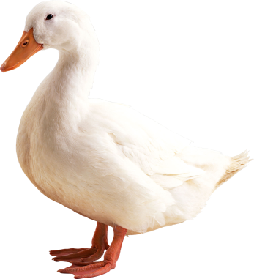
Quarks: Fundamental Constituents of Matter
Quark! Quark!
Quarks cannot exist alone
  Decay if alone
  Carry 1/3 or 2/3 of an electric charge
  Exist only in relationship to other quarks to create protons, neutrons, atoms, …, all matter
Matter, at its most fundamental level, must exist in relationship to exist at all!

Slide 24

Beatrice Bruteau: God’s Ecstasy
God Exists as “The One.”
  Absolute,
  Infinite,
  Necessary to all other existence,
  Exists in every possible way of being …
… must also exist as “The Many.”
God, the Ground of All Being, must exist in relationship to exist at all.

Slide 25
God: The Ground of All Being
Beatrice Bruteau
“Being is really Be-ing; it is not really a noun but a verb. ... To-exist is dynamic, not static.”
“Dynamic be-ing means more-being, being more. Endlessly more. Every kind of “more.”
Being must be both one and many.”

Slide 26
God’s Ecstasy
Beatrice Bruteau
“The Trinity is both one and many; Being is present there as Persons; the Persons are necessary and infinite; the Persons are both enstatic and ecstatic; and the Persons are Being-communicating”
The Universe is God’s Ecstasy

Slide 27
Hymn to Matter
“I bless you, matter, and you I acclaim: not as the pontiffs of science or the moralizing preachers depict you … but as you reveal yourself to me today, in your totality and your true nature …

Slide 28

Hymn to Matter
I acclaim you as the diving milieu, charged with creative power, as the ocean stirred by the Spirit, as the clay molded and infused with life by the incarnate Word.”
Pierre Teilhard de Chardin

Slide 29
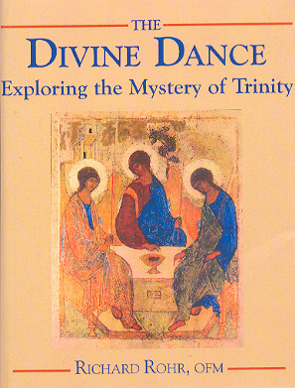
Trinity
Perichoresis = Dancing
  Developed by “Eastern Fathers”
    Didymous the Blind (313-398)
    Basil the Great (329-379)
    Gregory of Nazianzus (325-389)
“Whatever is going on in God is a flow that’s like a dance
and God is not a dancer,
God is the dance, itself.”
- Richard Rohr

Slide 30

Perichoresis: Divine Dance
Relationship is the theology of the Trinity
  God for us – Father: Total Giving
  God with us – Son: invites us into the dance
  God within us – Holy Spirit: allows someone else to love through us – participation in God
“Whatever is happening in God cannot be just an inner, hidden secret. It has to be reflected in the outer universe”
- Catherine LaCugna
© Copyright, Dr. Aileen O’Donoghue, St. Lawrence University

Slide 31
So what have we learned?
The universe dances.
God IS the dance.
So dance!

Slide 32
My Dancing Day
Traditional English Carol (c. 1400-1700)
Tomorrow shall be my dancing day, I would my true love would so chance To see the legend of my play, To call my true love to my dance
Then was I born to a virgin pure. From her I took fleshy substance. Thus was I knit to human nature To call my true love to my dance.
In a manger laid and wrapped I was, So very poor this was my chance. Betwixt an ox and a silly poor ass To call my true love to my dance.
Then later on baptized I was. The holy ghost on me did glance. The Father’s voice heard from above, To call my true love to my dance.
Sing O my love, O my love, my love, my love, my love,
This have I done for my true love.

Slide 33
Dance with the Universe
In every breath, every touch, every perception, matter & energy interact in space and time in the universe …
Your body is dancing with the universe …
Let your spirit dance with the universe and God!

