Slide 1



Announcements & Logistics
The Cosmos Within
Dr. Aileen A. O’Donoghue
August 19 – 21, 2017

Slide 2
My email aodonoghue@stlawu.edu
2nd talk at http://myslu.stlawu.edu/~aodo/ spirituality/KS2017/2_Forces.pptx
The Cosmos Within
Dr. Aileen A. O’Donoghue
August 19 – 21, 2017

Slide 3
Sunlight, Starlight & Grace
The Cosmos Within
Dr. Aileen A. O’Donoghue
August 19 – 21, 2017

Slide 4
Starlight and Grace
“Through the Word
all things came into being,
and apart form the Word
nothing came into being
that has come into being.
In the Word was life,
and that life was humanity’s light –
a Light that shines in the darkness,
a Light that the darkness has never overtaken.”

Slide 5
Seeing the Light
All we know of the universe is from light.
Light of all wavelengths falls everywhere all the time, filled with information.
We must learn to see the light …

Slide 6
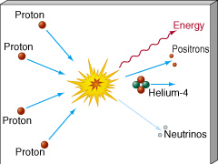
Source of the Light
Nuclear Fusion
  Light elements combine to make heavy elements.
Hydrogen fuses to Helium
Stars are nuclear explosions contained by gravity!

Slide 7
Fusion Releases Energy
Mass of 4 H atoms = 4 x (1.007940 amu)
= 4.031760 amu
Mass of 1 He atom = 4.002602 amu
Difference (loss) = 0.029158 amu
= 0.7 % of H
0.7% of mass DISAPPEARS!
Where does it go?
E = mc²
Energy!

Slide 8
Energy Of Fusion: Star Power
Convert 1 kg of H to He:
  0.7% ( = 7 grams) becomes energy
  by E = mc²,
  (0.007 kg)x(3.0 x 10⁸ m/s)² = 630 trillion joules
  = 175 x 10⁶ kWhr
  Fusing 1 kg of Hydrogen to Helium yields 175 MILLION kWhr of energy!!!!

Slide 9
Energy Of Fusion: Bring it Home
  1 kg of H to He = 175 x 10⁶ kWhr
  Kansas 2015 Energy Use = 317 x 10⁹ kWhr
  Fusing 5,774 kg of H to He could supply Kansas’ total energy for 1 year! (at 100% efficiency)
  Fusing 1,460 kg of H to He could replace coal energy for 1 year … but probably not the jobs ...
https://www.eia.gov/state/seds/seds-data-complete.php?sid=US#Consumption

Slide 10
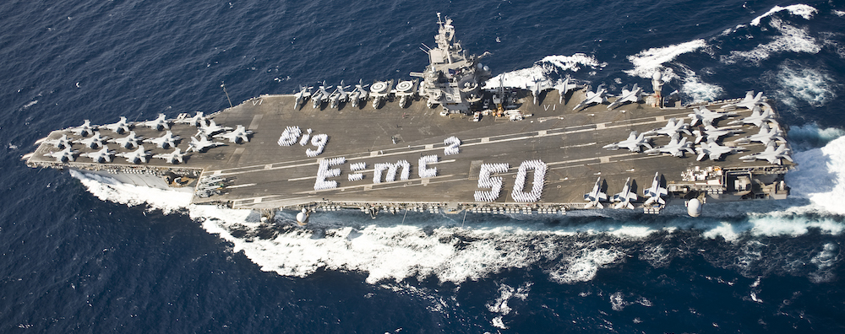
Energy Of Fusion: Power of Sol
  Total Luminosity = 3.83 x 10²⁶ W
  Energy from one fusion = 8.94 x 10⁻¹² J
  1 W = 1 J/sec
  Sun fuses = 5.98 x 10¹¹ kg of H/sec
  598,000,000,000 kg
  That’s 6070 aircraft carriers of H per sec. …
  … and 5774 kg would supply Kansas for a year!

Slide 11
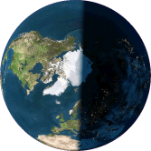
Abundance of Sol’s Energy
  Emitted energy = expanding spheres of energy 1 second thick
  Energy spreads over surface of sphere 1 second thick
r_{Sol} = 93 million miles
  Energy falling on entire Earth
= 0.0000005% of what Sun emits!
5/10 millionths of Sun’s Energy powers Earth!

Slide 12
God’s Love is as Abundant as Sunlight
“Are not five sparrows sold for two pennies? Yet not one of them is forgotten in God's sight. But even the hairs of your head are all counted. Do not be afraid; you are of more value than many sparrows.”
Luke 12:6-7

Slide 13
The Breadth Of The Spectrum
Different types of light arise from
  different energies
  different processes
  different objects
Energy
  Planck’s Constant h = 6.623 X 10⁻³⁴ J-s
Planck’s Constant
Frequency of the light
TINY!! This is why quantum effects are hard to study!
0.0000000000000000000000000000000006623 J-s

Slide 14
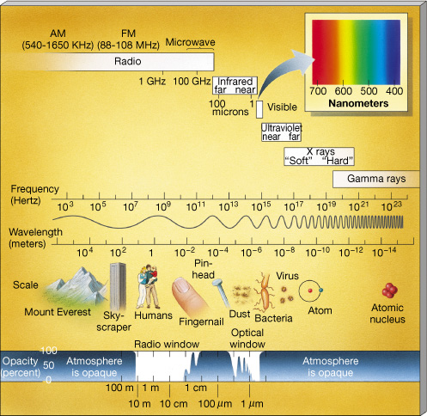
The EM* Spectrum
High Energy ⇒ high frequency, short wavelength
Microwaves are short radio waves
*ElectroMagnetic

Slide 15
Timeline Of Observatories
1609 First Telescope
1880 First Photos (of Orion Nebula)
1937 First Radio Telescope
1961 First Gamma-Ray Detection In Orbit
1965 First X-Ray Telescope In Orbit
1983 First Imaging IR Telescope In Orbit
1978 First Imaging X-Ray Observatory
1991 First Imaging γ-ray Observatory
Telescopic views of the universe are still very new!

Slide 16
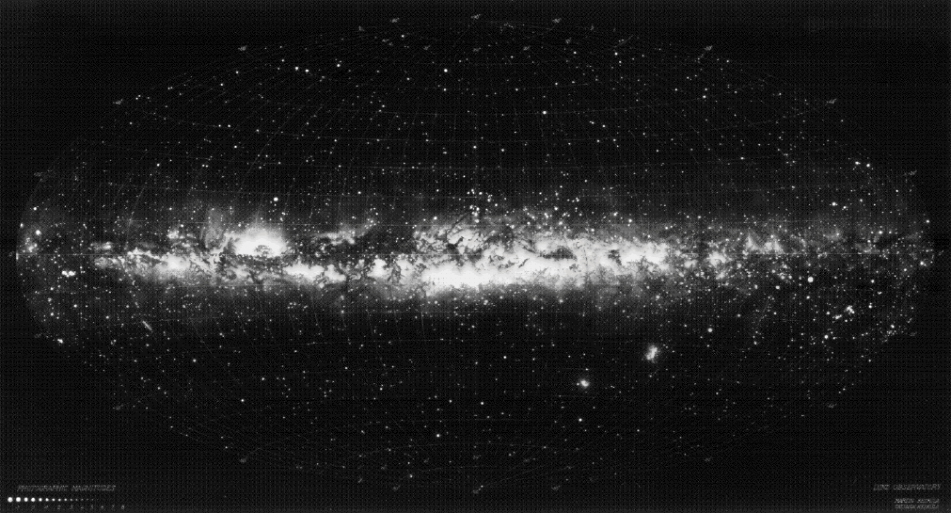
The Visible Sky
… stars, gas, & dust
Pollux
Castor
Vega
Antares
Procyon
Orion
Magellanic Clouds

Slide 17
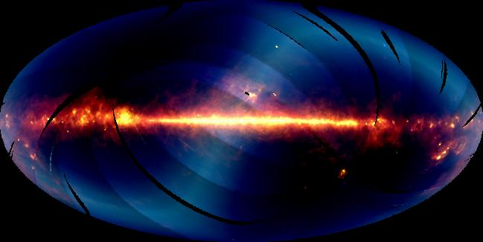
The Infrared Sky
… star formation & solar system dust
Solar system dust
Orion Nebula
Large Magellanic Cloud

Slide 18
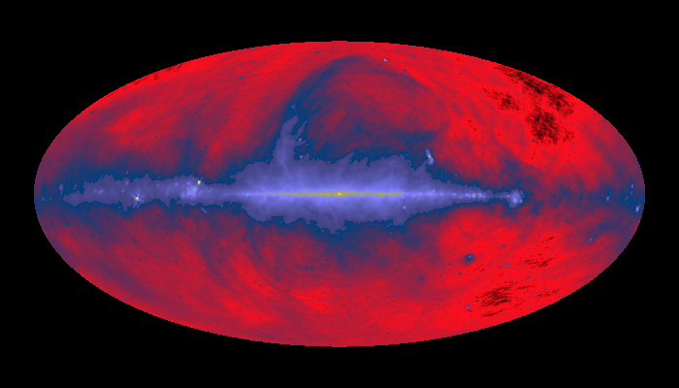
The Radio Sky
… atomic hydrogen & warm gas
Nearby gas bubble
Orion Nebula
Large Magellanic Cloud

Slide 19
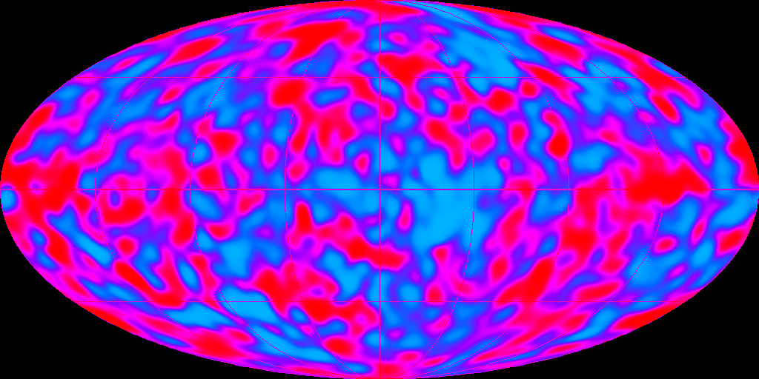
The Microwave Sky
The Echo of the Big Bang
Red = warmish
Blue = coolish
Differ by 1000ths of a degree!

Slide 20
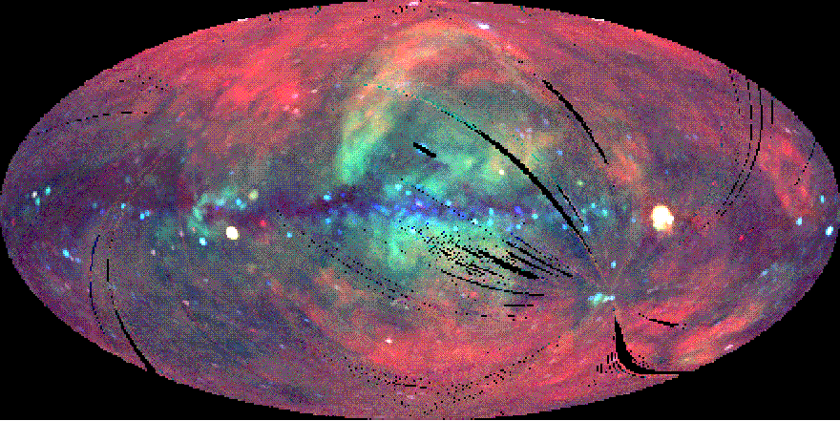
The X-Ray Sky
… very HOT gas halo
Red = low energy
Green = moderate energy
Blue = high energy
Supernova remnant kyr old
Black hole candidate in Cygnus
Large Magellanic Cloud

Slide 21
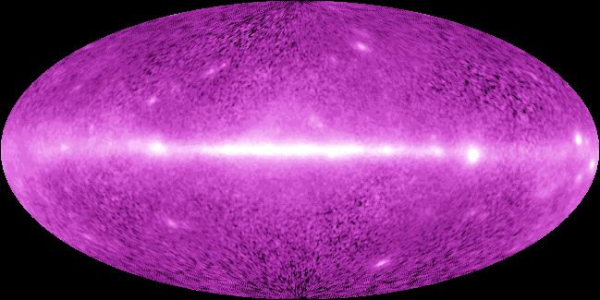
The γ-Ray Sky
… extremely energetic events
Stellar collisions, stars falling into black holes, stars exploding …

Slide 22
The Breadth of God’s Grace
“May Christ dwell in your hearts through faith, so that you , being rooted and grounded in love, will be able to grasp fully the breadth, length, height and depth of Christ’s love and, with all God’s holy ones, experience this love that surpasses all understanding, so that you may be filled with all the fullness of God. ”
Ephesians 3:18-19

Slide 23
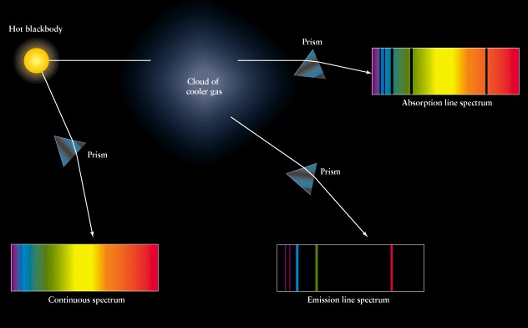
The Depth Of The Spectrum
Bright and Dark Lines Appear In Spectra
Absorption Spectrum: Opaque object seen through cloud of gas.
Continuous Spectrum: Glowing opaque object
Emission Spectrum: Glowing cloud of gas.

Slide 24
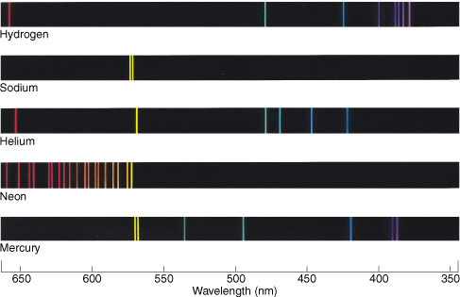
Spectral Lines
Each Element Emits Unique Set of Lines

Slide 25
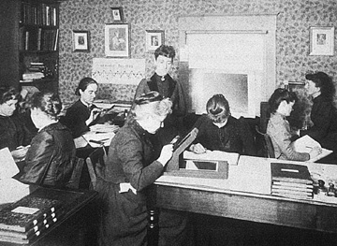
Spectra Of The Stars
Early spectra catalogued & analyzed mostly by women!
At Harvard College Observatory

Slide 26
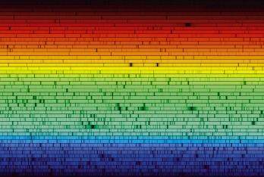
Spectra Of The Stars
The Solar Spectrum

Slide 27
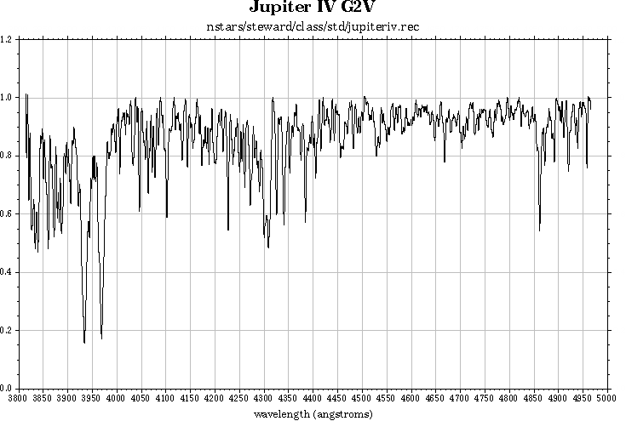
Spectra Of The Stars
The Spectrum Of the Sun (5800 °C)
Hydrogen Line
Calcium Lines

Slide 28
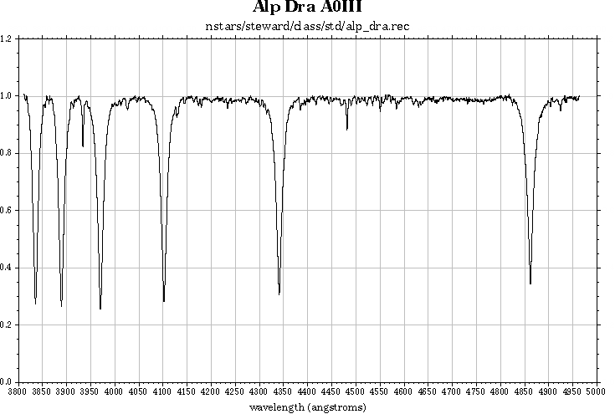
Spectra Of The Stars
The Spectrum Of Thuban (9800 °C)
Hydrogen Line
Calcium Line

Slide 29
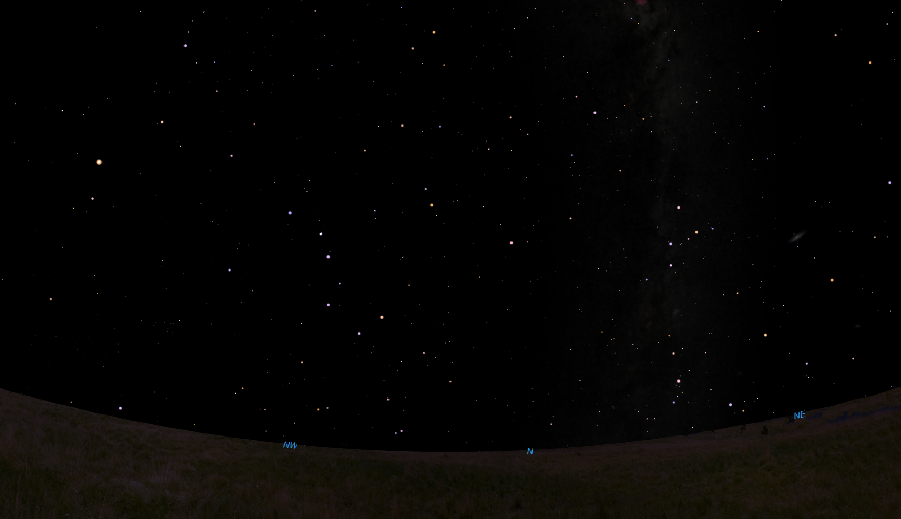
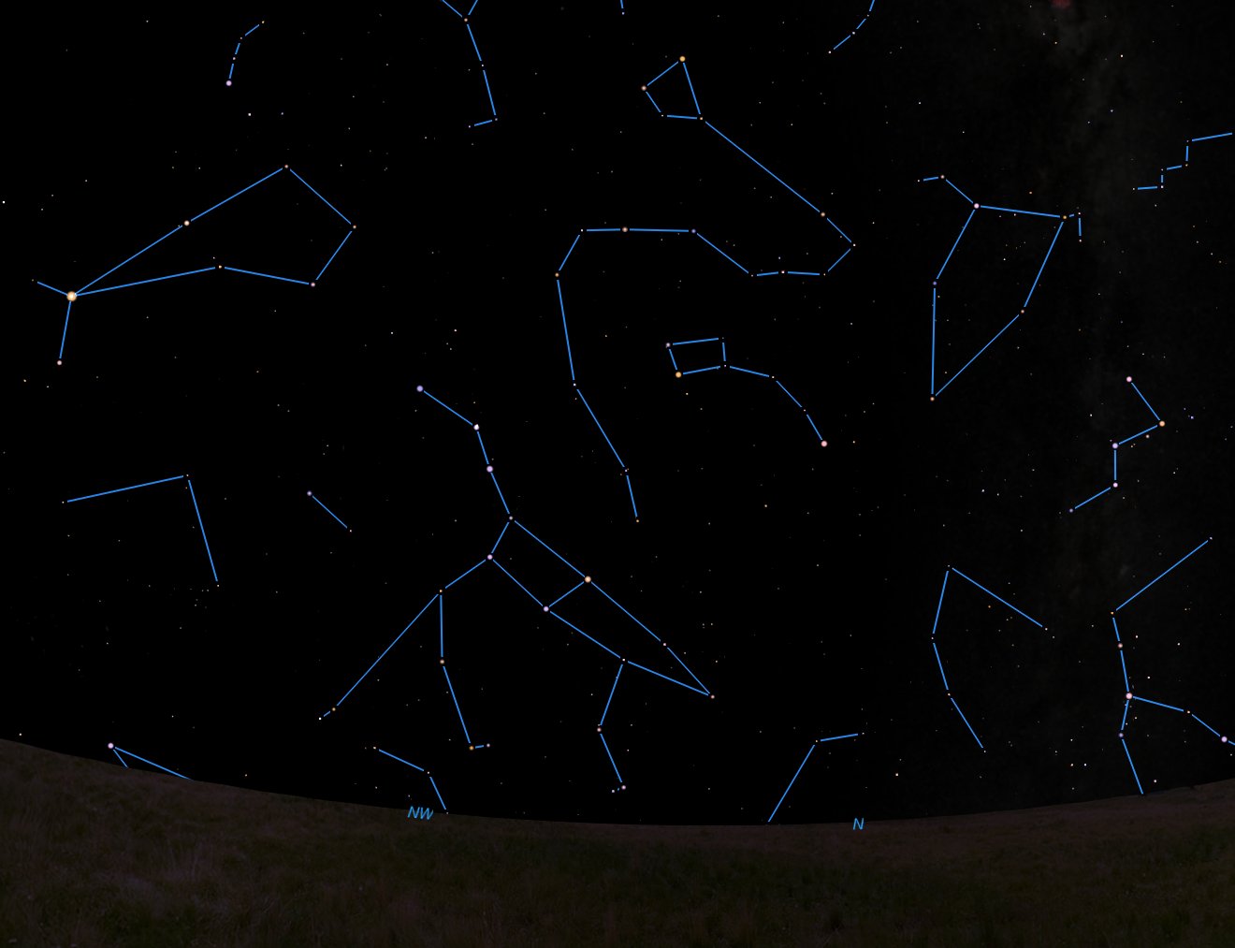
Thuban: α Draconis
Pole star in 2700 BCE, used by Egyptians
Arcturus
Boötes
Draco
Cephus
Thuban
Little Dipper
Arc to Arcturus
Polaris
Cassiopeia
Pointers to Polaris
Big Dipper
10:00 pm August 19, looking north northwest from Atchison

Slide 30
Spectra Of The Stars
Tell us
  Chemical Composition
    Helium first discovered in spectrum of the Sun!
  Temperatures
    3000K to 40,000K
    First determined by Cecila Payne-Gaposchkin
    (first PhD through HCO for anyone!)
Spectra tell us the chemistry and temperatures of the stars!
… but there’s MORE …

Slide 31
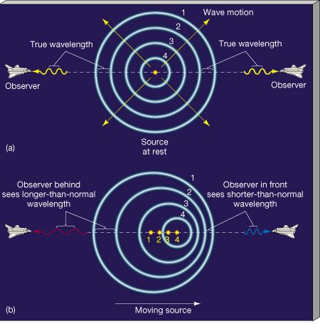
Doppler Shift
Waves are squashed or stretched by motion of the source …
✰ Horn of a passing car
Light of a moving
star or galaxy

Slide 32
Doppler Shift
We know the wavelength for no motion
  Measure wavelength shift
  Calculate velocity of object with respect to us
Really easy to measure!
Difference between proper and shifted wavelength
Speed of object
Speed of light
Proper wavelength

Slide 33
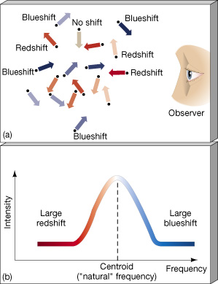
Spectral Lines
Breadth of Lines Gives Range of Speeds
Small stars: large range (wide lines)
Large stars: small range (narrow lines).
Spectra tell us the sizes of stars!

Slide 34
Spectra Of The Galaxies
Expansion of the Universe
All galaxy spectra are redshifted
  ⇒All galaxies are moving away
More distant galaxies more redshifted
  ⇒More distant moving faster

Slide 35
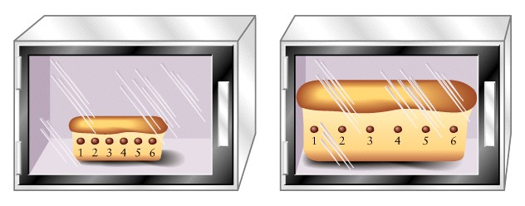
Spectra Of The Galaxies
Expansion of the Universe
As space expands, more distant objects move away faster.

Slide 36
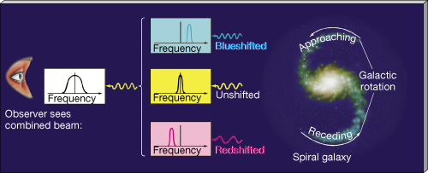
Spectra Of The Galaxies
Rotation creates red and blue shifts
  Shift tells us rotational speed
  Rotational speed tells us the mass of the galaxy by Newton’s laws!
Spectra tell us the masses of galaxies!

Slide 37
The Gift Of Starlight
The universe has been gratuitously showering us with information
about its objects, history, and origin since the Earth formed!
We only started finding this information in the past few centuries.
What else could we be missing?

Slide 38
God’s Gift Of Love
Ignatian 4th Week: Contemplation on the Love of God
4th Point: “God’s love shines down upon me like the light rays from the sun … Just as I see the sun in its rays, so God pours forth a sharing in divine life in all the gifts showered upon me. God’s delight and joy is to be with the ones called God’s children.”
-- David L. Fleming, S. J.
Draw Me Into Your Friendship

Slide 39
God’s Gifts of Grace
In your life, what is the
  Abundance of God’s grace?
    Gifts you might overlook?
  Breadth of God’s grace?
    Immanence to Transcendence
    In a single flower and distant galaxies
  Depth of God’s grace?
    What must you look deeply to see?
    God’s “hidden” actions?

