Slide 1



Introduction & Logistics
The Cosmos Within
Dr. Aileen A. O’Donoghue
August 19 – 21, 2017

Slide 2
The Substance of Ourselves
The Cosmos Within
Dr. Aileen A. O’Donoghue
August 19 – 21, 2017

Slide 3
Evening Came …
“As the universe expanded and cooled, darkness descended,

Slide 4
…And Morning Followed
“Then light dawned anew with the formation of the first stars.
Each star is a nuclear furnace where matter is coaxed into releasing a little of the energy it inherited from the primordial fireball.”
Timothy Ferris
The Creation of the Universe

Slide 5
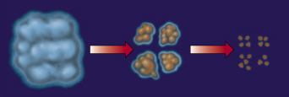
Starbirth
Interstellar clouds collapse under gravity and fragment into a cluster of denser clouds that continue collapsing.

Slide 6
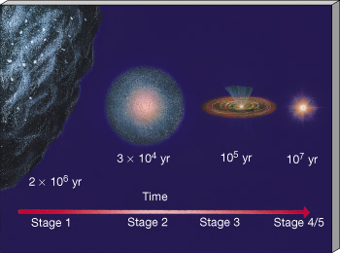
Starbirth
Interstellar cloud fragments collapse under gravity to form stars.

Slide 7
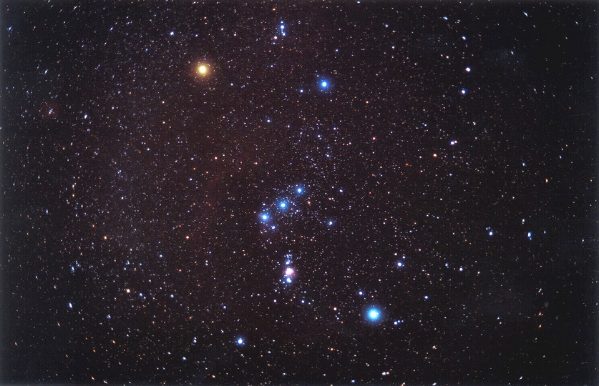
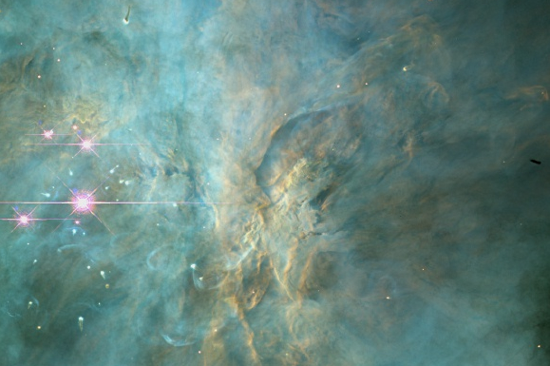
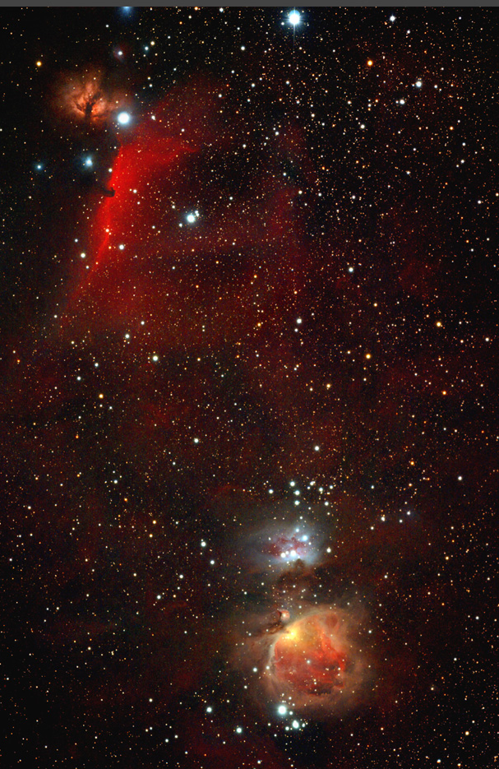
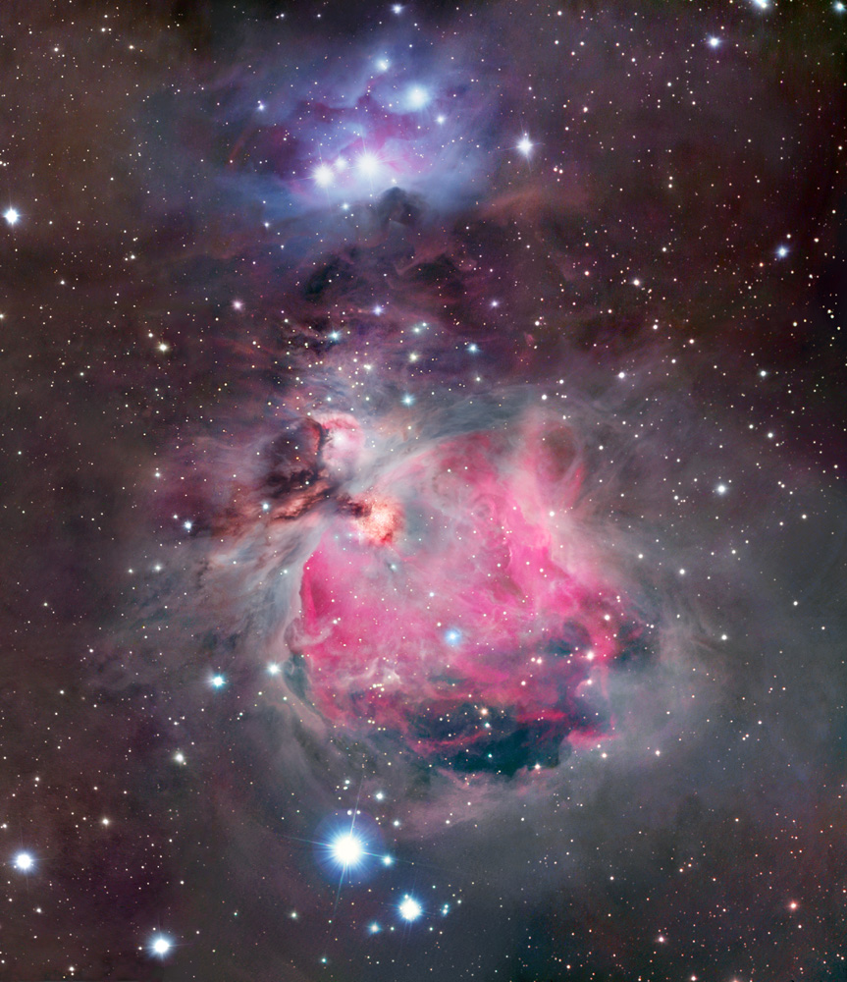
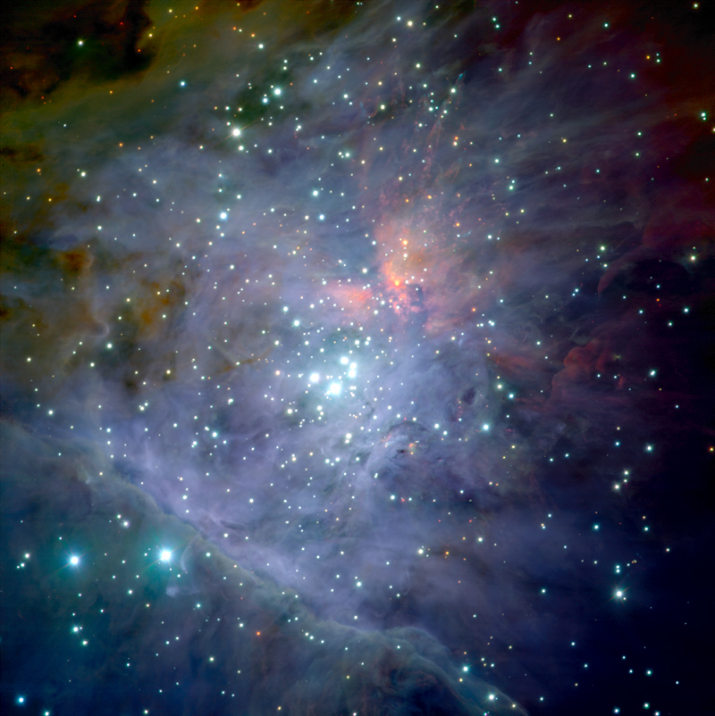
Starbirth Regions
Orion Nebula
Hot, giant stars illuminate nebula … lots of UV!
Thick, dusty disks protect forming stars & planetary systems

Slide 8
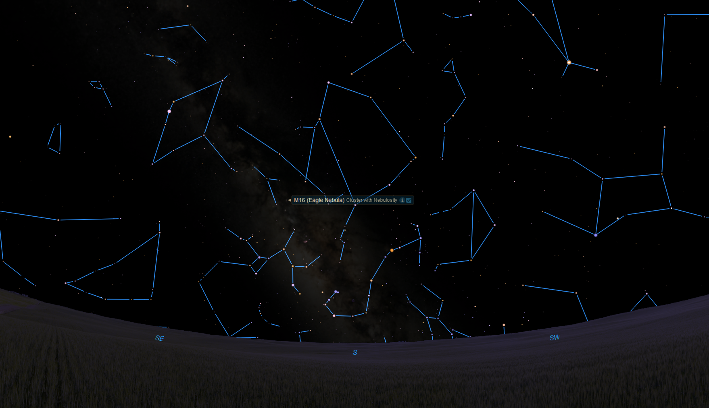
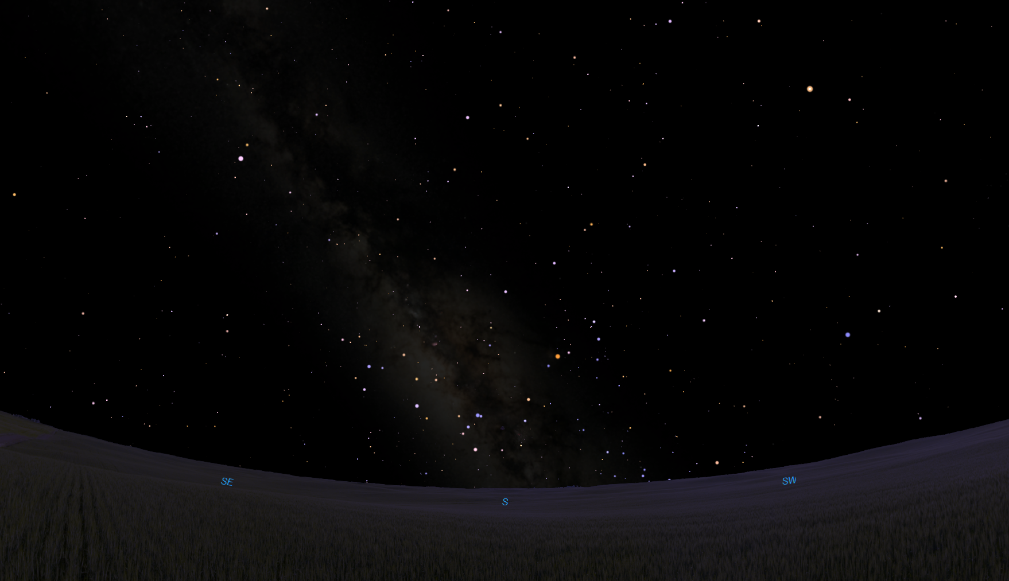
Starbirth In The Eagle Nebula
Tarazed
Altair
Aquila
Ophiuchus
Libra
Scutum
Saturn
Antares
Sagittarius (The Teapot)
Scorpius
Atchison’s southern sky at 8:40 pm, August 19, 2017

Slide 9
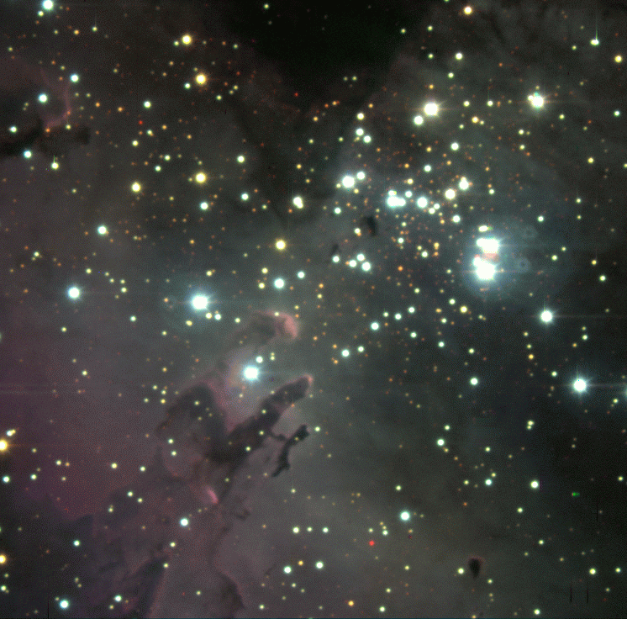
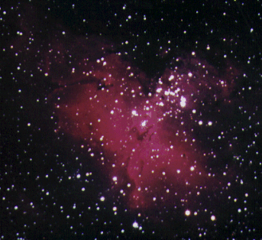
Starbirth In The Eagle Nebula
Tarazed
Altair
Aquila
Ophiuchus
Libra
Scutum
Saturn
Antares
Sagittarius (The Teapot)
Scorpius
Atchison’s southern sky at 8:40 pm, August 19, 2017

Slide 10
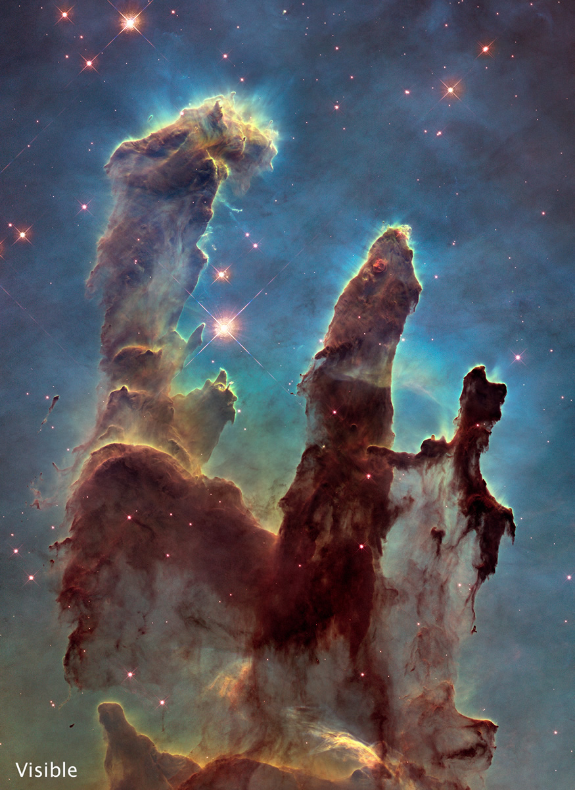
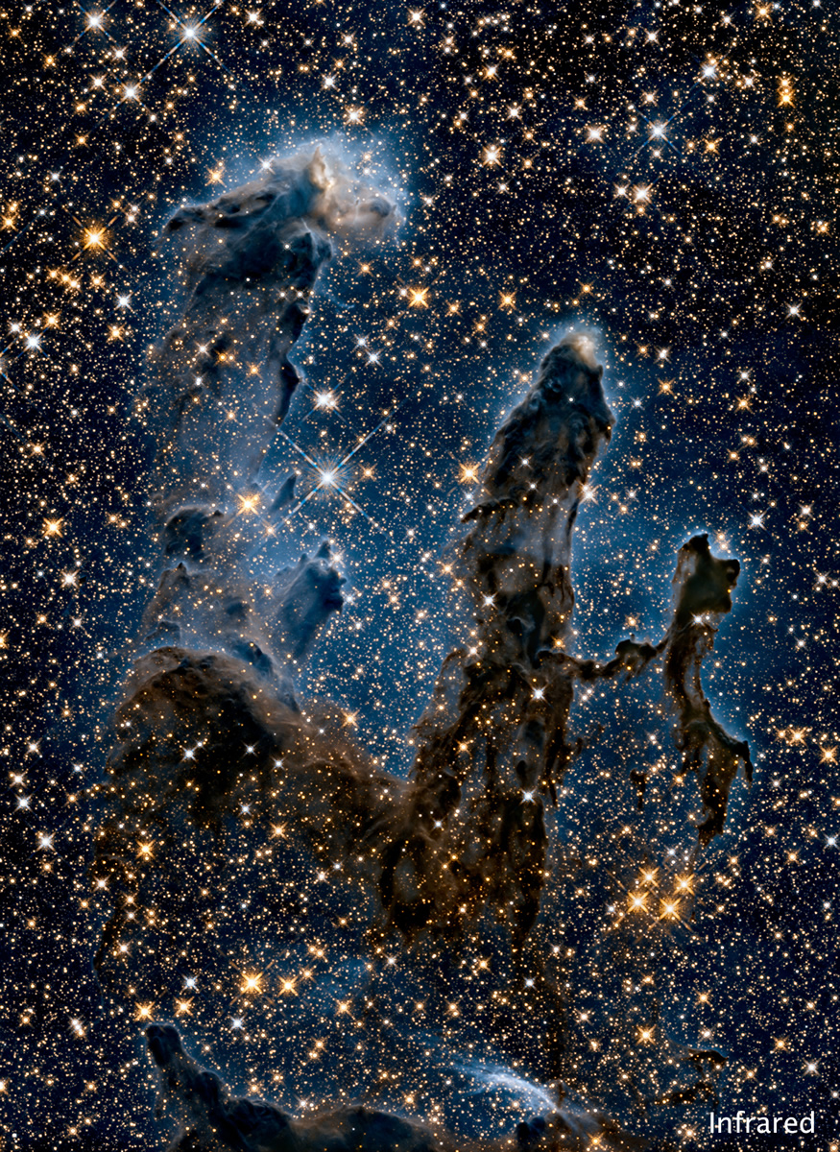
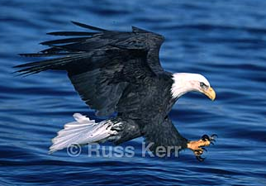
Starbirth In The Eagle
“Pillars of Creation”
Image from Russ Kerr’s Majesty of Birds website:www.magestyofbirds.com

Slide 11
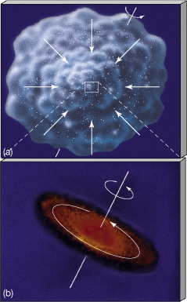
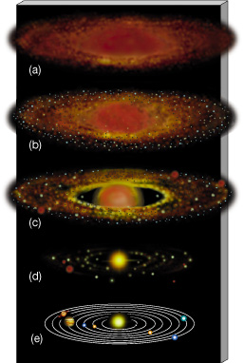
Solar System Formation
Planets form from debris around star.

Slide 12
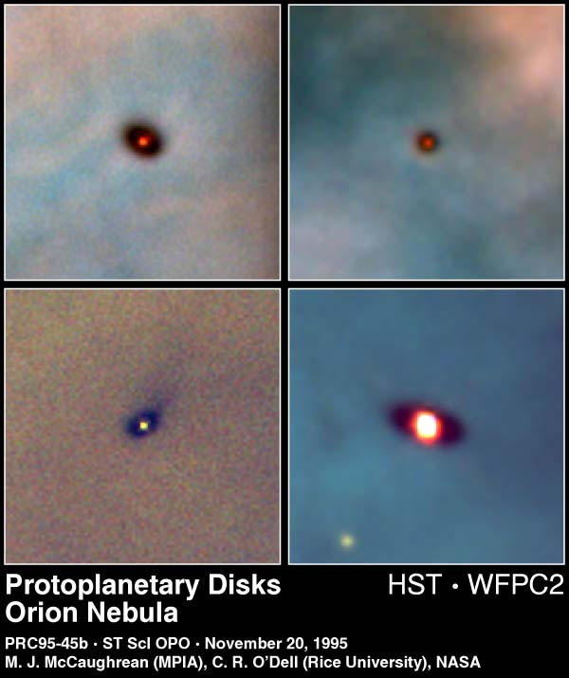
Forming Solar Systems
Disks of gas and dust surrounding forming stars form planets, moons, etc.

Slide 13
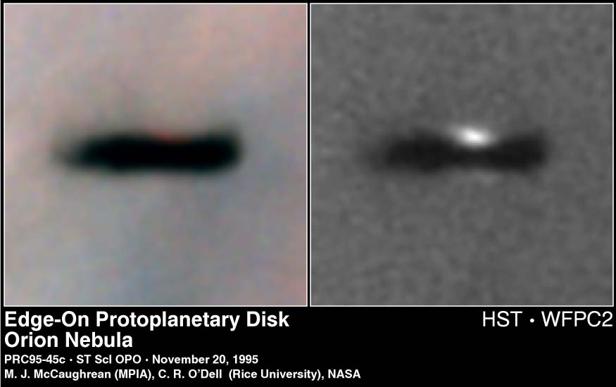
Forming Solar Systems
Disks of gas and dust surrounding forming stars seen edge-on in Orion

Slide 14
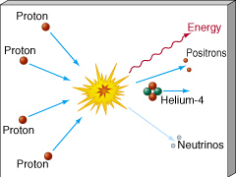
What Makes A Star?
Nuclear Fusion
Light elements combine to make heavy elements.
Hydrogen fuses to Helium

Slide 15
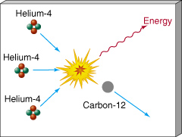
What Makes A Star?
Nuclear Fusion
Light elements combine to make heavy elements.
Helium fuses to Carbon, Oxygen, Nitrogen …

Slide 16
Fusion Releases Energy
Mass of 4 H atoms = 4 x (1.007940 amu)
= 4.031760 amu
Mass of 1 He atom = 4.002602 amu
Difference (loss) = 0.029158 amu
= 0.7 % of H
Where does it go?
E = mc²
Energy!

Slide 17
Products Of Stellar Fusion
Early universe was 75% H, 25% He
All other elements are the products of stars!

Slide 18
Substance of the Cosmos
Element abundance in the universe:
H, He, O, C, Ne, Fe, Ni, Si …
All elements of life came from stars that lived AND DIED before the sun formed.
Sun is a 2nd or 3rd generation star
1st stars were pure hydrogen and helium)
“We are the matter of the cosmos contemplating itself.”
- Carl Sagan

Slide 19
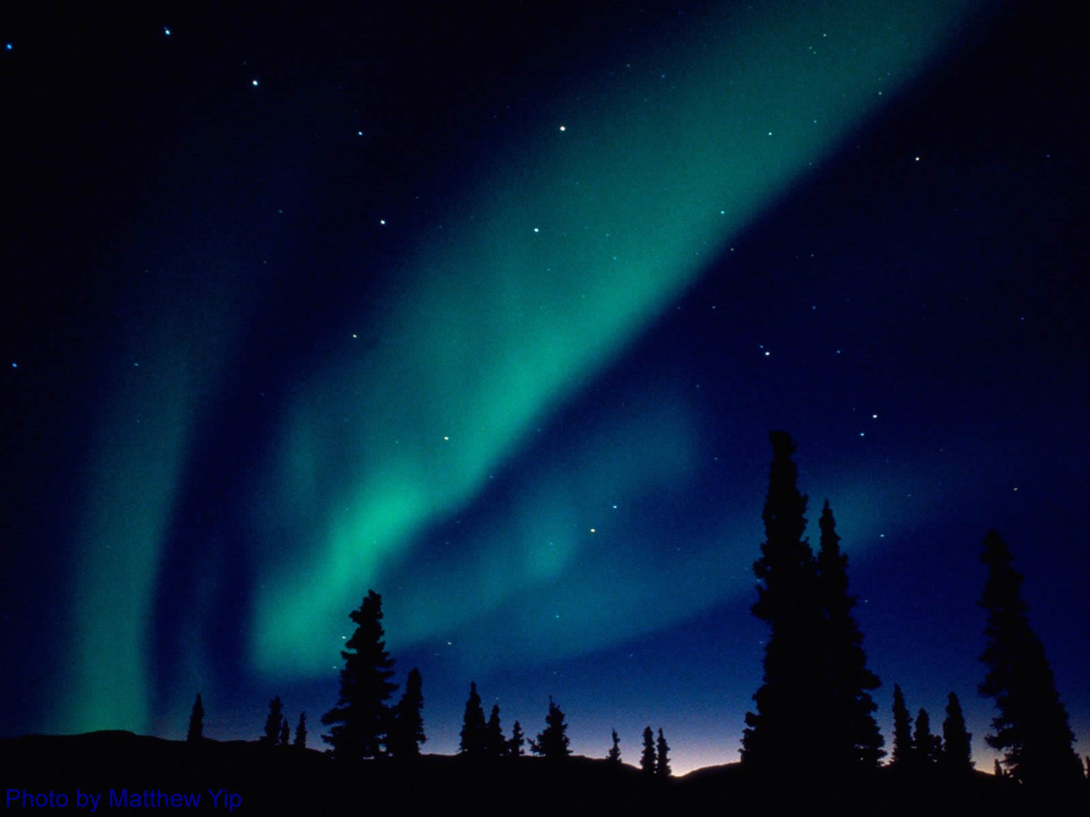
Interstellar Medium
Ancient stars enriched the ISM with the products of their fusion by
Stellar Winds
Stars constantly blow particles into space
Solar wind & storms cause aurorae on Earth
Deaths as Planetary Nebulae
Deaths as Supernovae

Slide 20
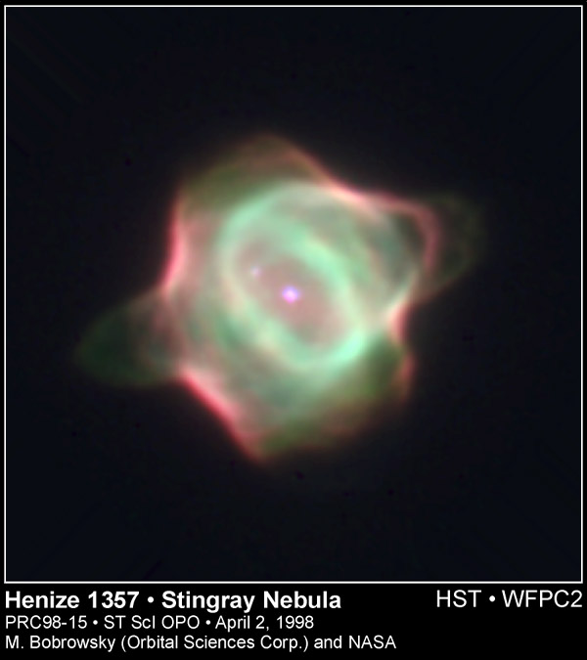
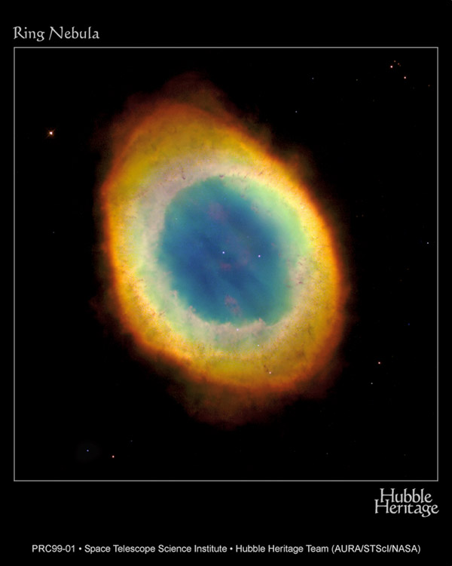
Planetary Nebulae
The source of common heavy elements (lighter than iron) … C, O, N, Ca, K, etc.

Slide 21
Planetary Nebulae
The source of common heavy elements (lighter than iron) … C, O, N, Ca, K, etc.
The air you breathe … 78% Nitrogen and 21% Oxygen … was blown out of a Sun-sized star more than 5 billion years ago. Your breath is older than the Earth and Sun!

Slide 22
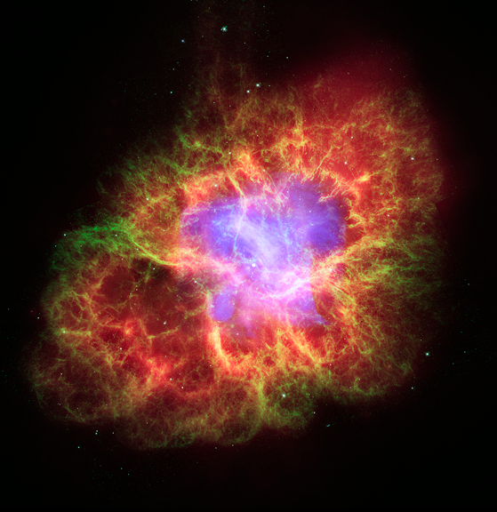
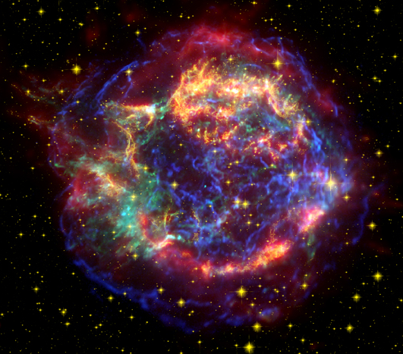
Supernova Explosions
The source of heavy elements (iron & heavier) … Fe, Ni, Cu, Zn, Ag, I, Au, Pb, etc.
Crab Nebula, 1054
Cas A, c. 1680

Slide 23
Supernova Explosions
The source of heavy elements (iron & heavier) … Fe, Ni, Cu, Zn, Ag, I, Au, Pb, etc.
The iron in your blood, carrying oxygen to your brain is cosmic ash from the explosion of a star!
Crab Nebula, 1054
Cas A, c. 1680

Slide 24

Ritual: We are the Ash of Stars
The carbon we’re made of was forged in ancient stars and will be blown back into the cosmos by the Sun’s death as a planetary nebula.
Let us sign each other with ashes* on our tables and say:
“Remember that you are stars and to the stars you will return!”
Ashes blessed at St. Thomas More Newman Center, University of Arizona on Ash Wednesday, 2002

Slide 25
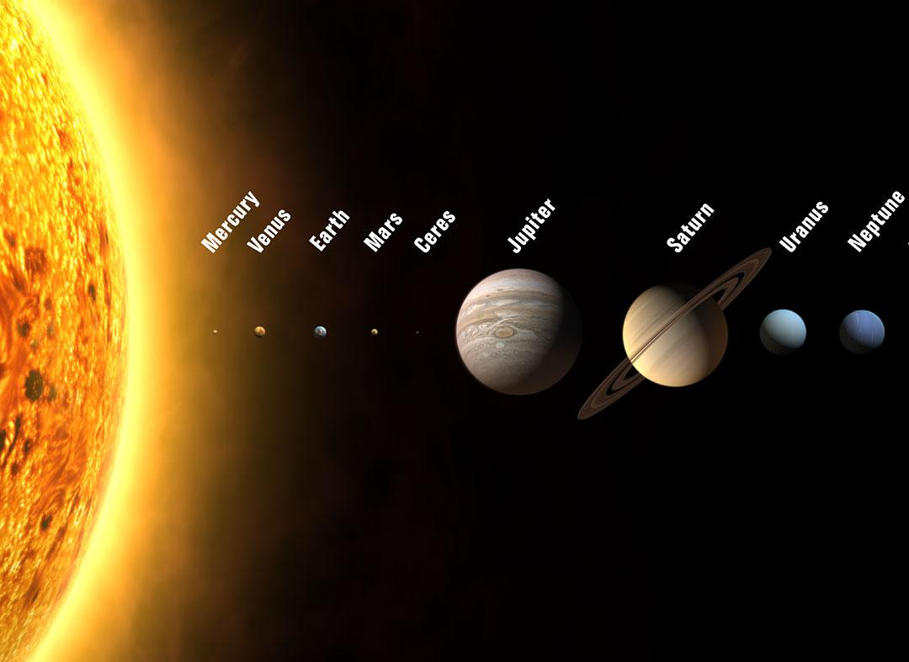
Planets And Moons
The Sun and all the planets formed from the same cloud of “used” star stuff enriched with heavy elements by previous generations of stars.

Slide 26
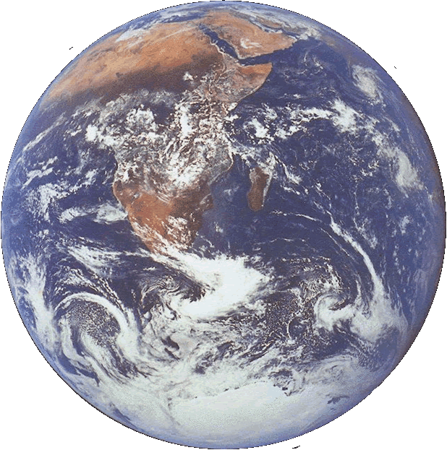
Earth
Life arose on Earth because
water from volcanoes
& comets condensed
into oceans that
Absorbed CO₂
from the early atmosphere
Allowed life to arise
protected from sun’s radiation
Regulate the temperature of entire planet
water is available as solid, liquid, & gas
oxygen was freed by life and formed the ozone layer
Pond scum polluted the entire atmosphere with oxygen!

Slide 27
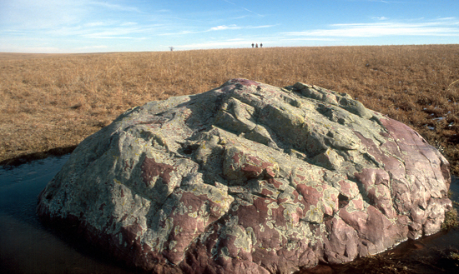
Substance of Earth
Element abundance in Earth’s crust:
O, Si, Al, Fe, Ca, Na, K, Mg, Ti, H, …
Crust of silicate minerals
Sioux Quartzite in NE Kansas, 2880 my old
Metamophosed sand
2800 my old
… Si, O, Fe …
Photo by John Carlton, KGS, Wabaunsee County, Kansas
We walk on the stuff of stars!
http://chasm.kgs.ku.edu/ords/pubcat.phd1.View_Photo?f_id=64&f_hd=Y

Slide 28
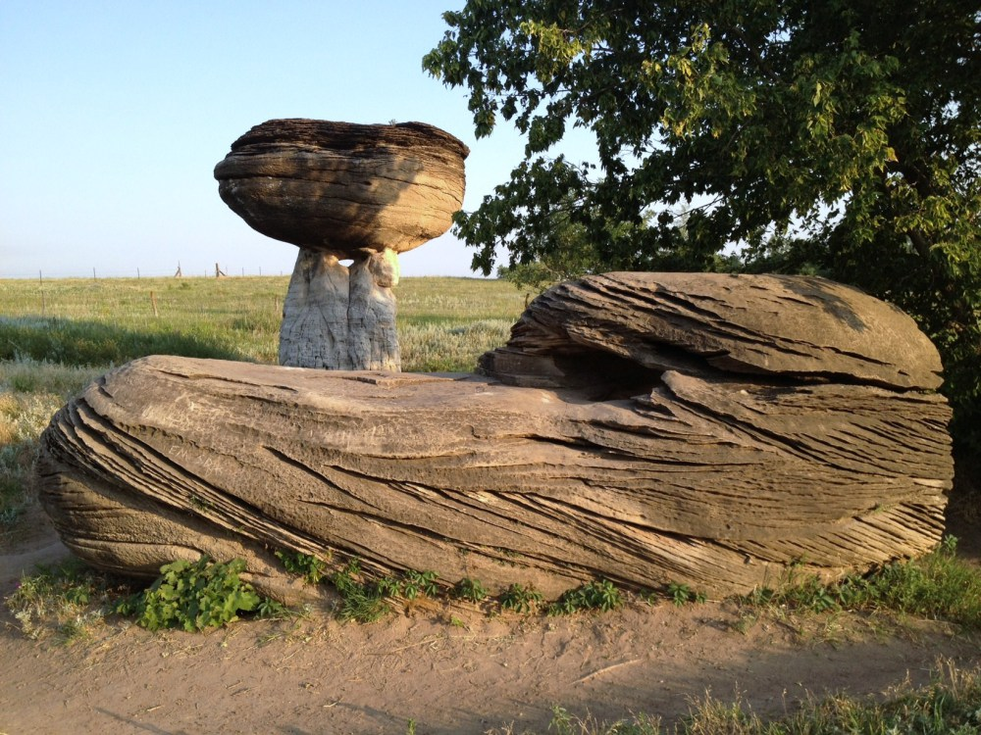
Substance of Earth
“In our own sun there are 700 oxygen atoms, 400 carbon atoms and 2 calcium atoms for every million atoms of hydrogen;
https://explorekansas.wordpress.com/tag/mushroom-rock/

Slide 29
Substance of Earth
“… these heavier atoms were created in stars antecedent to our sun, stars that illuminated the younger galaxy with a brilliant blue light.

Slide 30
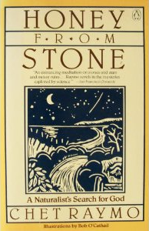
Substance of Earth
“One hundred septillion (10²⁶) hydrogen nuclei were processed in the interiors of Vega-like stars to create the pebble in my hand.”
- Chet Raymo, Honey From Stone

Slide 31

Earth
“… then God formed the earthling from the dust of the ground, breathed into it the breath of life, and the earthling became a living being …”
Genesis 2:7

Slide 32
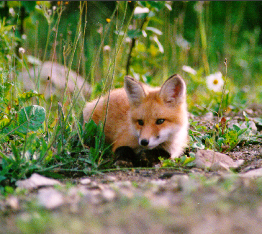
Earth Mother
“The Earth is at the same time mother,
she is mother of all that is natural,
mother of all that is human.
She is the mother of all,
For contained in her
are the seeds of all.

Slide 33
Earth Mother
“It is in so many ways fruitful.
All creation comes from it.
Yet it forms not only the basic
raw material for humankind,
but also the substance of the incarnation of God’s son.”
Hildegard of Bingen

Slide 34
Wisdom
“When God established the heavens I was there,
when God drew a circle
on the face of the deep,
when God made firm the skies above,
when God established
the fountains of the deep …

Slide 35
Wisdom
when God marked out
the foundations of the Earth,
then I was beside God,
like a master worker,
and I was daily God’s delight,
rejoicing with God always,
rejoicing in God’s inhabited world
and delighting in the human race”
(Proverbs 8:22-31)

Slide 36
The Substance of Yourself
Today, try to
Feel & Rejoice in your physical substance
the actual atoms forged in stars,
incorporated into planet Earth.
A cosmic wind moving through you, rocks, plants, and all other beings (you are renewed every 7 years!)
how is the matter, itself, inspirited?
find a rock to hold & keep in your pocket
Seek God in the substance of yourself

