Slide 1
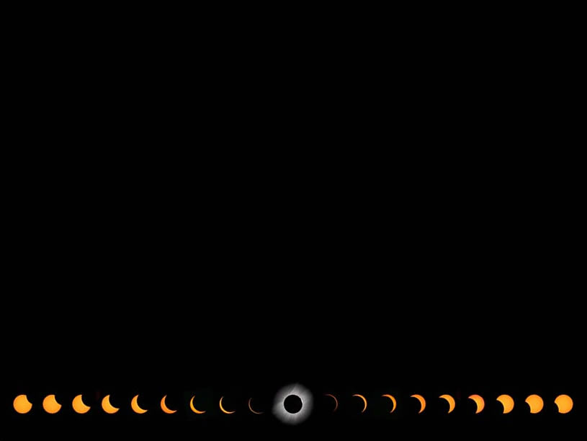



Announcements & Logistics
The Cosmos Within
Dr. Aileen A. O’Donoghue
August 19 – 21, 2017
© Copyright, Dr. Aileen A. O’Donoghue, St. Lawrence University

Slide 2
The Cosmos Within
my email
aodonoghue@stlawu.edu
Don’t hesitate to contact me!
Dr. Aileen A. O’Donoghue
August 19 – 21, 2017
© Copyright, Dr. Aileen A. O’Donoghue, St. Lawrence University

Slide 3
The Cosmos Within
Power Points will be available at
http://myslu.stlawu.edu/ ~aodo/spirituality/KS2017
by next weekend.
Dr. Aileen A. O’Donoghue
August 19 – 21, 2017
© Copyright, Dr. Aileen A. O’Donoghue, St. Lawrence University

Slide 4
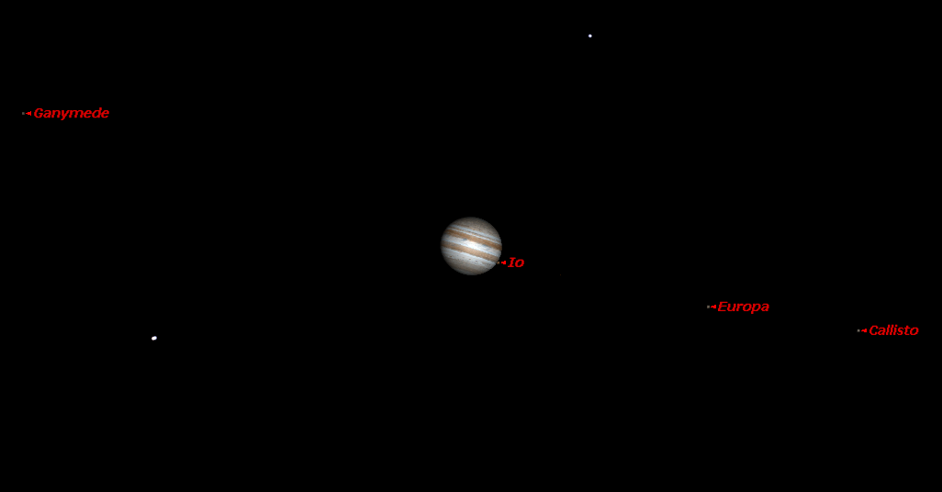
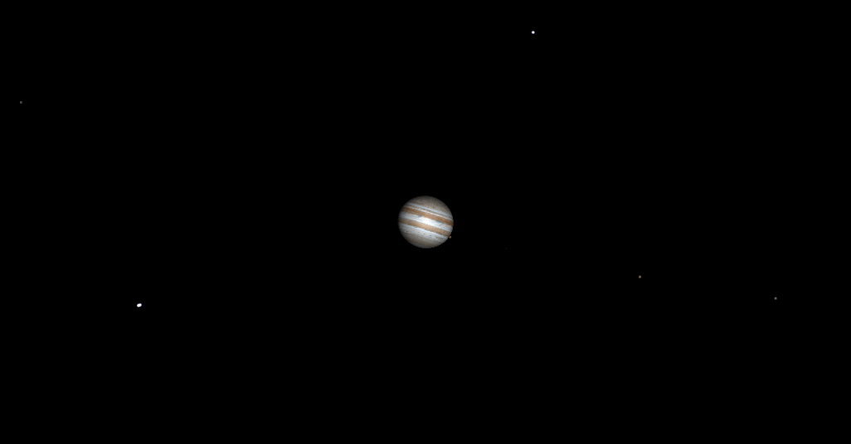
What we saw last night
Jupiter and the Galilean Moons
Ganymede
Europa
Io
Callisto

Slide 5
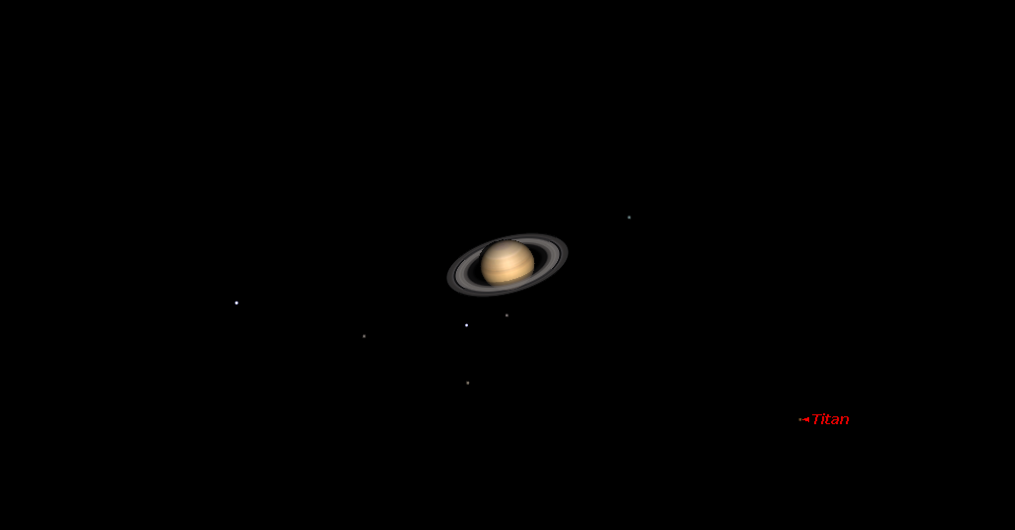
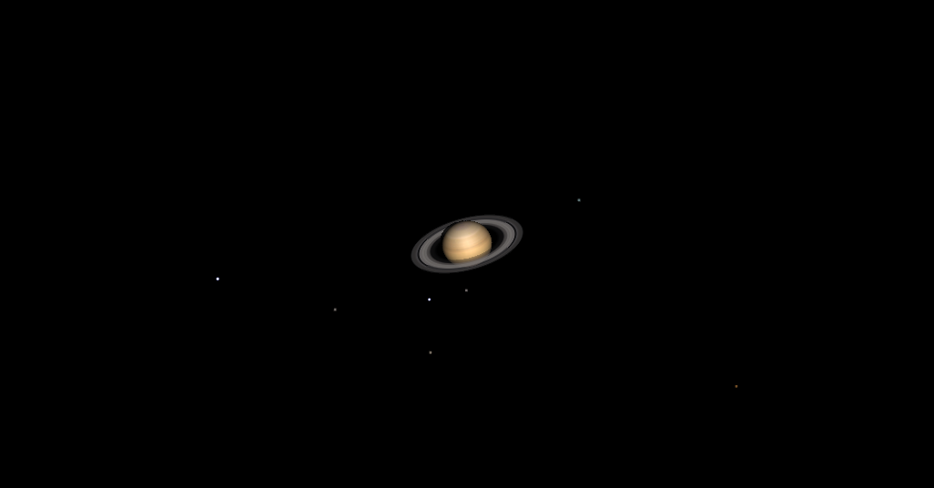
What we saw last night
Saturn and Titan
Titan

Slide 6
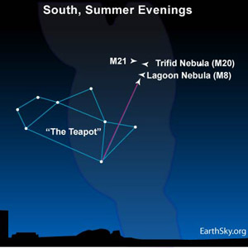
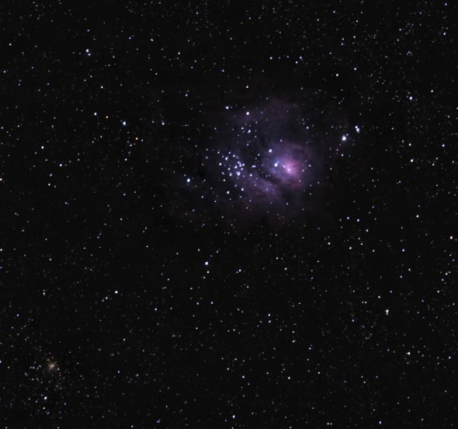
What we saw last night
Lagoon Nebula and M8 (Star Cluster)

Slide 7
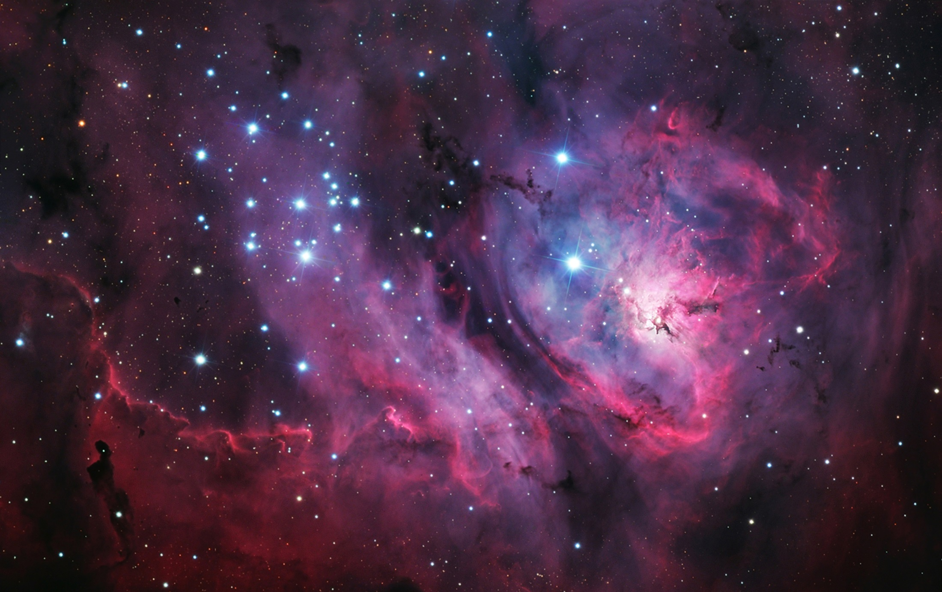
What we saw last night
Lagoon Nebula and M8 (Star Cluster)

Slide 8
Beneath (and Beyond) the Surface (of Earth and Sky)
The Cosmos Within
Dr. Aileen A. O’Donoghue
August 19 – 21, 2017

Slide 9
The Incarnation
“The Word was coming into the world –
Was in the world –
and though the world was made
through the Word,
the world didn’t recognize it.
Though the Word came to its own realm,
the Word’s own people didn’t accept it.
And the Word became flesh
and stayed for a little while among us;”
John 1:9-11,14
The Inclusive New Testament

Slide 10
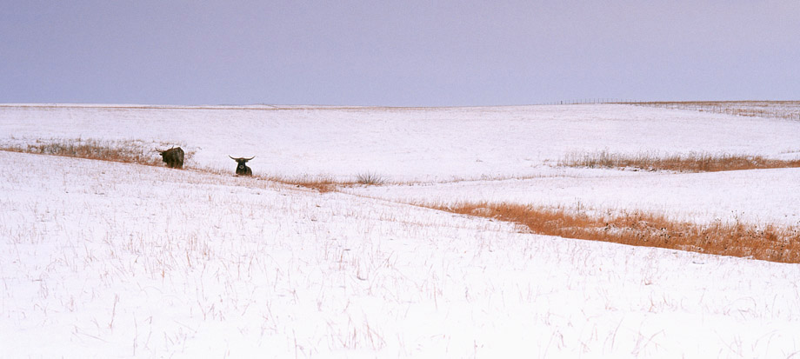
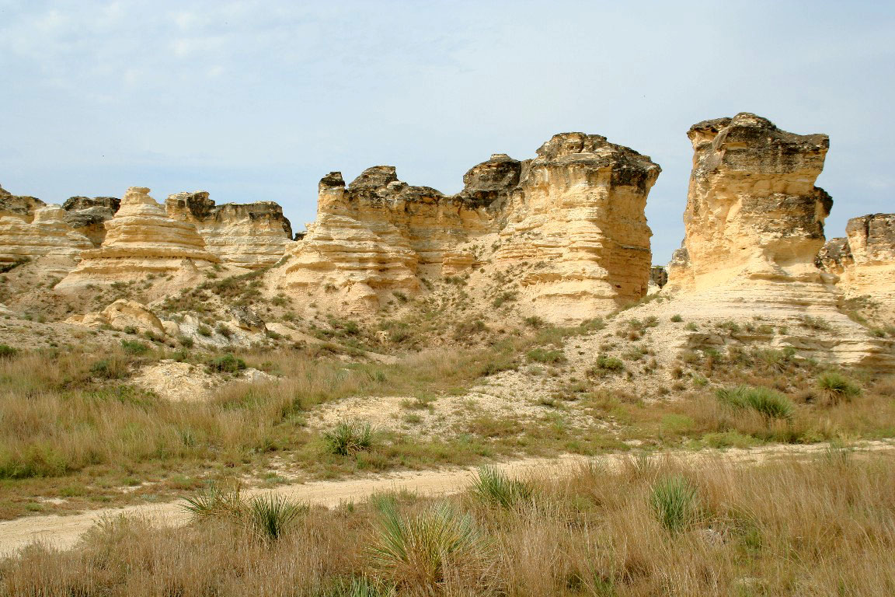
Life on the Prairie
Some regions & seasons can seem barren …
www.jnedreskyprairie.com
davidselvey.com

Slide 11
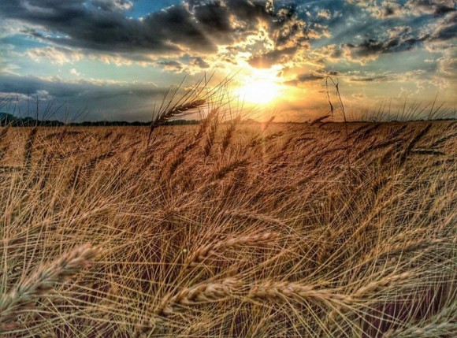
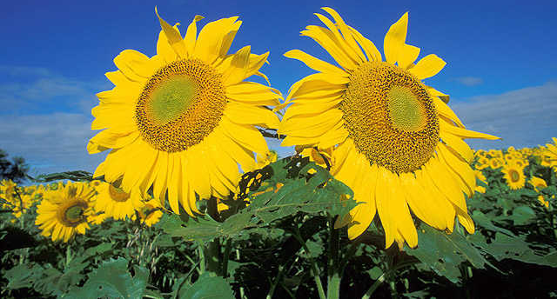
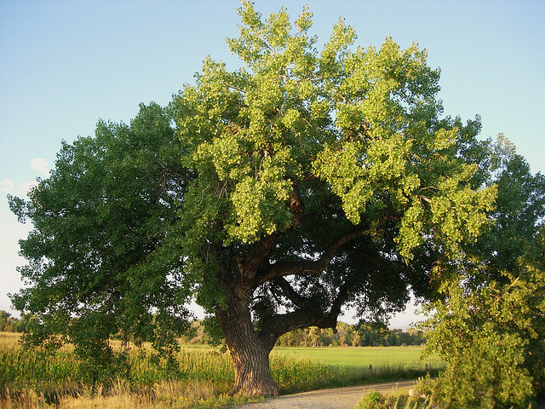
Life on the Prairie
But in others plants thrive …
… making their substance
out of air!
http://www.translationdirectory.com/god_has_created_flowers_001.php
ksn.com/2017/06/19/
statesymbolsusa.org/symbol-official-item/kansas/state-tree/cottonwood

Slide 12
The Secret Work of Plants
Plants use water & sunlight
to make wood out of air!
Photosynthesis:
6CO₂ + 6H₂O + Light → C₆H₁₂O₆ + 6O₂
Sugar … becomes cellulose
So the plants make themselves out of light, water and air (with the help of chlorophyll & nutrients)

Slide 13
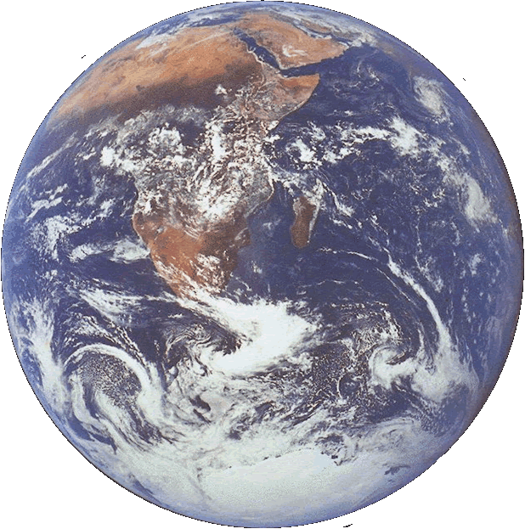
Quiz Question
The planet shown is unique for
A) Carbon Dioxide in its atmosphere
B) Solid water on its surface
C) Sticks
Sticks!
Yeah!
They’re amazing!

Slide 14
Genesis
“And God said, "Let the waters bring forth swarms of living creatures, and let birds fly above the earth across the dome of the sky." So God created the great sea monsters and every living creature that moves, of every kind, with which the waters swarm, and every winged bird of every kind. And God saw that it was good.
And there was evening and there was morning, the fifth day.

Slide 15
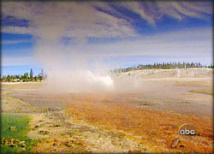
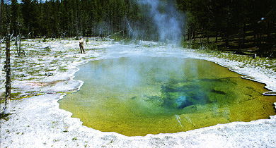
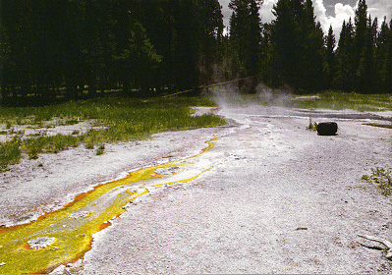
Life At High Temperature
Hot springs in Yellowstone National Park
Cyanobacteria … the oldest life on Earth

Slide 16
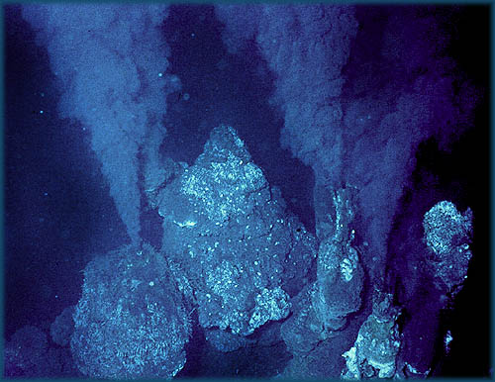
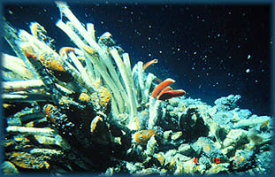
Life In The Dark
The Deep Sea Vents (“Black Smokers)”
Life utilizes minerals from Earth’s interior

Slide 17
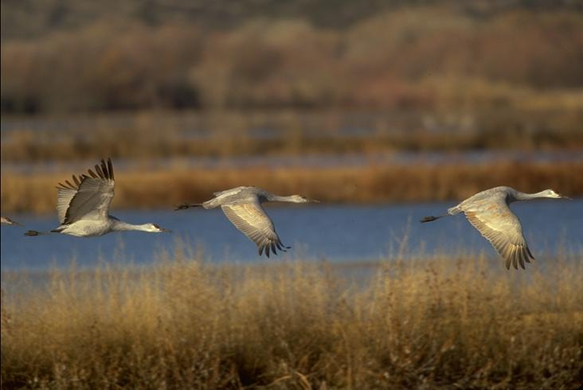
Life In The Air
Sandhill Cranes, Bosque Del Apache, Socorro, NM
The last of the dinosaurs!

Slide 18
Genesis
And God said, "Let the earth bring forth living creatures of every kind: cattle and creeping things and wild animals of the earth of every kind."
And it was so. God made the wild animals of the earth of every kind, and the cattle of every kind, and everything that creeps upon the ground of every kind. And God saw that it was good.

Slide 19
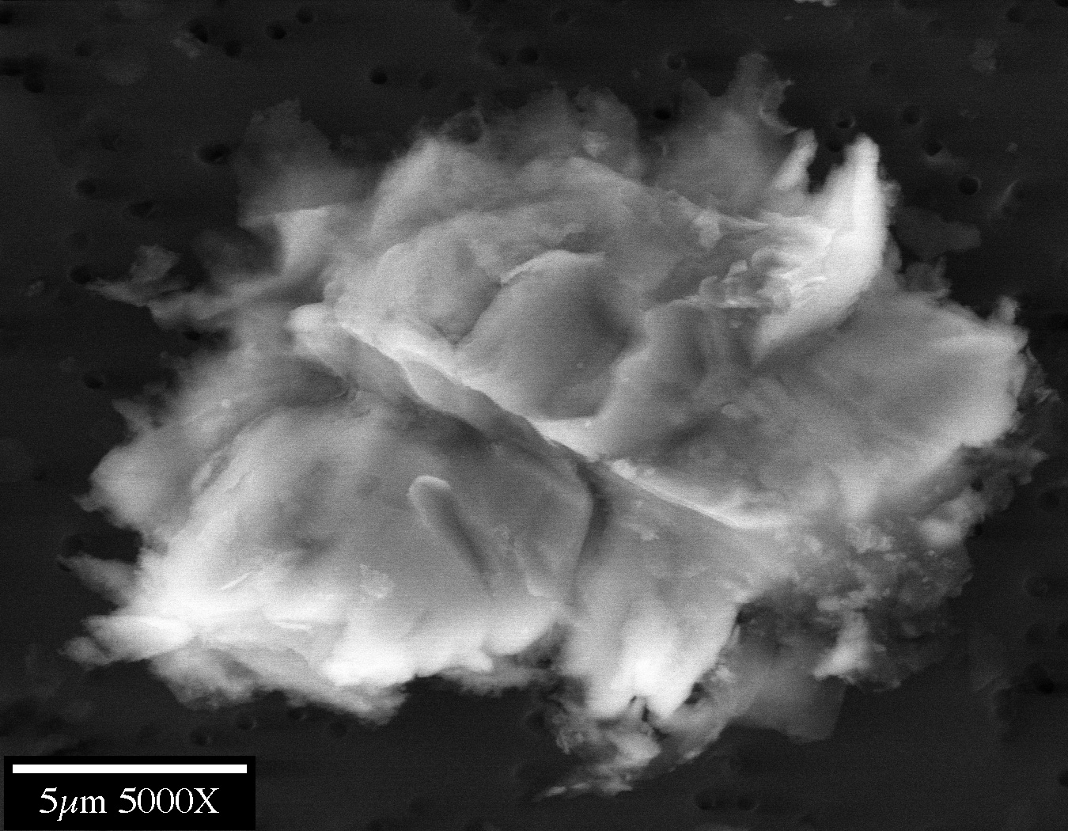
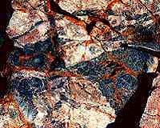
Abundance Of Life
Life survives in every ecosystem on Earth … even within ice and rocks!
Sulfide digesting bacteria on rocks
Microbe from Antarctic Ice

Slide 20
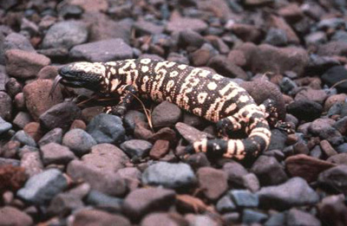
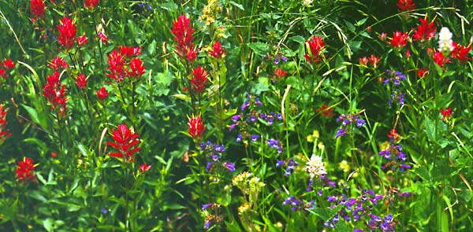
Life Everywhere On Land

Slide 21
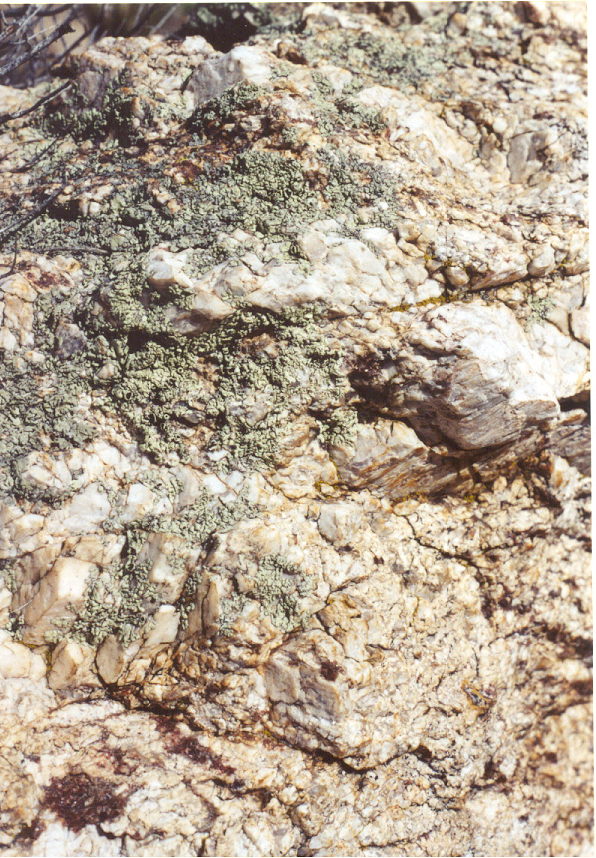
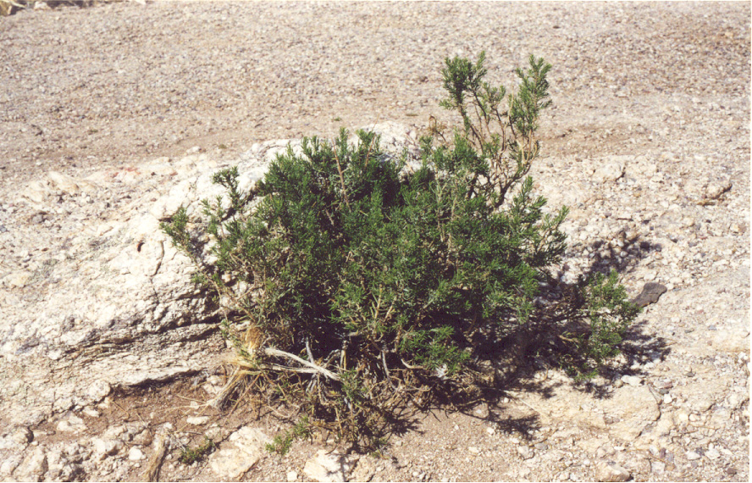
Life From The Rocks
Shrub on the desert pavement
Lichens: symbiotic associations of algae and fungi

Slide 22
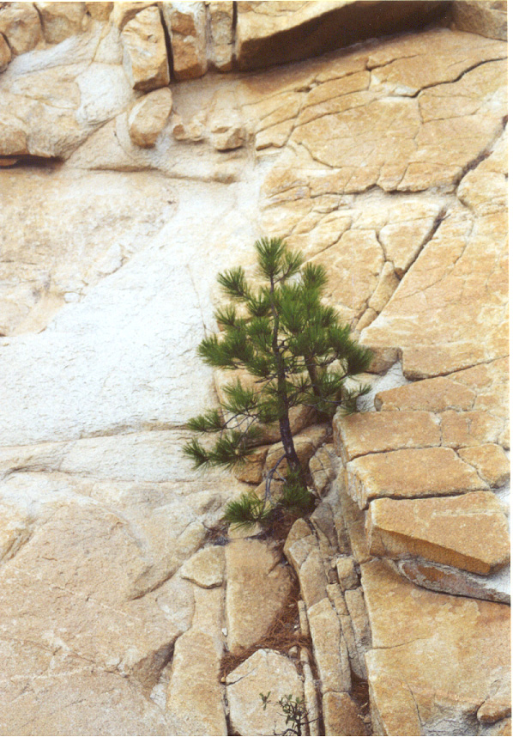
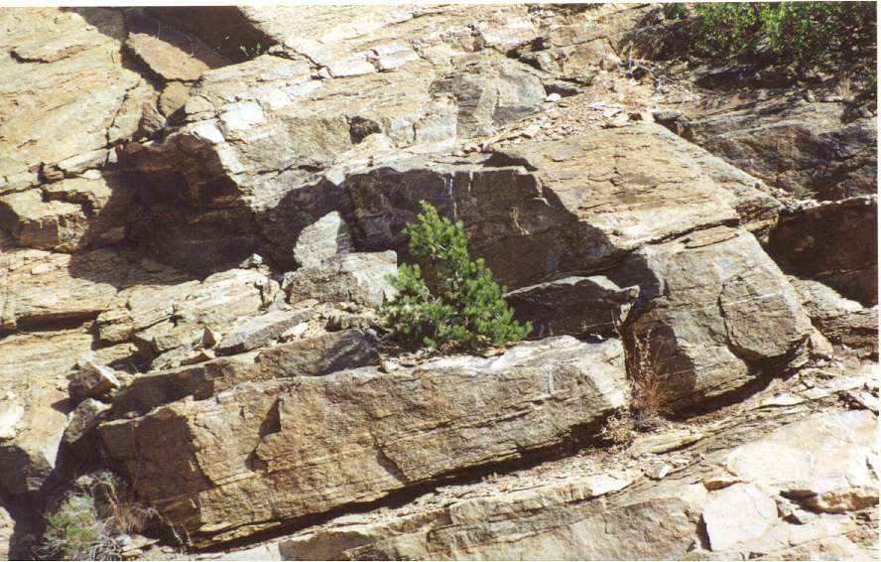
Trees From The Rocks

Slide 23
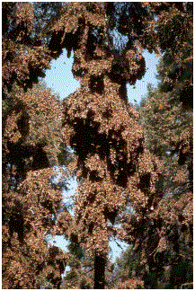
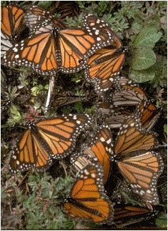
Life On The Trees

Slide 24
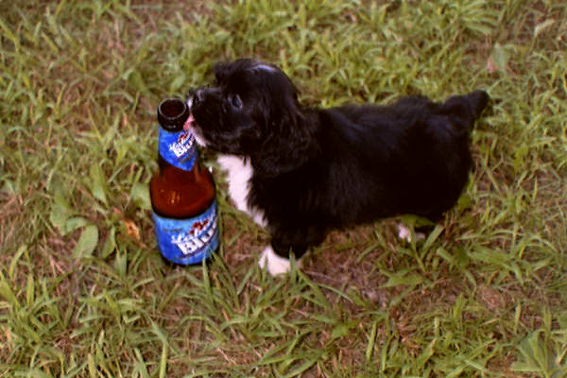
Given Hydrogen, Gravity & 15 Billion Years The Universe Made
Puppies!

Slide 25
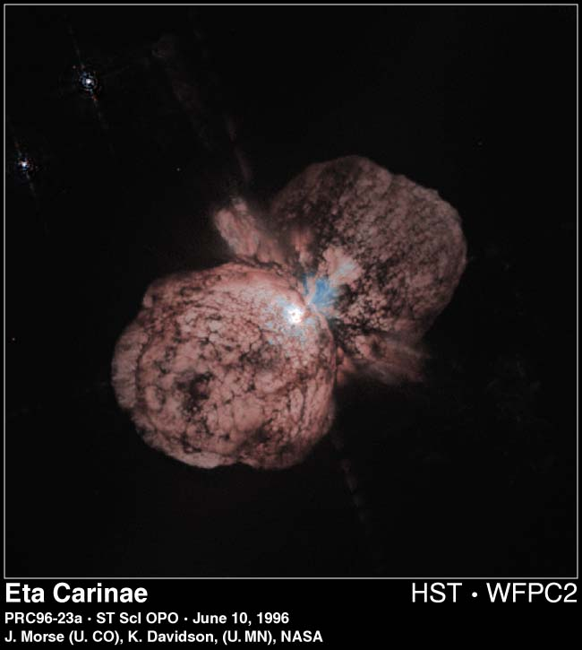
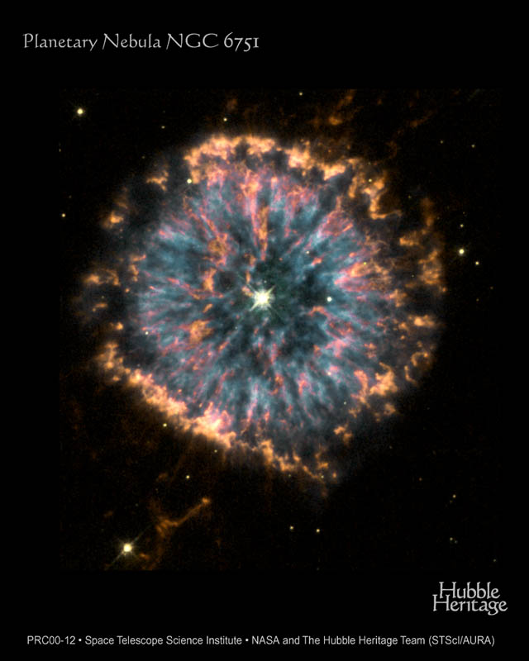
And All Is From The Stars!
Except the hydrogen which is from the first millisecond after the Big bang!
Sun-sized stars produced C, O, N …
Giant stars produced Fe, Zn, Au, Ag, Hg, Pb, I, Ba ...

Slide 26
So Look to the Stars!
During Totality
We’ll have a 360° sunset along the horizon
The Sun will be hidden by the black moon
The Corona will surround the Sun & Moon
Beyond them, stars will become visible …

Slide 27
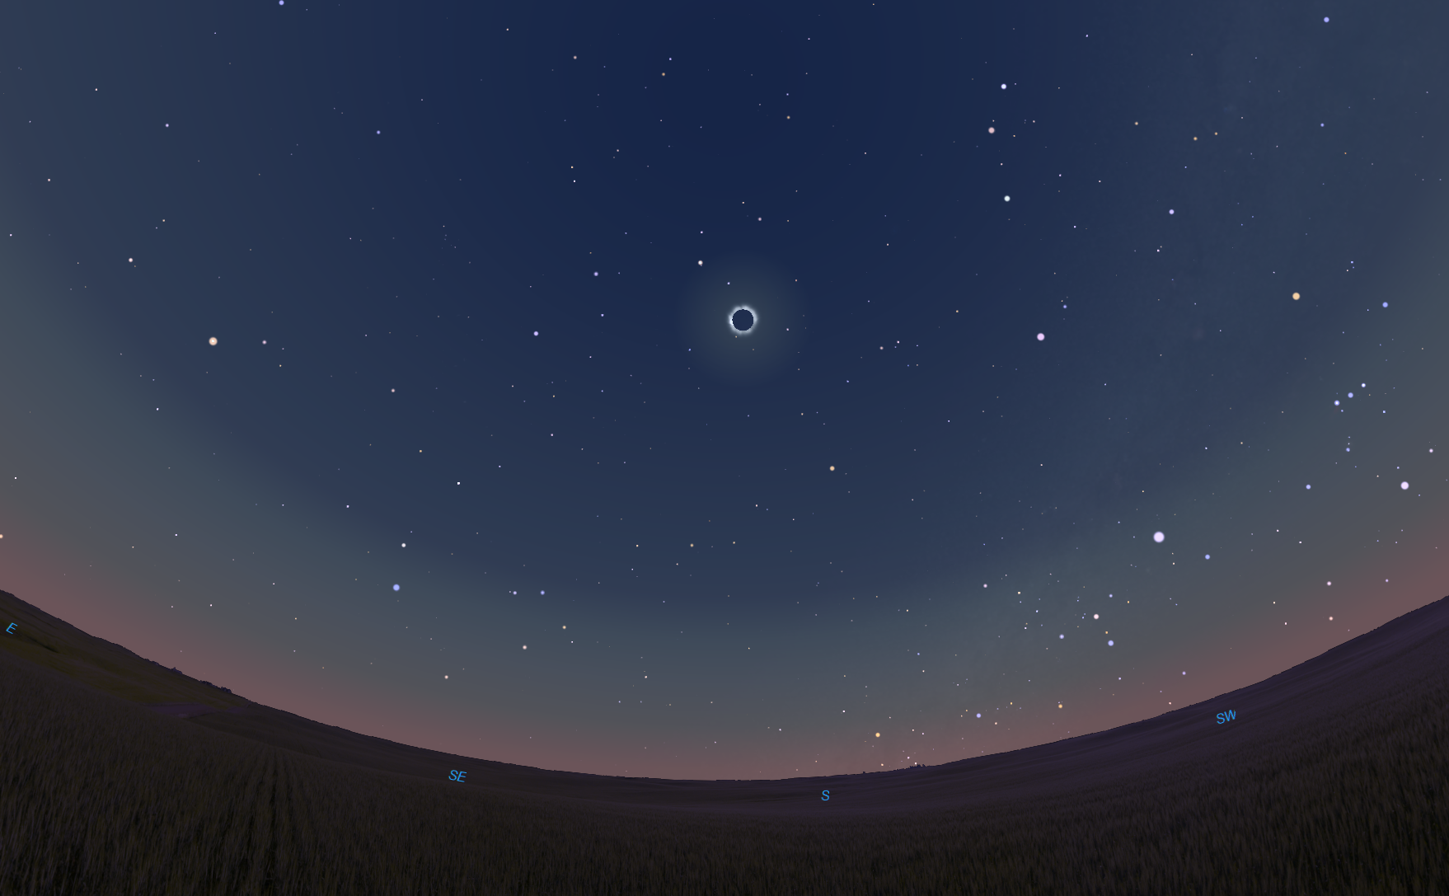
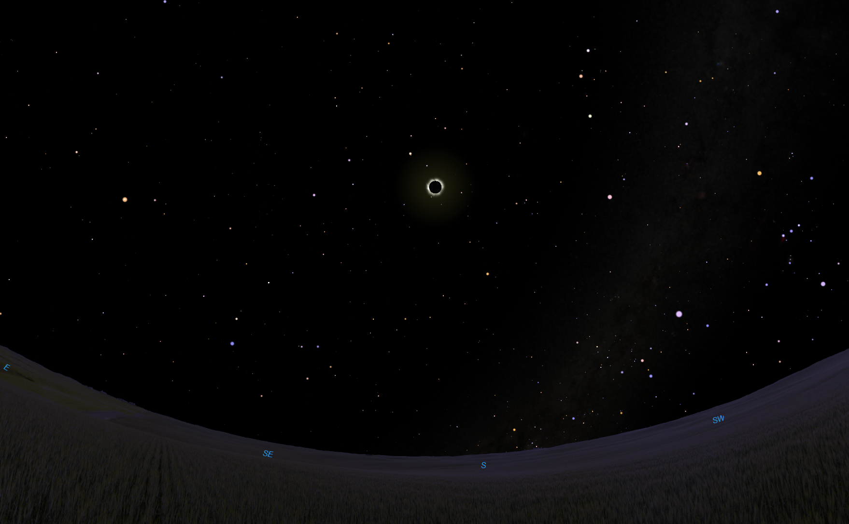
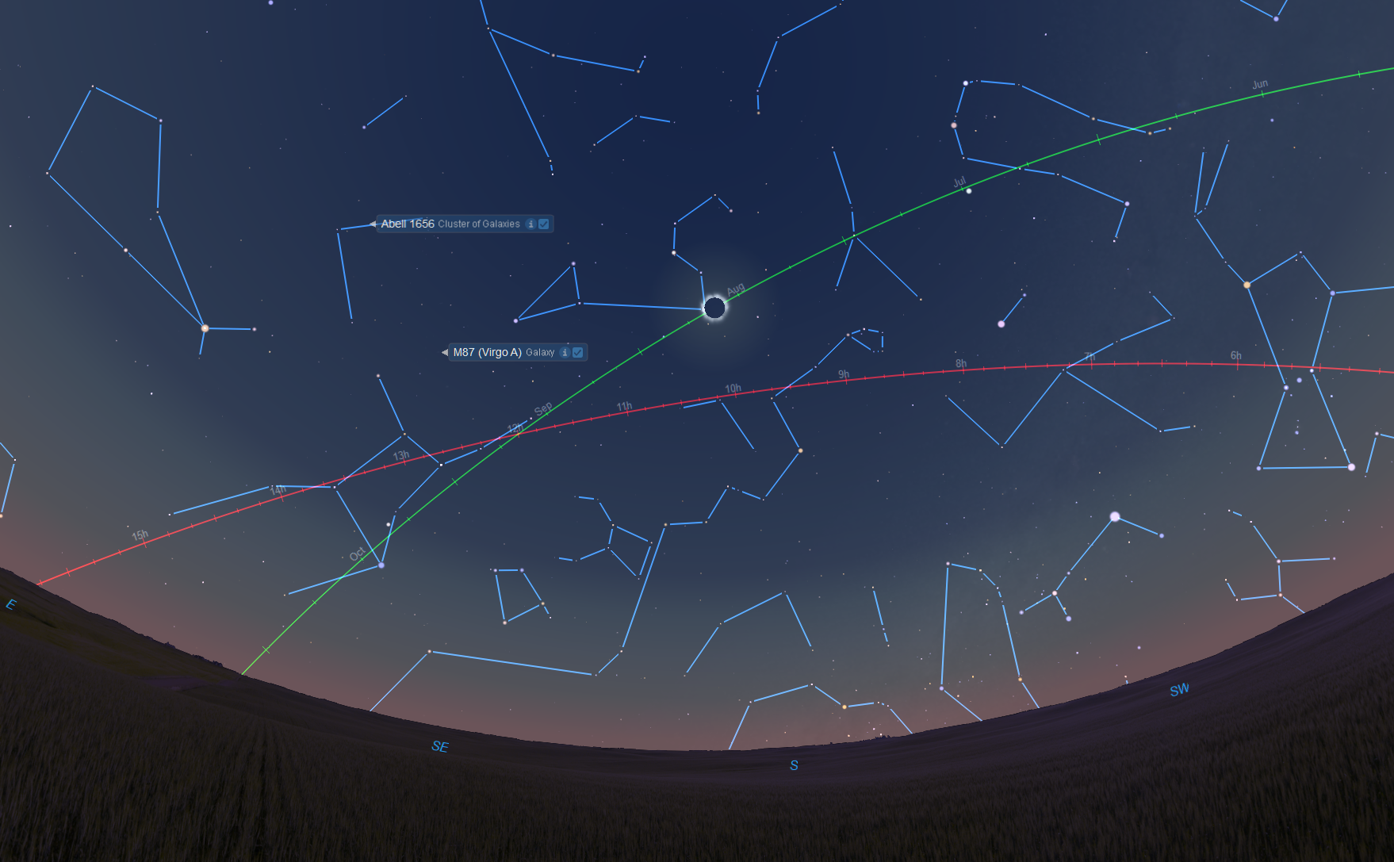
The Sky at Totality
Ecliptic: Path of the Sun & Planets
Venus
Mars
Jupiter
Sun moves ~1°/day

Slide 28
The Sky at Totality
Ecliptic: Path of the Sun & Planets
Summer Solstice
Venus
Orion
Mars
Betelgeuse
Procyon
Canis MINor
Celestial Equator
Autumnal Equinox
Sirius
Jupiter
Canis Major
Sun moves ~1°/day

Slide 29
The Sky at Totality
Ecliptic: Path of the Sun & Planets
Castor
Gemini
Pollux
Summer Solstice
Venus
Orion
Leo
Mars
Betelgeuse
Denebola
Cancer
Procyon
Canis MINor
Regulus
Celestial Equator
Virgo
Autumnal Equinox
Sirius
Jupiter
Canis Major
Spica
Sun moves ~1°/day

Slide 30
The Sky at Totality
Ecliptic: Path of the Sun & Planets
BoÖtes
Castor
Gemini
Coma Berenices
Pollux
Summer Solstice
Praesepe Star Cluster
Coma Galaxy Cluster
Venus
Orion
Coma Star Cluster
Leo
Mars
Betelgeuse
Arcturus
Denebola
Cancer
Procyon
Canis MINor
Virgo Galaxy Cluster
Regulus
Celestial Equator
Virgo
Autumnal Equinox
Sirius
Jupiter
Canis Major
Spica
Corvus
Sun moves ~1°/day

Slide 31
The Sky at Totality
Ecliptic: Path of the Sun & Planets
BoÖtes
Castor
Gemini
Coma Berenices
Pollux
Summer Solstice
Venus
Orion
Leo
Mars
Betelgeuse
Arcturus
Denebola
Cancer
Procyon
Canis MINor
Regulus
Celestial Equator
Virgo
Autumnal Equinox
Sirius
Jupiter
Canis Major
Spica
Corvus
Sun moves ~1°/day

Slide 32
The Sky at Totality
The “surface” of the sky …
Ecliptic: Path of the Sun & Planets
BoÖtes
Castor
Gemini
Coma Berenices
Pollux
Summer Solstice
Venus
Orion
Leo
Mars
Betelgeuse
Arcturus
Denebola
Cancer
Procyon
Canis MINor
Regulus
Celestial Equator
Virgo
Autumnal Equinox
… let’s go deeper
Sirius
Jupiter
Canis Major
Spica
Corvus
Sun moves ~1°/day

Slide 33
The Sky at Totality
The “surface” of the sky …
Ecliptic: Path of the Sun & Planets
BoÖtes
Castor
Gemini
Coma Berenices
Pollux
Summer Solstice
Praesepe Star Cluster
Venus
Orion
Coma Star Cluster
Leo
Mars
Betelgeuse
Arcturus
Denebola
Cancer
Procyon
Canis MINor
Regulus
Celestial Equator
Virgo
Autumnal Equinox
… let’s go deeper
Sirius
Jupiter
Canis Major
Spica
Corvus
Sun moves ~1°/day

Slide 34
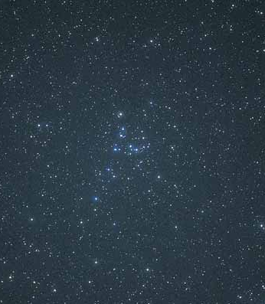
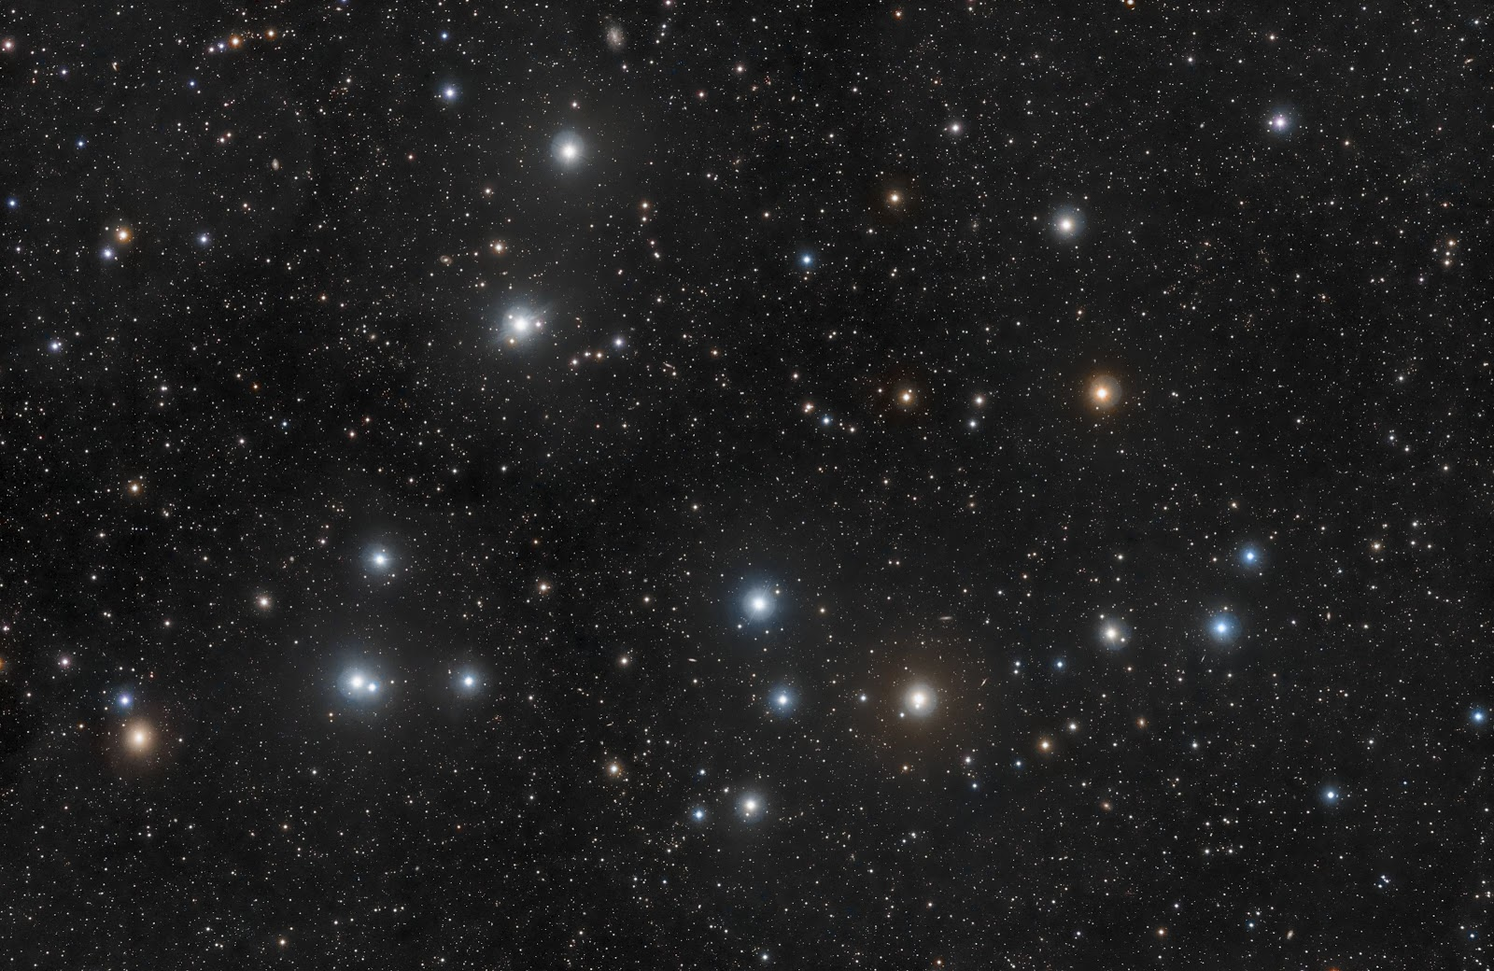
The Sky at Totality
View with binoculars or small telescope
Ecliptic: Path of the Sun & Planets
BoÖtes
Castor
Gemini
Coma Berenices
Pollux
Summer Solstice
Praesepe Star Cluster
Large telescope
About 80 “sibling” stars across ~5° of sky, 260 light-years away (light left around 1757!)
Venus
Orion
Coma Star Cluster
Leo
Mars
Betelgeuse
Arcturus
Denebola
Cancer
Procyon
Canis MINor
Regulus
Celestial Equator
Virgo
Autumnal Equinox
Sirius
Jupiter
Canis Major
Spica
Corvus
Sun moves ~1°/day
Coma Star Cluster

Slide 35
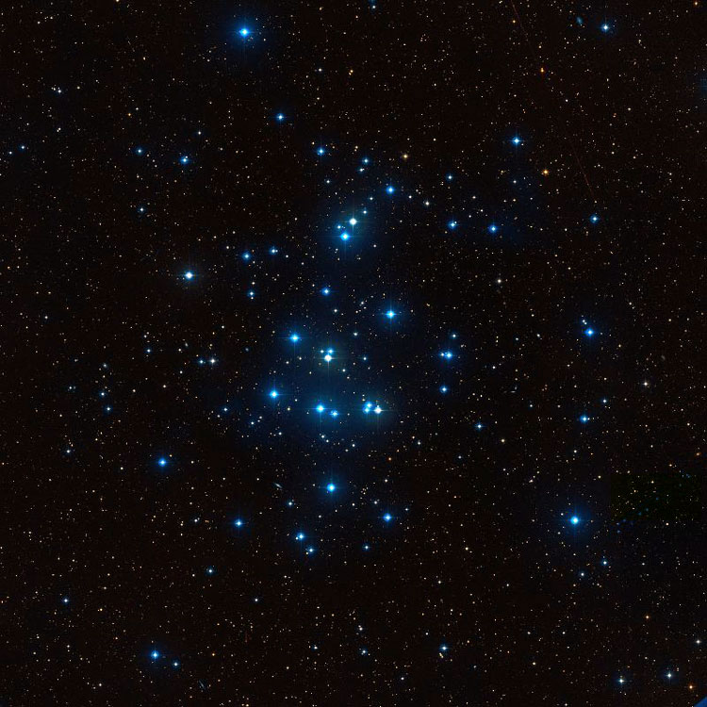
The Sky at Totality
View with binoculars or small telescope
Over 1000 “sibling” stars 577 light-years away (light left around 1440!)
Ecliptic: Path of the Sun & Planets
BoÖtes
Castor
Gemini
Coma Berenices
Pollux
Summer Solstice
Praesepe Star Cluster
And God is there!
Known by Ptolemy, studied by Galileo with his telescope.
Venus
Orion
Coma Star Cluster
Leo
Mars
Betelgeuse
Arcturus
Denebola
Cancer
Procyon
Canis MINor
Regulus
Celestial Equator
Virgo
Autumnal Equinox
Sirius
Jupiter
Canis Major
Spica
Corvus
Sun moves ~1°/day
Praesepe Star Cluster

Slide 36
The Sky at Totality
View with binoculars or small telescope
Over 1000 “sibling” stars 577 light-years away (light left around 1440!)
Lift up your eyes on high
and see who created these stars:
He leads out their army and numbers them,
calling them all by name.
By his great might and the strength of his power
not one of them is missing!
Isaiah 40:26
Ecliptic: Path of the Sun & Planets
BoÖtes
Castor
Gemini
Coma Berenices
Pollux
Summer Solstice
Praesepe Star Cluster
And God is there!
Known by Ptolemy, studied by Galileo with his telescope.
Venus
Orion
Coma Star Cluster
Leo
Mars
Betelgeuse
Arcturus
Denebola
Cancer
Procyon
Canis MINor
Regulus
Celestial Equator
Virgo
Autumnal Equinox
Sirius
Jupiter
Canis Major
Spica
Corvus
Sun moves ~1°/day
Praesepe Star Cluster

Slide 37
The Sky at Totality
View with binoculars or small telescope
Over 1000 “sibling” stars 577 light-years away (light left around 1440!)
Lift up your eyes on high
and see who created these stars:
He leads out their army and numbers them,
calling them all by name.
By his great might and the strength of his power
not one of them is missing!
Isaiah 40:26
Ecliptic: Path of the Sun & Planets
BoÖtes
Castor
Gemini
Coma Berenices
Pollux
Summer Solstice
Praesepe Star Cluster
And God is there!
Known by Ptolemy, studied by Galileo with his telescope.
Venus
Orion
Coma Star Cluster
Leo
Mars
Betelgeuse
Arcturus
Denebola
Cancer
Procyon
Canis MINor
Regulus
Celestial Equator
Virgo
Autumnal Equinox
Sirius
Jupiter
Canis Major
Let’s go even deeper!!
Spica
Corvus
Sun moves ~1°/day
Praesepe Star Cluster

Slide 38
The Sky at Totality
Ecliptic: Path of the Sun & Planets
BoÖtes
Castor
Gemini
Coma Berenices
Pollux
Summer Solstice
Praesepe Star Cluster
Coma Galaxy Cluster
Venus
Orion
Coma Star Cluster
Leo
Mars
Betelgeuse
Arcturus
Denebola
Cancer
Procyon
Canis MINor
Regulus
Celestial Equator
Virgo
Autumnal Equinox
Sirius
Jupiter
Canis Major
Spica
Corvus
Sun moves ~1°/day

Slide 39
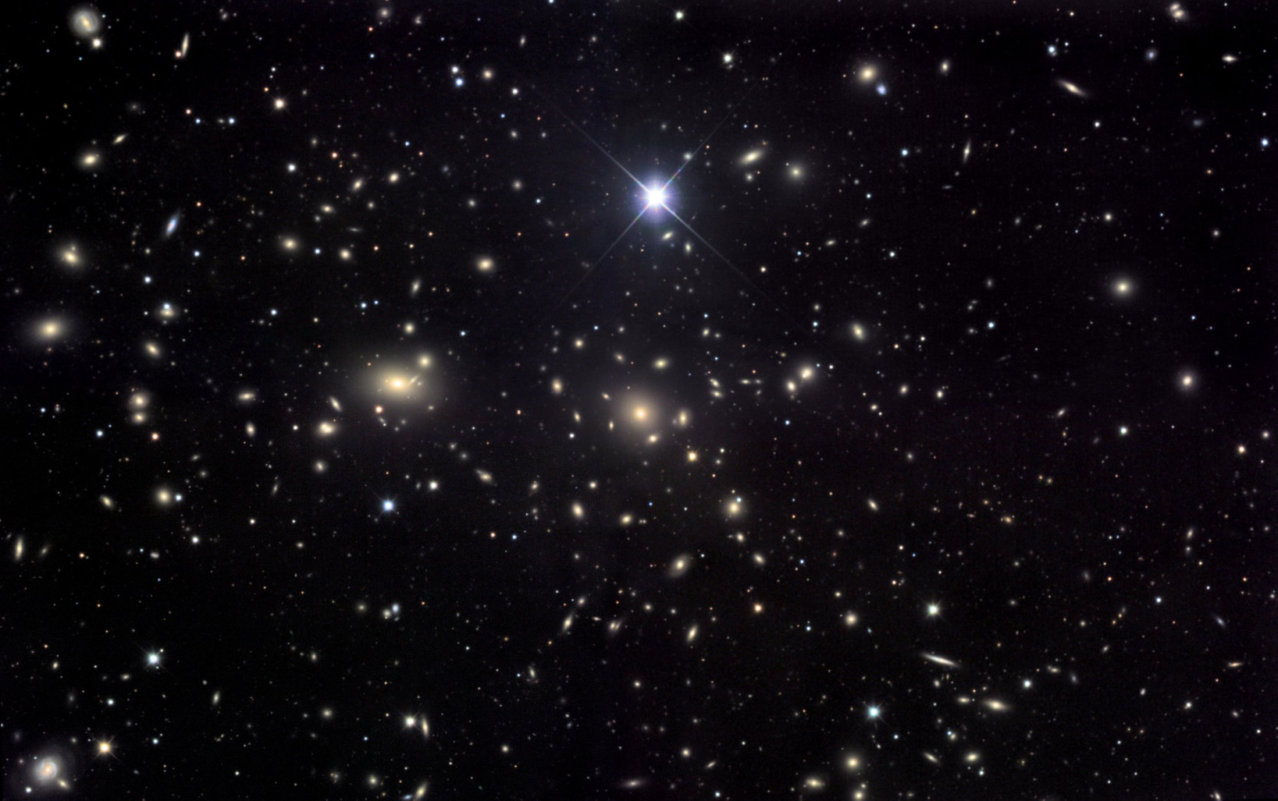
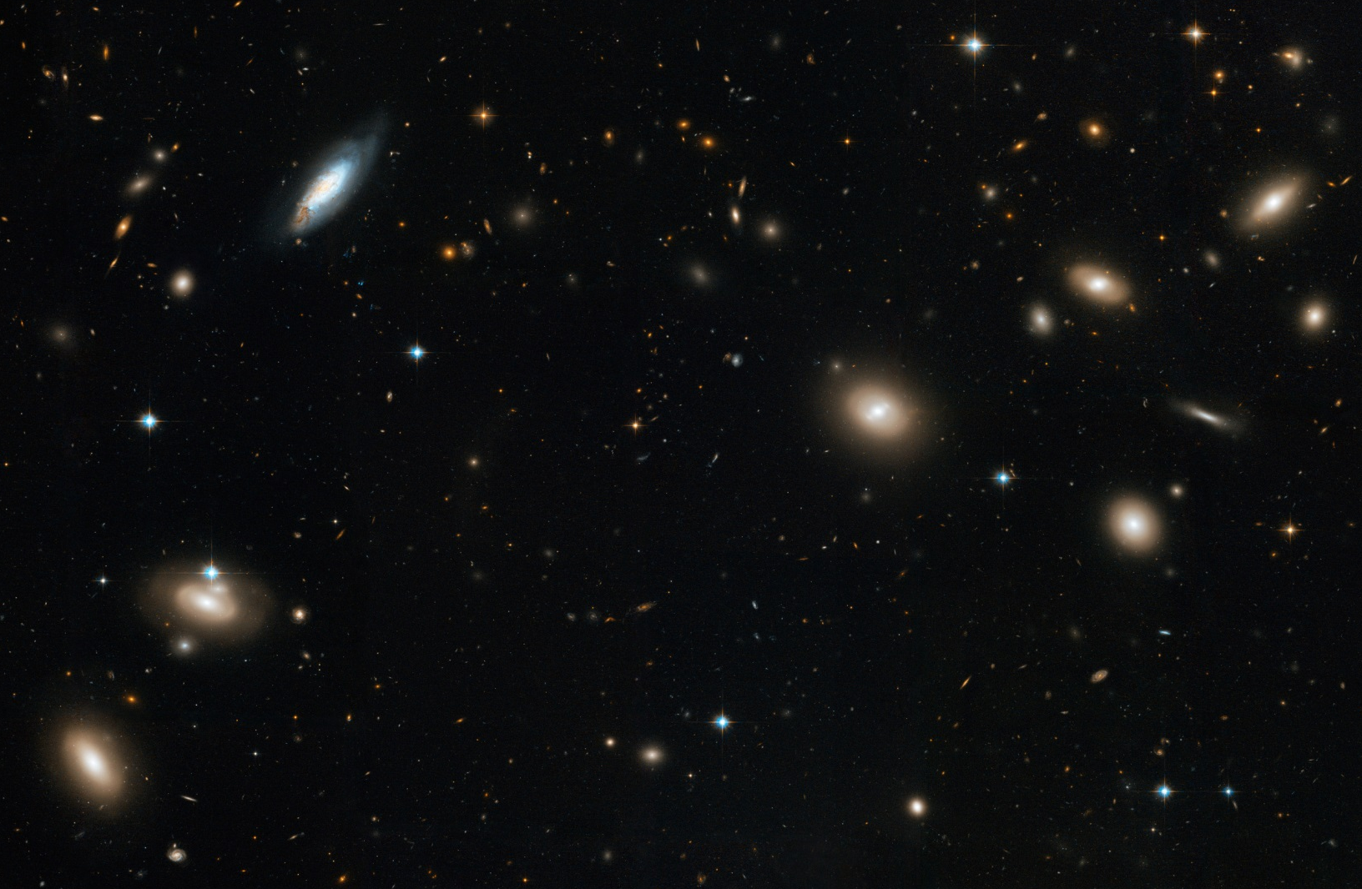
The Sky at Totality
Coma Cluster > 1,000 galaxies 321 million light years away
Ecliptic: Path of the Sun & Planets
BoÖtes
Castor
Gemini
Coma Berenices
Pollux
Summer Solstice
Praesepe Star Cluster
Coma Galaxy Cluster
Venus
Orion
Coma Star Cluster
Leo
Mars
Betelgeuse
Arcturus
Denebola
Cancer
Procyon
Canis MINor
Regulus
Celestial Equator
Virgo
Autumnal Equinox
Sirius
Jupiter
Canis Major
Spica
Corvus
Sun moves ~1°/day
Hubble image of a small portion of the cluster

Slide 40
The Sky at Totality
Ecliptic: Path of the Sun & Planets
BoÖtes
Castor
Gemini
Coma Berenices
Pollux
Summer Solstice
Praesepe Star Cluster
Coma Galaxy Cluster
Venus
Orion
Coma Star Cluster
Leo
Mars
Betelgeuse
Arcturus
Denebola
Cancer
Procyon
Canis MINor
Virgo Galaxy Cluster
Regulus
Celestial Equator
Virgo
Autumnal Equinox
Sirius
Jupiter
Canis Major
Spica
Corvus
Sun moves ~1°/day

Slide 41
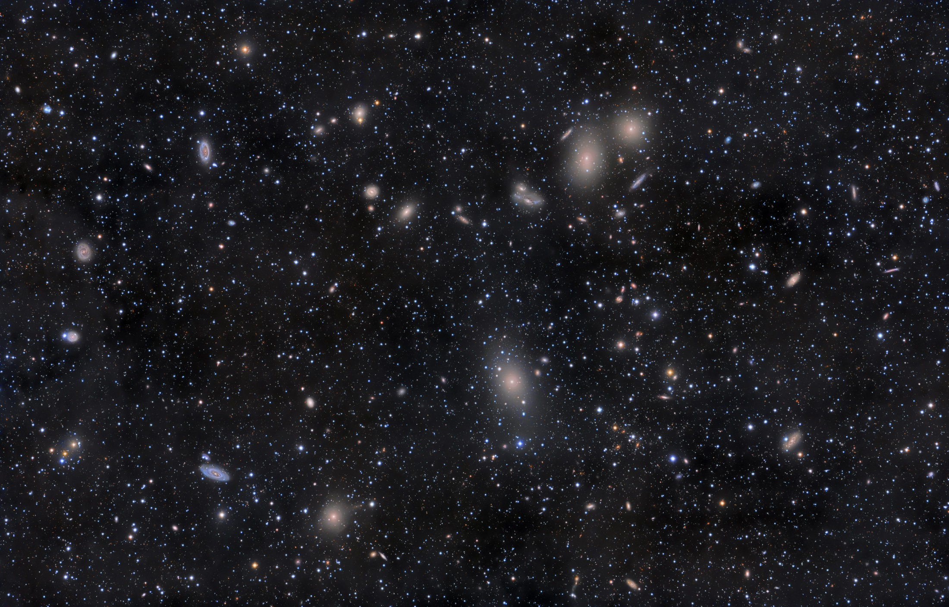
The Sky at Totality
Ecliptic: Path of the Sun & Planets
BoÖtes
Castor
Gemini
Coma Berenices
Pollux
Summer Solstice
Praesepe Star Cluster
Coma Galaxy Cluster
Venus
Orion
Coma Star Cluster
Leo
Mars
Betelgeuse
Arcturus
Denebola
Cancer
Procyon
Canis MINor
Virgo Galaxy Cluster
Regulus
Virgo Cluster 1,300 – 3,000 galaxies 53.8 million light years away
Celestial Equator
Virgo
Autumnal Equinox
Sirius
Jupiter
Canis Major
Spica
Corvus
Sun moves ~1°/day

Slide 42

The Sky at Totality
Toto, I've a feeling we're not in Kansas anymore
Ecliptic: Path of the Sun & Planets
BoÖtes
Castor
Gemini
Coma Berenices
Pollux
Summer Solstice
Praesepe Star Cluster
Coma Galaxy Cluster
Venus
Orion
But let us go even deeper!!
Leo
Mars
Coma Star Cluster
Betelgeuse
Arcturus
Denebola
Cancer
Procyon
Canis MINor
Virgo Galaxy Cluster
Regulus
Virgo Cluster 1,300 – 3,000 galaxies 53.8 million light years away
Celestial Equator
Virgo
Autumnal Equinox
Sirius
Jupiter
Canis Major
Spica
Corvus
Sun moves ~1°/day

Slide 43
The Sky at Totality
Ecliptic: Path of the Sun & Planets
BoÖtes
Castor
Gemini
Coma Berenices
Pollux
Summer Solstice
Praesepe Star Cluster
Coma Galaxy Cluster
Venus
Orion
Coma Star Cluster
Leo
Mars
Betelgeuse
Arcturus
Denebola
Cancer
Procyon
Canis MINor
Virgo Galaxy Cluster
Regulus
Celestial Equator
Virgo
Autumnal Equinox
Sirius
Jupiter
Canis Major
Spica
Corvus
Sun moves ~1°/day

Slide 44
The Sky at Totality
Ecliptic: Path of the Sun & Planets
BoÖtes
Castor
Gemini
Coma Berenices
Pollux
Summer Solstice
Praesepe Star Cluster
Venus
Orion
Virgo Super Cluster
Leo
Mars
Betelgeuse
Arcturus
Cancer
Procyon
Canis MINor
Regulus
Celestial Equator
Virgo
Autumnal Equinox
The Milky Way is falling toward the Virgo Super Cluster at 600 km/s … Atchison to the Colorado state line EVERY SECOND!
Jupiter
Spica
Sun moves ~1°/day

Slide 45
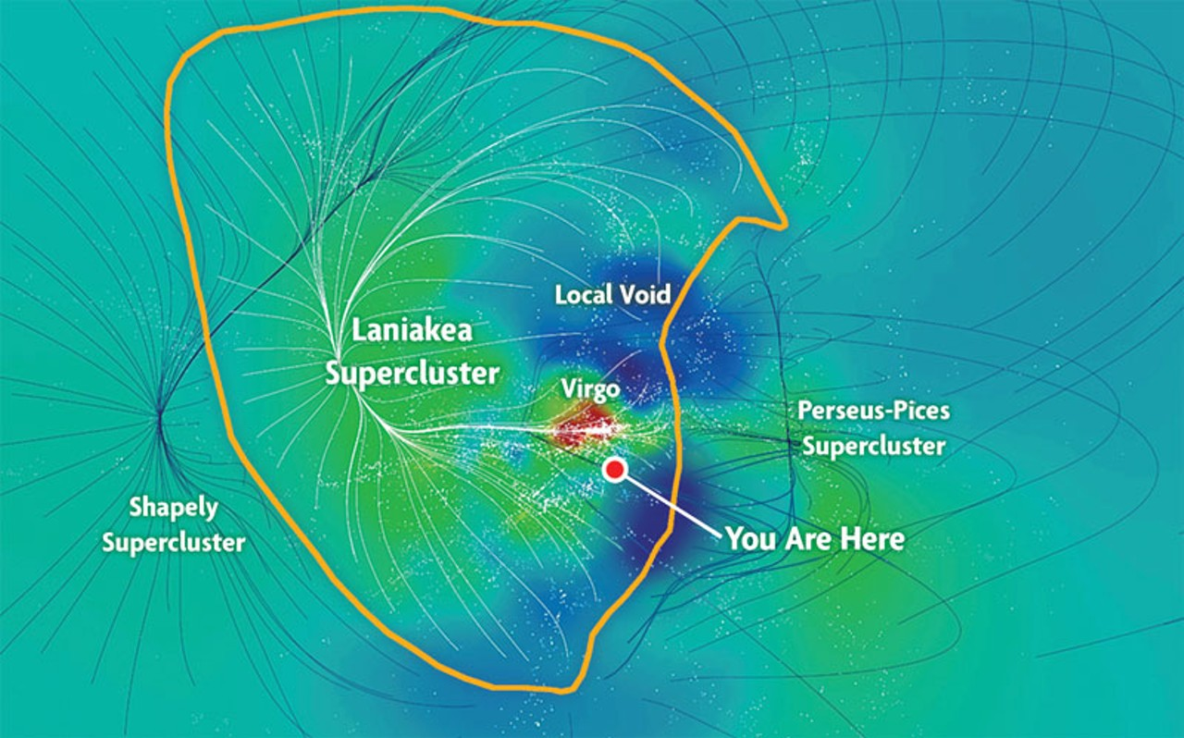
The Sky at Totality
“Immeasurable Heaven” is our true home … only found through astronomy.
And God is here, too!
Ecliptic: Path of the Sun & Planets
BoÖtes
Castor
Gemini
Coma Berenices
Pollux
Summer Solstice
Praesepe Star Cluster
Venus
Orion
Virgo Super Cluster
Leo
Mars
Betelgeuse
Arcturus
Cancer
Procyon
Canis MINor
Regulus
Celestial Equator
Virgo
Autumnal Equinox
The Milky Way is falling toward the Virgo Super Cluster at 600 km/s … Atchison to the Colorado state line EVERY SECOND!
Virgo is our neighborhood!
Jupiter
Spica
Sun moves ~1°/day

Slide 46
The Cosmos Within
“The Lord created me at the beginning of his work,
The first of his acts of long ago.
Ages ago I was set up, at the first, before the beginning of the Earth.
When he established the heavens, I was there.”
Proverbs 8:22-23, 27

Slide 47
The Cosmos Within
The entire universe
… including Laniakea
… is held in God
You are made of the universe
so the universe is within you …
… And you are within God

Slide 48
Look at Earth and Sky as your true home!
Know
“All shall be well, and all shall be well and all manner of thing shall be well.”
― Julian of Norwich

Slide 49
Thank You!
Thank you to Marcia & the Sisters of Mount St. Scholastica!
Thank you to all for your attention, kindness and companionship
Thank you to my sister Kate for joining me here and participating
Thank you to God for all the rich gifts of and for all of us …
… for my brother, Pat

Slide 50
The Sky at Totality
Ecliptic: Path of the Sun & Planets
BoÖtes
Castor
Gemini
Coma Berenices
Pollux
Summer Solstice
Praesepe Star Cluster
Coma Galaxy Cluster
Venus
Orion
Coma Star Cluster
Leo
Mars
Betelgeuse
Arcturus
Denebola
Cancer
Procyon
Canis MINor
Virgo Galaxy Cluster
Regulus
Celestial Equator
Virgo
Autumnal Equinox
Sirius
Jupiter
Canis Major
Spica
Corvus
Sun moves ~1°/day

