Slide 1
Why do we change the clocks?
Currently on Daylight Saving Time (EDT)
We “sprang ahead” on March 9
We’ll change back to EDT on March 8, 2026
Changing to Standard Time (EST)
Standard Time Begins on November 2, 2025
“Fall Back’’

Slide 2
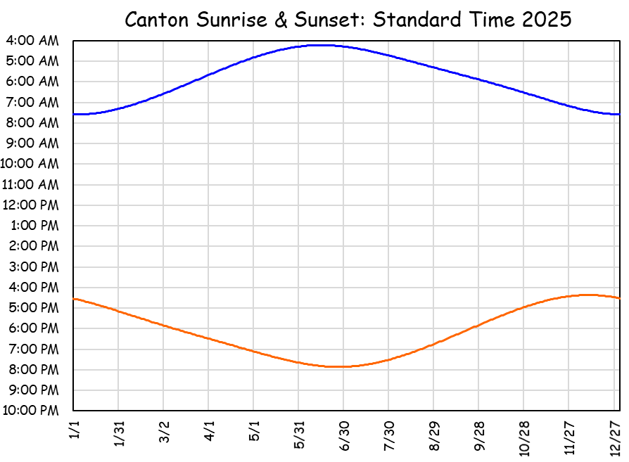
Why do we change the clocks??
Humans prefer to rise around sunrise
Stay in standard time
Summer sunrise at 4:13 am
Summer EST Sunrise at 4:13 am.
Are you kidding me? Sun is fully up before 5? How can a person sleep!

Slide 3
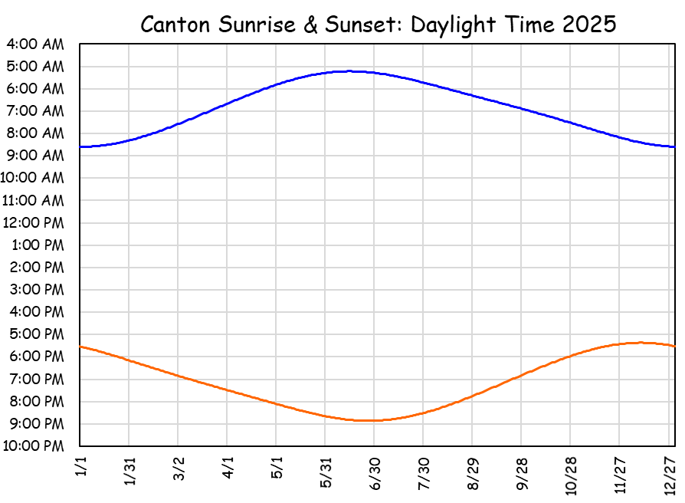
Why do we change the clocks??
Humans prefer to rise around sunrise
Stay in daylight time (as in 1974!)
Winter sunrise at 8:36 am
Winter EDT Sunrise at 8:36 am.
Are you kidding me? It’s dark until 8:30? You’d make us go to school in the dark?

Slide 4
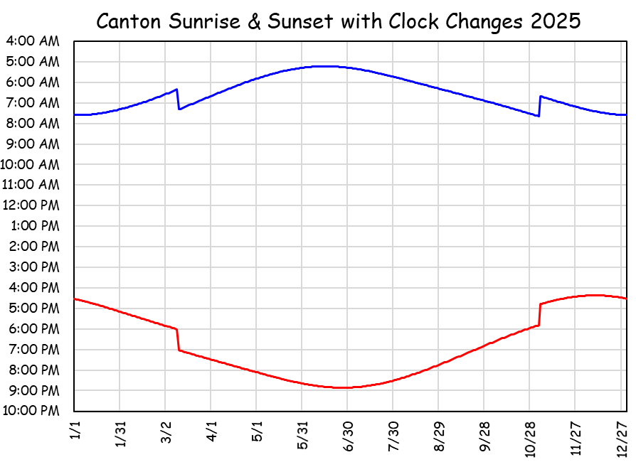
Why do we change the clocks??
Humans prefer to rise around sunrise
Changing clocks is the best compromise
Summer sunrise 5:13 am, Winter sunrise 7:36 am
Summer EDT Sunrise at 5:13 am.
Winter EST Sunrise at 7:36 am.
Are you kidding me? We have to change the clocks?

Slide 5
Why do we change the clocks??
Earth’s tilt changes day length constantly
At 44.6° N (Canton) this means
Shortest day (~ 12/21) is 8h 49m long
Longest day (~6/21) 15h 37m long
Difference = 6h 48m
On the equator, all days are 12h long
At 60 ° N, day length changes by 13 hours
18h 52m June, 5h 52m
On the arctic circle (66.5° N) day length
goes from 24 hours of dark to 24 hours of light

Slide 6
Why do we change the clocks??
We must cope with changing daylight
Standard time
Clock noon is solar noon
Sunset & sunrise symmetric about clock noon
Daylight time
1 pm is solar noon
Sunrise & sunset shifted an hour later
More light in the evening, dark in the morning
Daydark time
11 am is solar noon
Sunrise & sunset shifted an hour earlier
Yeah ... nobody does this, but it’s an option!!

Slide 7
The compromise of changing the clocks seems to work best.
We are here!

