Slide 1
Why do we change the clocks?
Currently on Standard Time (EST)
Changing to Daylight Saving Time (EDT)
Daylight Saving Time
Begins on March 8, 2026
“Spring Ahead’’

Slide 2
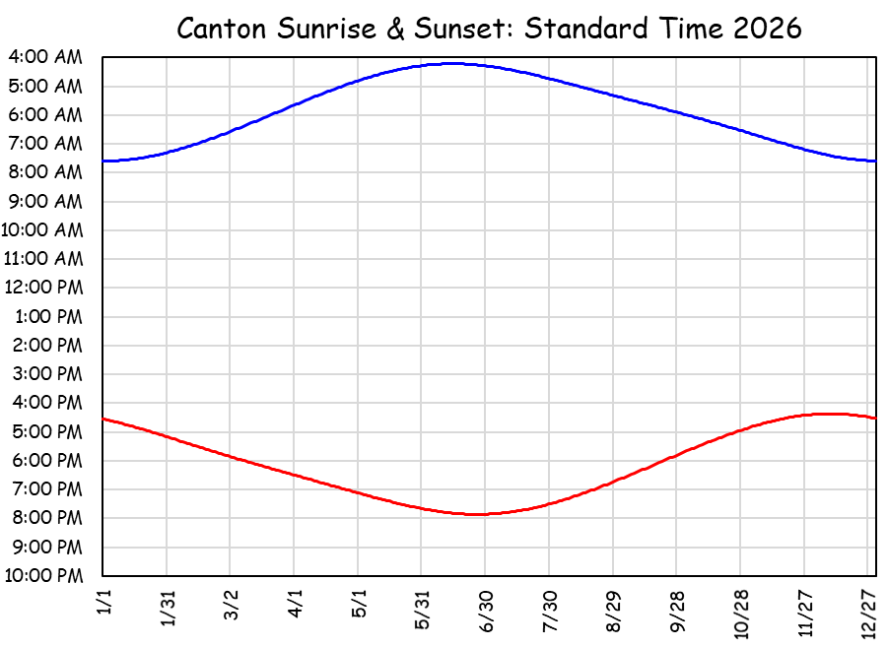
Why do we change the clocks??
Humans prefer to rise around Sun rise
  Stay in standard time
    Summer Sun rise at 4:13 am
Summer EST Sunrise at 4:13 am.
Are you kidding me? Sun is fully up before 5? How can a person sleep?!

Slide 3
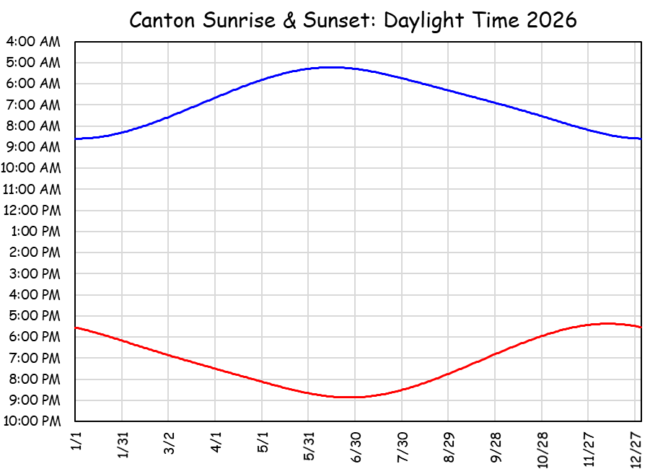
Why do we change the clocks??
Humans prefer to rise around Sun rise
  Stay in daylight time
    Winter Sun rise at 8:36 am
Winter EDT Sunrise at 8:36 am.
Are you kidding me? It’s dark until 8:30? You’d make us go to school in the dark?

Slide 4
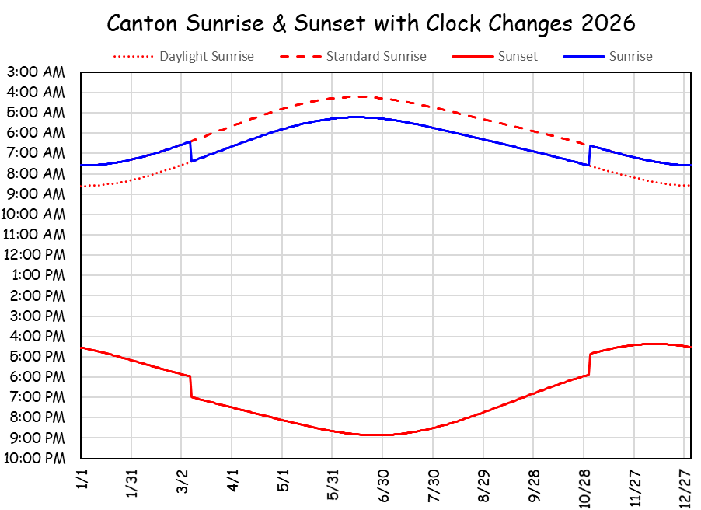
Why do we change the clocks??
Humans prefer to rise around Sun rise
  Changing clocks is the best compromise
    Summer Sun rise 5:13 am, Winter Sun rise 7:36 am
Summer EDT Sunrise at 5:13 am.
Winter EST Sunrise at 7:36 am.
Are you kidding me? We have to change the clocks?

Slide 5
Why do we change the clocks??
Earth’s tilt changes day length constantly
  At 44.6° N (Canton) this means
    Shortest day (~ 12/21) is 8h 49m long
    Longest day (~6/21) 15h 37m long
    Difference = 6h 48m
  On the equator, all days are 12h long
  At 60 ° N, day length changes by 13 hours
    18h 52m June, 5h 52m
  On the arctic circle (66.5° N) day length
  goes from 24 hours of dark to 24 hours of light

Slide 6
Why do we change the clocks??
We must cope with changing daylight
  Standard time
    Clock noon is solar noon
    Sunset & sunrise symmetric about clock noon
  Daylight time
    1 pm is solar noon
    Sunrise & sunset shifted an hour later
      More light in the evening, dark in the morning
  Daydark time
    11 am is solar noon
    Sunrise & sunset shifted an hour earlier
Yeah ... nobody does this, but it’s an option!!

Slide 7
The compromise of changing the clocks seems to work best.
We are here!

