Slide 1
Harvest Moon and Tides
Aileen A. O’Donoghue
SLU Physics

Slide 2
Harvest Moon 2025
Some full moons are named
  Harvest moon = full moon closest to equinox
    September 29, 5:57 am EDT
      Exact time of moon at elongation of 180°
    Moon bright at rising for days
    Allowed farmers to work into the night
  Hunter’s moon = follows Harvest moon
    October 28, 4:24 pm EDT
      Exact time of moon at elongation of 180°

Slide 3
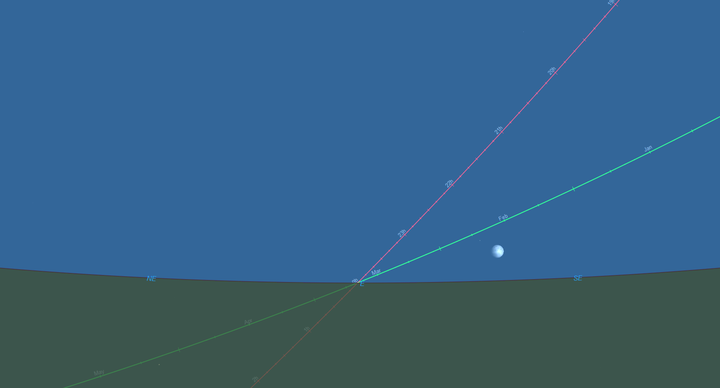
Harvest Moon 2023 Illustration
Some full moons are named
  Harvest moon = full moon closest to equinox
    September 29, 5:57 am EDT
      Exact time of moon at elongation of 180°
    Moon bright at rising for days
    Allowed farmers to work into the night
  Hunter’s moon = follows Harvest moon
    October 28, 4:24 pm EDT
      Exact time of moon at elongation of 180°
9/26/23 6:36 pm
Autumn ecliptic at low angle to horizon!
Ecliptic
Alt_{ecliptic} = ?

Slide 4
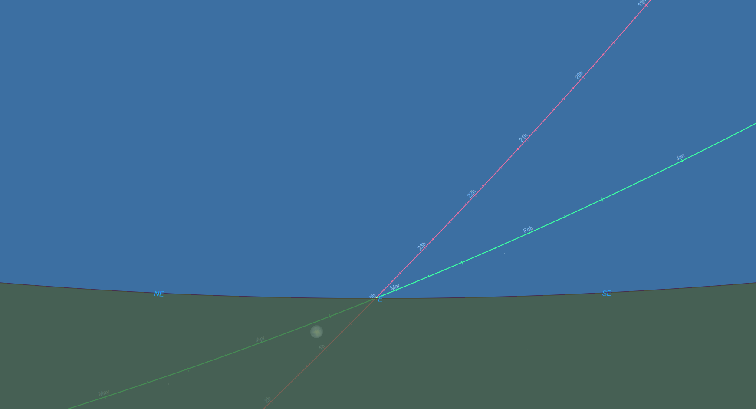
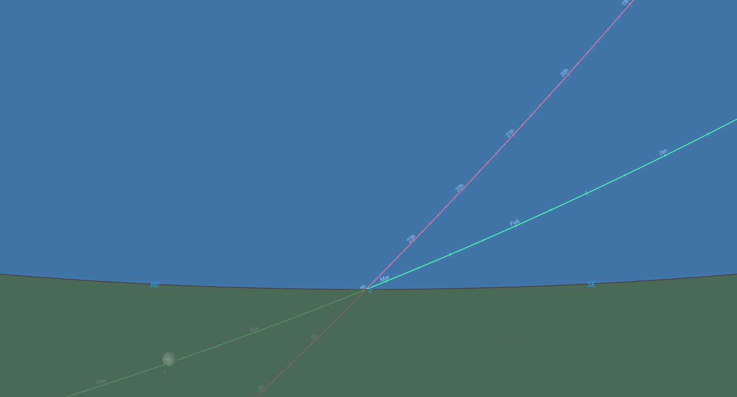

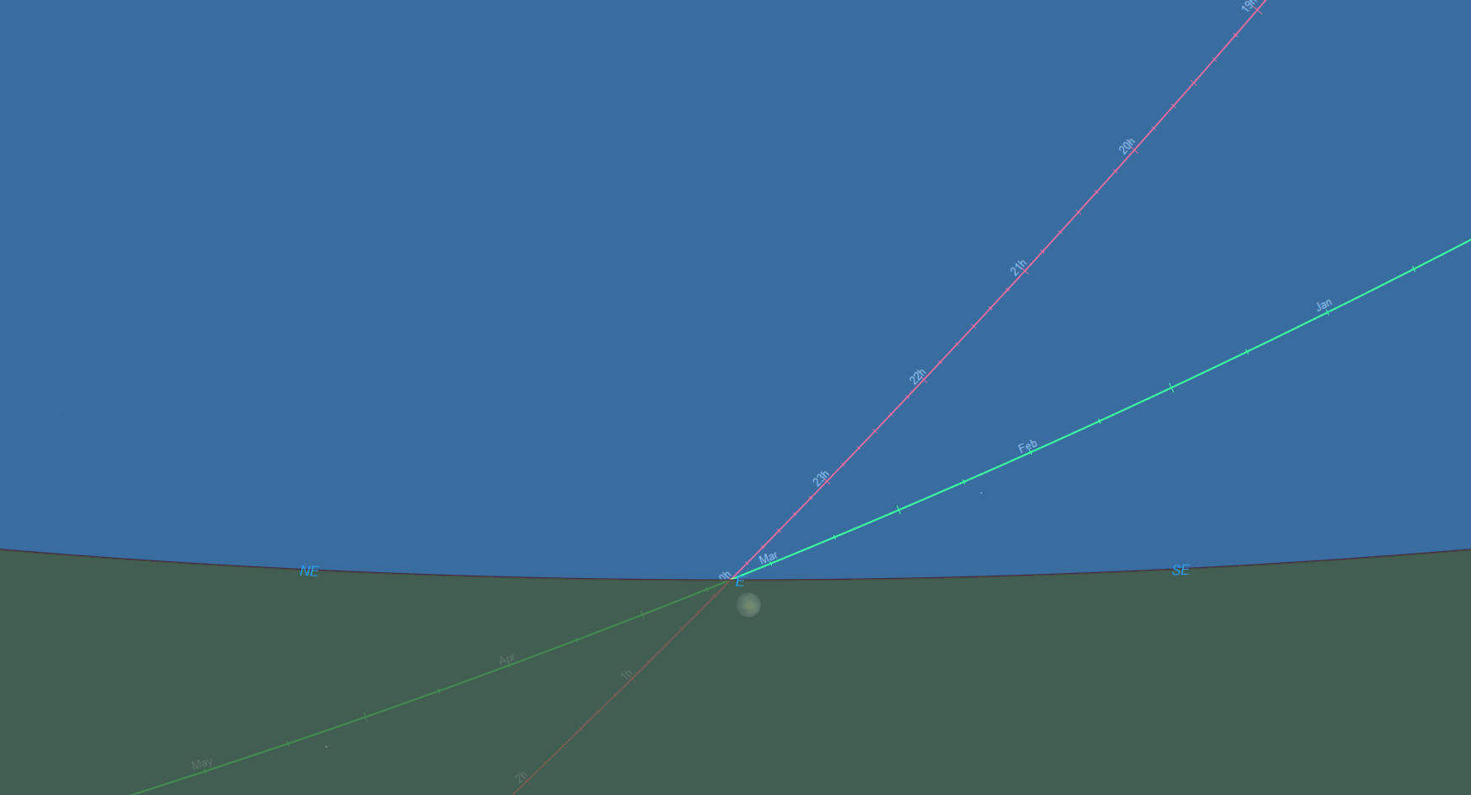
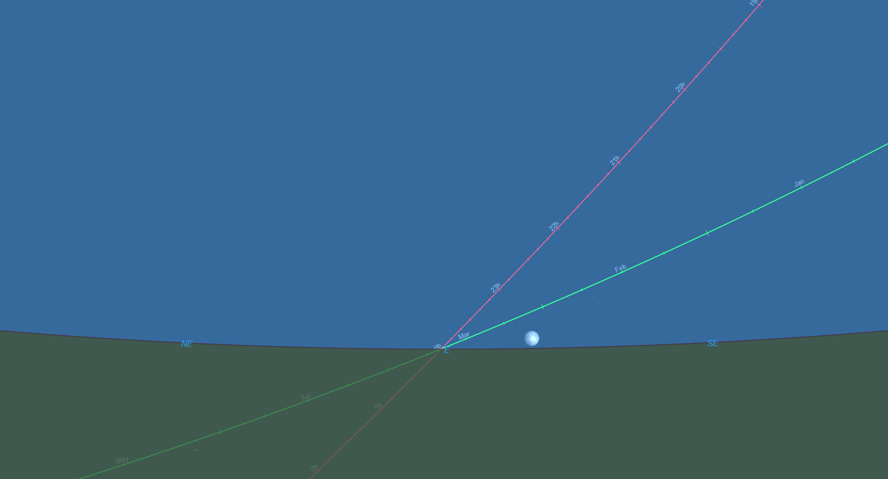
Harvest Moon 2023 Illustration
Harvest Moon at sunset
  Moon as Sept. Equinox rises over 6 days
9/26/23 6:36 pm, moonrise 58 min. before sunset
9/27/23 6:32 pm, moonrise 31 min. before sunset
Nearly full moon rises within an hour of sunset for 6 days.
9/28/23 6:28 pm, moonrise 7 min. before sunset
9/29/23 6:24 pm, moonrise 16 min. after sunset
9/30/23 6:20 pm, moonrise 40 min. after sunset
10/01/23 6:16 pm, moonrise 67 min. after sunset
Alt. = 5.7° Az. = 120.1°
Alt. = -14.5° Az. = 48.5°
Full Harvest Moon on 9/29/23

Slide 5
Harvest Moon 2023 Illustration
Harvest Moon at sunset
  Moon as Sept. Equinox rises over 6 days
9/26/23 6:36 pm, moonrise 58 min. before sunset
9/27/23 6:32 pm, moonrise 31 min. before sunset
Nearly full moon rises within an hour of sunset for 6 days.
9/28/23 6:28 pm, moonrise 7 min. before sunset
9/29/23 6:24 pm, moonrise 16 min. after sunset
9/30/23 6:20 pm, moonrise 40 min. after sunset
10/01/23 6:16 pm, moonrise 67 min. after sunset
Equinox position rises 4 minutes earlier each day!
Alt. = 5.7° Az. = 120.1°
Alt. = -14.5° Az. = 48.5°
Full Harvest Moon on 9/29/23

Slide 6
Harvest Moon 2023 Illustration
Harvest Moon at sunset
  Moon as Sept. Equinox rises over 6 days
9/26/23 6:36 pm, moonrise 58 min. before sunset
9/27/23 6:32 pm, moonrise 31 min. before sunset
Nearly full moon rises within an hour of sunset for 6 days.
9/28/23 6:28 pm, moonrise 7 min. before sunset
9/29/23 6:24 pm, moonrise 16 min. after sunset
9/30/23 6:20 pm, moonrise 40 min. after sunset
10/01/23 6:16 pm, moonrise 67 min. after sunset
120.1° – 48.5° = 71.6° Moon moves southward along horizon
(as Sun does after Sept. Equinox!)
5.7° + 14.5° = 20.2°
Alt. = 5.7° Az. = 120.1°
Moon stays close to horizon.
Alt. = -14.5° Az. = 48.5°
Full Harvest Moon on 9/29/23

Slide 7
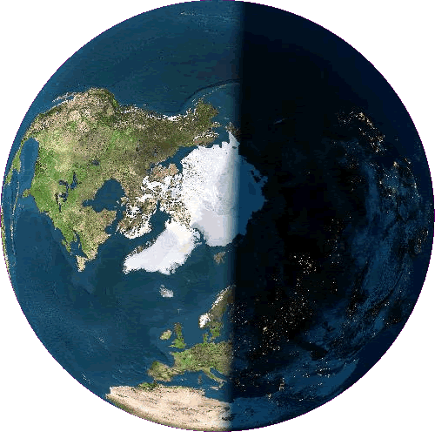
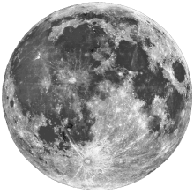
Tides
Gravity
  Depends on inverse of distance squared
Earth attracts Moon
Moon attracts Earth
SAME!

Slide 8
Tides
Gravity
  Depends on inverse
  of distance squared
  Differential gravity
    Moon’s pull stronger on near side of Earth than center or far side

Slide 9
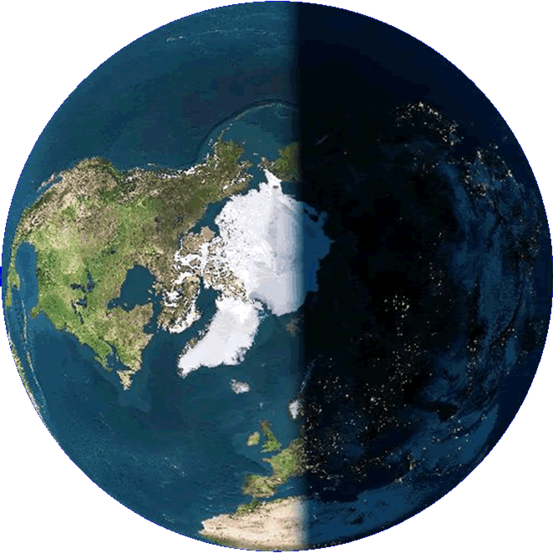
Tides
Differential Gravity
  Distorts Earth
    Pulls near side toward Moon
    Pulls center less hard
    Leaves far side behind
Tidal bulges
But Earth rotates!

Slide 10
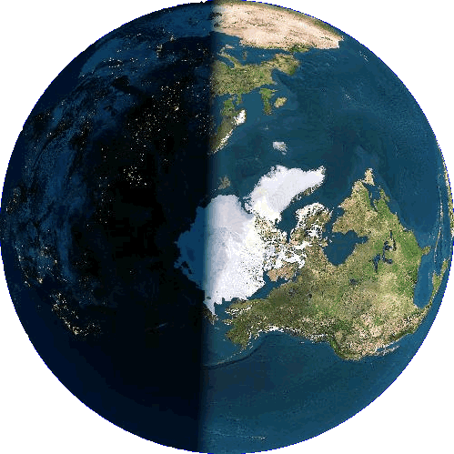
Tides
Tidal Bulges
  Earth rotates underneath
    Lag behind sunlunar point
Tidal bulges
It’s low tide
Sublunar point
It’s high tide

Slide 11
Tides
Tidal Bulges
  Slow Earth’s rotation
    Day lengthening by 1.4 ms each century
      4.5 billion years ago (moon formed), day 18 hours long
  Speed Moon in its orbit
    Moon is moving away at 3.82 cm/yr
      25% closer 3.2 billion years ago
Bulge attracts Moon
Moon attracts Bulge

Slide 12
Tides Caused by the Sun
Sun much bigger, much farther away
  Tides add to Moon’s
    Spring Tides
      Solar & Lunar tidal bulges add
      New & Full moon
Spring Tides
Lunar Tides
Solar Tides

Slide 13
Tides Caused by the Sun
Sun much bigger, much farther away
  Tides add to Moon’s
    Neap Tides
      Solar & Lunar tidal bulges perpendicular
      Quarter moons
Neap Tides
Solar Tides
Lunar Tides

Slide 14
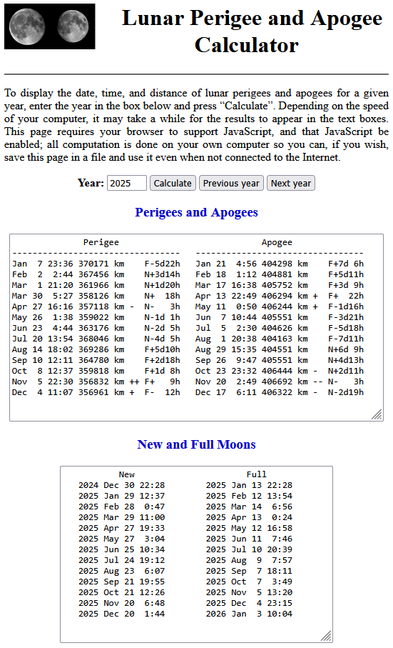
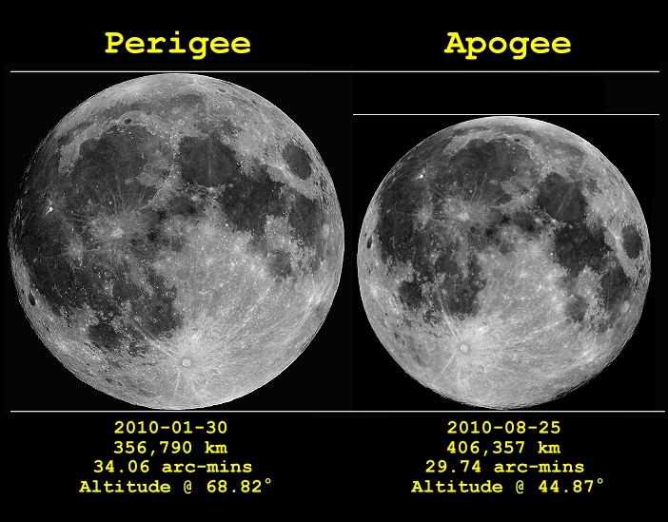
King Tides
King Tide = Spring Tide at Perigee
  Apogee (micromoon) weakens lunar tides
  Perigee (supermoon) strengthens lunar tides
https://www.fourmilab.ch/earthview/pacalc.html
https://epod.usra.edu/blog/2011/03/full-moon-comparison-of-2010.html

Slide 15
King Tides
https://www.fourmilab.ch/earthview/pacalc.html
King Tide = Spring Tide at Perigee
  Apogee (micromoon) weakens lunar tides
  Perigee (supermoon) strengthens lunar tides
https://www.fourmilab.ch/earthview/pacalc.html
New moons near perigee
Full moons near perigee
King Tides, Mar.-Apr. and Nov.-Dec. 2025
F = full moon, N = new moon
https://epod.usra.edu/blog/2011/03/full-moon-comparison-of-2010.html

Slide 16
King Tides
https://www.fourmilab.ch/earthview/pacalc.html
King Tide = Spring Tide at Perigee
  Apogee (micromoon) weakens lunar tides
  Perigee (supermoon) strengthens lunar tides
https://www.fourmilab.ch/earthview/pacalc.html
New moons near perigee
Full moons near perigee
King Tides, Mar.-May and Oct.-Dec. 2025
F = full moon, N = new moon
https://epod.usra.edu/blog/2011/03/full-moon-comparison-of-2010.html

Slide 17
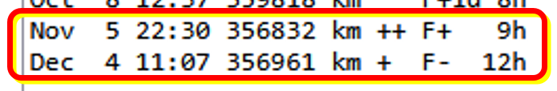
King Tides
https://www.fourmilab.ch/earthview/pacalc.html
King Tide = Spring Tide at Perigee
  Apogee (micromoon) weakens lunar tides
  Perigee (supermoon) strengthens lunar tides
Hunter’s and Cold Moons are super moons with perigee 9 hours after or 12 hours before full moon!
https://www.fourmilab.ch/earthview/pacalc.html
New moons near perigee
Full moons near perigee
King Tides, Mar.-May and Oct.-Dec. 2025
F = full moon, N = new moon
https://epod.usra.edu/blog/2011/03/full-moon-comparison-of-2010.html

