Slide 1


SOAR: Lives of Stars
Lives & Deaths of Large Stars
Aileen A. O’Donoghue Henry Priest Professor of Physics

Slide 2
The Lives of Stars
Star Birth: 9/10/26
  Nuclear Explosions Contained by Gravity
Lives & Deaths of Small Stars: 9/17/26
  Planetary Nebulae and White Dwarfs
Deaths of Large Stars: 9/24/26
  Supernovae, Neutron Stars and Black Holes
Black Holes: 10/1/26
  Spaghettification

Slide 3
Outline
Review Small Star Deaths
  Star life on the Main Sequence
  Star Deaths
    Sol: Red Giant, Planetary Nebula, White Dwarf
Evolution of Large Stars
  Fusion Layers & Neutrinos
  Type II Supernovae
    Neutron Stars & Pulsars
Types of Supernovae
  Origins of the Elements
States of Matter

Slide 4
Outline
Review Small Star Deaths
  Star life on the Main Sequence
  Star Deaths
    Sol: Red Giant, Planetary Nebula, White Dwarf
Evolution of Large Stars
  Fusion Layers & Neutrinos
  Type II Supernovae
    Neutron Stars & Pulsars
Types of Supernovae
  Origins of the Elements
States of Matter

Slide 5
Main Sequence Life
Hydrostatic Equilibrium Fusing H to He
  Gravity pulling inward
    weight of upper layers tries to compress star
  Pressure of heated gas pushing outward
    nuclear explosion tries to expand star
    balance lost when fuel runs out
Gravity
Ultimately, gravity will win!
Pressure

Slide 6
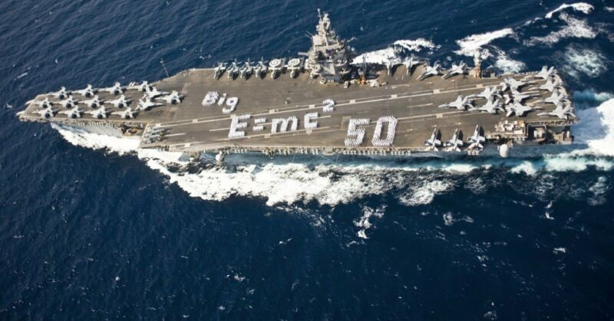
The Sun on the Main Sequence
A nuclear explosion
contained by gravity.
fusion core
17 Earths wide
Sol turns 45 Aircraft Carrier masses of H to pure energy each second ... every second!

Slide 7

Star Deaths
Lifespan, death depend on star’s mass
Small Stars (0.1 M_{Sol} < M_{star} ≤ 8M_{Sol})
  Longish lives (10’s of billions of years)
    No star smaller than 0.8 Msol has lived out its life!
  Planetary Nebula to White Dwarf
Giant Stars (M > 8M_{Sol}, M_{max} ≈100 M_{Sol})
  Lives can be very short (millions of years)
  Supernova to Neutron Star or Black Hole

Slide 8
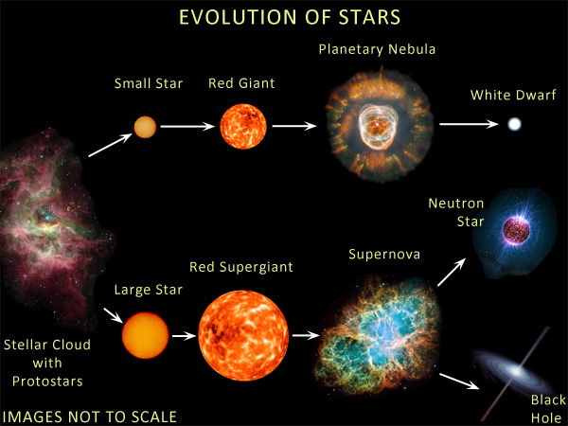
Star Death Depends on Mass
Clown Face Nebula
https://en.wikipedia.org/wiki/Eskimo_Nebula
Crab Nebula
https://en.wikipedia.org/wiki/Crab_Nebula

Slide 9
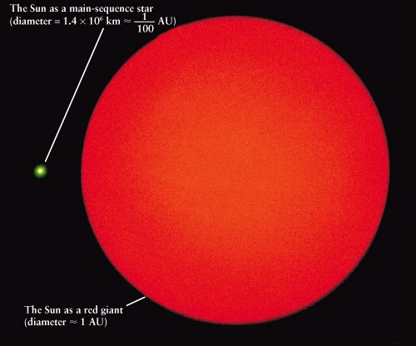
Sol will Become a Red Giant ...
Sol as red giant will engulf ☿and ♀
Expanding outer layers
Hydrogen fusing shell heating outer layers
Shrinking He core becoming degenrate electron gas
Sol may engulf Earth

Slide 10
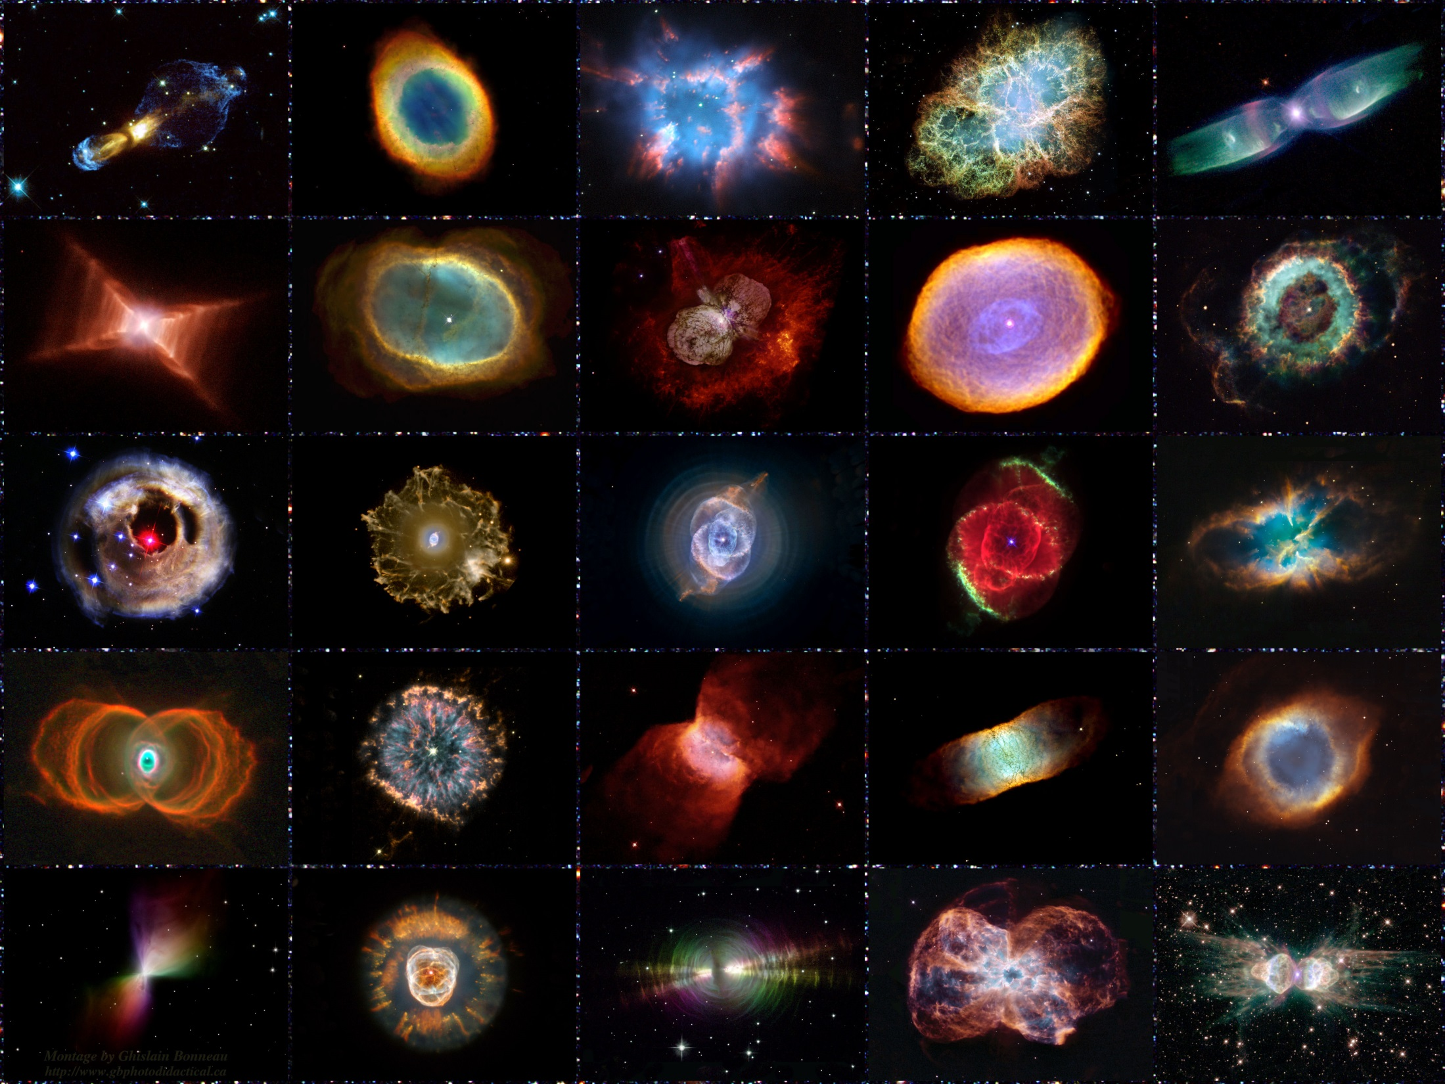
... Then a Planetary Nebula

Slide 11
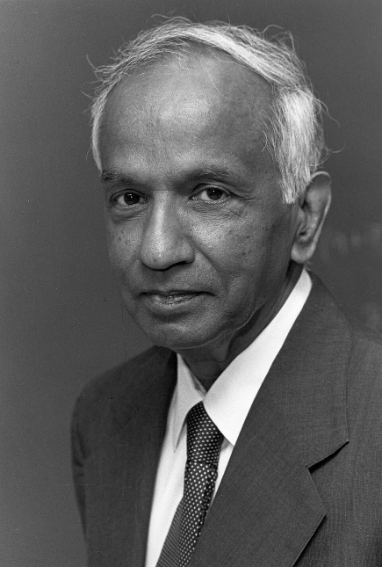
Sol’s Core will be a White Dwarf
Degenerate e⁻ gas
  atoms packed as close as possible
    electron clouds packed together
    all space squeezed out from between atoms
  does not expand on heating
  maximum mass = 1.4 M_{sol}
    Chandresekhar Limit
    electron degeneracy can’t hold itself up against gravity
Normal Gas
Atom
Degenerate e⁻ Gas
Subrahmanyan Chandrasekhar 1910-1995

Slide 12
Outline
Review Small Star Deaths
  Star life on the Main Sequence
  Star Deaths
    Sol: Red Giant, Planetary Nebula, White Dwarf
Evolution of Large Stars
  Fusion Layers & Neutrinos
  Type II Supernovae
    Neutron Stars & Pulsars
Types of Supernovae
  Origins of the Elements
States of Matter

Slide 13
Evolution of Massive Stars
Hydrogen core used up quickly (10⁷ yr!)
  Core contracts, heats, star expands
Helium fusion begins easily,
  No Helium flash
  H fusion in shell surrounding He fusing core
Helium core gets used up
  Core contracts, heats to fuse C easily (no C flash)
  He fusion in shell surrounding C fusing core
Carbon fusion shrinks star!
  Energy lost by neutrinos … heat pressure reduced
    Neutrinos only interact with atomic nuclei
    Neutrinos escape star quickly
      Light takes a million years ... interacts with atoms

Slide 14
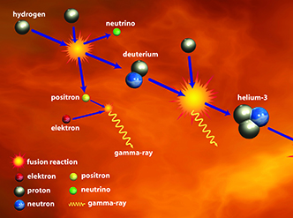
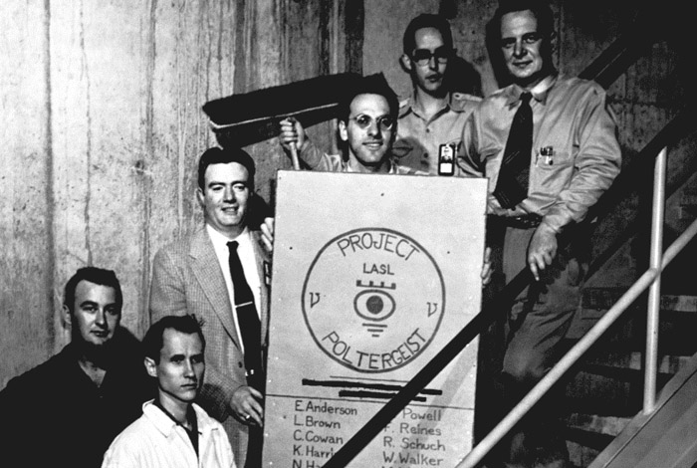
Neutrinos
Neutrinos
  Produced in fusion reactions
  Weakly interact with matter
    Pass through Sol, Earth, you constantly
    Hard to detect (only interact with nuclei)
Predicted in 1930
  Energy “missing” from nuclear reactions
    Pauli predicted particle
Detected in 1956
  Project Poltergeist
    Savannah River (nuclear)
    Plant, S.C. provided neutrinos
https://scienceinschool.org/wp-content/uploads/2014/11/issue19neutrinos.jpg
https://en.wikipedia.org/wiki/Cowan%E2%80%93Reines_neutrino_experiment

Slide 15
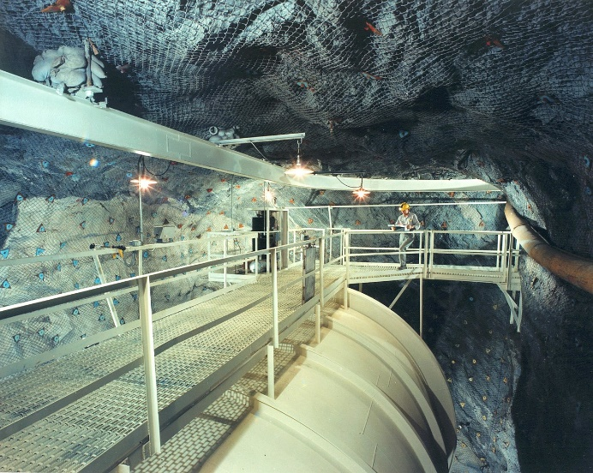
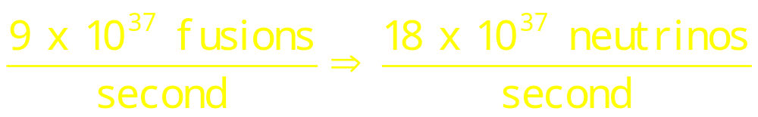
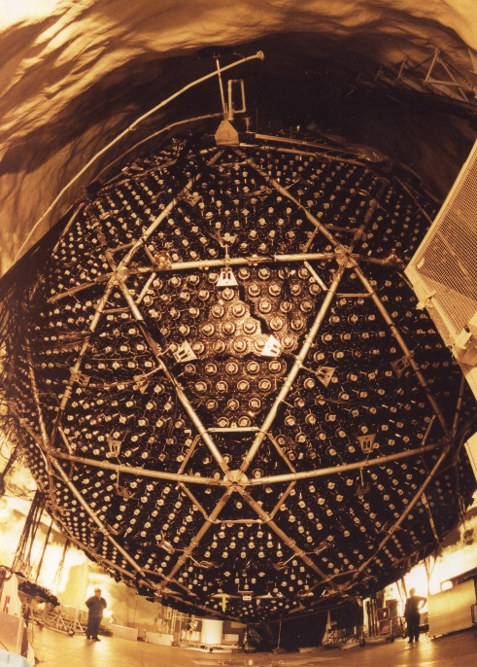


Neutrinos
Tank of dry cleaning fluid Homestake experiment
Solar Neutrinos
  2 Produced in each fusion
  Flux at Earth = 63 billion neutrinos/cm²!!
Solar neutrino problem
  1/3 of expected number detected in 1960s!
    Homestake Experiment, South Dakota
  Sudbury Neutrino Observatory
    neutrinos oscillate among 3 types
    -- e⁻, μ (mu) & τ (tau)
    SNO detected all three in 2002!

Slide 16
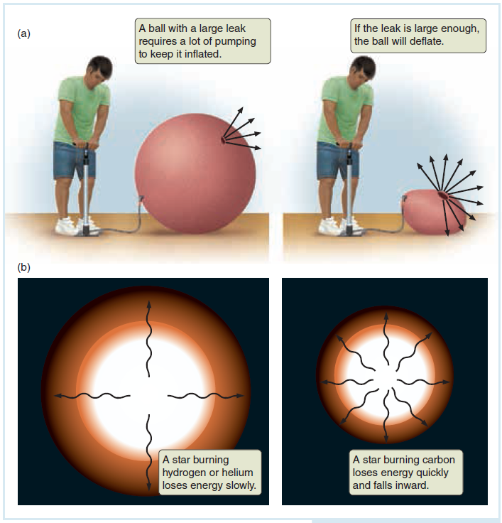
Carbon Fusion & Neutrinos
Star layers being held up by heat once Carbon starts fusing is like pumping up a leaky ball due to production of neutrinos!

Slide 17
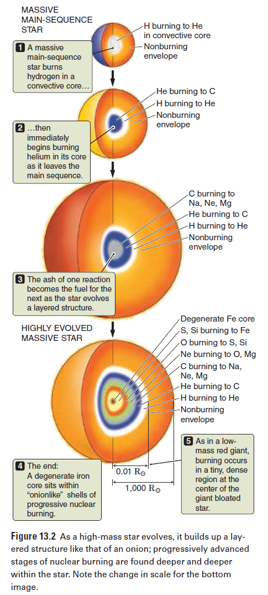
Fusion Cores
H to He
C fusion to N, Na, Mg
  Shrinks star!
  Energy escapes mostly in neutrinos
  Star shrinks
  Fusion increases (higher density!)
  Luminosity is maintained
  Supports star ~1000 years
Ne fusion to O
O fusion to S, Si
  Supports star ~ 1 year
Silicon fusion to iron
He to C
C to Na, Ne, Mg

Slide 18
Fusion Cores
H to He
C fusion to N, Na, Mg
  Shrinks star!
  Energy escapes mostly in neutrinos
  Star shrinks
  Fusion increases (higher density!)
  Luminosity is maintained
  Supports star ~1000 years
Ne fusion to O
O fusion to S, Si
  Supports star ~ 1 year
Silicon fusion to iron
He to C
C to Na, Ne, Mg
Note Difference in scales!!

Slide 19
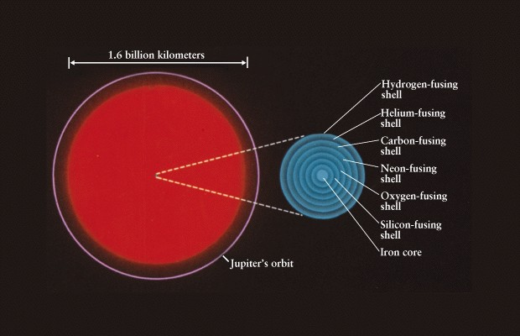
Red Supergiants
Formation of Iron Core is fatal …
Betelgeuse, Antares …

Slide 20
Outline
Review Small Star Deaths
  Star life on the Main Sequence
  Star Deaths
    Sol: Red Giant, Planetary Nebula, White Dwarf
Evolution of Large Stars
  Fusion Layers & Neutrinos
  Type II Supernovae
    Neutron Stars & Pulsars
Types of Supernovae
  Origins of the Elements
States of Matter

Slide 21
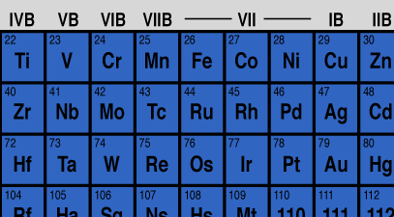
Type II Supernovae
Star is “onion” of fusion shells
Iron core does not fuse
  Iron fusion ABSORBS energy
    Iron most stable element
      absorbs energy in fusion AND fission
  Iron core builds to Chandrasekhar Limit (1.4M)
Core implodes
Star collapses in on itself
  center gets very dense
  outer layers bounce off dense center
Iron – Fe 26 protons
Supernova

Slide 22
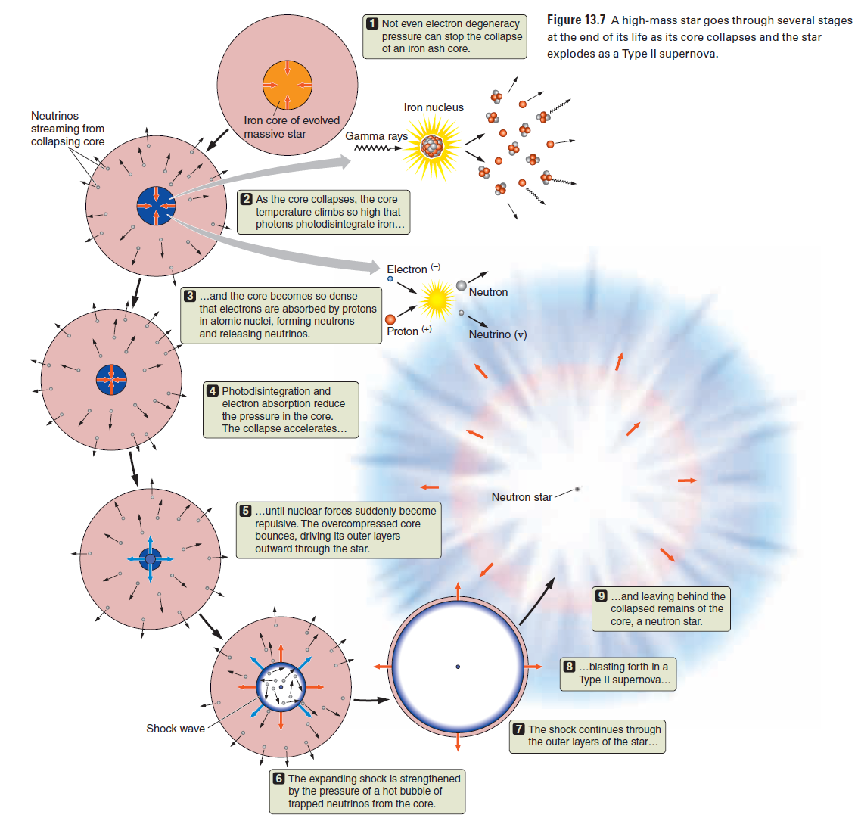
Type II Supernovae
This process takes about 1 second

Slide 23
Type II Supernovae
Core collapses under gravity and heats
This process takes about 1 second
Photons dissociate iron into H & He (Fe in us not from this process)
p⁺ absorb e⁻ to create n⁰ and ν
Core shrinks faster!

Slide 24
Type II Supernovae
Photons dissociate iron into H & He
This process takes about 1 second
p⁺ absorb e⁻ to create n⁰ and ν
Core shrinks faster!
Nuclear forces become repulsive … exploding core
Shock from core explodes star!! Supernova!!

Slide 25
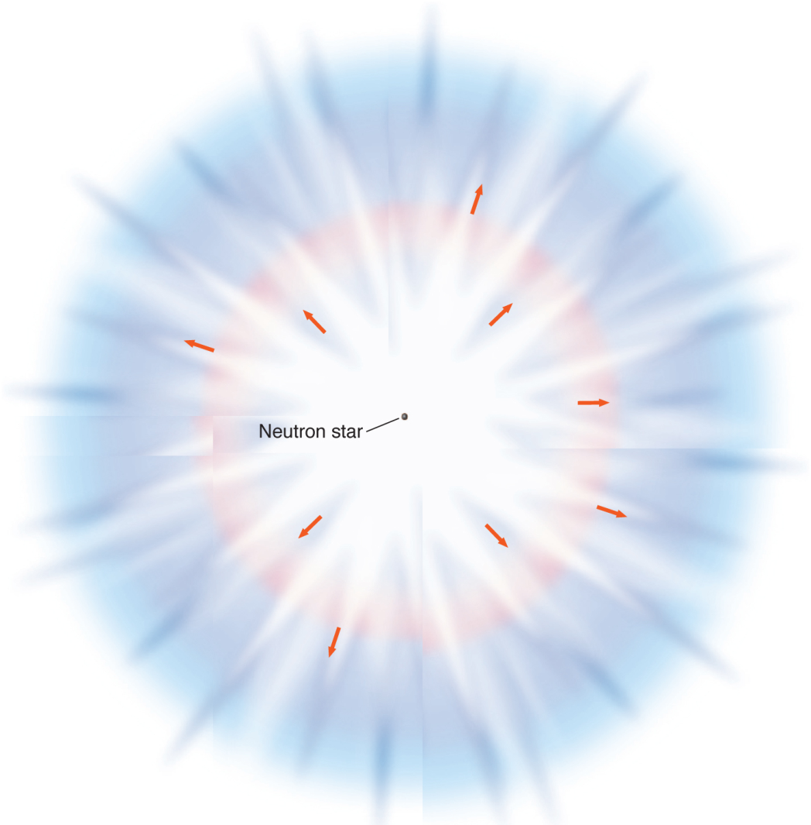
Type II Supernovae
Photons dissociate iron into H & He
This process takes about 1 second
p⁺ absorb e⁻ to create n⁰ and ν
Core shrinks faster!
Nuclear forces become repulsive … exploding core
Shock from core explodes star!! Supernova!!

Slide 26
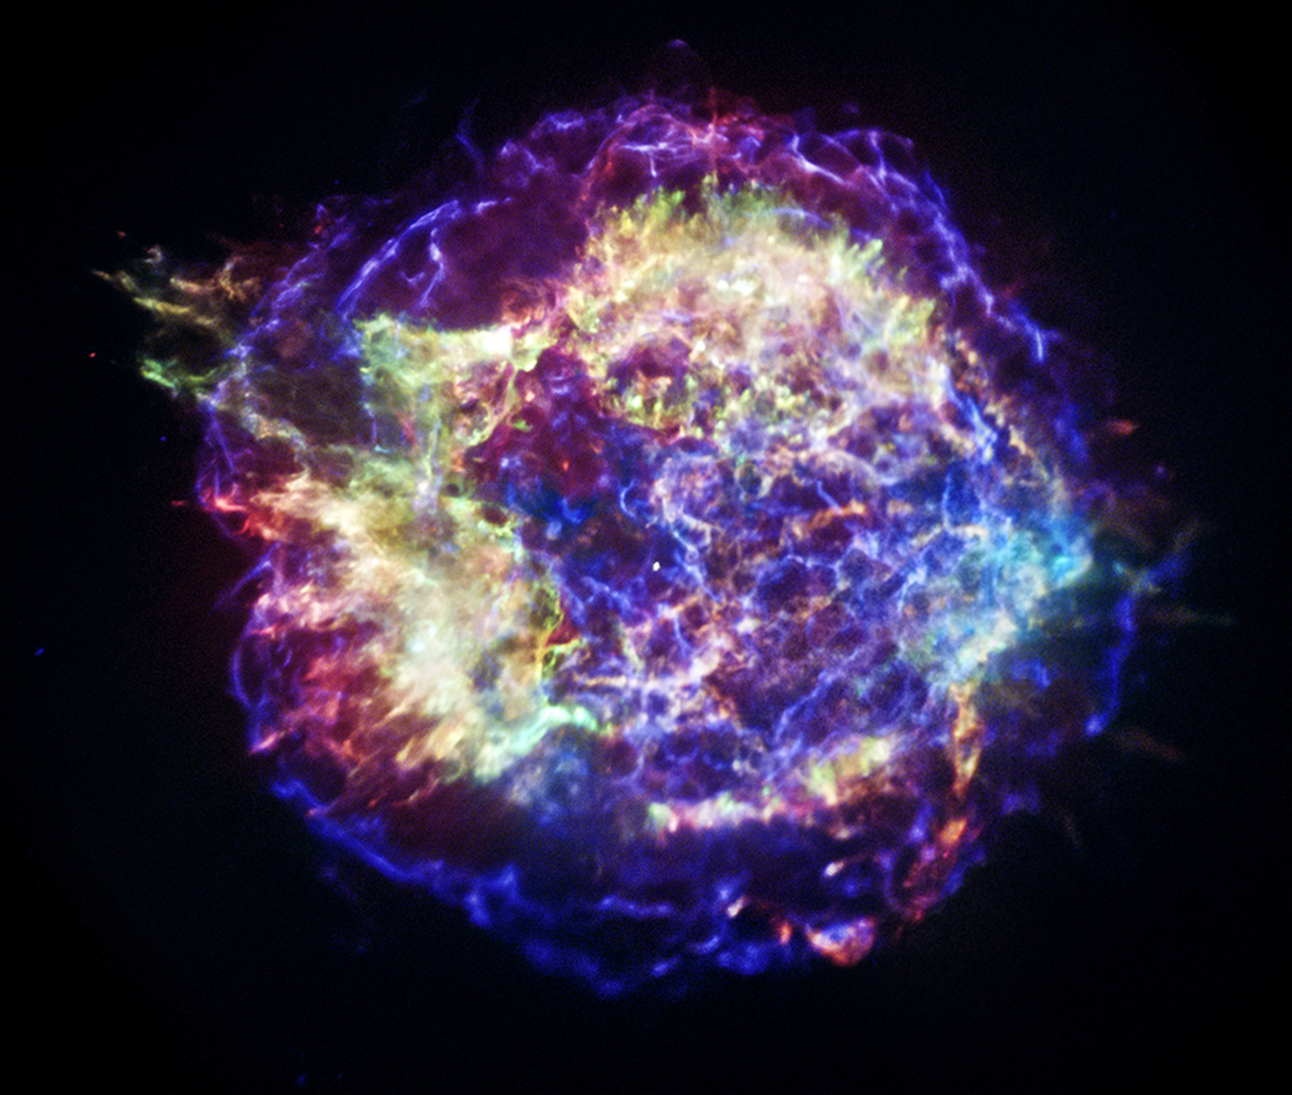
Cas A, Remnant of a Type II Supernova with a neutron star (~1660s)
The light is about 1% of energy released by the supernova!
X-Ray image from Chandra Telescope
http://chandra.harvard.edu/photo/2013/casa/

Slide 27
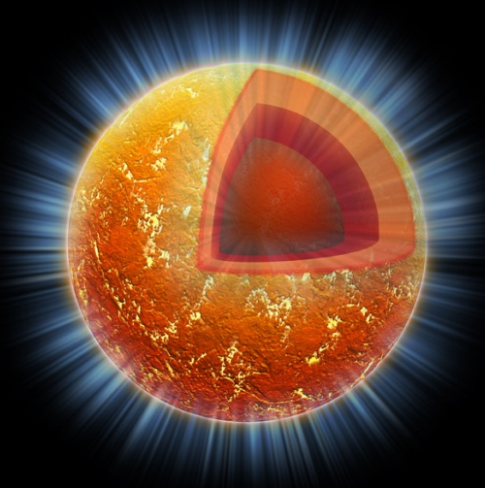
Cas A, Remnant of a Type II Supernova with a neutron star (~1660)
Neutron star 1 solar mass in a 10-mile diameter ball.
X-Ray image from Chandra Telescope
http://chandra.harvard.edu/photo/2011/casa/

Slide 28
Neutron Stars
Dense
  all space squeezed out from within atoms
Rotate Very Quickly
  spun up as core collapsed
Strong Magnetic Fields
  increased as core collapsed
  Radiation strongly beamed along axis
Enlarge H nucleus to size of a golf ball
The electron cloud is ~300 yards away
Normal Gas
Atom
Degenerate e⁻ Gas
p+
e⁻
n⁰
+
=

Slide 29
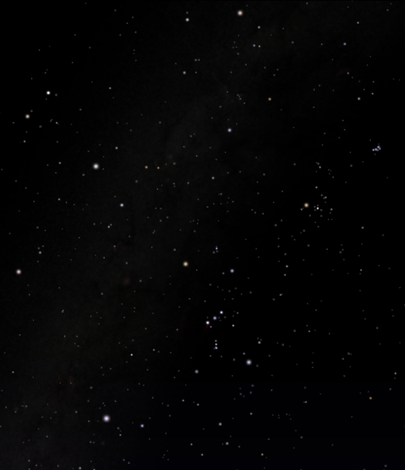
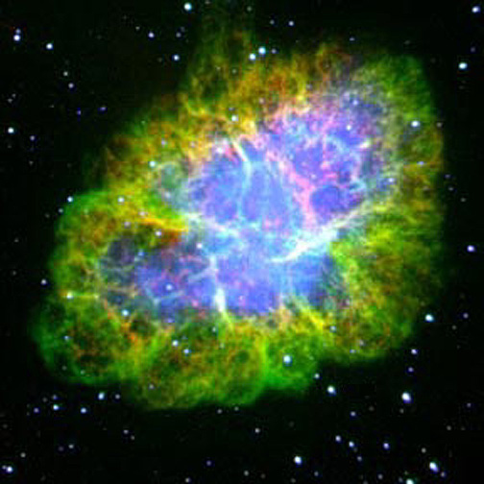
Crab Nebula
Capella in Auriga
Castor in Gemini
  Supernova Observed in 1054 by Chinese & Anazazi
Pollux in Gemini
M1
Aldebaran in Taurus
  6500 ly away
Procyon in Canis Minor
Rigel in Orion
Sirius in Canis Major

Slide 30
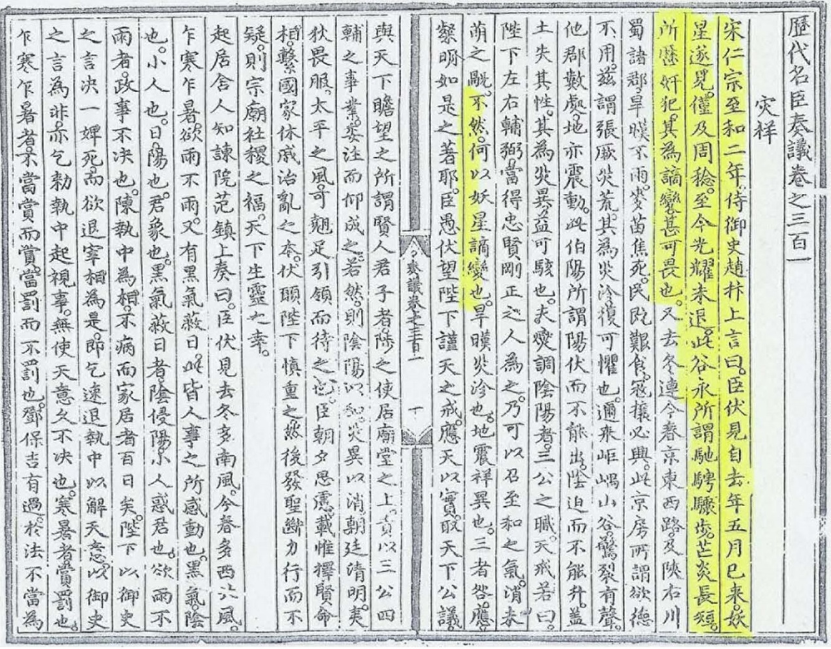

Crab Nebula
Capella in Auriga
  Observed 1054 by Chinese & Anazazi in NM
Castor in Gemini
Pollux in Gemini
M1
Aldebaran in Taurus
Procyon in Canis Minor
Rigel in Orion
Sirius in Canis Major

Slide 31
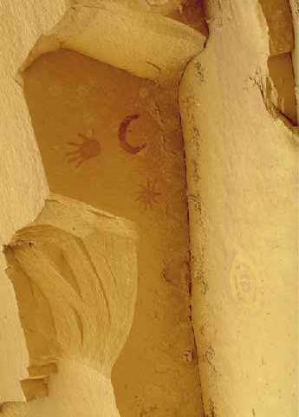
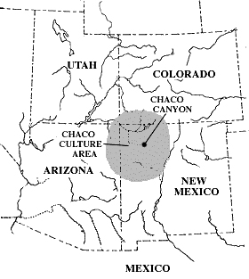
Crab Nebula
Capella in Auriga
  Observed 1054 by Chinese & Anazazi in NM
Castor in Gemini
Pollux in Gemini
M1
Aldebaran in Taurus
Procyon in Canis Minor
Rigel in Orion
Sirius in Canis Major

Slide 32
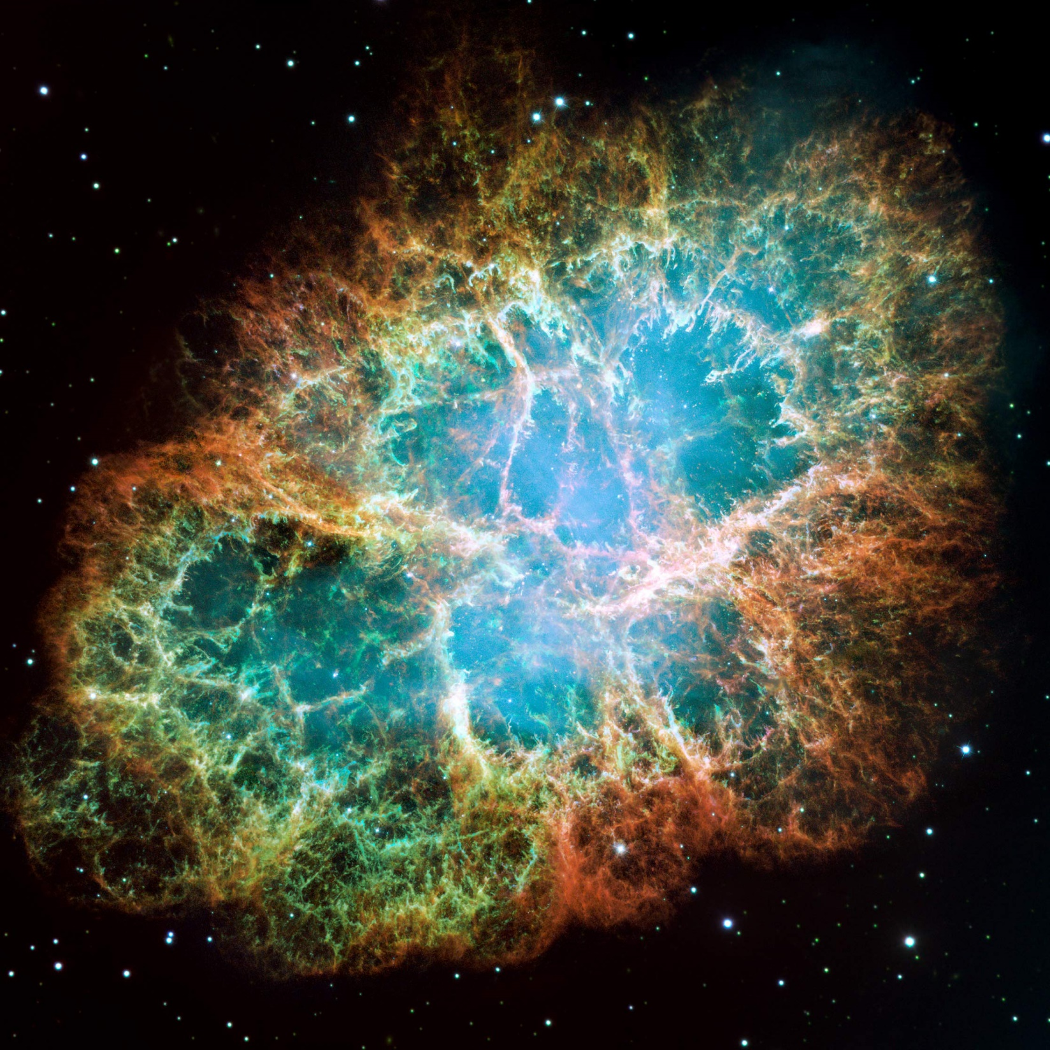
Crab Nebula
HST Optical Image

Slide 33
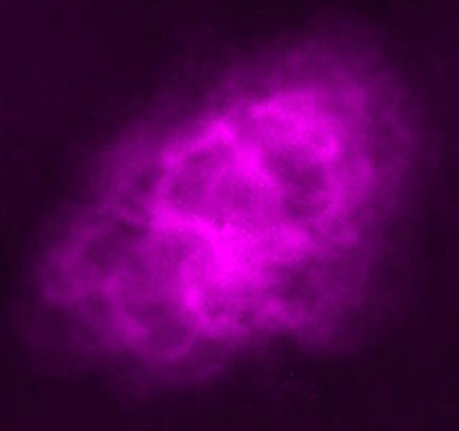
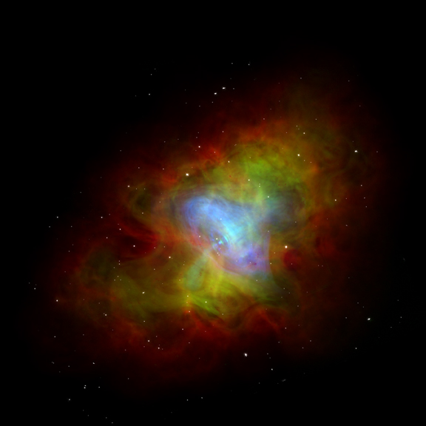
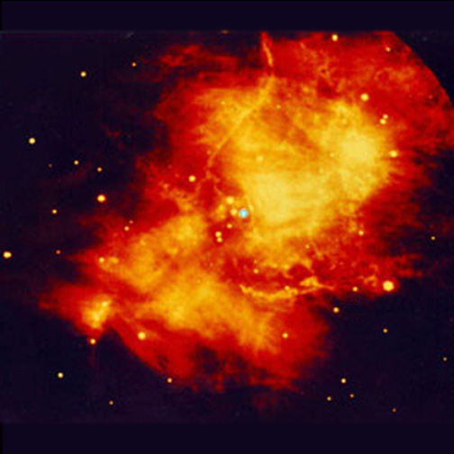
Crab Nebula
Combined Optical, Infrared and X-ray Image
VLA Radio Image
Keck IR Image
Palomar Optical Image
http://chandra.harvard.edu/photo/1999/0052/

Slide 34
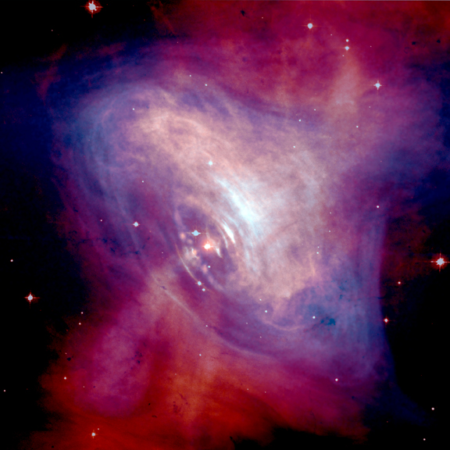
Inner Crab
Pulsar ... a spinning neutron star!
Combined HST optical and Chandra X-ray images.
Pulsar flashes 30 times per second!

Slide 35
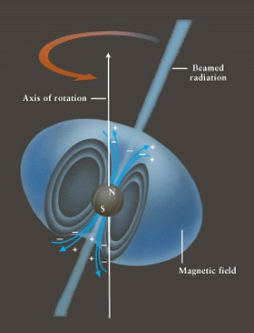

Pulsars
Rapidly Rotating Neutron Stars
  Stars “spin-up” during collapse like spinning skaters
  Emission “beamed” by magnetic fields
  Bright when beam points at Earth
Bright when beam aimed at us!

Slide 36
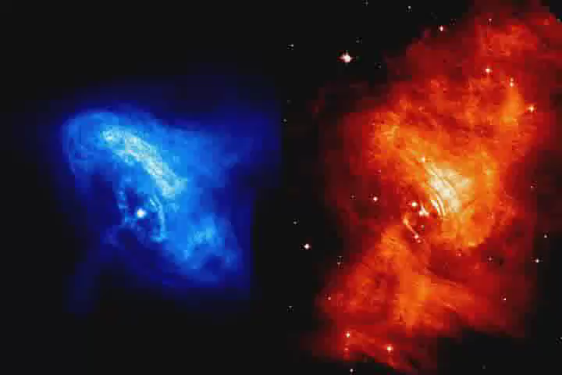
Crab Nebula in Motion
Chandra X-Ray Images
HST Optical Images
Pulsar rotating 30 times/second, driving emission from nebula.

Slide 37
Outline
Review Small Star Deaths
  Star life on the Main Sequence
  Star Deaths
    Sol: Red Giant, Planetary Nebula, White Dwarf
Evolution of Large Stars
  Fusion Layers & Neutrinos
  Type II Supernovae
    Neutron Stars & Pulsars
Types of Supernovae
  Origins of the Elements
States of Matter

Slide 38
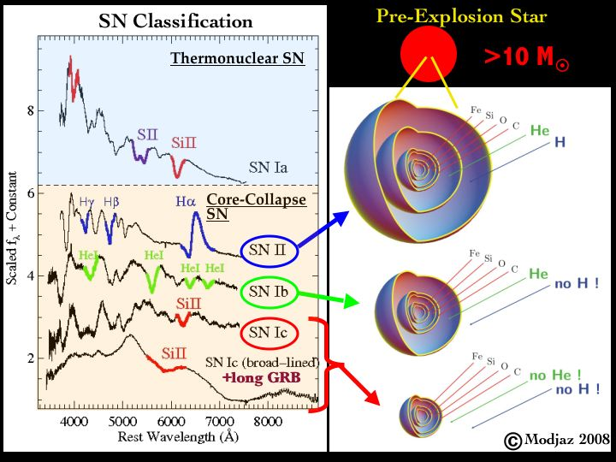
Types of Supernovae
Classified by their spectra
II
All collapsing cores
II
Ib
Ib
Core Collapse SNe
Ic
Ic
http://cosmo.nyu.edu/~mmodjaz/research.html

Slide 39
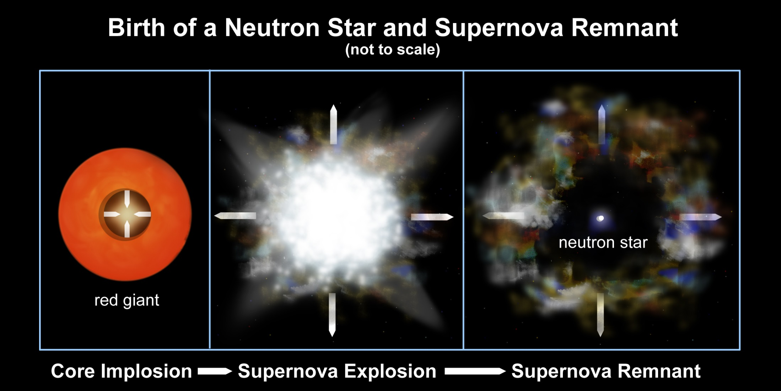
Supernovae
Core Collapse SNe: Type II, Ib & Ic
  Core left as neutron star, black hole or nothing
http://chandra.harvard.edu/resources/illustrations/supernova.html

Slide 40
Types of Supernovae
Classified by their spectra
White Dwarf SNe
Ia
All collapsing cores
II
Ib
Core Collapse SNe
Ic
http://cosmo.nyu.edu/~mmodjaz/research.html

Slide 41
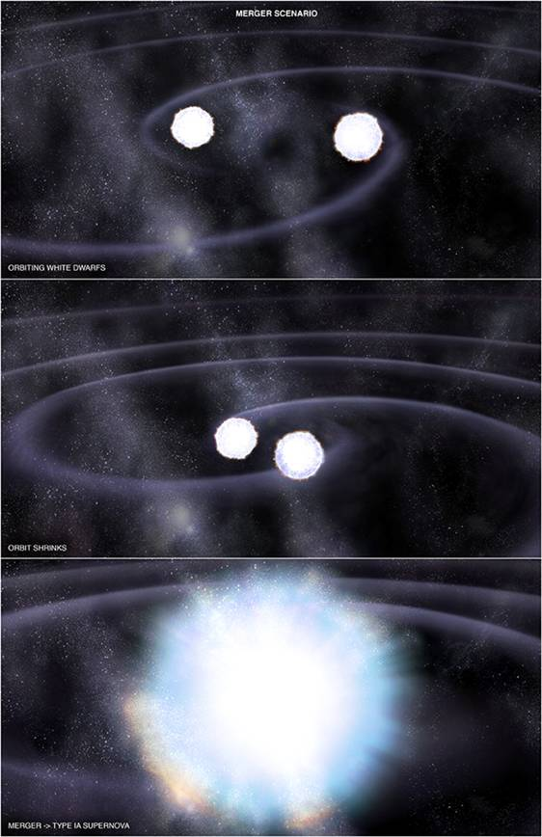
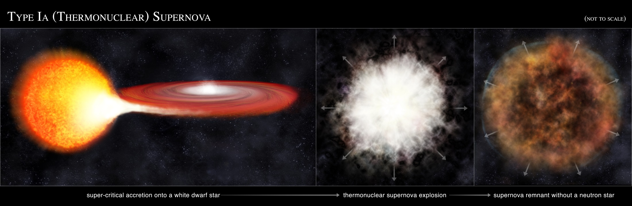
Supernovae
White Dwarf SNe: Type Ia
  Fusion starting in White Dwarf as it approaches 1.4 M☉ (Chandrasekhar Limit)
  Merger of two WDs
  WD draws matter off companion
  Most of Earth’s Fe is from these!
http://chandra.harvard.edu/resources/illustrations/supernova.html

Slide 42

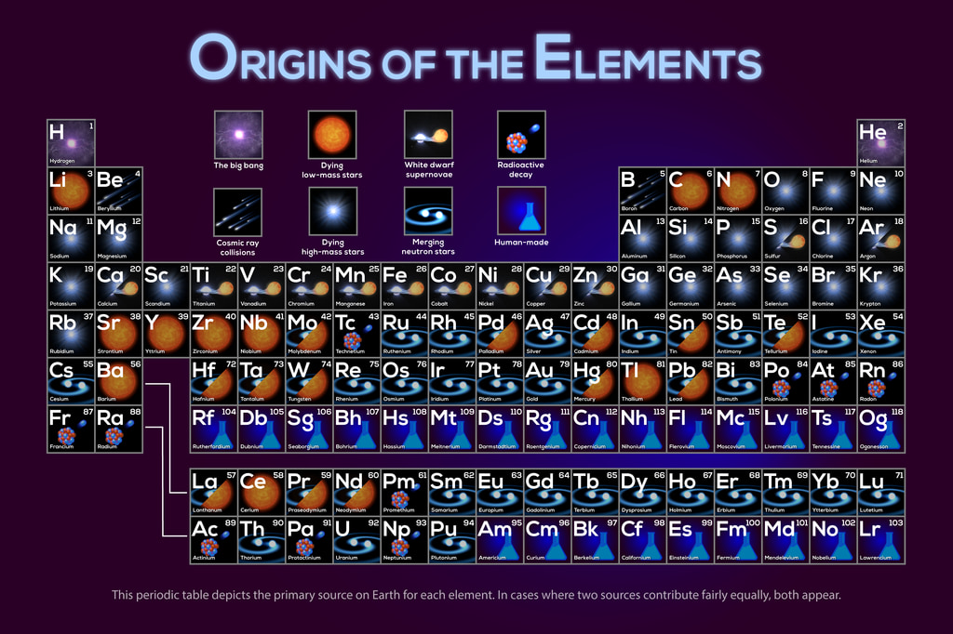
https://svs.gsfc.nasa.gov/13873/

Slide 43
Made from energy! E = mc²
Planetary Nebulae
Type Ia Supernovae
Arise from other elements
Decay very quickly ... not found in nature
CR from Sol and SNe explosions
Core Collapse Supernovae
Neutron Stars (not WDs!)
https://svs.gsfc.nasa.gov/13873/

Slide 44
Planetary Nebulae
Core collapse SNe
Type Ia Supernovae
https://svs.gsfc.nasa.gov/13873/

Slide 45
Planetary Nebulae
Core collapse SNe
Type Ia Supernovae
Your lungs of carbon (from small stars) are taking in nitrogen (from small stars) and oxygen (from Type II supernovae) that iron (from exploding white dwarfs Ia SN) is carrying throughout your body.
https://svs.gsfc.nasa.gov/13873/

Slide 46
Planetary Nebulae
Core collapse SNe
Neutron Star Mergers!
Type Ia Supernovae
Giant binary stars exploded as supernovae leaving neutron stars that merged to create all the gold and silver on Earth ... plus iodine and mercury ... your brain and metabolism NEED iodine!!
https://svs.gsfc.nasa.gov/13873/

Slide 47
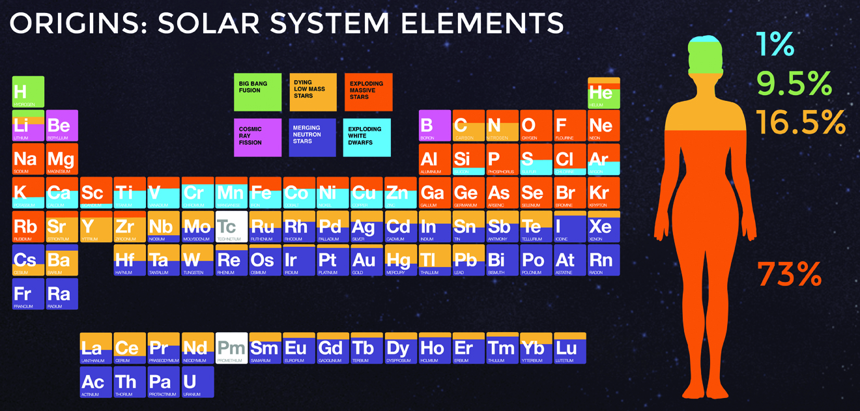
Planetary Nebulae
Core collapse SNe
Neutron Star Mergers!
Type Ia Supernovae
You are truly made of the stuff of stars!!
Giant binary stars exploded as supernovae leaving neutron stars that merged to create all the gold and silver on Earth ... plus iodine and mercury ... your brain and metabolism NEED iodine!!
Breathe in … Breathe out … the universe is flowing through you …
https://chandra.harvard.edu/photo/2017/casa_life/more.html
https://svs.gsfc.nasa.gov/13873/

Slide 48
Outline
Review Small Star Deaths
  Star life on the Main Sequence
  Star Deaths
    Sol: Red Giant, Planetary Nebula, White Dwarf
Evolution of Large Stars
  Fusion Layers & Neutrinos
  Type II Supernovae
    Neutron Stars & Pulsars
Types of Supernovae
  Origins of the Elements
States of Matter

Slide 49
White Dwarf Stars
Degenerate e⁻ gas
  atoms packed as close as possible
    electron clouds packed together
    all space squeezed out from between atoms
  does not expand on heating
  maximum mass = 1.4 M_{sol}
    Chandresekhar Limit
    electron degeneracy can’t hold itself up against gravity
Normal Gas
Atom
Degenerate e⁻ Gas
Subrahmanyan Chandrasekhar 1910-1995

Slide 50
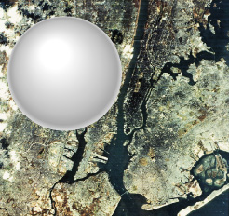
Neutron Stars
All space squeezed out from within atoms
Rotate Very Quickly
  spun up as core collapsed
Strong Magnetic Fields
  increased as core collapsed
  Particles & radiation strongly beamed along axis
Enlarge H nucleus to size of a golf ball
The electron cloud is ~300 yards away
Normal Gas
Atom
Degenerate e⁻ Gas
Degenerate n⁰ Gas
Sol as a neutron star over NYC
p+
e⁻
n⁰
+
=

Slide 51
States of Matter
Normal Gas
  Lots of space between atoms
Degenerate e⁻ gas
  Space squeezed out from between atoms
Degenerate n⁰ gas
  Space squeezed out from within atoms
Black Hole
  Atoms squeezed out of space
  Quantum Foam
    spacetime & matterenergy recombined
R_{Sol} = 100R_{Earth}
R_{Sol} ≈ R_{Earth}
R_{Sol} ≈ 10 mi
R_{Sol} ≈ 0

Slide 52
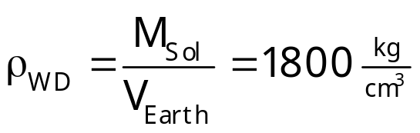
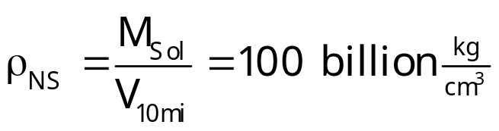
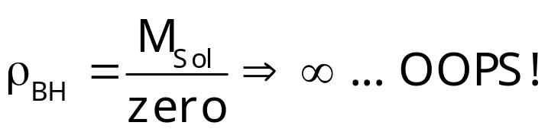
States of Matter
Normal Gas
  Lots of space between atoms
Degenerate e⁻ gas
  Space squeezed out from between atoms
Degenerate n⁰ gas
  Space squeezed out from within atoms
Black Hole
  Atoms squeezed out of space
  Quantum Foam
    spacetime & matterenergy recombined
R_{Sol} = 100R_{Earth}
R_{Sol} ≈ R_{Earth}
R_{Sol} ≈ 10k
R_{Sol} ≈ 0

Slide 53

States of Matter
Normal Gas
  Lots of space between atoms
Degenerate e⁻ gas
  Space squeezed out from between atoms
Degenerate n⁰ gas
  Space squeezed out from within atoms
Black Hole
  Atoms squeezed out of space
  Quantum Foam
    spacetime & matterenergy recombined
R_{Sol} = 100R_{Earth}
R_{Sol} ≈ R_{Earth}
R_{Sol} ≈ 10k
R_{Sol} ≈ 0

Slide 54
Exploring the STARS!
The Adventure Continues!

