Slide 1


SOAR: Lives of Stars
Supernovae and Black Holes
Aileen A. O’Donoghue Henry Priest Professor of Physics

Slide 2
The Lives of Stars
Star Birth: 9/10/26
  Nuclear Explosions Contained by Gravity
Lives & Deaths of Small Stars: 9/17/26
  Planetary Nebulae and White Dwarfs
Deaths of Large Stars: 9/24/26
  Supernovae, Neutron Stars and Black Holes
Black Holes: 10/1/26
  Spaghettification

Slide 3
Outline
Review Star Deaths
  Small: PN & WD, Large: SN & NS or BH
  States of Matter
General Relativity, Gravity, & Light
  Total Eclipses & Galaxy Clusters
Black Holes
  Escape Velocity & Spaghettification
  Detecting Black Holes
    X-Rays, Invisible Companions, Direct Imaging
The Adventure Continues

Slide 4
Outline
Review Star Deaths
  Small: PN & WD, Large: SN & NS or BH
  States of Matter
General Relativity, Gravity, & Light
  Total Eclipses & Galaxy Clusters
Black Holes
  Escape Velocity & Spaghettification
  Detecting Black Holes
    X-Rays, Invisible Companions, Direct Imaging
The Adventure Continues

Slide 5

Star Deaths
Lifespan, death depend on star’s mass
Small Stars (0.1 M_{Sol} < M_{star} ≤ 8M_{Sol})
  Longish lives (10’s of billions of years)
    No star smaller than 0.8 Msol has lived out its life!
  Planetary Nebula to White Dwarf
Giant Stars (M > 8M_{Sol}, M_{max} ≈100 M_{Sol})
  Lives can be very short (millions of years)
  Supernova to Neutron Star or Black Hole

Slide 6
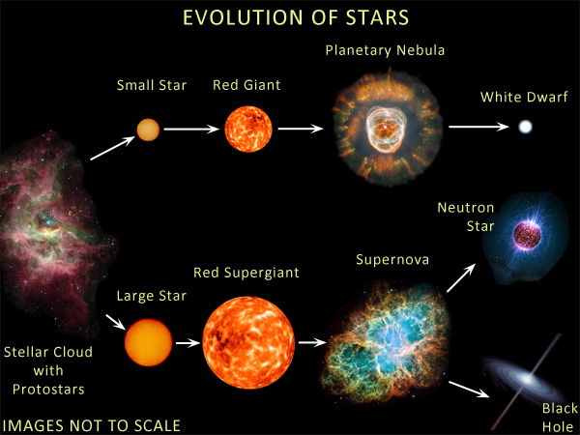
Star Death Depends on Mass
Clown Face Nebula
https://en.wikipedia.org/wiki/Eskimo_Nebula
Crab Nebula
https://en.wikipedia.org/wiki/Crab_Nebula

Slide 7
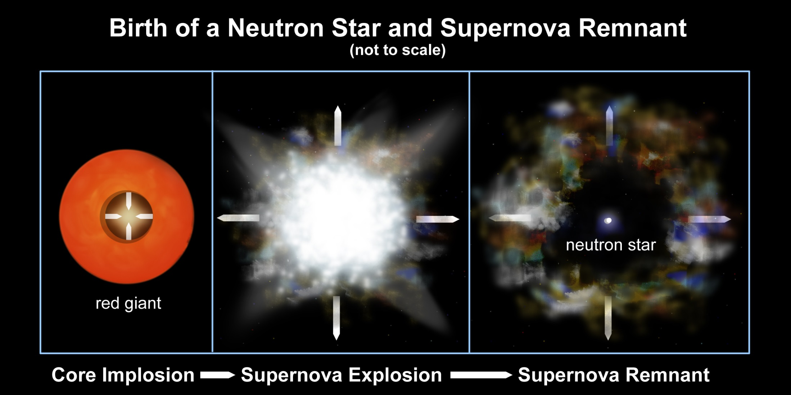
Core Collapse Supernovae
Type II, Ib & Ic
  Core left as neutron star, black hole or nothing
http://chandra.harvard.edu/resources/illustrations/supernova.html

Slide 8
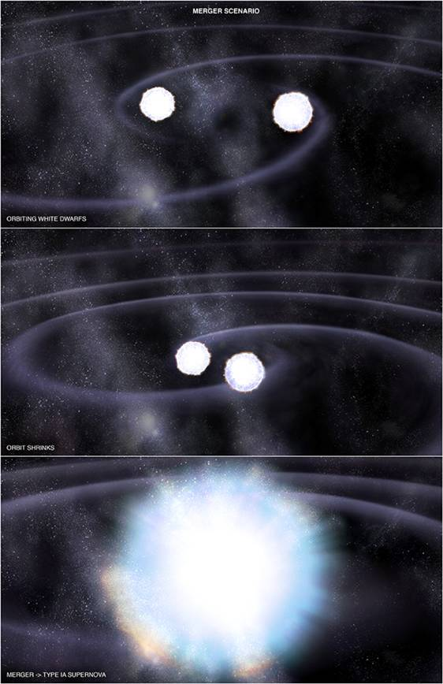
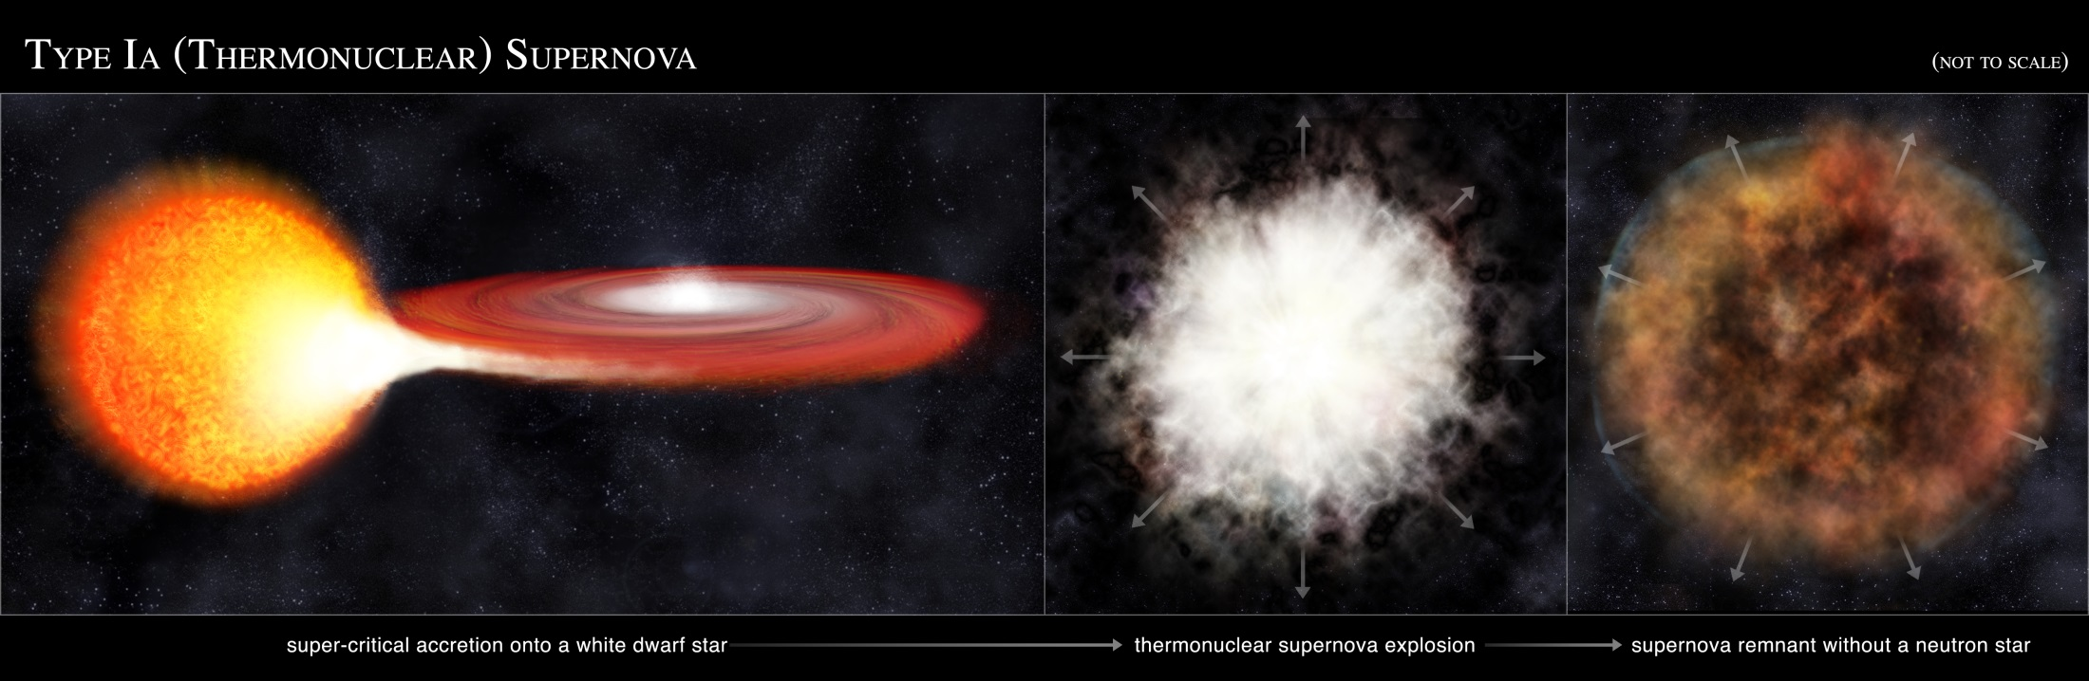
White Dwarf Supernovae
Type Ia
  Fusion starting in White Dwarf as it approaches 1.4 M☉ (Chandrasekhar Limit)
  Merger of two WDs
  WD draws matter off companion
  Most of Earth’s Fe is from these!
http://chandra.harvard.edu/resources/illustrations/supernova.html

Slide 9

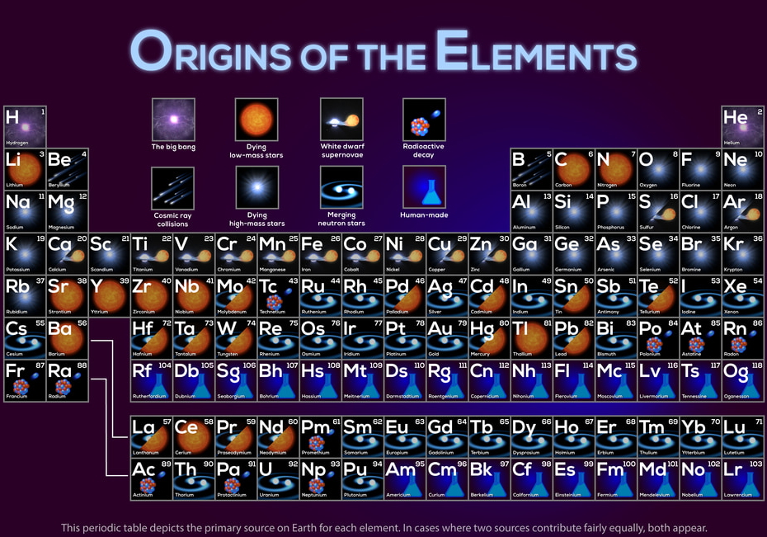
Planetary Nebulae
Core collapse SNe
Neutron Star Mergers!
Type Ia Supernovae
https://svs.gsfc.nasa.gov/13873/

Slide 10
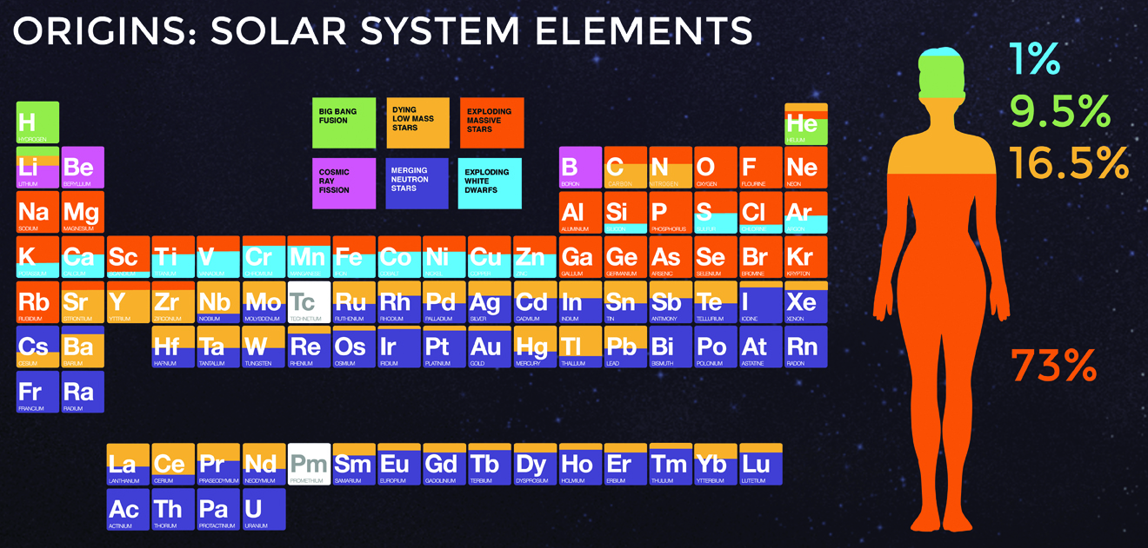
Planetary Nebulae
Core collapse SNe
Neutron Star Mergers!
Type Ia Supernovae
You are truly made of the stuff of stars!!
Breathe in … Breathe out … the universe is flowing through you …
https://chandra.harvard.edu/photo/2017/casa_life/more.html
https://svs.gsfc.nasa.gov/13873/

Slide 11
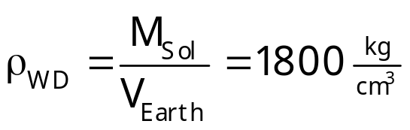
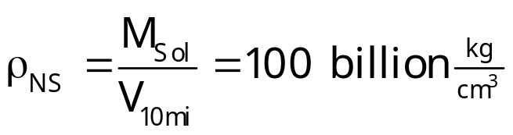
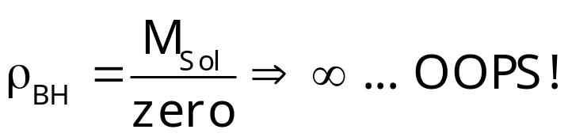
States of Matter
Normal Gas
  Lots of space between atoms
Degenerate e⁻ gas
  Space squeezed out from between atoms
Degenerate n⁰ gas
  Space squeezed out from within atoms
Black Hole
  Atoms squeezed out of space
  Quantum Foam
    spacetime & matterenergy recombined
R_{Sol} = 100R_{Earth}
R_{Sol} ≈ R_{Earth}
R_{Sol} ≈ 10k
R_{Sol} ≈ 0

Slide 12
Outline
Review Star Deaths
  Small: PN & WD, Large: SN & NS or BH
  States of Matter
General Relativity, Gravity, & Light
  Total Eclipses & Galaxy Clusters
Black Holes
  Escape Velocity & Spaghettification
  Detecting Black Holes
    X-Rays, Invisible Companions, Direct Imaging
The Adventure Continues

Slide 13
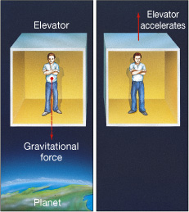

General Relativity
Acceleration bends light
Light beam appears to bend
Ship accelerates upward while beam is crossing
Observer sees beam crossing ship

Slide 14
General Relativity
Observations can’t tell gravity from acceleration
Acceleration bends light so
➔ Gravity must bend light!

Slide 15
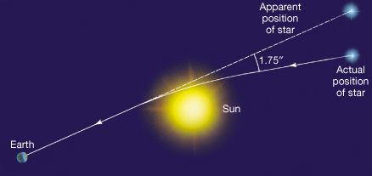
Gravity Bends Path of Light
Star positions change when near Sun!
  Seen during total eclipse
  A confirmation of General Relativity

Slide 16
Gravity Bends Path of Light
Star positions change when near Sun!
  Seen during total eclipse
  A confirmation of General Relativity
Non-bent light beam misses Earth
Light beam must bend to hit Earth
Observer “sees” star in different sky position

Slide 17
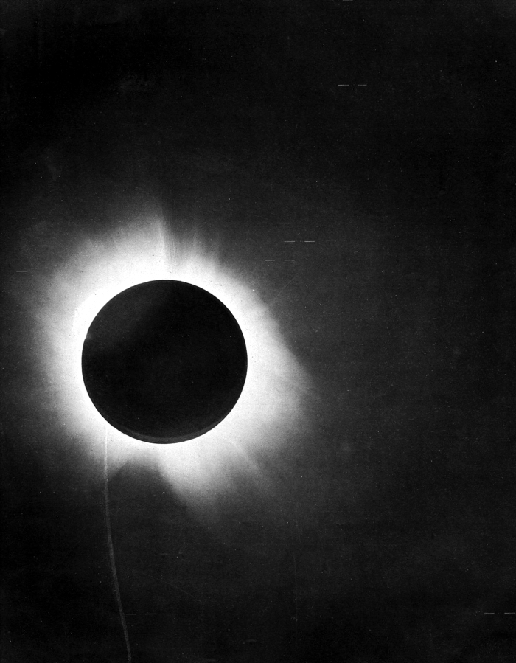
Gravity Bends Path of Light
Stars with positions deflected by the presence of the Sun.
Star positions change when near Sun!
  Seen during total eclipse
  A confirmation of General Relativity
Non-bent light beam misses Earth
Light beam must bend to hit Earth
Observer “sees” star in different sky position

Slide 18
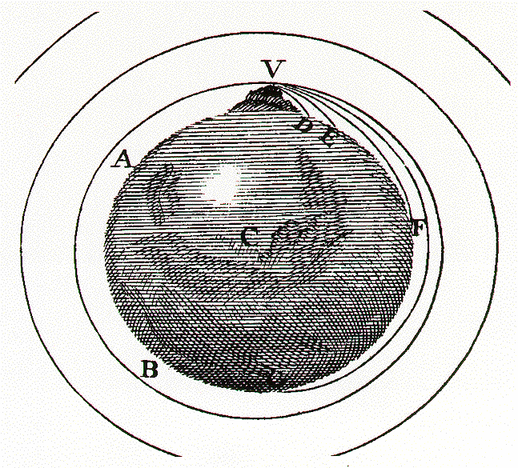
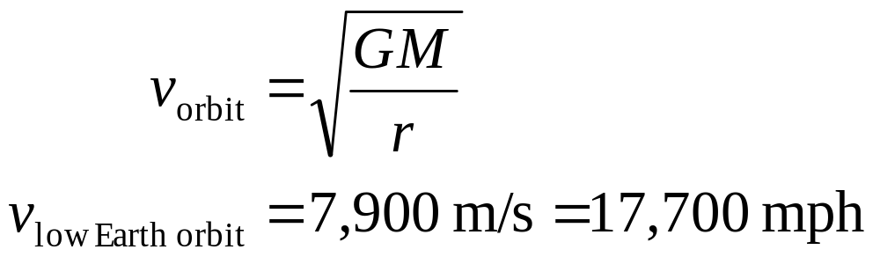
Orbits
Gravity bends the path of matter into orbits
Orbit is falling without hitting surface
  Orbital speed
  Light sphere = Orbit where speed is c
Newton's Mountain
http://galileoandeinstein.phys.virginia.edu/more_stuff/flashlets/NewtMtn/home.html

Slide 19
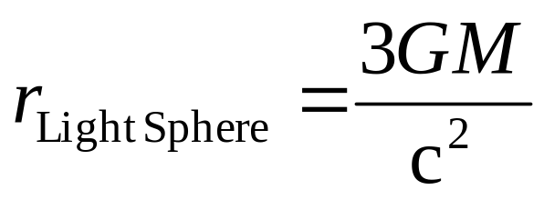
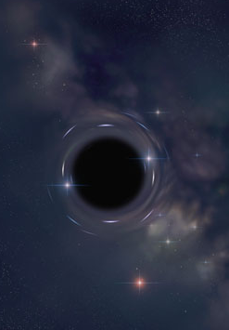
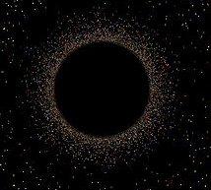
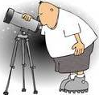
Gravity Bends Path of Light
Light can “orbit” black holes
Star
For a 1 Solar Mass Black Hole
Star light
r_{Light Sphere}= 4500 m
Star’s image

Slide 20
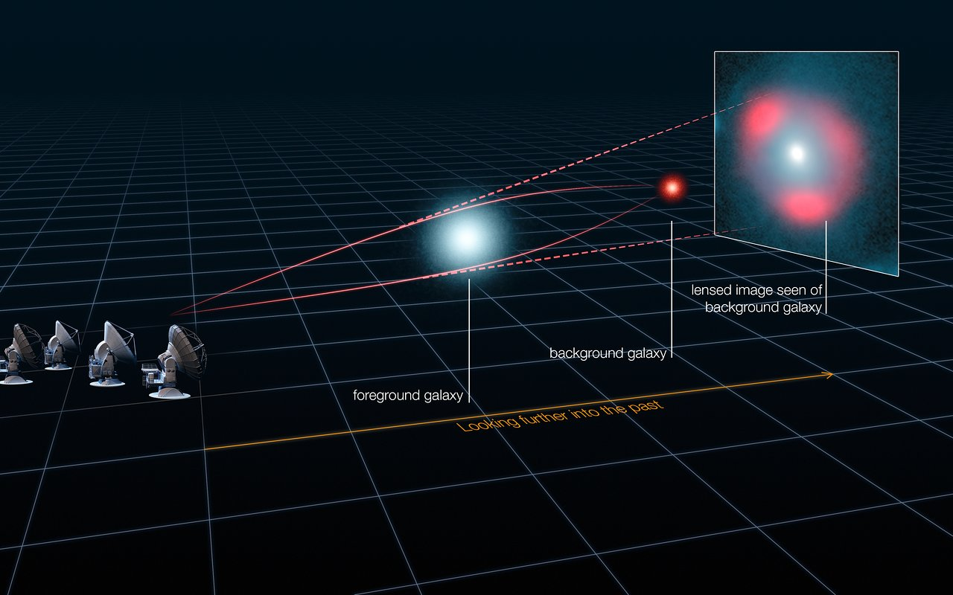
Gravitational Lensing
Galaxy Lensing
  Light rays bend around nearby galaxy
  focus to create image of distant galaxy
https://www.eso.org/public/images/eso1313b/

Slide 21
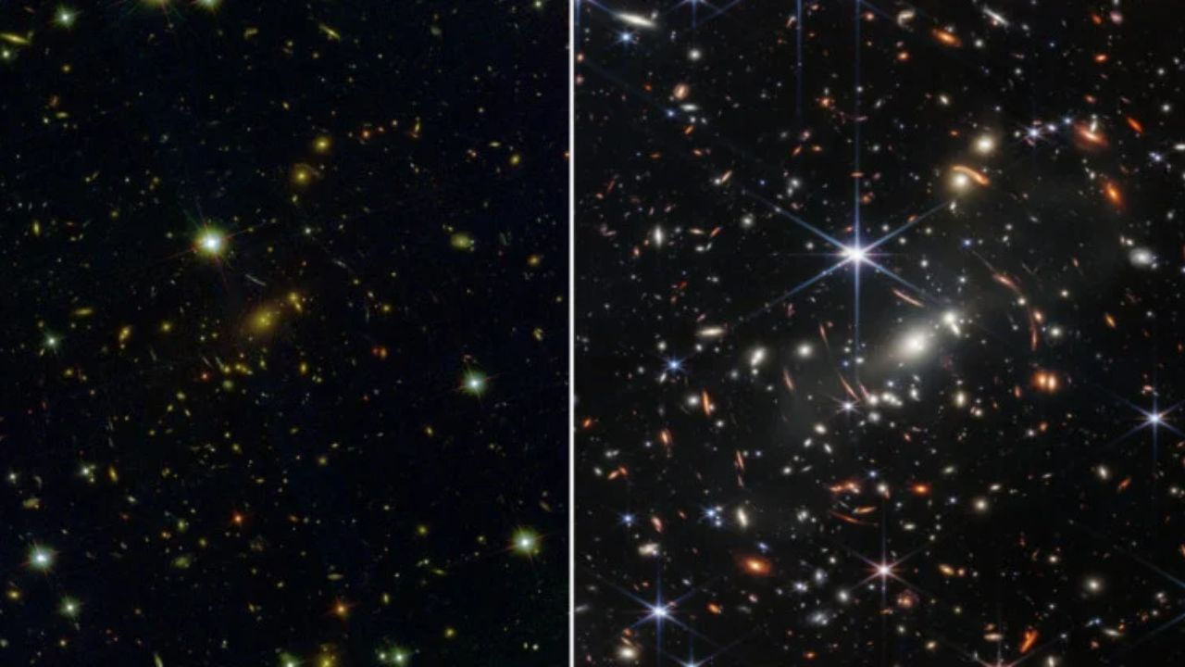
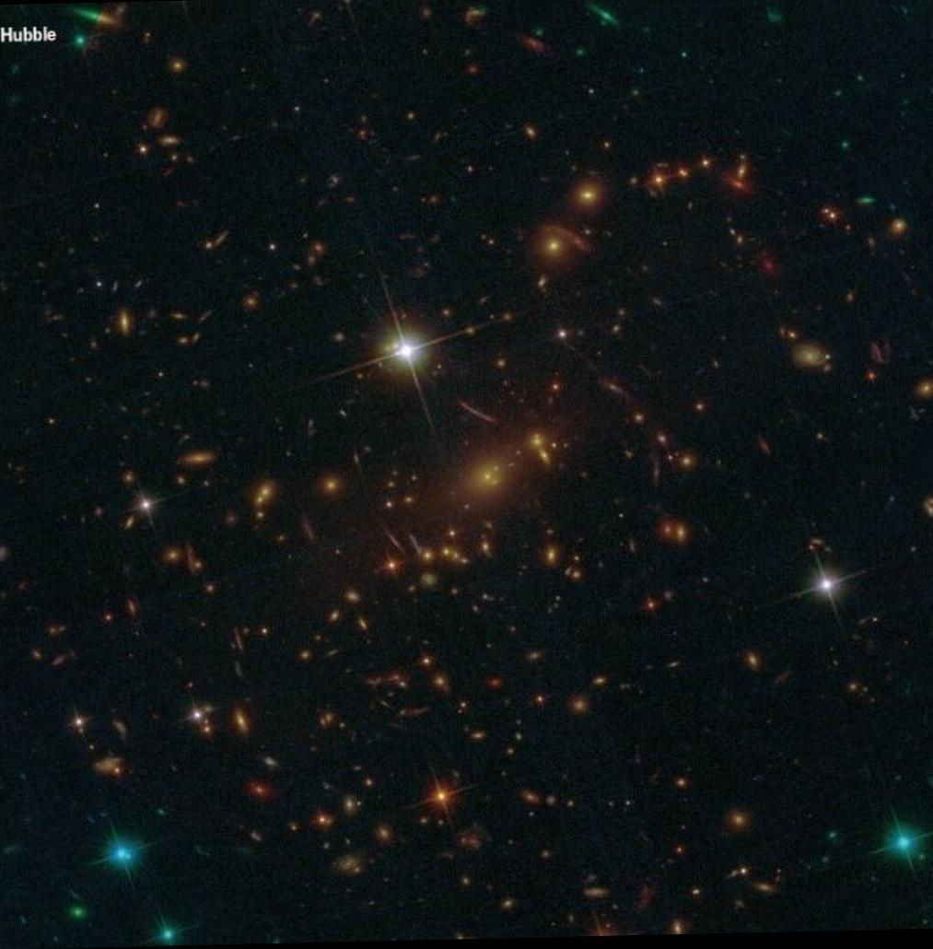
JWST Galaxy Images
Galaxy Cluster SMACS* 0723
  ~ 4 billion ly from Earth
    Earth barely cool from formation!
Hubble Image
JWST Image
Hubble Image
Arcs are warped images of galaxies farther away lensed by gravity of 0723
*Southern MAssive Cluster Survey

Slide 22
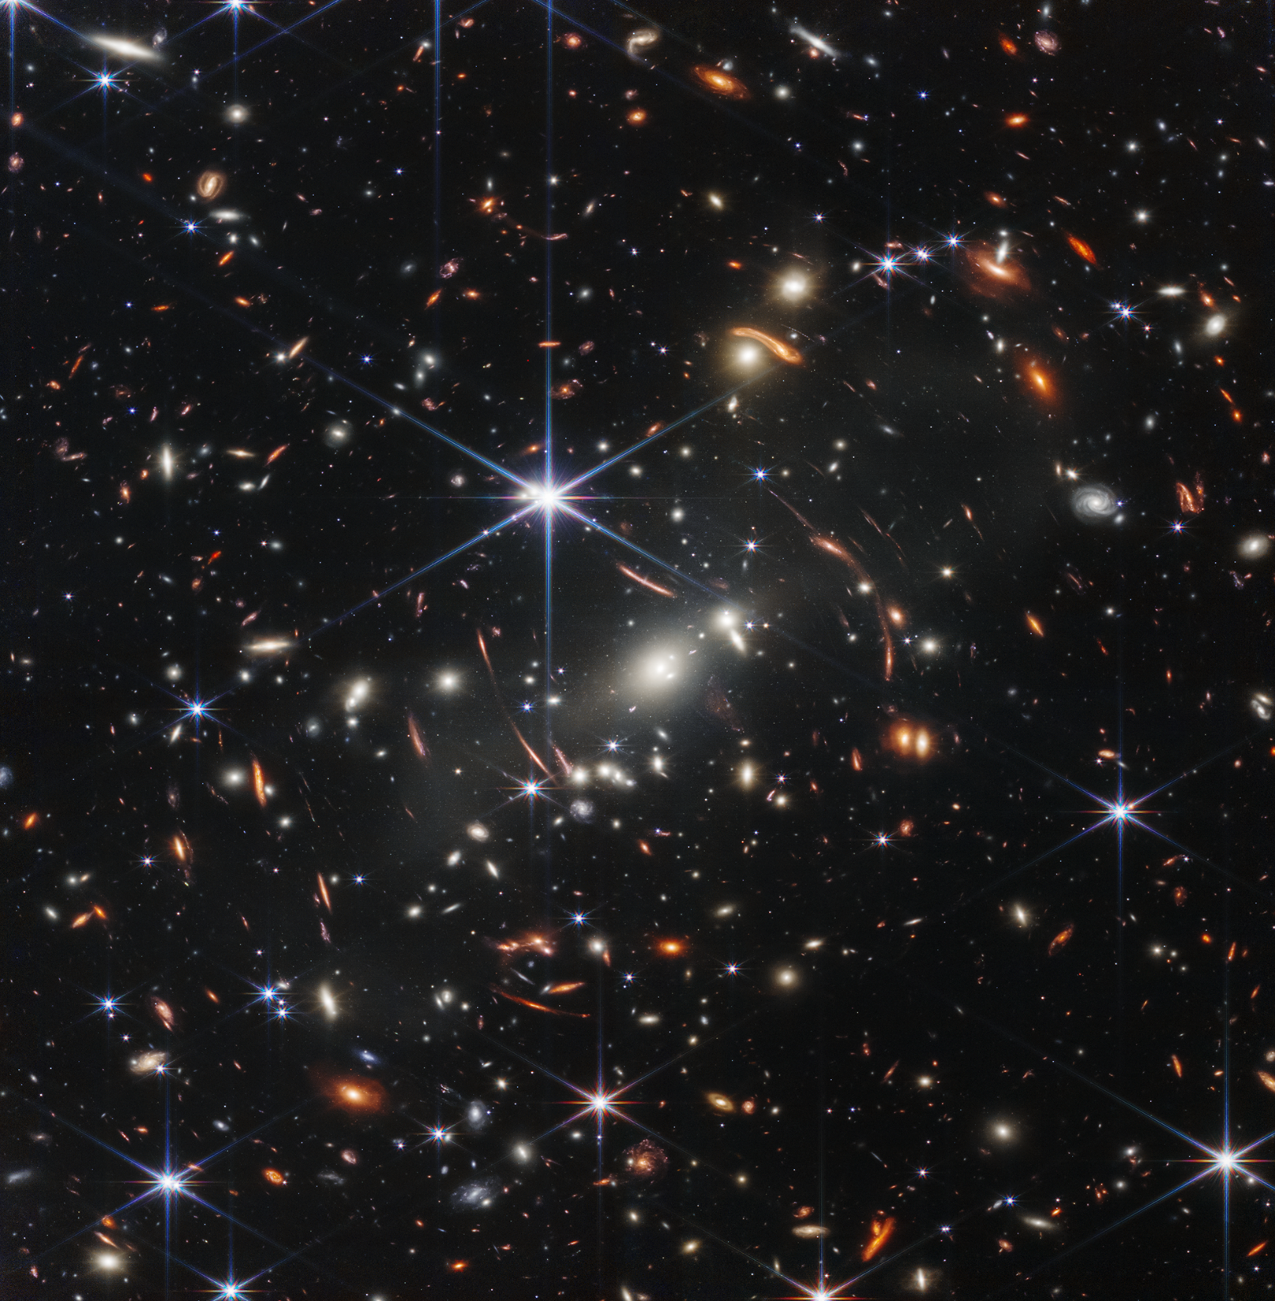
JWST Galaxy Images
Every spike-less smudge is a galaxy!
Galaxy Cluster SMACS* 0723
  ~ 4 billion ly from Earth
    Earth barely cool from formation!
Hubble Image
JWST Image
Arcs & smears are images of more distant galaxies!
Hubble Image
Arcs are warped images of galaxies farther away lensed by gravity of 0723
Stars have spikes due to telescope structure
*Southern MAssive Cluster Survey

Slide 23
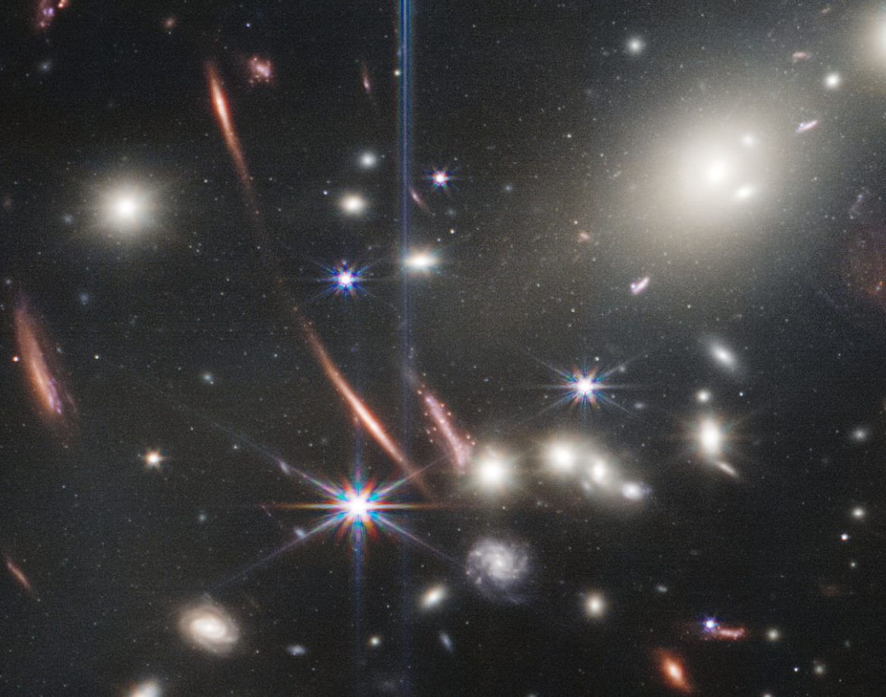
JWST Galaxy Images
Every spike-less smudge is a galaxy!
Galaxy Cluster SMACS* 0723
  ~ 4 billion ly from Earth
    Earth barely cool from formation!
Hubble Image
JWST Image
Arcs & smears are images of more distant galaxies!
Individual star clusters can be studied in lensed galaxies!
Hubble Image
Arcs are warped images of galaxies farther away lensed by gravity of 0723
Stars have spikes due to telescope structure
Southern MAssive Cluster Survey

Slide 24
Outline
Review Star Deaths
  Small: PN & WD, Large: SN & NS or BH
  States of Matter
General Relativity, Gravity, & Light
  Total Eclipses & Galaxy Clusters
Black Holes
  Escape Velocity & Spaghettification
  Detecting Black Holes
    X-Rays, Invisible Companions, Direct Imaging
The Adventure Continues

Slide 25
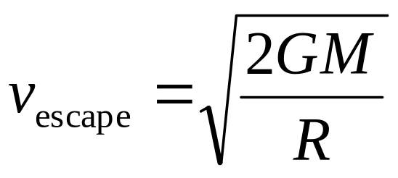
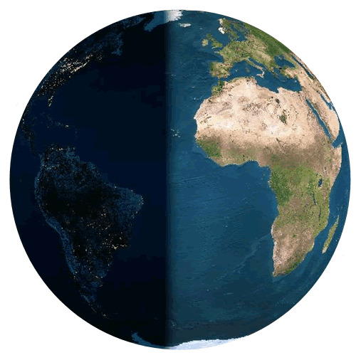
Escape Velocity
Speed for an object to escape to infinity
  Event horizon ⇒ escape speed = c
G = Gravitational Constant
M = Mass of world
R = Radius of world
v_{e,Earth} = 11.2 km/s = 25,000 mph
v_{e,Jupiter} = 59.5 km/s = 133,000 mph
v_{e,Sol} = 617.5 km/s = 1,381,000 mph
v_{e,BH} = c = 300,000 km/s
= 671,000,000 mph

Slide 26
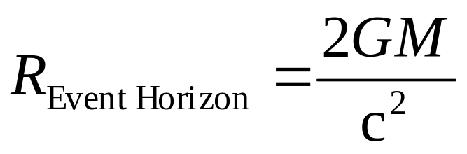
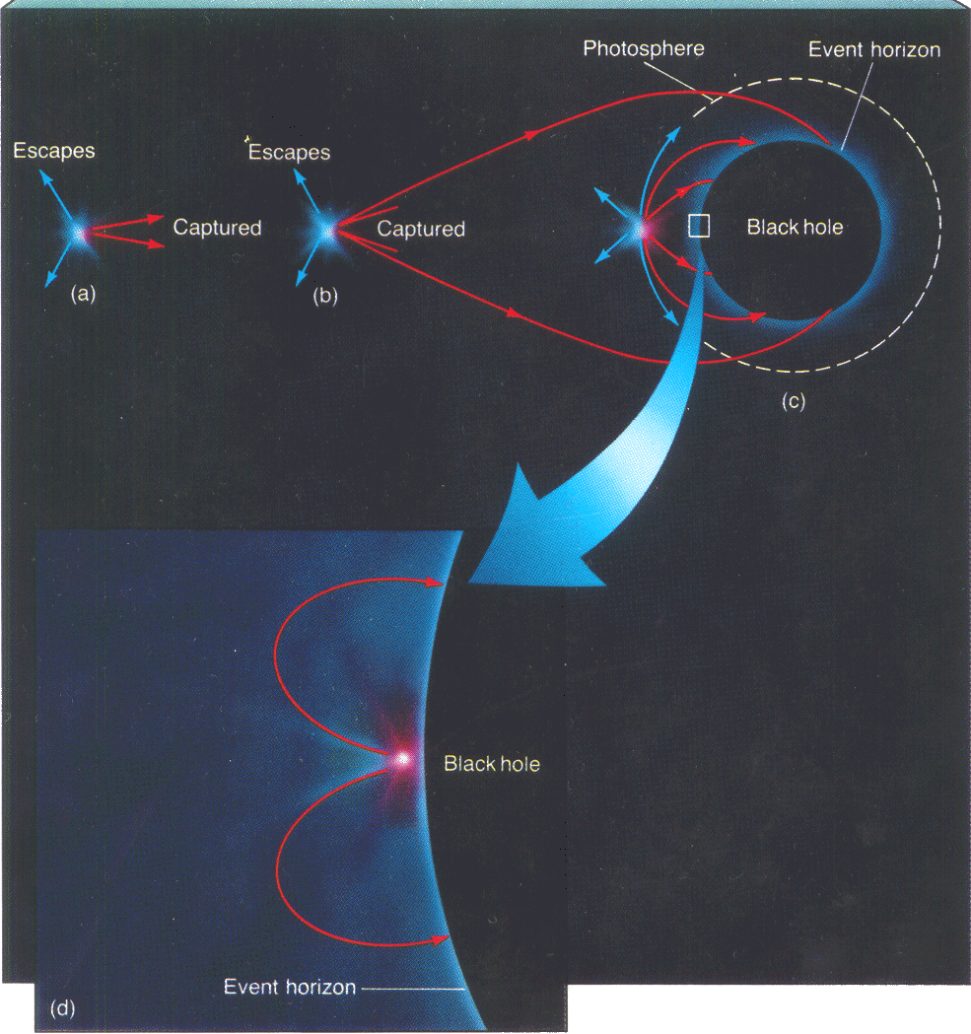
Gravity Bends Path of Light
Light can’t escape black holes
For a 1 Solar Mass Black Hole
R_{Event Horizon}= 2952 m
Light leaving black hole escapes outside EH

Slide 27
Gravity Bends Path of Light
Light can’t escape black holes
For a 1 Solar Mass Black Hole
R_{Event Horizon}= 2952 m
Light leaving black hole escapes outside EH
Light at EH can’t escape

Slide 28
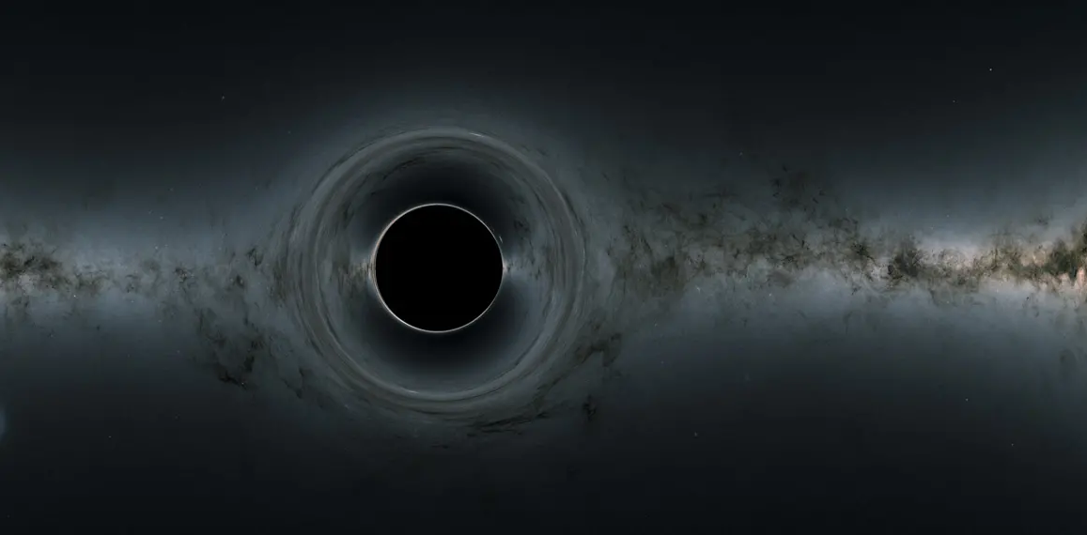
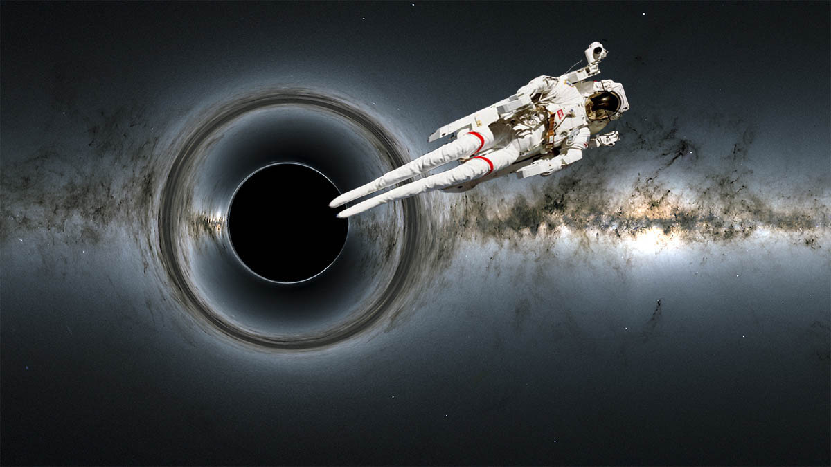
Escape Velocity & Event Horizon
Event Horizon is where escape speed = c
  Light inside EH can not escape BH
Objects falling into BH feel tidal forces
  Can get to EH and fall in!!
Tidal Forces squeeze and lengthen astronaut falling in ...
Spaghettification!

Slide 29
Outline
Review Star Deaths
  Small: PN & WD, Large: SN & NS or BH
  States of Matter
General Relativity, Gravity, & Light
  Total Eclipses & Galaxy Clusters
Black Holes
  Escape Velocity & Spaghettification
  Detecting Black Holes
    X-Rays, Invisible Companions, Direct Imaging
The Adventure Continues

Slide 30
Black Holes
Detecting Black Holes
  Bright X-Ray sources orbiting stars
    Cygnus X-1 ... no star at X-ray source
    X-Rays from accretion
    particles accelerate as they spiral in
      Emit at higher and higher frequencies (energies)
      X-Rays = “death scream” of infalling matter
  Direct imaging by Event Horizon Telescope
    M87 and SgrA*
  Bipolar Jets
    Supermassive Black Holes in Galaxies
      Jets of material create radio “plumes”
      AOD’s PhD. Thesis project

Slide 31
Black Holes
Detecting Black Holes
  Bright X-Ray sources orbiting stars
    Cygnus X-1 ... no star at X-ray source
    X-Rays from accretion
    particles accelerate as they spiral in
      Emit at higher and higher frequencies (energies)
      X-Rays = “death scream” of infalling matter
  Direct imaging by Event Horizon Telescope
    M87 and SgrA*
  Bipolar Jets
    Supermassive Black Holes in Galaxies
      Jets of material create radio “plumes”
      AOD’s PhD. Thesis project

Slide 32
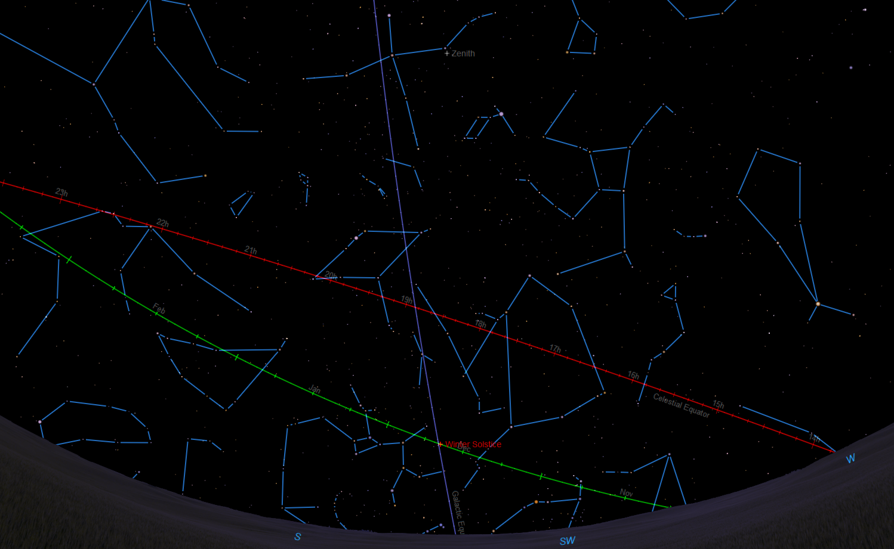
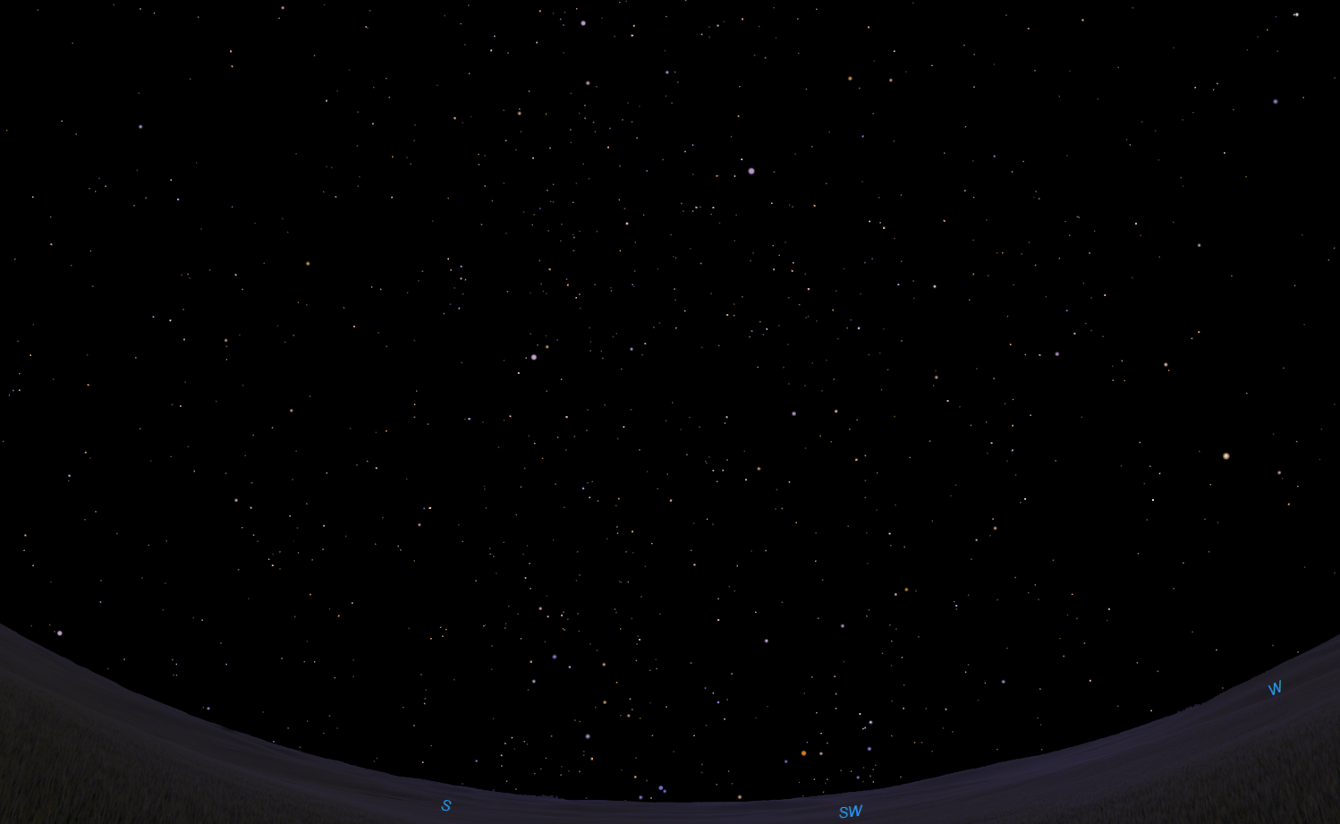
The Sky Tonight
Deneb
Sadr
Zenith
Cygnus
Hercules
Lyra
Vega
Alberio
Boötes
The Keystone
Corona Borealis
Summer Triangle
Altair
Ecliptic Path of the Sun
Alphekka
Aquila
Arcturus
Capricornus
Galactic Equator
December Solstice
Sagittarius
Sgr A*: Galaxy Center

Slide 33
Black Holes
κ
ι
N. Am. and Pelican Nebulae
Stellar Remnants
Deneb
δ
Northern Coalsack
Sadr
Vega
Deneb
ε
Cygnus
Lyra
η
Sheliak
ζ
Sulafat
Cygnus X-1
Ring Nebula
Veil Nebula
Alberio
Summer Triangle
Vulpecula
Dumbbell Nebula
Sadr
Sagitta
Delphinus
η
Altair
Tarazed
Cygnus X-1
Aquila
Black Hole in Cyg is bright in X-rays
Scutum
Wild Duck
Eagle Nebula

Slide 34
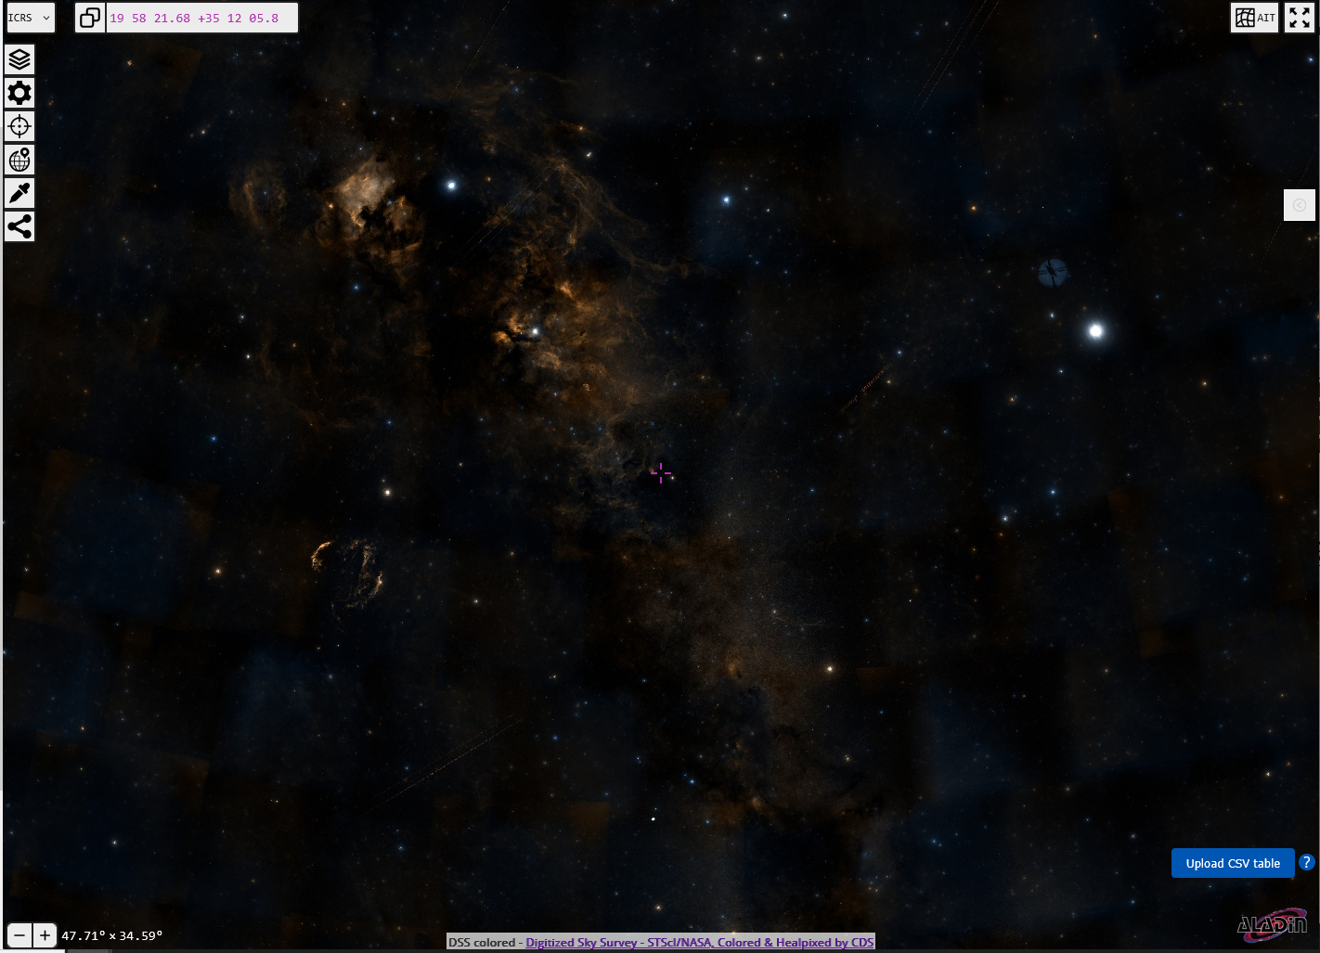

Black Holes
κ
ι Cyg
ι
North America Nebula
θ Cyg
N. Am. and Pelican Nebulae
Stellar Remnants
Deneb
δ
Deneb
Fawaris
Northern Coalsack
Sadr
Vega
Deneb
ε
Cygnus
Lyra
η
Sheliak
ζ
Cygnus
Sulafat
Ring Nebula
Lyra
Vega
Cygnus X-1
Sadr
Veil Nebula
Alberio
Summer Triangle
Vulpecula
Dumbbell Nebula
η Cyg
Sadr
Sagitta
Gienah
Sheliak
Delphinus
Sulafat
ζ Cyg
Cyg X-1
η
Cygnus Loop
Altair
Tarazed
Cygnus X-1
Albireo
Aquila
Black Hole in Cyg is bright in X-rays
Scutum
Wild Duck
Eagle Nebula
https://aladin.cds.unistra.fr/AladinLite/

Slide 35
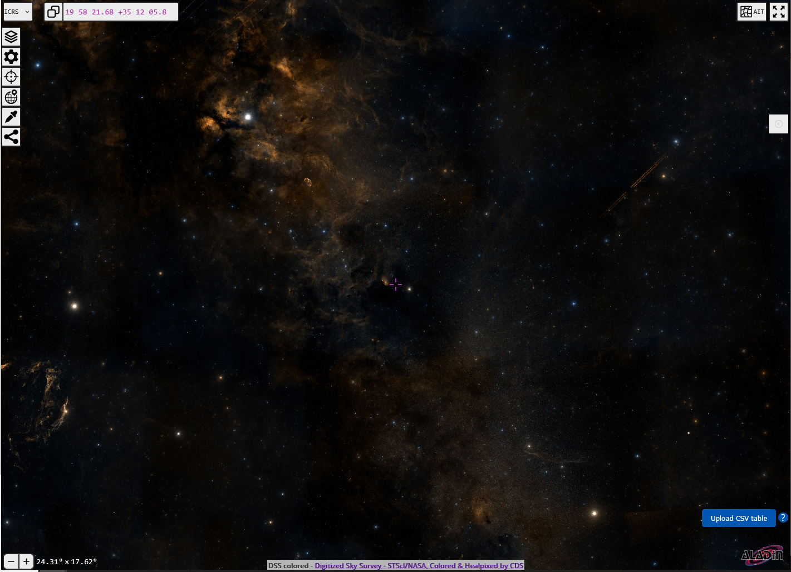
Black Holes
κ
ι Cyg
ι
North America Nebula
θ Cyg
N. Am. and Pelican Nebulae
Stellar Remnants
Deneb
δ
Deneb
Northern Coalsack
Sadr
Fawaris
Sadr
Vega
Deneb
ε
Cygnus
Lyra
η
Sheliak
ζ
Cygnus
Sulafat
Ring Nebula
Lyra
Vega
Cygnus X-1
Sadr
Veil Nebula
Alberio
Summer Triangle
Tulip Nebula
Vulpecula
Dumbbell Nebula
η Cyg
Sadr
Sagitta
η Cyg
Sheliak
Delphinus
Gienah
Gienah
Sulafat
ζ Cyg
Cyg X-1
η
Cyg X-1
Cygnus Loop
Altair
Tarazed
Cygnus X-1
Albireo
Aquila
Cygnus Loop
Black Hole in Cyg is bright in X-rays
Scutum
Albireo
Wild Duck
Eagle Nebula
https://aladin.cds.unistra.fr/AladinLite/

Slide 36
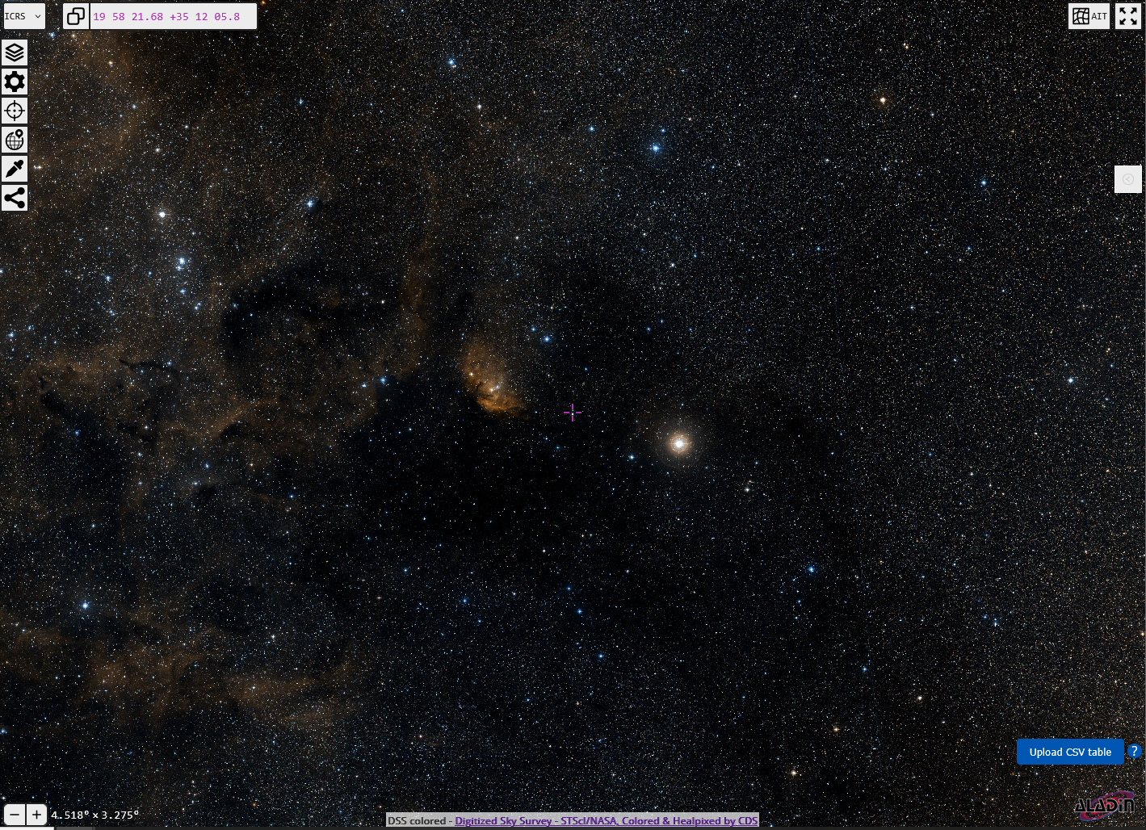
Black Holes
κ
ι Cyg
ι
North America Nebula
θ Cyg
N. Am. and Pelican Nebulae
Stellar Remnants
Deneb
δ
Deneb
Northern Coalsack
Sadr
Fawaris
Sadr
Vega
Deneb
ε
Cygnus
Lyra
η
Sheliak
ζ
Cygnus
Sulafat
Ring Nebula
Lyra
Vega
Cygnus X-1
Sadr
Veil Nebula
Alberio
Tulip Nebula
Summer Triangle
Tulip Nebula
Vulpecula
Dumbbell Nebula
η Cyg
Sadr
Sagitta
η Cyg
Sheliak
Delphinus
Gienah
η Cyg
Gienah
Sulafat
ζ Cyg
Cyg X-1
η
Cyg X-1
Cyg X-1
Cygnus Loop
Altair
Tarazed
Cygnus X-1
Albireo
Aquila
Cygnus Loop
Black Hole in Cyg is bright in X-rays
Scutum
Albireo
Wild Duck
Eagle Nebula
https://aladin.cds.unistra.fr/AladinLite/

Slide 37
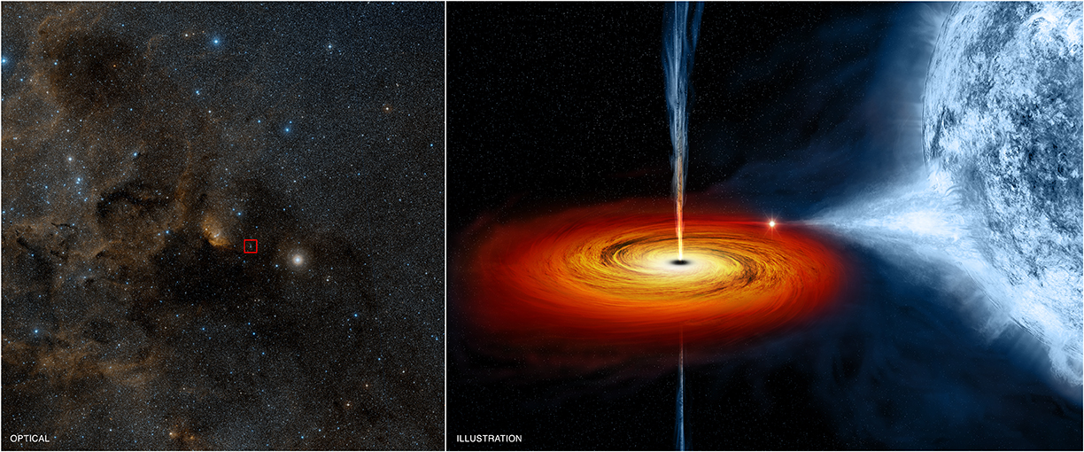
Black Holes
κ
https://chandra.harvard.edu/photo/2011/cygx1/index.html
ι
N. Am. and Pelican Nebulae
Stellar Remnants
Deneb
δ
Northern Coalsack
Sadr
Vega
Deneb
ε
Cygnus
Lyra
η
Sheliak
ζ
Sulafat
Cygnus X-1
Ring Nebula
Veil Nebula
Alberio
Summer Triangle
Vulpecula
Dumbbell Nebula
Sadr
Sagitta
Delphinus
η
Altair
Tarazed
Cygnus X-1
Aquila
Black Hole in Cyg is bright in X-rays
Scutum
Wild Duck
Eagle Nebula

Slide 38
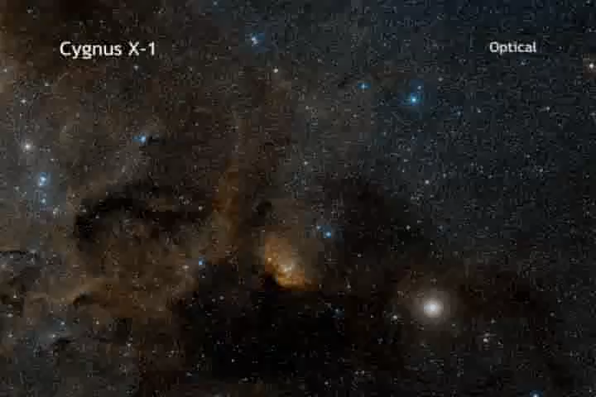
Black Holes
κ
https://chandra.harvard.edu/photo/2011/cygx1/index.html
ι
N. Am. and Pelican Nebulae
Stellar Remnants
Deneb
δ
Northern Coalsack
Sadr
Vega
Deneb
ε
Cygnus
Lyra
η
Sheliak
ζ
Sulafat
Cygnus X-1
Ring Nebula
Veil Nebula
Alberio
Summer Triangle
Vulpecula
Dumbbell Nebula
Sadr
Sagitta
Delphinus
η
Altair
Tarazed
Cygnus X-1
Aquila
Black Hole in Cyg is bright in X-rays
Scutum
Wild Duck
Eagle Nebula

Slide 39
The Sky Tonight
Deneb
Sadr
Zenith
Cygnus
Hercules
Lyra
Vega
Eta Cygni
Alberio
Boötes
The Keystone
Corona Borealis
Summer Triangle
Altair
Ecliptic Path of the Sun
Alphekka
Aquila
Arcturus
Capricornus
Galactic Equator
December Solstice
Sagittarius
Sgr A*: Galaxy Center

Slide 40
The Sky Tonight
Deneb
Sadr
Zenth
Cygnus
Hercules
Lyra
Vega
Eta Cygni
Alberio
Boötes
The Keystone
Corona Borealis
Summer Triangle
Altair
Ecliptic Path of the Sun
Alphekka
Aquila
Arcturus
Capricornus
Galactic Equator
December Solstice
Sagittarius
Sgr A*: Galaxy Center

Slide 41
Black Holes
Detecting Black Holes
  Bright X-Ray sources orbiting stars
    Cygnus X-1 ... no star at X-ray source
    X-Rays from accretion
    particles accelerate as they spiral in
      Emit at higher and higher frequencies (energies)
      X-Rays = “death scream” of infalling matter
  Direct imaging by Event Horizon Telescope
    M87 and SgrA*
  Bipolar Jets
    Supermassive Black Holes in Galaxies
      Jets of material create radio “plumes”
      AOD’s PhD. Thesis project

Slide 42
M87, Virgo A, Virgo X-1
Supergiant elliptical galaxy
  53.5 Million light years (ly) away
  6 trillion times the mass of the Sun (M☉)
    Milky Way has about 1.4 trillion M☉
  Stellar envelope 490,000 ly in diameter
    Milky Way’s is 330,000 ly in diameter
Observations
  Optical: M87, NGC 4486
  Radio: Virgo A
  X-ray: Virgo X-1

Slide 43
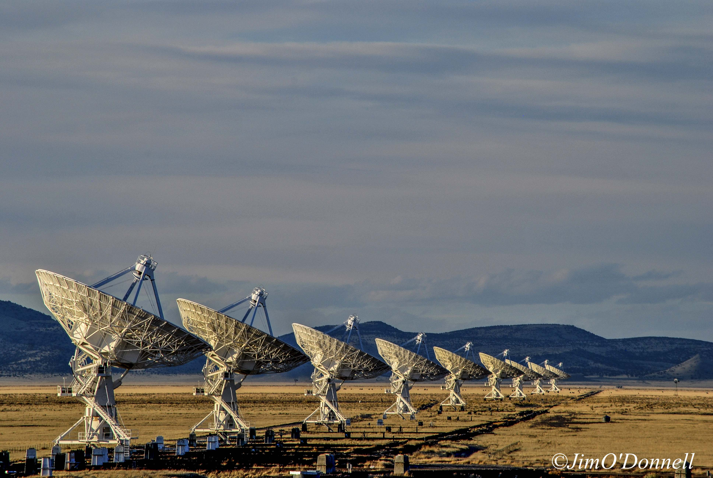
Radio Galaxies
Radiate in radio frequencies
  Like waves from cell tower to your phone
    e.g. AT&T 4G/LTE 710-716 MHz & 740-746 MHz
    e.g. Verizon 746-757 MHz & 776-787 MHz
Detected by receivers
  Images created from data in computers
    NOT like images viewed on your phone!!
http://www.aroundtheworldineightyyears.com/wp-content/uploads/2012/01/DSC_0132-1-2.jpg
© Jim O’Donnell

Slide 44
Radio Galaxies
Electrons “glow” in radio
  electrons spiral along magnetic field lines
Radiate due to acceleration (centripetal acceleration) “beamed” in forward direction (relativistic motion)‏
synchrotron radiation

Slide 45
M87
Virgo A radio emissions detected 1947
  Stanley & Slee 1950 Australia
Confirmed to be from M87 1953
  Thought to originate in jet
Virgo X-1 X-ray emissions detected in 1967
  Million-degree gas glowing
X-ray emission

Slide 46
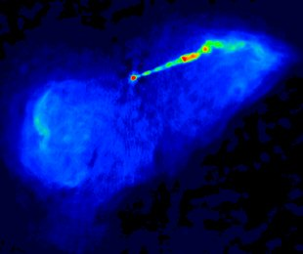
M87: Virgo A
VLA Radio images
  The 20 cm image of M87 I knew in the 1980’s
~4,000 ly
Angle of the jet changes due to orientation of telescope. Jet is same one seen in optical.
~17,000 ly
http://www.aoc.nrao.edu/~jeilek/research/M87Virgo.html
Image Credit: F. Owen, NRAO & J. Eilek, NMINT

Slide 47
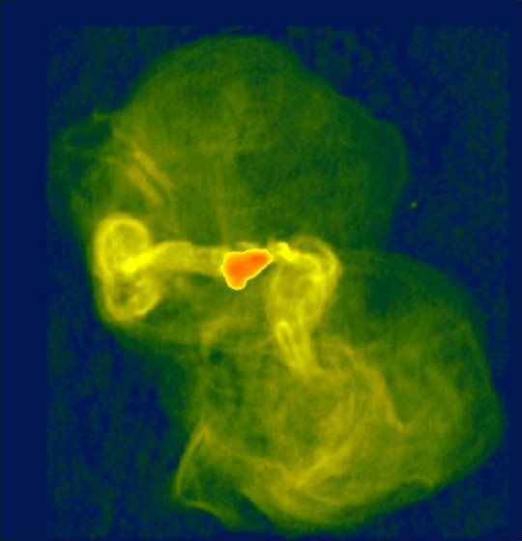
M87: Virgo A
VLA Radio images
  The 90 cm image of M87
http://www.aoc.nrao.edu/~fowen/M87_halo.html
~4,000 ly
Wider field image of lower energy plasma shows bubbles & turbulence
~17,000 ly
http://www.aoc.nrao.edu/~jeilek/research/M87Virgo.html
Image Credit: F. Owen, NRAO & J. Eilek, NMINT

Slide 48
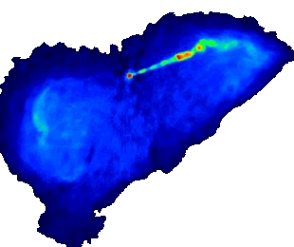
M87: Virgo A
http://www.aoc.nrao.edu/~fowen/M87_halo.html
VLA Radio images
  The 90 cm image of M87
~450,000 ly
~4,000 ly
Wider field image of lower energy plasma shows bubbles & turbulence
~250,000 ly
~17,000 ly
http://www.aoc.nrao.edu/~jeilek/research/M87Virgo.html
Image Credit: F. Owen, NRAO & J. Eilek, NMINT

Slide 49
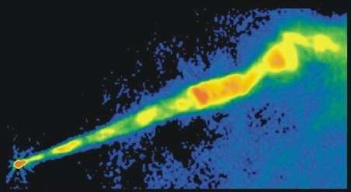
M87: Virgo A
VLA Radio images
  The 2 cm image of M87
Higher resolution image of higher energy plasma shows jet emerging from nucleus
~4,000 ly
~17,000 ly
~4,000 ly
http://www.aoc.nrao.edu/~jeilek/research/M87Virgo.html
Image Credit: F. Owen, NRAO & J. Eilek, NMINT
http://www.aoc.nrao.edu/~fowen/M87_jet.html

Slide 50
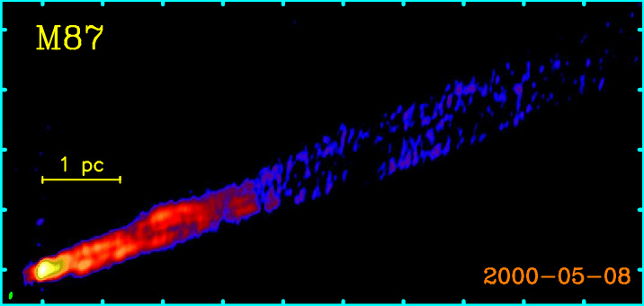
M87: Virgo A
VLBA Radio images: higher resolution
  The 2 cm image of M87
Even higher resolution image shows jet emerging from nucleus
~4,000 ly
~17,000 ly
~4,000 ly
~10 ly
http://www.aoc.nrao.edu/~jeilek/research/M87Virgo.html
Image Credit: F. Owen, NRAO & J. Eilek, NMINT
Kellermann, K. I, Kovalev, Y. Y., Lister, M. L, et al. 2007, Ap&SS, 311, 231 Figure 9

Slide 51
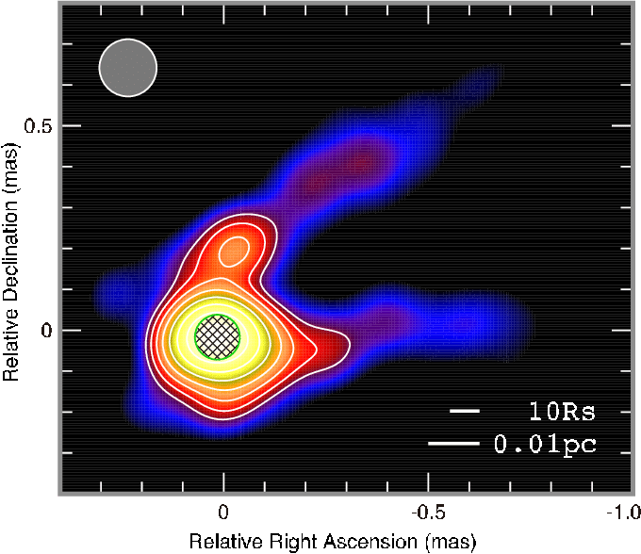
M87: Virgo A
VLBA Radio images: higher resolution
  The 7 mm image of M87
Even higher resolution image shows jet emerging from nucleus
~4,000 ly
~0.03 ly = 60 times Neptune’s orbit
~17,000 ly
~4,000 ly
~10 ly
http://www.aoc.nrao.edu/~jeilek/research/M87Virgo.html
Image Credit: F. Owen, NRAO & J. Eilek, NMINT
Kino, M, Takahara, F, Hada, , K, & Doi, A., 2013, EPJ Web of Conferences

Slide 52
What object smaller than 0.03 ly can shoot material out 300,000 ly??
~450,000 ly
Even higher resolution image shows jet emerging from nucleus
~4,000 ly
~0.03 ly = 60 times Neptune’s orbit
~250,000 ly
10 million times size of plasma source!!
~17,000 ly
~4,000 ly
~10 ly
http://www.aoc.nrao.edu/~jeilek/research/M87Virgo.html
Image Credit: F. Owen, NRAO & J. Eilek, NMINT

Slide 53
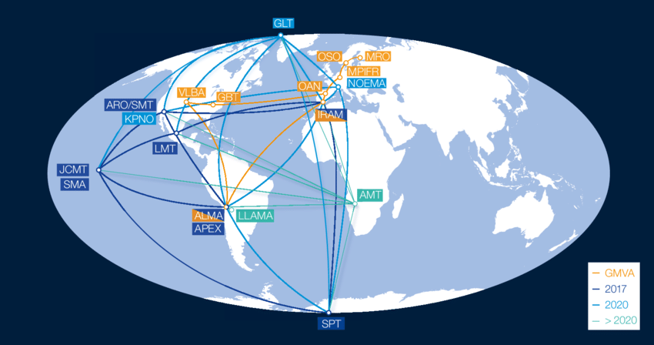
Event Horizons Telescope
A telescope the size of Earth
  Radio observations synchronized & combined!
https://eventhorizontelescope.org/array

Slide 54
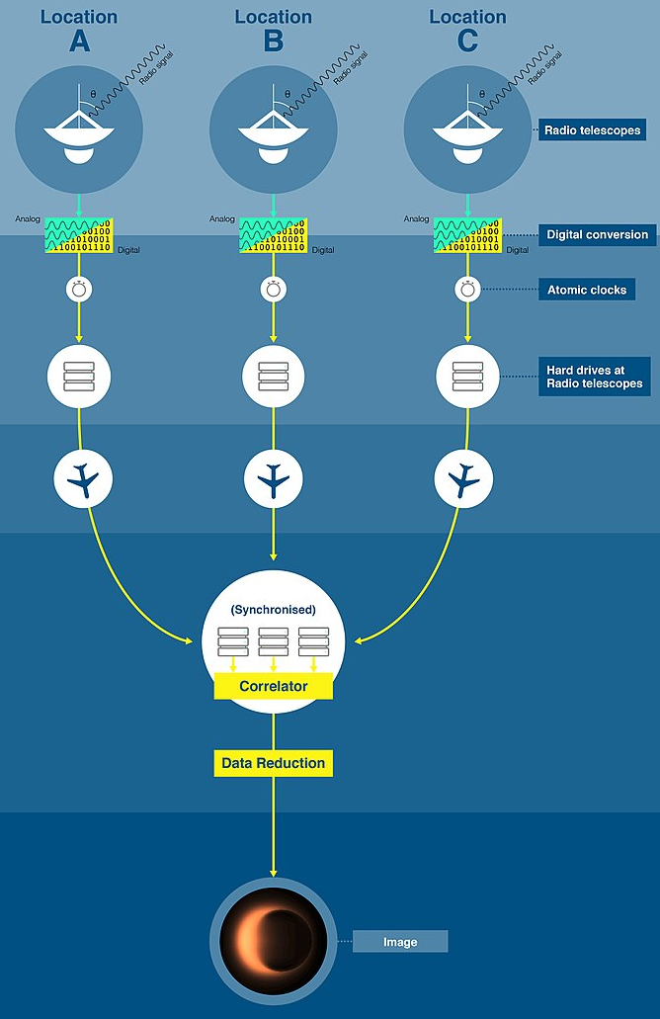
Event Horizon Telescope (EHT)
Observations at same times
  Atomic clock timers
Data recorded on hard drives at sites
Hard drives flown by commercial aircraft to MIT and Max Planck for analysis

Slide 55
Event Horizon Telescope (EHT)
Observations at same times
  Atomic clock timers
Data recorded on hard drives at sites
Hard drives flown by commercial aircraft to MIT and Max Planck for analysis

Slide 56
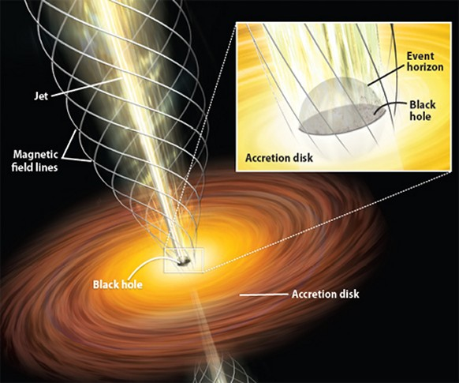

Accretion Disks
Material spirals into black hole
  accelerates as it gets closer
    Particles fly off in all directions
  charged particles create magnetic field
    Very strong, spiraling out from black hole
    Constrains particles to create jets
http://www.daviddarling.info/index.html
https://www.physicsoftheuniverse.com/topics_blackholes_event.html

Slide 57
Accretion Disks
Material spirals into black hole
  accelerates as it gets closer
    Particles fly off in all directions
  charged particles create magnetic field
    Very strong, spiraling out from black hole
    Constrains particles to create jets
https://www.physicsoftheuniverse.com/topics_blackholes_event.html
https://www.physicsoftheuniverse.com/topics_blackholes_event.html

Slide 58
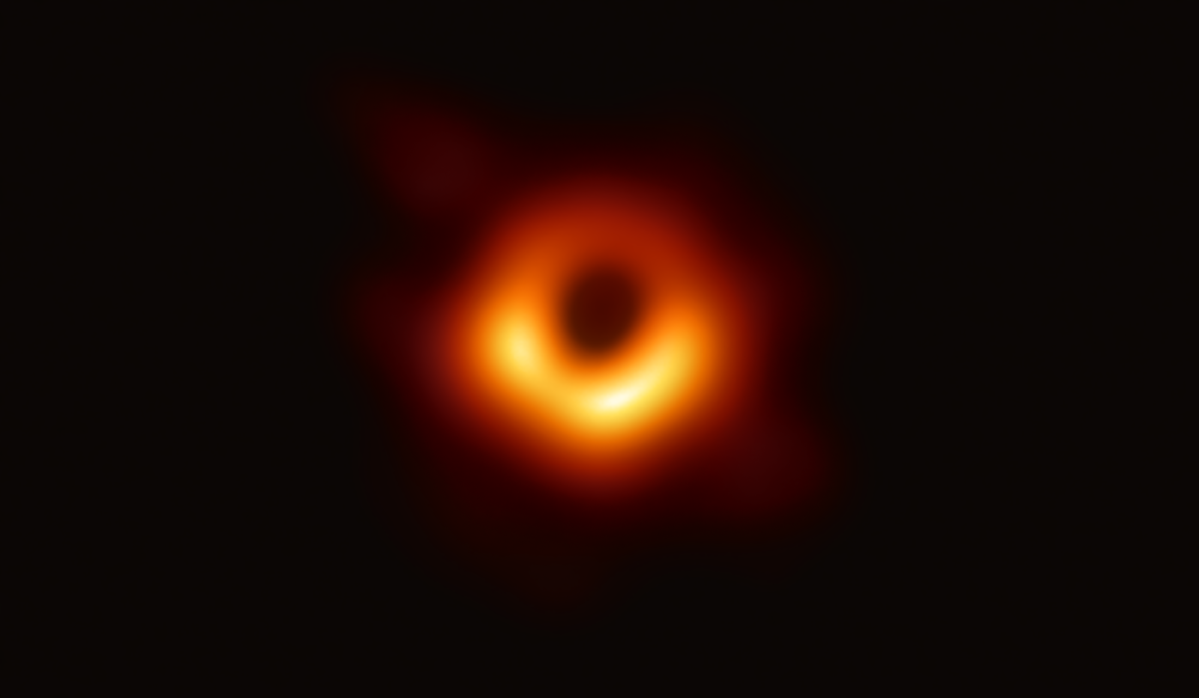

Image of a Black Hole
M87 Giant Galaxy in Virgo
  Radiation from material orbiting black hole imaged by Event Horizons Telescope in 2019
https://eventhorizontelescope.org/

Slide 59
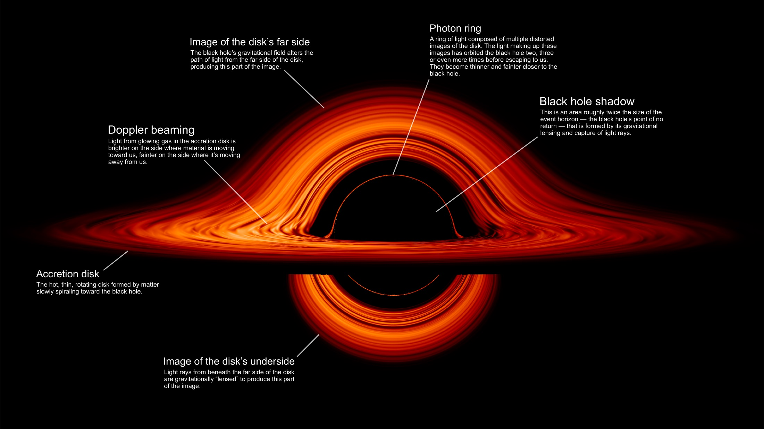
Black Hole Images
NASA: Black Hole’s Warped World
https://www.nasa.gov/feature/goddard/2019/nasa-visualization-shows-a-black-hole-s-warped-world

Slide 60
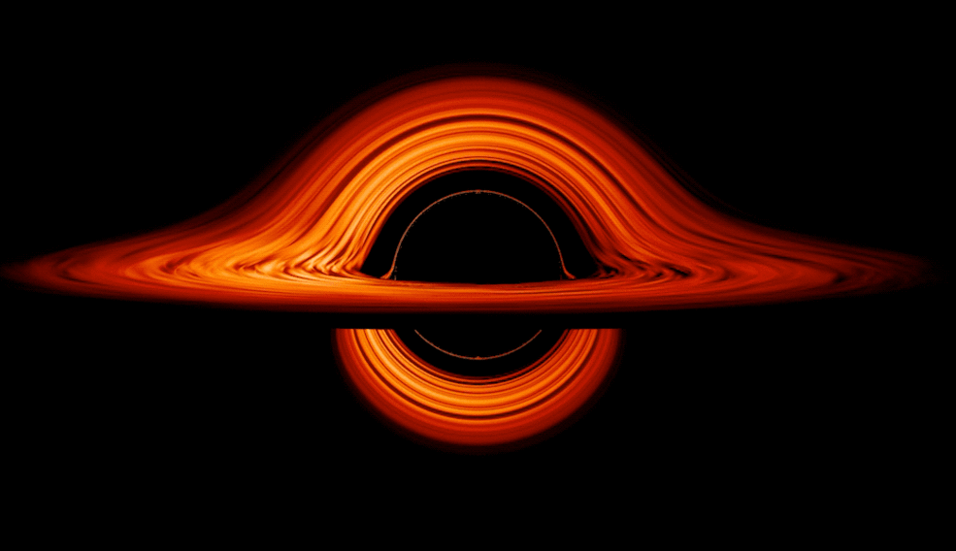
Black Hole Images
NASA: Black Hole’s Warped World
https://www.nasa.gov/feature/goddard/2019/nasa-visualization-shows-a-black-hole-s-warped-world

Slide 61
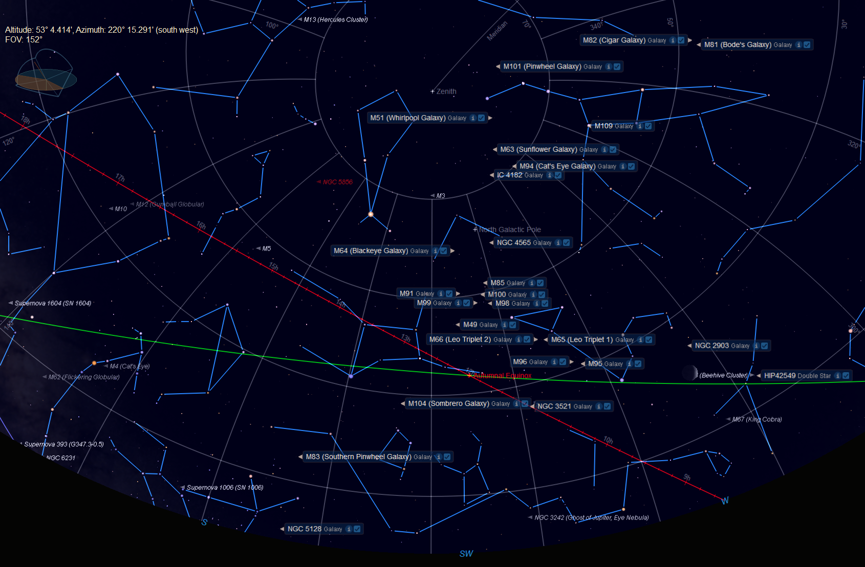

Where is M87? ... the Sky Today
2:45 pm, 9/30/26
Corona Borealis
Zenith
Big Dipper
Ursa Major
Boötes
Arc to Arcturus
Celestial Equator
Arcturus
Supergalactic Equator
Spike to Spica
Leo
Cancer
Antares
Libra
Spica
Virgo
Ecliptic
Autumnal Equinox
Scorpius
Sun Today
W
S
Image made using Starry Night Software
SW

Slide 62
Where is M87? ... the Sky Tonight
4:00 am, 3/13/24
Corona Borealis
Zenith
Big Dipper
Ursa Major
Boötes
Coma Berenices
Celestial Equator
Arcturus
Three leaps of the gazelle
The Pond
Leo
Cancer
Antares
Libra
Spica
Virgo
Ecliptic
Scorpius
W
S
Image made using Starry Night Software
SW

Slide 63
Where is M87? ... the Sky Tonight
4:00 am, 3/13/24
Corona Borealis
Zenith
Big Dipper
Ursa Major
Boötes
Coma Berenices
Celestial Equator
Arcturus
Three leaps of the gazelle
The Pond
Leo
Cancer
Antares
Libra
Spica
Virgo
Ecliptic
Scorpius
W
S
Image made using Starry Night Software
SW

Slide 64
Where is M87? ... the Sky Tonight
4:00 am, 3/13/24
Corona Borealis
Zenith
Big Dipper
Ursa Major
Boötes
Coma Berenices
Celestial Equator
Arcturus
North Galactic Pole
Galaxies!
M87
Leo
Cancer
Antares
Libra
Spica
Virgo
Ecliptic
Scorpius
W
S
SW

Slide 65
Black Hole in M87
M87 Giant Galaxy in Virgo
  Radiation from material orbiting black hole imaged by Event Horizons Telescope in 2019
https://eventhorizontelescope.org/

Slide 66

Center of the Milky Way from ALMA
Sagittarius A*
Atacama Large Millimeter Array
https://www.eso.org/public/images/eso2208-eht-mwc/

Slide 67

Center of the Milky Way from ALMA
Sagittarius A*
ALMA
Atacama Large Millimeter Array
https://www.eso.org/public/images/eso2208-eht-mwc/

Slide 68


Stars Orbiting Galactic Center
“SO-16 swung a mere 60 AU from the black hole!
Motion in 7 years
1995 to 2002
Sagittarius = Sgr

Slide 69
Stars Orbiting Galactic Center
“SO-16 swung a mere 60 AU from the black hole!
Motion in 7 years
2000 AU in 7 years
Sagittarius = Sgr
Zippy!
2,000 AU
4,000 AU

Slide 70


Stars Orbiting Galactic Center
Mass needed in center of orbits = 4.1 million times the mass of Sol!
http://www.astro.ucla.edu/~ghezgroup/gc/images_science.html

Slide 71


Stars Orbiting Galactic Center
http://www.galacticcenter.astro.ucla.edu/animations.html
Mass needed in center of orbits = 4.1 million times the mass of Sol!
http://www.astro.ucla.edu/~ghezgroup/gc/images_science.html

Slide 72

Image of a Black Hole
Sagittarius A* Center of the Milky Way
  Stars orbit center at high speeds!
    Observed from 1995 until 2019
    Orbital speeds give mass of object in center
M_{MW Black Hole} = 4.3 million M_{Sun}
Milky Way’s black hole is 4.3 million times the Sun’s mass in a volume much smaller than the Sun ... r_{BH} = 0
72 million miles =
8 x 10⁻⁹ degrees on the sky = 8 x 10⁻⁹ x pinky at arm’s length = donut on the surface of the moon

Slide 73
Black Hole Images
M 87 vs. Sgr A*: Pluto orbit ~100 x Mercury’s
https://www.eso.org/public/images/eso2208-eht-mwe/

Slide 74


Black Hole Images
Why orange?
  Human eye can see more levels
    Black → orange → yellow → white
    Standard for images in low frequencies (JWST)

Slide 75
Outline
Review Star Deaths
  Small: PN & WD, Large: SN & NS or BH
  States of Matter
General Relativity, Gravity, & Light
  Total Eclipses & Galaxy Clusters
Black Holes
  Escape Velocity & Spaghettification
  Detecting Black Holes
    X-Rays, Invisible Companions, Direct Imaging
The Adventure Continues

Slide 76
We are the Legacy of the Stars
We are alive!
  We are made of stars ...
  ... And we KNOW that we are!

Slide 77
We are the Legacy of the Stars
We are alive!
  We are made of stars ...
  ... And we KNOW that we are!
  Every “ordinary” thing around us ...
    the Earth
    the mountains and rusty nails!
    the rivers and oceans and puddles!
    all the other Earthlings ... Puppies and Bugs!
  ... Are made of STARS and we know it!

Slide 78
We are the Legacy of the Stars
We are alive!
  We are made of stars ...
  ... And we KNOW that we are!
  Every “ordinary” thing around us ...
    the Earth
    the mountains and rusty nails!
    the rivers and oceans and puddles!
    all the other Earthlings ... Puppies and Bugs!
  ... Are made of STARS and we know it!
Breathe in, Breathe out ...
... the Cosmos lives within you

Slide 79
We are the Legacy of the Stars!
The Adventure Continues!

