Slide 1

Why DO We Fool with the Clocks???
Dr. Aileen O’Donoghue St. Lawrence University Physics Department

Slide 2
Standard to Daylight Time 2025
In Canton we are currently in EST
  EST = Eastern Standard Time
2 am on Sunday, March 9 change to EDT
  EDT = Eastern Daylight Time
Daylight Time Begins on March 9, 2025
“Spring Ahead’’

Slide 3
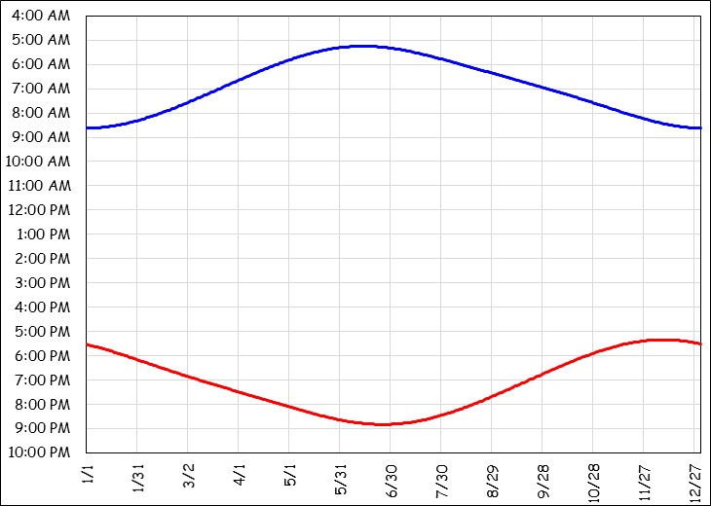
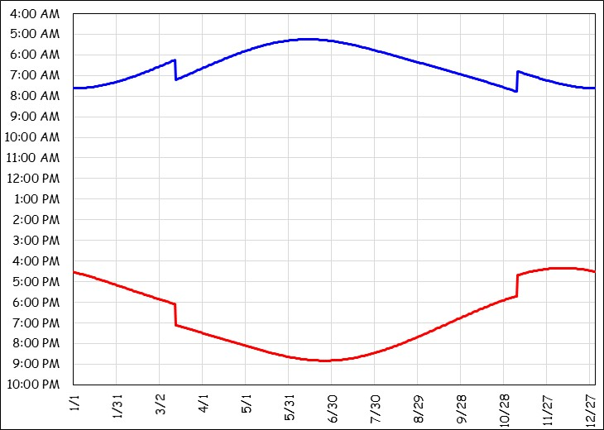
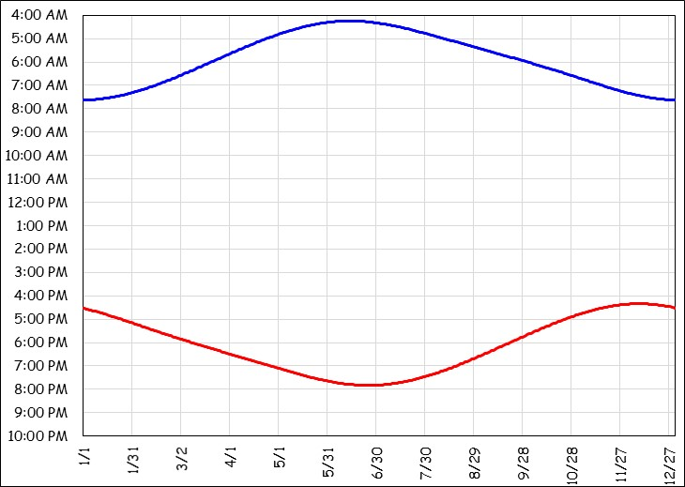
Standard Time
Day lengths in Canton
  Longest = 15^{h}33^{m}57^{s}, Shortest = 8^{h}49^{m}05^{s} s
  Natural sunrise & sunset varies:
Sunrise from 4:13 am to 7:36 am
Sunrise at 4:13 am? Who wants that??
Times of sunrise & sunset in Canton on Eastern Standard Time (EST).
Sunset from 4:22 pm to 7:52 pm

Slide 4
Daylight Saving Time
Shifts an hour of sunlight to evening
  Industrial workday: 8 am – 5 pm
    Shifts daylight from before work to after work
    Was thought to save energy (more light after work)
Sunrise from 5:13 am to 8:36 am
Sunrise at 8:36 am? Who wants that??
Times of sunrise & sunset in Canton on Eastern Daylight Time (EST).
Sunset from 5:22 pm to 8:52 pm

Slide 5
Why Change?
All-year EST or EDT has problems
  EST: Summer Sun rises at 4:13 am
  EDT: Winter Sun rises at 8:36 am
  ⇒ Keep sunrise from being really early or late: Switch!!
Narrows range of sunrise
Sunrise from 5:13 am to 7:36 am
EST
EDT
EST
Times of sunrise & sunset in Canton for EST and EDT.
Widens range of sunset
Sunset from 4:22 pm to 8:52 pm

Slide 6
Daylight to Standard Time 2025
2 am on Sunday, March 9 begin EDT
  EDT = Eastern Daylight Time
2 am on Sunday, November 2 begin EST
    (First Sunday after Halloween)
  EST = Eastern Standard Time
Standard Time Begins on November 2, 2025
“Fall Back’’

