Slide 1
Why DO We Fool with the Clocks???
Dr. Aileen O’Donoghue St. Lawrence University Physics Department

Slide 2
Daylight to Standard Time 2024
In Canton we are currently in EDT
EST = Eastern Daylight Time
2 am on Sunday, Nov. 3 change to EST
EDT = Eastern Standard Time
Standard Time Begins on November 3, 2024
“Fall Back’’

Slide 3
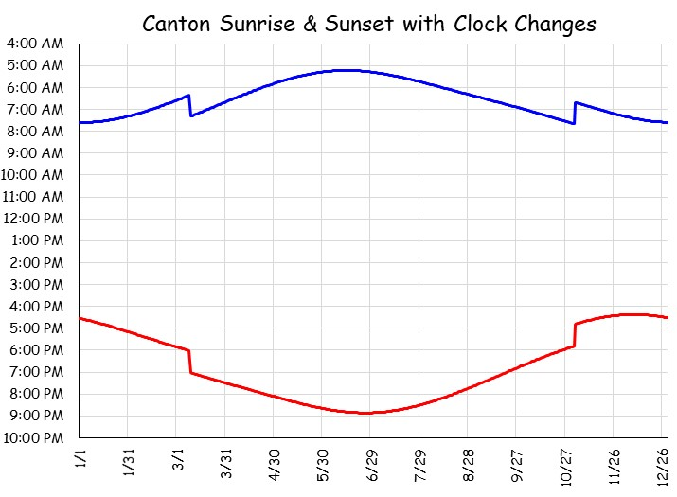
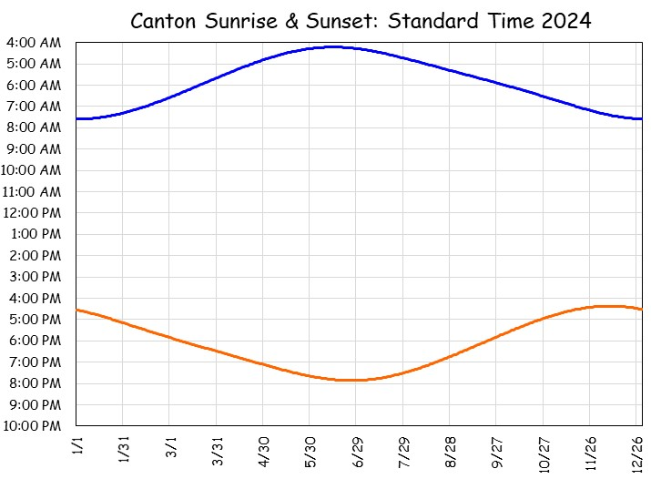
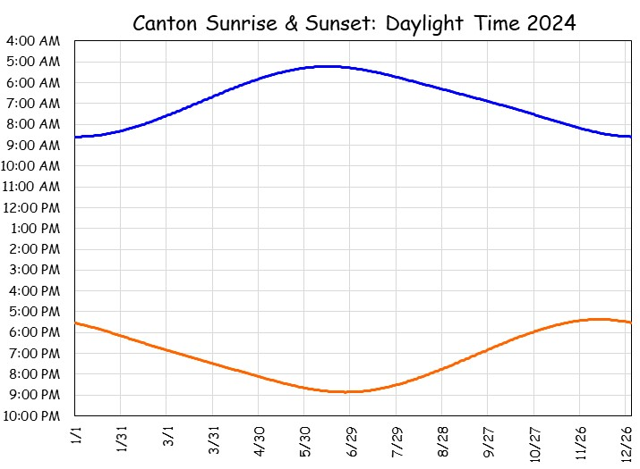
Standard Time
Day lengths in Canton
Longest = 15^{h}37^{m}23^{s}, Shortest = 8^{h}52^{m}26^{s}
Natural sunrise & sunset varies:
Sunrise from 4:13 am to 7:36 am
Sunrise at 4:13 am? Who wants that??
Times of sunrise & sunset in Canton on Eastern Standard Time (EST).
Sunset from 4:22 pm to 7:52 pm

Slide 4
Daylight Saving Time
Shifts an hour of sunlight to evening
Industrial workday: 8 am – 5 pm
Shifts daylight from before work to after work
Was thought to save energy (more light after work)
Sunrise from 4:13 am to 8:36 am
Sunrise at 8:36 am? Who wants that??
Times of sunrise & sunset in Canton on Eastern Daylight Time (EST).
Sunset from 5:22 pm to 8:52 pm

Slide 5
Why Change?
All-year EST or EDT has problems
EST: Summer Sun rises at 4:13 am
EDT: Winter Sunrise at 8:36 am
⇒ Keep sunrise from being really early or late: Switch!!
Narrows range of sunrise
Sunrise from 5:13 am to 7:36 am
EST
EDT
EST
Times of sunrise & sunset in Canton for EST and EDT.
Sunset from 4:22 pm to 8:52 pm
Widens range of sunset

Slide 6
Standard to Daylight Time 2025
2 am on Sunday, 11/3/2024 begin EST
(First Sunday after Halloween)
EST = Eastern Standard Time
2 am on Sunday, 3/9/2025 begin EDT
EDT = Eastern Daylight Time
Daylight Time Will Begin on March 9, 2025
“Spring Ahead’’

