Slide 1
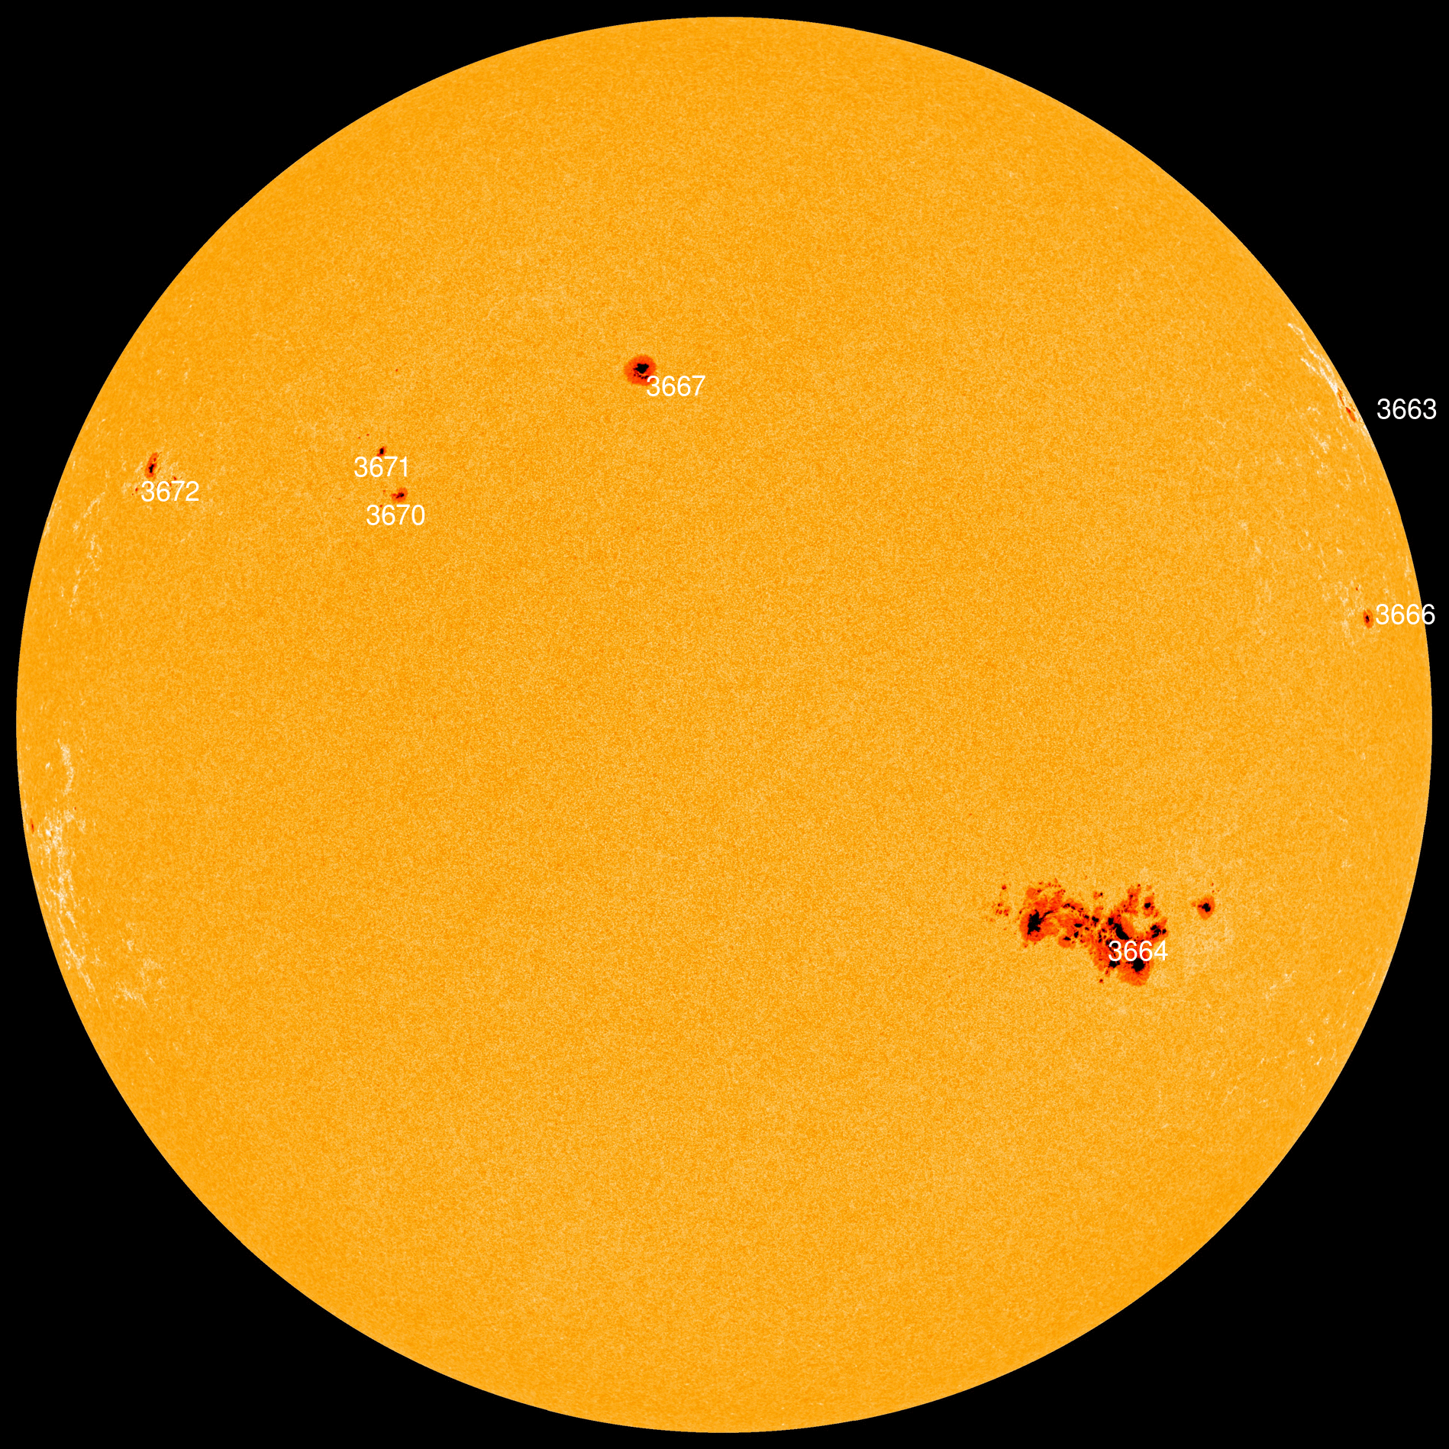
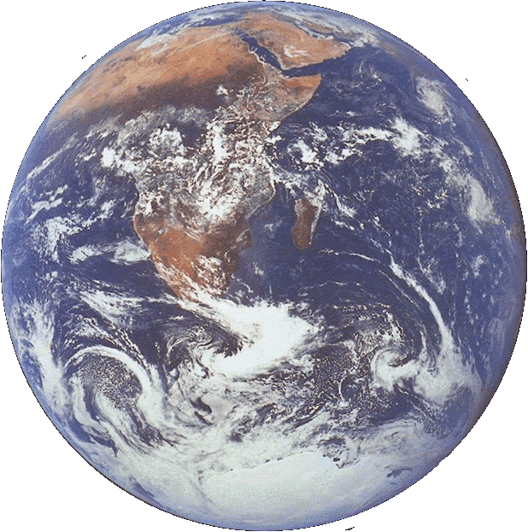
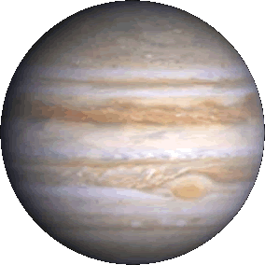
The Sun 5/10/24
Sunspots at high solar latitudes.
Earth to scale
Current Solar Images from NASA
Earth & Jupiter to scale
They’re HUGE!

Slide 2
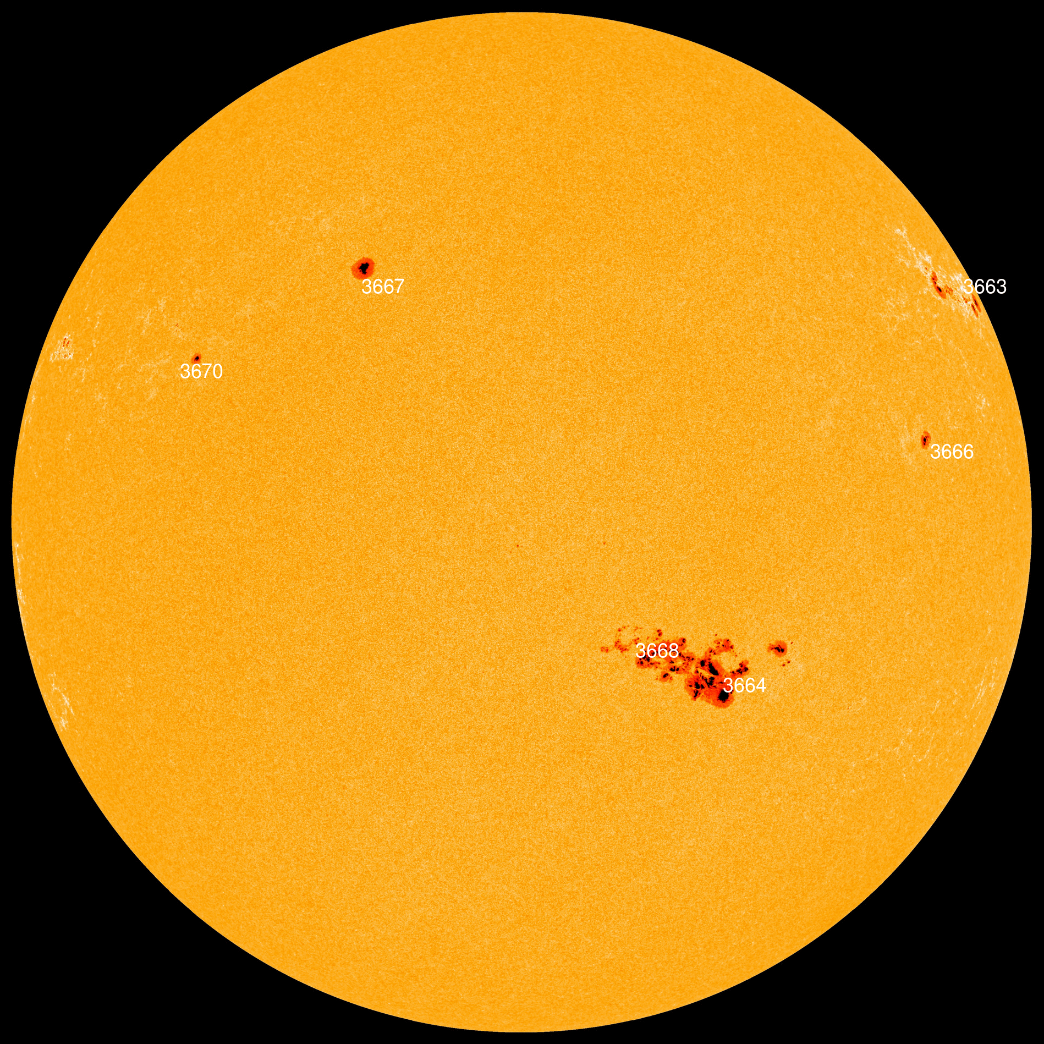
The Sun 5/9/24
Sunspots at high solar latitudes.
Earth to scale
Current Solar Images from NASA
Earth & Jupiter to scale

