Slide 1
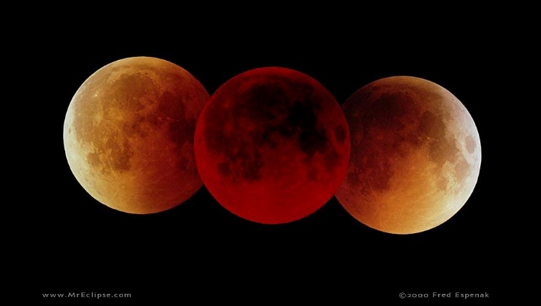
Total Lunar Eclipse 3/14/2025
Aileen O’Donoghue St. Lawrence University Physics Department

Slide 2
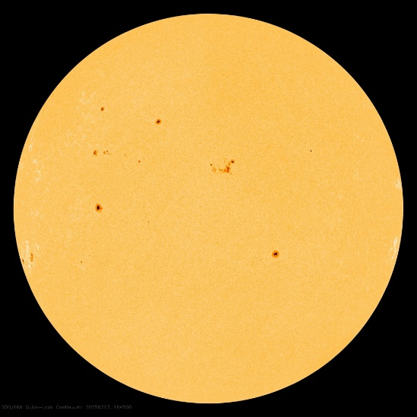
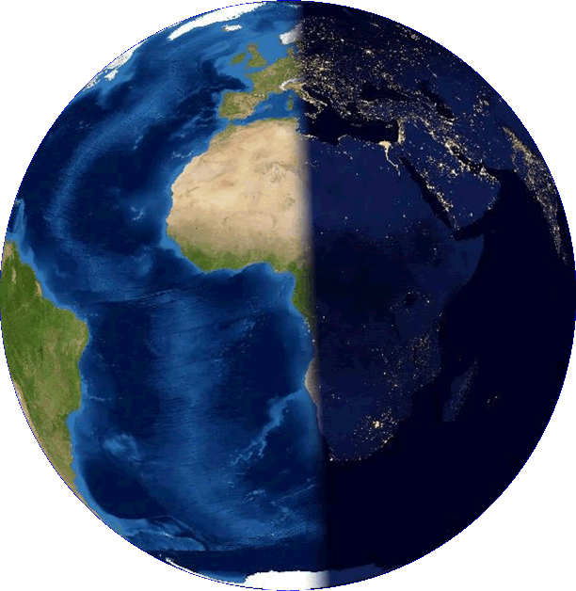
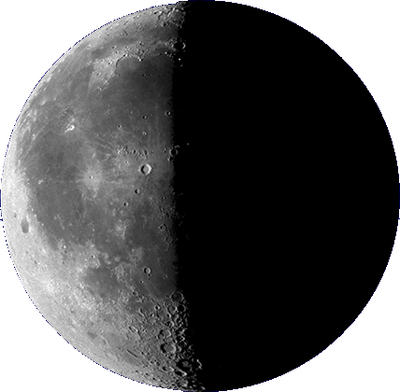
Lunar Eclipses
Moon passes through Earth’s shadow
  Moon in penumbra is barely noticeable
    shadow darkens as Moon approaches umbra
  Moon in umbra
    partial eclipse until moon is entirely in umbra
Earth’s penumbra: Sun partially blocked
Earth’s umbra: Sun entirely blocked
penumbra ≈ 4.5 R_{Moon}
umbra ≈ 3 R_{Moon}

Slide 3
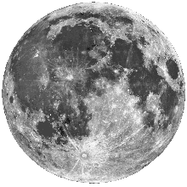
Canton’s View, March 13-14, 2025
2:59 am Eclipse Maximum: Moon centered in northern part of Earth’s umbra
11:57 pm 3/13/15 Moon enters Earth’s penumbra (barely noticeable) ... lunar eclipse begins
1:10 am 3/15/15 Moon enters Earth’s umbra ... Partial eclipse begins
6:00 am Moon entirely out of penumbra ... lunar eclipse ends
2:25 am Moon entirely within umbra ... Total eclipse begins
3:31 am Moon begins to leave umbra ... Total eclipse ends
3:31 am Moon entirely out of umbra ... Total eclipse ends
Earth’s penumbra: Sun partially blocked
Ecliptic: Earth’s orbit
Earth’s umbra: Sun entirely blocked
Times in EDT

Slide 4
Total Lunar Eclipse, March 2025
Event Times
  Moon enters penumbra 11:57 pm
    barely noticeable!
  Moon enters umbra 1:10 am, 3/14/25
    start of partial eclipse
  Moon entirely within umbra 2:26 am
    start of total eclipse
  Maximum eclipse 2:59 am
    center of northern part of umbra
  Moon begins to leave umbra 3:31 am
    total eclipse ends, partial begins again
  Moon entirely out of umbra 4:48 am
    partial eclipse ends
  Moon leaves penumbra 6:00 am
    Moon is entirely out of Earth’s shadow

