Slide 1
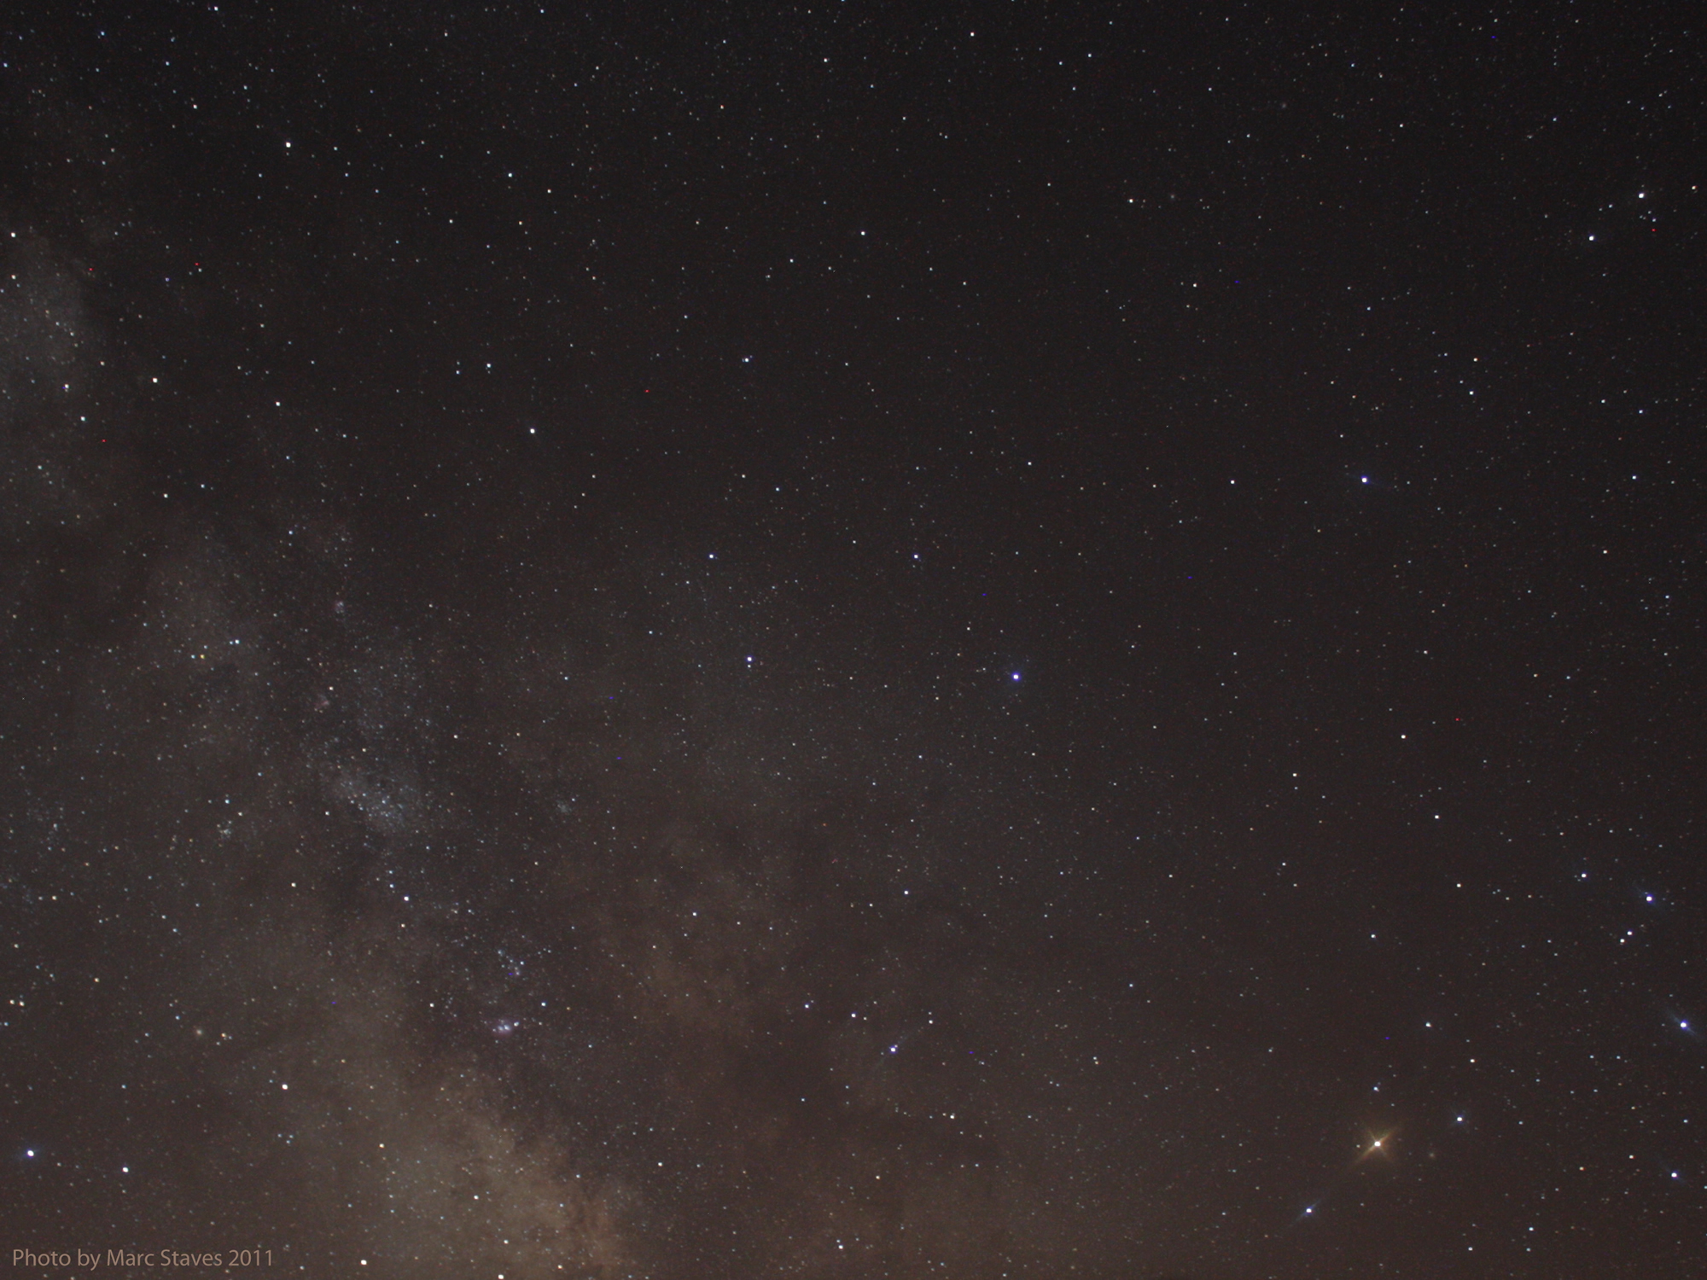


Logistics
The Cosmos Within
Dr. Aileen A. O’Donoghue
July 8 – 13, 2019

Slide 2
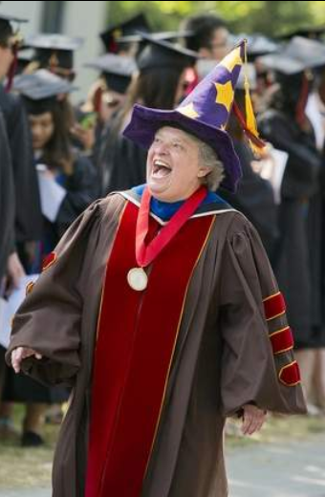
Introductions
Aileen
  Who am I to be leading this?
Conferences
  Ask questions as they come
  No quizzes, no exams
  … take what you can!
Stargazing
  If clear, 9:30 – 10:30 pm
  Depending on weather & darkness

Slide 3
Contact Information
email:
aodonoghue@stlaw.edu
Spirituality Web site:
http://myslu.stlawu.edu/~aodo/spirituality/

Slide 4
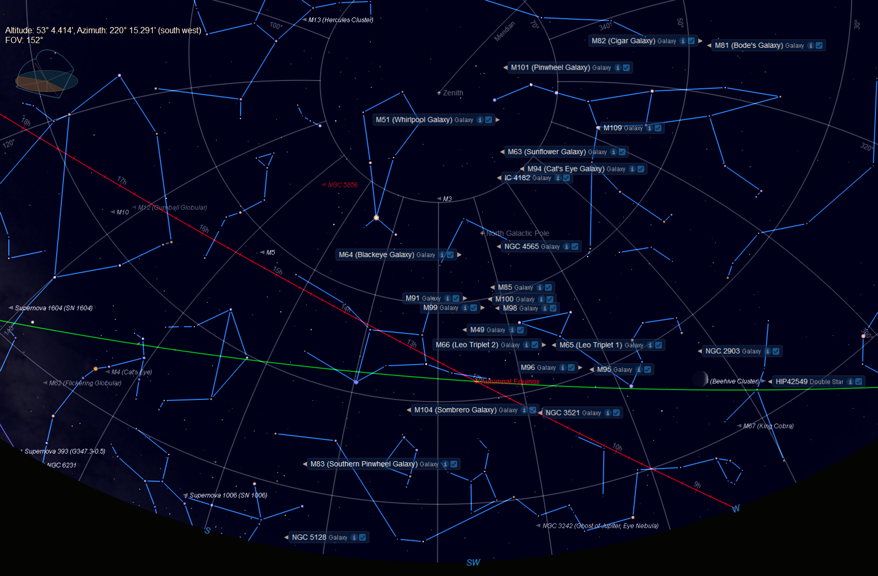
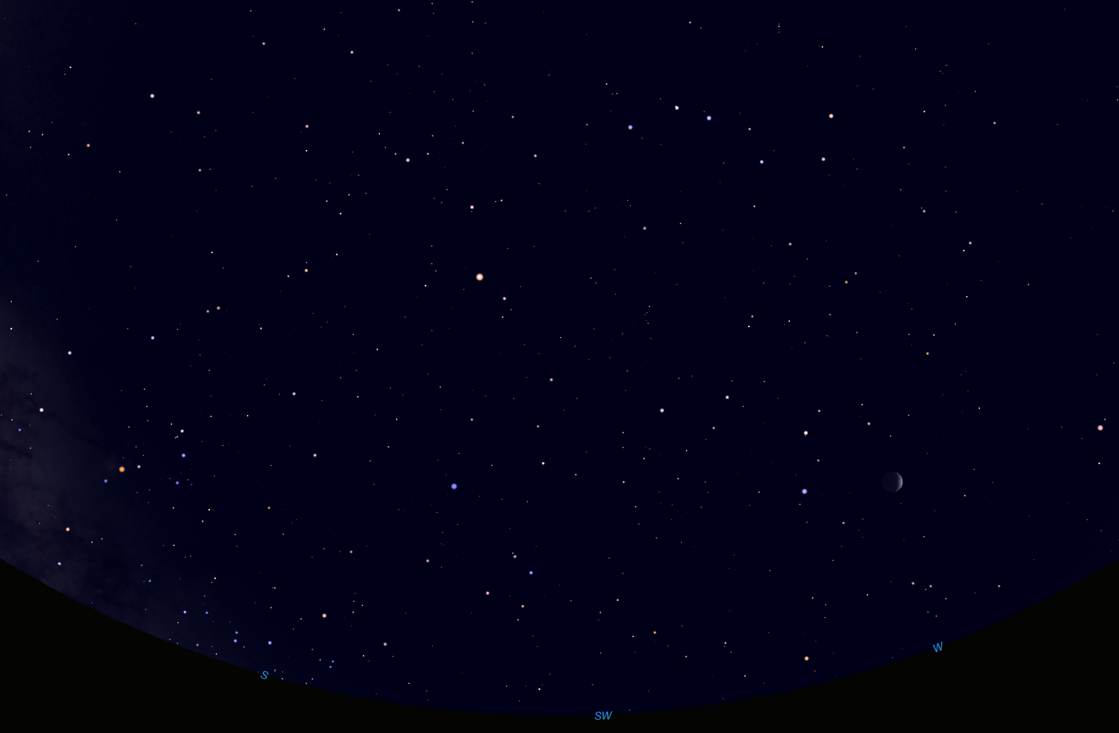
The Sky Tonight
10:00 pm, 7/8/19
Zenith
Big Dipper
Ursa Major
Boötes
Arc to Arcturus
Arcturus
Spike to Spica
Denebola
Leo
Cancer
Porrima
Spica
Virgo
Regulus
W
S
Image made using Starry Night Software
SW

Slide 5
The Sky Tonight
10:00 pm, 7/8/19
Zenith
Big Dipper
Stars move 15° to the west parallel to this line every hour.
Ursa Major
Boötes
Arc to Arcturus
Celestial Equator
Arcturus
Supergalactic Equator
Spike to Spica
Zubeneschamali
Leo
Jupiter
Denebola
Cancer
Antares
Libra
Zubenelgenubi
Porrima
Spica
Virgo
Regulus
Ecliptic
Autumnal Equinox
Sun moves ~1° to the east along this line every day!
Scorpius
Brachium
Sun will move south of the Celestial Equator on September 23, 2019 at 3:50 am EDT
W
S
Image made using Starry Night Software
SW

Slide 6
The Sky Tonight
10:00 pm, 7/8/19
Rasalhague
Corona Borealis
Zenith
Big Dipper
Ophiuchus
Ursa Major
Serpens Caput
Boötes
Arcturus
Zubeneschamali
Leo
Jupiter
Denebola
Cancer
Antares
Libra
Zubenelgenubi
Porrima
Spica
Virgo
Regulus
Scorpius
Brachium
Corvus
Hydra
Alphard
W
S
Image made using Starry Night Software
SW

Slide 7
The Sky Tonight
10:00 pm, 7/8/19
Rasalhague
Corona Borealis
Zenith
Big Dipper
Ophiuchus
Ursa Major
Serpens Caput
Boötes
Coma Berenices
Arcturus
Three leaps of the gazelle
The Pond
Zubeneschamali
Leo
Jupiter
Denebola
Cancer
Antares
Libra
Zubenelgenubi
Porrima
Spica
Virgo
Regulus
Scorpius
Brachium
Corvus
Hydra
Alphard
W
S
Image made using Starry Night Software
SW

Slide 8
The Sky Tonight
10:00 pm, 7/8/19
Rasalhague
Corona Borealis
Zenith
Big Dipper
Ophiuchus
Ursa Major
Serpens Caput
Boötes
Coma Berenices
Arcturus
Three leaps of the gazelle
The Pond
Jupiter
Leo
Cancer
Antares
Libra
Spica
Virgo
Scorpius
Corvus
Hydra
Alphard
W
S
Image made using Starry Night Software
SW

Slide 9
The Sky Tonight
10:00 pm, 7/8/19
Rasalhague
Corona Borealis
Zenith
Big Dipper
Ophiuchus
Ursa Major
Serpens Caput
Boötes
Coma Berenices
Arcturus
North Galactic Pole
Galaxies!
Jupiter
M87
Leo
Cancer
Antares
Libra
Spica
Virgo
Scorpius
Corvus
Hydra
Alphard
W
S
SW

Slide 10
Where is St. Lawrence
Named for the County
Named for the River
Named for the Estuary
Named for the Day …
Jacques Cartier entered the St. Lawrence Estuary on August 10, 1534

Slide 11
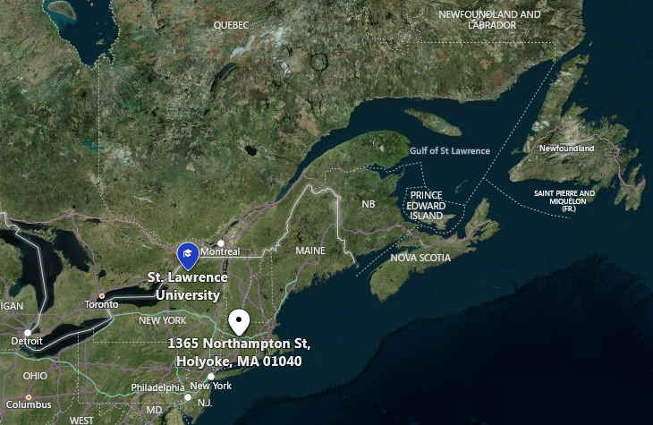
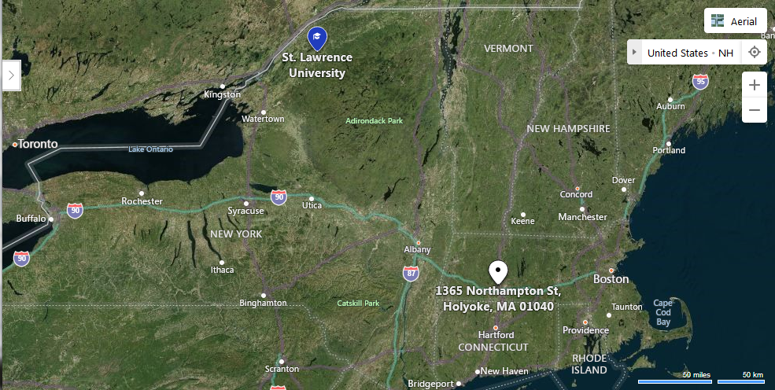
Where is St. Lawrence
Named for the County
Named for the River
Named for the Estuary
Named for the Day …
Jacques Cartier entered the St. Lawrence Estuary on August 10, 1534

Slide 12
Talks … order may vary
In the Beginning
The Gift of Darkness
Dark Matter & Dark Energy
Forces & Interactions
Starlight and Grace
Substance of Ourselves
Minerals and Machines
Einstein, Gravity, & the Fabric of our Souls
© Copyright, Dr. Aileen O’Donoghue, St. Lawrence University

Slide 13
The Point
We are matter and spirit integrated
  Our spirits are of God
  Our matter is of God, too
Awareness of the origin and nature of matter
  Invites us into the wholeness of ourselves
  Guides us to God’s wholeness within us
  Deepens our presence in God and the Universe

Slide 14
A Weird Retreat
This is a retreat
  Yes, I’ll cite and quote scripture & spiritual writers and we’ll have a prayer ritual
But it’ll be weird!
  I’m going to talk about physics …
    … weird physics!
  Because it’s ONE Universe
    We are the image of GOD … spirit and flesh
    The universe is spirit and matter
    … the physics of the universe also speaks of GOD

Slide 15
First Evening: The Gift of Darkness
The Cosmos Within
Dr. Aileen A. O’Donoghue
July 8 – 13, 2019

Slide 16
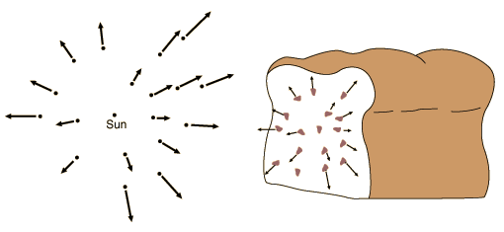
In the Beginning …
Expansion of the Universe
  All galaxies are moving away from us
  More distant galaxies moving away faster
Space, itself, is expanding!
Raisins move with dough, not through it.
Galaxies move with space, not through it!

Slide 17
In the Beginning …
Current Cosmological Theory
  Use equations to “run time backwards”
    Universe gets smaller, denser, hotter
    Can go back to ~10⁻⁴³ sec after Big Bang
Observations support Theory
  Early universe is glowing ball of energy seen as Cosmic Microwave Background
0.0000000000000000000000000000000000000000001 seconds!
… So what have we learned?

Slide 18
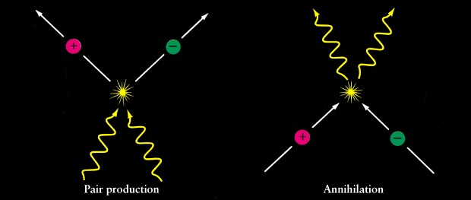
Expansion of the Universe
The Universe cooled as it expanded
  Particles condensed out of the light …
  … light and matter are the same stuff!
All matter is “frozen” energy!
Energy
is
Matter
E=mc²
Light becomes Particles …
Particles become Light …

Slide 19
The Early Universe
A sea of light and particles
  quarks that make up protons & neutrons
  electrons, muons and other leptons (tiny!!)
Uniformly bright
  light coming from everywhere!
    like a very bright fog
    the Universe was opaque
After a few hundred thousand years of cooling, atoms began to form …

Slide 20
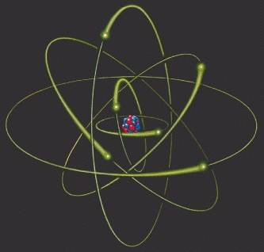
Atoms
Nucleus of protons (+) and neutrons (0)
  surrounding cloud of electrons (-)
    clouds at distances determined by their energy
quantum model: e⁻’s in clouds of probability surrounding nucleus
classical model: e⁻’s in orbits
© Copyright, Dr. Aileen O’Donoghue, St. Lawrence University

Slide 21
Atoms and Light
To change “orbit” emit or absorb energy
Outgoing photon of energy equal to difference between n = 1 and n = 3 levels
“Quantum Leap”
“Quantum Leap”
electron transitions to n = 3 level
electron transitions to n = 1 level
Incoming photon of energy equal to difference between n = 1 and n = 3 levels
n = 1
n = 2
n = 3
Atoms interact with only some wavelengths of light!
© Copyright, Dr. Aileen O’Donoghue, St. Lawrence University

Slide 22
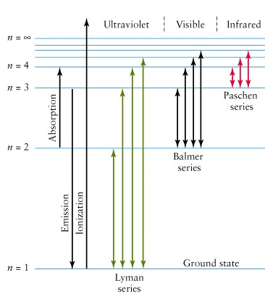
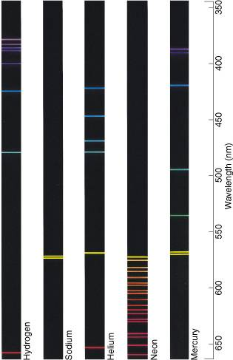
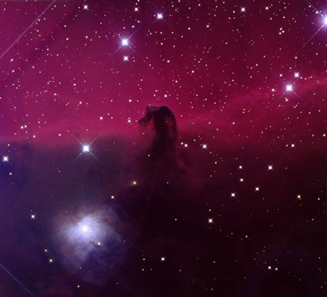
Atoms and Light
Each element creates unique spectrum
Balmer Spectrum of Hydrogen
δ
γ
β
α
Red in astronomical images is Balmer Alpha
Lyman Spectrum of Hydrogen in Ultraviolet
© Copyright, Dr. Aileen O’Donoghue, St. Lawrence University

Slide 23


Atoms & Light
Each element emits & absorbs a unique spectrum
Photons interact with every ion
Only a few photons interact with atoms
ions: nuclei & electrons
atoms
Sees closest ion
Sees across universe
Light
Most photons don’t interact ⇒ observer sees across universe
© Copyright, Dr. Aileen O’Donoghue, St. Lawrence University

Slide 24
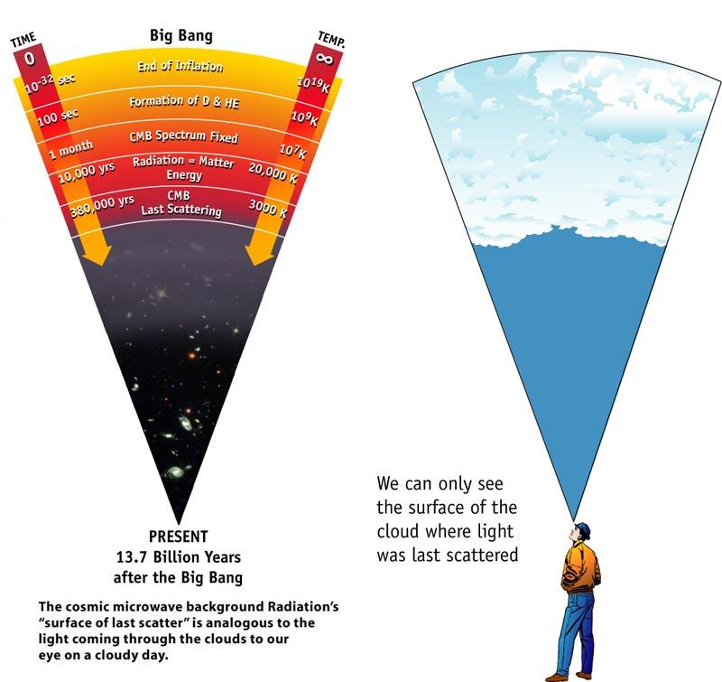
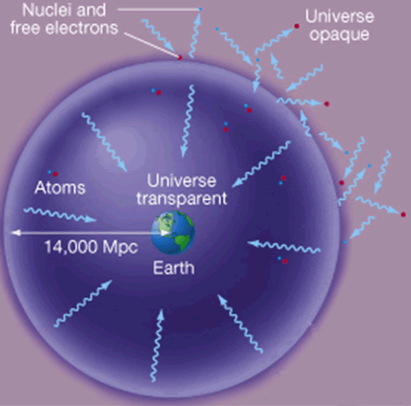
Cosmic Background Radiation (CBR)
Like light from (opaque) clouds
Within clouds light can’t go far without interacting with water droplets ⇒ clouds (fog) are opaque.
Only certain λ interact with atoms
All λ interact with free particles

Slide 25
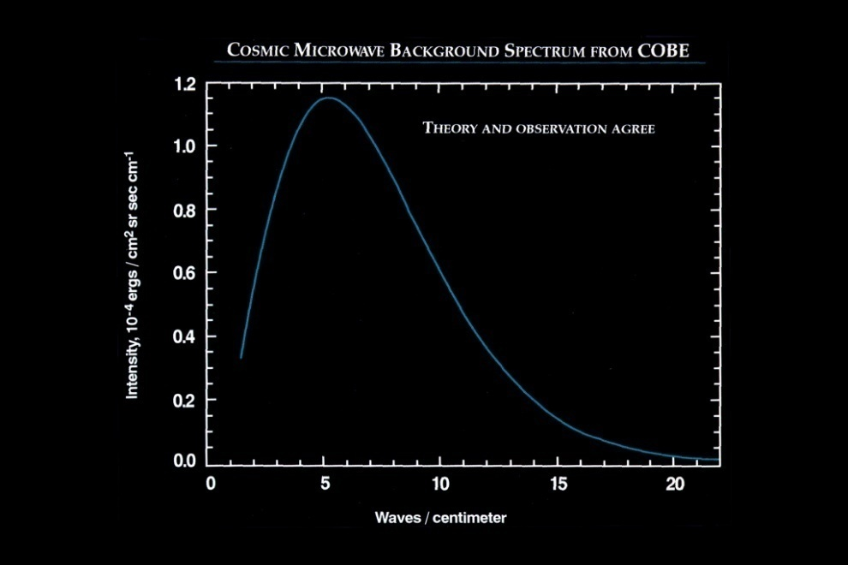
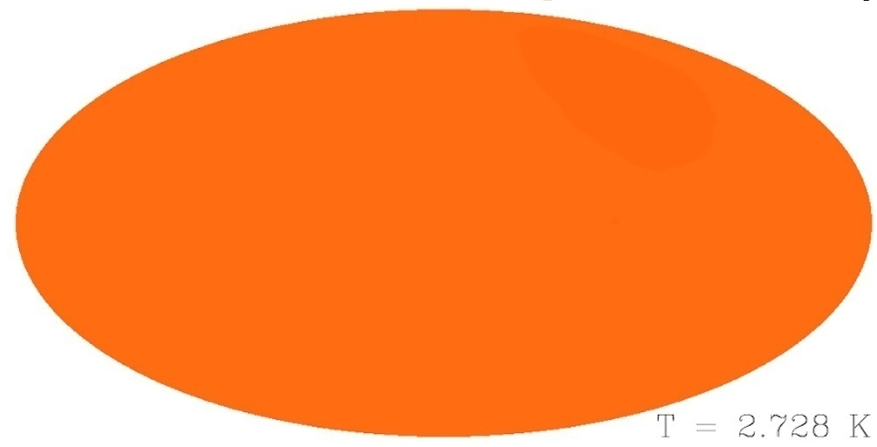
Cosmic Background Radiation (CBR)
“Echo” of the Big Bang
  PREDICTED by Big Bang Cosmology
    Glow of opaque universe
      Should be perfect Planck curve!
      Should be redshifted from 4000K to 3K
      λ_{Peak} at 4000K = (2.898 x 10⁶/4000) = 724 nm (barely IR)
      λ_{Peak} at 3K = (2.898 x 10⁶/2.728) = 1,062,000 nm = Microwaves
  Found as static in communications equipment
CBR at 1.062 mm
282,213 on FM dial!
CBR Planck Curve
21cm line = 1,428 on FM dial
Cosmic Background Explorer

Slide 26
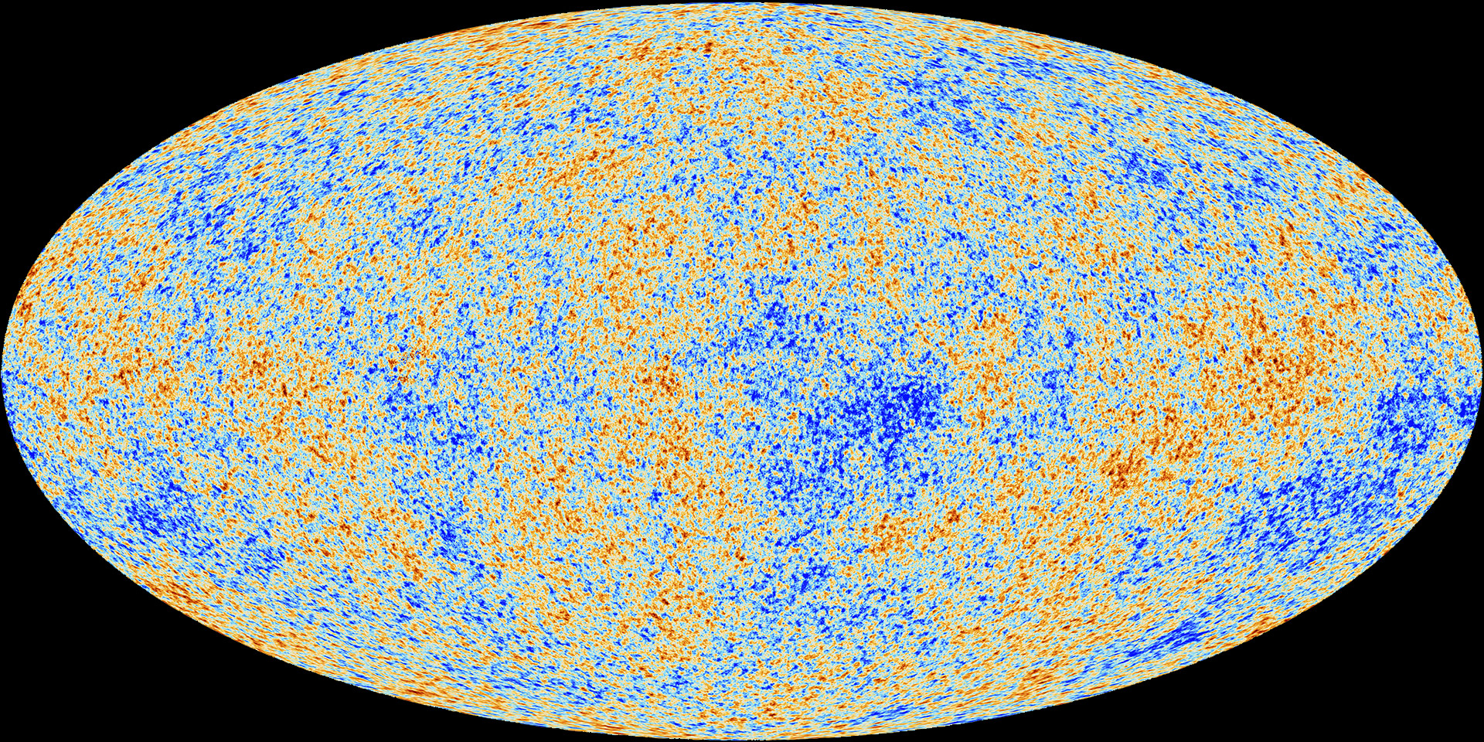
Cosmic Background Radiation
“opaque wall” at ~12-15 billion ly
  predicted and observed!
Planck
Red: Matter denser … ⇒ other matter is falling in
Blue: Matter less dense ⇒ not heating up
Variations over 1 part in 1,000,000
http://www.esa.int/Our_Activities/Space_Science/Planck/Planck_and_the_cosmic_microwave_background

Slide 27
The First Night
500,000 years after the Big Bang …
Atoms of Hydrogen (75%) and Helium (25%)
  Absorbed some light
  Most light traveled freely without interacting with any matter.
    Universe became transparent
…darkness fell for the first time.
© Copyright, Dr. Aileen O’Donoghue, St. Lawrence University

Slide 28
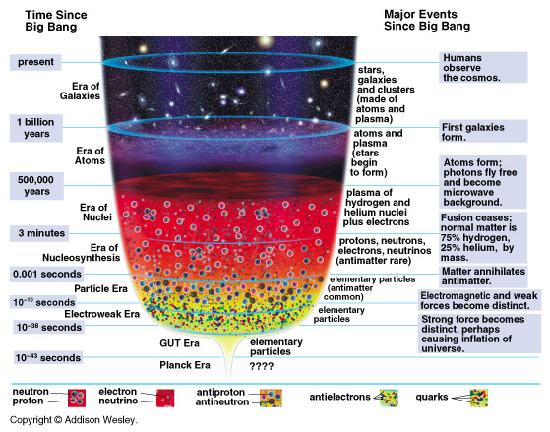
Era of Atoms
t > 500,000 yr: Atoms
  Universe initially dark!
      no stars yet!
  Lights up as
  first stars form

Slide 29
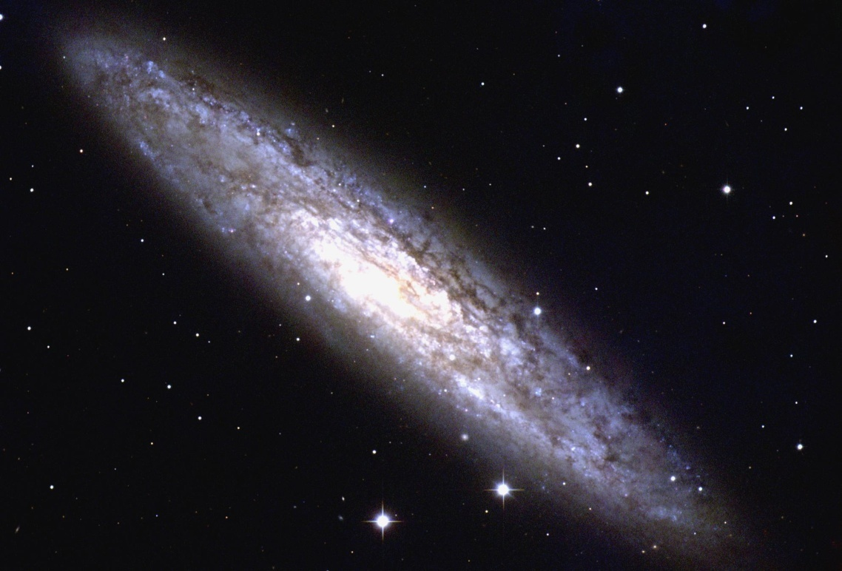
The Cosmos’ Gift of Darkness
Required the “freezing” of the Big Bang Energy into atoms … matter … us.
We are here
Requires us to be away from Galactic Nucleus or star cluster
NGC 253 (NOAO)
Darkness is not nothing …
… it’s something!

Slide 30
Darkness As Something
The Principle and Foundation of St. Ignatius
We are created to share in God’s love and life for eternity. The experience of this love is manifested in our response of praise, reverence and service, that is, loving God with all our heart all our mind and all our will.
All of God’s created cosmos is intended to reveal this sharing of God’s life and love.
… the darkness is God’s creature.
cf. John Veltri, S.J., www.sentex.net/~jveltri

Slide 31
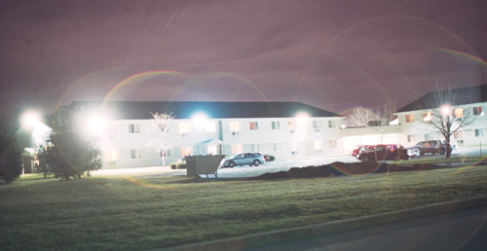
Darkness Eludes Us
Outdoor lighting tries to DISPEL THE DARKNESS!
Deprives us of the night
the stars
the dark …

Slide 32
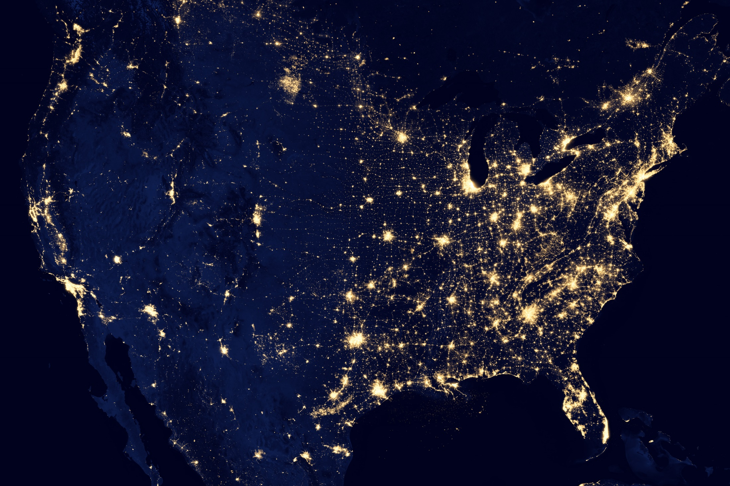
Darkness Eludes Us
Potsdam, NY
Holyoke

Slide 33
Seeking Darkness
Astronomers and Monastics
  Seek what daylight hides
    Stars, nebulae, galaxies …
    God of the vast darkness …
“And night to night declares knowledge.”
Psalm 19

Slide 34
Seeking In The Darkness
The Dark Night
St. John of the Cross
One dark night,
fired with love’s urgent longings
ah, the sheer grace –
I went out unseen,
my house being now all stilled.

Slide 35
Seeking In The Darkness
“God has to work in the soul in secret and in darkness because if we fully knew what was happening, and what Mystery, transformation, God and Grace will eventually ask of us, we would either try to take charge or stop the whole process.”
- St. John of the Cross

Slide 36
Seek The Darkness
Find some darkness & sit with it…
What can you see there that you can’t see in the daylight?
Know that the frozen energy of the Big Bang you’re sitting on allows the darkness to exist …
Seek to comprehend that the darkness came into being through the Word and is not separate from God’s creative Love …

Slide 37
In the beginning …
there was the Word;
The Word was in God’s presence,
and the Word was God.
The Word was present to God
from the beginning
Through the Word
all things came into being,
And apart from the Word
nothing came into being
that has come into being.
…not even the darkness!

