Slide 1
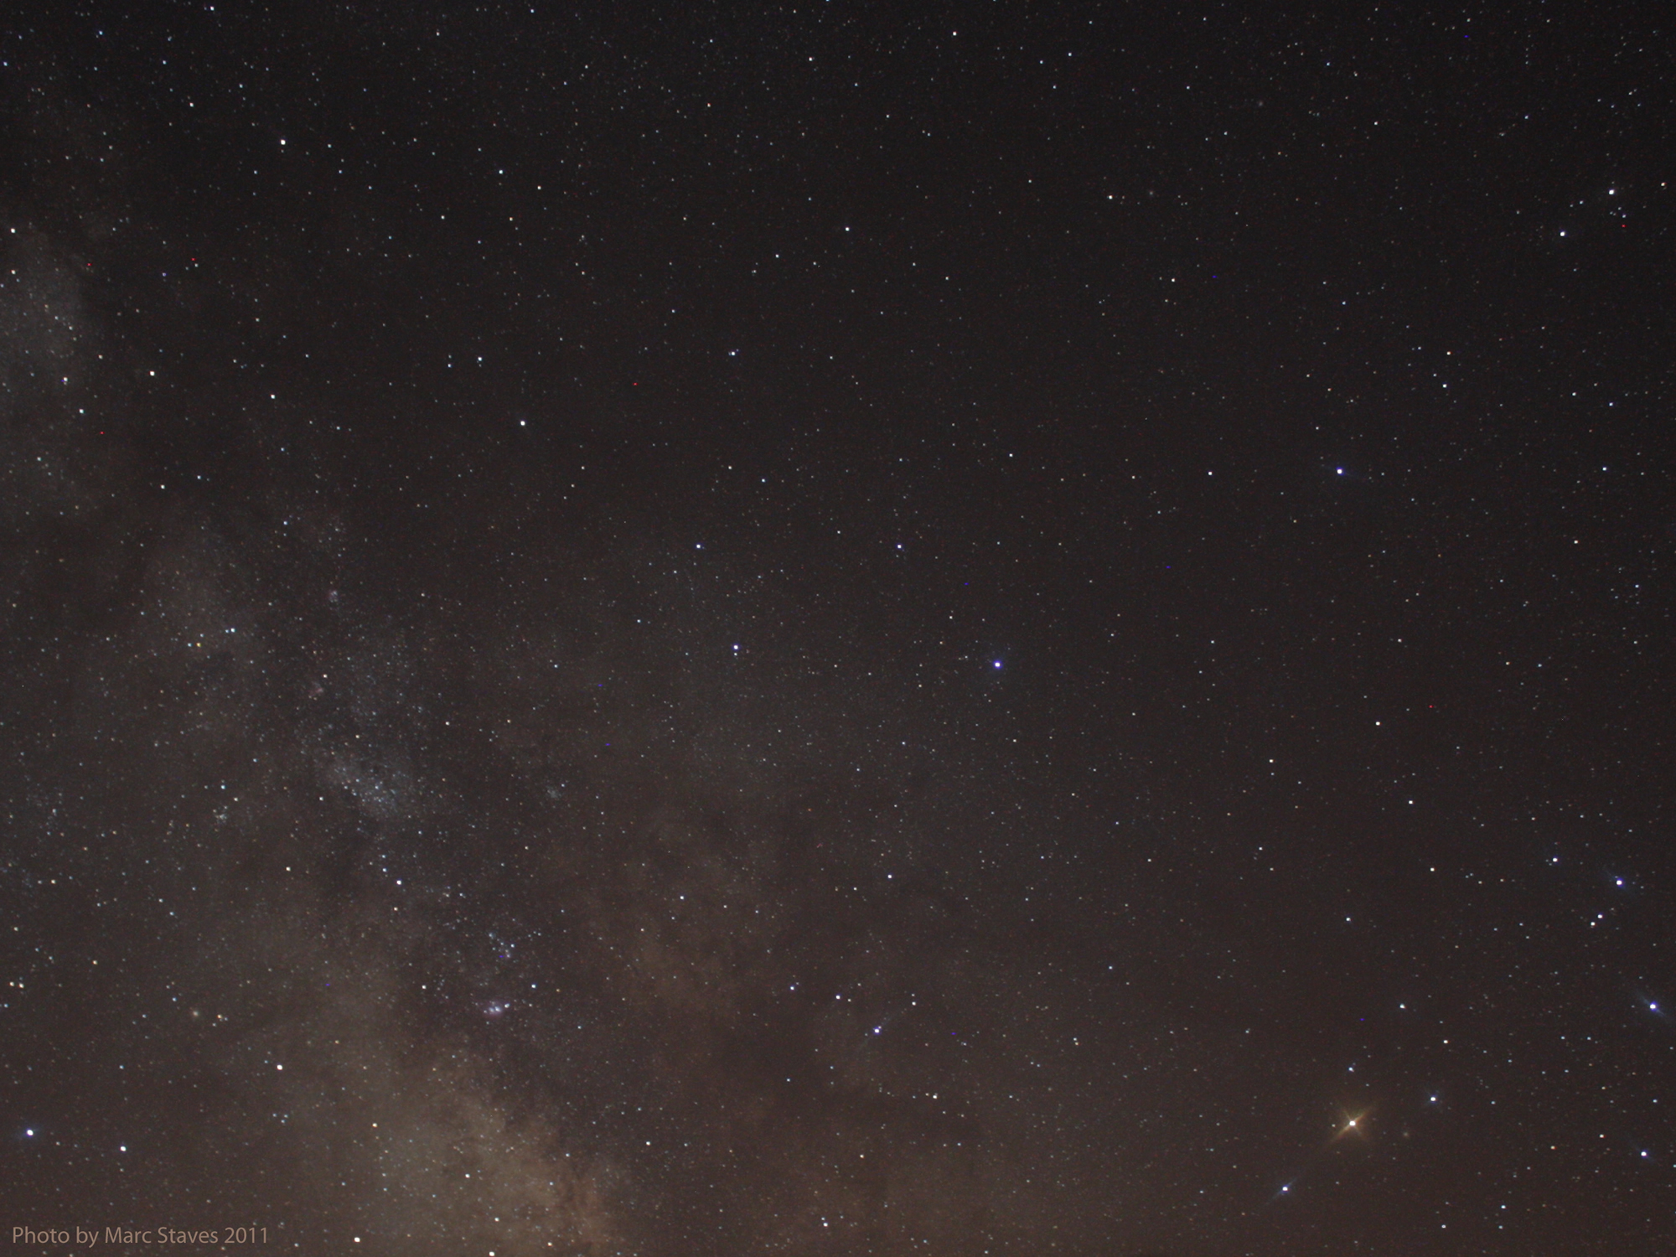


Introduction & Logistics
The Cosmos Within
Dr. Aileen A. O’Donoghue
July 20 – 21, 2018

Slide 2
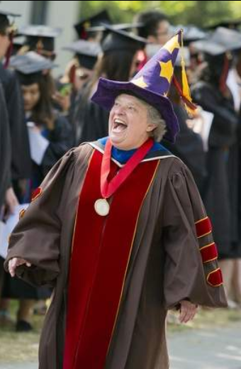
Introductions
Aileen
  Who am I to be leading this?
Conferences
  Ask questions as they come
  No quizzes, no exams
  … take what you can!
Stargazing
  If clear, 9:00 – 10:00 pm Saturday & Sunday

Slide 3
Introductions
Talks
  The Gift of Darkness
    Darkness is something, not nothing
  Forces & Interactions
    Forces are what move us
  Starlight and Grace
    The power and richness of light
  Substance of Ourselves
    We’re made of stars
  Beneath the Surface
    Substance and spirit dance
© Copyright, Dr. Aileen O’Donoghue, St. Lawrence University

Slide 4
Introductions
The Point
  We are matter and spirit integrated
    Our spirits are of God
    Our matter is of God, too
  Awareness of the origin and nature of matter
    Invites us into the wholeness of ourselves
    Guides us to God’s wholeness within us
    Deepens our presence in God and the Universe

Slide 5
Introductions
This is a retreat
  Yes, I’ll cite and quote scripture & spiritual writers and we’ll have a prayer ritual
But it’ll be weird!
  I’m going to talk about physics …
    … weird physics!
  Because it’s ONE Universe
    We are the image of GOD … spirit and flesh
    The universe is spirit and matter
    … the physics of the universe also speaks of GOD

Slide 6
First Evening: The Gift of Darkness
The Cosmos Within
Aileen O’Donoghue
July 20 – 21, 2018

Slide 7
The Wisdom of Solomon
“The Lord created me at the beginning of his work,
The first of his acts of long ago.
Ages ago I was set up, at the first, before the beginning of the Earth.
When he established the heavens, I was there.”
.
.
.
Proverbs 8:22-23, 27

Slide 8
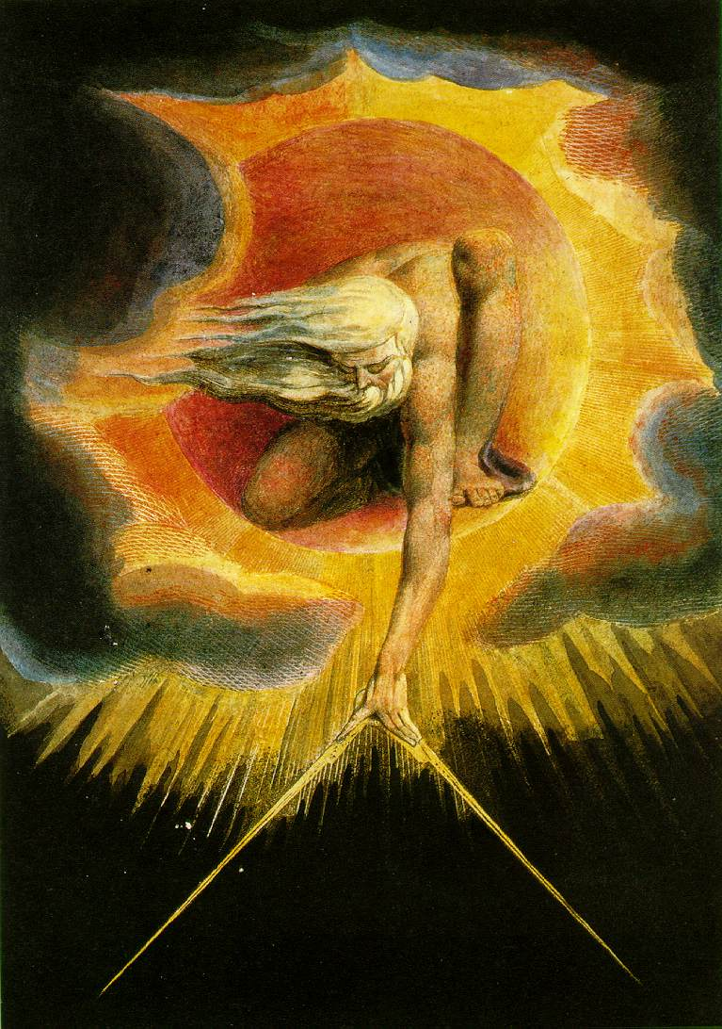
“In the beginning
when God Created
the heavens
and the Earth,
the Earth was a formless void and darkness covered the face of the deep”
Genesis 1:1

Slide 9
Physics Says: In the Beginning …
What Started It?
At t = 0 seconds
  Time began
  Space began
  Universe began
We Don't Know!
What DO we know?
  All galaxies are moving away from us
  More distant galaxies moving away faster
  Entire universe glows in microwaves

Slide 10




In the Beginning …
What DO we know?
  All galaxies are moving away from us
  More distant galaxies moving away faster
California Raisin Cosmology
Raisins separated by meters
-1
0
1
2
3
Distances Double in 1 sec
Singing Raisin Moves at 1 m/s
Radio Raisin Moves at 3 m/s
-2
-1
0
1
2
3
4
5
6

Slide 11
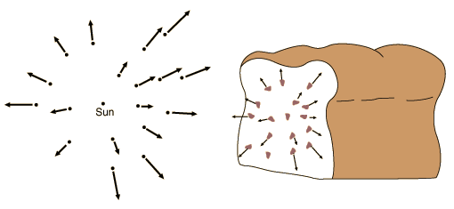
In the Beginning …
Expansion of the Universe
  All galaxies are moving away from us
  More distant galaxies moving away faster
… The universe is like a raisin bread!
Raisins move with dough, not through it.
Galaxies move with space, not through it!

Slide 12
In the Beginning …
Expansion of the Universe
  All galaxies are moving away from us
  More distant galaxies moving away faster
Space, itself, is expanding!
Raisins move with dough, not through it.
Galaxies move with space, not through it!

Slide 13
In the Beginning …
Current Cosmological Theory
  Use equations to “run time backwards”
    Universe gets smaller, denser, hotter
    Can go back to ~10⁻⁴³ sec after Big Bang
Observations support Theory
  Early universe is glowing ball of energy seen as Cosmic Microwave Background
0.0000000000000000000000000000000000000000001 seconds!
… So what have we learned?

Slide 14
In The Beginning There Was …
At t=10⁻⁴³ Seconds There Was …
LIGHT
But no sound … that was just to get your attention!
© Copyright, Dr. Aileen O’Donoghue, St. Lawrence University

Slide 15
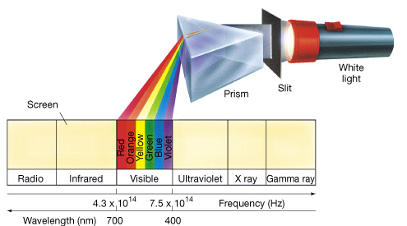
The Big Bang
After 10⁻⁴³ seconds
  Time and space began expanding
  The universe contained time, space & energy
The energy was in the form of electromagnetic radiation … light

Slide 16
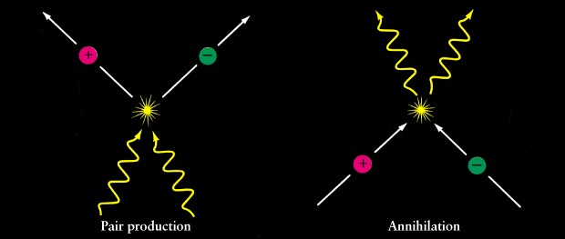
Expansion of the Universe
The Universe cooled as it expanded
  Particles condensed out of the light …
  … light and matter are the same stuff!
All matter is “frozen” energy!
Energy
is
Matter
E=mc²
Light becomes Particles …
Particles become Light …

Slide 17
The Early Universe
A sea of light and particles
  quarks that make up protons & neutrons
  electrons, muons and other leptons (tiny!!)
Uniformly bright
  light coming from everywhere!
    like a very bright fog
    the Universe was opaque
After a few hundred thousand years of cooling, atoms began to form …

Slide 18
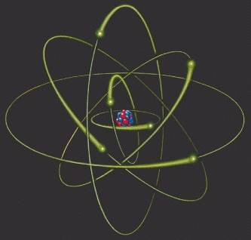
Atoms
Nucleus of protons (+) and neutrons (0)
  surrounding cloud of electrons (-)
    clouds at distances determined by their energy
quantum model: e⁻’s in clouds of probability surrounding nucleus
classical model: e⁻’s in orbits
© Copyright, Dr. Aileen O’Donoghue, St. Lawrence University

Slide 19
Atoms and Light
To change “orbit” emit or absorb energy
Outgoing photon of energy equal to difference between n = 1 and n = 3 levels
“Quantum Leap”
“Quantum Leap”
electron transitions to n = 3 level
electron transitions to n = 1 level
Incoming photon of energy equal to difference between n = 1 and n = 3 levels
n = 1
n = 2
n = 3
Atoms interact with only some wavelengths of light!
© Copyright, Dr. Aileen O’Donoghue, St. Lawrence University

Slide 20
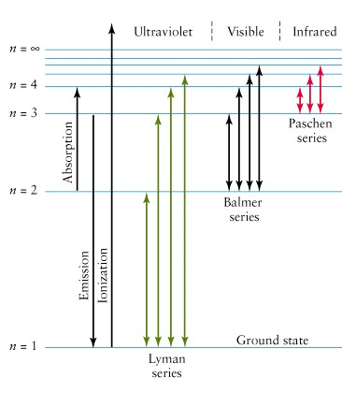
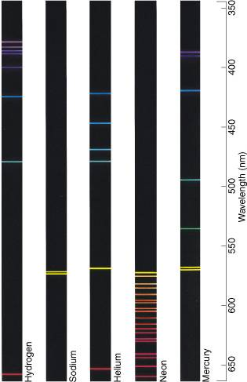
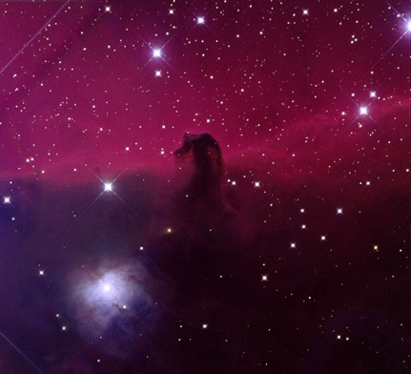
Atoms and Light
Each element creates unique spectrum
Balmer Spectrum of Hydrogen
δ
γ
β
α
Red in astronomical images is Balmer Alpha
Lyman Spectrum of Hydrogen in Ultraviolet
© Copyright, Dr. Aileen O’Donoghue, St. Lawrence University

Slide 21


Atoms & Light
Each element emits & absorbs a unique spectrum
Photons interact with every ion
Only a few photons interact with atoms
ions: nuclei & electrons
atoms
Sees closest ion
Sees across universe
Light
Most photons don’t interact ⇒ observer sees across universe
© Copyright, Dr. Aileen O’Donoghue, St. Lawrence University

Slide 22
The First Night
500,000 years after the Big Bang …
Atoms of Hydrogen (75%) and Helium (25%)
  Absorbed some light
  Most light traveled freely without interacting with any matter.
    Universe became transparent
…darkness fell for the first time.
© Copyright, Dr. Aileen O’Donoghue, St. Lawrence University

Slide 23
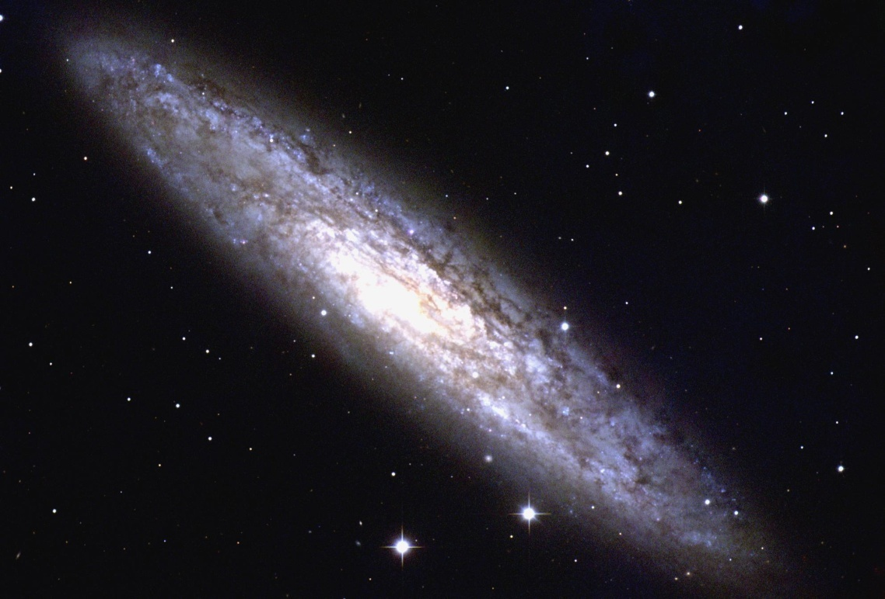
The Cosmos’ Gift of Darkness
Required the “freezing” of the Big Bang Energy into atoms … matter … us.
We are here
Requires us to be away from Galactic Nucleus or star cluster
NGC 253 (NOAO)
Darkness is not nothing …
… it’s something!

Slide 24
Darkness As Something
The Principle and Foundation of St. Ignatius
We are created to share in God’s love and life for eternity. The experience of this love is manifested in our response of praise, reverence and service, that is, loving God with all our heart all our mind and all our will.
All of God’s created cosmos is intended to reveal this sharing of God’s life and love.
… the darkness is God’s creature.
cf. John Veltri, S.J., www.sentex.net/~jveltri

Slide 25
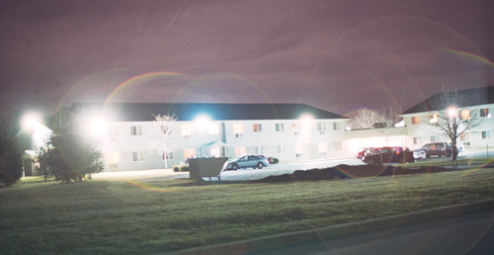
Darkness Eludes Us
Outdoor lighting tries to DISPEL THE DARKNESS!
Deprives us of the night
the stars
the dark …

Slide 26
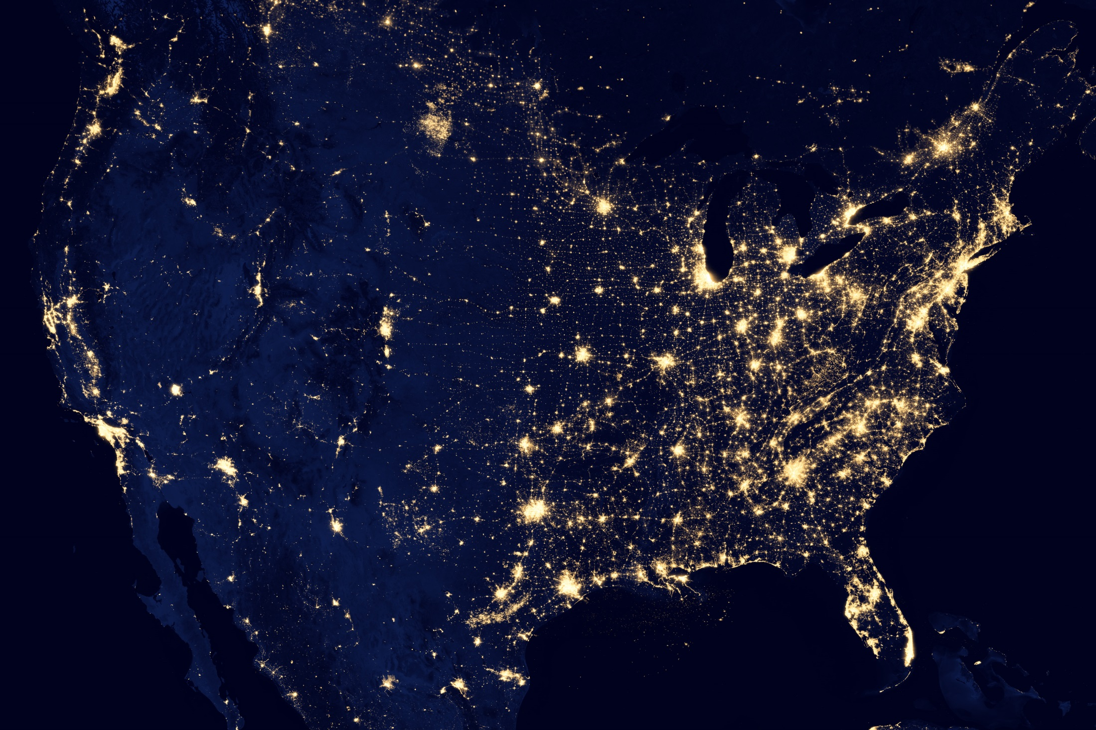
Darkness Eludes Us
Ogdensburg

Slide 27
Seeking Darkness
Astronomers and Monastics
  Seek what daylight hides
    Stars, nebulae, galaxies …
    God of the vast darkness …
“And night to night declares knowledge.”
Psalm 19

Slide 28
Seeking In The Darkness
The Dark Night
St. John of the Cross
One dark night,
fired with love’s urgent longings
ah, the sheer grace –
I went out unseen,
my house being now all stilled.

Slide 29
Beginning Retreat: Seek The Darkness
Sit with darkness …
What can you see there that you can’t see in the daylight?
Know that the frozen energy of the Big Bang you’re sitting on allows the darkness to exist …
Seek to comprehend that the darkness came into being through the Word and is not separate from God’s creative Love …

Slide 30
In the beginning …
there was the Word;
The Word was in God’s presence,
and the Word was God.
The Word was present to God
from the beginning
Through the Word
all things came into being,
And apart from the Word
nothing came into being
that has come into being.
…not even the darkness!

