Slide 1
Simultaneous resistive, Hall and optical measurements of hydriding and dehydriding MgPd bilayers
D. W. Koon, C. C. W. Griffin
Physics Dept., St. Lawrence University
Canton, NY 13617, USA
J. R. Ares, F. Leardini, C. Sánchez
Depto. de Física de Materiales, Facultad de Ciencias
Universidad Autónoma de Madrid
Cantoblanco, 28049, Madrid, Spain
Email: dkoon@stlawu.edu
This Powerpoint: Linked at http://it.stlawu.edu/~koon

Slide 2
ACKNOWLEDGEMENTS:
Spanish Minister of Education and Science
MEC Contract # MAT2005-06738-C02-01
St. Lawrence University Board of Trustees
St. Lawrence University First Year Program
C. Crawford, F. Moreno (technical assistance on two continents)
I. J. Ferrer, J. F. Fernández (helpful discussions)

Slide 3
The MgH_{x} system
The good.
Light metal -- 4th lightest metallic element
Abundant -- 2% of earth’s crust, by mass
Absorbs two hydrogens per metal atom
The bad.
Cannot absorb molecular hydrogen
  Requires Pd cover layer
Tight binding of hydrogen:
  Absorbs H too easily: MgH₂ forms at surface of Mg, blocks further diffusion of H.
    Hydriding can occur at low pressure, but patience required.
  Room temperature desorption very slow.

Slide 4
Simultaneous measurement: charge transport and optics
Can we use Hall coefficient, R_{H} = 1/ne, as measure of volume fraction of as-yet unhydrided film?
Can we measure various physical quantities as functions of hydrogen fraction (as determined by Hall coefficient)?

Slide 5
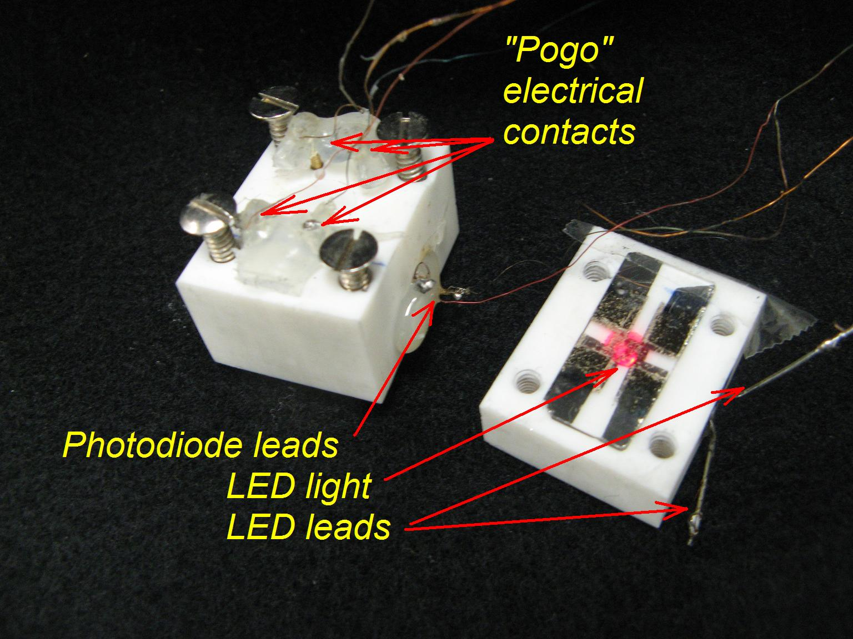
The sample holder
In situ high-T magnets
  0.1Tesla
  N38SH (150°C max.)
Resistivity and Hall measure-
ment during hydriding,
desorption.
  van der Pauw method
  LabVIEW + GPIB control
Additional redundant Hall measurements to minimize effects of drifting resistivity.¹

Slide 6
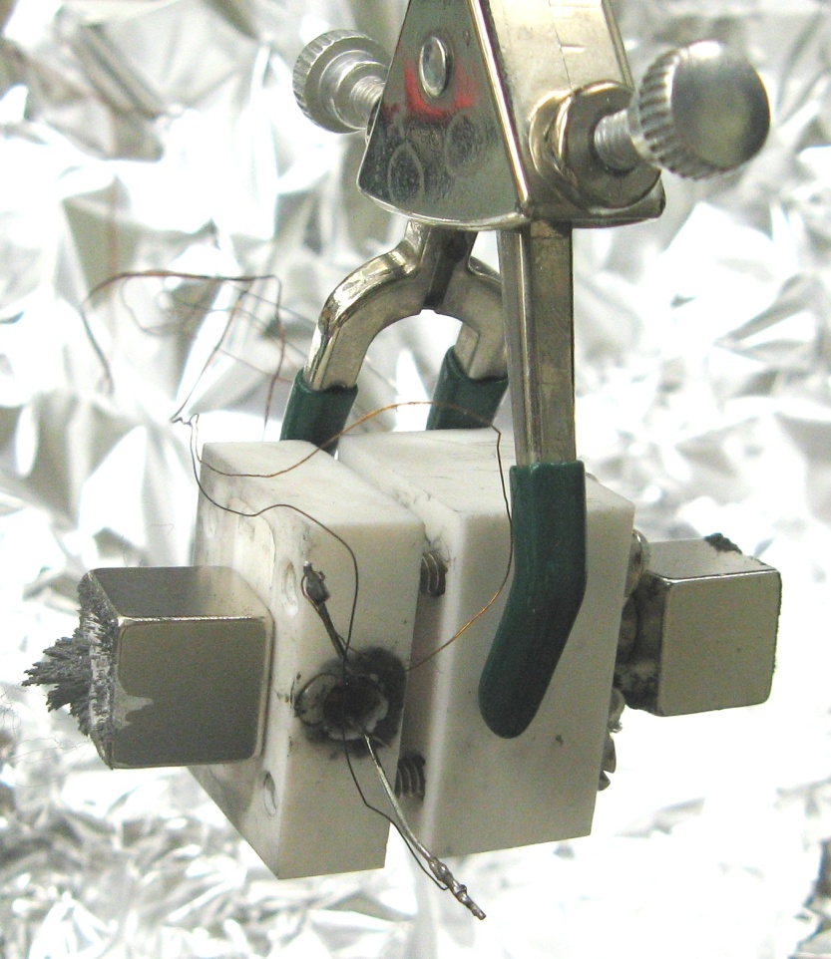
The sample holder
In situ high-T magnets
  0.1Tesla
  N38SH (150°C max.)
Resistivity and Hall measure-
ment during hydriding,
desorption.
  van der Pauw method
  LabVIEW + GPIB control
Additional redundant Hall measurements to minimize effects of drifting resistivity.¹

Slide 7
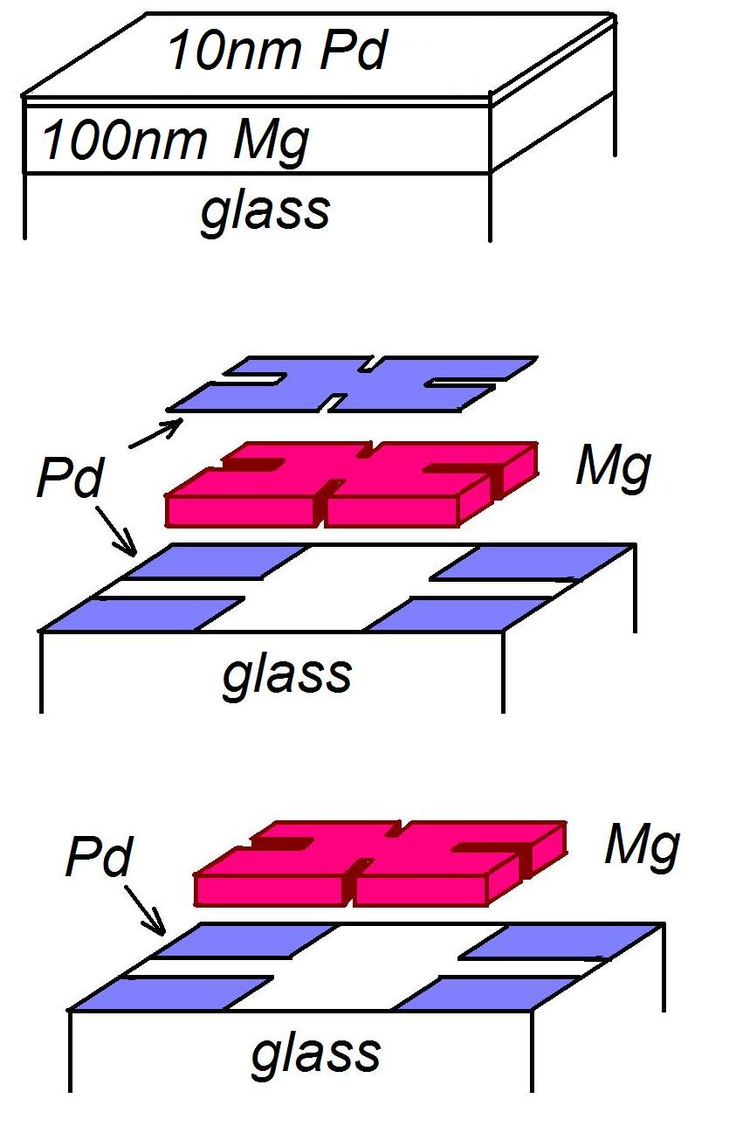
Bilayer geometries used
Resistivity + Hall measurements already reported.
Resistivity + Hall + optical transmission. (this work)
Resistivity + Hall + optical transmission. (stay tuned)

Slide 8
Film deposition
Electron gun source
  2×10⁻⁶ mbar residual base pressure.
Mg:Pd bilayers
  300+30nm, 100+10, 10+10nm – verified by profilometry
  Glass substrates for electronic studies.
Appearance: metallic (shiny & opaque) as deposited, semitransparent after hydriding.
Electrical resistivity: “dirty metals” as deposited.
  Pd: 6x bulk value
  Mg: 2.5x bulk value

Slide 9
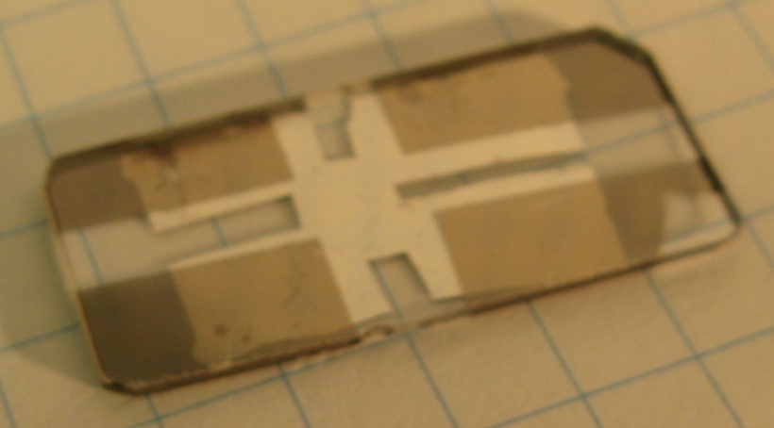
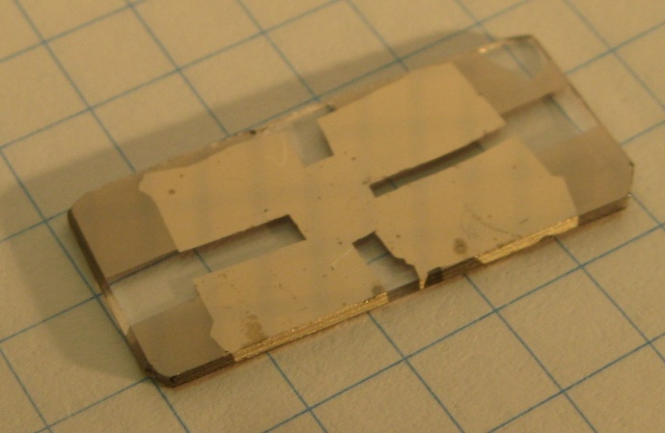
The films
100nm Mg with 10nm Pd covering layer
  10mm x 25mm glass substrate
For Resistivity+Hall+Optical studies:
  Mg + Pd bilayer in cloverleaf geometry
  Pd pads on four corners, underneath bilayer
bottom
top

Slide 10
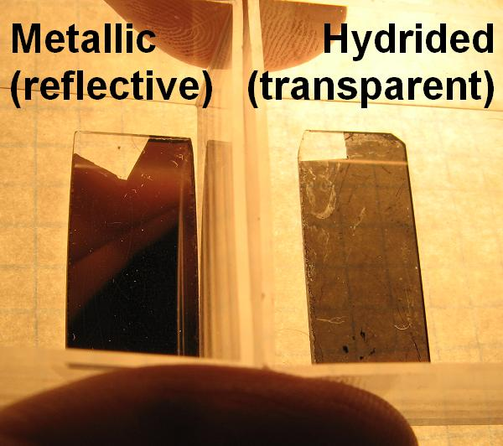
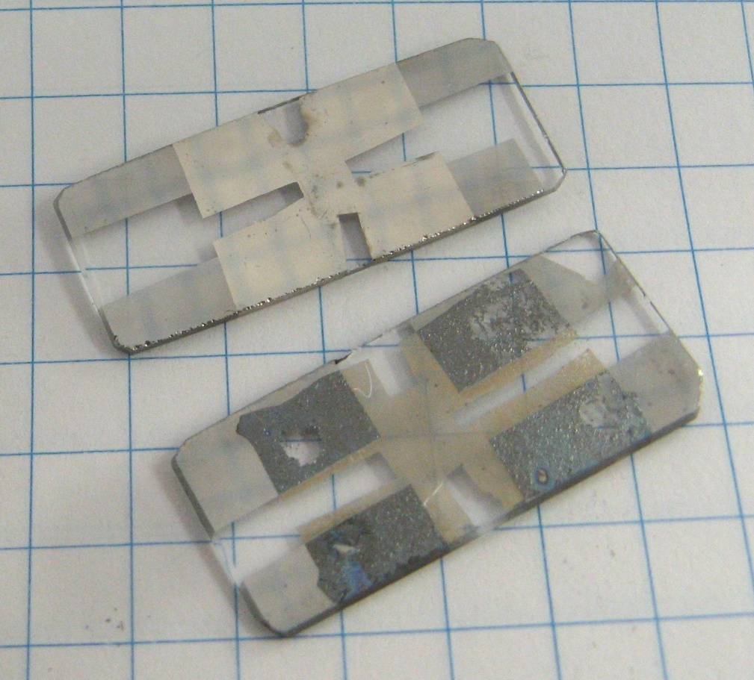
Optical effects of hydriding
Visual inspection: before and after hydriding

Slide 11
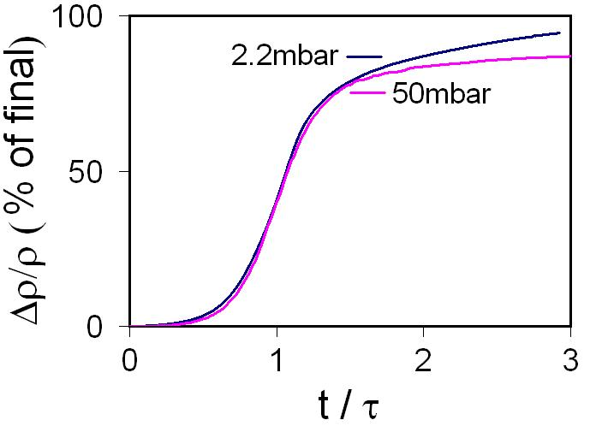
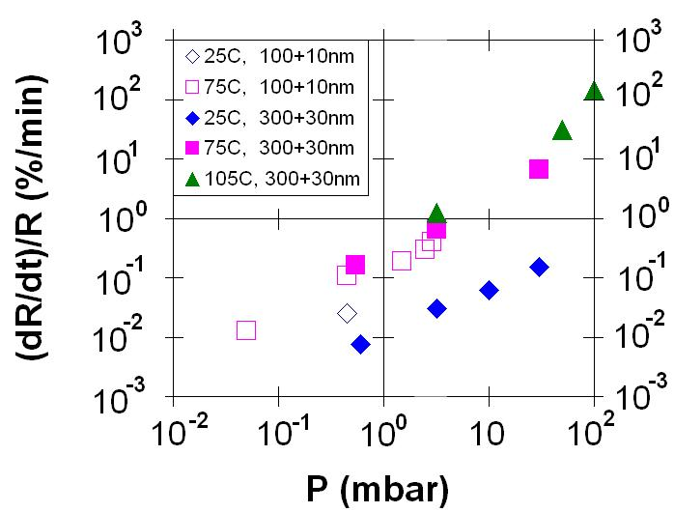
Hydriding rate
Hydriding process consistent across over 20x change in charging rate.
Hydriding rate:
Linear or sub-linear with P.
Increases with T.
  30x increase: 25°C-75°C.
  Smaller incr.: 75°C-105°C.

Slide 12
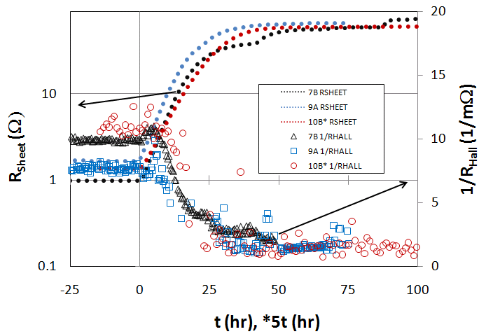
Hydriding MgPd bilayer: Charge transport

Slide 13
The Hall concentration
1/R_{Hall} is a measure of as-yet unhydrided volume fraction of film.
n_{H} = Hall concentration
n = charge carrier concentration
d = thickness
A = Hall scattering factor ≈1

Slide 14
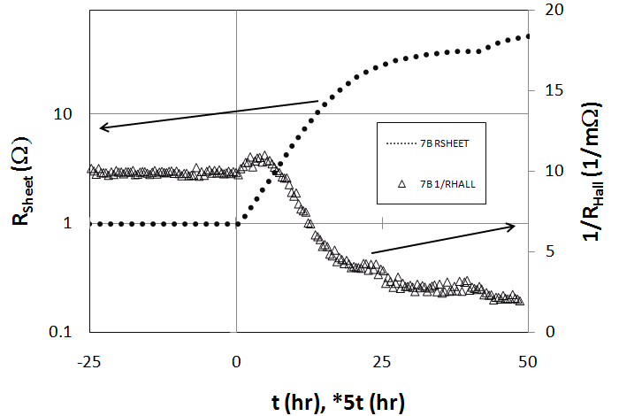
Hydriding MgPd bilayer: Charge transport

Slide 15
Bilayer correction
Resistances measured for a film:
For film layers in parallel, the quantities that add are:

Slide 16
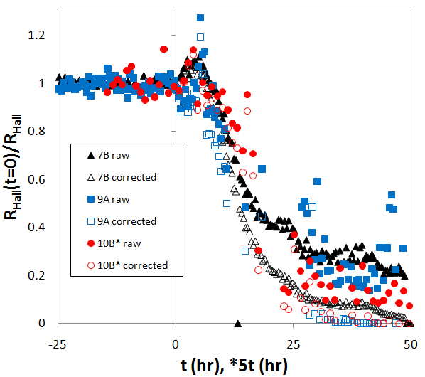
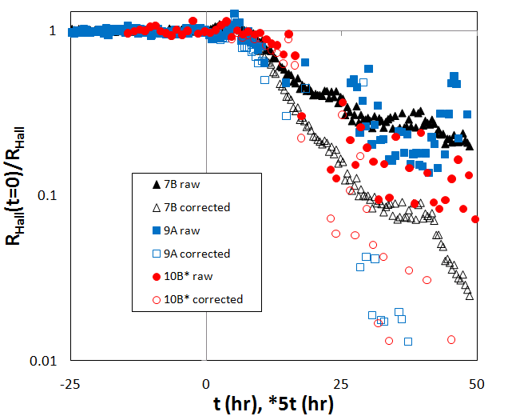
Bilayer effect correction

Slide 17
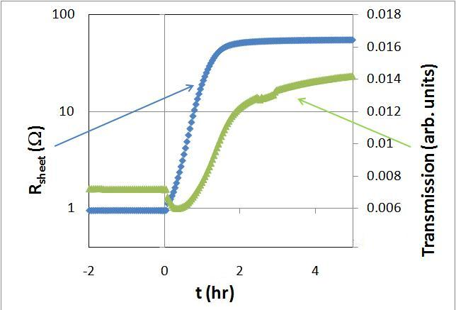
Resistivity and Transmission
Simultaneous sheet resistance and optical transmission of 100+10nm MgPd bilayer during 10mbar hydriding at room temperature

Slide 18
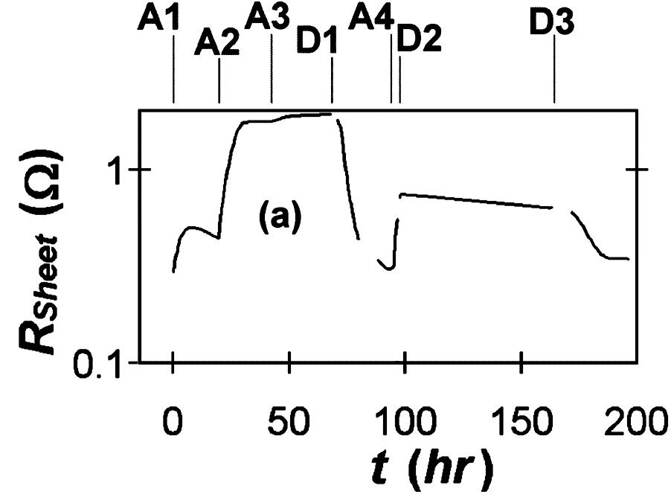
Absorption + Desorption
A1: 0.6mbar | D1: Air
A2: 2.3mbar | D2: Vacuum
A3: 3.2mbar | D3: Air
A4: 3.2mbar
Multiple absorption, desorption cycles possible near 300K for some films.
  Minimal desorption in vacuum, even up to 75°C.
  Desorption in air about 10x times faster than vacuum.
  Minimal desorption in 1atm of N₂. Desorption likely due to O₂ or H₂O.

Slide 19
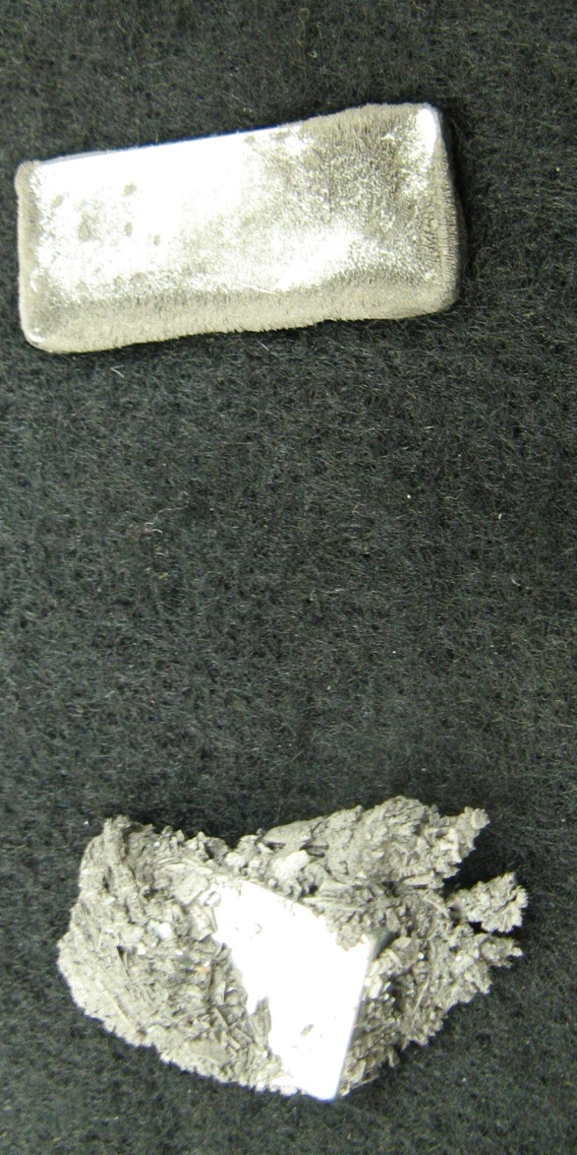
WARNING
While the N38 magnets performed well, cycled well, catastrophic failure did sometimes occur in presence of H₂, even at room temperature.
Material from inside magnet becomes a material that resembles iron filings.

Slide 20
CONCLUSIONS:
Hall measurement as diagnostic tool
Hall concentration, n_{H}, serves as crude measure of hydrogen content in MgH_{x}.
  Corrections
    x<<2: Hall scattering factor (?)
    x≈2:Bilayer correction
  Signal-to-noise: Tiny Hall angle, Θ_{H}, (10⁻⁴ to 10⁻⁵) limits role of n_{H} as diagnostic tool.

Slide 21
CONCLUSIONS:
Room-temperature Mg hydriding
Mg can be hydrided at room temperature, low pressure
  Rate vares with P (up to about 50mbar at R.T.)
MgH₂ decomposition enhanced in air.

Slide 22
CONCLUSIONS:
The data I didn’t show
(Mg monolayer with lateral hydriding)
Mg can be hydrided laterally at room temperature, low pressure
  Resistivity shows large anisotropy in hydriding
  Hall effect shows larger effect than Resistivity
    Hall effect samples more of the periphery of specimen.
  After 7 hours at 30mbar H₂, electrical contact lost. (Dihydride layer in lateral direction?)

Slide 23
REFERENCE:
D. W. Koon, J. R. Ares, F. Leardini, J. F. Fernández, I. J. Ferrer, “Polynomial-interpolation algorithm for van der Pauw Hall measurement in a metal hydride film”, Meas. Sci. Technol. 19 (10), 105106 (2008).

