Slide 1
So you want to build a power play
A presentation on power plays by Sean Tierney (@ChartingHockey) for the #OTTHAC19 conference

Slide 2
What we’ll do…
Review Parnass and Cane (really quickly)
Check out some team-level power play data by Corey Sznajder (@Shutdownline)
Find some relationships with some historical data (via @EvolvingWild)
Dig into some player-level tendencies
Bring it all together to build the best power play combinations

Slide 3
Some background
Parnass (2016) notes that controlled zone entries are key to power plays
1-3-1 formation best
HQCG in-formation seemed important but wasn’t repeatable out-of-sample
Still pointed in a useful direction
Cane (2015, 2017) demonstrates values of 4F-1D power play formation
4F-1D formations take more shots, score more goals, post better goal differentials
4F-1D gain entries with greater ease
hockey-graphs.com/2016/04/25/how-can-we-quantify-power-play-performance-in-formation/
https://hockey-graphs.com/2017/03/07/second-units-and-zone-entries-why-teams-should-go-all-in-on-the-4-forward-power-play/

Slide 4
Relationships
rate of shots for (CF60) has an
r^2 of 0.12 with goal rate
→ rate of quality for (xGF60) has an r^2 of 0.25 with goal rate

Slide 5
So, what works?
As Parnass explained, PP units can shoot whenever – not connected to positive results
As the great Ryan Stimson has implored, initiating play from behind the net works well
The one-timer

Slide 6
Best PP units are “picky” i.e. stop yelling “shoot!”
Deflections (and the screen) work
but may be connected to low-to-high, which doesn’t
Behind the net, don’t kick back to the top
cross-slot + one-timer requires pickiness and patience but is effective
Behind net -> faceoff dot -> cross-slot -> one-timer

Slide 7
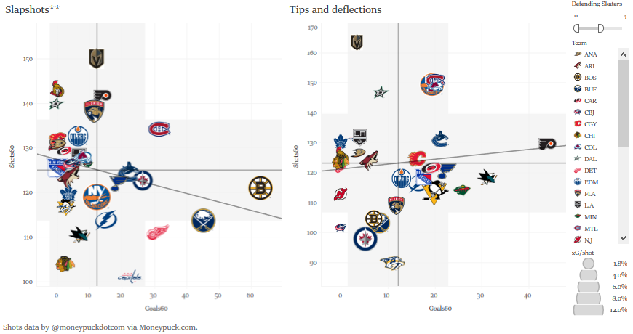
Pivot to teams and players
Slapshots
MTL
BOS, BUF, DET, WSH
WPG, STL, VAN
Tips/Deflections
NYI, COL, MTL
PHI?!
The Viz

Slide 8
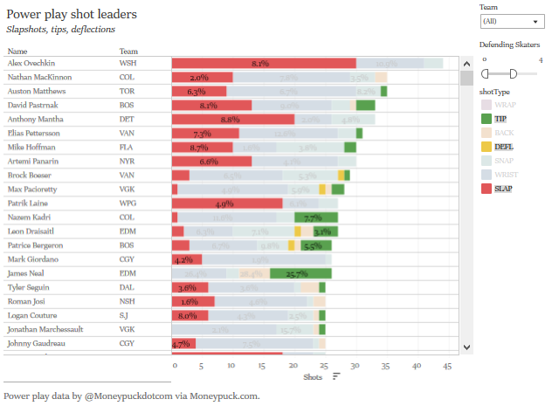
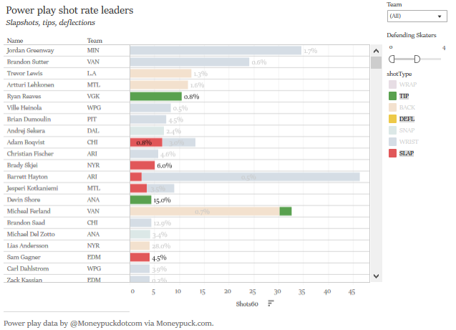
The players
Shot leaders overall
Shot rate leaders

Slide 9
Takeaways…for now:
DO
Have Ovechkin
If not, someone with a slap shot (might be a defender!)
Set up in 1-3-1 formation with a 4F1D setup (or 5F) (or forwardize a defender)
Best slap shot shooter on a faceoff dot – less on quality and quantity but best chance to score
Initiate play from behind the net
Use cross-slot pass for one-timer
DON’T
Yell “shoot”
Getting shots on the PP is easy and doesn’t correlate with goals
Unless you have a noted tippists or…deflectist and it’s purposeful
Go low-to-high

