Slide 1
Clocks and Racing Planets Fall 2026
Aileen A. O’Donoghue SLU Physics Department

Slide 2
Why do we change the clocks??
Earth’s tilt changes day length constantly
  At 44.6° N (Canton) this means
    Shortest day (~ 12/21) is 8h 49m long
    Longest day (~6/21) 15h 37m long
    Difference = 6h 48m
  On the equator, all days are 12h long
  At 60 ° N (& S), day length changes by 13 hr.
    18h 52m June, 5h 52m December
  On & north of the Arctic Circle (66.5° N) day length goes from 24 hours of dark to 24 hours of light (same on & S. of Antarctic Circle)

Slide 3
Why do we change the clocks??
We must cope with changing daylight
  Standard time
    Clock noon is solar noon
    Sunset & sunrise (almost) symmetric about clock noon
  Daylight time
    1 pm is solar noon
    Sunrise & sunset shifted an hour later
      More light in the evening, more dark in the morning
  Daydark time
    11 am is solar noon
    Sunrise & sunset shifted an hour earlier
Yeah ... nobody does this, but it’s an option!!

Slide 4
Why do we change the clocks??
What would it be like to have
  Year-Round Standard time
    Clock noon is solar noon
  Year-Round Daylight time
    1 pm is solar noon
    Sunrise & sunset shifted an hour later
      More light in the evening, more dark in the morning
    Started in January 1974 ... Repealed in October
      Everyone hated it!!
    Proposed in “Sunshine Protection Act”
      Passed in the House on 7/14/26, stalled in the Senate
        Some senators remember 1974!!

Slide 5
Current Practice
Daylight Saving Time (EDT)
  Begins on 2nd Sunday in March
    Spring Equinox ~ 3rd week of March (~3/21)
    Change clocks ~ 1 week before equinox
  Ends on 1st Sunday in November
    Halloween in EDT for trick-or-treaters on 10/31
Standard Time (EST)
  Begins on 1st Sunday in November
    Autumnal Equinox ~ 3rd week of September (~9/21)
    Change clocks ~ 6 weeks after equinox
      Like starting EDT on 2nd Sunday of February!
      Lack of symmetry due to Halloween accommodation!

Slide 6
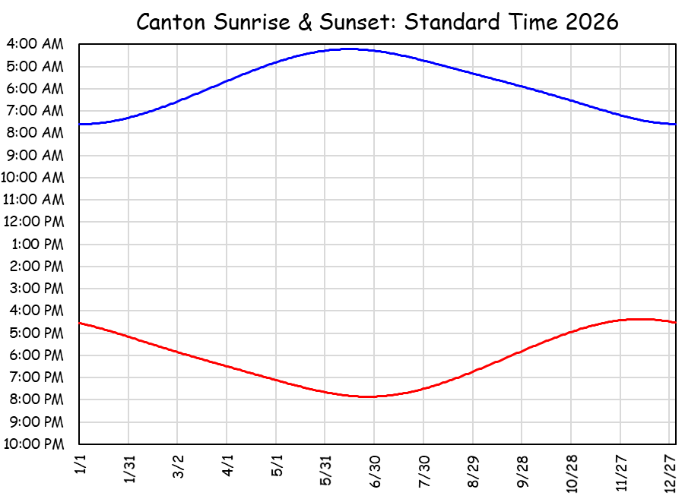
Year-Round Standard Time
Humans prefer to rise around Sun rise
  Year-round standard time
    Summer Sun rise at 4:13 am
Summer EST Sunrise at 4:13 am.
Are you kidding me? Sun is fully up before 5? How can a person sleep?!

Slide 7
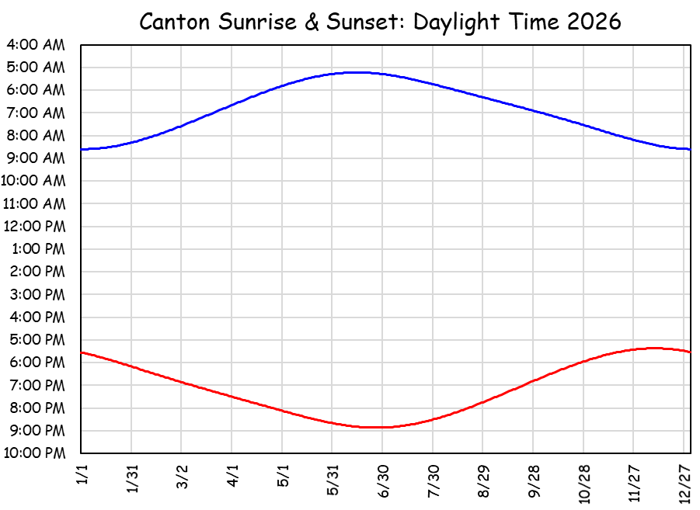
Year-Round Daylight Saving Time
Humans prefer to rise around Sun rise
  Stay in daylight time
    Winter Sun rise at 8:36 am
Winter EDT Sunrise at 8:36 am.
Are you kidding me? It’s dark until 8:30? You’d make us go to school in the dark?

Slide 8
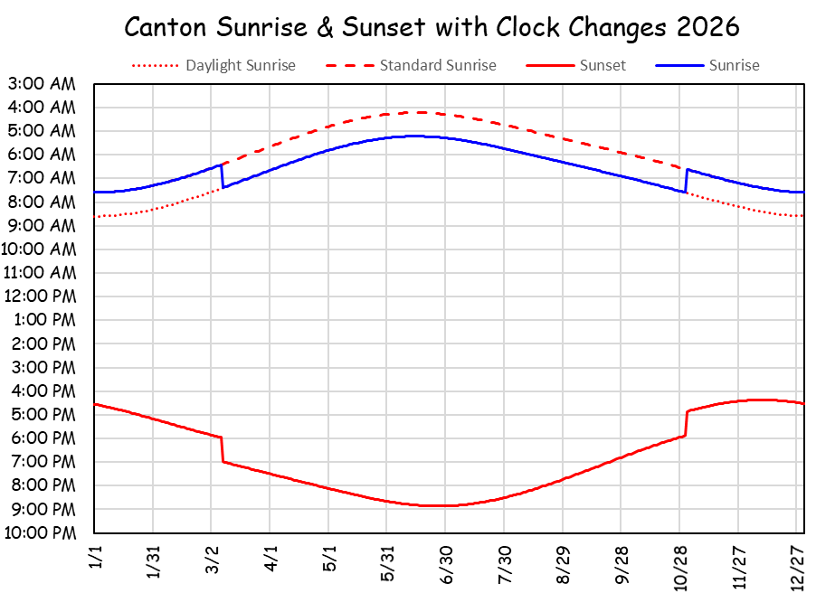
Changing Clocks in 2026
Humans prefer to rise around Sun rise
  Changing clocks is the best compromise
    Summer Sun rise 5:13 am, Winter Sun rise 7:36 am
Summer EDT Sunrise at 5:13 am.
Winter EST Sunrise at 7:36 am.
Are you kidding me? We have to change the clocks?

Slide 9
The compromise of changing the clocks seems to work best.
We are here!

Slide 10
Clocks in 2026
Daylight Saving Time (EDT)
  Started 3/8/2026, will start 3/14/2027
Standard Time (EST) in the winter
Standard Time
Begins on November 1, 2026
“Fall Back’’

Slide 11
Racing Morning Planets
Jupiter in Leo
  Orbit 5 times larger than Earth’s
    Yearly path longer than Mars (10πR_{Earth orbit})
    Weaker solar gravity makes it slower in orbit
      Jupiter at about 30,000 mph
Mars in Cancer, moving toward Leo
  Orbit 1.5 times larger than Earth’s
    Yearly path shorter than Jupiter’s (3πR_{Earth orbit})
    Stronger solar gravity makes it faster than Jupiter
      Mars at 54,000 mph
      Earth at about 67,000 mph

Slide 12
Racing Morning Planets
Jupiter & Mars high in sky at 6 am
  Jupiter 50° above SE horizon
    Brightest object in morning sky (other than moon)
    Above Leo’s front paw (Sphinx looking west)
  Mars 7° west (right, higher) and reddish
Mars will pass Jupiter on 11/16
  Moon passes both on November 2
    Waning Crescent ... Light on left, ~47% illuminated
  Mars will be 1° N (above) Jupiter
    Conjunction = objects close in sky
Illustrated on following slides

Slide 13
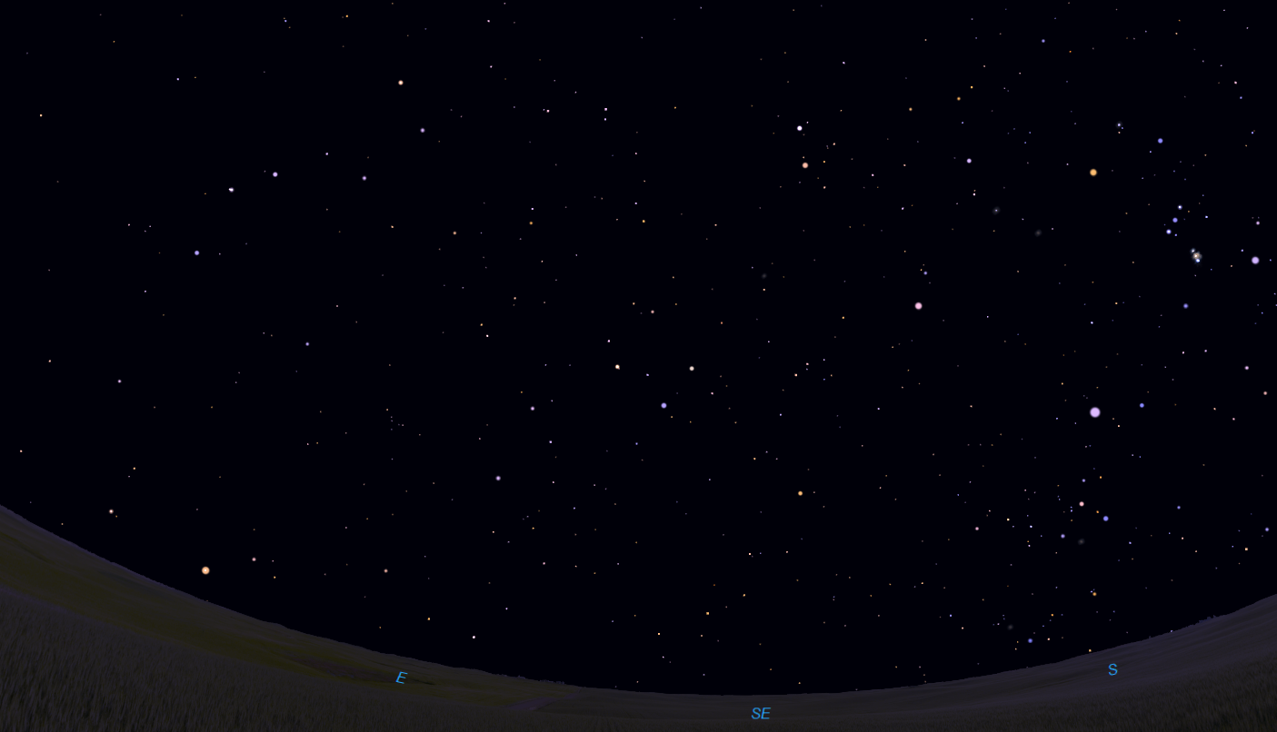
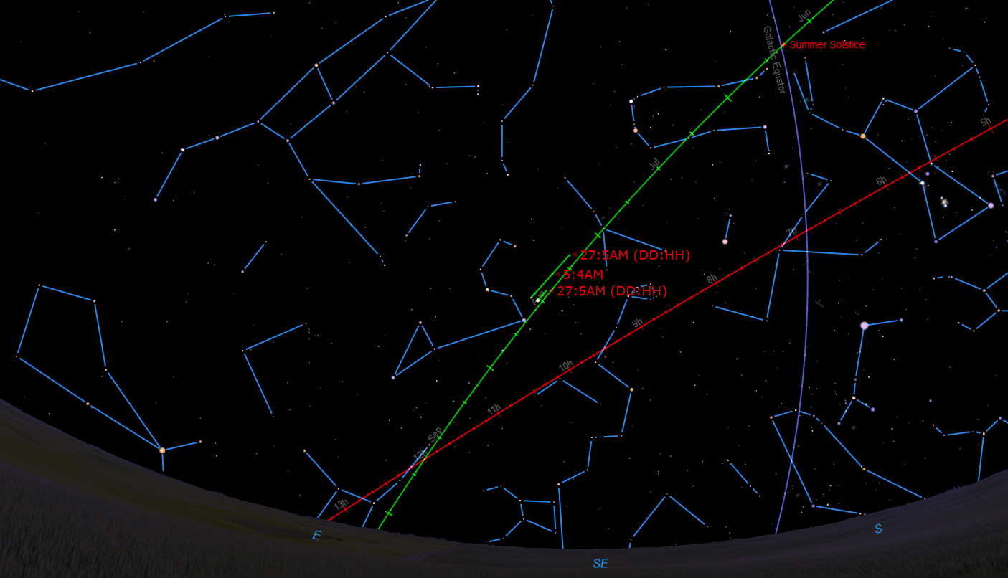
Racing Morning Planets
Mars overtakes Jupiter on 11/16/26
Summer Solstice
Dubhe
Gemini
Orion
Megrez
Merak
Castor
Mizar & Alcor
Pollux
Betelgeuse
Alioth
Phecda
Mintaka
Three leaps of the gazelle
Alnitak
Alkaid
Path of Sun & Planets
Canis Minor
Rigel
Procyon
Canes Venatici
10/27
Cancer
Saiph
Arc to Arcturus
Mars
Leo
11/16
10/27
Jupiter
The Pond
Regulus
Sirius
Boötes
Canis Major
Coma Berenices
Denebola
Celestial Equator
Alphard
Ecliptic
Arcturus
Autumnal Equinox

Slide 14
Racing Morning Planets
Mars overtakes Jupiter on 11/17/26

Slide 15
Racing Morning Planets
Mars overtakes Jupiter on 11/17/26

Slide 16
In the Wilderness Above,
The adventure continues ...

